Slide 1
BATTLE OF NEIGHBORHOODS
Applied Data Science Capstone Project
By,
Manasi Khare

Slide 2
Roadmap
Introduction
Data acquisition and data wrangling
Exploratory data analysis
Foursquare API
Clustering
Recommendation engine
Discussion
Conclusion
References

Slide 3
Introduction: Background and interest
There are almost 400 national parks across United States
With so many opportunities to explore the nature, planning a visit to a park is a lot of work
This project is aimed towards –
Visualize national parks in clusters
Helping stakeholders gather venue resources
Equip stakeholders with venue analysis
Recommend potential park destinations per user preferences

Slide 4
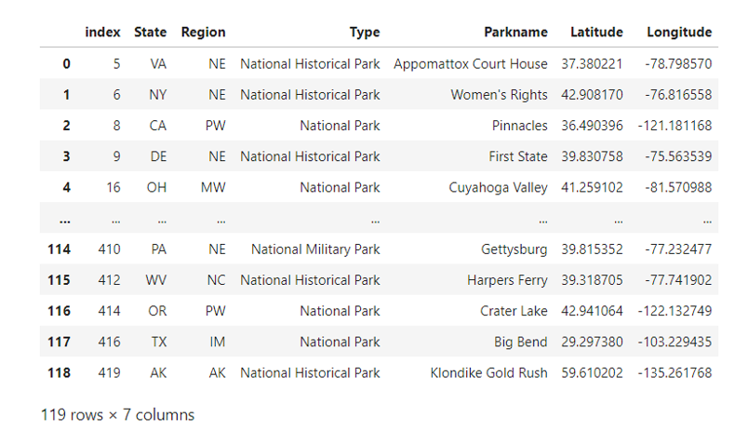
Data acquisition and cleaning
Raw dataset:
https://public.opendatasoft.com/explore/dataset/us_nps/export/?disjunctive.unit_name&disjunctive.state&sort=unit_name
Data wrangling includes:
Getting coordinate data in separate columns
Handling missing values
Correcting data types
Removing un-necessary data columns

Slide 5
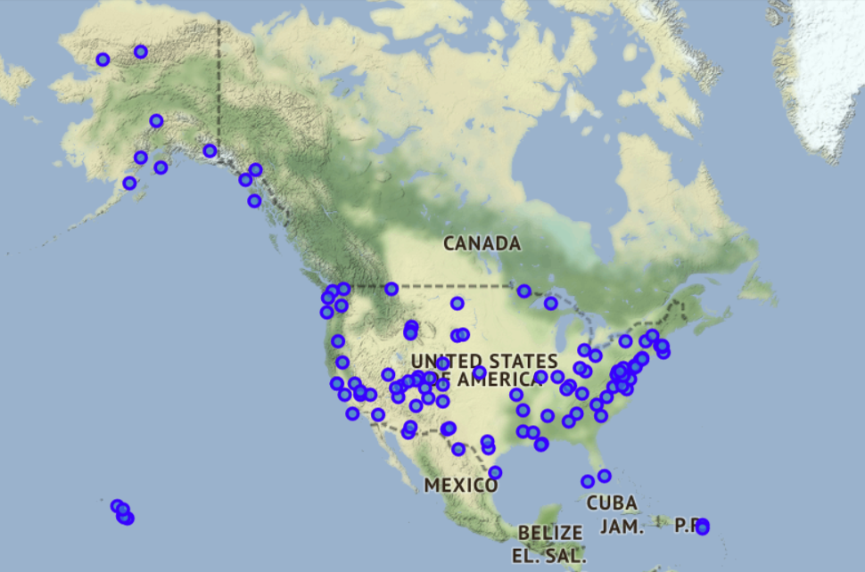
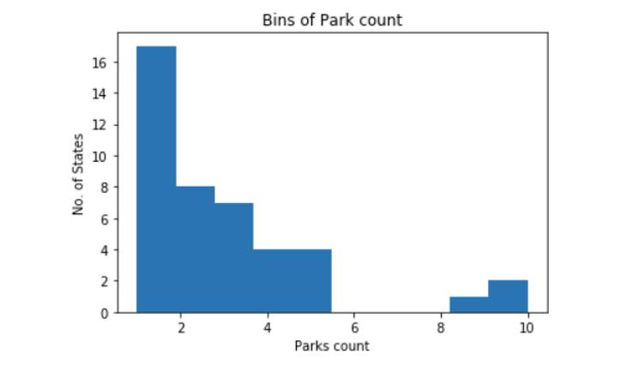
Exploratory data analysis
Data visualization with Folium map
Data pre-processing using bar plot and binning

Slide 6
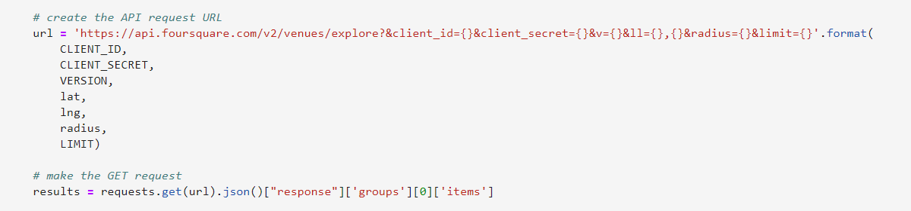
Foursquare API
URL setup to explore the park and surroundings
~3500 venue results gathered
~330 unique venue categories were obtained

Slide 7
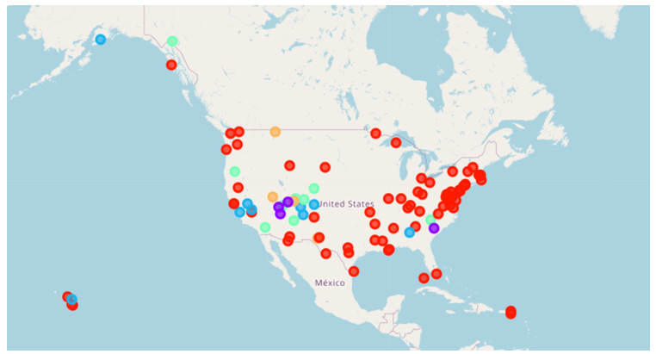
Clustering
K-means clustering is used for segmentation
5 clusters
Clusters individually examined

Slide 8
Recommendation engine
Recommendation engine using content based filtering algorithm
User can include 5 preferences
Park recommendations are provided to stakeholders based on preferences
Specific venue can be further explored using Foursquare API

Slide 9
Discussion/Conclusion
This project attempts to analyze National parks with the help of various machine learning algorithms
With recommendation engine, the goal of the project is completed
Study can be further extended to other destinations

Slide 10
References
National Park Services: https://www.nps.gov/index.htm
Opendata soft: https://public.opendatasoft.com/explore/?sort=modified
Pandas user guide: https://pandas.pydata.org/docs/user_guide/index.html
Matplotlib user guide: https://matplotlib.org/3.2.1/users/index.html
Scikit-learn: https://scikit-learn.org/stable/

