Slide 1
Smart T-Congestion Alert & Management
Designed & Developed by – Manasi Laddha
NUID - 001665853
Application Engineering & Development Final Project (INFO 5100)

Slide 2
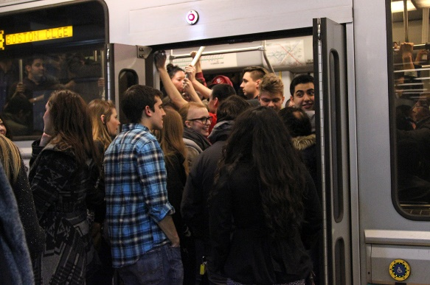
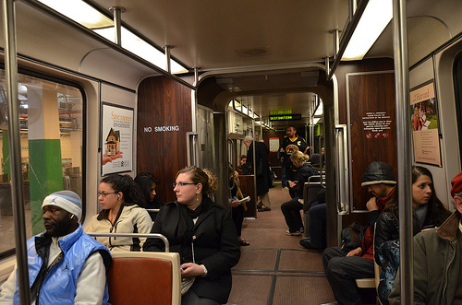
Problem Statement
High congestion levels in train increases riders’ travel stress, causing adverse affects on health.
Chances of incidents increases during rush hours due to congestions.
People with disabilities faces difficulty to get in train during crowdedness.
Present system lacks the technology to track the real-time travelers.
[1]. Actual scenario in train during peak hours [2]. Expected scenario in train during peak hours

Slide 3
Project Objective
Generate information about congestion levels in train by leveraging the power of IOT using PIR and OMRON D6T sensors installed at the entrance of compartments of the train.
Provide the information about crowdedness in incoming train to travelers.
Information people with disabilities about empty reserved seats in train compartments, restrooms or space for luggage/bicycle to riders.
Assist Transit Authorities in analyzing trains capacity over time and improving it.
Helps Train Authority alerting travelers about manageable & unmanageable congestion levels in trains.
Assist riders to raise incident request and get assistance at next station before arriving.

Slide 4
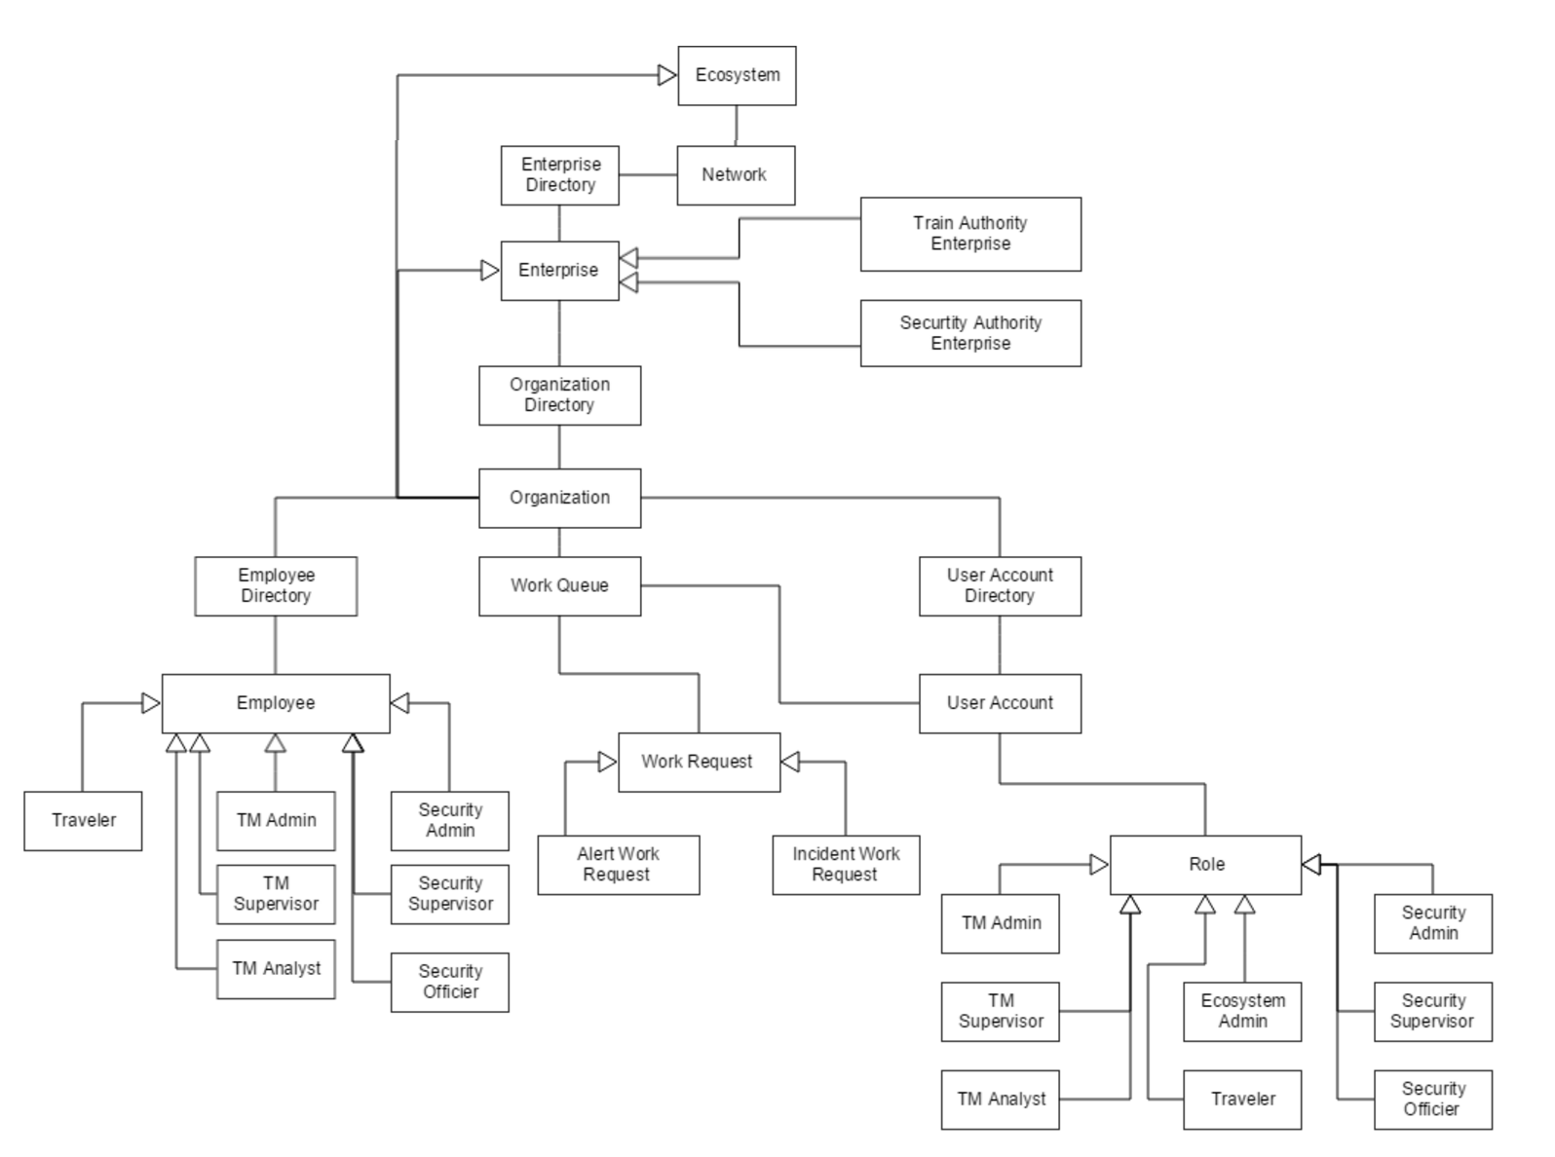
Smart T-Congestion Management Application Architecture

Slide 5
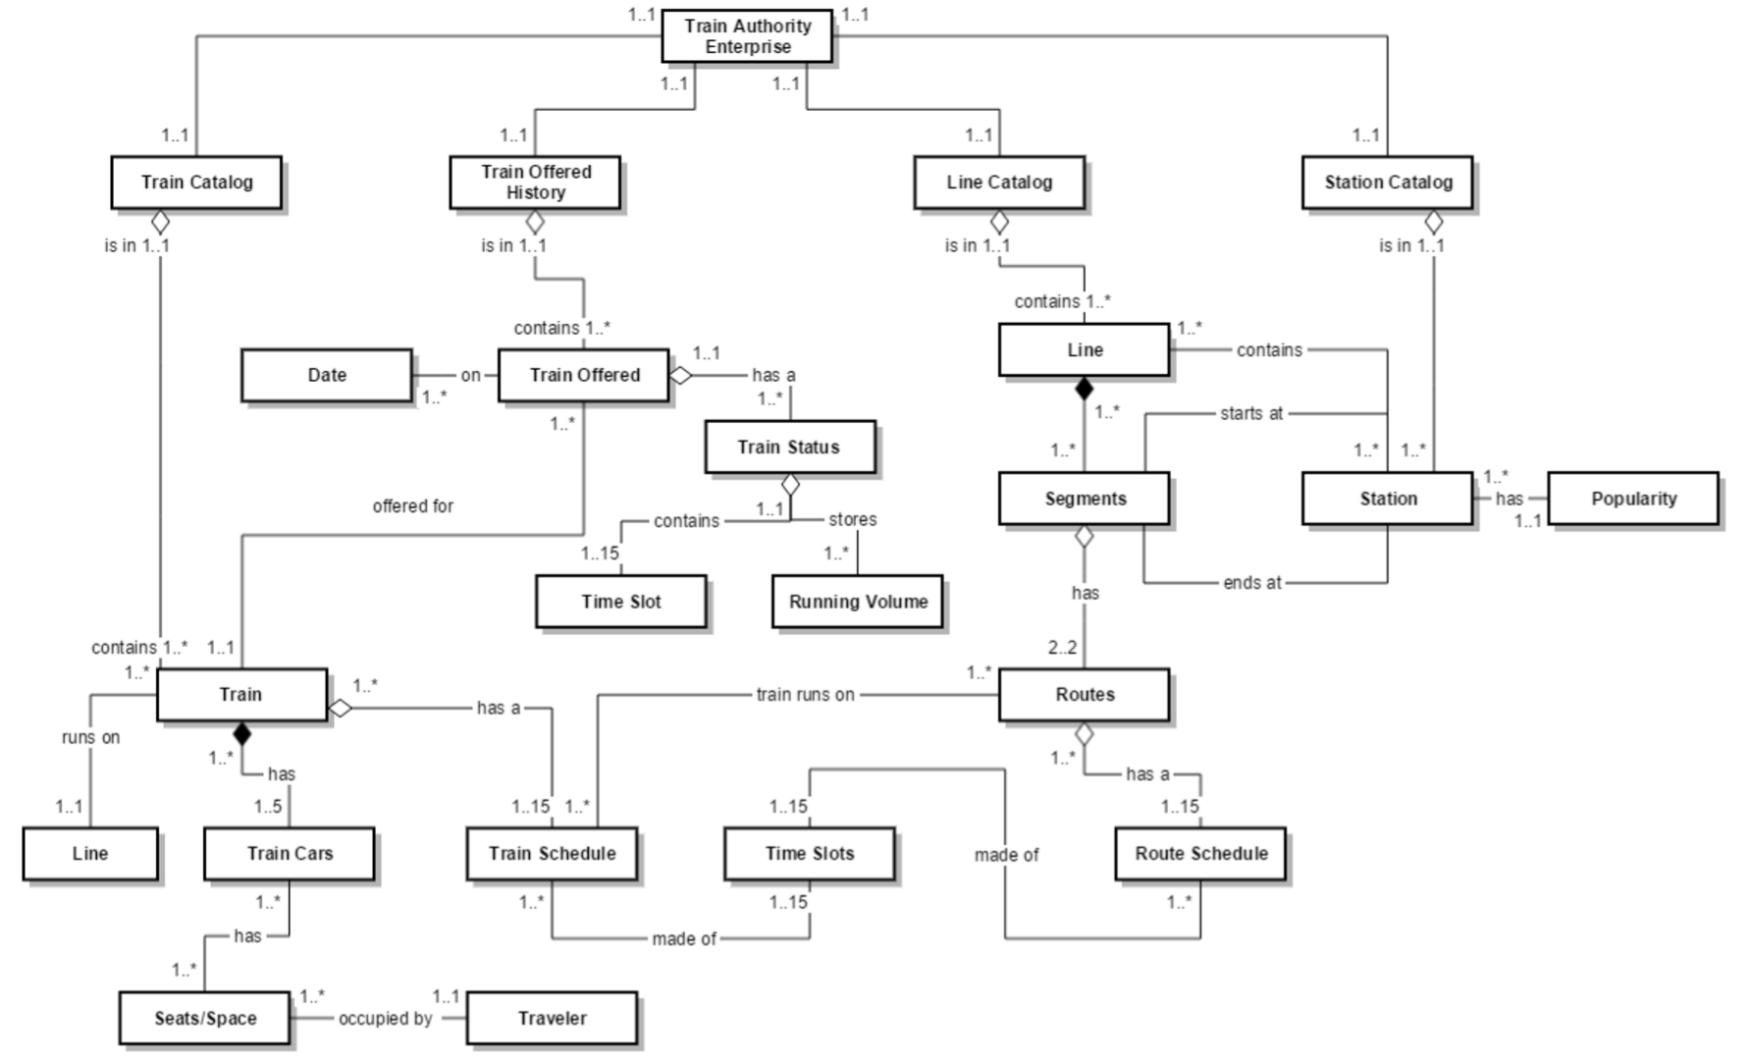
Train Authority Enterprise Architecture

Slide 6
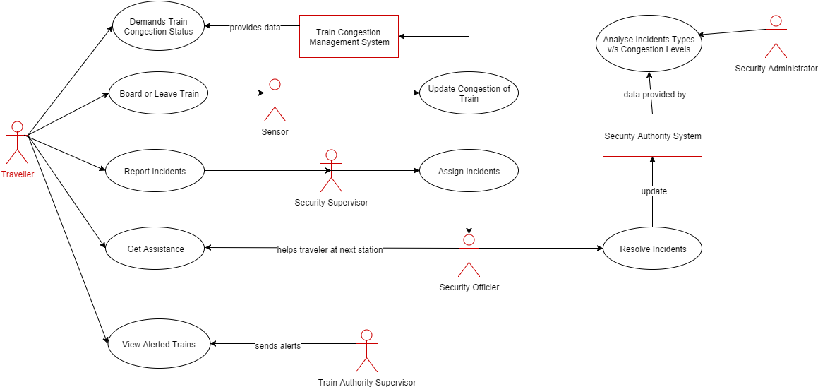
Application Use Cases – Traveler Workflow

Slide 7
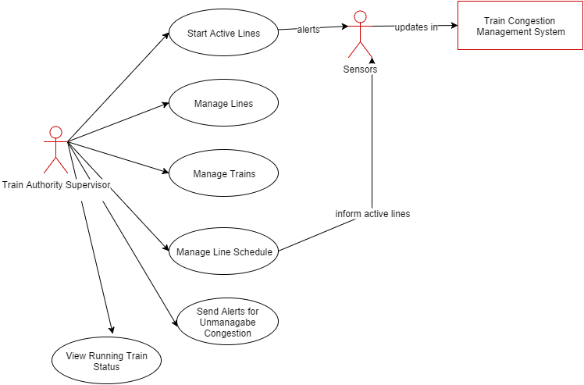
T-Supervisor Workflow

Slide 8
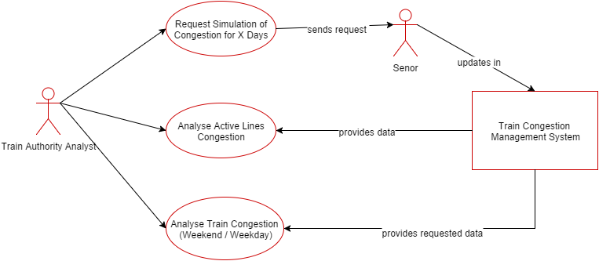
T-Analyst Workflow

Slide 9
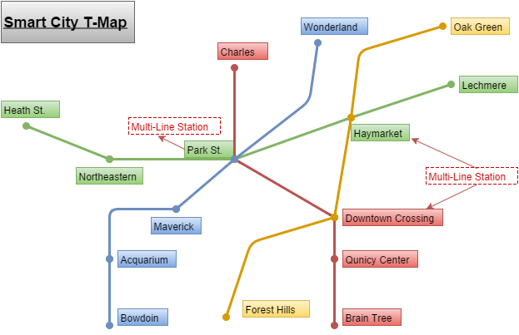
Simulated T-Map

Slide 10
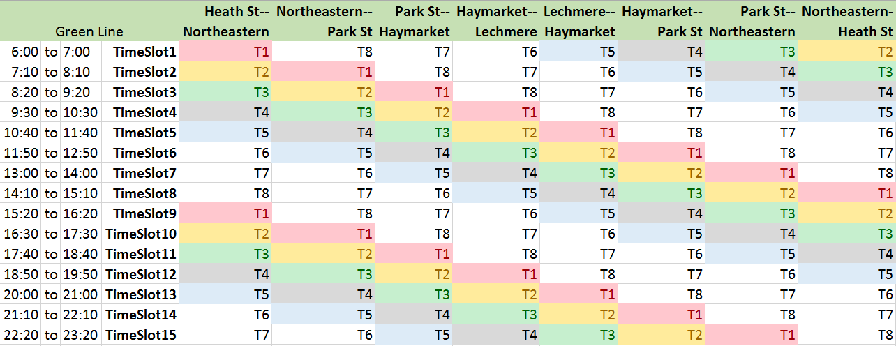
Simulated T-Schedule

Slide 11
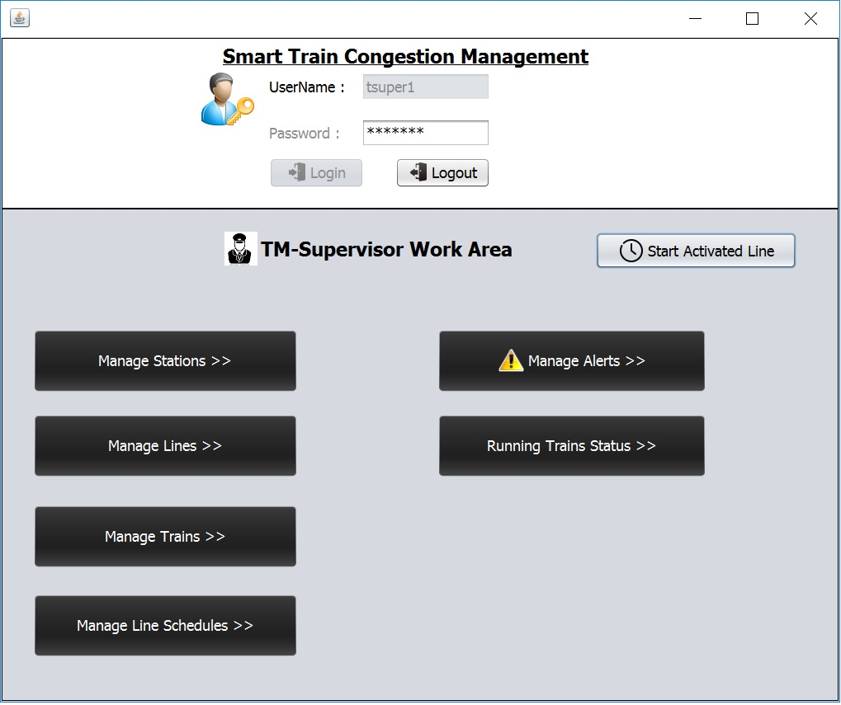
Application Screenshots

Slide 12
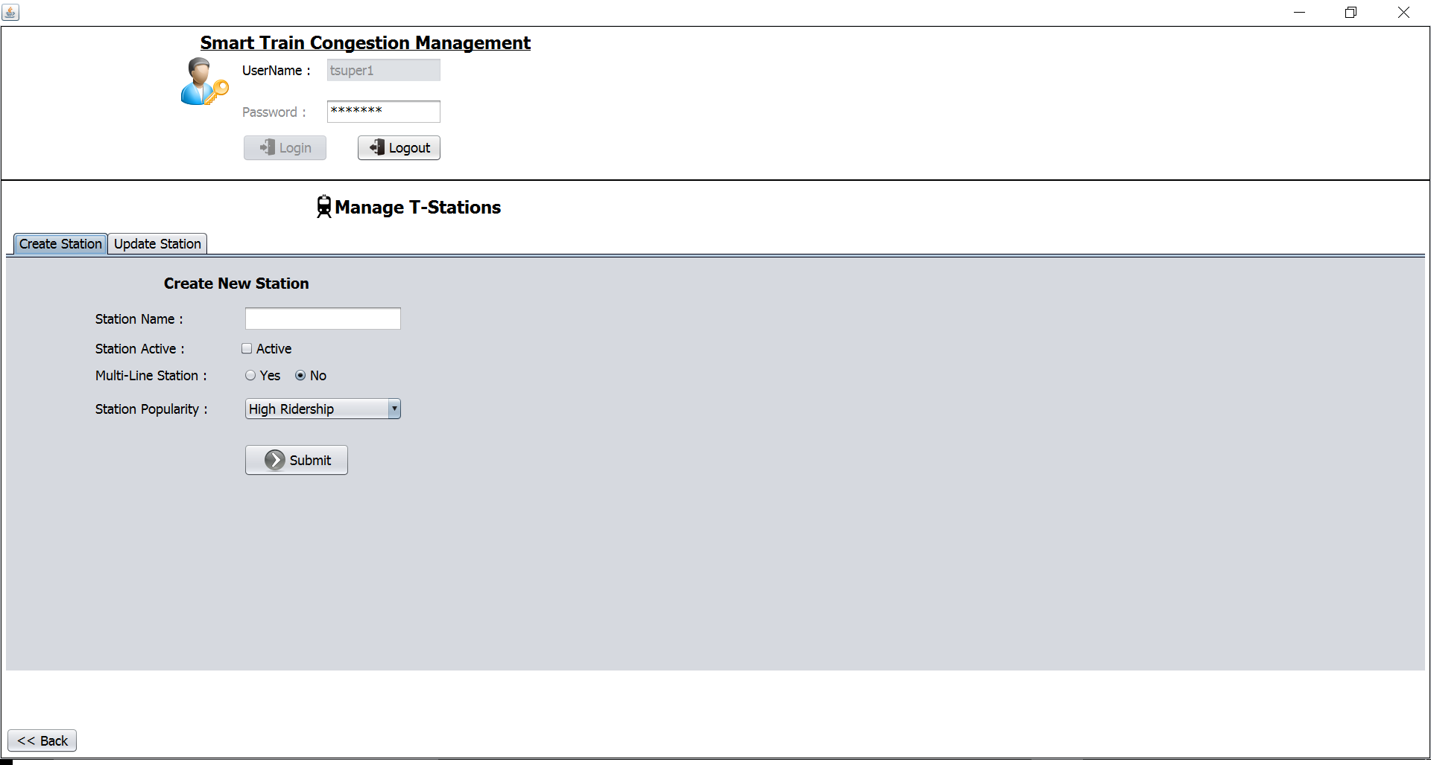
Application Screenshots

Slide 13
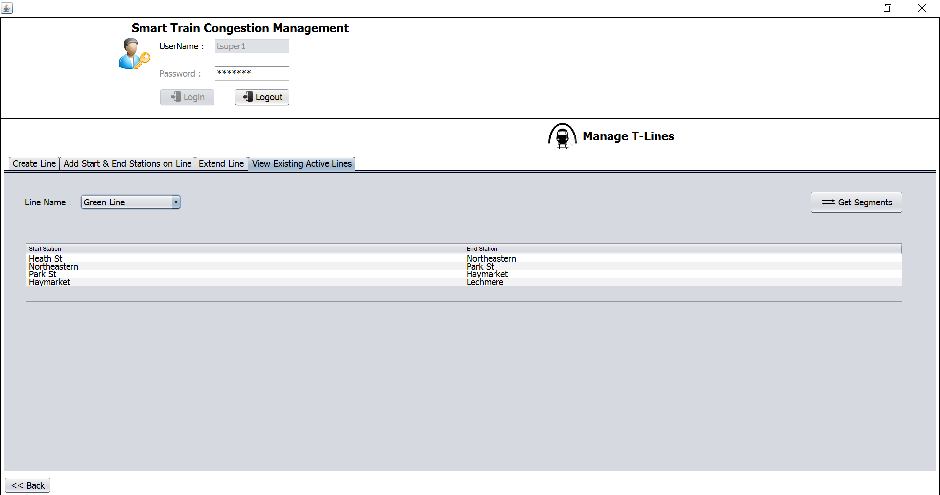
Application Screenshots

Slide 14
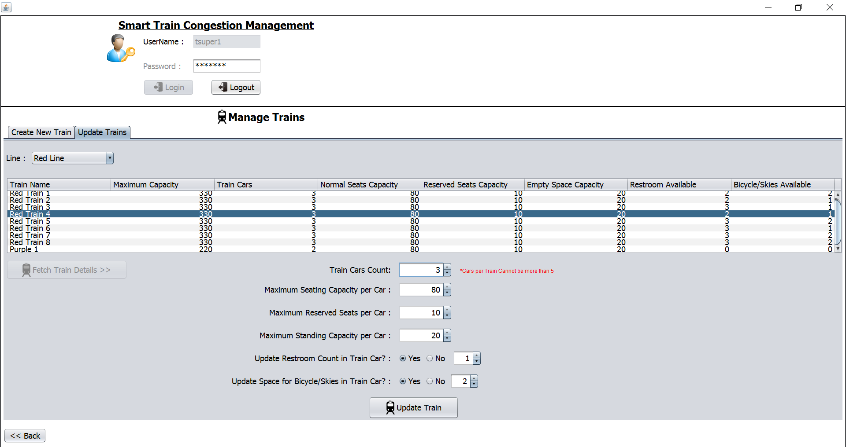
Application Screenshots

Slide 15
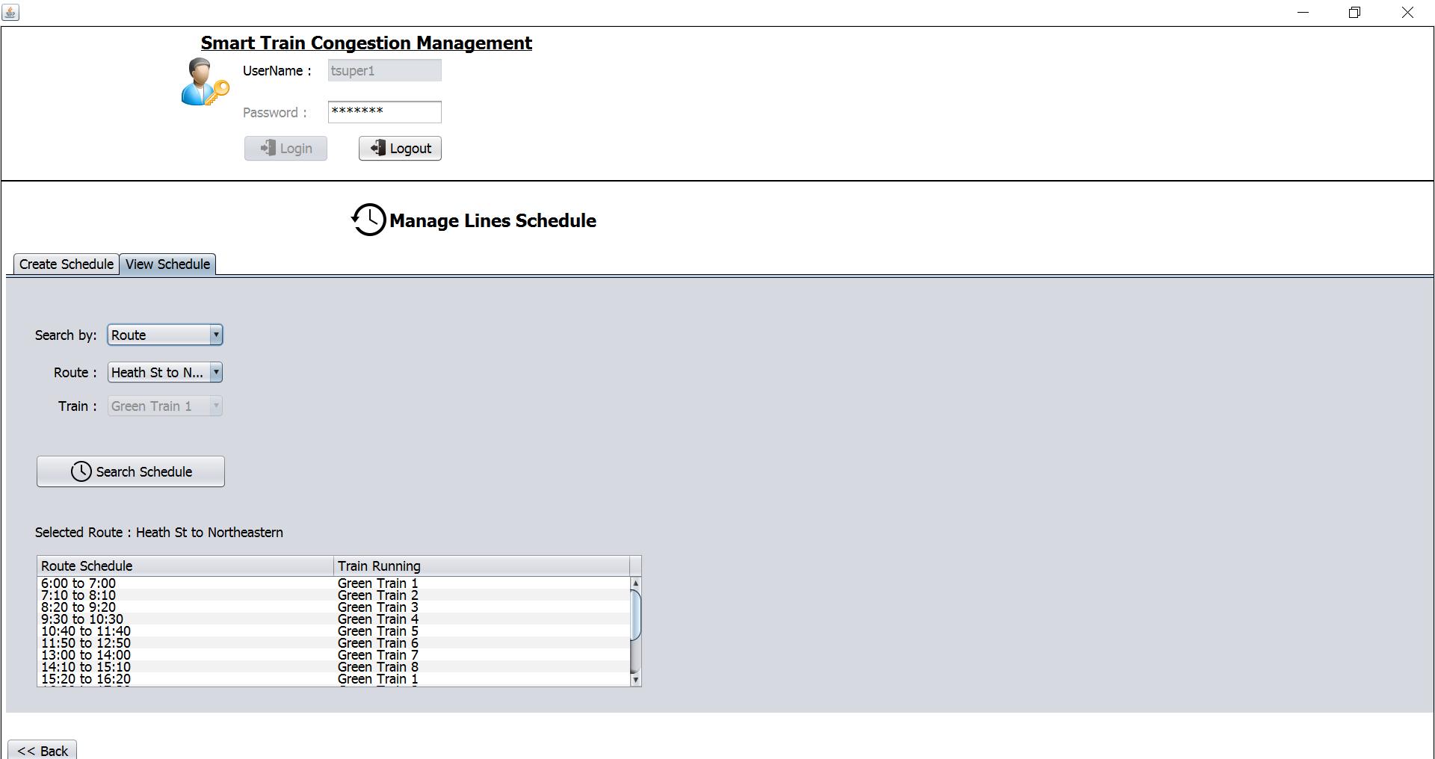
Application Screenshots

Slide 16
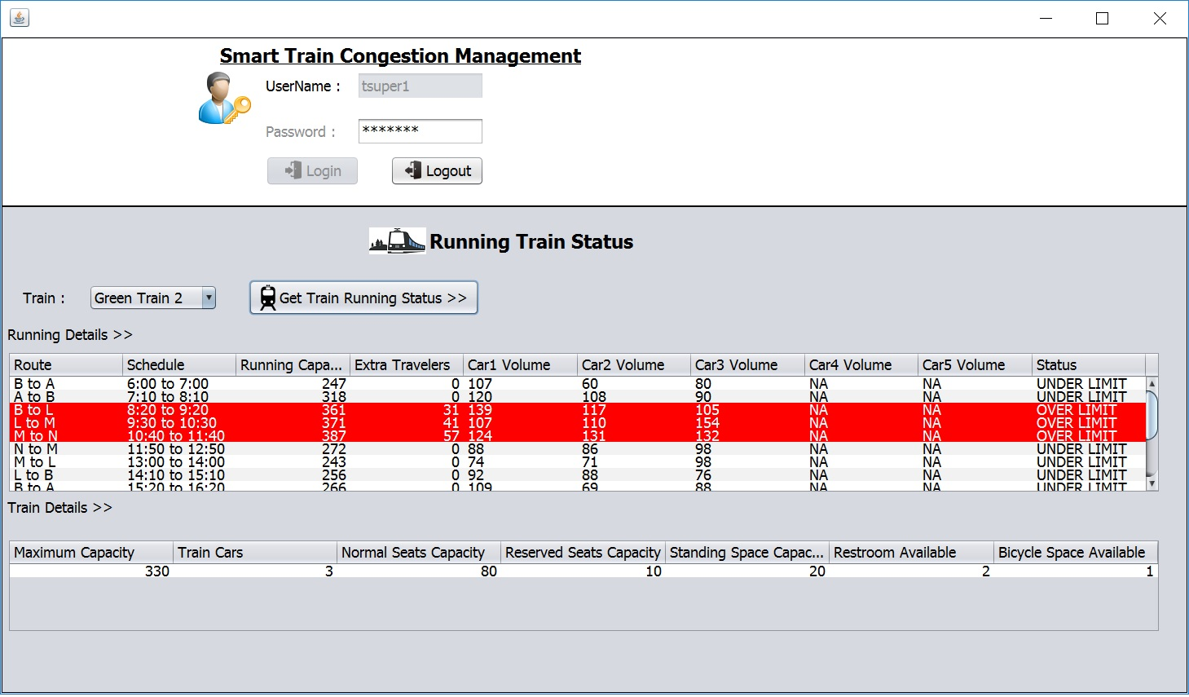
Application Screenshots

Slide 17
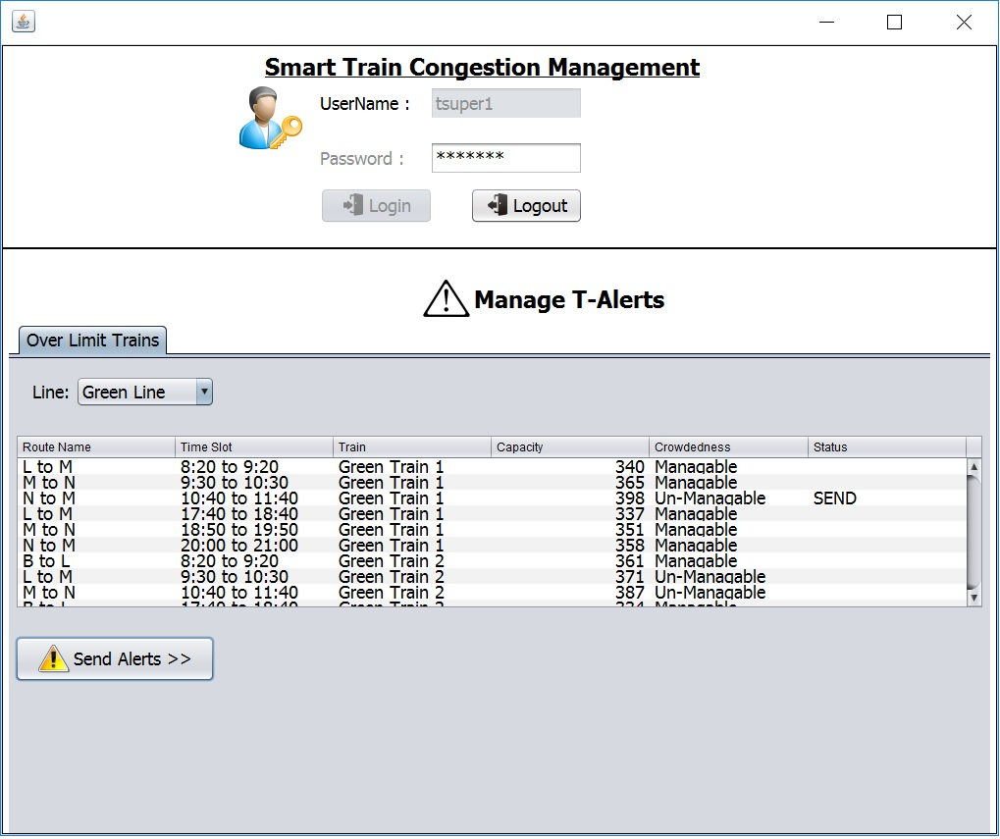
Application Screenshots

Slide 18
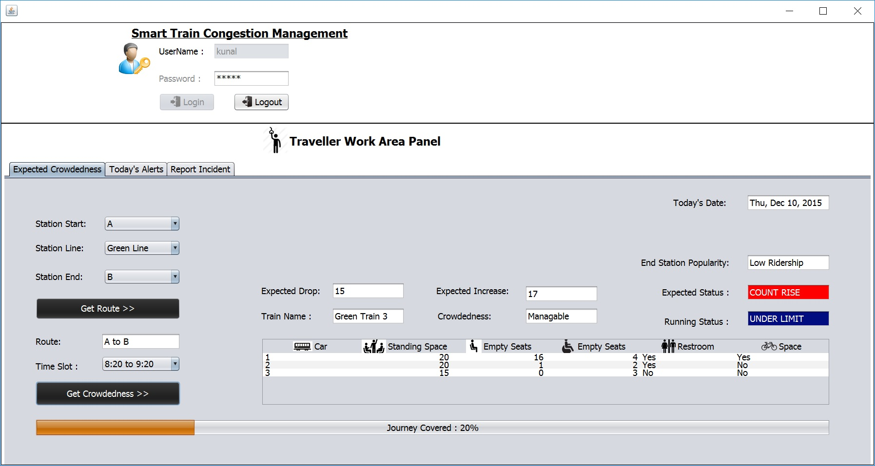
Application Screenshots

Slide 19
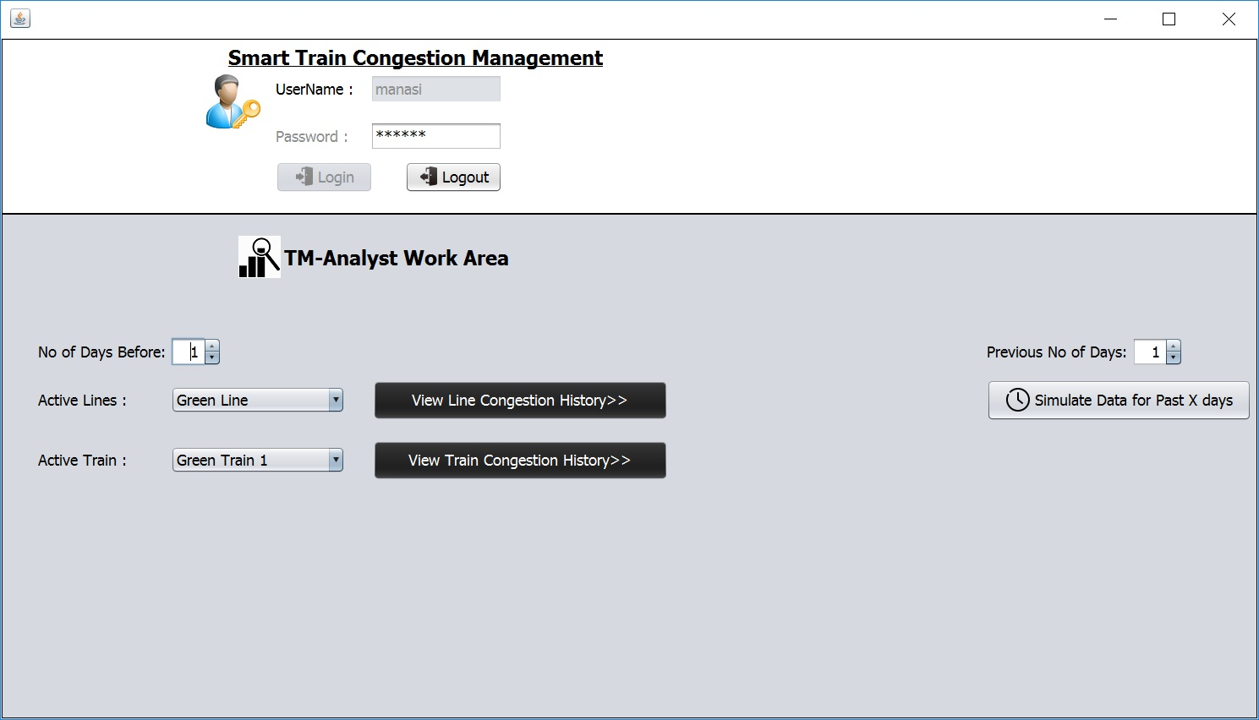
Application Screenshots

Slide 20
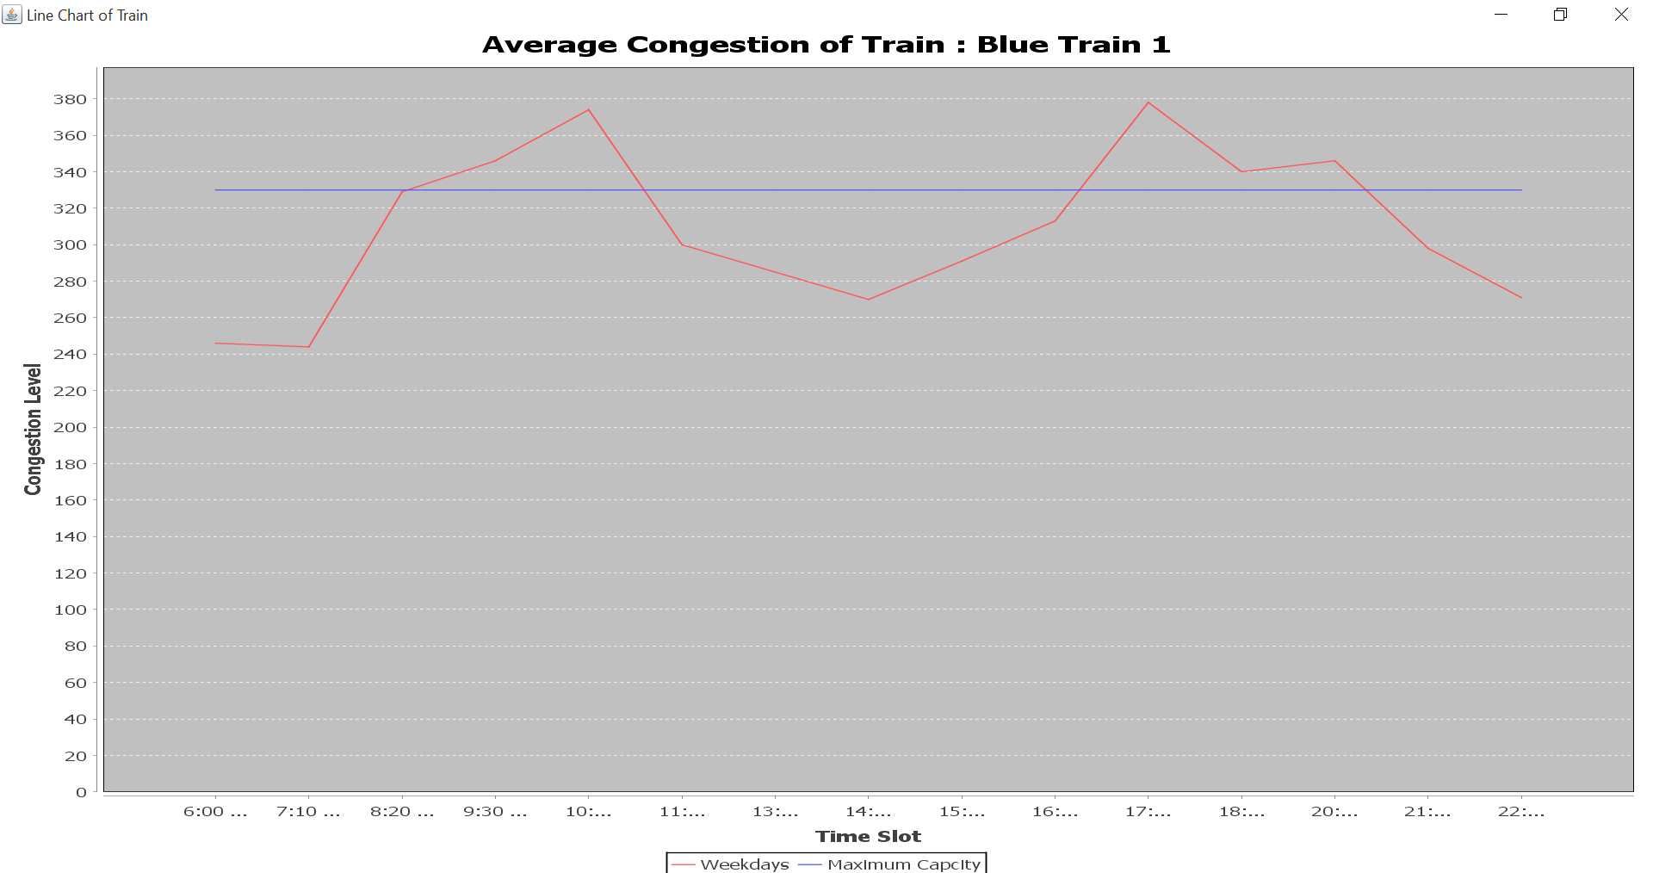
Application Screenshots

Slide 21
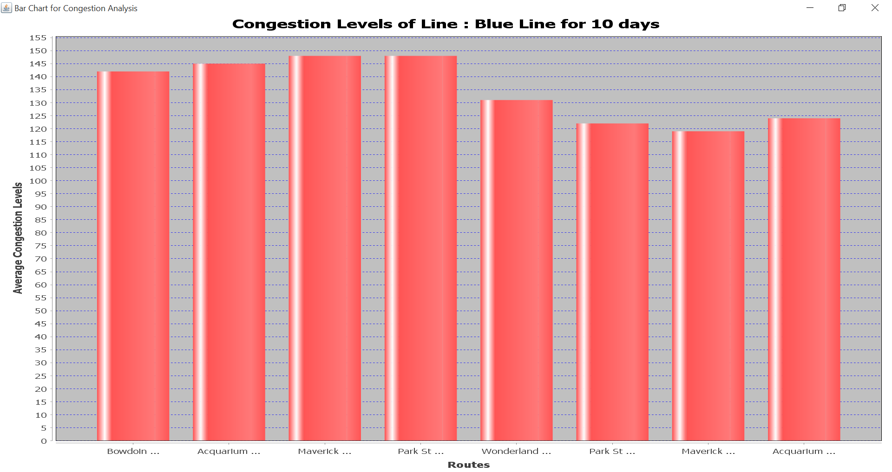
Application Screenshots

Slide 22
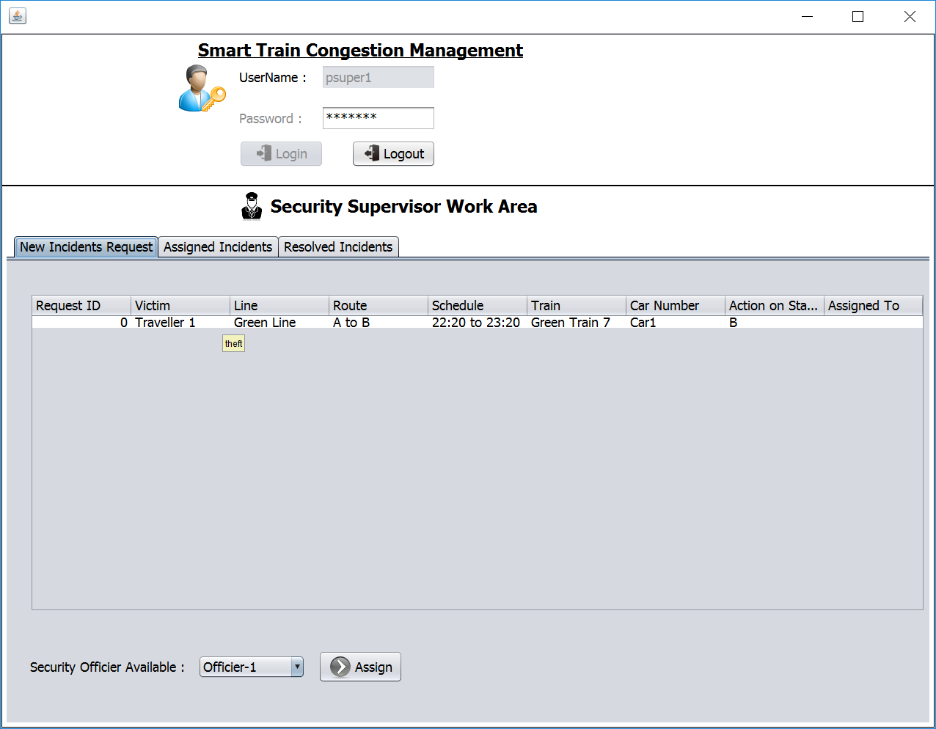
Application Screenshots

Slide 23
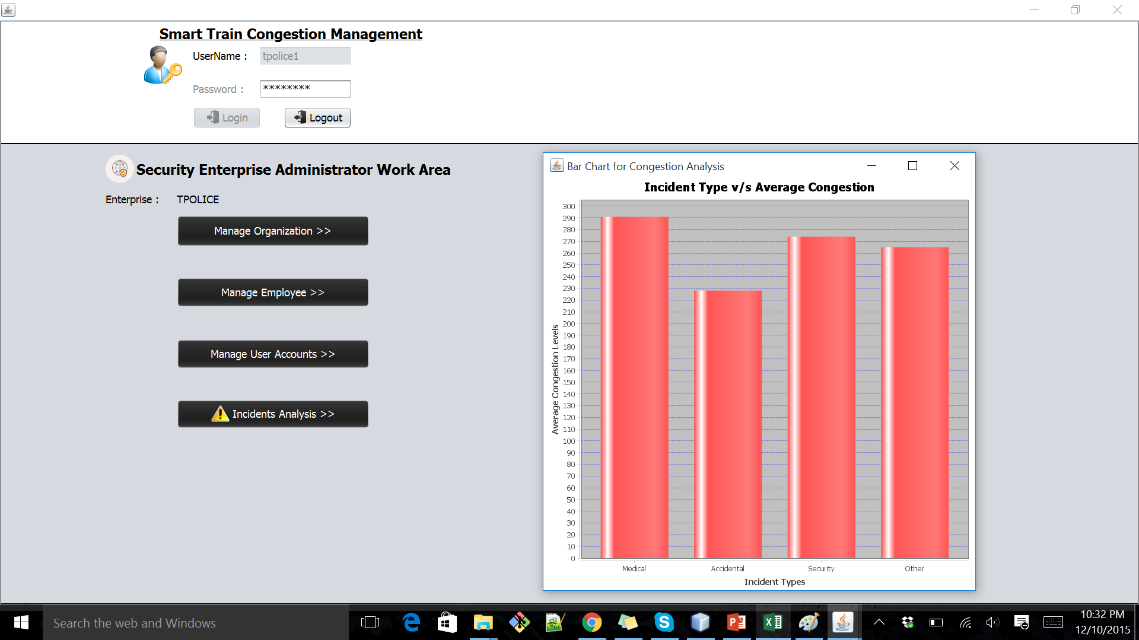
Application Screenshots

