Slide 1
Readmission of hospital patients
Course Project
(DSCI 633)
Manasi Patil
Rochester Institute of Technology

Slide 2
Analysis Strategy
Pre-Processing Steps:
Data Cleaning:
Feature Engineering:
Encoded categorical variables using one-hot encoding(race)
Used label encoding(diagnosis column) and ordinal transformations (age replaced with midpoints).
Data Splitting:
X and y variables were introduced.
Dataset was divided into two parts: 70% for training and 30% for testing
Balancing dataset: Applied SMOTE to address imbalanced readmission classes, ensuring a fair model performance.
Handled missing values and imputing them
Dropped irrelevant features with excessive missing values (e.g., payer_code, weight)
Checked for duplicate rows and removed if any
Removed identifier columns (encounter_id, patient_nbr) as they lacked predictive power.
Dropped columns which have very low correlation with the target variable (readmitted)

Slide 3
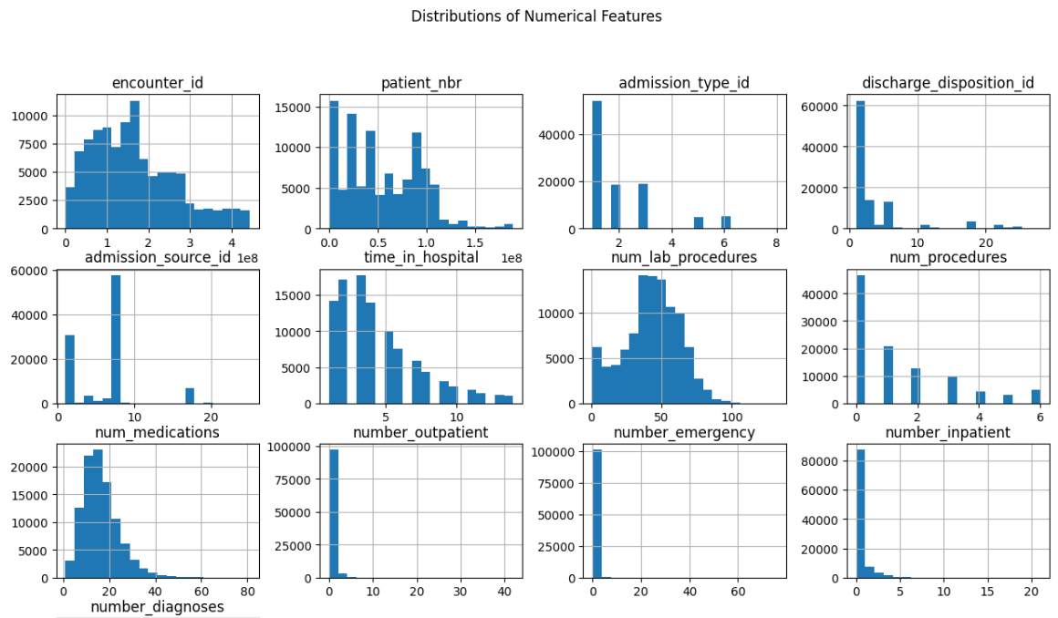
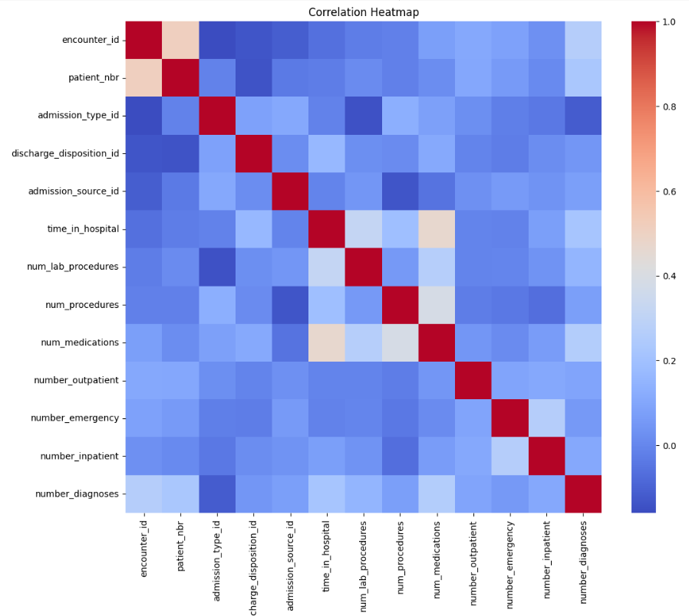
Plots

Slide 4
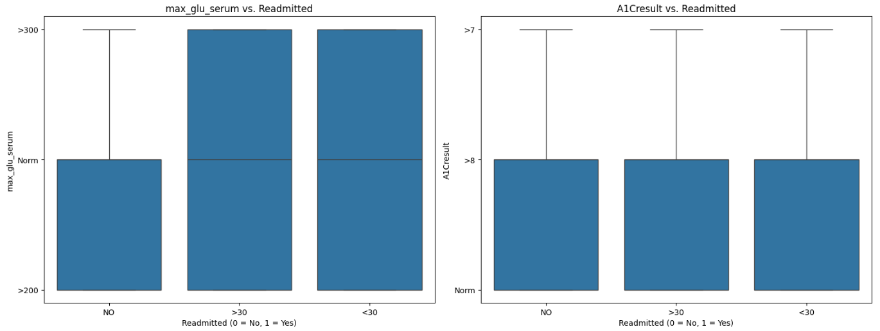
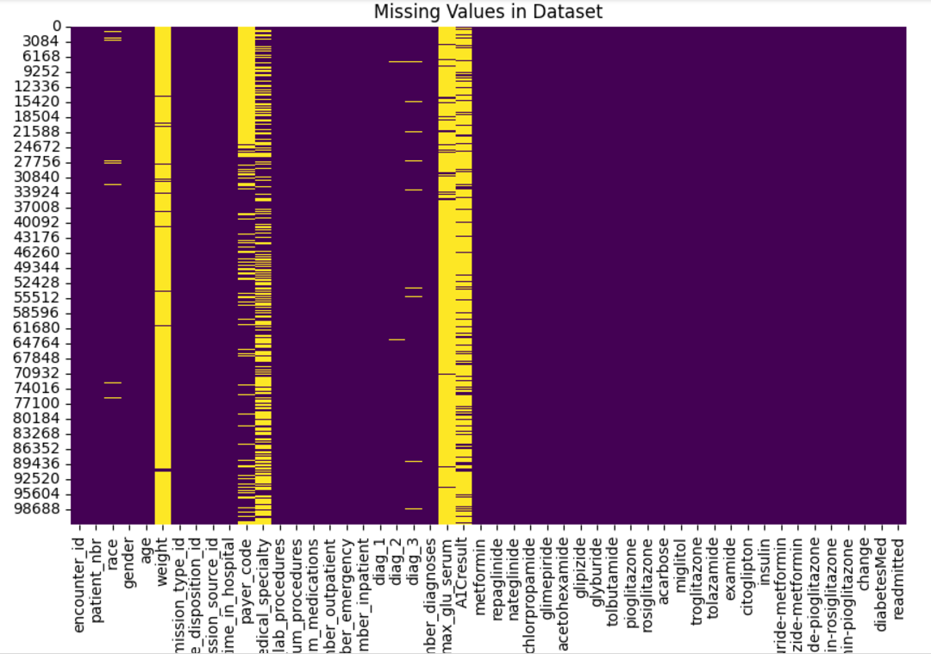
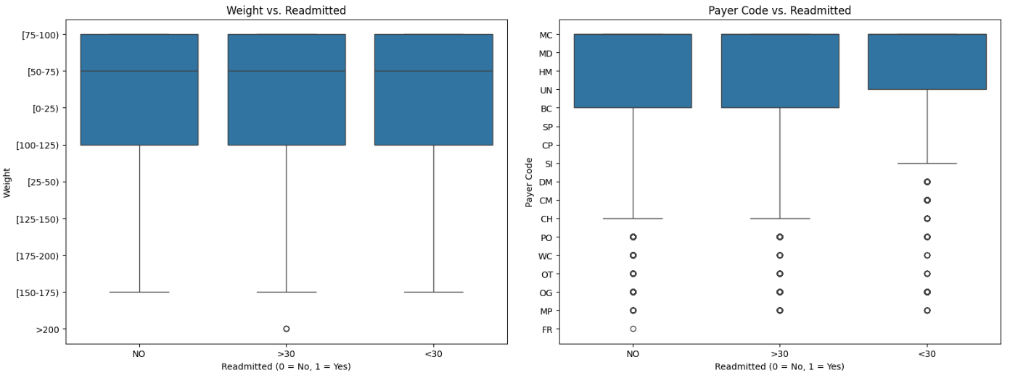
Plots

Slide 5
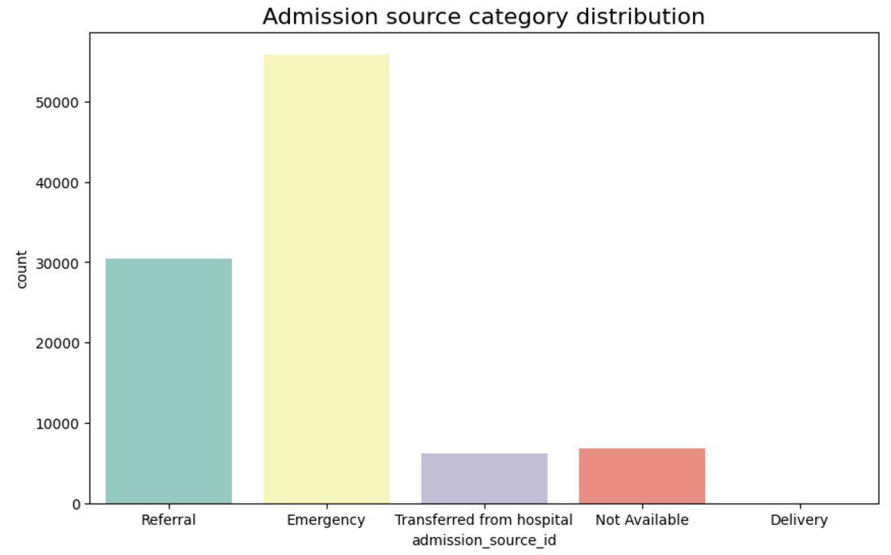
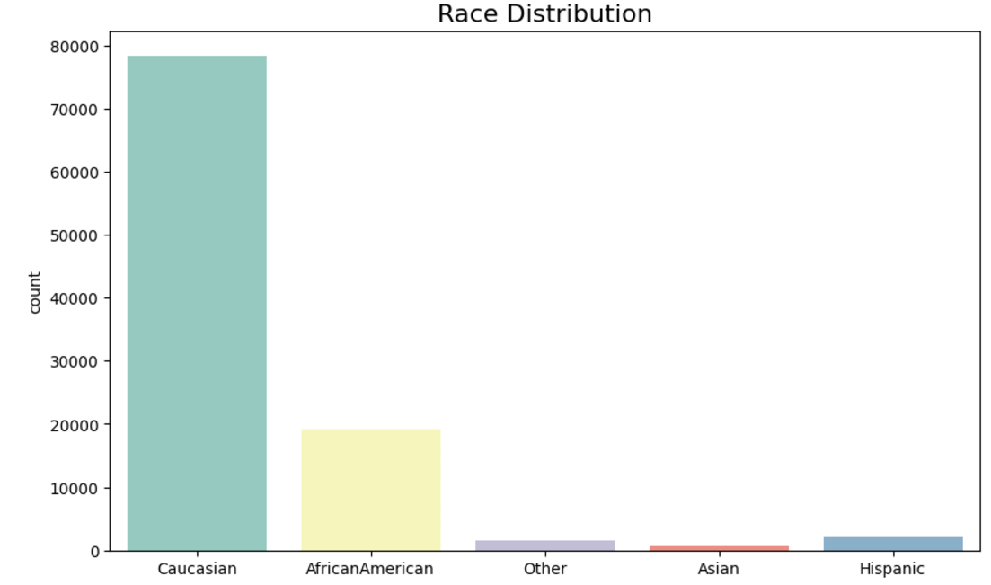
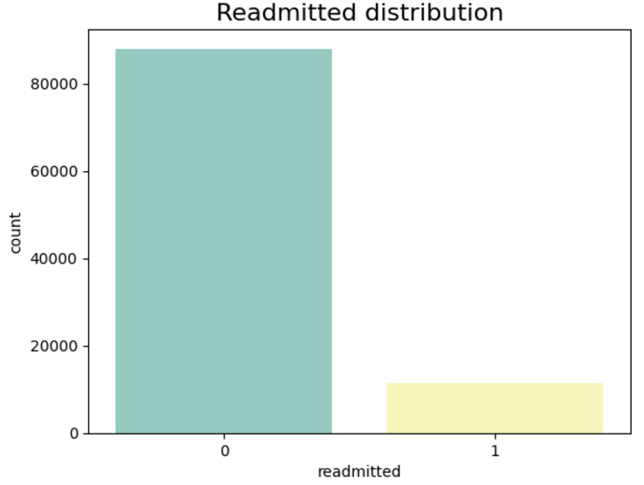
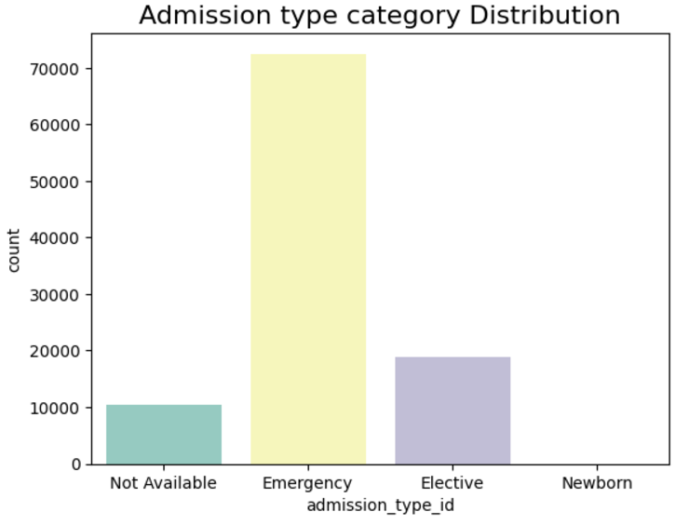
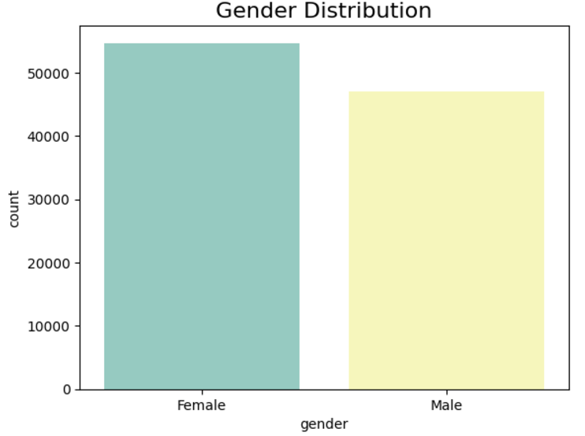
Plots

Slide 6
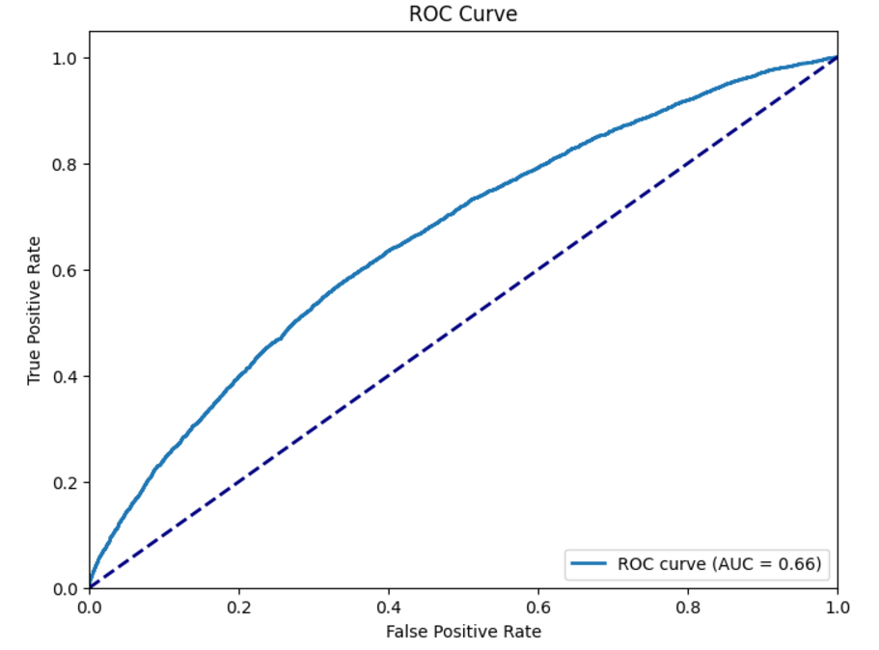
Model Selection and Evaluation
Implemented Logistic Regression, Decision Tree Classifier, XGBoost Classifier and Random Forest Classifier
To prevent overfitting and ensure that the model generalizes well, 5-fold cross-validation was used.
Hyperparameter tuning done using GridSearchCV
Parameters includes max_iterations, penalty, solver, etc.
The performance of the models were evaluated based on the accuracy, f1 score, precision and recall.
AUC-ROC curve was also drawn to help visualize and identify better performing model.
XGBoost Classifier is evaluated as the best model due to balanced
performance across all the metrics.
XGBoost also achieved the highest AUC-ROC curve, demonstrating
its superior ability to discriminate between patients.
Decision Tree and Random Forest models had good accuracy but
had very poor recall and were biased.
Logistic Regression has the best recall of 52 percent
but had weak precision and accuracy.
Challenge:
The hyperparameter tuning process required a significant amount of time computationally.

Slide 7
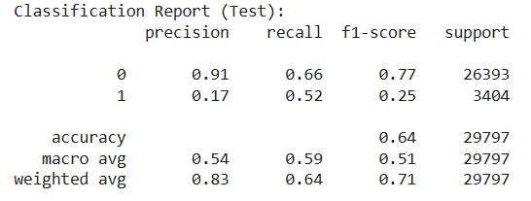
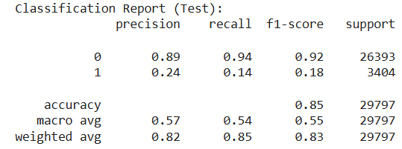
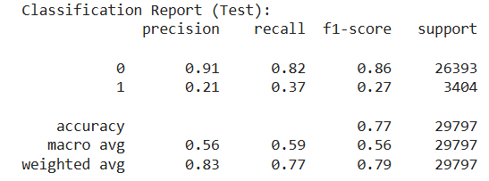
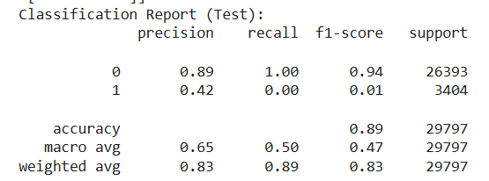
Evaluations
Logistic Regression
Decision Tree Classifier
XGB Classifier
Random Forest Classifier

Slide 8
Thank You !!!

