Slide 1
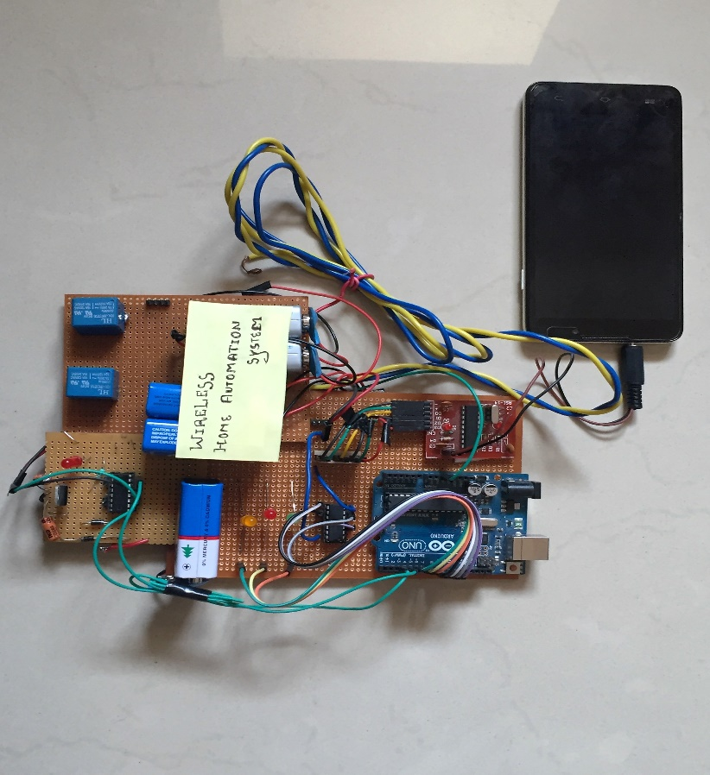
WIRELESS DOMOTICS ASSISTANCE
PRESENTED BY :-
MANAS JAIN
UDDESHYA MISHRA

Slide 2
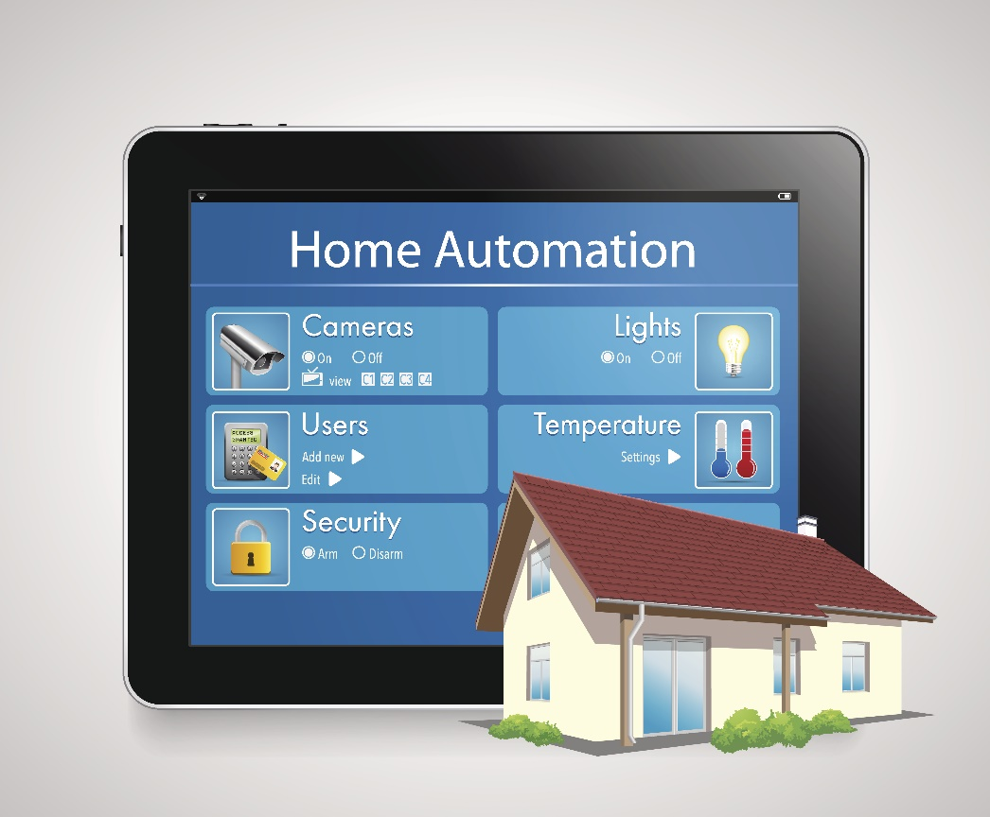
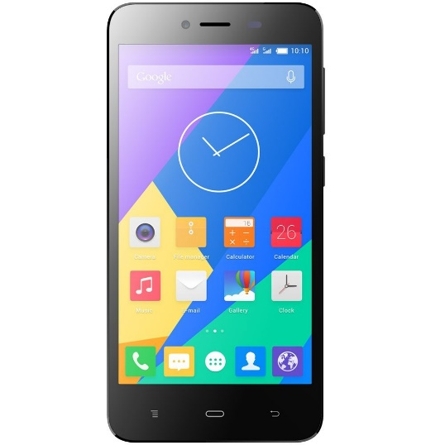
INTODUCTION
Home automation covers all the aspects of centralized control of lighting, HVAC (heating, ventilation and air conditioning), home appliances, security locks of windows and doors.
Wireless home automation provides better facilities and increases quality of life for the elderly and disabled who might otherwise require specialised care and be left to fend off for themselves.
Our Idea is to implement Wireless Home automation using Mobile phones. All the
user needs to do is to use his/her mobile phone to automatically on/off devices at
his/her Home.

Slide 3
IMPLEMENTATION
Mobile Phone
DTMF Decoder
Use input through a Mobile Phone to automatically on/off devices
Now the input is wirelessly transferred to DTMF Module which is the main part of our Project
Output to Devices
Microcontroller
Invertor IC
Now the corresponding O/P is fed to devices.
Now the O/P is fed to MCU as Input and the corresponding O/P is obtained
The O/P through DTMF module is fed to Invertor IC

Slide 4
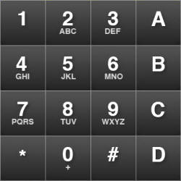
DTMF
The DTMF (Dual Tone Multi Frequency) decoder circuit spots the dial tone from the telephone line and decodes the key pressed on the telephone.
When any of the key like “1”, “2”, “*”, “#” etc. is pressed particular code is transmitted. This code is consist of two frequency among which one is higher frequency and second one is lower frequency.
679 Hz
770 Hz
852 Hz
941 Hz
1209 Hz
1336 Hz
1447 Hz

Slide 5
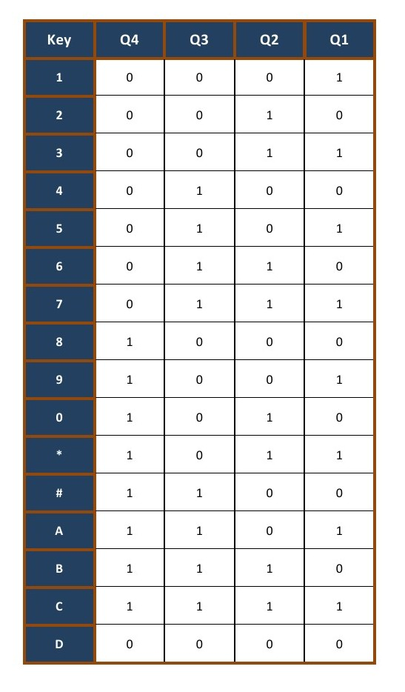
It gives 4-bit digital output q1, q2, q3, and q4 according to the received key.
Now. According to key Pressed by User we have 4 outputs.

Slide 6
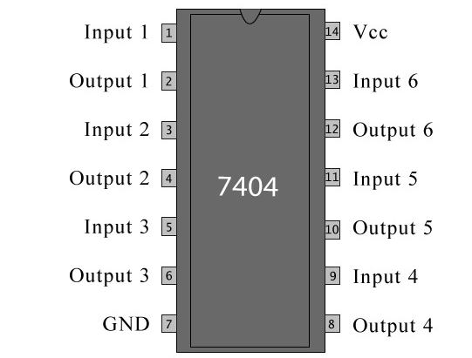
INVERTER IC
Outputs from the DTMF according the key pressed by the user is fed to Invertor IC, which is used to buffer the Inputs.
7404 is a NOT gate IC. It consists of six inverters
which perform the logical inverting action.
The output of an inverter is the direct complement
of its input logic state i.e. when input is high its
corresponding output is low and the other way
round.

Slide 7
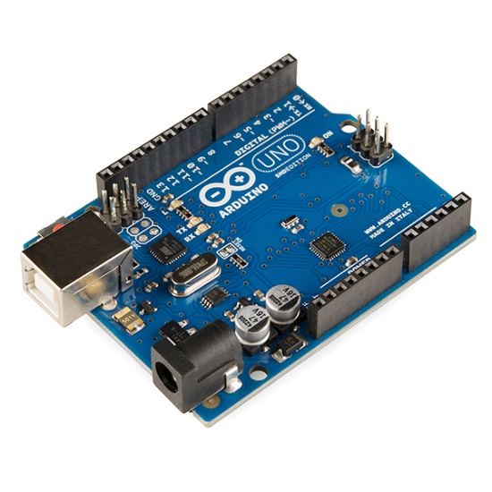
ARDUINO-UNO
Outputs from the Invertor IC is fed to Arduino Uno which are then processed according to the Algorithm burnt in the Arduino Uno
ARDUINO Computer software and hardware company
which designs and develops microcontroller
development boards.
The Arduino has a nearly limitless array of innovative
applications for everything from robotics and lighting
to games !
Here , we are using Arduino- Uno as our microcontroller
development board.
Microcontroller – Atmega328
14 digital input/output pins (of which 6 can be used as
PWM outputs), 6 analog inputs
16 MHz quartz crystal
USB connection, a power jack
Notes:
Here Explaination about Arduino , its technical details Technical specs
Microcontroller-ATmega328P
Operating Voltage-5V
Input Voltage (recommended)-7-12V
Input Voltage (limit)-6-20V
Digital I/O Pins-14 (of which 6 provide PWM output)
Analog Input Pins-6
DC Current per I/O Pin-20 mA
DC Current for 3.3V Pin-50 mA
Flash Memory-32 KB (ATmega328P)of which 0.5 KB used by bootloaderSRAM2 KB (ATmega328P)
EEPROM-1 KB (ATmega328P)
Clock Speed-16 MHz
Length-68.6 mm
Width-53.4 mm
Weight-25 g

Slide 8
BASIC FUNCTIONS OF ARDUINO
INPUT
Takes input through its input pins
PROCESS
Decides the output corresponding to the input based on the program
OUTPUT
Sends these outputs to components through its output pins
We have to process the outputs from the Invertor IC by an algorithm that is stored in our MCU, so that we can have desired outputs to On/off our devices.

Slide 9
Now We’ll Have Clear Idea …..
Mobile Phone
DTMF Decoder
Use input through a Mobile Phone to automatically on/off devices
Now the input is wirelessly transferred to DTMF Module which is the main part of our Project
Output to Devices
Microcontroller
Invertor IC
Now the corresponding O/P is fed to devices.
Now the O/P is fed to MCU as Input and the corresponding O/P is obtained
The O/P through DTMF module is fed to Invertor IC

Slide 10
COST ANALYSIS
Component | Price Per Piece (INR) | Quantity Required | Total (INR)
Micro-controller ( Arduino Uno) | 1200 | 1 | 1200
Invertor IC | 50 | 1 | 50
DTMF Module | 200 | 1 | 200
Motor Driver IC | 100 | 1 | 100
Relays | 20 | 2 | 40
Batteries | 30 | 5 | 150
Packaging cost | 250 | - | 250
Miscellaneous | 500 | - | 500
Total - Rs 2490

Slide 11
PROFIT MAKING PRODUCTION
Total production cost will include our profit as well as
principle amount that we estimated in cost analysis.
It will also include packing cost fluctuations and will
entirely depend on how we plan to produce it at commercial level.
However ,it will definitely be affordable and will catch market interest.

Slide 12
APPLICATIONS
Communication between a microphone and a loud speaker is possible between multiple rooms using an Intercom system. Residents can be made to view the door camera automatically by connecting the intercom to the telephone, or of the video door entry system to the television set.
Temperature and Humidity can be controlled using the Heating, Ventilation and Air conditioning (HVAC) systems.
Switch lights can be used based on a time cycle using a Lighting Control System, or arranged to automatically switch-off when the room is vacant.
Central locking of all the doors and windows can be achieved by connecting the household security system with the home automation system.

Slide 13
LIMITATIONS
Unwanted expense on outgoing calls from the mobile phone in order to operate devices from it.
One mobile phone needs to be always connected to the main circuit at home in order for wireless home automation.
Limitation on the number of devices that we want to operate through the mobile.
Ratings of the devices should be known and must be within the range of the components used.

Slide 14


