Slide 1

SpotNFix: Smart pothole reporting and severity detection system
Aditya Sawant: 22106084
Jay Yadav: 23206007
Pranal Vernekar: 23206008
Manas Jagtap: 23206011
Project Guide
Dr. Rahul Ambekar

Slide 2
Outline
Introduction
Literature Survey of the existing ML Models
Limitations of the existing systems
Problem statement and Objective
Proposed System and System Design
Experimental Setup
Implementation
Conclusion and future work

Slide 3
Introduction
Roads in cities and towns often develop potholes due to heavy traffic, rain, and poor maintenance.
Potholes cause accidents, vehicle damage, and traffic congestion.
Current solutions include manual complaint systems, helplines, or municipal apps, but adoption is low.
Problems with existing systems:
Citizens’ complaints often go unresolved or delayed.
Lack of transparency in how pothole repairs are assigned.
No effective tracking or accountability for contractors.
Duplicate reports and false reports waste government resources.
ML-based image validation and smart workflows are still not widely integrated in real-time pothole management

Slide 4
Motivation
Daily observation of unsafe roads with unreported potholes.
Frequent road accidents due to potholes, especially in urban India.
Citizens’ complaints often ignored or lost in bureaucratic processes.
Corruption and inefficiency in contractor assignments and fund usage.
Need for a transparent, automated, and accountable platform where every
pothole is reported, tracked, and repaired.

Slide 5
Objectives
Provide an easy-to-use platform for citizens to report potholes with location & images.
Use Machine Learning (YOLO) to validate pothole presence and
classify severity.
Enable government officials to efficiently verify and track pothole reports.
Create a transparent bidding system for contractors to ensure fair pricing.
Integrate donation/funding support for community participation.
Ensure accountability & quality control through penalties and performance
tracking.
Provide dashboards & analytics for citizens, government, and contractors.

Slide 6
Literature Survey of the existing ML Models
Paper Name | Author Name | Method Used | Gap
Deep learning based pothole detection | D. R. Rajan, M. K. Faizan, R. Kundelu, N. Nandal, V. S. Gunda | Deep learning-based pothole detection | Limited focus on broader road-damage classification and end-to-end reporting integration
Asphalt pavement pothole detection using deep learning method based on YOLO neural network | E. N. Ukhwah, E. M. Yuniarno, Y. K. Suprapto | YOLO-based object detection | Likely limited in real-time large-scale deployment and public reporting workflow
PADS: A reliable pothole detection system using machine learning | J. Ren, D. Liu | Machine learning-based detection system | Older method; may lack modern deep learning accuracy and robustness in complex road conditions
Smart pothole detection using deep learning based on dilated convolution | K. R. Ahmed | Dilated convolution in deep learning | Focused mainly on detection, with limited severity estimation or response automation

Slide 7
Literature Survey of the existing ML Models
Paper Name | Author Name | Method Used | Gap
Real-time machine learning-based approach for pothole detection | O. A. Egaji, G. Evans, M. Griffiths, G. Islas | Real-time machine learning approach | May not include full maintenance reporting or multi-stakeholder workflow
Smart pothole detection system using vehicle-mounted sensors and machine learning | A. Anaissi, N. L. D. Khoa, T. Rakotoarivelo, M. M. Alamdari, Y. Wang | Vehicle-mounted sensors + machine learning | Sensor-based approach may need dedicated hardware and may not scale easily for public use
Indian pothole detection based on CNN and anchor-based deep learning method | M. Anandhalli, A. Tanuja, V. Baligar, P. Baligar | CNN + anchor-based deep learning | May be focused on Indian road conditions, with limited generalization to other environments
Road damage detection and reporting system using YOLOv7: Enhancing public participation in infrastructure maintenance | N. Nizamiyati, B. Muhamad | YOLOv7 + reporting system | Likely still needs stronger integration with automated severity assessment and contractor allocation

Slide 8
Outcome of Literature survey (Pothole ML Models)
Deep Learning Improves Detection Accuracy:
CNN-based and YOLO-based models can accurately detect potholes and road damage,
outperforming traditional image processing methods.
Severity Estimation Is Feasible:
Pothole severity can be estimated using image-based models, enabling prioritization
for repair and informed decision-making for road maintenance.
Environmental and Contextual Factors Affect Performance:
Lighting conditions, shadows, weather, camera angles, and vehicle speed can reduce detection accuracy or lead to misclassification.
Generalization Limitations:
Models trained on specific datasets may not perform well across different regions, road types, or conditions due to limited diversity in training data.
Public Participation and Data Quality Are Key:
Citizen reporting can enhance coverage, but variability in image quality and GPS accuracy may impact model performance and reliability of the reporting system.

Slide 9
Name of Existing Systems
CPRAMS (Centralized Public Grievance Redress and Monitoring System – Nationwide) – Allows citizens to lodge road and civic complaints, including potholes, across India with government departments.
Meri Sadak (Nationwide) – A central government app for citizens to provide feedback and report road quality issues, especially under PMGSY.
Pothole QuickFix (BMC Mumbai) – A Mumbai-specific app to geotag and report
potholes directly to the Brihanmumbai Municipal Corporation for quicker repairs.
PCMC Pothole App (Pune) – A dedicated app by Pimpri-Chinchwad Municipal Corporation for citizens to report potholes with photos and live tracking of complaint status.

Slide 10
Limitations of Existing Systems
Delayed action – Even after reporting, potholes may take weeks/months to be
fixed.
Low accountability – Complaints are sometimes marked “resolved” without actual
repair; no stringent measures for pothole resolution.
No automated ML integration – False pothole reports may get assigned; no
automated model to verify authenticity.
Technical glitches – Apps often crash, have GPS/photo upload issues, or don’t send
proper updates.
Lack of communication – Weak coordination between citizens, government
officials, and contractors; no democratized or gamified feedback feature.
No contractor penalties – Contractors are rarely penalized for poor or temporary
repair work.
No bidding system – Lack of transparent bidding among contractors for efficient
and cost-effective pothole repair.

Slide 11
Problem statement
India’s pothole problem persists despite existing apps like CPRAMS, Meri Sadak, Pothole QuickFix, and PCMC Pothole App. Current systems face issues of delayed action, poor accountability, limited coverage, technical glitches, and lack of contractor penalties. They also miss advanced features like ML-based authenticity checks, severity-based prioritization, transparent bidding, gamified citizen engagement, and community/NGO fund crowdsourcing. This results in inefficient reporting and weak resolution mechanisms, leaving potholes largely unaddressed.

Slide 12
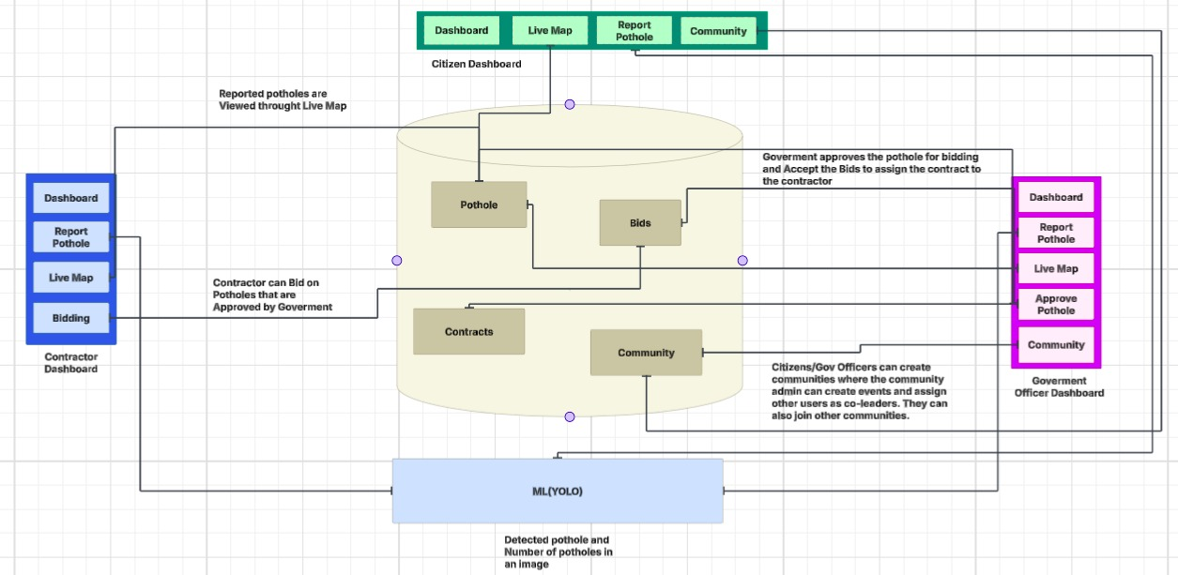
System Design

Slide 13
Explanation of System design
Multi-role Platform – Citizens, Contractors, Government Officers, and Admin with role-based
dashboards.
Secure Authentication – Email OTP & Google Sign-In; contractors/government need admin
approval.
Smart Pothole Reporting – Mapbox pin + reverse geocoding + photo upload.
ML Validation – YOLOv11 detects potholes and classifies severity
Centralized Storage – Supabase DB for reports, bids, contracts; Supabase Storage for images &
documents.
Live Map Monitoring – Status-based color markers (reported, verified, discarded, assigned, repaired).
Bidding & Contracts – Contractors submit bids; lowest tracked; government assigns & manages contracts.
Duplicate Detection – RPC/Haversine ensures no duplicate reports in same area.

Slide 14
Explanation of System Diagram
Community & Philanthropy Donations – Citizens/NGOs contribute funds for pothole
repairs.
Smart Assignment Workflow – Contractors assigned, repairs tracked, and completion
verified by government.
Penalty System – Fines or restrictions for contractors delivering poor-quality work.
Dashboards & Analytics – Visual insights on pothole density, contractor performance,
donations, and repair status.

Slide 15
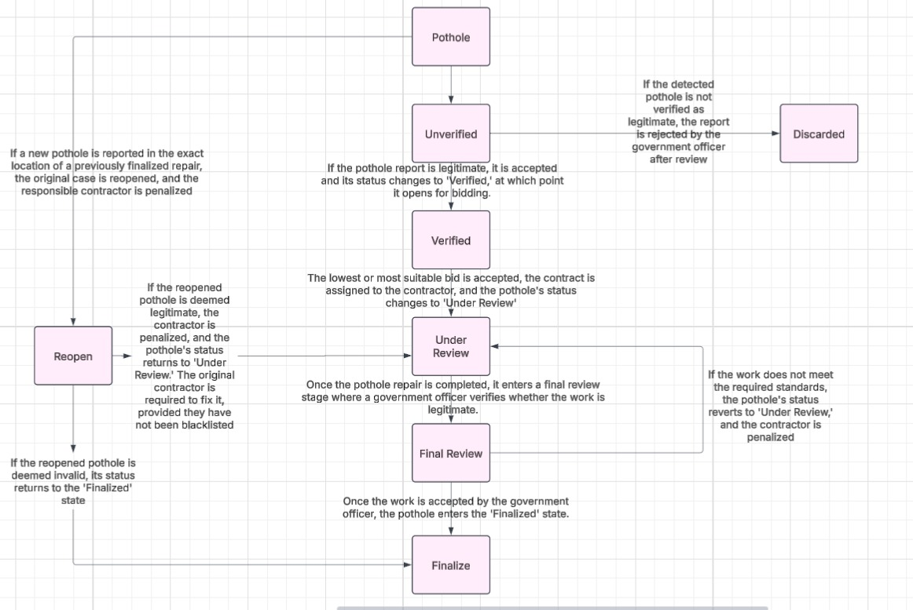
Pothole Lifecycle

Slide 16
Yolo Hyperparameters
Model base → Starts from yolo11n.pt (small and fast model).
Input size → Configurable image size (default 640×640).
Device selection → Automatically uses GPU if available, else CPU.
Augmentations → HSV, flips, mosaic, geometric transforms to reduce overfitting.
Regularization → Dropout (0.1) and weight decay (5e-4) to improve generalization.
Optimizer & LR → AdamW with warmup (3 epochs) and cosine decay for smooth training
Loss gains → Weighted box, class, and DFL losses for balanced training.
Performance → Mixed precision (AMP) and caching for faster training.
Batch & LR scaling → Configurable batch, nominal batch used to scale learning rate.
Early stopping → Stops if no improvement for a set patience period.

Slide 17
Improvement from Existing Systems
AI-powered validation – YOLOv11 & MobileNet models ensure pothole images and severity are verified automatically.
Role-based workflows – Separate dashboards for citizens, contractors, and officials vs. generic reporting apps.
Bidding mechanism – Contractors compete for repair jobs instead of fixed vendor assignment.
Severity-based pricing – Automated base repair cost derived from ML severity classification.
Community-driven funding – Donation system to support repairs, unlike government-only funding (Potholes with personal funding don’t need government approval).
Accountability & penalties – Quality-based evaluation with penalties for poor contractor performance.
Transparency – Live Map with status tracking (reported → verified → assigned → repaired).
Integrated admin approval – Contractors and officials verified before system access for trust & compliance.

Slide 18
Technologies and methodologies
Frontend – React + Vite, Redux, Mapbox GL, axios, react-hot-toast
Backend – Node.js + Express, Supabase (Postgres + Storage + RPC), JWT, multer,
CORS
Machine Learning –
YOLOv11 (ONNX Runtime + OpenCV, Flask API) → pothole detection in images and Severity detection
Geospatial Logic – Mapbox reverse geocoding; Haversine formula for duplicate detection
Authentication – Email OTP verification; Google Sign-In for citizens
Admin Tools – Supabase Storage for document verification; hardcoded admin with
JWT-protected APIs
APIs – REST (Auth, Pothole reporting, Verification, Bidding, Admin verification, ML
detection)

Slide 19
Outocomes
Faster and accurate pothole detection using ML models (YOLO + MobileNet).
Transparent workflow from citizen report → verification → repair → fund release.
Competitive bidding ensures cost-effective and timely repairs.
Community donations enable faster resolution beyond government budgets.
Accountability through penalties improves contractor performance.
Dashboards provide real-time insights for all stakeholders.

Slide 20
SDG Goals
SDG 9 (Industry, Innovation & Infrastructure): Uses technology to improve road infrastructure through pothole detection
SDG 11 (Sustainable Cities & Communities): Enhances urban safety and mobility by addressing pothole issues

Slide 21
Thank You...!!

