Slide 1

CampusCare- Hostel Healthcare Web-application
Project Guide
Ms. Bharti Khemani
22106090 | Vedant Vethekar
23206007 | Jay Yadav
23206008 | Pranal Vernekar
23206011 | Manas Jagtap

Slide 2
Outline
Introduction
Problem Statement
Literature Review
Objective
Flowchart
Technologies Stack
Implementation
Conclusion

Slide 3
Introduction
In a university hostel environment, where hundreds or even thousands of students live together, access to timely and efficient healthcare is not just a necessity but a critical factor in ensuring the well-being of residents. However, existing healthcare systems often fall short, lacking integration, accessibility, and real-time responsiveness. This gap leaves students vulnerable, especially during medical emergencies or outbreaks of contagious illnesses.
CampusCare emerges as a game-changing solution designed specifically for this dynamic and communal living environment. By leveraging modern technology, the platform redefines the way healthcare services are accessed and delivered in university hostels. It focuses on creating a seamless, user-centric experience that combines accessibility, efficiency, and innovation.
.

Slide 4
Problem Statement
In the dynamic environment of a university hostel, timely healthcare access is crucial. However, the current system lacks integration and real-time responsiveness, leaving students vulnerable during medical emergencies. Our project aims to revolutionize hostel healthcare by introducing a comprehensive digital platform. With features like real-time ambulance tracking, secure patient information sharing, isolation alerts, and pharmacy delivery, we ensure swift, coordinated responses to health needs.

Slide 5
Literature Review
“Human Disease Prediction using Machine Learning Techniques and Real-life
Parameters”, K. Gaurav et. al
The SVM model is used to verify whether predictions from the LSTM and Random Forest models are correlated and caused by the same factors. If both models predict "Hepatitis," SVM checks the validity of this correlation. Prior research has used SVM for symptom-based predictions, but here, it solely determines relationships between model outputs. SVM is chosen for its strong classification ability, ensuring accurate final predictions by analyzing the dependencies between results from the LSTM and Random Forest models.
“Hostel Management System”, Rachana Rajendra Patil et. al.
A web-based hostel management system using PHP-MySQL was proposed to replace manual processes. It includes administrator, warden, and student modules with unique dashboards. The system streamlines hostel management, enabling data tracking for students, rooms, and hostels. Administrators can send notifications via email. RFID tags are issued during registration to track student movements, enhancing security and efficiency. The system eliminates traditional paperwork, providing a secure, globally accessible platform for hostel management with improved automation and monitoring.

Slide 6
Objective
Secure Digital Health Records: Facilitates efficient sharing of patient information between students and healthcare providers.
Isolation Alerts: Helps manage contagious illnesses by notifying peers and engaging patients with content.
Pharmacy Delivery: Automates prescription orders, ensuring timely access to medication.
Health Monitoring: Tracks health using real-time device monitoring for continuous care
User-Friendly Interface: Mobile-responsive design ensures easy access across devices

Slide 7
"Online Hostel Automation",K V CHANDRASHEKAR et al.(2016)
This paper presents a web-based hostel management system designed to automate administrative tasks, reducing manual effort and enhancing efficiency. Developed using HTML, CSS, JavaScript, PHP, and MySQL, it features online applications, automated student selection, mess calculations, complaint registration, and a digital notice board. Students receive approval notifications via email and can access hostel fees and mess menus. The system also enables communication with parents about hostel presence and academic progress. It supports online payments and biometric attendance tracking to prevent duplications, ensuring data accuracy and accessibility while streamlining hostel operations.
"Development of an Automated Hostel Facility Management System",Olusegun O. Omitola et al.(2014)
In this paper, They addresses the inefficiencies of traditional hostel management by introducing an automated solution. The system is developed using Visual Basic for the application interface and Microsoft Access for the underlying database, offering a user-friendly graphical interface. It incorporates authentication algorithms to prevent unauthorized access, enhancing security. By automating tasks such as room allocation, student records management, and fee processing, the system aims to improve organizational efficiency and data accuracy in educational institutions.

Slide 8
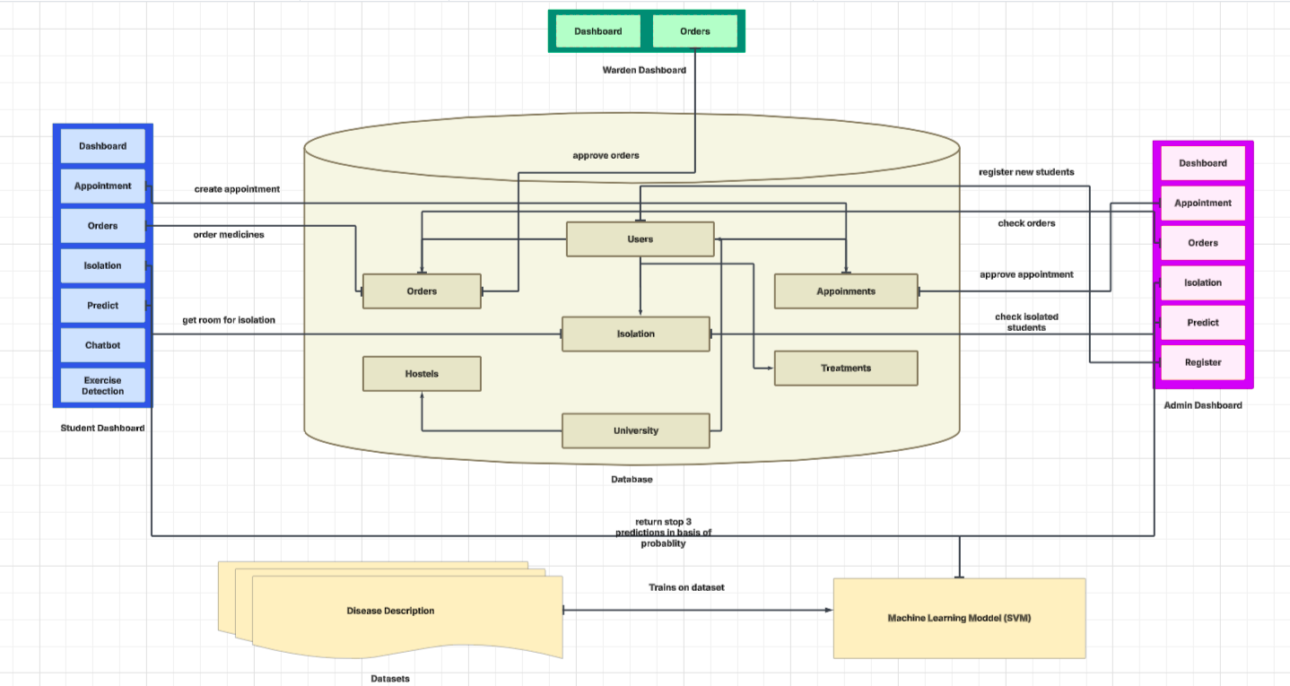
Flowchart

Slide 9





Technology Stack
Python
ReactJS
Tailwind CSS
VS Code
Firebase

Slide 10
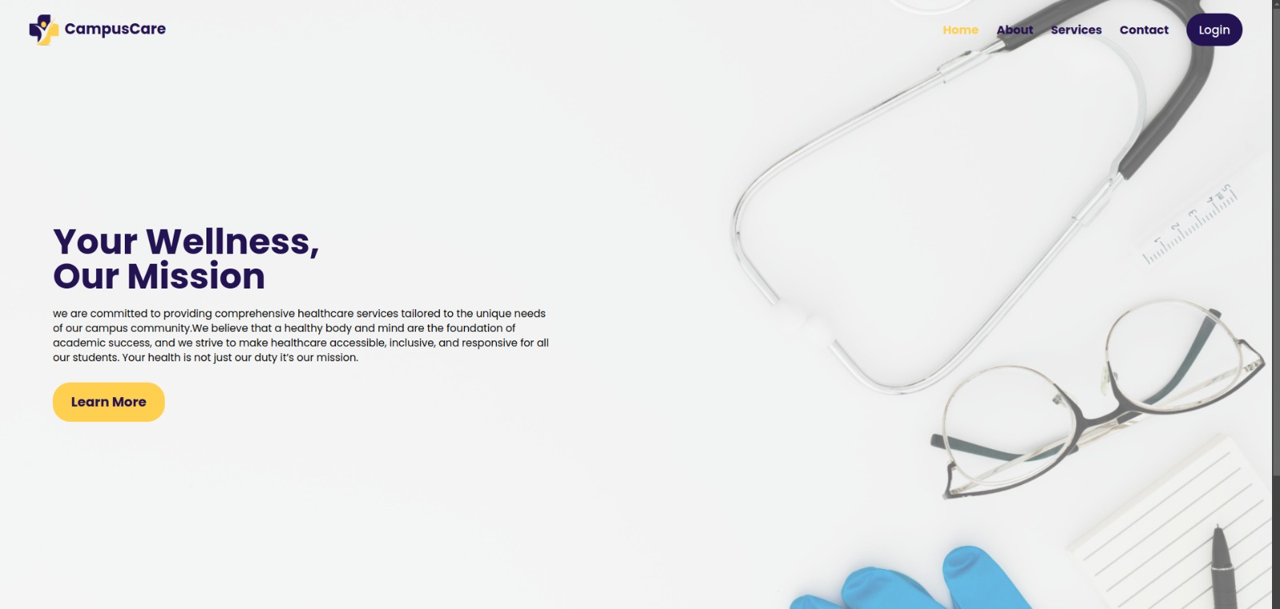
Implementation

Slide 11
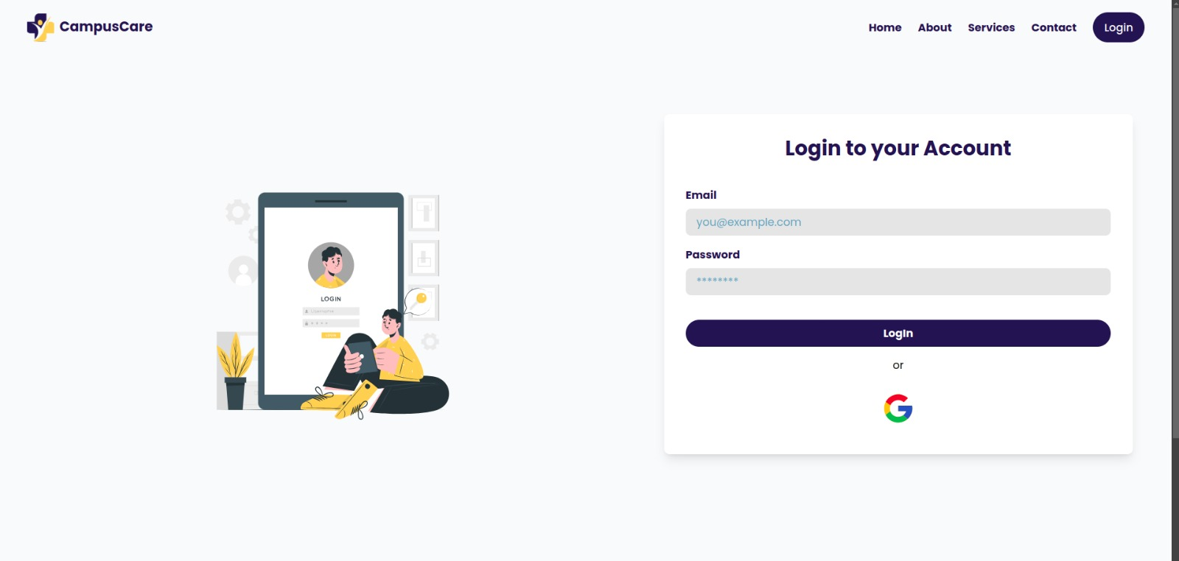
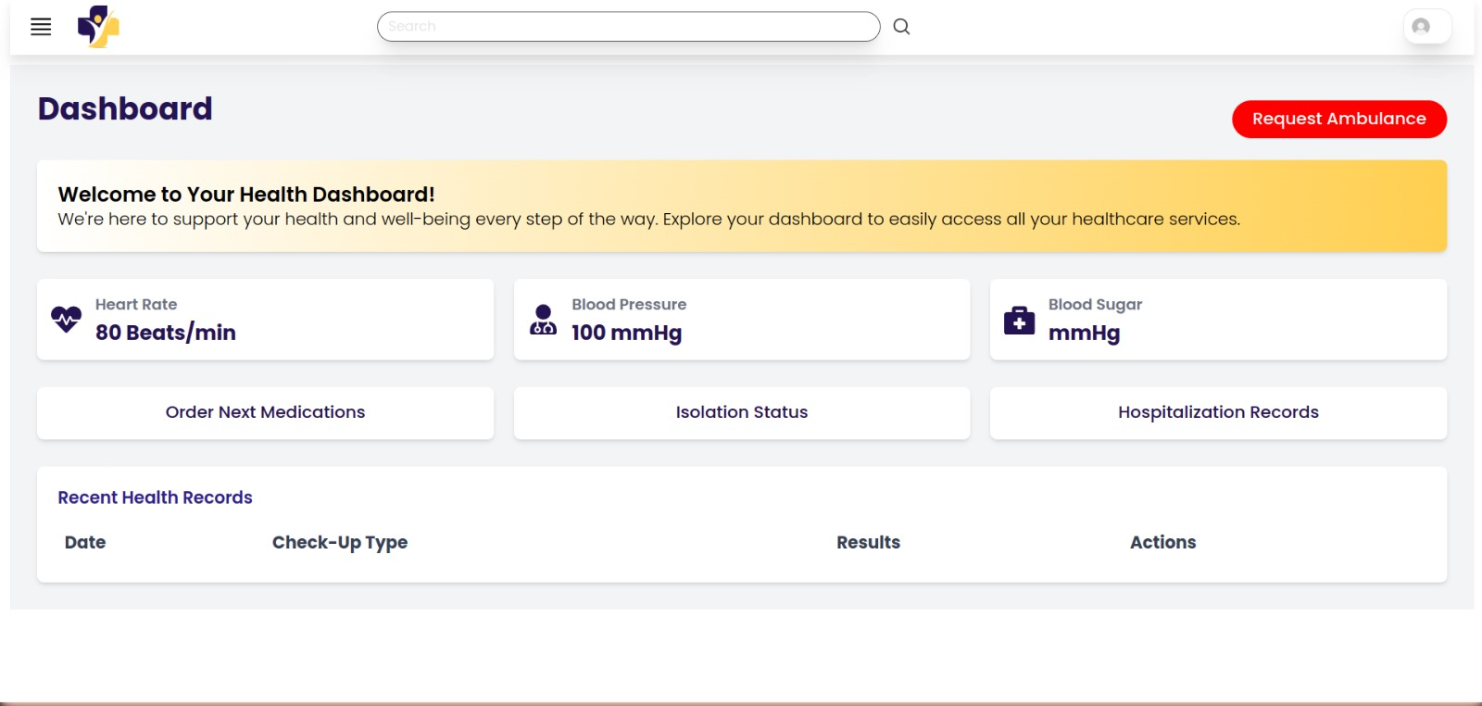

Slide 12
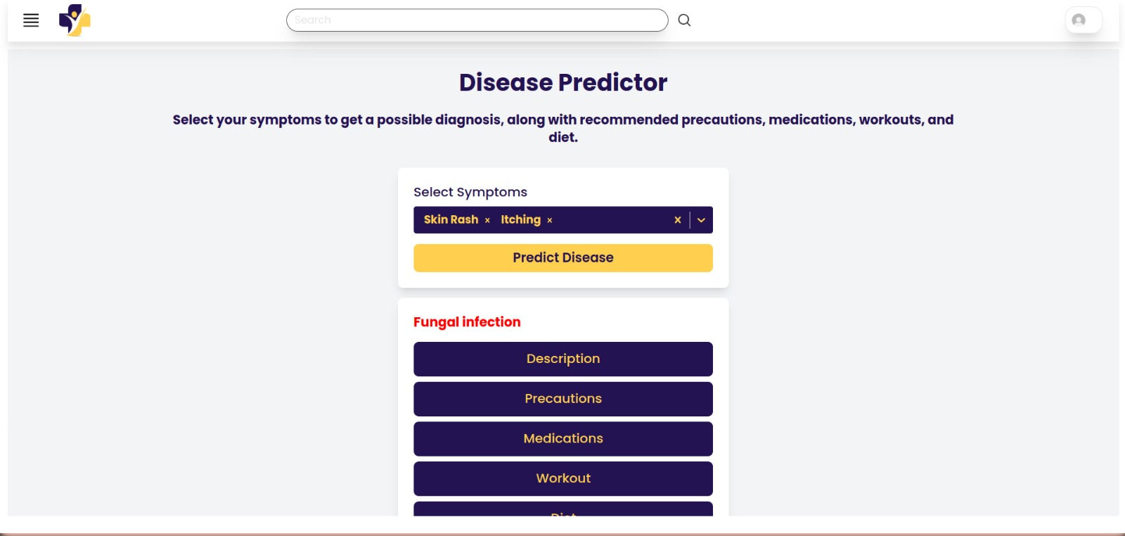
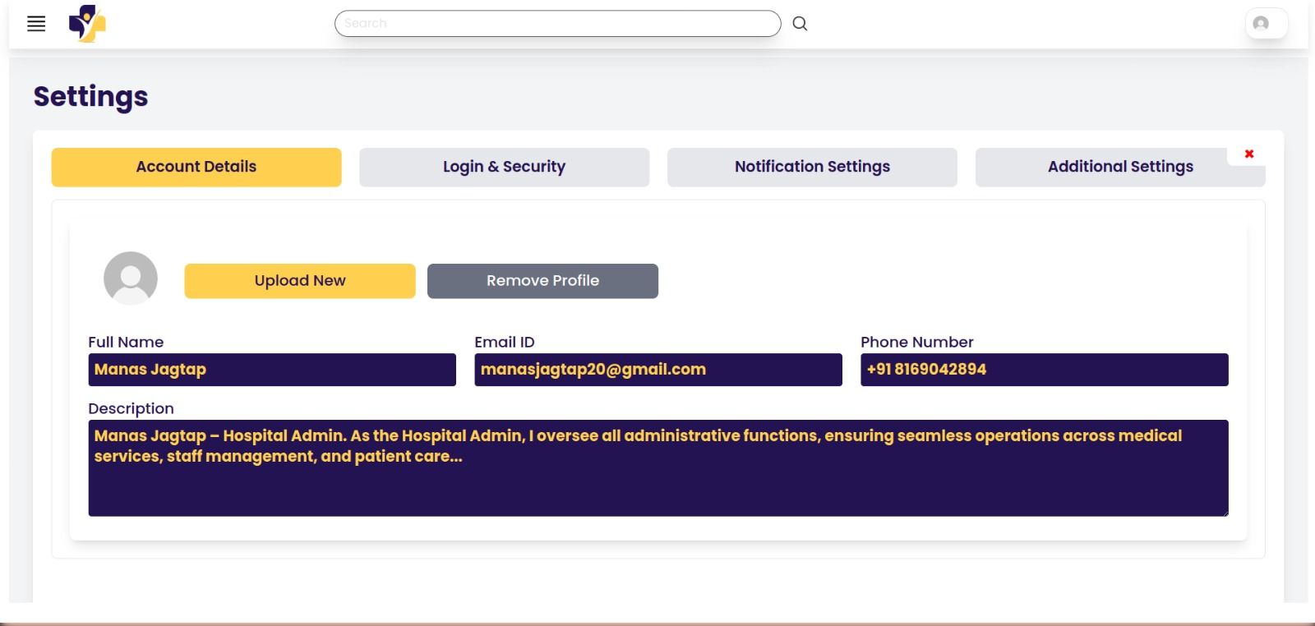

Slide 13
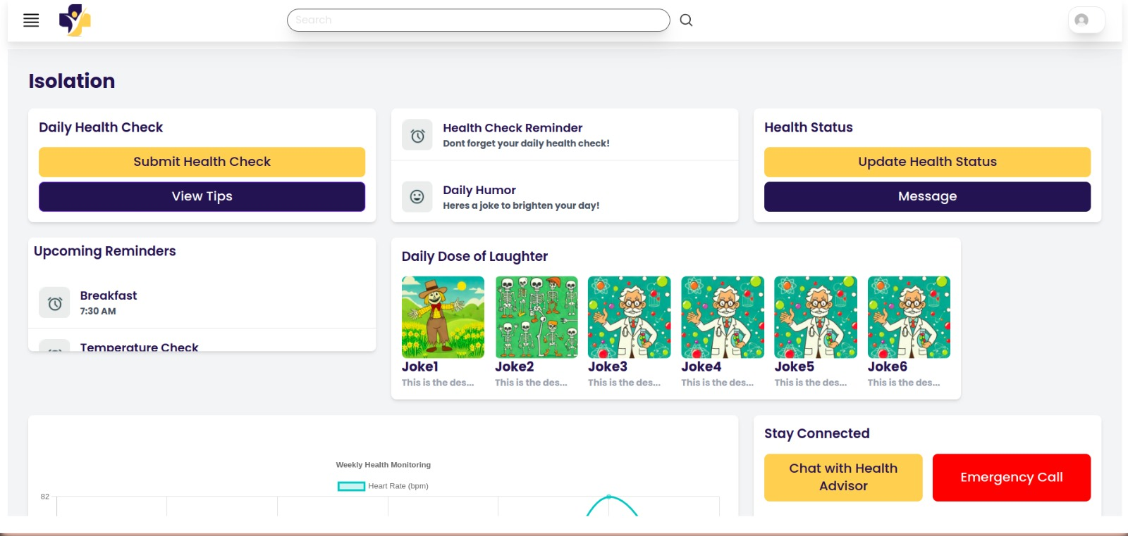
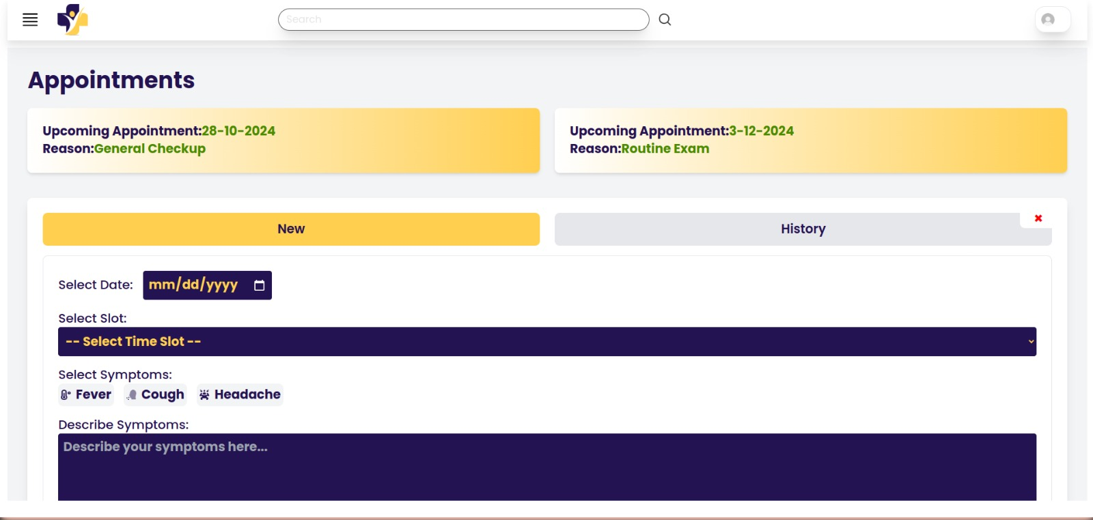

Slide 14
Conclusion
CampusCare represents a transformative leap forward in addressing the healthcare challenges faced by university hostel residents. By combining advanced technology with user-centric design, the platform offers a comprehensive, inclusive, and efficient solution to ensure timely access to medical care.

Slide 15
Thank You

