Slide 1

Image Classifier Using ML
By
Manas Jain
199302120
Under the guidance of
Mr. Dhananjay Kumar Singh
Assistant Professor

Slide 2
Introduction
Image classification is where a computer can analyze an image and identify the ‘class’ the image falls under. (Or a probability of the image being part of a ‘class’.) A class is essentially a label, for instance, ‘car’, ‘animal’, ‘building’ etc.
For example, you input an image of a sunflower. Image classification is the process of the computer analyzing the image and telling you it’s a sunflower. (Or the probability that it’s a sunflower.)

Slide 3
Statement of Problem
To build an image classifier using any machine learning algorithm such that in a given set of images and prior knowledge about the content of the images we will able to find the correct semantic label for the pixels in the image/s

Slide 4
Objective
To design an image classifier program such that it will improve efficiency of the normal user to classify and identify images.
No prior knowledge will be needed for the user to use this system. Thus, it will be a user-friendly program.

Slide 5
Methodology
ML Algorithm that has been used here is SVM. It is a supervised machine learning algorithm which can be used for classification or regression problems.
It uses a technique called the kernel trick to transform your data and then based on these transformations it finds an optimal boundary between the possible outputs. The most commonly used kernels are:
- Linear Kernel
- Gaussian Kernel
- Polynomial Kernel

Slide 6
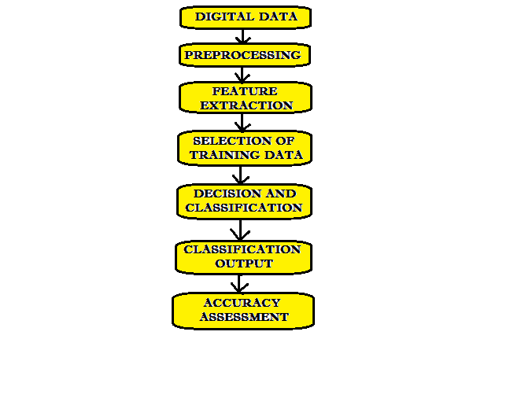
Work Flow Chart

Slide 7
Classification Technique - SVM
The goal of the SVM algorithm is to create the best line or decision boundary that can segregate n-dimensional space into classes so that we can easily put the new data point in the correct category in the future. This best decision boundary is called a hyperplane.
Good separation is achieved by the hyper plane that has the largest distance to the nearest training data point of any class, generally larger the margin lower the generalization error of the classifier.
Performance and accuracy depends on the Hyper-plane selections and kernel parameter.

Slide 8
WHY SVM ?
It has good generalization capabilities which prevent it from over-fitting.
A small change to the data does not greatly affect the hyperplane and hence a SVM model is stable.
SVM can efficiently handle non-linear data using Kernel trick
It is relatively memory efficient.

Slide 9
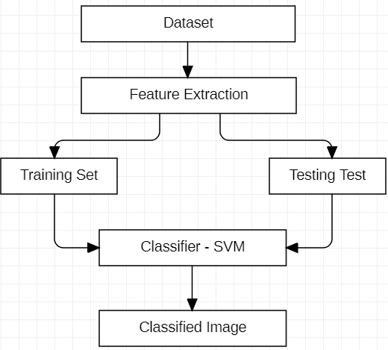
System Architecture

Slide 10
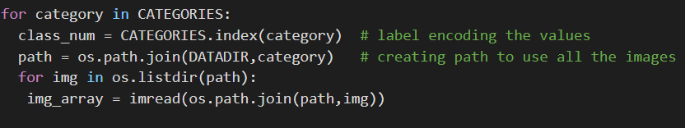
Implementation
1. Gathering Dataset - Dataset used in this project to train the model is manually downloaded from the web and stored in google drive. There are 3 categories of image classes in the training dataset namely, ‘pretty sunflower’, ‘rugby ball leather’, ‘ice cream cone’. Each image class has 40 images each resulting total images in the dataset is 40*3 (i.e., 120).
2. Label encoding the values for CATEGORIES – Indexing all the three classes in CATEGORIES i.e., 0 for ‘pretty sunflower’, 1 for ‘rugby ball leather’, 2 for ‘ice cream cone’ respectively.
3. Creating Path – using os library a path is created to access all the images in the categories by performing join operation

Slide 11
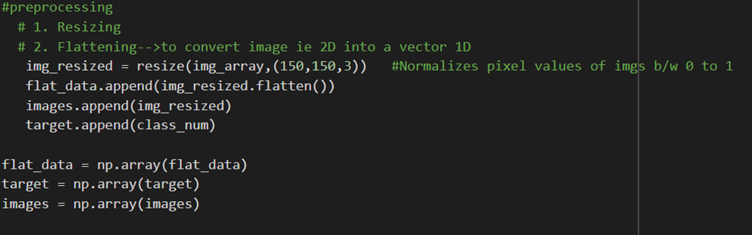
Implementation
4. Preprocessing –
Resizing – images are resized into dimension of 150,150,3 and pixel values gets normalized between 0 to 1
Flattening – resized images are converted from 2D to 1D vector and appended into flat_data

Slide 12
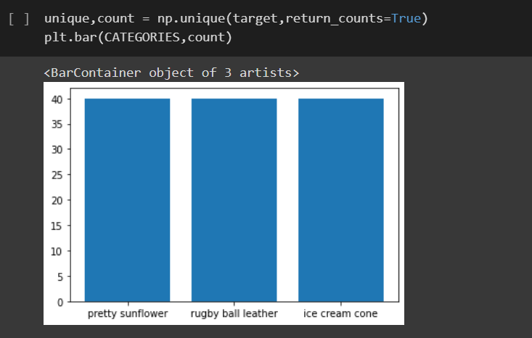
Implementation
5. Plotting a Bar Graph – A bar Graph is plotted showing each category and number of image data it contains
6. Splitting the data into training and testing - Image data is split into x_train ,x_test and y_train, y_test using train_test_split from sklearn.model_selection library. Test size is kept 30%.

Slide 13
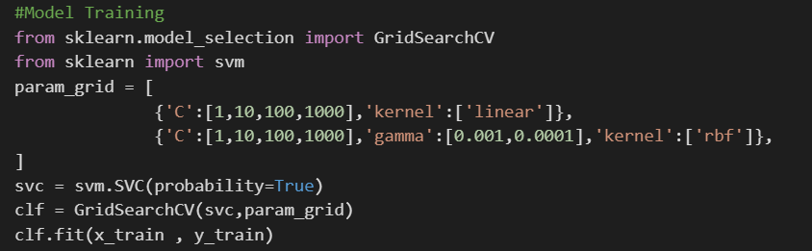
Implementation
7. Model Training Using SVM – With the help of GridSearchCV we determined the parameters in param_grid for SVM. Model is trained using training data in this way:
→ model.fit(training_data, expected_output)

Slide 14
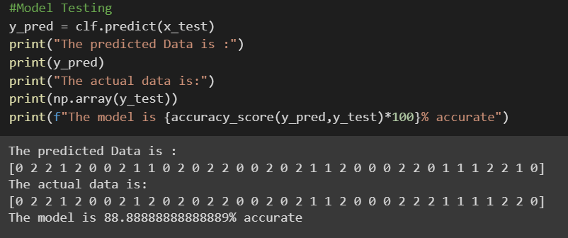
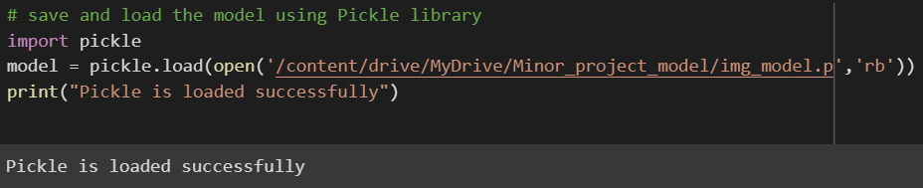
8. Model testing: Now the model is tested using testing data in this way
→ model.predict(testing_data)
The accuracy of the model calculated using the accuracy_score() method from sklearn.metrics.
9. Saving and loading the model using Pickle library

Slide 15
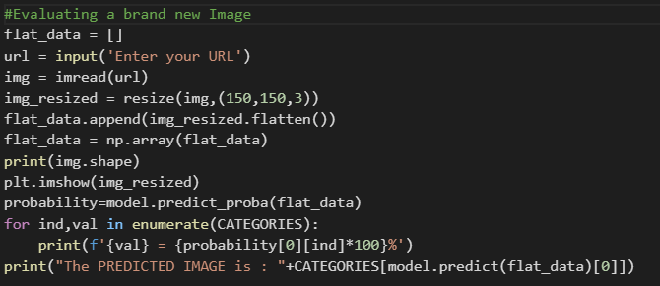
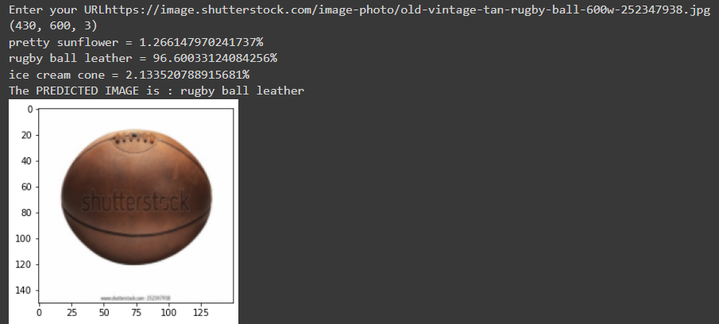
10. Model Evaluation: Finally, in the Model evaluation phase, the model generated can be used to evaluate new data.
The final output would be like this:

Slide 16
Conclusion
In this project work, I assembled and trained the SVM model to classify images of pretty sunflower, rugby ball leather and ice cream cones. I used GridSearchCV to find out the best parameters for SVM to classify the images and have measured the accuracy of the model.

Slide 17
Application Of Image Classification
Biomedical imaging
Vehicle navigation
Robot navigation
Remote sensing
Industrial visual inspection
Biometry

Slide 18
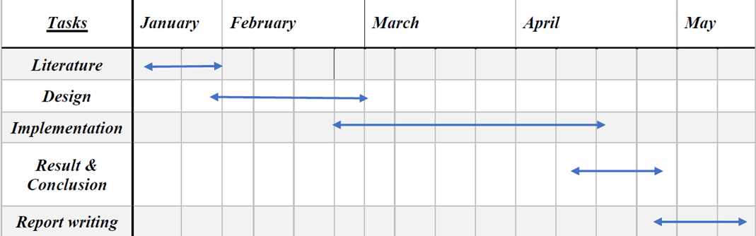
Time Line Chart

Slide 19
References
[1] Python: https://www.python.org/
[2] Javatpoint. “Best Python libraries for Machine Learning” https://www.javatpoint.com/best-python-libraries-for-machine-learning
[3] Vegi Shanmukh.“Image Classification Using Machine Learning-SVM”: https://medium.com/analytics-vidhya/image-classification-using-machine-learning-support-vector-machine-svm-dc7a0ec92e01
[4] Taru Jain. “Basics of Image Classification Techniques in Machine Learning”:
https://iq.opengenus.org/basics-of-machine-learning-image-classification-techniques/
[5] The Python Standard Library: https://docs.python.org/3/library/
[6] Google Colab: https://colab.research.google.com/

Slide 20
Thank You!

