Slide 1
Merchant Dispute Management
Agentic AI Powered Case Management
March 2026

Slide 2
Contents
1 | Introduction
2 | Features list
3 | Functional Scope
4 | Agentic AI Solution Workflow
5 | Solution Architecture
6 | Project Timelines
7 | Assumptions & Dependencies

Slide 3
Introduction
A unified chargeback platform that improves win rates and ROI by ensuring the best evidence is always used, decisions are made with full context, and teams act faster and with clarity.
Higher Win Rate, Better ROI Automatically identifies and prioritises the strongest evidence per chargeback, so only high‑probability disputes are challenged.
Single, Centralised View Brings together issuer data, merchant evidence, and AI insights in one dashboard, eliminating fragmented workflows.
Time Savings Through Intelligent Automation Summarisation, evidence enrichment, and decision support reduce manual investigation effort and turnaround time.
Clear Actionability Highlights exactly what to do next — enrich, challenge, or accept — with transparent reasoning behind every suggestion.
It is not about challenging more chargebacks — about challenging the right ones, the right way.

Slide 4
Feature List
Chargeback Workflow Features
Other features
Proactive dashboard – Proactive ingestion of issuer claims for instant, lag-free review.
Unified Chargeback View – Issuer-side dispute data auto-summarized for rapid understanding
On‑Demand Evidence Enrichment – AI Agent dynamically fetches most apt merchant, PSP, and delivery evidence. Thinking beyond the templates.
Agentic Decision Intelligence – AI agents reason, verify, and annotate evidence before recommending actions
Intelligent Decision Support – Analyzes the full evidence map (Issuer vs. Merchant) to recommend "Challenge" or "Accept." If "Accept" is suggested, the agent provides a detailed gap analysis of what was missing to win.
Human-in-the-loop Control – Users can enrich manually, override AI, or proceed independently
Explainable & Auditable AI – Every recommendation backed by evidence availability and reasoning
Cost-Aware AI Usage – LLM calls invoked only when value is added
500+ Ecosystem Adapters – On-demand data fetching from PSPs, shipping carriers, and merchant databases.
Pre-Chargeback Prevention – Integrated Ethoca Alerts to stop disputes before they escalate into formal chargebacks.
Policy Diff Engine – Automated analysis of network rule changes (Mastercard/Visa) with proactive configuration suggestions.
Dynamic Policy & Governance Engine (Settings) – A sophisticated control suite that allows administrators to:
Automate via Thresholds: Set "Auto-Accept" or "Auto-Submit" rules based on transaction value or win probability to eliminate manual touchpoints on low-value claims.
Customizable AI Autonomy: Toggle AI recommendations and "Enrichment" levels on or off to balance between deep reasoning and high-speed processing.
Admin Policy Intelligence: Upload new network rulebooks (Mastercard/Visa) for immediate AI-driven "Diff" analysis, ensuring system settings always align with the latest industry compliance.

Slide 5
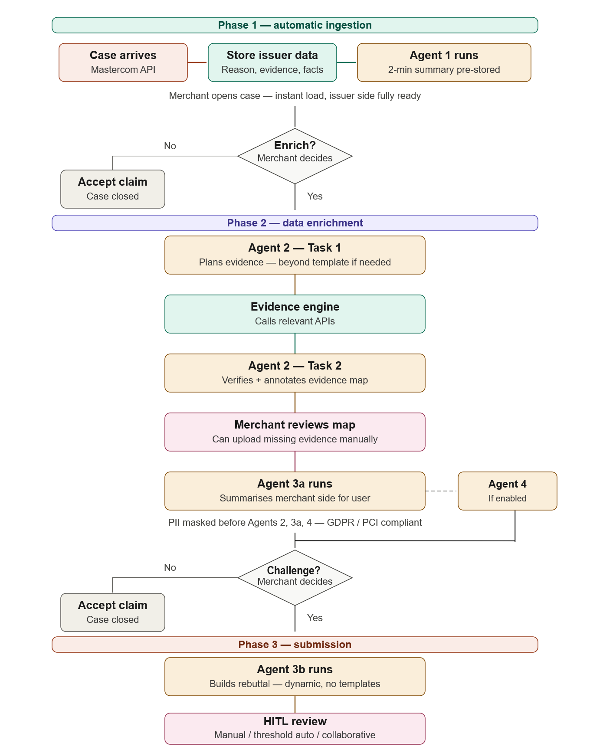
Solution Workflow
Phase 1 — Automatic ingestion
A new case arrives via the Mastercom API. Issuer data — reason code, customer's stated reason, and supporting evidence — is stored immediately. Agent 1 generates a 2-minute summary of the issuer side story and stores it. When the merchant opens the case, everything is pre-loaded with zero wait. The merchant reviews the issuer's side and decides whether to enrich.
Phase 2 — Data enrichment
Triggered only when the merchant chooses to enrich. Agent 2 reads the claim and plans exactly what evidence is needed — going beyond the standard template if the case demands it. The evidence engine calls only the 2–4 relevant APIs for that specific case. Agent 2 then verifies what was returned and produces an annotated evidence map, clearly marking what was obtained and what is missing. The merchant reviews this map and may manually upload any gaps. Agent 3a then summarises the merchant's side into a readable view. If enabled in settings, Agent 4 uses both the issuer's case and the enriched evidence to recommend whether to challenge. This recommendation is advisory only — the merchant decides.
Phase 3 — Submission
If the merchant decides to challenge, Agent 3b generates a dynamic rebuttal document — no templates, optimised for an issuer to read in 2–3 minutes. Submission then follows the merchant's configured mode: manual review, threshold-based auto-submit, or collaborative team review before anything is sent to Mastercom.

Slide 6
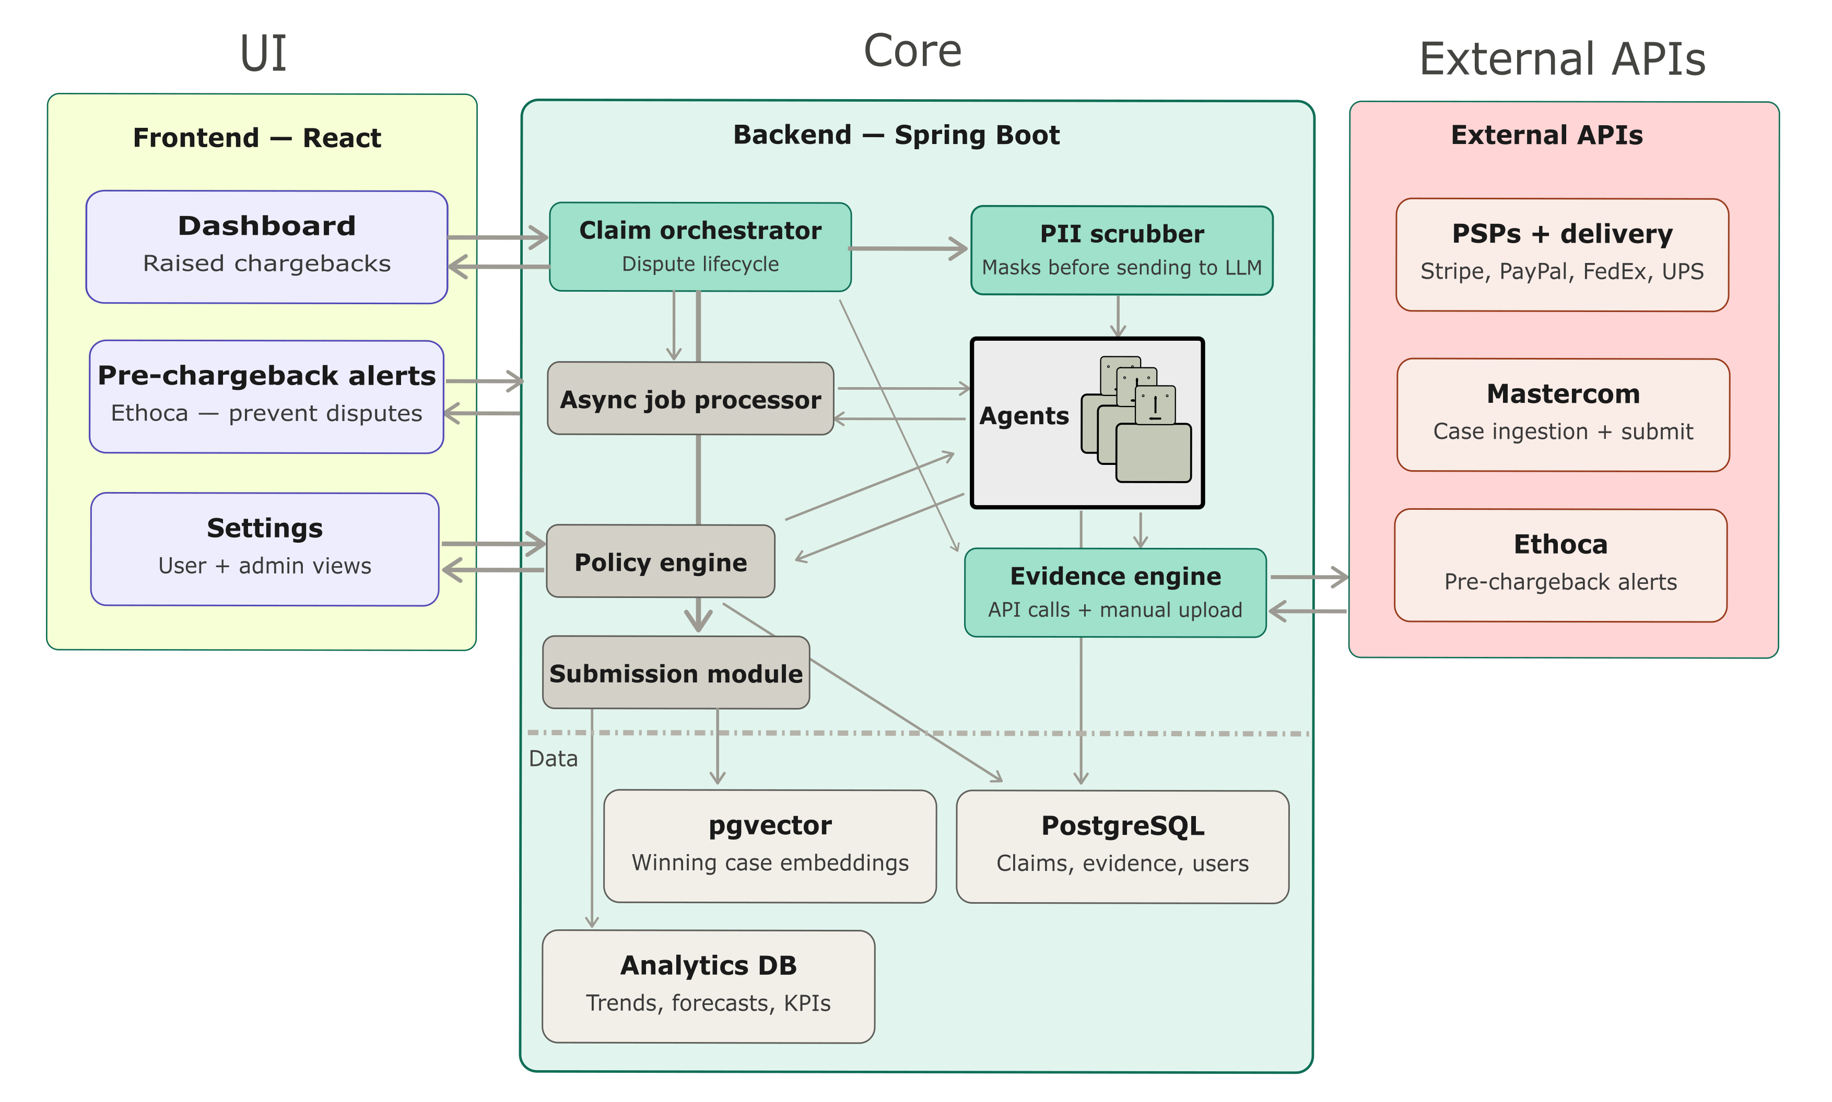
Solution Architecture Blocks
User Interface
Has a single dashboard view for all the chargeback related activities. Pre-chargeback alerts integrated with Ethoca to prevent a dispute to turn into a chargeback. Settings tab allows merchant to stay in total control and apply its own business rules.
Core
Comprises of various AI Agents orchestrated in the backend and integration with external APIs.
External APIs
They include mastercard APIs, PSPs and delivery partner APIs for evidence collection.

Slide 7
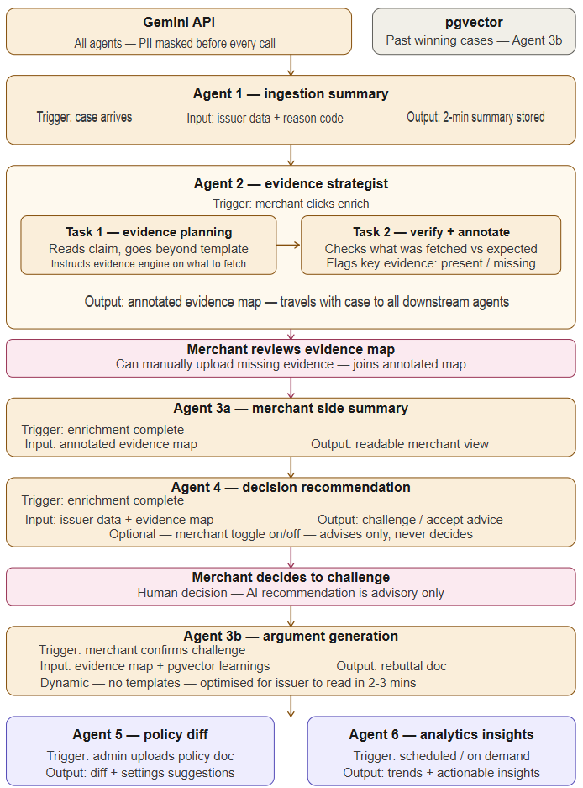
Agent Map
Agent 1
Summarises the issuer claim by checking all the evidences and customer’s claim.
Agent 2
When the user decides to enrich the evidences, it plans the evidences that would be best for challenging the claim. Once the evidence engine returns the fetched evidences, it also verifies if all the required evidences were fetched.
Agent 3
After the merchant side evidences are enriched, it prepares a short summary keeping the merchant’s case for representment to make it easy for the issuer to understand the merchant side of the story.
Agent 4
This agent now recommends by comparing the evidences of both sides if it should be challenged.
Agent 5
This agent recommends changes is config if there’s any change in the merchant or the network policies.
Agent 6
This agent analyses the recent trend and suggests insights for the operations/finance teams to reduce the incoming chargeback claim cases.

Slide 8
Scenarios
Scenario 1: Enrich & Challenge
AI‑Assisted Path
Deterministic steps
Agents involved
New chargeback claim is registered
User clicks on a claim in the dashboard
User does evidence enrichment
An Agent comes into action
Challenge Decision Feedback
The new case is fetched via the Mastercom API
It goes through all the evidence files provided by the issuer and summarise the reason for this dispute.
Gets to see all the details of the dispute and the summary to understand it quickly.
Agent helps decide which evidences are apt for challenging. Those API calls are made to fetch the data from external data points.
The agent checks if the necessary evidences got fetched. Accordingly, it suggests if this claim should be challenged.
User gets any missing evidences
Response received from issuer
User submits representment
When a response is received it is stored in the database as a historical data for the ML model to learn and get better in the future.
Final report is generated by the agent which can easily be understood by issuer in 2-3 minutes. If user is satisfied, they submit it.
If the agent reports that any crucial data is missing, user can escalate with the data provider and get it and upload it.
Notes:
Text

Slide 9
Scenarios
Scenario 2: Do Not Challenge
Early Decision Path
Deterministic steps
Automated steps involved
New chargeback claim is registered
User clicks on a claim in the dashboard
An Agent comes into action
The new case is fetched via the Mastercom API
It goes through all the evidence files provided by the issuer and summarise the reason for this dispute.
Gets to see all the details of the dispute and the summary to understand it quickly.
Chooses to not do evidence enrichment and not challenge
Based on: Internal rules, or Merchant judgment, the merchant chooses to not enrich and to not challenge.
Notes:
Text

Slide 10
Business Value and Advantages
Higher Win Rates
Challenges only when evidence quality supports success
Lower Operational Cost
Avoids enriching and challenging weak cases.
AI compute used only when enabled and required.
Faster Decision Making
Issuer and merchant views clearly separated and summarized
Merchant Trust & Control
AI assists but never forces decisions. Highly customizable to allow the merchant to decide where Agents should step-in.
Scalable Across Dispute Types
Evidence planning adapts dynamically to reason codes and narratives
Audit‑Ready & Explainable
Every recommendation backed by evidence presence or absence

