Slide 1

BITS Wiki
Divya Tyagi 2017B3A70727P
Manas Mishra 2017B5A70546P
Lakshya Agarwal 2017B4A70630P

Slide 2

PROBLEM
No centralised and easily accessible place for college resources.
Most of the difficulties faced by students in the academic courses are already faced & solved by the seniors. But due to no proper platform new students have to go through it all over again.
Students do not get their all the doubts solved as
Some students often hesitate to approach teachers.
Students generally discuss among friends but sometimes the problem is not solved
Also the solutions of queries are not accessible by other students as well.
SOLUTION
Create a centralised place for having all the thread like discussions and resources available to everyone.

Slide 3

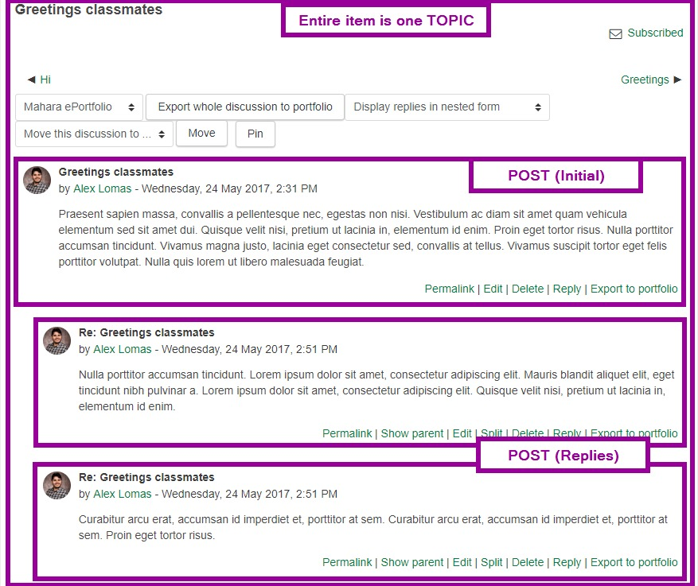
Discussion Form
Students can ask doubts to community
and
get help from people who want to help.

Slide 4
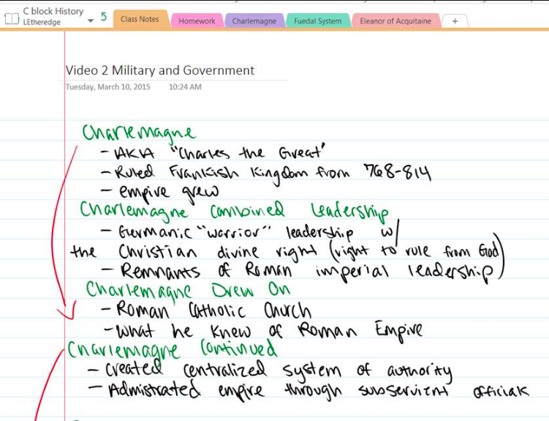
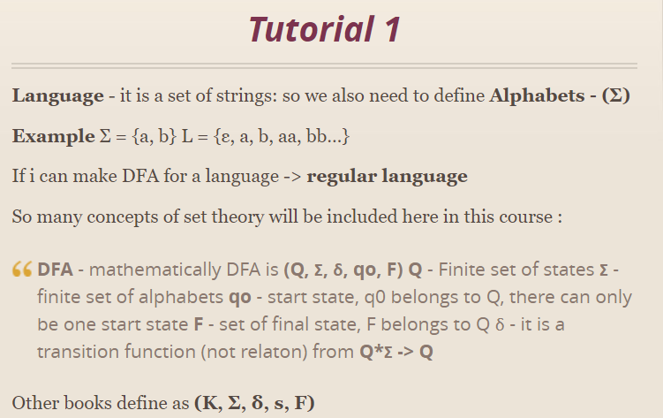
Note Taking
Upload handwritten notes
Share notes
Make your own notes

Slide 5
Complete Academic Material
Major features
Publicly available individual queries/doubts with accepted answers
Note making and sharing functionality
Other minor features
Availability of notes made by seniors & batchmates
Previous Year question papers
Other reference material like documents, books, YouTube resources, links, etc.
Organise your resources at one place like Google Drive

