Slide 1





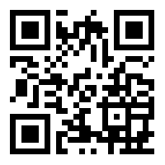

schickling.me/immersive

