Slide 1

Online Book Store
Name: Manas Mehta
Roll no: 105
Enrollment no: 21002170110076
Division: A3
Branch: Computer Engineering

Slide 2
Introduction:
Here I have used Tkinter for user interface where we add, delete, search and update books
I have already entered a bunch books initially which are available at the store.
In I have used Database for storing data of Books.

Slide 3
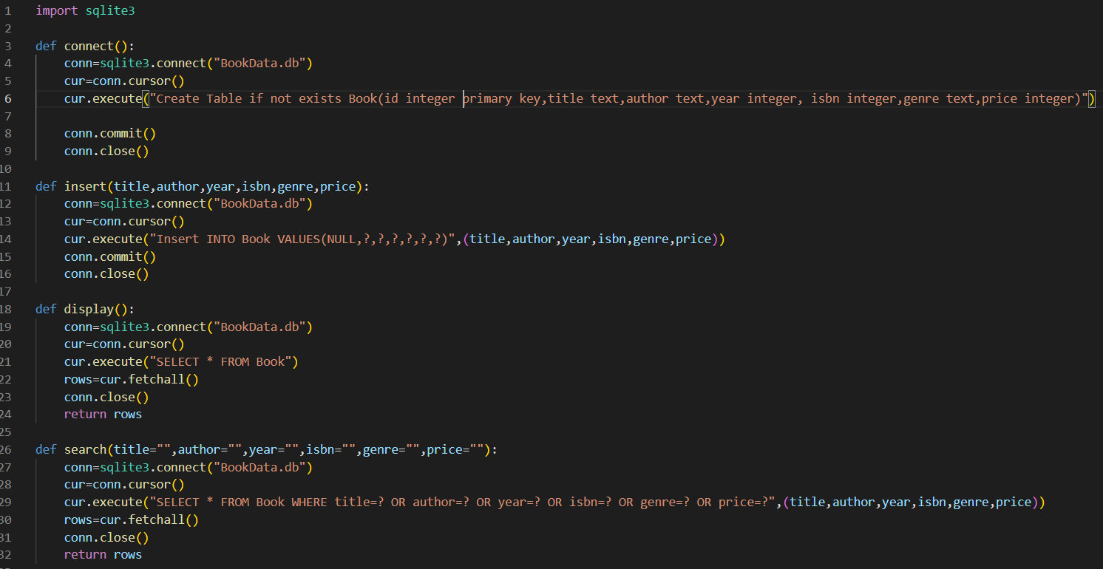
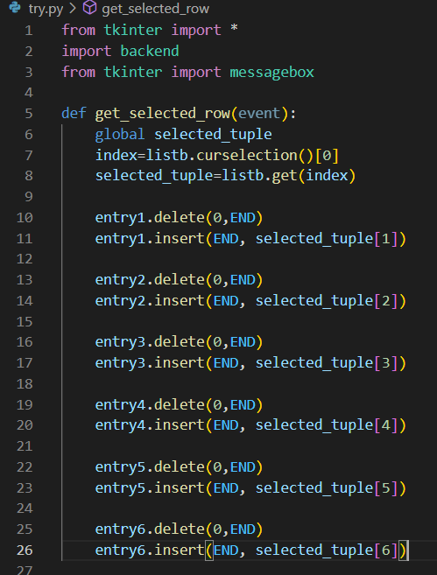
Code
Display code for issued books
Main Structures

Slide 4

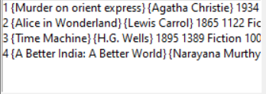
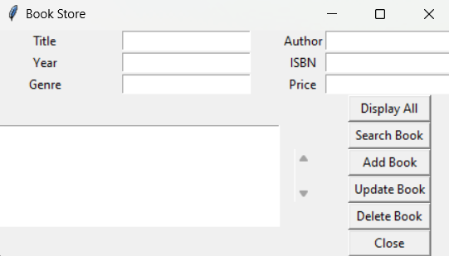
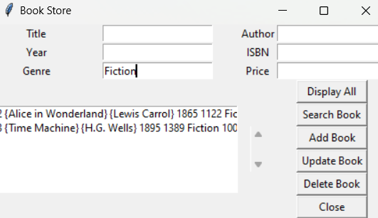
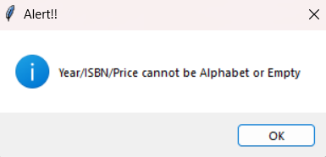
Books Available
Main Menu
Search By Genre
Error Showing

Slide 5
Merits:
It is easily accessible.
It is very easy to understand.
Easy to use
Very useful in library or bookstores

Slide 6
Thank You

