Slide 1
NEXTHIKES SOLUTIONS
Feature Extraction &
Price Prediction for Mobile Phones
Enhancing Pricing Strategies Through Machine Learning & Data Analytics
DATA
MODEL
STRATEGY
Explore & clean
Train & evaluate
Price with insight
Manasmita Mohakud

Slide 2
Executive Summary
OBJECTIVE
APPROACH
BUSINESS IMPACT
Predict phone market price from technical specifications.
Explore data, engineer features, train models, evaluate on held-out data.
Support consistent pricing, product positioning and inventory decisions.
DATA → MODEL → STRATEGY
2

Slide 3
Project Scenario & Market Context
• Mobile pricing depends on multiple interacting hardware and product attributes.
• The project estimates price and identifies which inputs most affect predictions.
• Deliverables: cleaned dataset, reproducible pipeline, evaluation plots and business recommendations.
CHALLENGE
Many specifications, brands and product tiers make manual comparisons difficult.
GOAL
Create a transparent, repeatable baseline for price estimation.
GUARDRAIL
Validate against current, real-world listings before business use.
3

Slide 4
Dataset Overview & Feature Space
Model | Brand | Color | RAM_GB | Storage_GB | Battery_mAh | Rear_Camera_MP | Processor_Tier | AI_Lens | Price_INR
Nova-001 | Nova | Silver | 8 | 128 | 3551 | 108 | Entry | 0 | 27509
Apex-002 | Apex | Green | 8 | 512 | 4712 | 50 | Ultra | 1 | 49345
BudgetCo-003 | BudgetCo | Blue | 12 | 512 | 6022 | 50 | Midrange | 0 | 34191
Apex-004 | Apex | Silver | 6 | 256 | 6493 | 108 | Midrange | 0 | 34657
Orion-005 | Orion | Blue | 6 | 1024 | 4658 | 64 | Midrange | 0 | 36153
BudgetCo-006 | BudgetCo | Silver | 8 | 128 | 6111 | 50 | Flagship | 0 | 39850
Sample size: 180 generated records
Target variable: Price_INR
Mix of numeric, categorical and binary fields. Prices are simulated to demonstrate the workflow.
Features include RAM, storage, battery, camera specs, processor tier, color, AI lens and release year.
4

Slide 5
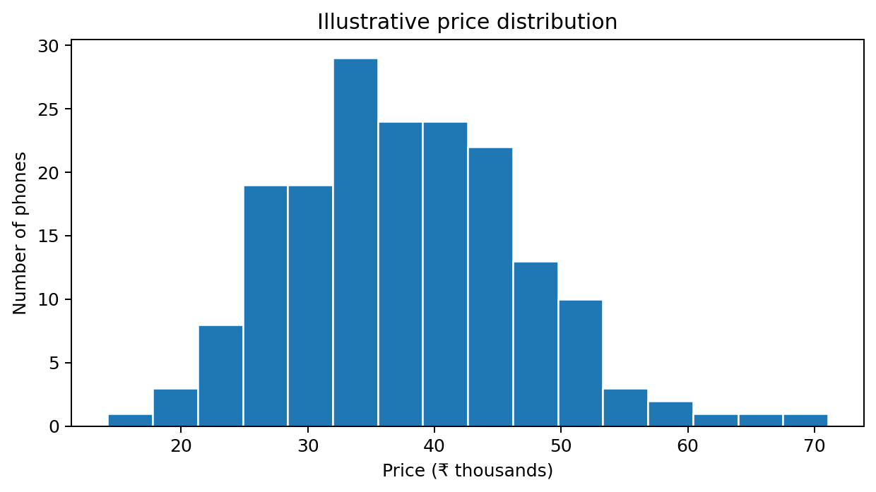
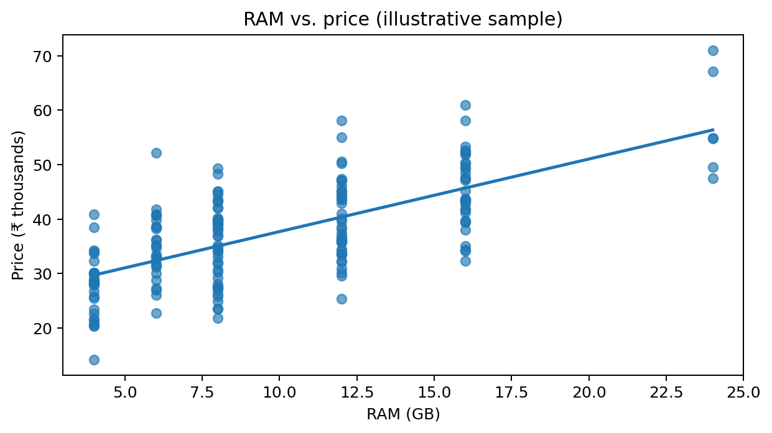
Data Exploration & Structure Analysis
• Rows: 180
• Numeric and categorical fields inspected
• Price distribution and RAM relationship visualized
• Next: investigate missing values, duplicates and outliers
5

Slide 6
Data Preprocessing & Hygiene
MISSING VALUES
CATEGORICAL ENCODING
Median imputation for numeric fields; most-frequent imputation for categorical fields.
One-hot encode brand, color and processor tier.
OUTLIERS & LEAKAGE
REPRODUCIBILITY
Review extreme prices; fit preprocessing only on training data.
Use a fixed random seed and train/test split.
Pipeline: raw rows → validation → imputation/encoding → model-ready matrix
6

Slide 7
Feature Extraction Framework
• Correlation analysis to explore linear relationships among numeric features.
• One-hot encoding converts categories into model-readable columns.
• Permutation importance measures how model error changes when a feature is shuffled.
• Compare feature groups; avoid interpreting importance as proof of causation.
INPUT FEATURES
Hardware + brand + release-year attributes
FEATURE PROCESSING
Impute, encode and validate
OUTPUT
Prediction + ranked drivers
7

Slide 8
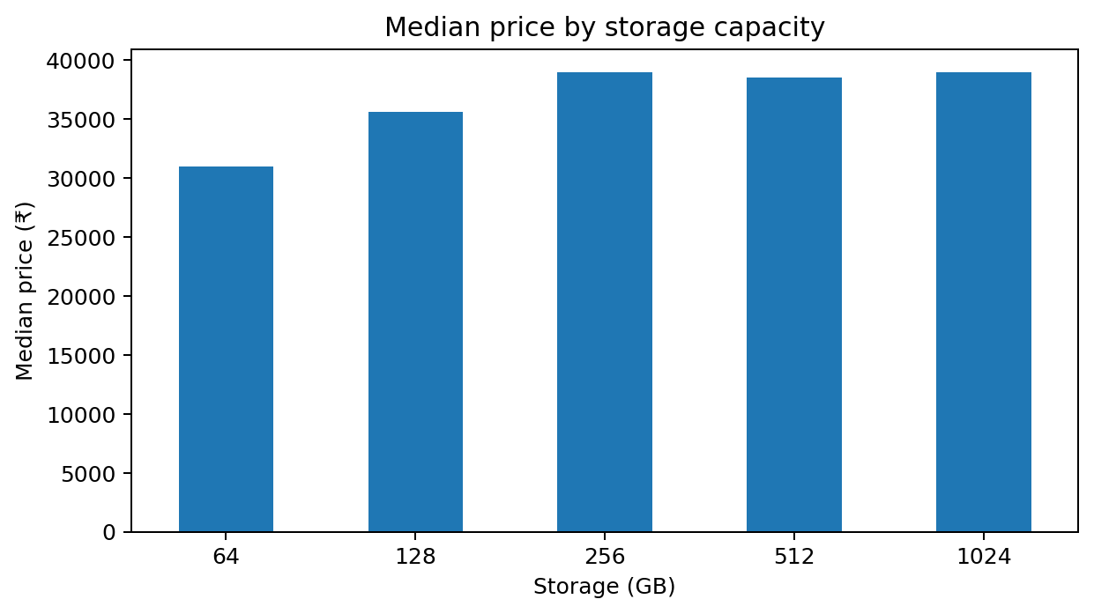
Correlation Analysis Insights
8

Slide 9
Model Building & Architecture
01 • SPLIT
02 • BASELINE
03 • ENSEMBLES
04 • SELECT
80% train / 20% test
Linear Regression
Random Forest & Gradient Boosting
Compare MAE, RMSE and R²
Dataset → preprocessing pipeline → training → held-out predictions → evaluation
9

Slide 10
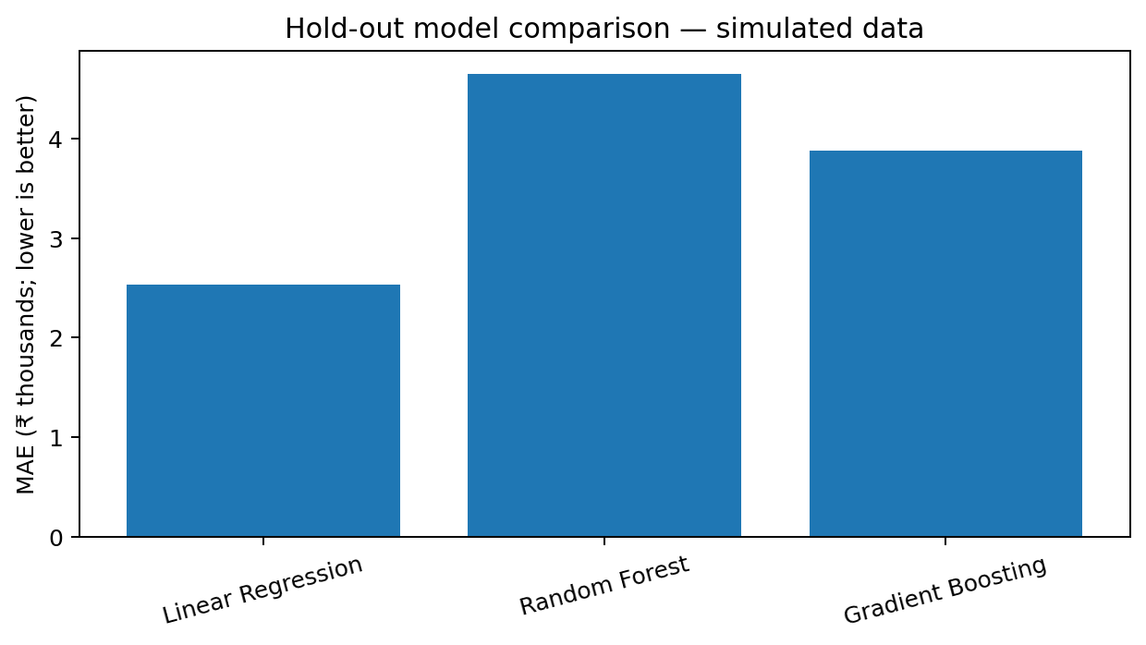
Model Training & Optimization
• Use a held-out test set for final comparison.
• Cross-validation can estimate stability during tuning.
• Ensemble models can capture non-linear relationships.
• Reported scores below come from a simulated dataset.
10

Slide 11
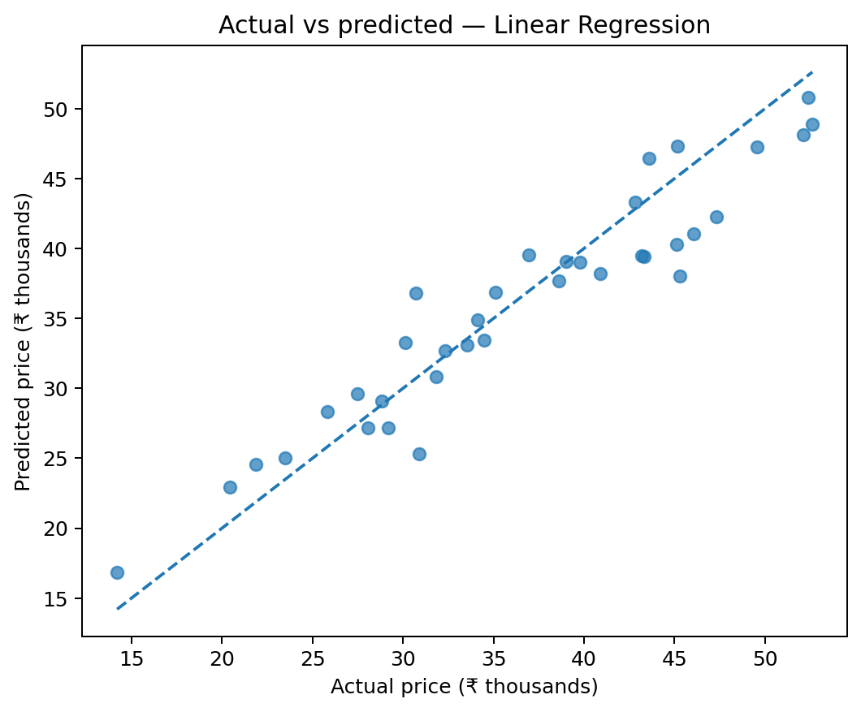
Model Evaluation & Error Metrics
HELD-OUT TEST RESULTS
Model | MAE ₹ | RMSE ₹ | R²
Linear Regression | 2,536 | 3,091 | 0.89
Random Forest | 4,646 | 5,710 | 0.64
Gradient Boosting | 3,881 | 4,678 | 0.76
Lowest MAE in this run: Linear Regression. MAE = average absolute error; RMSE penalizes larger errors; R² measures variance explained.
11

Slide 12
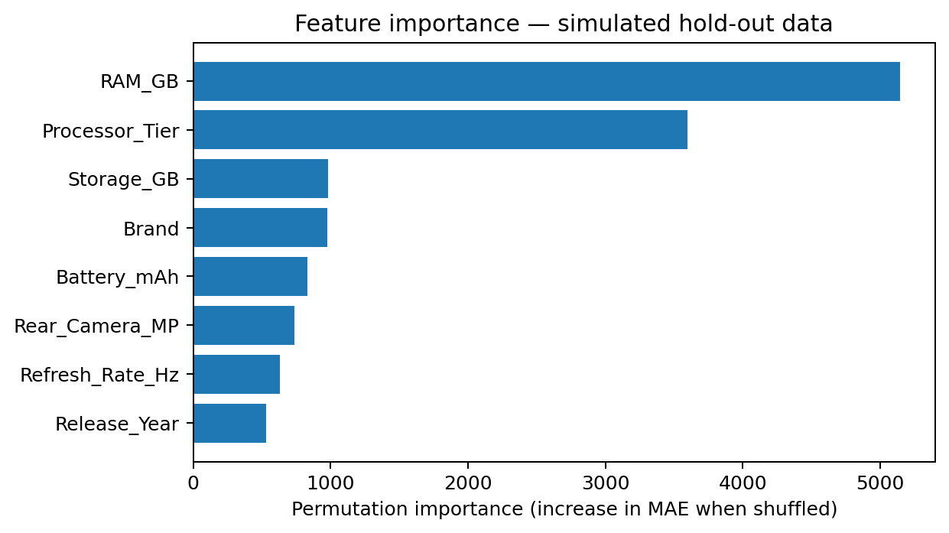
Feature Importance Confirmation
• Importance is estimated by shuffling one input at a time.
• Top-ranked fields are specific to this generated sample and split.
• Brand, processor and hardware effects may overlap.
• Re-run on the real dataset before making definitive claims.
12

Slide 13
Summary of Technical Findings
01 • Hardware matters
03 • Validate assumptions
RAM, storage and processor tier are plausible value signals.
Camera and AI-lens effects must be tested on real listings.
02 • Market context matters
Brand and release year may capture positioning and product age.
Technical takeaway: interpret model explanations alongside domain knowledge and data quality.
13

Slide 14
Recommendations: Optimized Pricing Strategy
• Use predicted price as a decision-support reference, not an automatic final price.
• Create tier bands around RAM, storage and processor combinations.
• Refresh the model with competitor prices and dated listings.
• Monitor errors by brand and price segment before deployment.
PRICING
Use model ranges + human review
MONITORING
Track drift and segment-level error
14

Slide 15
Recommendations: Marketing & Inventory
• Highlight specs customers compare directly: RAM, storage, processor and battery.
• Use feature evidence to support product-tier messaging.
• Combine predicted demand, margin and sell-through before procurement decisions.
• Avoid assuming feature importance directly measures customer preference.
MARKETING
Communicate verified product benefits
INVENTORY
Balance spec tiers against demand
15

Slide 16
CONCLUSION & FUTURE ROADMAP
From specifications to pricing insight
NOW
NEXT
FUTURE
Exploratory analysis + baseline models
atory analysis + baseline
Scheduled refresh, drift monitoring and deployment
uled refresh, drift monitoring
Validate on real phone listings
ate on real phone listings

Slide 17
THANK YOU

