Slide 1
Review-1
Manas ojha(22BCE3283)
Anish umate(22BCE2490)

Slide 2
Alzheimer's Detection through MRI Scan using
convolutional neural network (cnn)

Slide 3
AIM OF THE PROJECT
The primary aim of this research is to understand CNN principles and apply them to enhance neural networks for Alzheimer's disease detection, focusing on proposing and evaluating the model architecture.
The focus is on improving accuracy in brain tissue segmentation from MRI scans through this model framework, leveraging cutting-edge advancements in neural network design.
The scope involves developing and implementing this model for automated AD diagnosis using diverse MRI imaging data representing different disease stages and cognitive statuses.
Data preprocessing ensures quality and consistency in the collected MRI dataset, crucial for training and evaluating the model’s performance.
This model will utilize advanced CNN techniques tailored for MRI image analysis to extract meaningful features indicative of AD-related structural changes in the brain.
Evaluation and validation will assess the model’s performance against established metrics, potentially integrating it into healthcare systems to facilitate early and accurate AD diagnosis, thus improving patient outcomes and healthcare efficiency.

Slide 4
PROBLEM STATEMENT
The escalating prevalence of Alzheimer's disease poses a significant societal and economic burden.
Projections indicate a substantial increase in affected individuals, necessitating advanced diagnostic tools and efficient healthcare management.
Current manual analysis of MRI images for Alzheimer's disease detection is time-consuming, exacerbating strain on medical infrastructure.
There is an urgent need for an automated AD classification and grading system to streamline the evaluation process.
The proposed model aims to enhance accuracy and efficiency in AD detection, surpassing the limitations of existing methodologies.

Slide 5
MOTIVATION
Addressing the urgent need for improved Alzheimer's diagnosis aligns with the project's aim to make a tangible difference in healthcare outcomes and societal well-being.
The intersection of AI and medical imaging presents an exciting opportunity to explore innovative solutions to complex healthcare challenges, driving the project's focus on Alzheimer's diagnosis.
By developing a robust AI-driven framework for Alzheimer's diagnosis, the project aims to empower clinicians with a powerful tool to enable early intervention, personalized treatment strategies, and ultimately improve patient care and outcomes.

Slide 6
WHAT IS ALZHEIMER'S DISEASE
Alzheimer's disease, a progressive neurological disorder, primarily impairs memory and cognitive function, affecting an individual's ability to think, reason, and remember.
It is the leading cause of dementia, constituting approximately 60-80% of dementia cases, with its prevalence rising with age.
Characterized by abnormal protein deposits like beta-amyloid plaques and tau tangles in the brain, Alzheimer's disrupts neuronal communication and function.
Symptoms typically start with mild memory loss and confusion, advancing to severe impairments in language, judgment, and daily activities as the disease progresses.
While there's no cure for Alzheimer's, treatments and interventions can manage symptoms, improve quality of life, and slow disease progression in some cases.

Slide 7
ANALYSIS
MRI is pivotal in Alzheimer's disease (AD) diagnosis, evaluating brain atrophy, staging the disease, and informing treatment decisions, despite the complexity of MRI data posing analysis challenges.
Traditional machine learning methods for AD diagnosis involve manual feature extraction, yielding high accuracy but demanding specialized software and expert knowledge, resulting in time-consuming and subjective analyses.
Deep learning, notably convolutional neural networks (CNNs), offers a promising alternative for AD diagnosis, obviating manual feature extraction and providing enhanced flexibility and generalization.

Slide 8
SUMMARY OF PREVIOUS WORKS
Preprocessing steps, including space normalization, skull dissection, and bias field correction, are essential for preparing MRI images for analysis in AD classification pipelines.
Conv-Swinformer, a model combining CNN and Transformer-based approaches, has been proposed for automatic AD classification using MRI images, achieving improved performance by integrating planar feature extraction and weighted feature vector fusion.
Image preprocessing techniques, such as skull stripping, intensity correction, and spatial normalization, are critical for ensuring robust and accurate MRI classification results in AD diagnosis studies.
CNN architectures like VoxCNN and ResNet have been evaluated for brain MRI categorization tasks, achieving high accuracies across multiple binary classification tasks related to Alzheimer's disease and cognitive impairment.
Feature selection methods, including mRMR and LASSO regression, have been employed to optimize feature sets and improve classification accuracy in AD diagnosis using MRI data.
Novel architectures, such as NMF-TDNet, based on non-negative matrix factorization and Tucker decomposition, have been proposed for feature extraction from 3D MR images, showing promise in AD diagnosis and clinical score prediction tasks.

Slide 9
THE 4 CLASSES OF MRI CLASSIFICATION
Cognitively Normal (CN) (Non Demented): Individuals exhibit typical cognitive functioning for their age group, without significant impairments in memory, thinking, reasoning, or other cognitive abilities, and show no symptoms of cognitive decline or dementia.
Early Mild Cognitive Impairment (MCInc) (Very Mild Demented): Characterized by noticeable cognitive decline beyond typical aging but not meeting dementia criteria, individuals may experience subtle changes in memory, language, reasoning, or other cognitive functions, while still being able to independently carry out daily activities.
Late Mild Cognitive Impairment (MCIc) (Mild Demented): Represents further progression of cognitive decline beyond early MCI but not meeting dementia criteria, individuals may experience more pronounced cognitive impairments, potentially interfering with daily tasks, yet retaining some degree of independence and functionality.
Alzheimer's Disease (AD) (Moderate Demented): A progressive neurodegenerative disorder, Alzheimer's is the most common cause of dementia.

Slide 10
HOW THE PROPSED MODEL DETECTS AD
Alzheimer's disease obliterates connections between brain cells, leading to cell death and brain shrinkage. Key affected areas include the hippocampal region (impacting memory), frontal lobe (affecting judgment and executive processes), temporal lobe (impacting memory and language), and parietal lobe (impacting language).
The temporal lobe, associated with memory processing and language comprehension, undergoes significant alterations in Alzheimer's patients, reflecting cognitive decline. Similarly, anomalies in the frontal lobe impair executive processes like problem-solving and decision-making, affecting judgment and thinking.

Slide 11
HOW THE PROPSED MODEL DETECTS AD
The brain shrinks when cells die. The hippocampal region, which aids in the formation of new memories, is one of the brain's damaged sections. Cognitive, behavioral, and judgment issues eventually result from damage to the frontal lobe of the brain.
This focuses on the shrinkage observed in Hippocampus, Frontal, Parietal and Temporal lobe.

Slide 12
Supplementary References to support the working of this Model
Frontal lobe and executive dysfunction:
Pennington, C., Hodges, J. R., & Hornberger, M. (2011). Neural correlates of episodic memory in behavioral variant frontotemporal dementia. Journal of Alzheimer's Disease, 24(Suppl 2), 199–209.
Perry, R. J., & Hodges, J. R. (1999). Attention and executive deficits in Alzheimer's disease: A critical review. Brain, 122(Pt 3), 383–404.
Temporal lobe alterations and language impairment:
Catani, M., Jones, D. K., & Ffytche, D. H. (2005). Perisylvian language networks of the human brain. Annals of Neurology, 57(1), 8–16.
Warren, J. D., Rohrer, J. D., Rossor, M. N., & Warren, J. E. (2013). Clinical review. Progressive non-fluent aphasia: Language, cognitive, and neuroimaging findings. Neuropathology and Applied Neurobiology, 39(2), 170–180.
Parietal lobe and language dysfunction:
Gorno-Tempini, M. L., & Price, C. J. (2001). Identification of famous faces and buildings: A functional neuroimaging study of semantically unique items. Brain, 124(Pt 10), 2087–2097.
Grossman, M. (2010). Primary progressive aphasia: Clinicopathological correlations. Nature Reviews Neurology, 6(2), 88–97.

Slide 13
WORKING PRINCIPLE: PREPROCESSING FOR ALZH-NET PIPELINE
LOAD THE MRI AND PREPARE THE SCANS
DC-GAN
HISTOGRAM MATCHING
BALANCING?
ALZH-NET
TESTING THE MODEL
EVALUATION METRICS AND HEAT MAPS

Slide 14
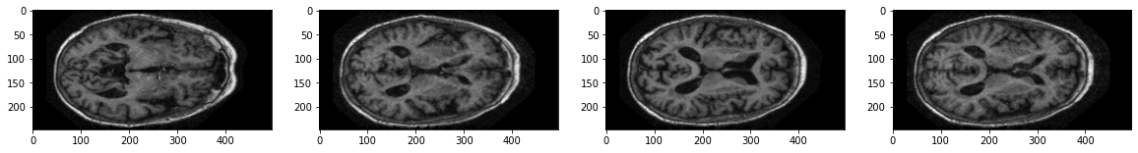
SAMPLE RAW MRI SCANS

Slide 15
HOW MRI SCANS ARE CHOSEN?
At an early stage of AD, the CSF (Cerebro Spinal Fluid) circulation in the subarachnoid space could be correlated with beta-Amyloid deposition. Therefore, CSF flow in the subarachnoid space could be a useful imaging marker to predict the presence of beta-amyloid in the brain. The beta-amyloid protein involved in Alzheimer's is formed from the breakdown of a larger protein called the amyloid precursor. It comes in several different molecular forms that collect between neurons. Hence we chose images where CSF spaces were clearly visible.
Reference : Kim, J., Barcus, R.A., Lipford, M.E., Yuan, H., Hudson, J.P., Sai, K.K.S., Lockhart, S.N., Craft, S. and Whitlow, C.T. (2023), The Role of Cerebrospinal Fluid Flow in the Subarachnoid Space in Beta-Amyloid Clearance. Alzheimer's Dement., 19: e071202. https://doi.org/10.1002/alz.071202
Journal: Alzheimer's & Dementia. Journal of the Alzheimer's Association.

Slide 16
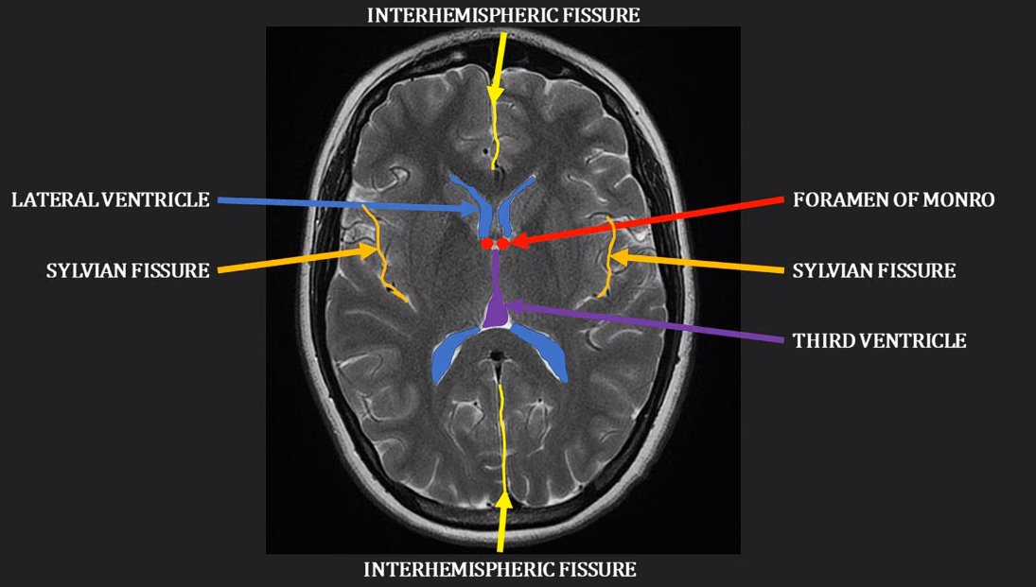

Slide 17
Interhemispheric Fissure : Separates Left and Right Hemisphere.
Lateral Ventricle : The lateral ventricles are paired C-shaped structures comprising a body and atrium along with 3 projections into the frontal, temporal, and occipital lobes, termed “horns.”
Any change of volume or shape occurring in these structures must affect the volume and shape of the ventricles. It is well known that ventricular volume is significantly higher in AD patients compared to age-matched healthy subjects.
Reference : Ferrarini L, Palm WM, Olofsen H, van Buchem MA, Reiber JH, Admiraal-Behloul F. Shape differences of the brain ventricles in Alzheimer's disease. Neuroimage. 2006;32(3):1060-1069. doi:10.1016/j.neuroimage.2006.05.048
Foreman Monro: is a short conduit connecting the paired lateral ventricles with the third ventricle of the brain.
Sylvian Fissure: A large diagonal fissure on the lateral surface of the brain which separates off the temporal lobe.
The width of the Sylvian fissure is the most sensitive sulcal measures and could be useful neuroanatomical markers for detecting early-stage AD.
Reference : Cai K, Xu H, Guan H, et al. Identification of Early-Stage Alzheimer's Disease Using Sulcal Morphology and Other Common Neuroimaging Indices. PLoS One. 2017;12(1):e0170875. Published 2017 Jan 27. doi:10.1371/journal.pone.0170875

Slide 18
DC-GANs
DC-GANs: Abbreviation for Deep Convolutional Generative Adversarial Networks, specialized for generating images by learning from a dataset's statistical distribution.
Deep Generative Models: Learn data distribution from a sample and generate diverse data while preserving original data qualities.
GANs: Implicit probability models comprising a generator and a discriminator network that compete to produce realistic data samples.
Generator: Produces synthetic data samples, while the discriminator distinguishes between real and generated samples.
Deep Convolutional GANs (DC-GANs): Specifically designed for image generation tasks, employing convolutional neural networks in both generator and discriminator for high-fidelity image generation.
Image Generation: DC-GANs leverage CNNs to generate images with realistic details, learning features directly from the data distribution.

Slide 19
DCGAN Architecture: Features symmetrical architectures in both generator and discriminator, employing convolutional and convolutional-transpose layers. The generator upsamples random noise (e.g., MRI scans) to produce images with increasing resolution.
Generative Adversarial Networks (GANs): Implicit likelihood models generating data samples from the dataset's statistical distribution, capturing its variations. Comprises generator and discriminator networks.
Generator Loss: Reflects how effectively the generator deceives the discriminator.
Ideal Generator Loss: Should decrease over time as the generator produces more realistic data, but a too rapid decrease or early convergence to zero may indicate lack of diversity.
Diversity in Generated Data: While decreasing generator loss is desirable, rapid convergence to zero suggests limited sample variety, undermining the model's effectiveness.
Generator Loss Monitoring: Crucial to ensure generator loss decreases gradually over time, maintaining diversity and fidelity in generated samples.

Slide 20
Generator Components: Comprises a dense layer to map noise to higher-dimensional space, a reshape layer, and transposed convolutional layers for gradual upsampling to the desired image size.
Discriminator Function: Takes an image as input, utilizing convolutional layers followed by fully connected layers to classify real vs. fake.
Loss Function in GANs: Min-max game where the discriminator aims to classify real/fake images accurately, while the generator seeks to minimize this probability.
Desirable Discriminator Loss: Should decrease over time, indicating improved discrimination between real and generated data.
Warning Sign: Rapid decrease or early convergence to zero in discriminator loss may lead to mode collapse, where the generator fails to produce diverse samples.
Optimal Training Scenario: Both discriminator and generator losses should gradually decrease over time, ensuring balanced improvement and diverse sample generation.

Slide 21
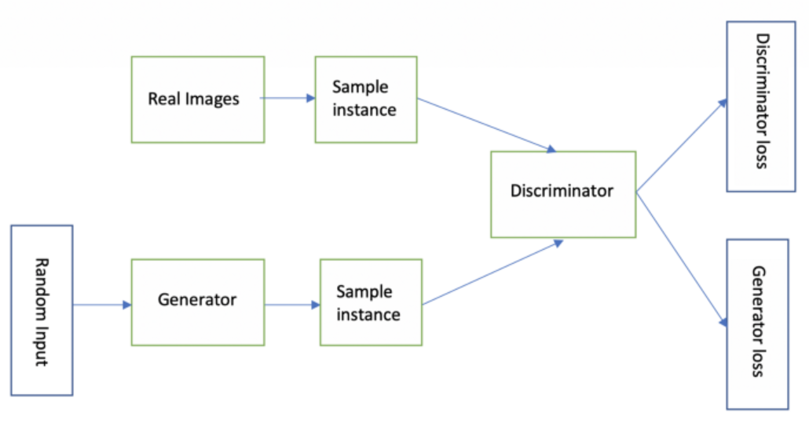
DC-GAN Schematic

Slide 22
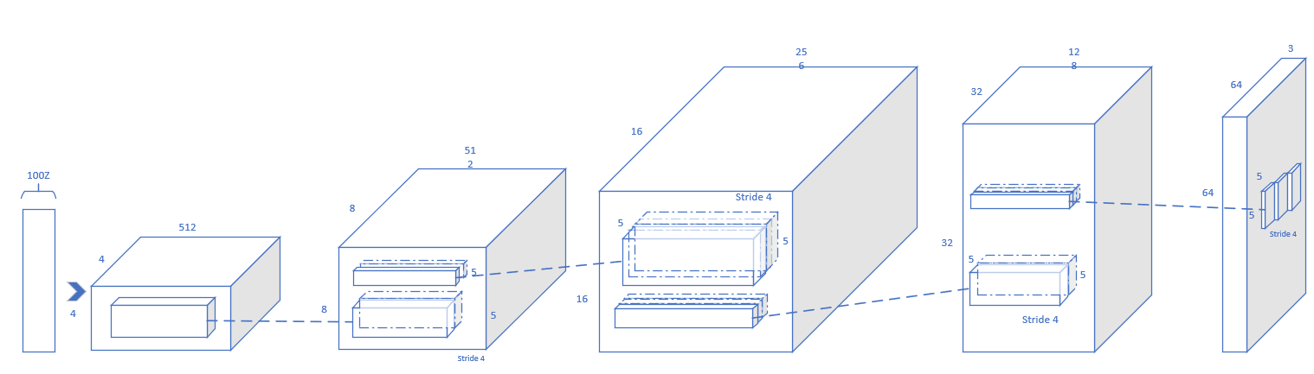
GENERATOR IN DC GAN

Slide 23
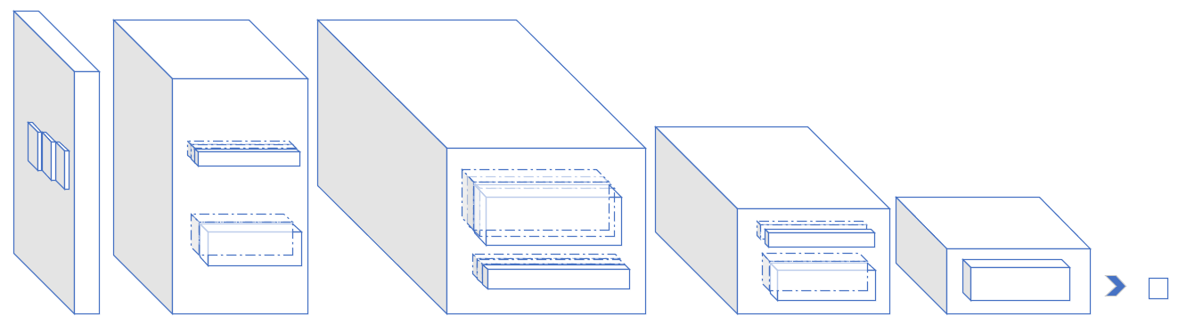
DISCRIMINATOR IN DC-GAN

Slide 24
Figure below illustrates a plot of distributions of pixel intensity values for both real and generated images. It provides a visual comparison between the distribution of pixel intensities in real MRI images and the distribution of pixel intensities in synthetic MRI images generated by the generator network.
A substantial overlap in the distribution suggests that, in terms of pixel intensity values, the generated images significantly resemble genuine images.

Slide 25
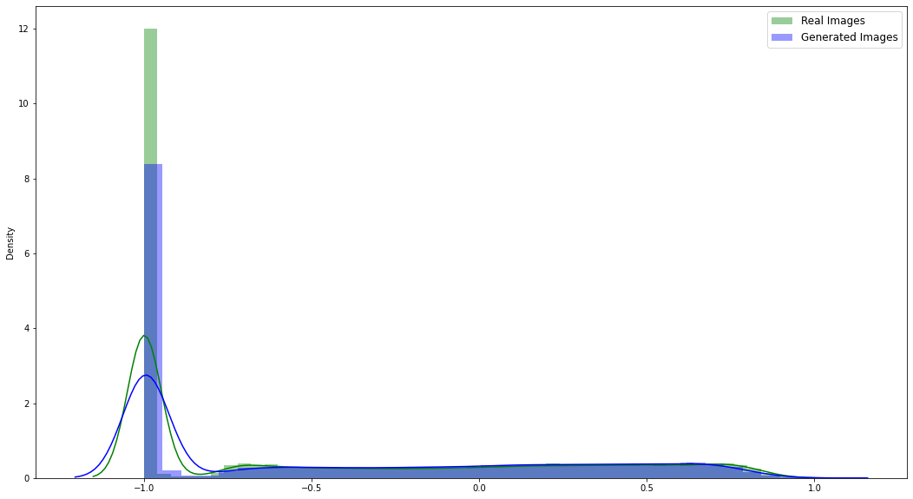
Pixel Density vs Pixel Intensity graph

Slide 26
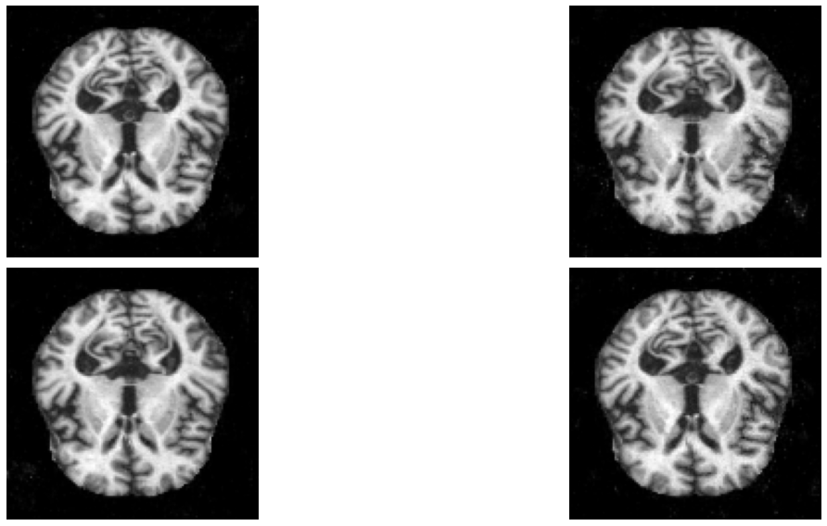
SAMPLE GENERATED IMAGES

Slide 27
HISTOGRAM MATCHING
Intensity Mismatch in Generated Images: The generated images exhibit overlap in pixel intensity with the original scans, but the intensity is generally lower.
Histogram Matching: Employed to address intensity mismatch, histogram matching adjusts the pixel intensity distribution of generated images to match a specified target distribution.
Purpose of Histogram Matching: Also known as histogram equalization or histogram specification, this technique enhances image contrast and aligns color distribution, improving visual quality and fidelity.
Image Processing Technique: Histogram matching is a fundamental image processing method used to manipulate pixel intensity distributions, commonly employed in medical imaging, computer vision, and other fields.
Application in MRI Image Generation: Crucial for ensuring generated MRI scans retain comparable intensity levels to original scans, enhancing the usefulness and accuracy of generated medical images for diagnostic and research purposes.

Slide 28
Histogram: A histogram represents the distribution of pixel intensities in an image. It plots the frequency of occurrence of each intensity value along the horizontal axis, with the intensity values ranging from 0 to 255 for an 8-bit grayscale image.
Cumulative Distribution Function (CDF): The cumulative distribution function (CDF) is derived from the histogram and represents the cumulative probability of occurrence of pixel intensities. It is calculated by summing up the histogram values at each intensity level and normalizing the result.
Matching Process:
Source Image: The histogram matching process starts with a source image whose pixel intensity distribution we want to adjust.
Reference Image: A reference image is chosen with the desired pixel intensity distribution that we want to match.
Histogram Equalization: The CDF of both the source and reference images is calculated. Then, a mapping function is created that maps the pixel intensities of the source image to new intensity values based on the cumulative distribution function of the reference image.
The result of histogram matching is an image whose pixel intensity distribution closely resembles that of the reference image. This can lead to improved visual quality, enhanced contrast, and better alignment with the desired color or intensity characteristics.

Slide 29
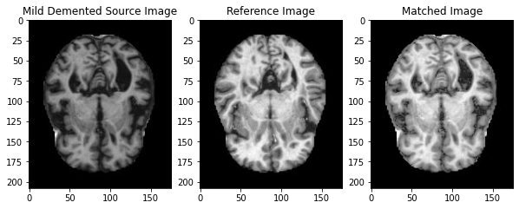
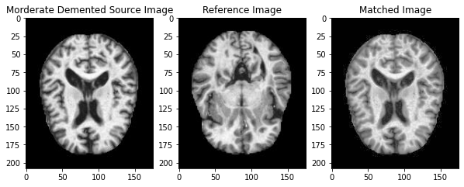
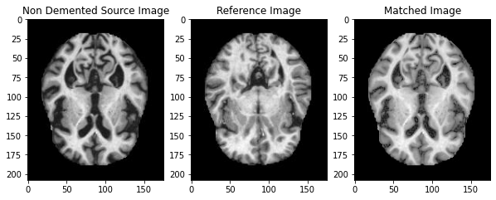
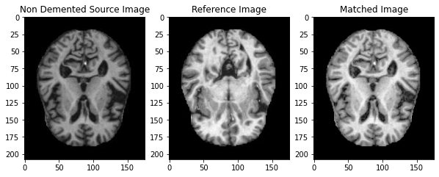
SAMPLE FOR HISTOGRAM MATCHING

Slide 30
ADVANTAGES OF HISTOGRAM MATCHING
Enhanced Contrast for Alzheimer's Identification: Histogram matching improves MRI image contrast, aiding in identifying subtle changes associated with Alzheimer's disease.
Standardization of Intensity Levels: Ensures consistency across MRI images, enabling clinicians to interpret images reliably.
Artifact Mitigation: Reduces imaging artifacts like noise and motion artifacts, enhancing diagnostic accuracy.
Alignment with Reference Atlases: Aligns MRI images with reference atlases, assisting in the localization of abnormalities.
Early Detection of Alzheimer's: Enhances visibility of subtle brain structure changes, facilitating early detection of Alzheimer's disease.
Quantitative Analysis: Enables quantitative analysis and biomarker extraction from histogram-matched MRI images.
Integration with Machine Learning: Facilitates automated disease classification and prediction using MRI data, improving diagnostic efficiency and accuracy.

Slide 31
Supplementary References for justifying usage of Histogram Matching.
N. Senthilkumaran and J. Thimmiaraja, "Histogram Equalization for Image Enhancement Using MRI Brain Images," 2014 World Congress on Computing and Communication Technologies, Trichirappalli, India, 2014, pp. 80-83, doi: 10.1109/WCCCT.2014.45. keywords: {Histograms;Magnetic resonance imaging;Adaptive equalizers;Brain;Image enhancement;Brightness;Computer science;Medical image processing;MRI brain image;Contrast enhancement;Histogram equalization}
Patel, S., Bharath, K. P., & Muthu, R. K. (n.d.). Medical image enhancement using histogram processing and feature extraction for cancer classification.
Schiano Di Cola V, Mango DML, Bottino A, Andolfo L and Cuomo S (2023) Magnetic resonance imaging enhancement using prior knowledge and a denoising scheme that combines total variation and histogram matching techniques. Front. Appl. Math. Stat. 9:1041750. doi: 10.3389/fams.2023.1041750

Slide 32
SMOTE
Class Balancing with SMOTE: The Synthetic Minority Over-sampling Technique (SMOTE) is used to address class imbalance.
It generates synthetic samples for the minority class to balance the class distribution. This is achieved by oversampling the minority class instances.
In our case we're training a model to identify Alzheimer's Disease. The MRI of this disease coming positive is rare (minority class) but growing in trend, while normal scans are common (majority class). An imbalanced dataset can lead the model to focus on the majority class and perform poorly on the minority class (false detection). Refer image in the next slide
• SMOTE tackles this by creating synthetic samples for the minority class. It works like this:
1.Pick a minority class data point.
2.Find its closest neighbors (other minority class points).
3.Randomly choose a neighbor.
4.Create a new data point by slightly adjusting the features between the original point and its neighbor.

Slide 33
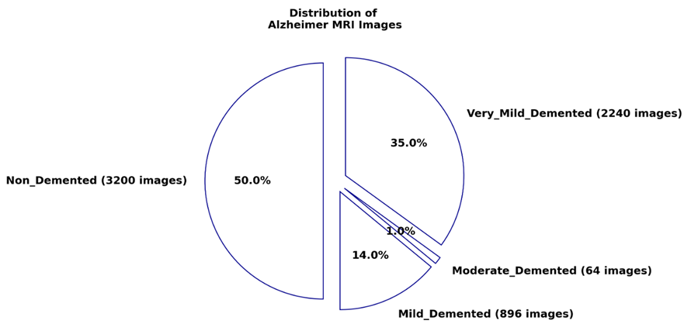

Slide 34
Supplementary References for justifying usage of SMOTE.
Deep Learning Augmented with SMOTE for Timely Alzheimer's Disease Detection in MRI Images P Gayathri1 , N. Geetha2 , Dr. M. Sridhar3 , Ramu Kuchipudi4 , Dr. K. Suresh Babu5 , Lakshmana Phaneendra Maguluri6 , Dr B Kiran Bala
Classifying Alzheimer's disease based on a convolutional neural network with MRI images, Murat Avşar, Kemal Polat*
Liu Y, Tang K, Cai W, et al. MPC-STANet: Alzheimer's Disease Recognition Method Based on Multiple Phantom Convolution and Spatial Transformation Attention Mechanism. Front Aging Neurosci. 2022;14:918462. Published 2022 Jun 10. doi:10.3389/fnagi.2022.918462

Slide 35
WEIGHTED CLASS SAMPLING
Class weights are utilized to mitigate the challenges posed by imbalanced datasets, where minority classes are vastly outnumbered by dominant ones.
By assigning larger weights to underrepresented classes during training, class weights ensure the model focuses more on learning from instances belonging to these minority classes.
Class weights aim to provide fair representation to all categories in the dataset by adjusting the loss function based on the relative frequencies of distinct classes.
By modifying the loss function according to class frequencies, class weights prevent the model from favoring majority classes over minority ones, resulting in a fairer decision-making process.
While helpful, class weights may not completely resolve the underlying class imbalance issue, especially in datasets with significant class skews.

Slide 36
Class weights do not fundamentally change the distribution of instances in the dataset but rather adjust the learning signal to account for class imbalances.
In cases of substantial underrepresentation of minority classes, the impact of class weights may be insufficient to improve model performance adequately.
The effectiveness of class weights relies on accurately adjusting weight values to reflect the imbalance ratio across classes.
Through equitable representation, class weights contribute to a more balanced decision-making process by preventing the model from disproportionately favoring majority classes.
Despite limitations, properly implemented class weights can significantly improve the model's ability to learn from minority class instances, leading to more robust and fairer predictive models.

Slide 37

Class weights are calculated by calculating the frequency with which each class appears in the training data. The balanced weighting technique gives greater weight to less frequent classes and less weight to more frequent classes in order to correct for class imbalance.
Let’s denote:
n_{i} as the number of instances in class i.
N as the total number of instances in all classes.
w_{i} as the weight assigned to class i.
k is the number of classes.
The class weight is therefore calculated as follows:

Slide 38
3 CLASS CLASSIFICATION
Performing a 3-class classification (CN vs MCInc vs MCIc) reduces the complexity of the classification task compared to a 4-class classification, potentially simplifying model training and interpretation.
Focus on Disease Progression: The classification model can focus more directly on distinguishing between cognitively normal individuals (CN), individuals with mild cognitive impairment without progression to Alzheimer's disease (MCInc), and those with MCI progressing to Alzheimer's disease (MCIc). As , in most situations, AD and MCIc induced by Alzheimer's disease are closely linked illnesses with similar symptoms and pathological processes. Reference The National Institute on Aging and the Alzheimer’s Association Research Framework for Alzheimer’s disease: Perspectives from the Research Roundtable - PMC (nih.gov)
Improved Class Balance: Improve the balance among the remaining classes (CN, MCInc, MCIc), reducing the impact of class imbalance on model performance.
Simplified Decision-Making: With fewer classes to consider, the decision-making process for classifying individuals becomes more straightforward, potentially leading to more accurate and reliable predictions.
Trade-off with Granularity: While this approach sacrifices some granularity in categorization by lumping together AD and MCIc cases, it can help mitigate the challenges associated with class imbalance, ultimately improving the overall performance of the classification model.

Slide 39
ALZH-NET ARCHITECTURE
The proposed methodology involves the utilization of two distinct CNN models, Alzh-Net Upper and Alzh-Net Lower, designed to extract features from input images at varying scales and levels of abstraction.
Both models consist of convolutional and dense blocks, each playing a specific role in the feature extraction process. Convolutional blocks identify low-level features and spatial patterns, while dense blocks capture high-level abstract features crucial for discerning intricate patterns and nuances.
The mathematical operations of convolutional and dense layers involve the element-wise multiplication of input feature maps with learnable weights and biases, followed by the application of a non-linear activation function, typically ReLU, to introduce non-linearity.
Max-pooling layers are strategically placed within the architecture to downsample the feature maps, reducing their spatial dimensions while retaining prominent features. This process helps in abstracting away fine-grained details and focusing on important features.

Slide 40
Alzh-Net Lower operates on a different scale compared to Alzh-Net Upper, capturing features at a different degree of granularity. It employs convolutional layers with varying strides and max-pooling layers to capture more global and abstract patterns in the input images.
The feature representations generated by Alzh-Net Upper and Alzh-Net Lower are concatenated along a new feature dimension, creating a unified feature representation. This concatenated representation is then passed through additional dense layers to prevent overfitting.
The output layer of the architecture applies a softmax activation function to generate class probabilities for the input images. This enables the model to assign probabilities to each class label, facilitating the classification process.
The entire architecture, comprising both Alzh-Net Upper and Alzh-Net Lower, is trained end-to-end using an optimization algorithm such as Adam. The categorical cross-entropy loss function is minimized during training to optimize the model parameters.
We will be focusing on 4 class(4c) classification i.e Cognitively Normal (CN), Early Mild Cognitive Impairment (MCInc), Late Mild Cognitive Impairement (MCIc) , Alzheimer's Disease (AD) and 2 class (2c) classification i.e

Slide 41
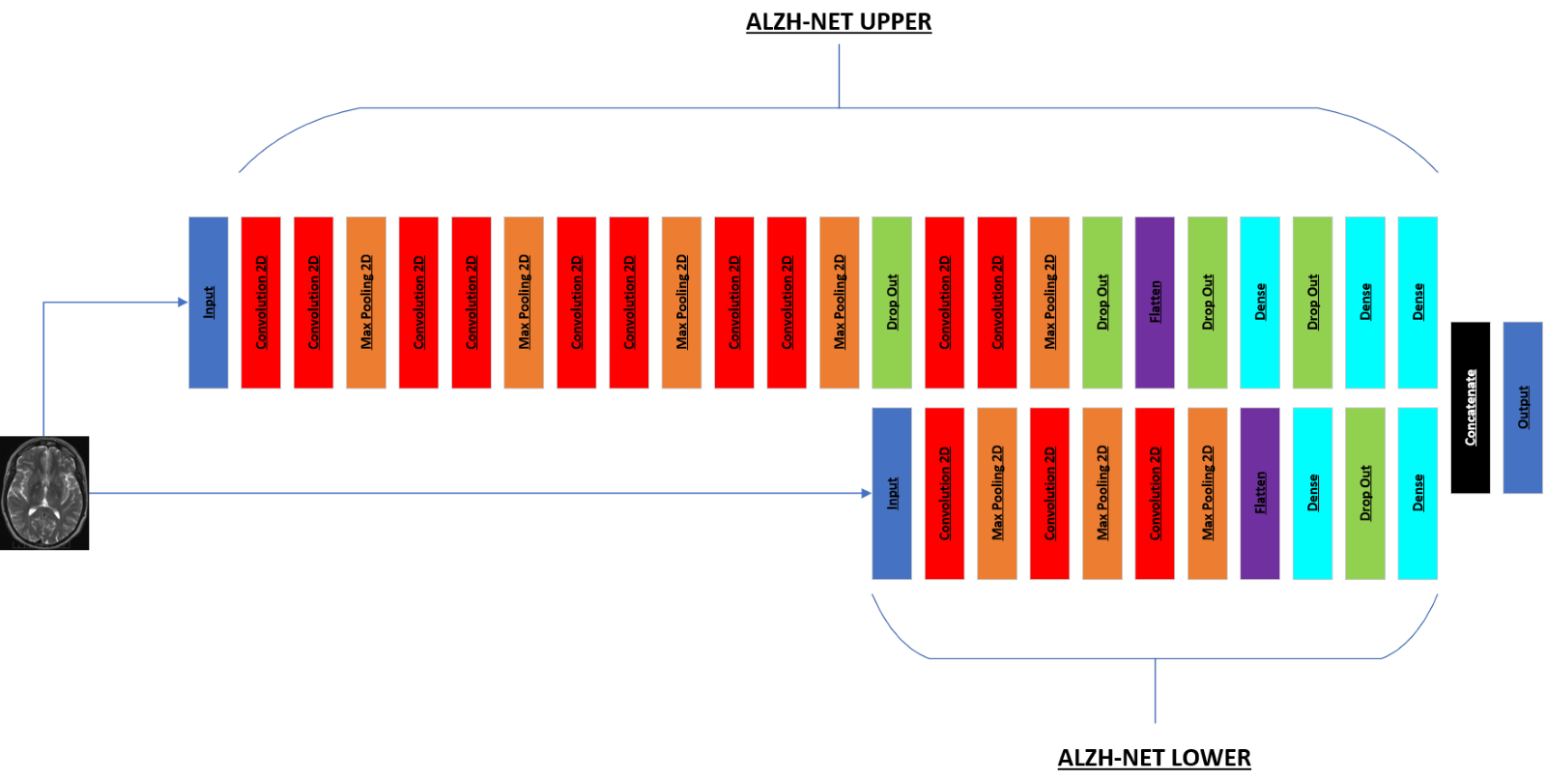

Slide 42
Dimensions and Parameters of each layer in Alzh-Net.
Layer (type) | Output Shape | Parameters
InputLayer | [(None, 176, 176, 3)] | 0
Conv2D | [(None, 176, 176, 16)] | 448
Conv2D | [(None, 176, 176, 16)] | 2320
MaxPooling2D | [(None, 88, 88, 16)] | 0
Conv2D | [(None, 88, 88, 32)] | 4640
Conv2D | [(None, 88, 88, 32)] | 9248
MaxPooling2D | [(None, 44, 44, 32)] | 0
Conv2D | [(None, 44, 44, 64)] | 18496
Conv2D | [(None, 44, 44, 64)] | 36928
MaxPooling2D | [(None, 22, 22, 64)] | 0
Conv2D | [(None, 22, 22, 128)] | 73856
Conv2D | [(None, 22, 22, 128)] | 147584
MaxPooling2D | [(None, 11, 11, 128)] | 0
DropOut | [(None, 11, 11, 128)] | 0
Conv2D | [(None, 11, 11, 256)] | 295168
Conv2D | [(None, 11, 11, 256)] | 590080
MaxPooling2D | [(None, 5, 5, 256)] | 0
DropOut | [(None, 5, 5, 256)] | 0
Flatten | [(None, 6400)] | 0
DropOut | [(None, 6400)] | 0
Dense | [(None, 512)] | 3277312
DropOut | [(None, 512)] | 0

Slide 43
Dense | [(None, 128)] | 65664
Dense | [(None, 4)] | -
InputLayerb. | [(None, 176, 176, 3)] | 0
Conv2D | [(None, 88, 88, 32)] | 896
MaxPooling2D | [(None, 44, 44, 32)] | 0
Conv2D | [(None, 22, 22, 64)] | 18496
MaxPooling2D | [(None, 11, 11, 64)] | 0
Conv2D | [(None, 6, 6, 128)] | 73856
MaxPooling2D | [(None, 3, 3, 128)] | 0
Flatten | [(None, 1152)] | 0
Dense | [(None,1024)] | 1180672
DropOut | [(None, 1024)] | 0
Dense | [(None, 4)] | -
Concatenate | [(None, 8)] | -
OutputLayer | [(None, 4)] | -

Slide 44
Hyperparameter Setting
Alzh-Net Upper Architecture:
Will utilize multiple convolutional blocks with 3x3 kernels and ReLU activation.
Includes batch normalization layers and max-pooling (2x2) for stabilization and down-sampling.
Strategically places dropout layers (0.2 rate) to prevent overfitting.
Incorporates dense blocks with varying units (512, 128, 64) and dropout rates (0.7, 0.5, 0.3) for feature representation.

Slide 45
Hyperparameter Setting
Alzh-Net Lower Architecture:
Features convolutional layers with 32, 64, and 128 filters (3x3 kernels).
Applies ReLU activation throughout and max-pooling (2x2) for spatial information preservation.
Implements dropout regularization (0.3 rate) after the fully connected layer.
Optimization and Training:
Employs Adam optimizer with default parameters and categorical cross-entropy loss function.
Implements early stopping (patience: 15 epochs) and custom callback for termination based on validation accuracy.
Trains over 50 epochs with flexibility to adjust based on specific requirements.

Slide 46
Evaluation Metrics
Precision Score: It quantifies the correct positive predictions made. It is calculated as follows:
Accuracy: Is a metric that measures how often a machine learning model correctly predicts the outcome. You can calculate accuracy by dividing the number of correct predictions by the total number of predictions.

Slide 47

F1 Score: It tries to combine both precision and recall which would help in indicating reliability. It is calculated as follows:
Recall also called as Sensitivity is a statistic that indicates how often a machine learning model accurately detects positive examples (true positives) among all of the actual positive samples in the dataset.

Slide 48
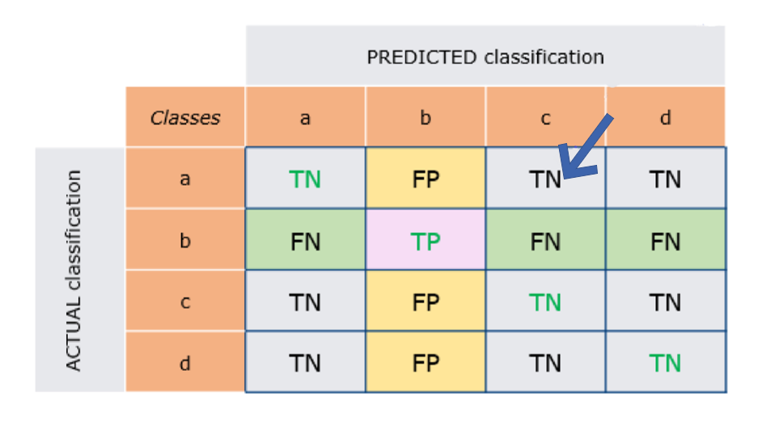
The green row and yellow column appear to imply that the example is now focused on the categorization of class 'b' against the others. The cell to which the arrow points contains the examples that were projected to be class 'c' but were really class 'a'.

Slide 49
Confusion Matrix: A confusion matrix is a performance measuring approach used in machine learning to assess the effectiveness of a classification model. It is most beneficial when working with binary classification issues, although it may also be applied to multi-class classification.
The confusion matrix is a table that visualizes an algorithm's performance by comparing expected and actual classes. It comprises of four major components:
True Positives (TP) are instances in which the model accurately predicted the positive class.
True Negatives (TN) are instances in which the model accurately predicted the negative class.

Slide 50
False Positives (FP), also known as Type I errors, occur when the model incorrectly predicted a positive class (where the actual class was negative).
False Negatives (FN), also known as Type II error, occur when the model mistakenly predicts the negative class (when the actual class is positive).
The example depicts the scenario for computing Class 'b' values, with TP being the value of the right prediction that is compatible with the goal. The TN are the classes that do not include Class 'b', either in the forecast or the target. The FP is the sum of the classes that were incorrectly forecasted as Class 'b ', whereas the FN is the sum of the courses that should have been anticipated as Class 'b'. This procedure should be repeated for all classes, with the model's overall TP, FP, TN, and FN being averaged over the individual values.

Slide 51
ENSEMBLE METHODS
Ensemble Methods used were:
Random Forest
AdaBoost
GradientBoost
XGBoost
CatBoost

Slide 52
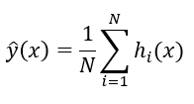
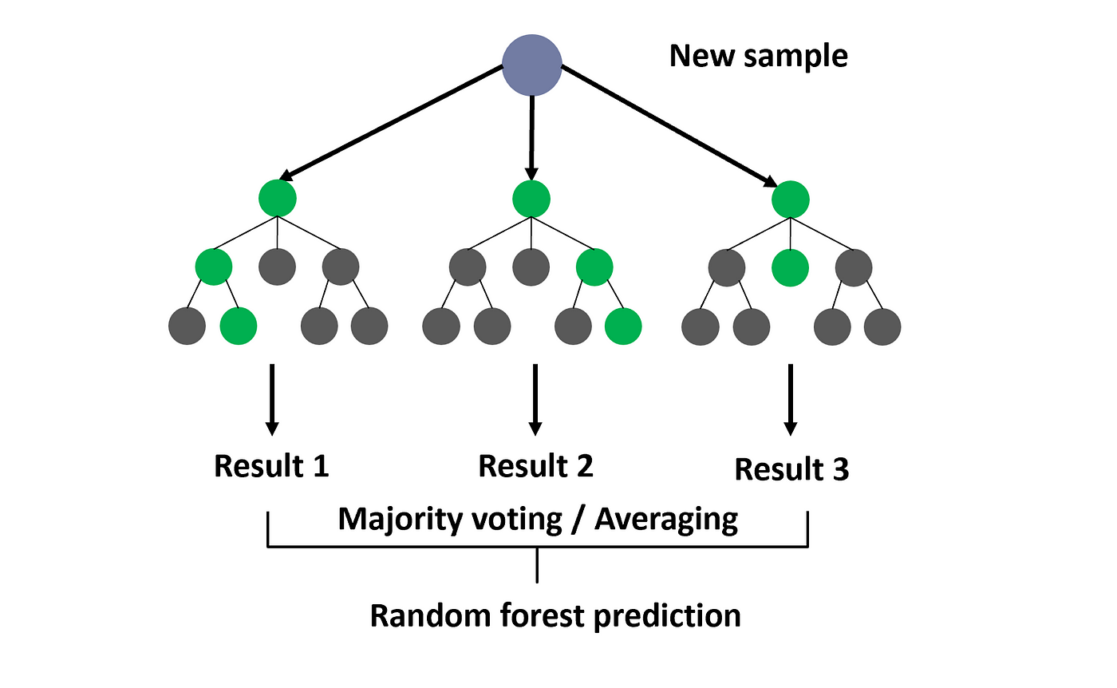
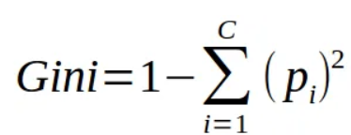
RANDOM FOREST
Random Forest is an ensemble learning method based on decision trees.
In a Random Forest, multiple decision trees are trained independently on random subsets of the training data. The final prediction is made by aggregating the predictions of all decision trees through averaging or voting.
Mathematically we can represent the voting as follows. Where, ŷ is the final prediction by voting the prediction of all decision trees and h_{i}(x) represents the prediction of i-th decision tree.
Gini was used for the decision making. Where pi represents the relative frequency of the class you are observing in the dataset and c represents the number of classes..

Slide 53
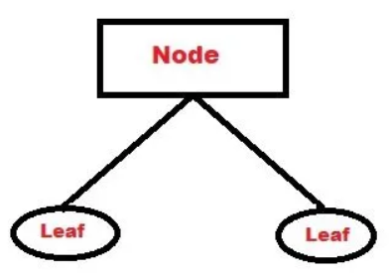

ADABOOST
AdaBoost is an ensemble method that combines multiple weak learners (e.g., shallow decision trees) to create a strong learner. Technically Weak Learners are called as stumps.
In AdaBoost, each weak learner is trained sequentially, and the subsequent learners focus more on the examples that were misclassified by the previous ones.
The final prediction is made by weighted majority voting of all weak learners. Mathematically we can represent it as follows.
Mathematically we can represent the voting as follows. Where, hi(x) represent the prediction of i-th weak learner. The final prediction ŷ(x) is obtained by weighted majority voting of all weak learners where αi represent the class weights assigned to the i-th weak learner.

Slide 54

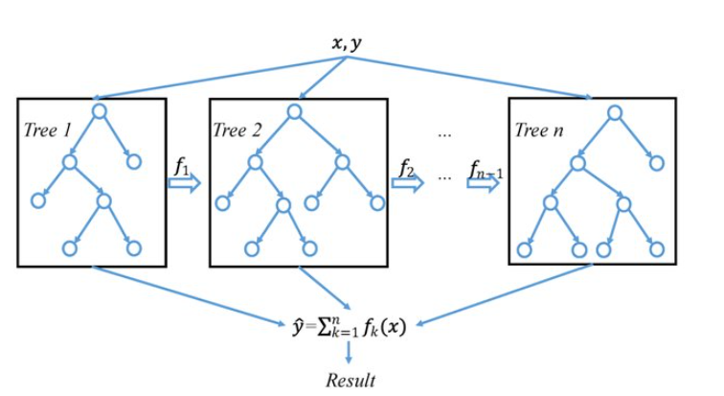
XGBOOST
XGBoost is a gradient boosting approach that improves model performance by successively building an ensemble of weak learners (usually decision trees).
Unlike AdaBoost, XGBoost trains weak learners concurrently and using gradient descent optimization to minimize a predetermined loss function.
The final forecast is calculated by adding the predictions of all weak learners, weighted by their learning rates. Mathematically we can represent it as follows. Where, h_{i}(x) represent the prediction of i-th weak learner. The final prediction ŷ(x) is obtained by weighted majority voting of all weak learners where η_{i} represent the learning rate of the i-th weak learner.

Slide 55

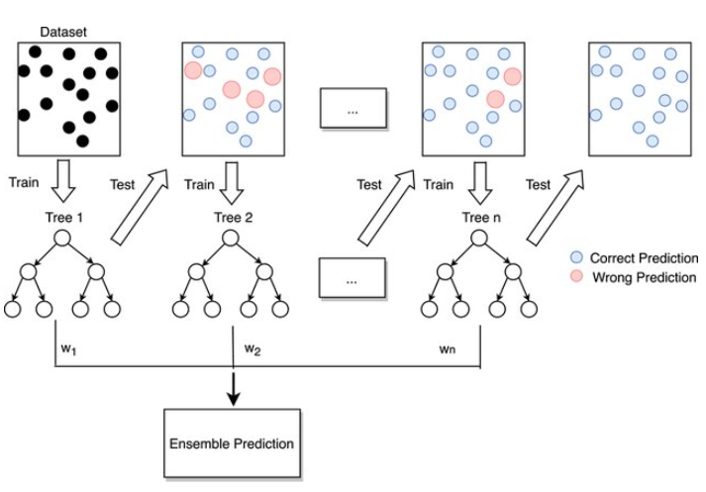
GRADIENTBOOST
Gradient Boosting is a machine learning approach used to perform regression and classification tasks. It operates by adding weak learners (usually decision trees) to an ensemble in a sequential manner, with each new learner focused on the preceding one's faults.
The algorithm minimizes the loss function L by updating the ensemble F(x) at each iteration m using gradient descent. γm is the learning rate and hm (x) is the weak learner's contribution. The objective is to find the optimal hm (x) that minimizes the loss function L over the training dataset

Slide 56

SAMPLE KAGGLE ENVIRONMENT

Slide 57
WORKING ENVIRONMENT - KAGGLE
Kaggle is a free online platform for data scientists and machine learning enthusiasts. It allows users to:
Find and publish datasets
Explore and build models,
Work with other data scientists and machine learning engineers
Share code snippets.
The reason why we chose Kaggle over other platforms such as Google Colab is because Kaggle provides access to powerful GPU and TPU hardware, which can significantly speed up the training of machine learning models. This allows the models to train faster and more efficiently, which can be especially useful for large datasets or complex models.
Easy to maintain and create datasets.

Slide 58
SPECS COMPARISON
Component | Our PC | Google-Collab | Kaggle
Type of CPU | Intel Core i5 | Intel Xeon | Intel Xeon
Number of Cores | 4 | 2 | 4
Size of RAM | 8 Gb | 13 Gb | ~16 Gb
Disk Size | 1 TB (HDD) | Depends on Google Drive (general usage upto 15 Gb) | 73 GB
Type of GPU | 1-Nvidia Ge-Force GTX | 1-NVIDIA Tesla T4 | 1-Nvidia Tesla P100
Size of GPU | 4 Gb | 16 Gb | ~16 Gb
TPU (Tensor Processing Unit) | Non existent | Very limited access | Open Access

Slide 59
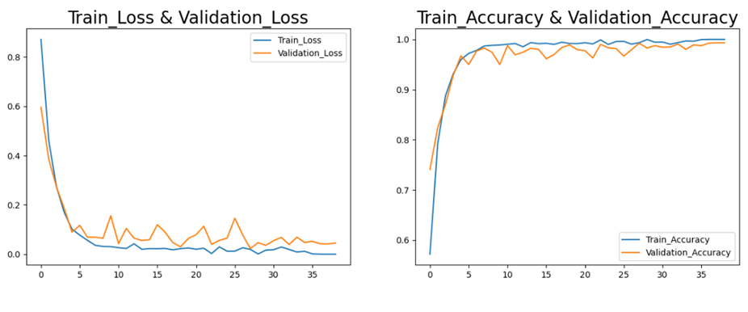
ACCURACY AND LOSS CURVES FOR ALZH-NET

Slide 60
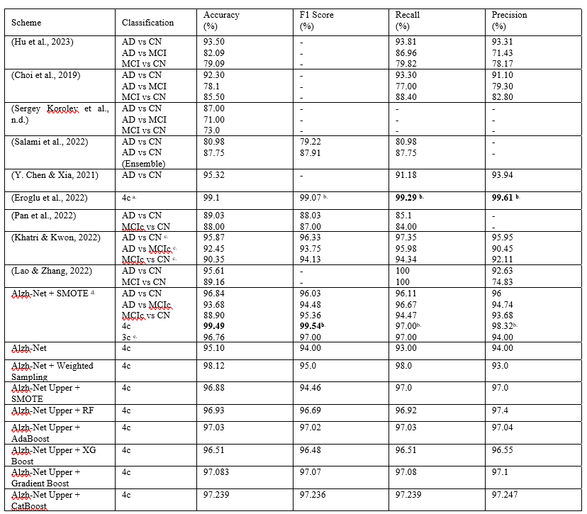
PERFORMANCE METRIC RESULTS OF ALZH-NET AND COMPARISON WITH SOTA MODELS

Slide 61
LIMITATIONS AND CHALLENGES
Limited Access to MRI Scans: Procurement of only the OASIS 1 dataset posed a formidable constraint, restricting access to additional sources despite extensive outreach efforts.
Lack of Open-source Data sets. Very difficult to procure Raw Images.
Very small datasize. We are using around 6400 images after data augmentation. More images can make the system robust.
Challenges in Obtaining Past MRI Scans: Difficulty in acquiring historical MRI scans hindered comprehensive comparative analysis, thereby limiting dataset breadth and compromising model robustness.
Lack of Supplementary Patient Health Information: Absence of contextual insights from patient health data impeded understanding of Alzheimer's progression, posing a significant challenge.
Resizing MRI Images: Resizing images to 175 x 175 pixels due to computational constraints resulted in fidelity loss compared to higher-resolution originals, impacting model performance potential.
Focuses only on 2D scans of Axial slice. But it can be extended to Sagittal and Coronal with minor tweaks.
Brain scans with multiple ailments will give inaccurate results.

Slide 62
Hardware Limitations: Inadequate hardware setup with limited RAM, and GPU capacities necessitated leveraging Kaggle's computational expertise for efficient model implementation and evaluation.
Even on robust platforms like Kaggle, processing high-resolution imaging remained challenging, highlighting ongoing resource limitations.
Addressing dataset imbalance through strategies like SMOTE and weighted sampling mitigated skewness but introduced complexities in model complexity and interpretability. Class balancing introduce bias in most cases . Since the new data points are generated from the old ones, they can't introduce much variance to the dataset.
Shift in Classification Paradigm: Transitioning from a 4-class to a 3-class framework would lead to loss of granularity in classification.

Slide 63
FUTURE DEVELOPMENT
Getting access to OASIS 2,3,4 and ADNI 1,2,3,Go (or other credible datasets) and to make the system robust.
Incorporating additional health parameters such as blood pressure, age, and sex into the model can enhance diagnostic accuracy and provide a more comprehensive understanding of neurodegenerative disorders.
Expanding the model to 3D MRI Scans.
Expanding the model to ensure other brain ailments are taken into account whilst detecting Alzh-Net.
Ability to take high resolution MRI scans as input.

Slide 64
CONCLUSION
Alzh-Net’s improved performance metrics demonstrate its potential in automating MRI scan classification for Alzheimer's detection.
It addresses the need for improved diagnostics, especially in regions with limited healthcare resources, ensuring timely patient care.
Cloud storage streamlines dementia categorization, image analysis, and result generation, enhancing diagnostic efficiency.
While 2D scans offer valuable insights, they may lack the depth needed for comprehensive neurodegenerative condition analysis.
Adoption of 3D imaging provides enhanced spatial information but introduces challenges like increased data volume and resource requirements.
Future enhancements could include incorporating additional health parameters and utilizing more sophisticated datasets to improve diagnostic accuracy.
Within the scope and constraints, we have achieved a commendable outcome, demonstrating the effectiveness of Alzh-Net in automating MRI scan classification for Alzheimer's detection.

Slide 65
REFERENCES
[1] N. G. Müller and R. T. Knight, “The functional neuroanatomy of working memory: Contributions of human brain lesion studies,” Neuroscience, vol. 139, no. 1, pp. 51–58, 2006, doi: 10.1016/j.neuroscience.2005.09.018.
[2] I. E. van Gennip, H. R. W. Pasman, M. G. Oosterveld-Vlug, D. L. Willems, and B. D. Onwuteaka-Philipsen, “How Dementia Affects Personal Dignity: A Qualitative Study on the Perspective of Individuals With Mild to Moderate Dementia,” The Journals of Gerontology: Series B, vol. 71, no. 3, pp. 491–501, May 2016, doi: 10.1093/geronb/gbu137.
[3] M. F. Mendez and G. T. H. Lim, “Seizures in Elderly Patients with Dementia,” Drugs Aging, vol. 20, no. 11, pp. 791–803, 2003, doi: 10.2165/00002512-200320110-00001.
[4] Dening T and Sandilyan MB, “Art & science dementia series: 1 Dementia: definitions and types,” 2015. doi: 10.7748/ns.29.37.37.e9405.
[5] S. P. A. N. D. M. V. A. N. D. V. Jackson-Lewis, “Series Introduction: Neurodegeneration: What is it and where are we?,” J Clin Invest, vol. 111, no. 1, pp. 3–10, Feb. 2003, doi: 10.1172/JCI17522.
[6] A. Solomon et al., “Advances in the prevention of Alzheimer’s disease and dementia,” J Intern Med, vol. 275, no. 3, pp. 229–250, 2014, doi: https://doi.org/10.1111/joim.12178.
[7] J. Gaugler et al., “2022 Alzheimer’s disease facts and figures,” Alzheimers & Dementia, vol. 18, no. 4, pp. 700–789, 2022.
[8] P. Scheltens et al., “Alzheimer’s disease,” The Lancet, vol. 397, no. 10284, pp. 1577–1590, 2021, doi: https://doi.org/10.1016/S0140-6736(20)32205-4.
[9] B. Lam, M. Masellis, M. Freedman, D. T. Stuss, and S. E. Black, “Clinical, imaging, and pathological heterogeneity of the Alzheimer’s disease syndrome,” Alzheimers Res Ther, vol. 5, no. 1, p. 1, 2013, doi: 10.1186/alzrt155.
[10] M. E. Murray, N. R. Graff-Radford, O. A. Ross, R. C. Petersen, R. Duara, and D. W. Dickson, “Neuropathologically defined subtypes of Alzheimer’s disease with distinct clinical characteristics: a retrospective study,” Lancet Neurol, vol. 10, no. 9, pp. 785–796, Sep. 2011, doi: 10.1016/S1474-4422(11)70156-9.
[11] J. L. Whitwell et al., “Neuroimaging correlates of pathologically defined subtypes of Alzheimer’s disease: a case-control study,” Lancet Neurol, vol. 11, no. 10, pp. 868–877, Oct. 2012, doi: 10.1016/S1474-4422(12)70200-4.
[12] K. A. Jellinger, “Neuropathological subtypes of Alzheimer’s disease,” Acta Neuropathol, vol. 123, no. 1, pp. 153–154, 2012, doi: 10.1007/s00401-011-0889-9.
[13] P. Chen et al., “Four Distinct Subtypes of Alzheimer’s Disease Based on Resting-State Connectivity Biomarkers,” Biol Psychiatry, vol. 93, no. 9, pp. 759–769, May 2023, doi: 10.1016/J.BIOPSYCH.2022.06.019.
[14] H. Il Suk, S. W. Lee, and D. Shen, “Hierarchical feature representation and multimodal fusion with deep learning for AD/MCI diagnosis,” Neuroimage, vol. 101, pp. 569–582, Nov. 2014, doi: 10.1016/J.NEUROIMAGE.2014.06.077.
[15] H.-I. Suk and D. Shen, “Deep Learning-Based Feature Representation for AD/MCI Classification,” in Medical Image Computing and Computer-Assisted Intervention – MICCAI 2013, K. Mori, I. Sakuma, Y. Sato, C. Barillot, and N. Navab, Eds., Berlin, Heidelberg: Springer Berlin Heidelberg, 2013, pp. 583–590.

Slide 66
16] X. Bai, Y. Zhang, H. Liu, and Y. Wang, “Intuitionistic Center-Free FCM Clustering for MR Brain Image Segmentation,” IEEE J Biomed Health Inform, vol. 23, no. 5, pp. 2039–2051, 2019, doi: 10.1109/JBHI.2018.2884208.
[17] R. Wright et al., “Automatic quantification of normal cortical folding patterns from fetal brain MRI,” Neuroimage, vol. 91, pp. 21–32, May 2014, doi: 10.1016/J.NEUROIMAGE.2014.01.034.
[18] W. Zhang et al., “Deep convolutional neural networks for multi-modality isointense infant brain image segmentation,” Neuroimage, vol. 108, pp. 214–224, Mar. 2015, doi: 10.1016/J.NEUROIMAGE.2014.12.061.
[19] M. Thambisetty, J. Wan, A. Carass, Y. An, J. L. Prince, and S. M. Resnick, “Longitudinal changes in cortical thickness associated with normal aging,” Neuroimage, vol. 52, no. 4, pp. 1215–1223, Oct. 2010, doi: 10.1016/J.NEUROIMAGE.2010.04.258.
[20] H. Rusinek et al., “Regional Brain Atrophy Rate Predicts Future Cognitive Decline: 6-year Longitudinal MR Imaging Study of Normal Aging,” Radiology, vol. 229, no. 3, pp. 691–696, Dec. 2003, doi: 10.1148/radiol.2293021299.
[21] M. A. Warsi, “THE FRACTAL NATURE AND FUNCTIONAL CONNECTIVITY OF BRAIN FUNCTION AS MEASURED BY BOLD MRI IN ALZHEIMER’S DISEASE,” 2012.
[22] S. K. Madsen et al., “3D maps localize caudate nucleus atrophy in 400 Alzheimer’s disease, mild cognitive impairment, and healthy elderly subjects,” Neurobiol Aging, vol. 31, no. 8, pp. 1312–1325, Aug. 2010, doi: 10.1016/j.neurobiolaging.2010.05.002.
[23] P. J. LaMontagne et al., “OASIS-3: Longitudinal Neuroimaging, Clinical, and Cognitive Dataset for Normal Aging and Alzheimer Disease,” medRxiv, 2019, doi: 10.1101/2019.12.13.19014902.
[24] K. A. Ellis et al., “The Australian Imaging, Biomarkers and Lifestyle (AIBL) study of aging: Methodology and baseline characteristics of 1112 individuals recruited for a longitudinal study of Alzheimer’s disease,” Int Psychogeriatr, vol. 21, no. 4, pp. 672–687, 2009, doi: 10.1017/S1041610209009405.
[25] I. B. Malone et al., “MIRIAD—Public release of a multiple time point Alzheimer’s MR imaging dataset,” Neuroimage, vol. 70, pp. 33–36, Apr. 2013, doi: 10.1016/J.NEUROIMAGE.2012.12.044.
[26] N. Mahendran and D. R. V. P M, “A deep learning framework with an embedded-based feature selection approach for the early detection of the Alzheimer’s disease,” Comput Biol Med, vol. 141, p. 105056, Feb. 2022, doi: 10.1016/J.COMPBIOMED.2021.105056.
[27] T. Illakiya and R. Karthik, “Automatic Detection of Alzheimer’s Disease using Deep Learning Models and Neuro-Imaging: Current Trends and Future Perspectives,” Neuroinformatics, vol. 21, no. 2, pp. 339–364, 2023, doi: 10.1007/s12021-023-09625-7.
[28] J. Samper-González et al., “Reproducible evaluation of classification methods in Alzheimer’s disease: Framework and application to MRI and PET data,” Neuroimage, vol. 183, pp. 504–521, Dec. 2018, doi: 10.1016/J.NEUROIMAGE.2018.08.042.
[29] A. Krizhevsky, I. Sutskever, and G. E. Hinton, “ImageNet classification with deep convolutional neural networks,” Commun ACM, vol. 60, no. 6, pp. 84–90, Jun. 2017, doi: 10.1145/3065386.
[30] K. Simonyan and A. Zisserman, “Very Deep Convolutional Networks for Large-Scale Image Recognition,” Sep. 2014, [Online]. Available: http://arxiv.org/abs/1409.1556

Slide 67
[31] C. Szegedy et al., “Going Deeper with Convolutions,” Sep. 2014, [Online]. Available: http://arxiv.org/abs/1409.4842
[32] K. He, X. Zhang, S. Ren, and J. Sun, “Deep Residual Learning for Image Recognition.” [Online]. Available: http://image-net.org/challenges/LSVRC/2015/
[33] I. Thayumanasamy and K. Ramamurthy, “Performance Analysis of Machine Learning and Deep Learning Models for Classification of Alzheimer’s Disease from Brain MRI,” Traitement du Signal, vol. 39, no. 6, pp. 1961–1970, Dec. 2022, doi: 10.18280/ts.390608.
[34] Z. Hu, Y. Li, Z. Wang, S. Zhang, and W. Hou, “Conv-Swinformer: Integration of CNN and shift window attention for Alzheimer’s disease classification,” Comput Biol Med, vol. 164, Sep. 2023, doi: 10.1016/j.compbiomed.2023.107304.
[35] B.-K. Choi et al., “Convolutional Neural Network-based MR Image Analysis for Alzheimer’s Disease Classification,” Current Medical Imaging Formerly Current Medical Imaging Reviews, vol. 16, no. 1, pp. 27–35, Nov. 2019, doi: 10.2174/1573405615666191021123854.
[36] S. Pieper, M. Halle, and R. Kikinis, “3D Slicer,” in 2004 2nd IEEE International Symposium on Biomedical Imaging: Macro to Nano (IEEE Cat No. 04EX821), IEEE, pp. 632–635. doi: 10.1109/ISBI.2004.1398617.
[37] Sergey Korolev, Amir Safiullin, Mikhail Belyaev, and Yulia Dodonova, Residual and Plain Convolution Neural Networks for 3D Brain MRI Classification.
[38] R. Cuingnet et al., “Automatic classification of patients with Alzheimer’s disease from structural MRI: A comparison of ten methods using the ADNI database,” Neuroimage, vol. 56, no. 2, pp. 766–781, May 2011, doi: 10.1016/J.NEUROIMAGE.2010.06.013.
[39] F. Salami, A. Bozorgi-Amiri, G. M. Hassan, R. Tavakkoli-Moghaddam, and A. Datta, “Designing a clinical decision support system for Alzheimer’s diagnosis on OASIS-3 data set,” Biomed Signal Process Control, vol. 74, Apr. 2022, doi: 10.1016/j.bspc.2022.103527.
[40] M. Jenkinson, C. F. Beckmann, T. E. J. Behrens, M. W. Woolrich, and S. M. Smith, “FSL,” Neuroimage, vol. 62, no. 2, pp. 782–790, Aug. 2012, doi: 10.1016/J.NEUROIMAGE.2011.09.015.
[41] M. Jenkinson and S. Smith, “A global optimisation method for robust affine registration of brain images,” Med Image Anal, vol. 5, no. 2, pp. 143–156, Jun. 2001, doi: 10.1016/S1361-8415(01)00036-6.
[42] Y. Chen and Y. Xia, “Iterative sparse and deep learning for accurate diagnosis of Alzheimer’s disease,” Pattern Recognit, vol. 116, Aug. 2021, doi: 10.1016/j.patcog.2021.107944.
[43] Y. Eroglu, M. Yildirim, and A. Cinar, “mRMR-based hybrid convolutional neural network model for classification of Alzheimer’s disease on brain magnetic resonance images,” Int J Imaging Syst Technol, vol. 32, no. 2, pp. 517–527, Mar. 2022, doi: 10.1002/ima.22632.
[44] D. Pan et al., “Adaptive 3DCNN-Based Interpretable Ensemble Model for Early Diagnosis of Alzheimer&#x2019;s Disease,” IEEE Trans Comput Soc Syst, Feb. 2022, doi: 10.1109/TCSS.2022.3223999.
[45] U. Khatri and G. R. Kwon, “Alzheimer’s Disease Diagnosis and Biomarker Analysis Using Resting-State Functional MRI Functional Brain Network With Multi-Measures Features and Hippocampal Subfield and Amygdala Volume of Structural MRI,” Front Aging Neurosci, vol. 14, May 2022, doi: 10.3389/fnagi.2022.818871.
[46] H. Lao and X. Zhang, “Regression and Classification of Alzheimer’s Disease Diagnosis Using NMF-TDNet Features from 3D Brain MR Image,” IEEE J Biomed Health Inform, vol. 26, no. 3, pp. 1103–1115, Mar. 2022, doi: 10.1109/JBHI.2021.3113668.

Slide 68
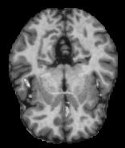
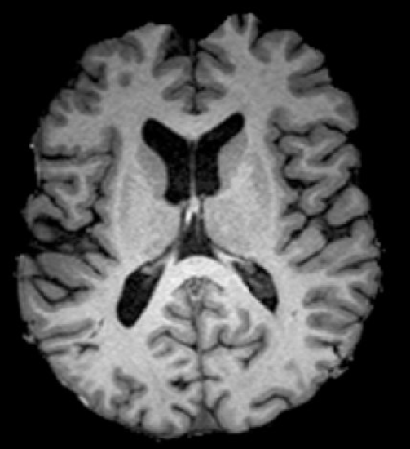
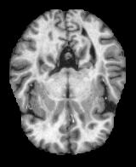
PREPARATION OF REFERENCE IMAGE
Reference image was chosen by running the Histogram Equalization on Non Demented Image from OASIS data set with a reference image from the paper given below
Despotović, I., Goossens, B., & Philips, W. (2015). MRI Segmentation of the Human Brain: Challenges, Methods, and Applications. In Computational and Mathematical Methods in Medicine (Vol. 2015, pp. 1–23). Hindawi Limited. https://doi.org/10.1155/2015/450341

Slide 69
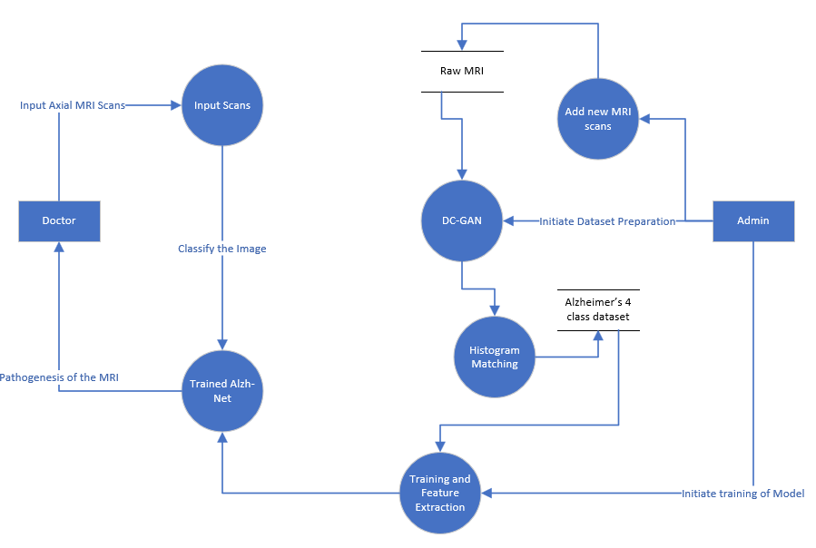
DATA FLOW DIAGRAM

Slide 70
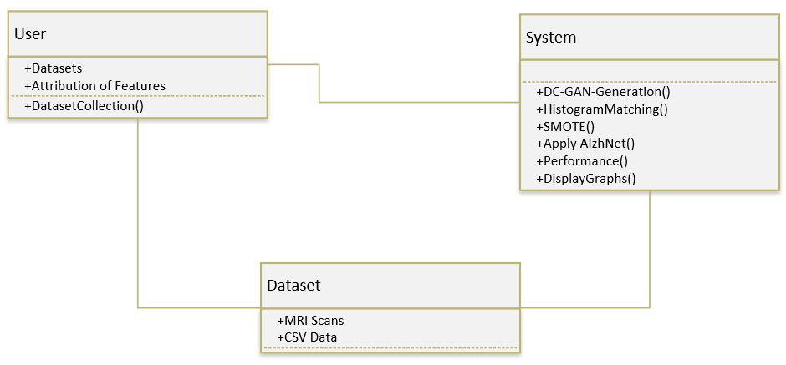
CLASS DIAGRAM

Slide 71
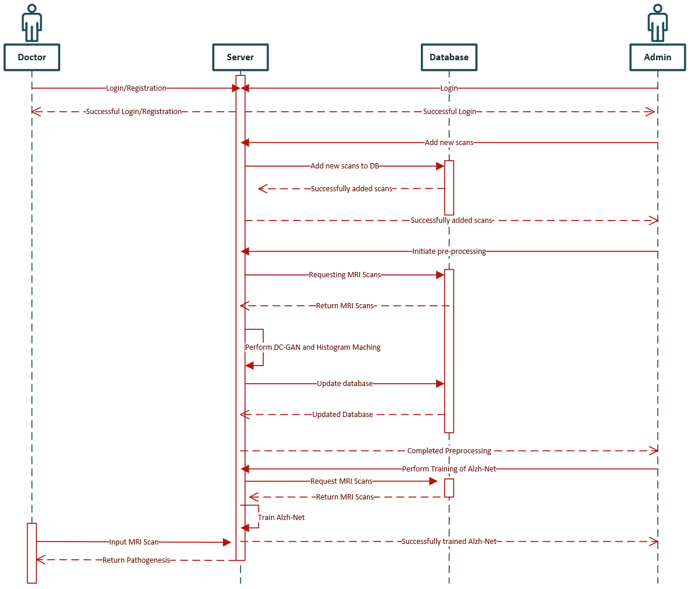
SEQUENCE DIAGRAM

Slide 72
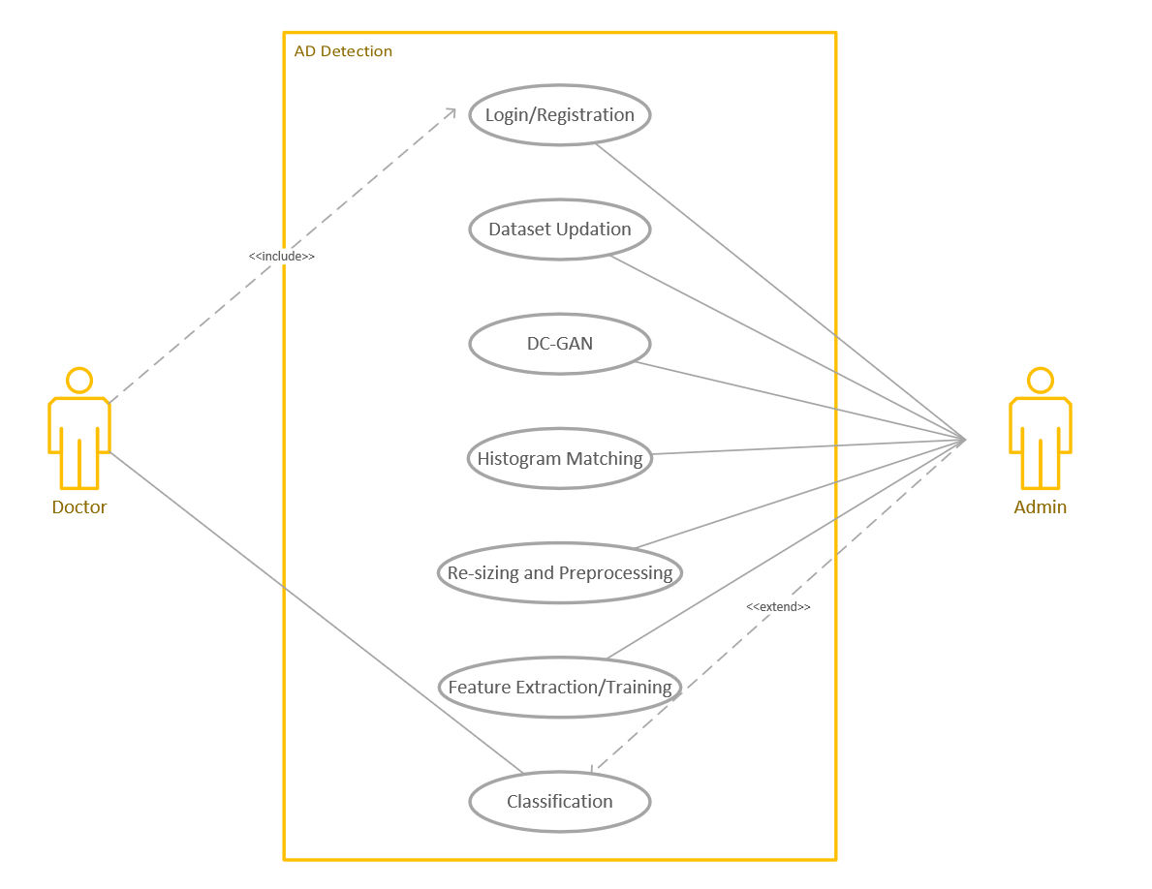
USE CASE DIAGRAM

Slide 73
Hyper Parameter Tuning
Identify the hyperparameters of your CNN model that you want to tune. These could include:
Learning rate
Dropout rate
Activation functions
Optimizer type
Batch size
Number of epochs

Slide 74
Learning rate: [0.001, 0.01, 0.1]
Dropout rate: [0.2, 0.5, 0.7]
Activation functions: ['relu', 'sigmoid','softmax']
Batch size: [32, 64]
Number of epochs: [10, 20, 30]
Use nested loops to iterate over all possible combinations of hyperparameters from the defined parameter grid.
Choose the model with the best performance on your validation set based on the chosen evaluation metric.
Once we selected the best model, evaluate its performance on a separate test set to get an unbiased estimate of its performance.
Refine your grid based on the initial results and perform another round of grid search to further optimize hyperparameters.

Slide 75
Coming up with Alzh-net
Understanding the problem we're trying to solve is crucial her it is classification task of images with four output classes.
As the input are images, a CNN architecture is a natural choice. Convolutional layers are adept at capturing spatial patterns in images.
The architecture starts with simple convolutional layers to capture basic features in the image. These layers are stacked to create deeper representations, typically followed by max-pooling layers to downsample and reduce spatial dimensions.

Slide 76
The architecture includes two separate CNN models (model1 and model2). This might have been done with the intention of creating diverse models that capture different aspects of the data or to leverage model ensembling for improved performance.
The final output layer is obtained by concatenating the outputs from the two separate models and passing them through an additional dense layer. This allows the model to combine information from both models before making a final prediction.

Slide 77
Biases in Class Balancing methods
Overrepresentation of Minority Class: Techniques like oversampling or generating synthetic samples for minority classes can lead to overrepresentation of these classes in the dataset. While this helps address class imbalance, it can bias the model towards these classes, potentially leading to poorer performance on majority classes.
Loss of Information: Undersampling or removing samples from majority classes can result in the loss of valuable information, making the model less capable of generalizing to these classes.
Model Training Bias: Some class balancing techniques modify the loss function during training to give more weight to minority classes. While this helps in improving the model's sensitivity to minority classes, it can also introduce biases in the learning process, potentially affecting the model's overall performance.
Data Distribution Shift: Balancing techniques may alter the distribution of data, leading to a shift in the data manifold. This shift can affect the model's ability to generalize to unseen data and may introduce biases in predictions.
Assumption of Equal Importance: Balancing techniques often assume that all classes are equally important, which may not be the case in real-world scenarios. Biases can arise if certain classes are inherently more critical or have different costs associated with misclassification.
Influence of Noise: Synthetic sample generation techniques may introduce noise into the dataset, especially if the generation process does not accurately capture the underlying data distribution. This noise can bias the model's decision boundaries and degrade performance.
Evaluation Bias: Class balancing techniques can also bias model evaluation metrics. For example, accuracy may not be an appropriate metric for evaluating a balanced dataset if the class distribution in the test set differs from that in the training set.

Slide 78
Omission of ROC Scores.
While ROC (Receiver Operating Characteristic) curves are widely utilized for evaluating the performance of binary classification algorithms, their application to multiclass classification poses certain challenges and limitations. The primary reason why ROC curves are not commonly used in multiclass classification is rooted in their inherent design and interpretation.
Binary Nature: ROC curves are inherently binary in nature, plotting the true positive rate (sensitivity) against the false positive rate (1-specificity) for different decision thresholds. In binary classification, there are only two possible outcomes (positive and negative), making it straightforward to define true positives, true negatives, false positives, and false negatives. However, in multiclass classification, where there are multiple classes, the interpretation of true positives, false positives, etc., becomes less clear-cut.
Class Imbalance: Multiclass classification problems often exhibit class imbalance, where some classes may have significantly fewer instances than others. ROC curves can be biased towards the majority classes, especially in cases where the positive class is imbalanced. This can lead to misleading interpretations of the classifier's performance, particularly for minority classes.
While ROC curves are a valuable tool in binary classification, their application to multiclass classification is less straightforward due to the complexity of interpreting results and the availability of alternative evaluation metrics better suited to the task.

