Slide 1
Two Dashboards

Slide 2
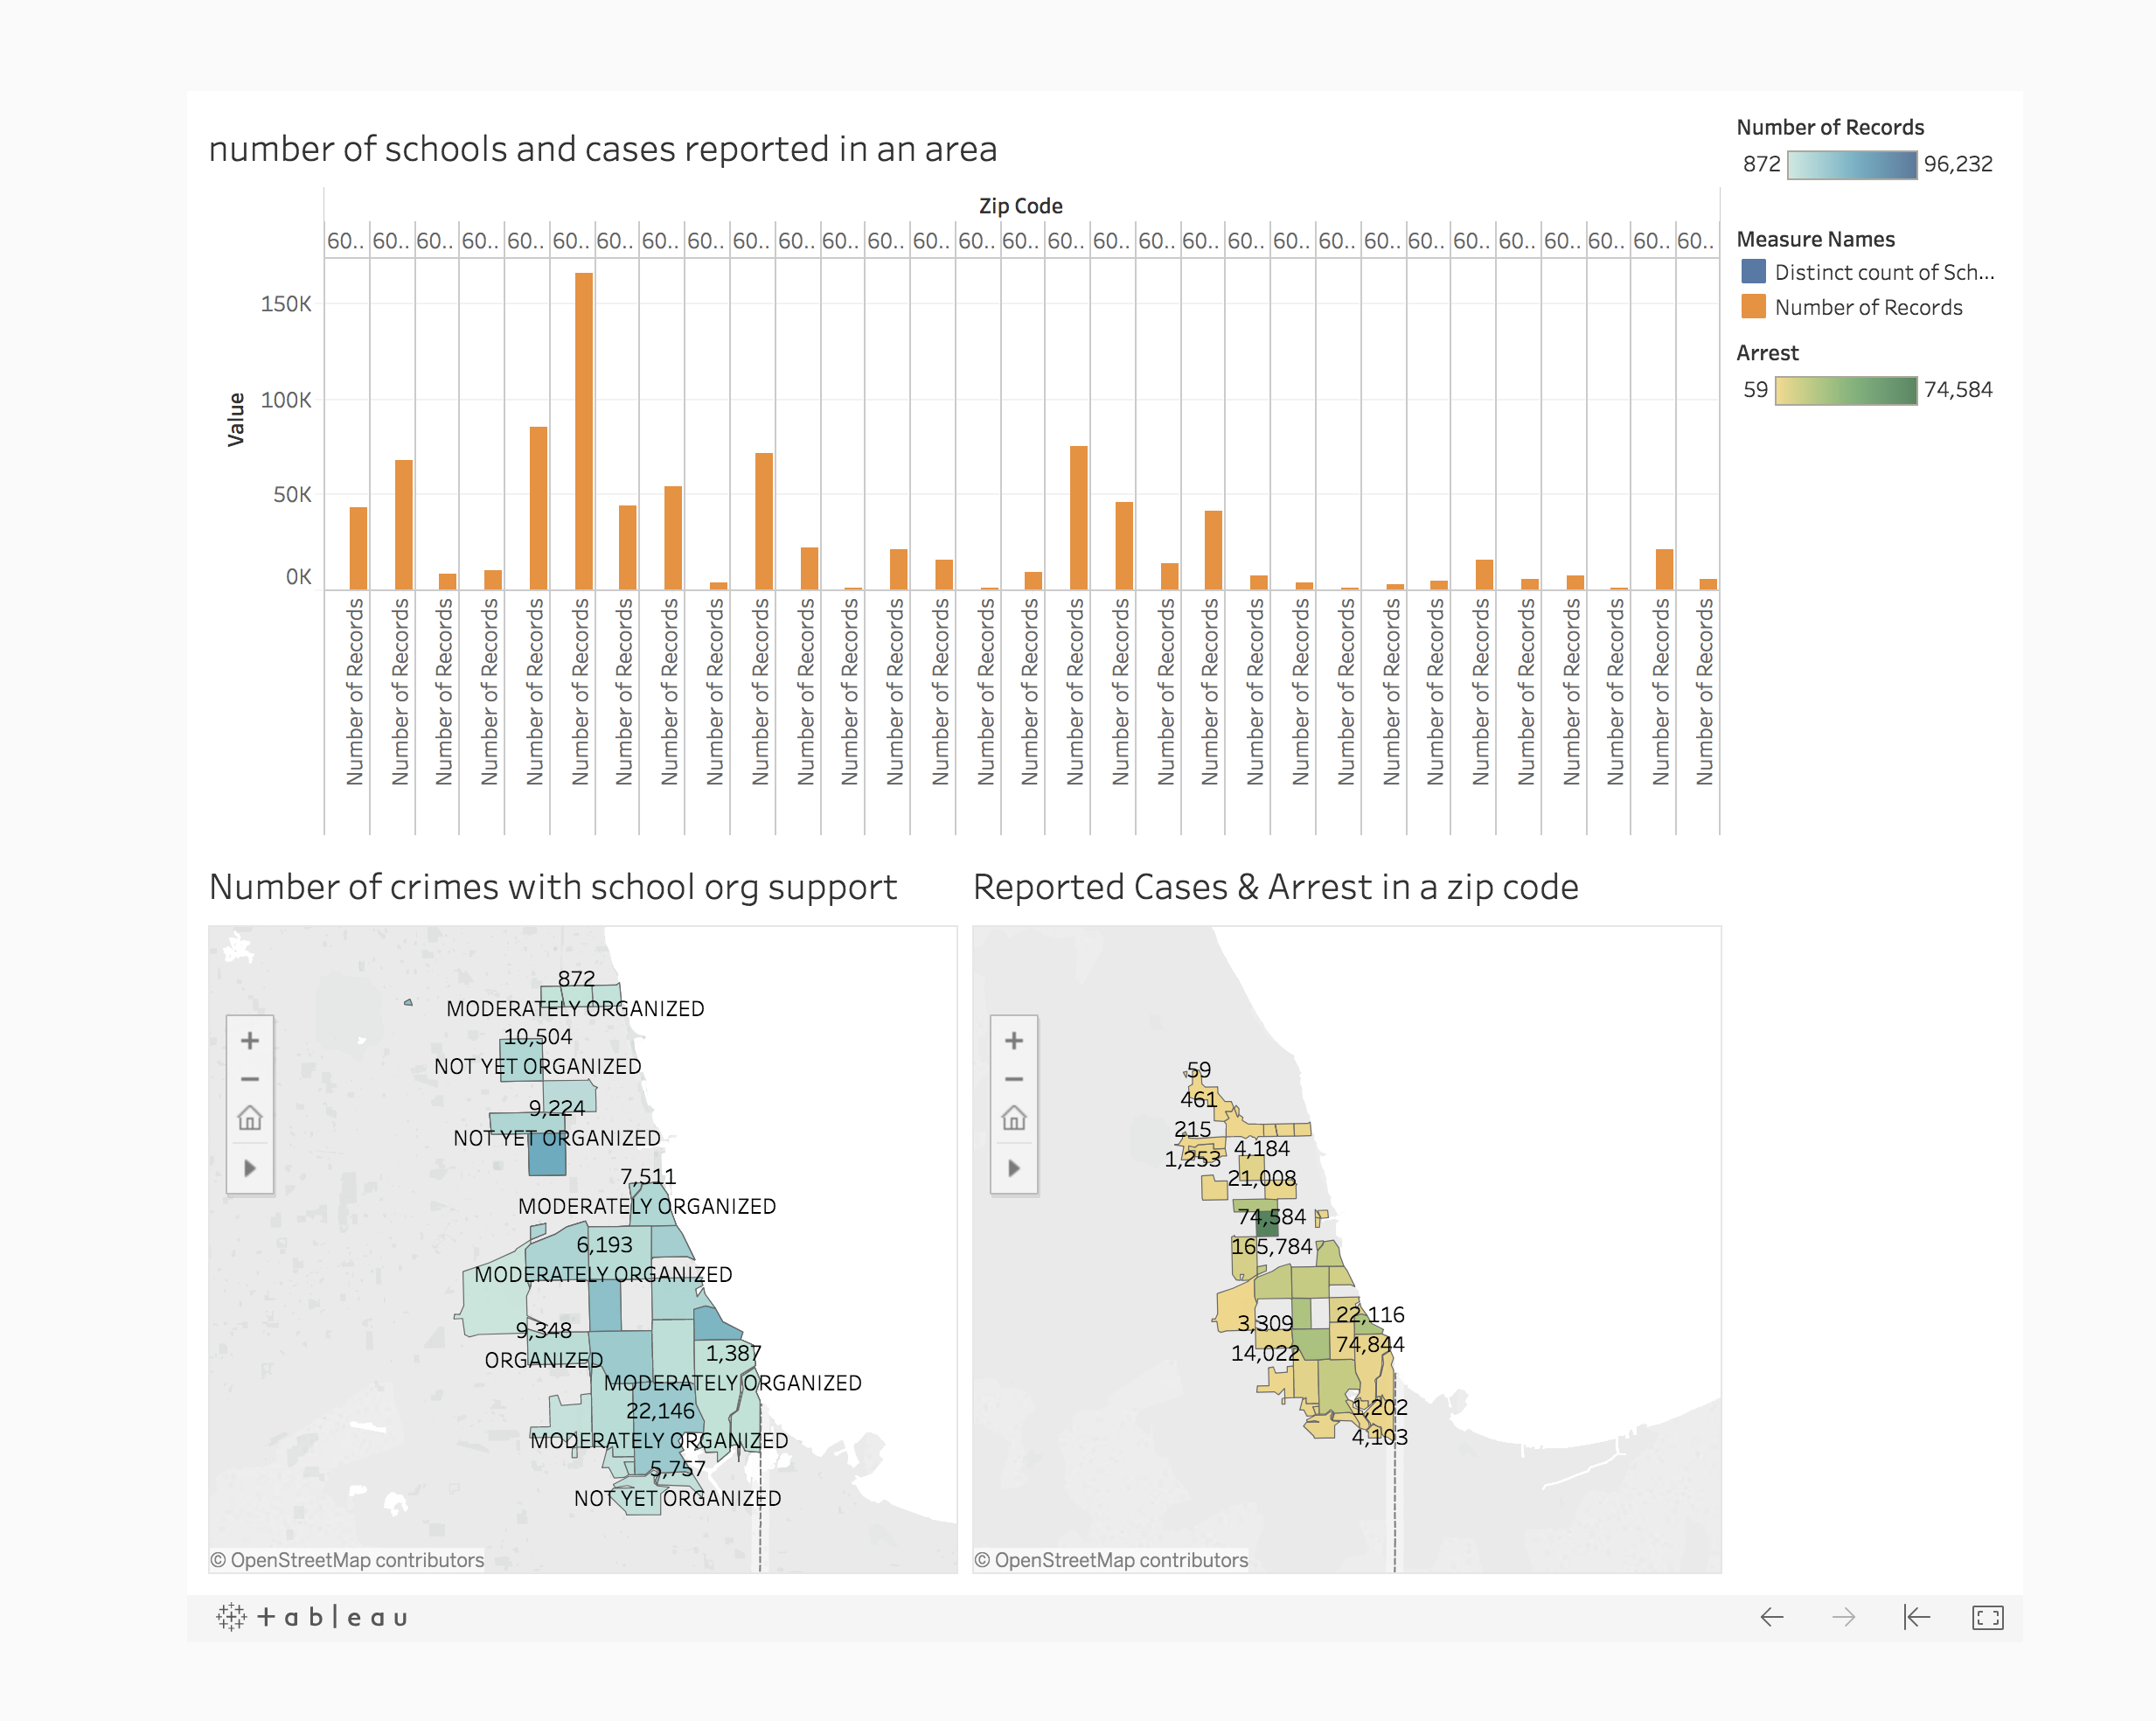
Tableau public link

Slide 3
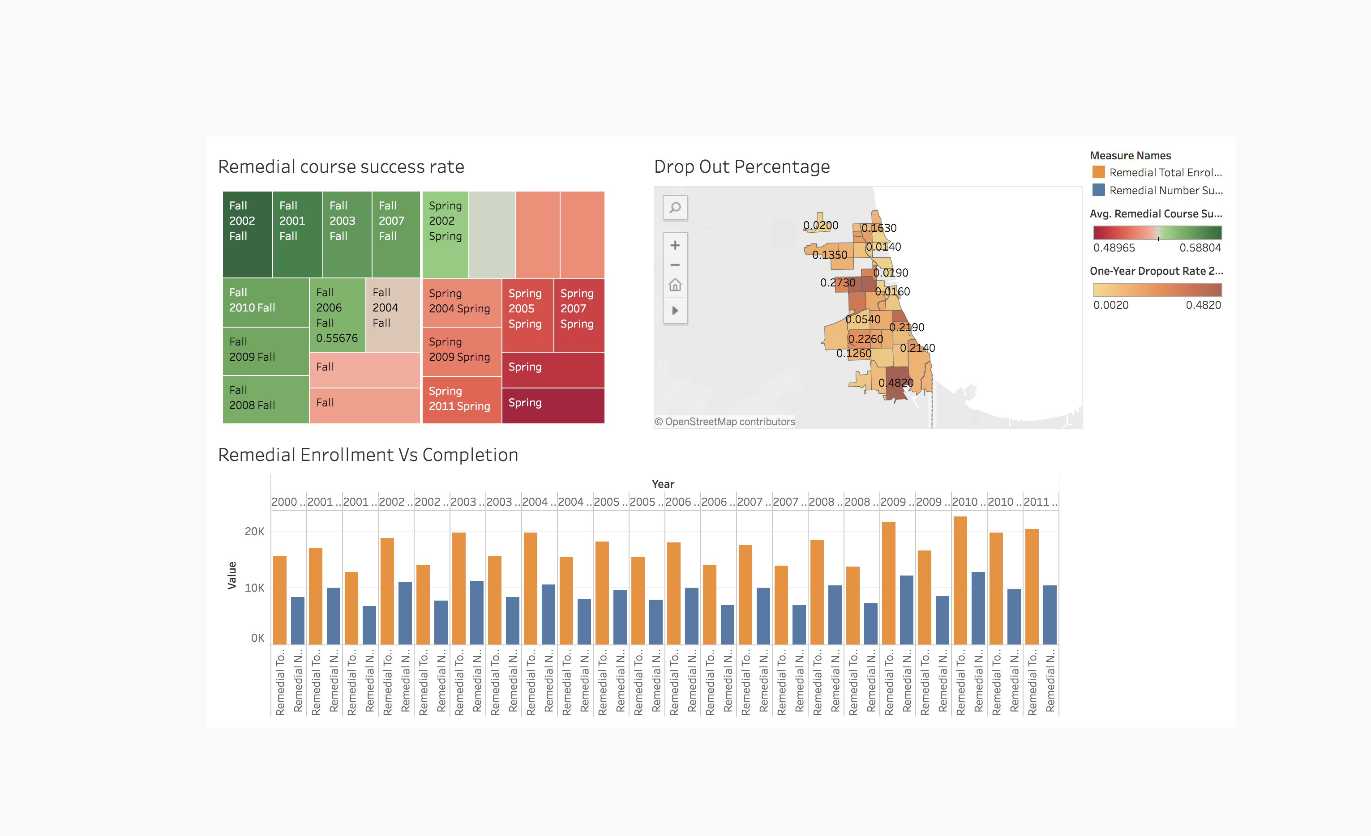
Tableau public link

Slide 4
Thanks!

