Slide 1
WEEK-1 LAB
AP20110010736
Manas Prabhas Gobburi
GITHUB-LINK

Slide 2
Question:
Develop a basic HTML page for your targeted application (say healthcare, e-commerce, ticket booking/any other - don't focus much on graphics, take a few text and number inputs), save the data in XML format and then write a Java code for parsing the XML file to display the entered data in HTML table.
Target application: - health care application

Slide 3
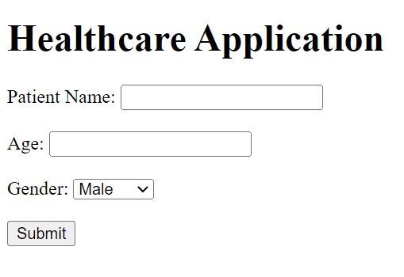
Step-1
Make an HTML page with a specific application in mind.
My "Healthcare Application" page is here.

Slide 4
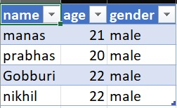
Step-2
To store all the entered data in an xml file, a server was now constructed.
All of the data is recorded in the xml file whenever the customer enters it on the "Healthcare application" page.

Slide 5
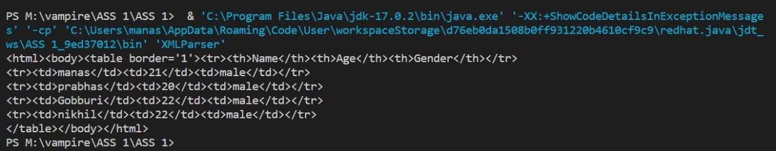
Step-3
Develop a Java program that can effectively extract data from an XML file, proceeding to compile this data into an HTML format, resulting in the creation of a web page.

Slide 6
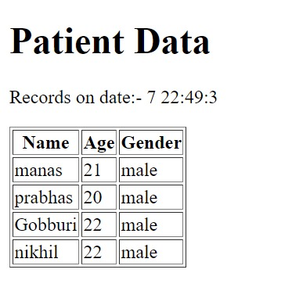
Step-4
Ultimately, the entire content within the XML file is showcased within an HTML page.

Slide 7
THANK YOU

