Slide 1
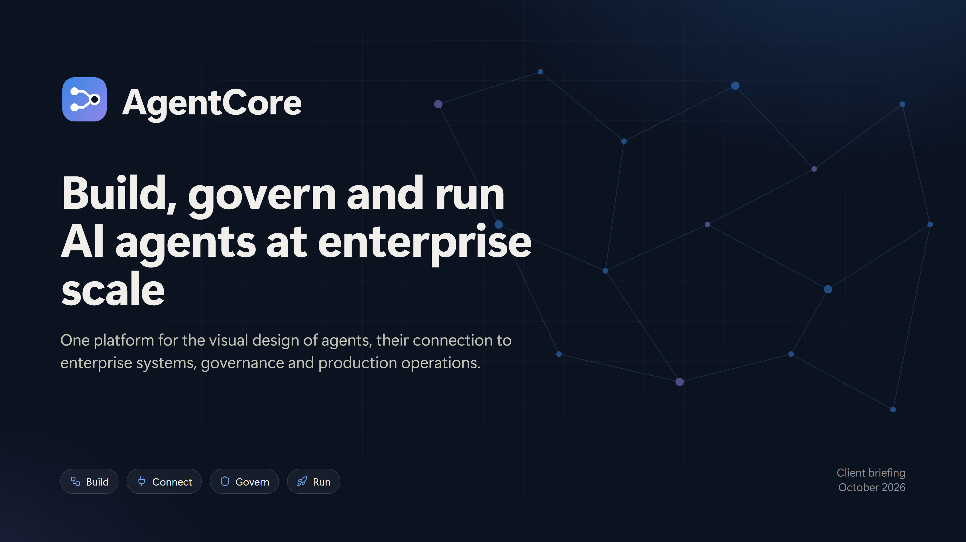
Notes:
AgentCore: build, govern and run AI agents at enterprise scale. One platform for the visual design of agents, connection to enterprise systems, governance and production operations. Four pillars: Build, Connect, Govern, Run.

Slide 2
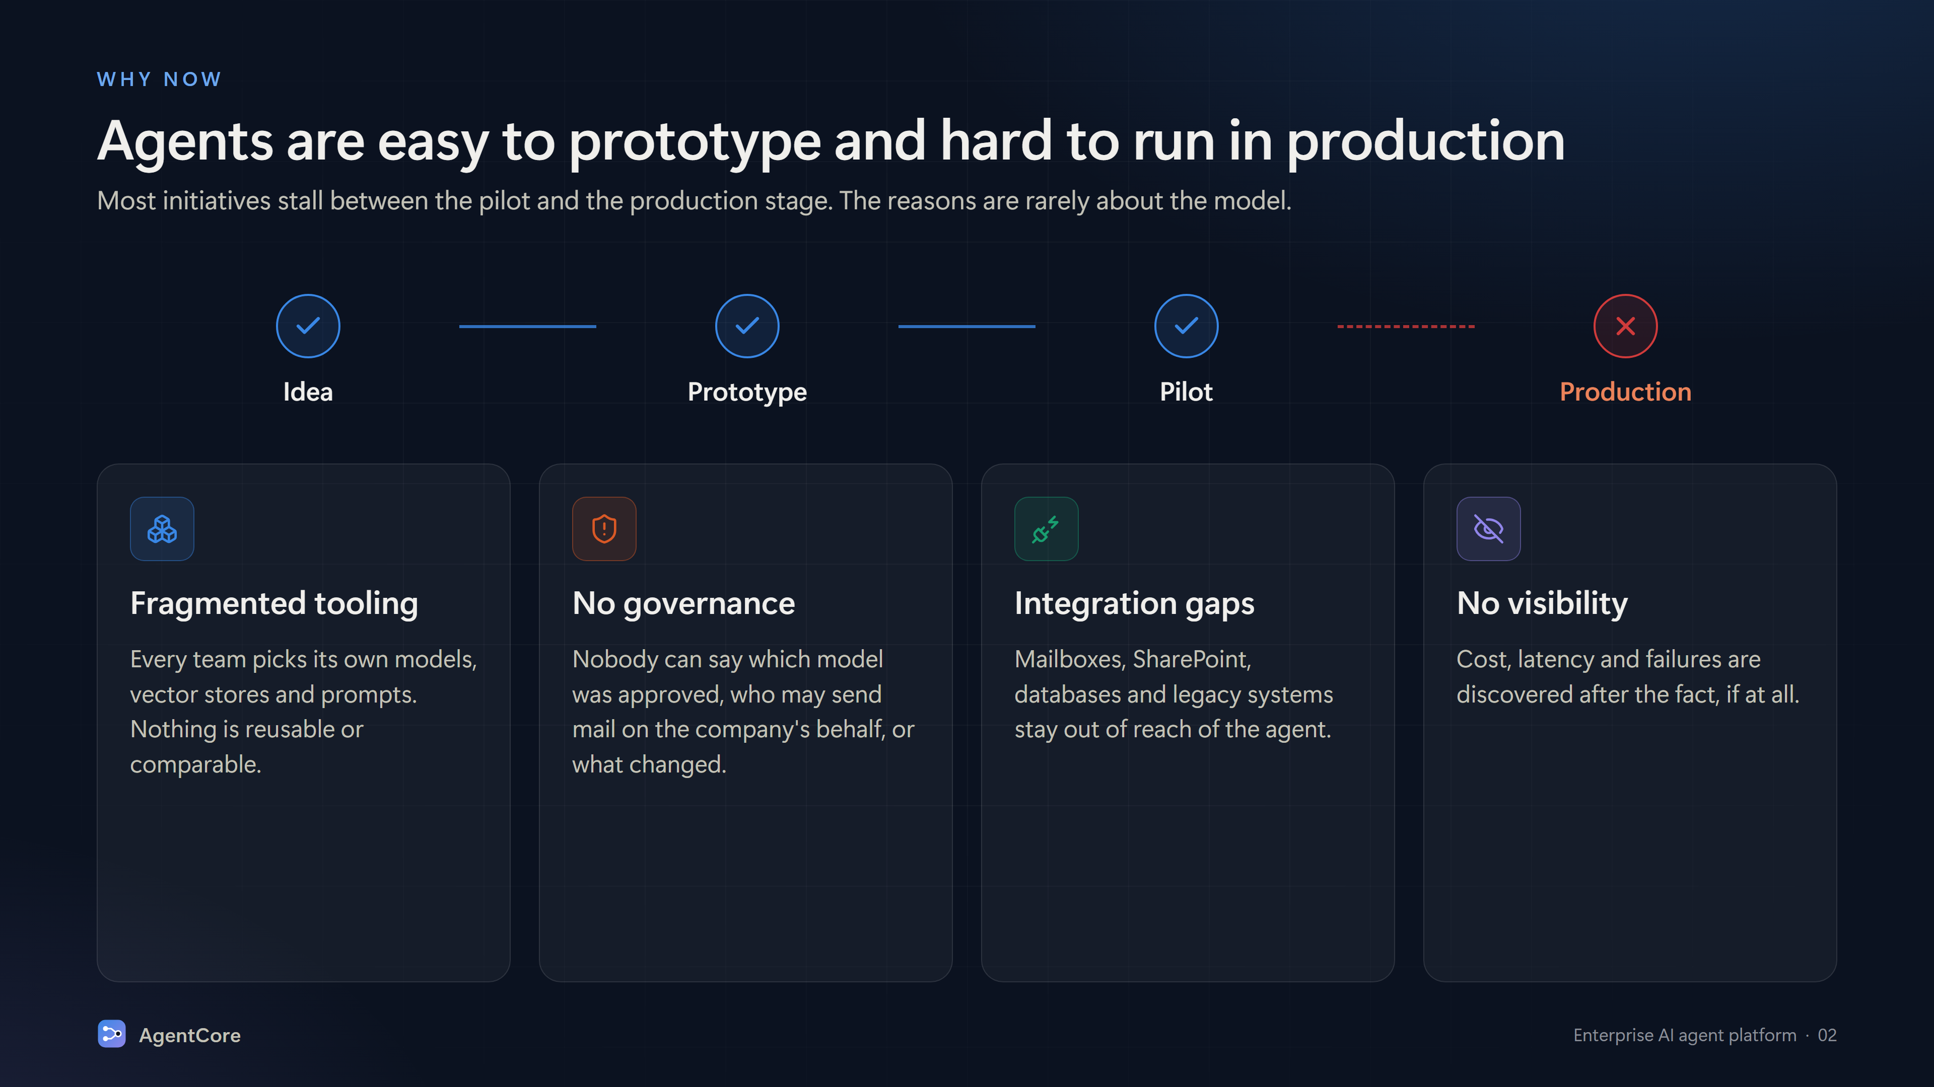
Notes:
Agents are easy to prototype and hard to run in production. Four blockers: fragmented tooling, no governance, integration gaps, no visibility.

Slide 3
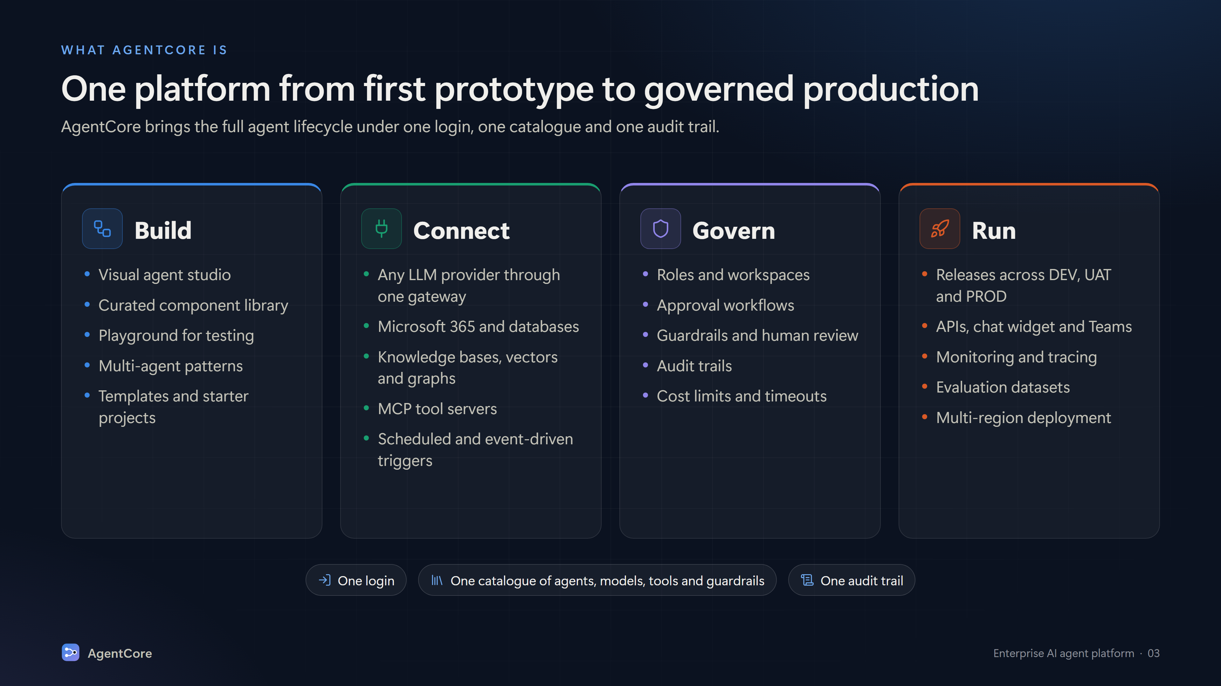
Notes:
One platform from first prototype to governed production. Build: visual studio, component library, playground, multi-agent. Connect: LLM gateway, Microsoft 365, databases, knowledge, MCP. Govern: roles, approvals, guardrails, audit. Run: releases, APIs, widget, Teams, schedules, monitoring.

Slide 4
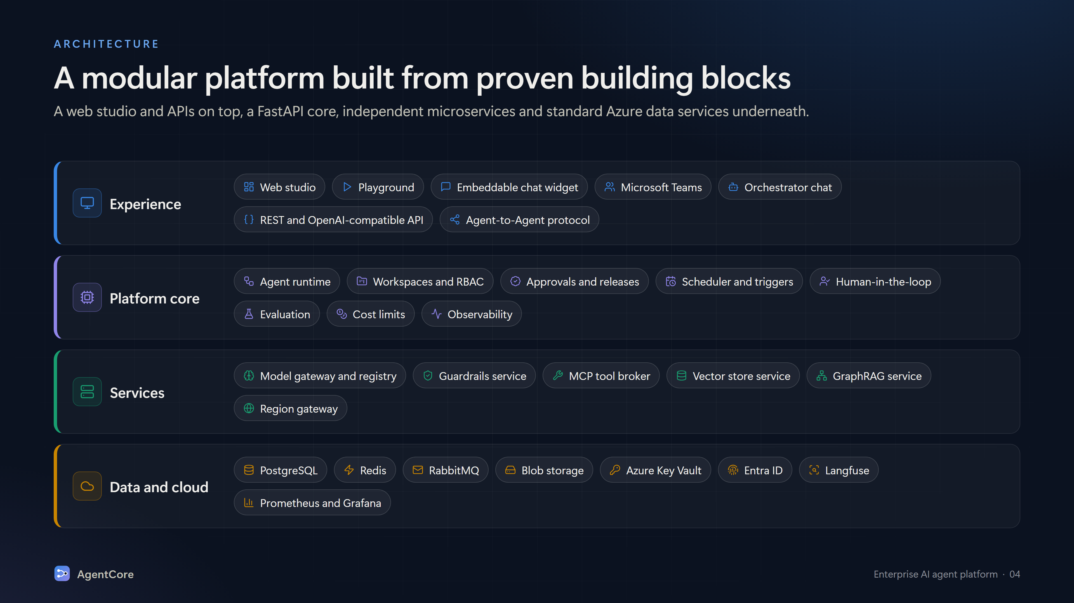
Notes:
Architecture layers. Experience: web studio, playground, embeddable chat widget, Teams, orchestrator chat, REST/OpenAI-compatible API, A2A. Platform core: agent runtime, workspaces and RBAC, approvals and releases, scheduler and triggers, HITL, evaluation, cost limits, observability. Services: model gateway, guardrails, MCP tool broker, vector store (Pinecone), GraphRAG (Neo4j), region gateway. Data and cloud: PostgreSQL, Redis, RabbitMQ, Blob storage, Key Vault, Entra ID, Langfuse, Prometheus/Grafana.

Slide 5
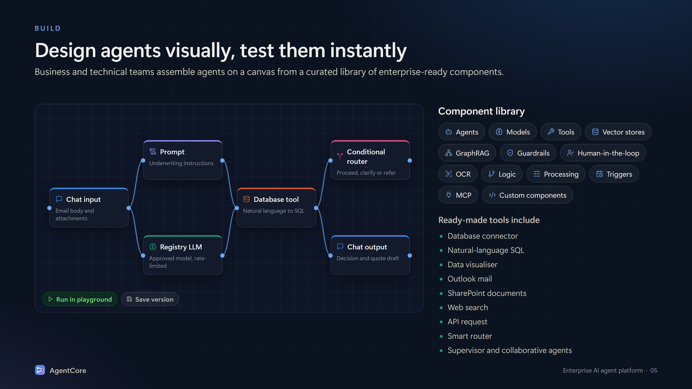
Notes:
Build: a visual canvas for designing agents. Component categories: agents, models, tools, vector stores, GraphRAG, guardrails, human-in-the-loop, OCR, logic, processing, triggers, MCP, custom components. Ready tools: database connector, NL-SQL, data visualiser, Outlook, SharePoint, web search, API request, smart router, supervisor and collaborative agents. Playground to run and save versions.

Slide 6
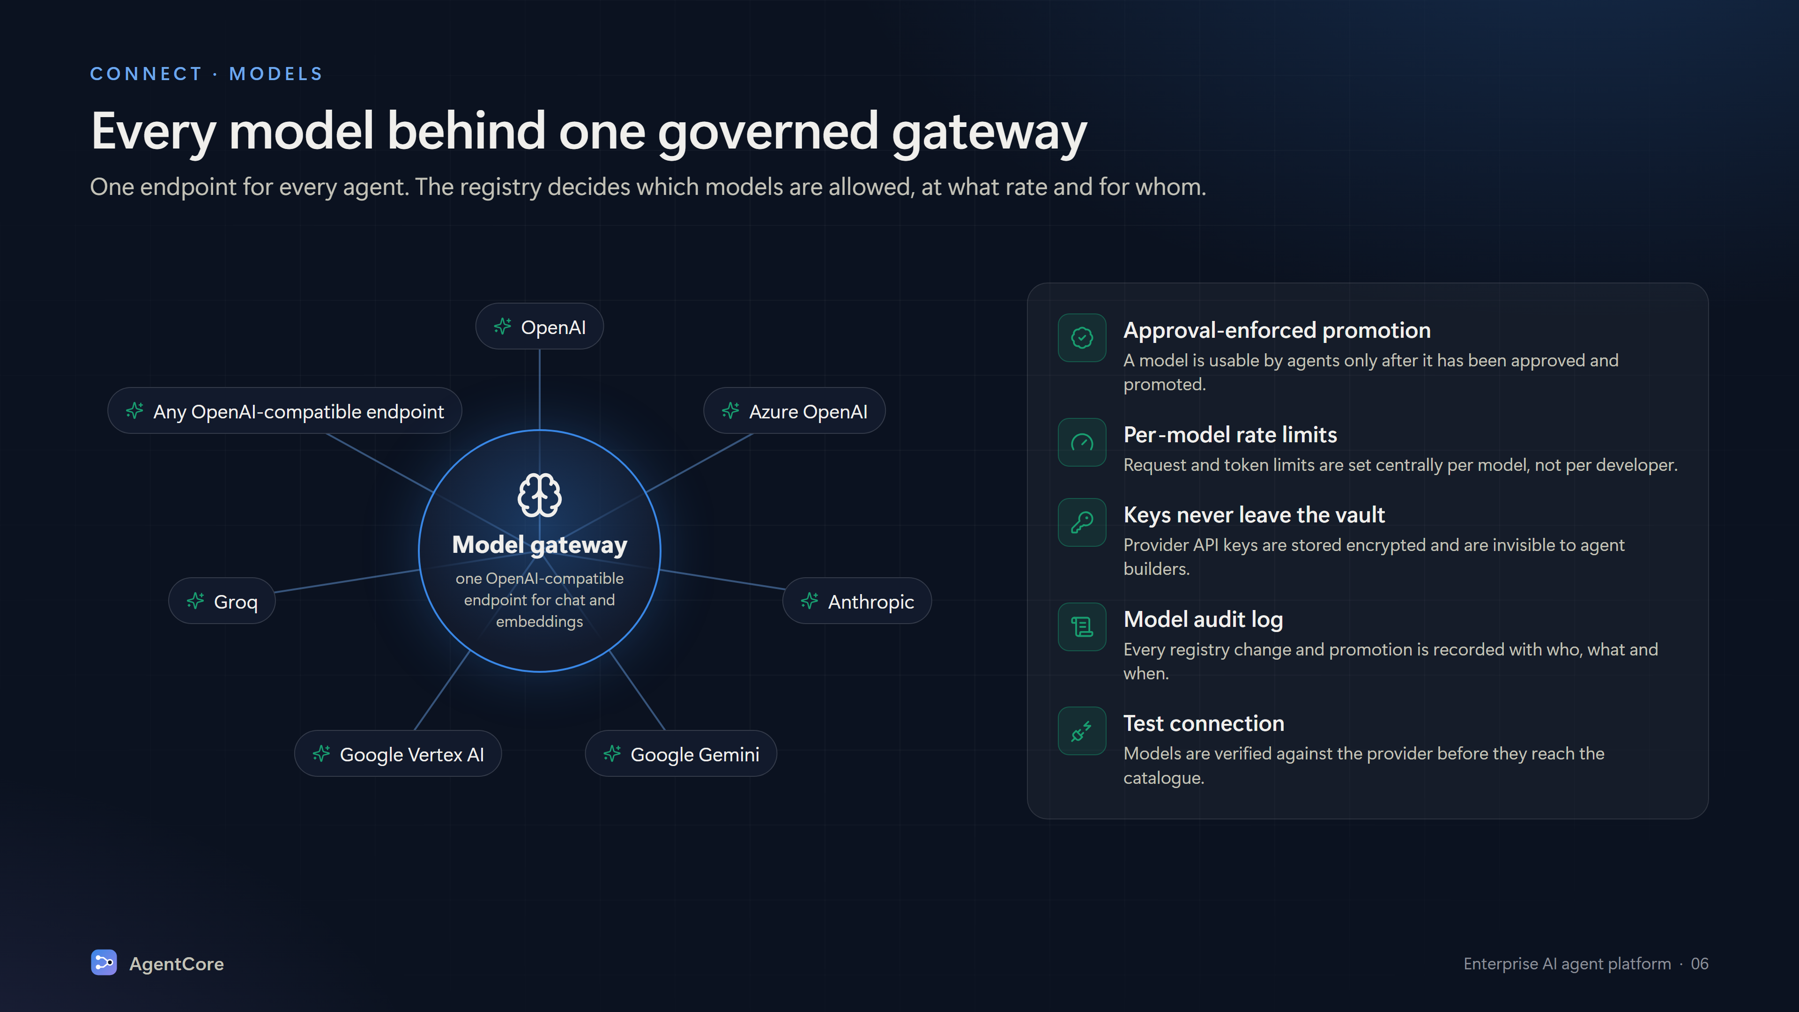
Notes:
Models: one OpenAI-compatible gateway for chat and embeddings across OpenAI, Azure OpenAI, Anthropic, Google Gemini, Google Vertex AI, Groq and any OpenAI-compatible endpoint. Registry: approval-enforced promotion, per-model rate limits, keys stored encrypted, model audit log, test connection.

Slide 7
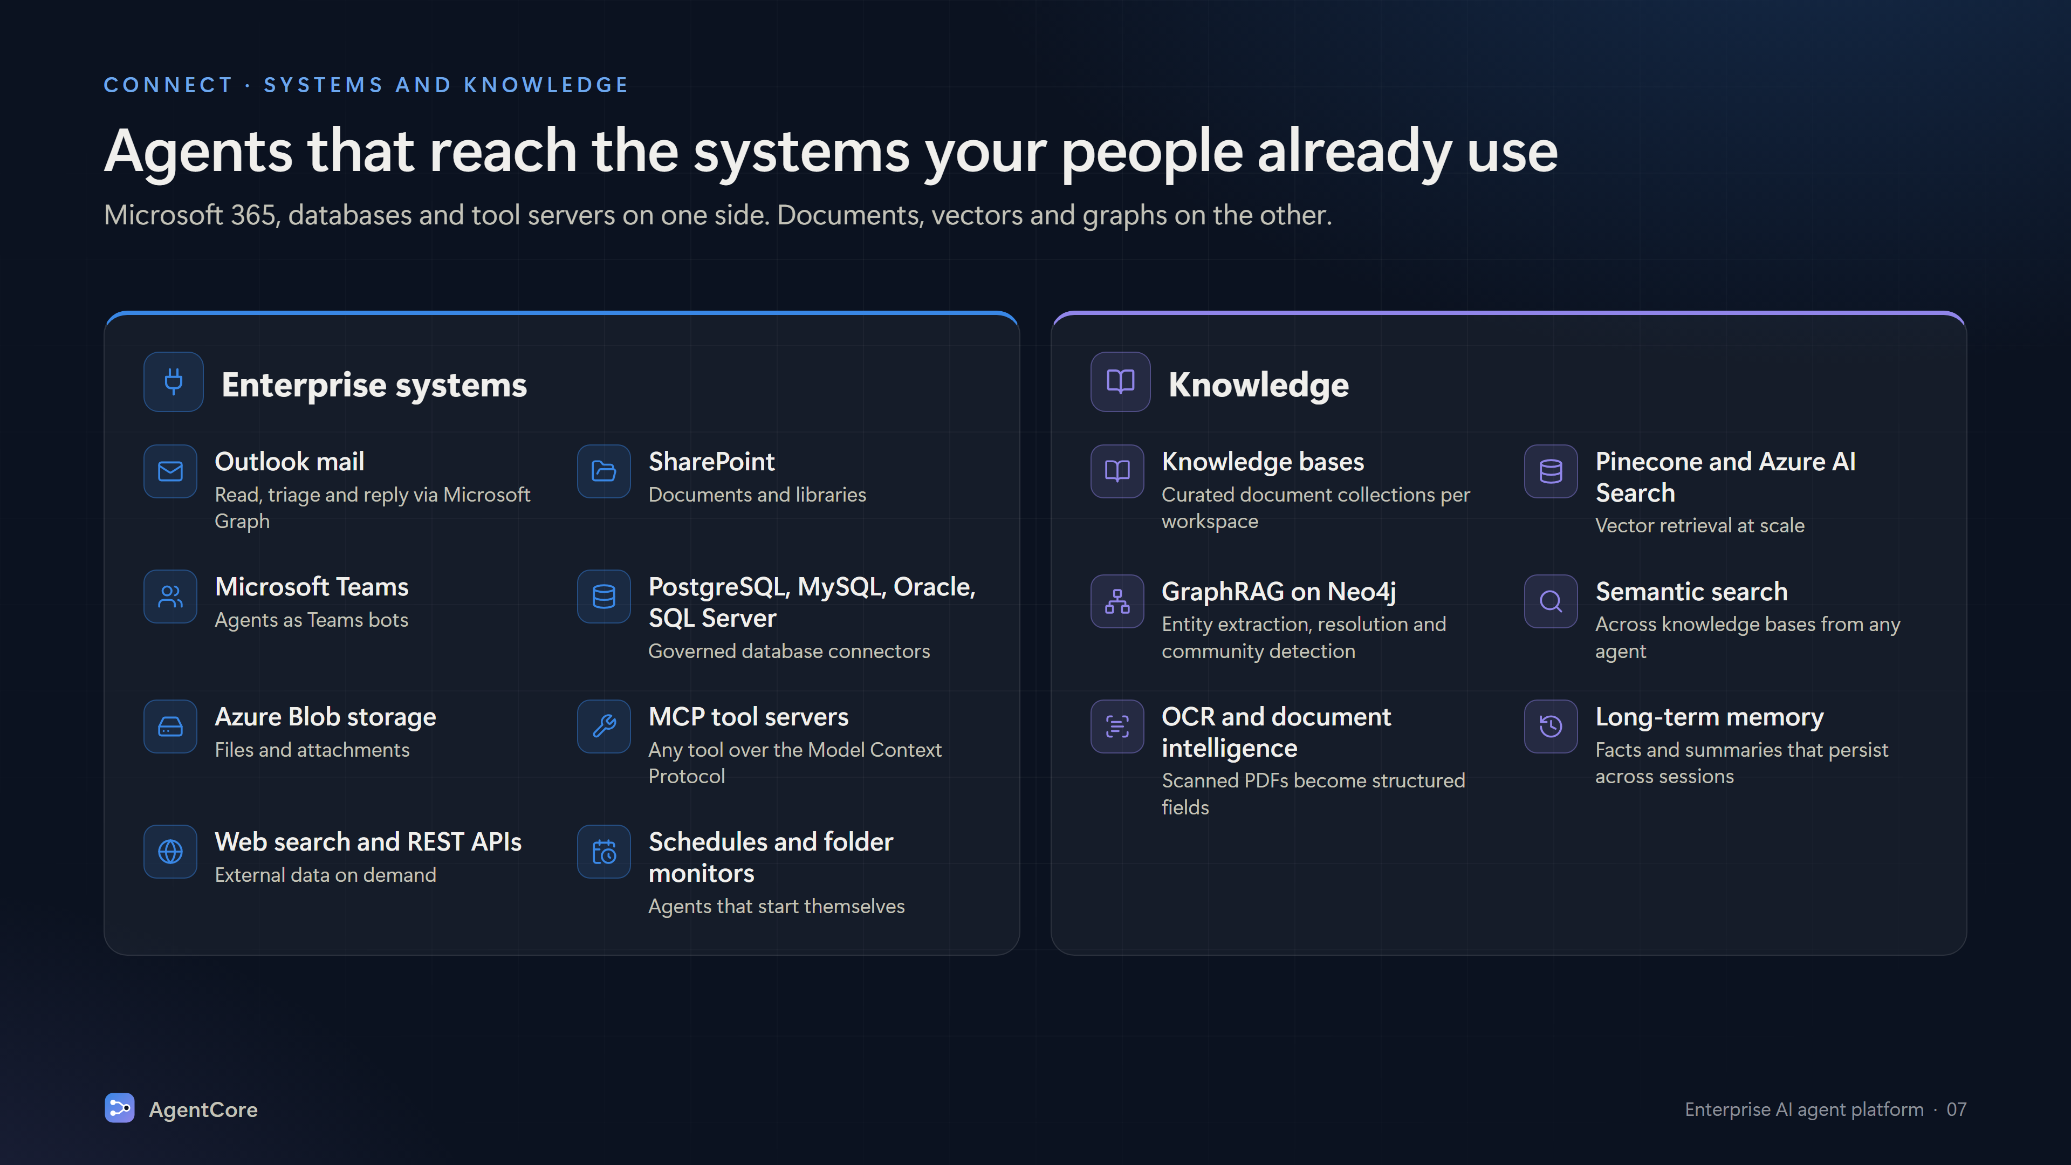
Notes:
Connect: Outlook mail, SharePoint, Teams, PostgreSQL/MySQL/Oracle/SQL Server, Azure Blob, MCP tool servers, web search and REST APIs, schedules and folder monitors. Knowledge: knowledge bases, Pinecone and Azure AI Search, GraphRAG on Neo4j, semantic search, OCR and document intelligence, long-term memory.

Slide 8
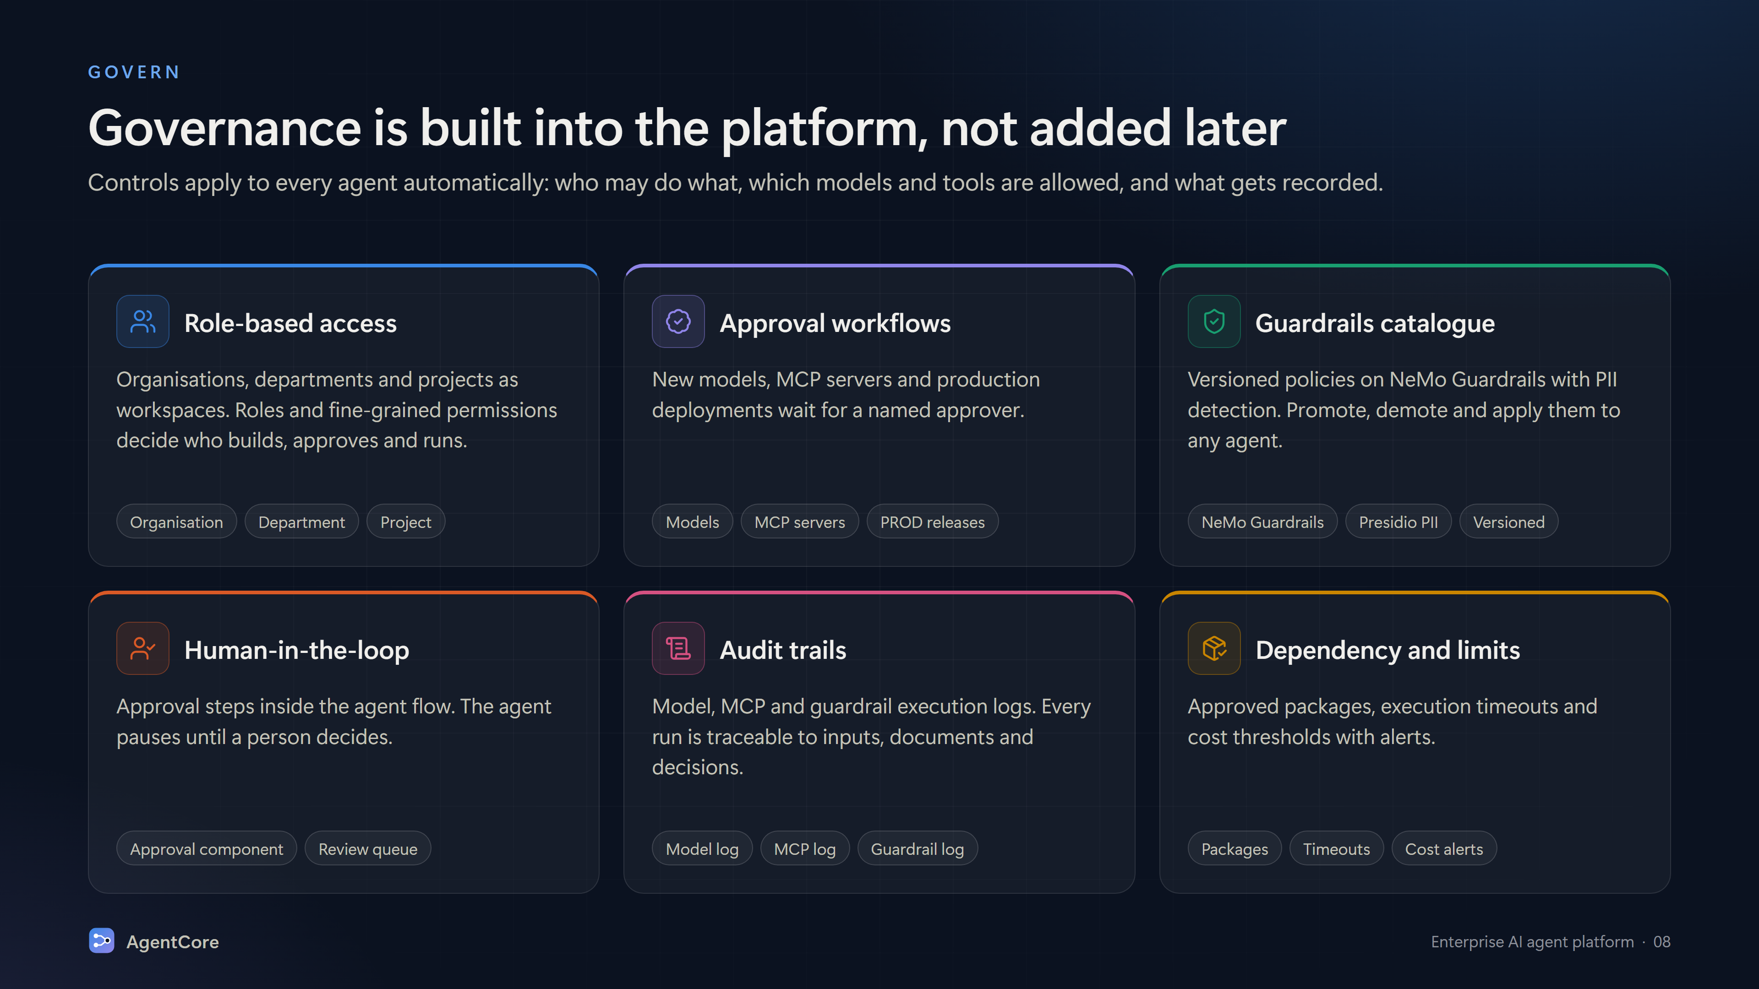
Notes:
Govern: role-based access with organisation/department/project workspaces; approval workflows for models, MCP servers and PROD deployments; guardrails catalogue on NeMo Guardrails with Presidio PII; human-in-the-loop; audit trails; dependency governance, timeouts and cost limits.

Slide 9
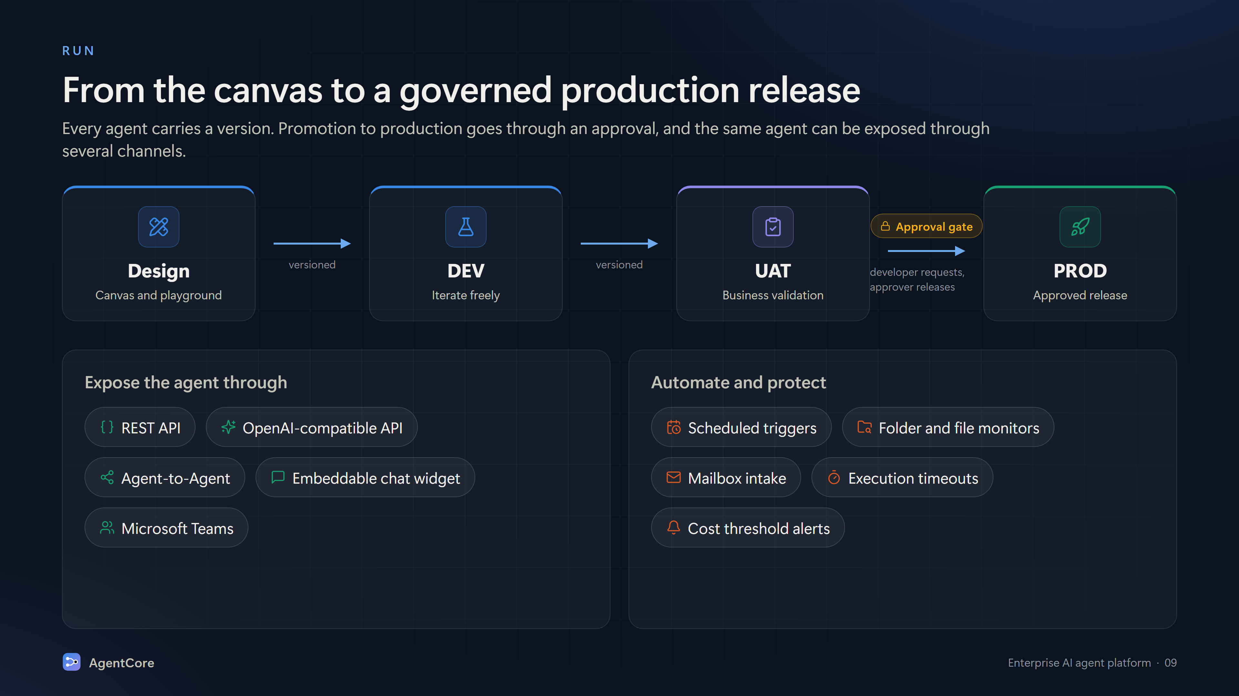
Notes:
Run: Design → DEV → UAT → PROD with versioning and an approval gate before production. Expose via REST API, OpenAI-compatible API, Agent-to-Agent, embeddable chat widget, Microsoft Teams. Automate with scheduled triggers, folder monitors, mailbox intake; protect with timeouts and cost alerts.

Slide 10
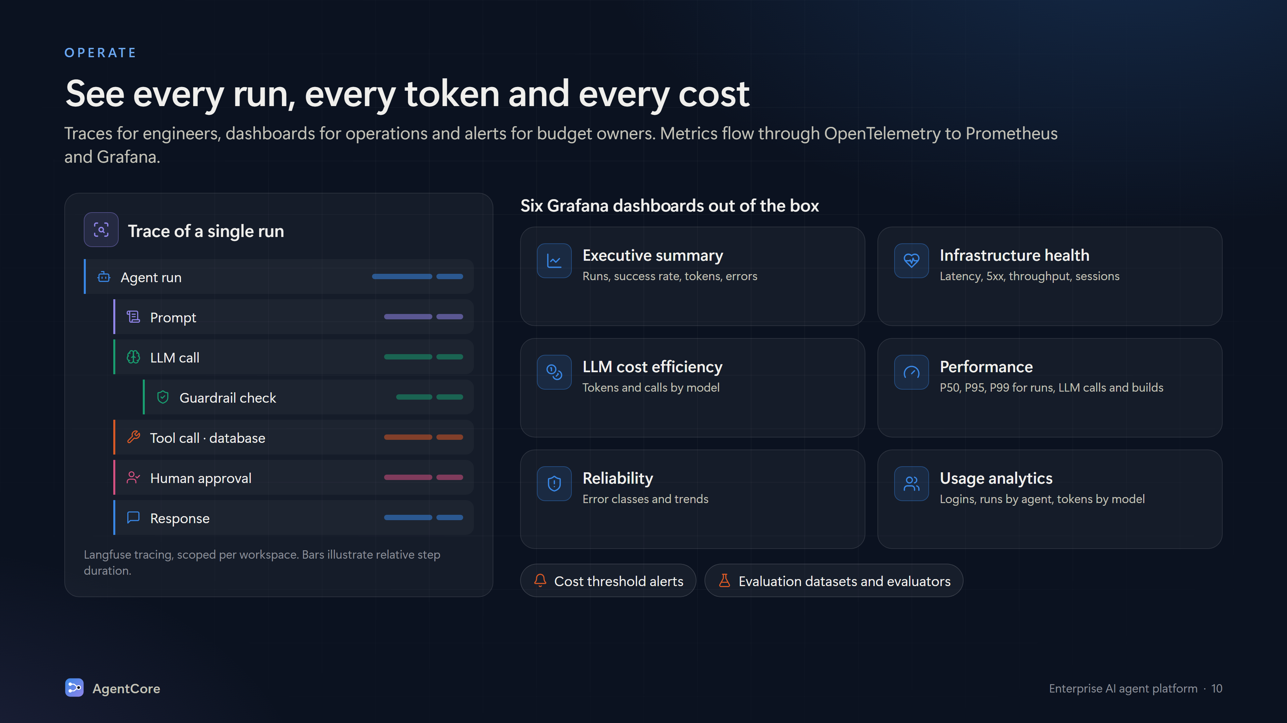
Notes:
Operate: Langfuse traces per run scoped per workspace; OpenTelemetry metrics to Prometheus and Grafana with six dashboards: executive summary, infrastructure health, LLM cost efficiency, performance (P50/P95/P99), reliability, usage analytics. Cost threshold alerts and evaluation datasets/evaluators.

Slide 11
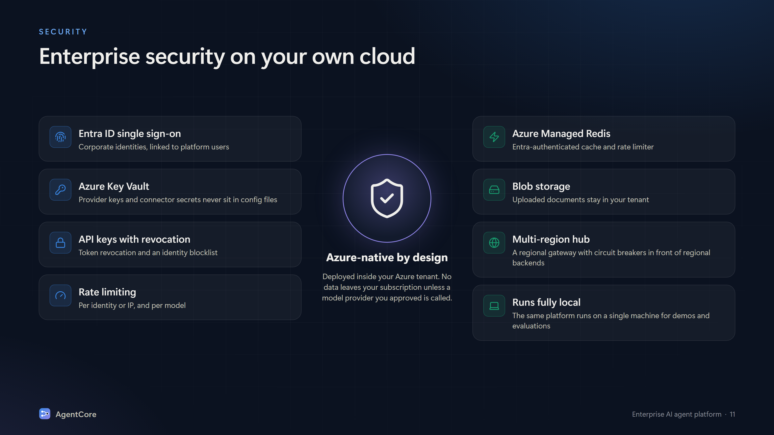
Notes:
Security: Entra ID SSO, Azure Key Vault for secrets, API keys with revocation and identity blocklist, rate limiting per identity/IP and per model, Azure Managed Redis with Entra auth, Blob storage in your tenant, multi-region hub with circuit breakers, and the ability to run fully local for demos.

Slide 12
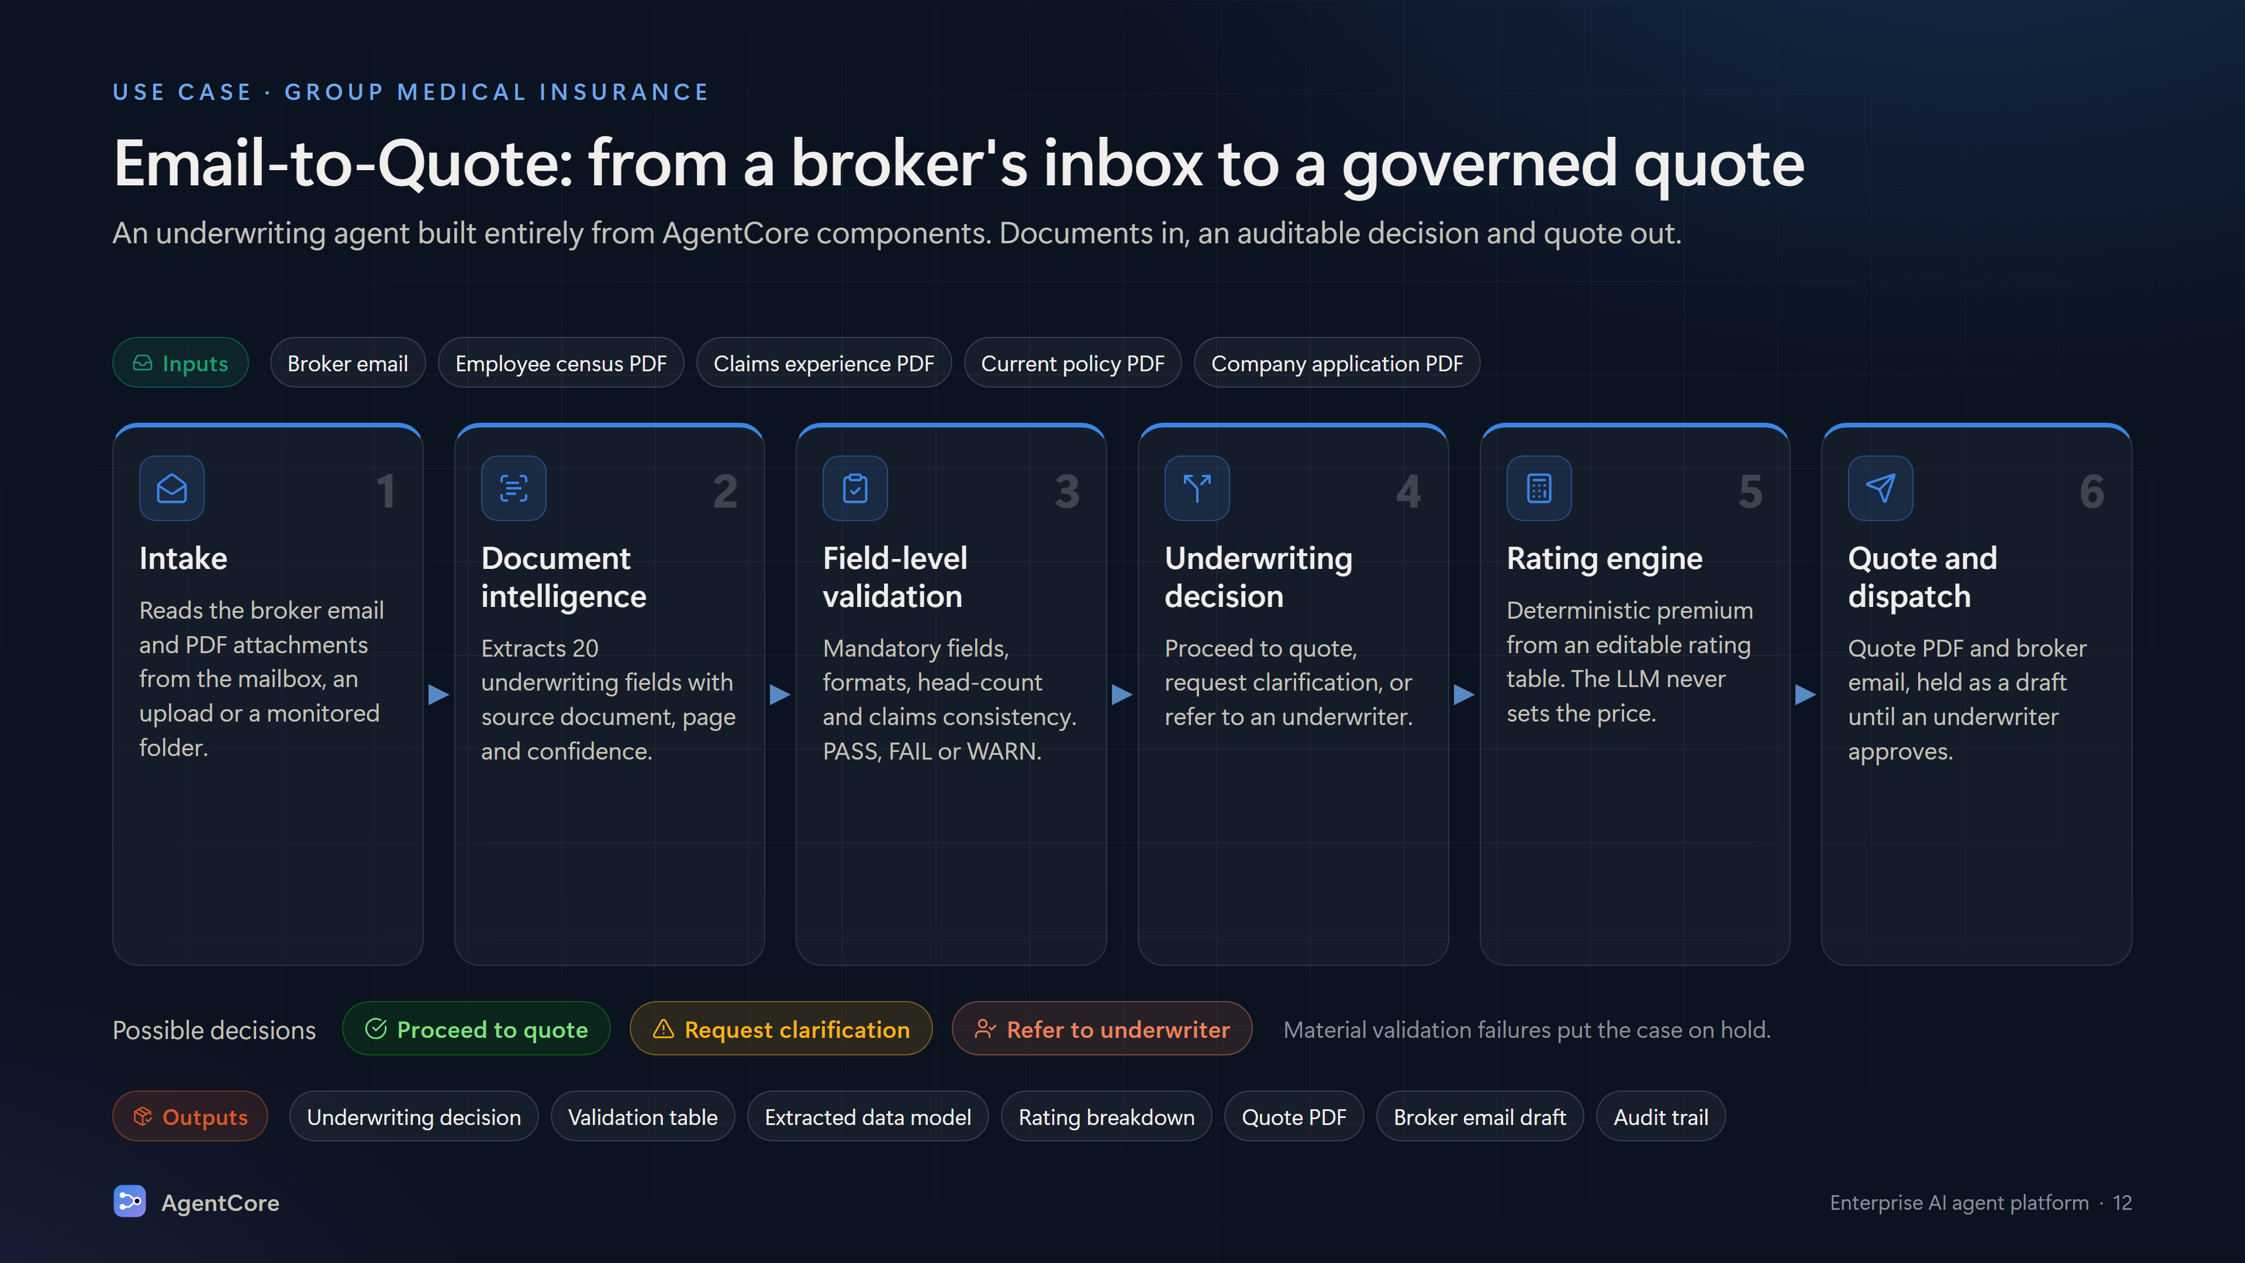
Notes:
Use case: Email-to-Quote underwriting for group medical insurance. Inputs: broker email plus census, claims, policy and application PDFs. Steps: intake, document intelligence (20 fields with page and confidence), field-level validation (PASS/FAIL/WARN), underwriting decision (proceed/clarify/refer), deterministic rating engine, quote PDF and email draft. Outputs: decision, validation table, data model, rating breakdown, quote PDF, email draft, audit trail.

Slide 13
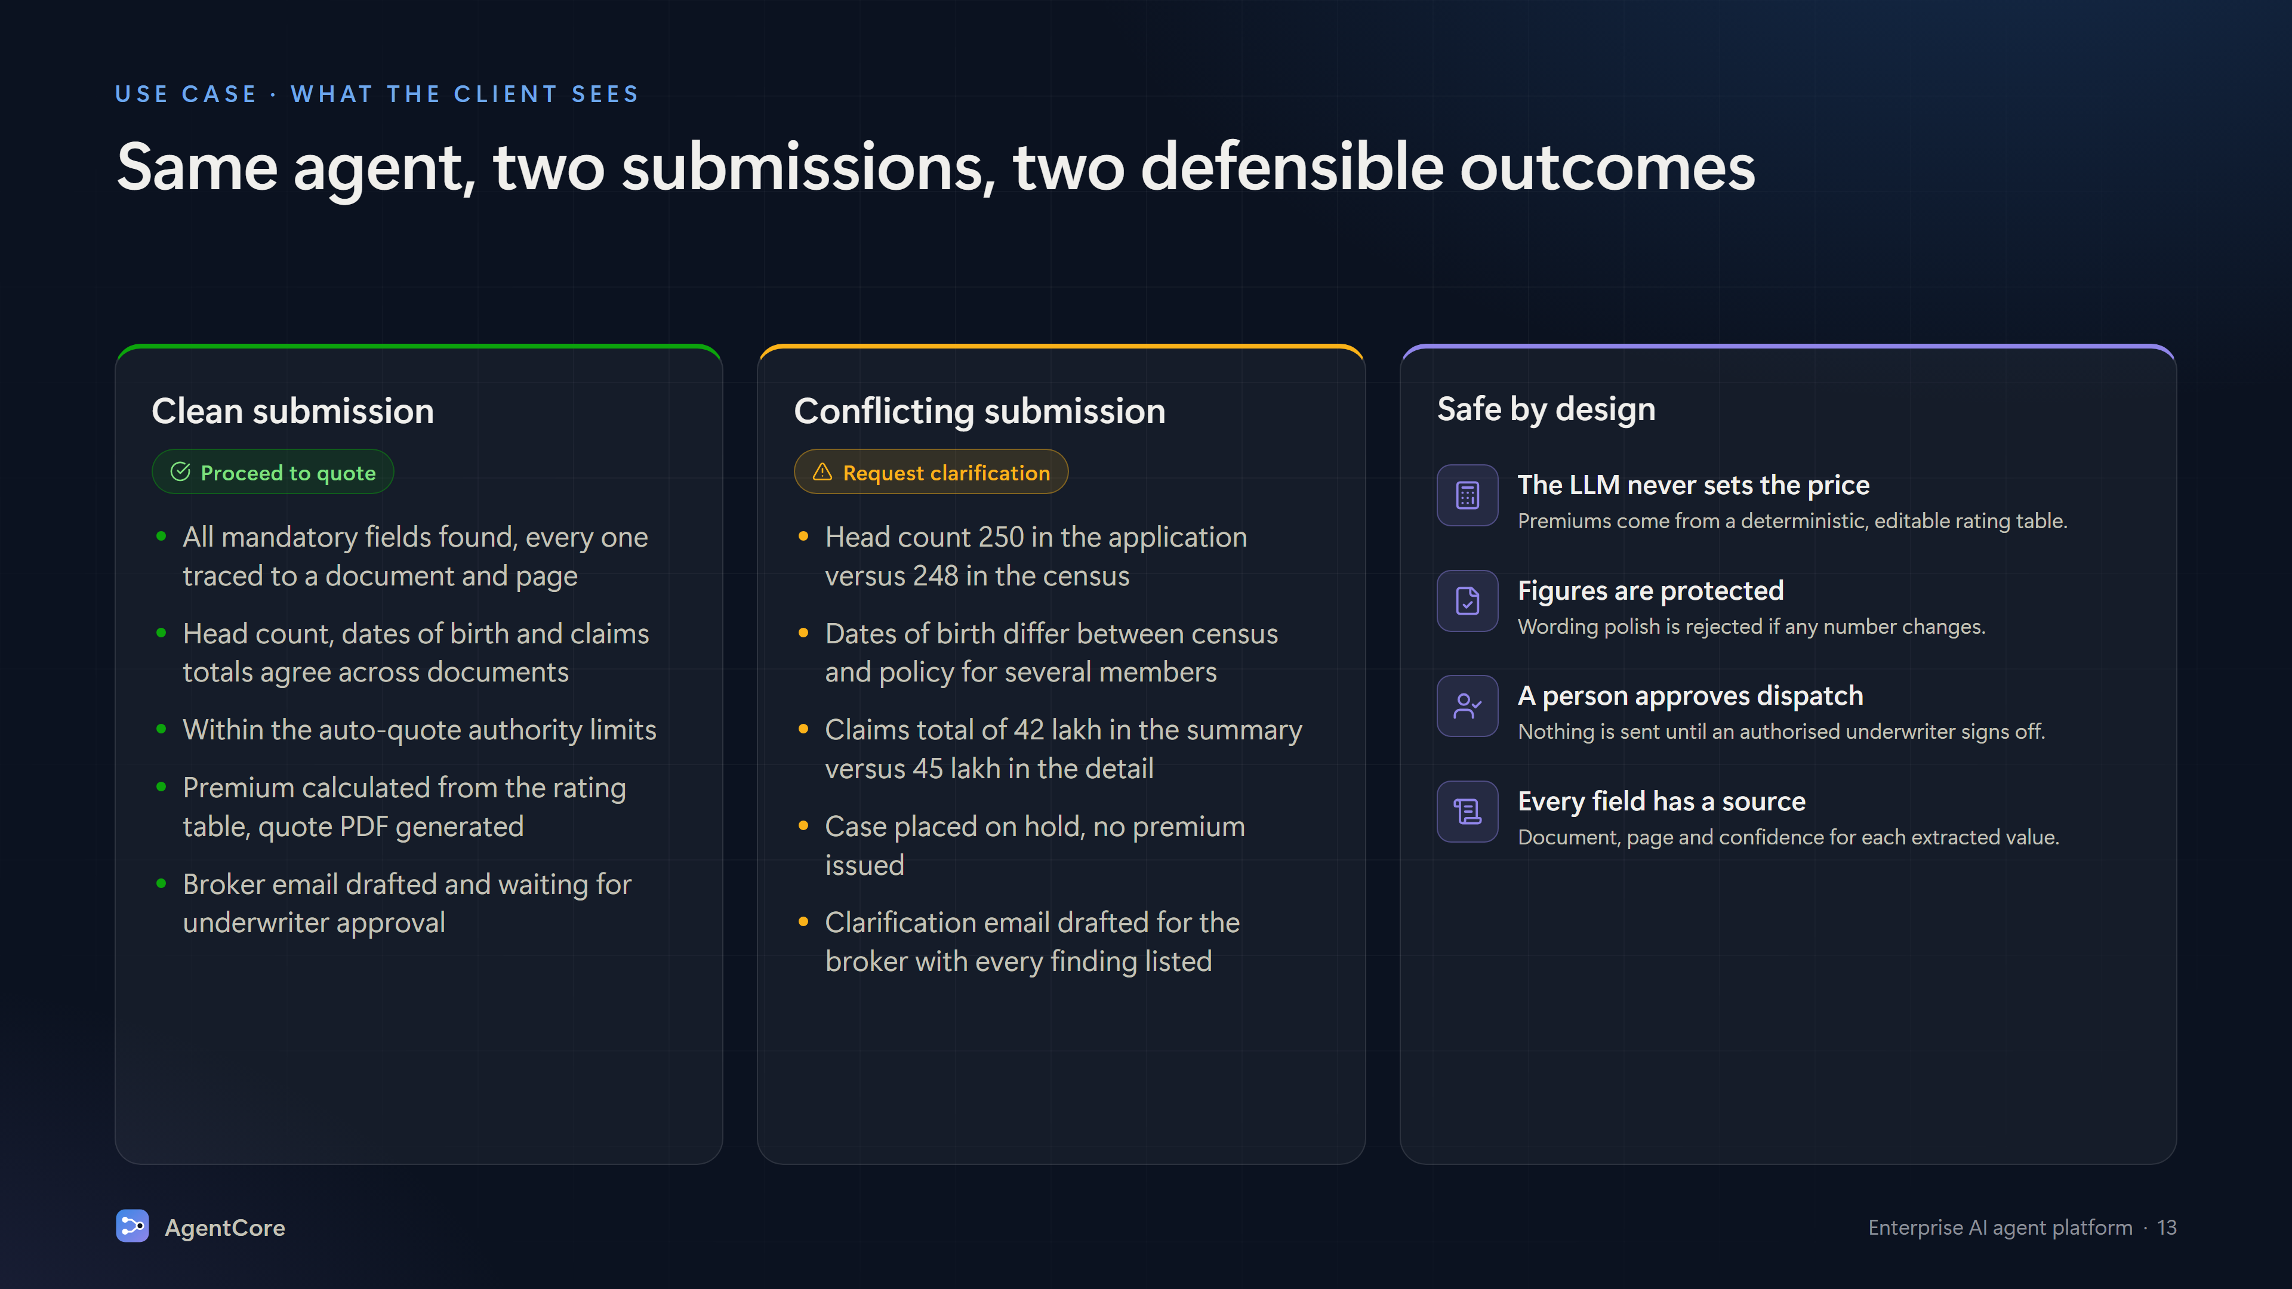
Notes:
Two sample submissions. Clean: all fields found and consistent, within authority, premium from rating table, quote PDF and email draft pending approval. Conflicting: head count 250 vs 248, DOB mismatches, claims 42 lakh vs 45 lakh, case on hold, clarification email drafted. Principles: LLM never sets the price, figures protected, human approves dispatch, every field has a source.

Slide 14
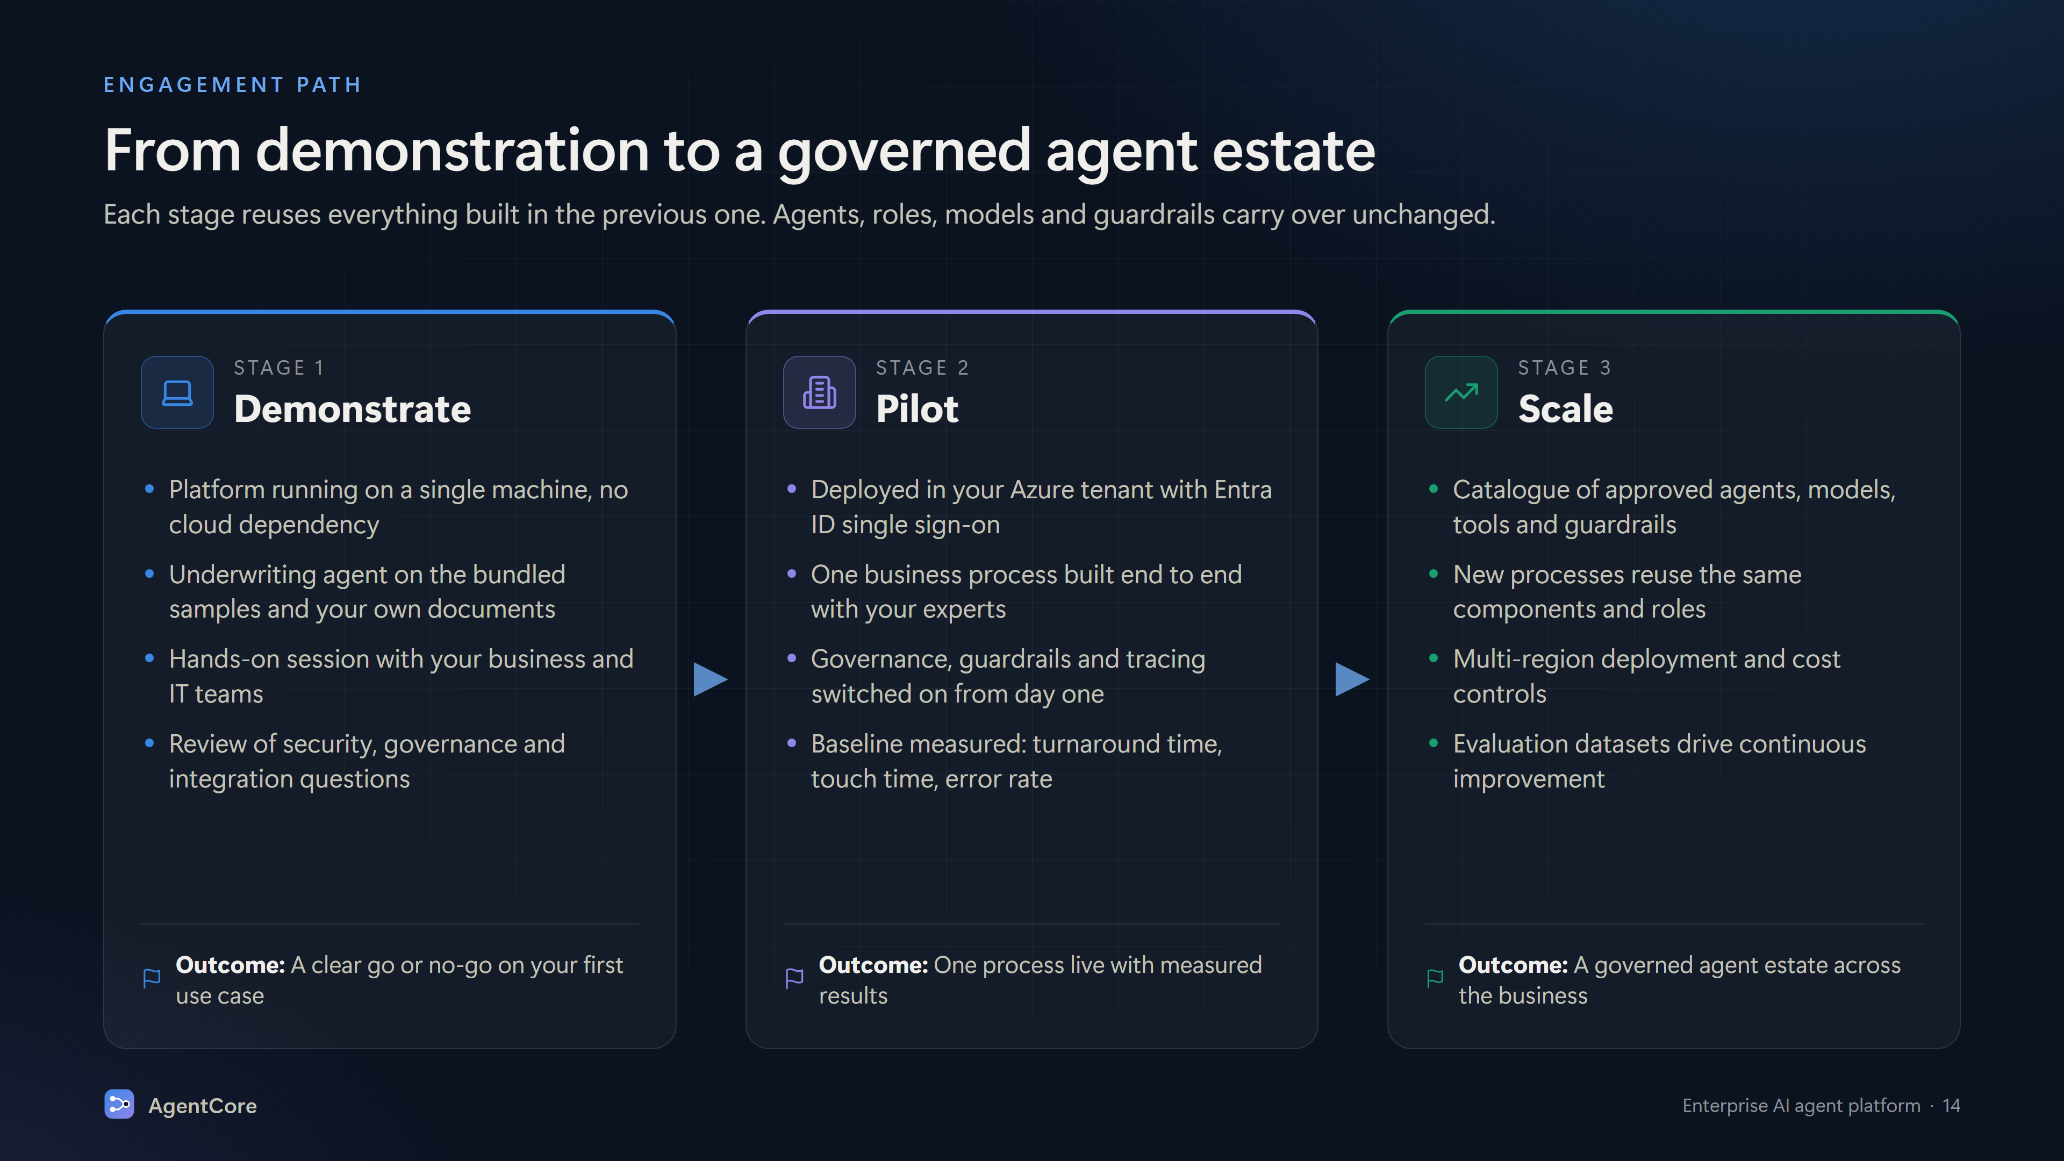
Notes:
Engagement path. Demonstrate: platform on a single machine, underwriting agent on sample and client documents. Pilot: deployed in the client's Azure tenant with SSO, one process end to end, governance on. Scale: catalogue of approved agents, multi-region, cost controls, evaluation.

Slide 15
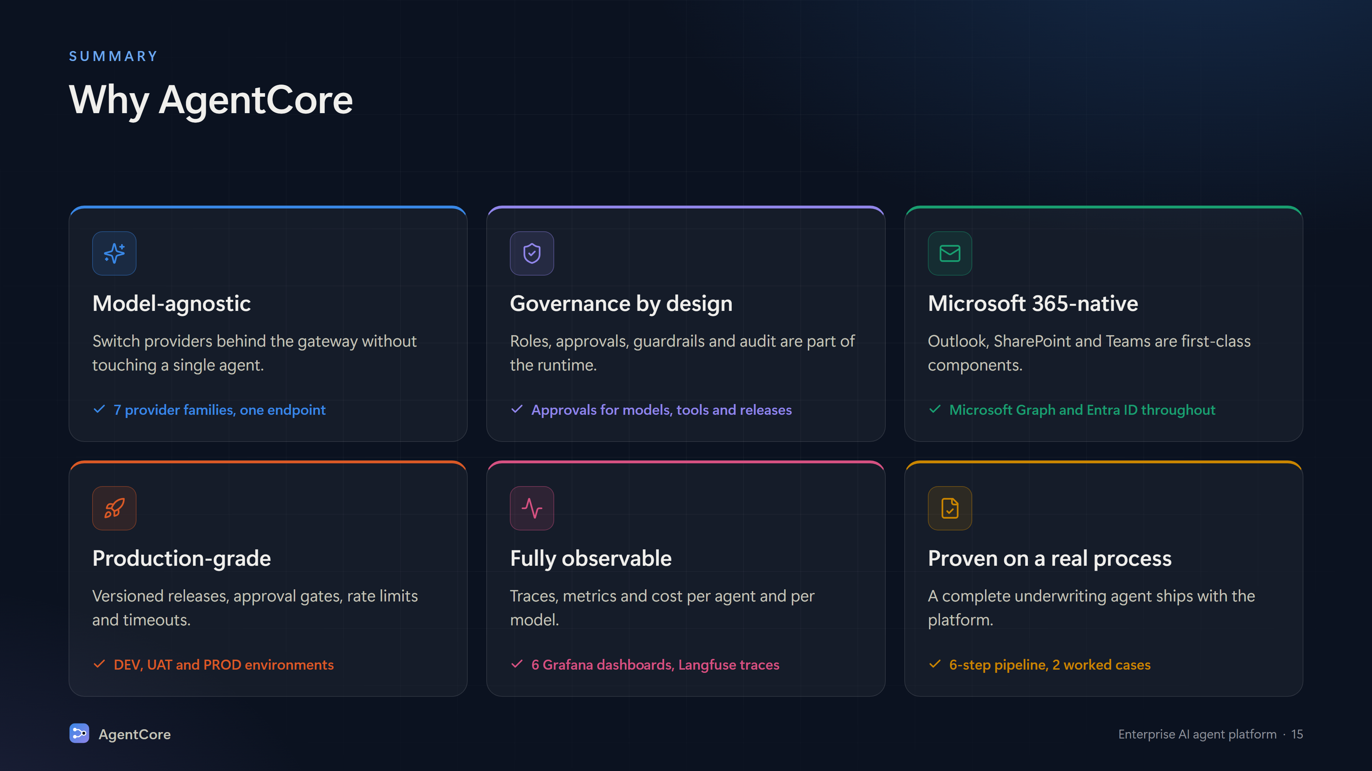
Notes:
Why AgentCore: model-agnostic, governance by design, Microsoft 365-native, production-grade runtime, fully observable, proven on a real underwriting process.

Slide 16
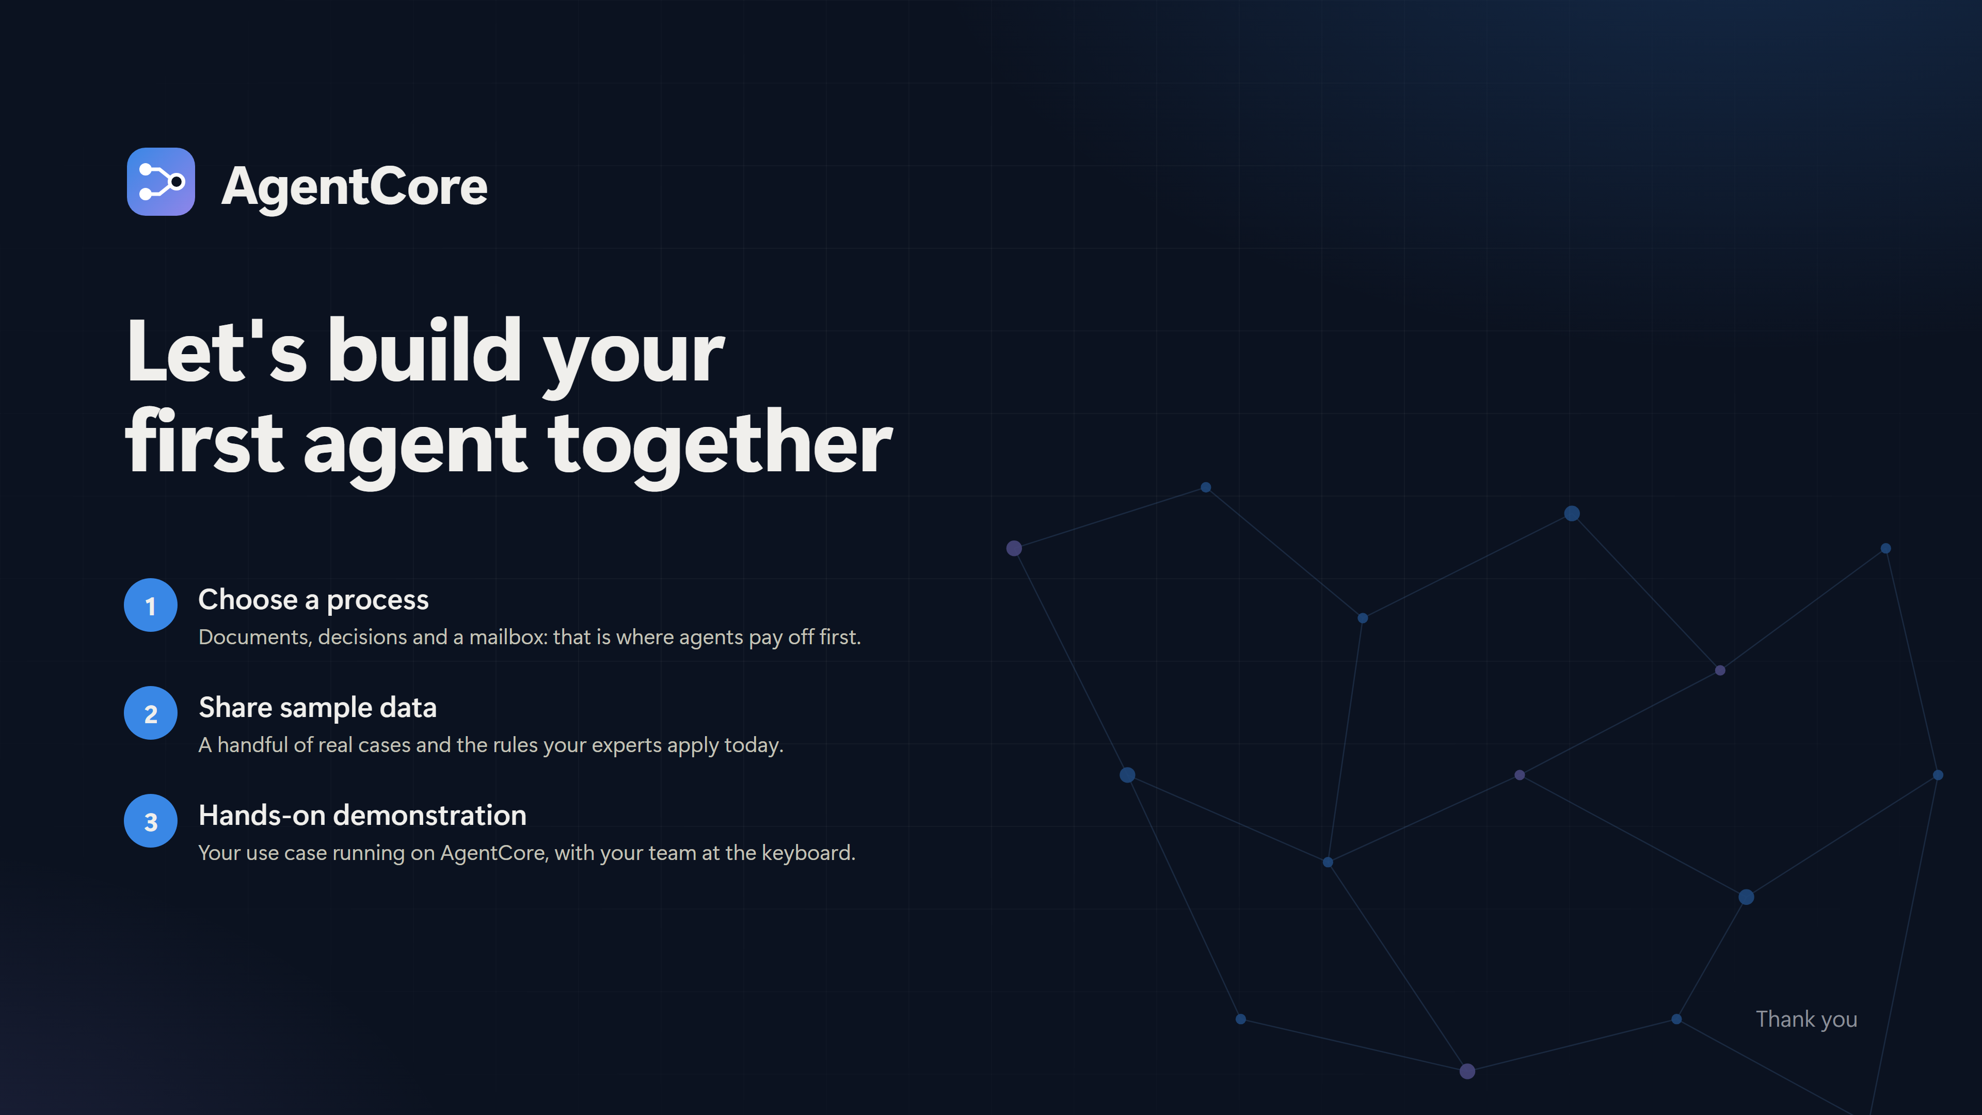
Notes:
Closing. Next steps: choose a process with documents, decisions and a mailbox; share sample data and the rules experts apply; a hands-on demonstration of the client's use case on AgentCore.

