Slide 1
Data Processing Framework Overview

Slide 2
Database Explorer
This PowerPoint presentation provides an overview of the data processing framework divided into Phase I and Phase II.
Phase I is further divided into three stages, each with specific modules aimed at preparing and refining data for analysis.
Phase II consists of independent modules such as Chatbot, ER Diagram generator, and Migration Script generator, offering a range of features for different data processing needs.

Slide 3
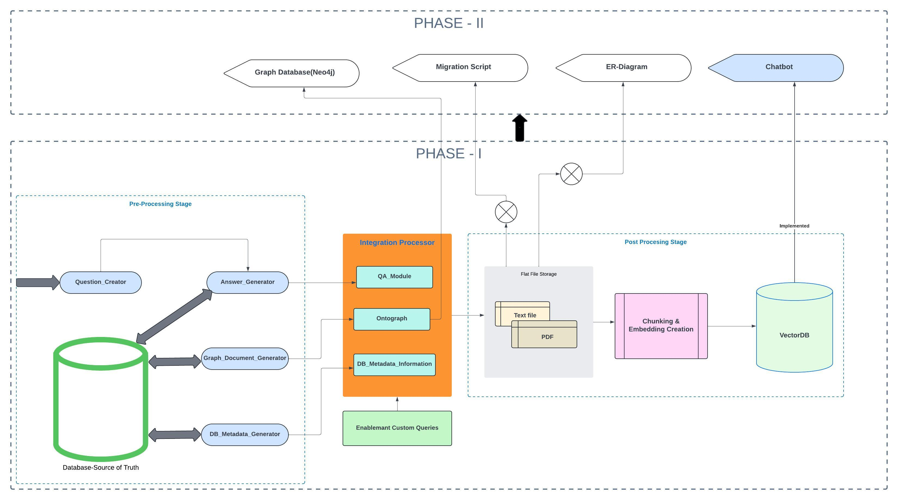

Slide 4
Phase I
Pre-processing Stage
QuestionGenerator: Utilizes LLL model to generate insightful questions about the database.
AnswerGenerator: Generates answers based on the questions from the source database.
GraphDocumentGenerator: Creates a graph model of the database with tables as nodes and relationships as edges.
DatabaseMetadataGenerator: Generates metadata information such as table lists, indexes, and table relationships.
Processing and Refinement Engine
Automate chat module refining output from pre-processing stage using custom queries and context.
Post-Processing Stage
Documents processed into text, pdf, etc., inserted into a VectorDB.
VectorDB and Document serves as a input model for Phase II.

Slide 5
Phase II
Independent modules: Chatbot, ER Diagram generator, Migration Script generator.
Features for discovery phase, data migration, API generation, spec generation, and more.

