Slide 1
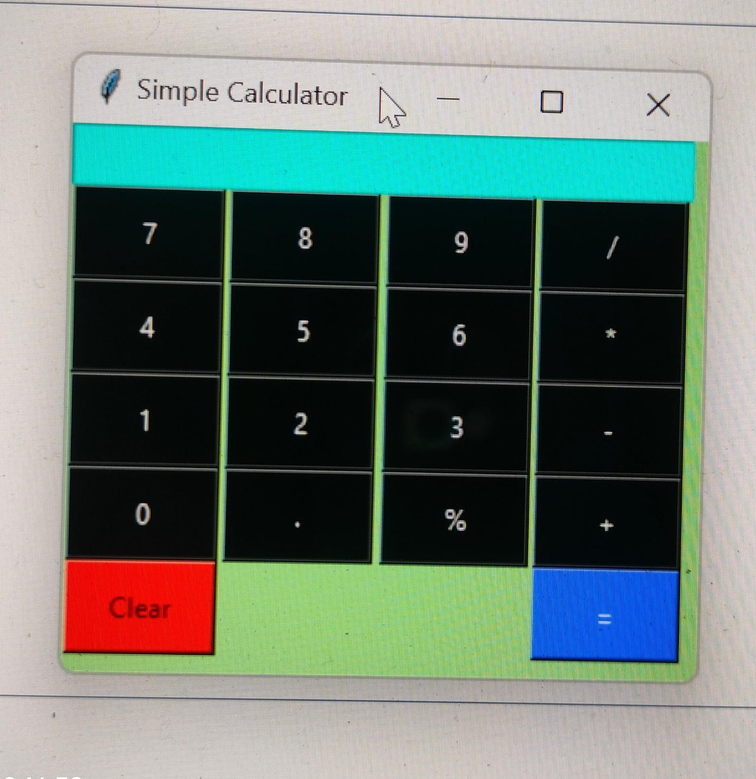
Project Title: Tkinter Calculator
Your Name: Manas Ranjan Mahakud
State:Odisha,Bhadrak
Affiliation: Digicrome Academy

Slide 2
Introduction to Tkinter Calculator
Brief Introduction: Introduce the Tkinter Calculator project.
Purpose: Explain the purpose of creating a calculator using Tkinter.
Problem Statement
Need for a Calculator: Highlight the need for a user-friendly calculator application.
Importance of GUI: Discuss the significance of using Tkinter for creating a graphical user interface (GUI) for the calculator.

Slide 3
Tkinter Library
Overview: Provide an overview of the Tkinter library.
Features: Highlight the key features of Tkinter for GUI development.
Implementation of Tkinter Calculator
Design: Discuss the design and layout of the calculator interface.
Functionality: Explain the functionalities implemented using Tkinter widgets such as buttons, entry widgets, etc.

Slide 4
Key Features
Basic Operations: Addition, subtraction, multiplication, and division.
Advanced Operations: Support for advanced mathematical operations.
User Interaction: Responsive interface with error handling.
Challenges Faced
Initial Challenges: Discuss any initial hurdles faced during the development process.
Solutions: Explain how challenges were overcome through problem-solving techniques.

Slide 5
Future Enhancements
Potential Improvements: Discuss potential enhancements or additional features for the calculator application.
Community Contributions: Encourage community involvement for further development and enhancement.
Conclusion
Summary: Summarize the key points discussed in the presentation.
Appreciation: Thank the audience for their attention and interest in the Tkinter calculator project.

Slide 6
References
List any references or resources used during the development of the Tkinter calculator application.

