Slide 1

Notes:
Slide 1: rasterized slide artwork generated from the approved reference style and M1C4 updated flow.

Slide 2

Notes:
Slide 2: rasterized slide artwork generated from the approved reference style and M1C4 updated flow.

Slide 3

Notes:
Slide 3: rasterized slide artwork generated from the approved reference style and M1C4 updated flow.

Slide 4

Notes:
Slide 4: rasterized slide artwork generated from the approved reference style and M1C4 updated flow.

Slide 5

Notes:
Slide 5: rasterized slide artwork generated from the approved reference style and M1C4 updated flow.

Slide 6

Notes:
Slide 6: rasterized slide artwork generated from the approved reference style and M1C4 updated flow.

Slide 7

Notes:
Slide 7: rasterized slide artwork generated from the approved reference style and M1C4 updated flow.

Slide 8

Notes:
Slide 8: rasterized slide artwork generated from the approved reference style and M1C4 updated flow.

Slide 9

Notes:
Slide 9: rasterized slide artwork generated from the approved reference style and M1C4 updated flow.

Slide 10

Notes:
Slide 10: rasterized slide artwork generated from the approved reference style and M1C4 updated flow.

Slide 11


Slide 12

Notes:
Slide 11: rasterized slide artwork generated from the approved reference style and M1C4 updated flow.

Slide 13

Notes:
Slide 12: rasterized slide artwork generated from the approved reference style and M1C4 updated flow.

Slide 14
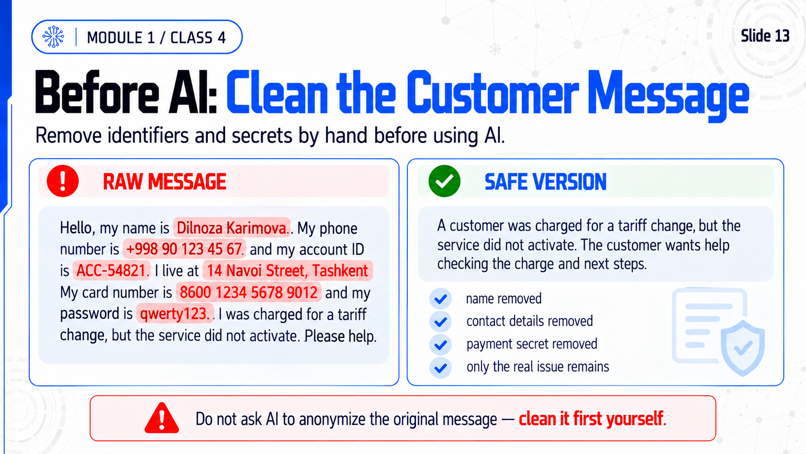
Notes:
Slide 13: rasterized slide artwork generated from the approved reference style and M1C4 updated flow.

Slide 15

Notes:
Slide 14: rasterized slide artwork generated from the approved reference style and M1C4 updated flow.

Slide 16

Notes:
Slide 15: rasterized slide artwork generated from the approved reference style and M1C4 updated flow.

Slide 17

Notes:
Slide 16: rasterized slide artwork generated from the approved reference style and M1C4 updated flow.

Slide 18

Notes:
Slide 17: rasterized slide artwork generated from the approved reference style and M1C4 updated flow.

