Slide 1

Notes:
MODULE 3 / CLASS 1. Slide 1. Can we trust this table?. Inspect → decide → change → verify; Keep the source unchanged; One checked correction, with evidence. Goal: explain one real cleaning decision.

Slide 2
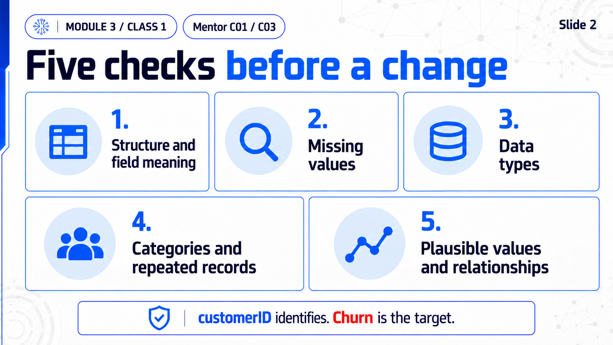
Notes:
MODULE 3 / CLASS 1. Slide 2. Five checks before a change. Structure and field meaning; Missing values; Data types; Categories and repeated records; Plausible values and relationships. customerID identifies. Churn is the target.

Slide 3
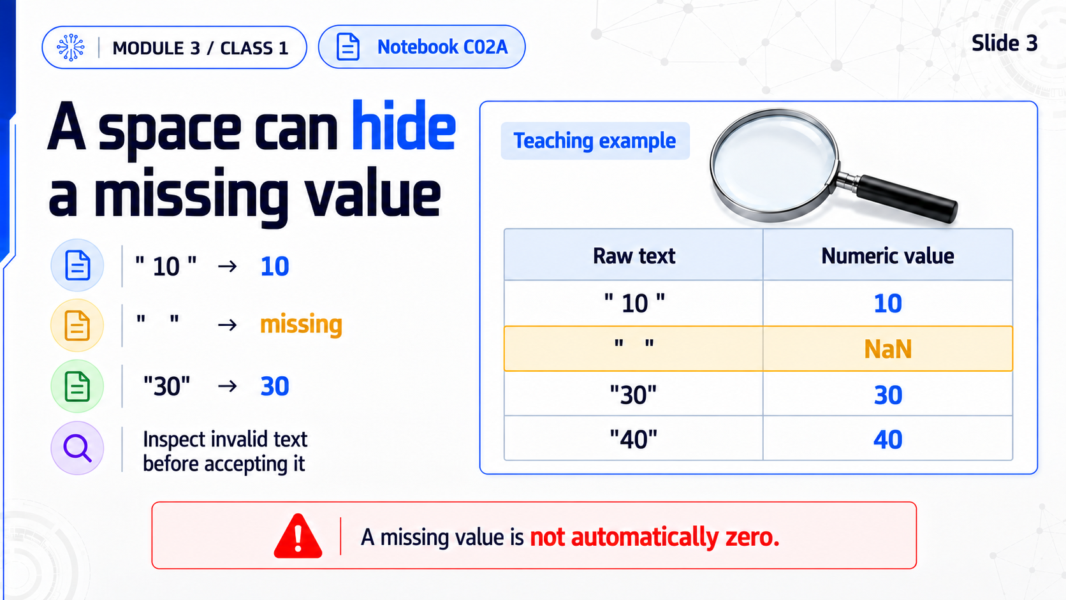
Notes:
MODULE 3 / CLASS 1. Slide 3. A space can hide a missing value. " 10 " → 10; " " → missing; "30" → 30; Inspect invalid text before accepting it. A missing value is not automatically zero.

Slide 4
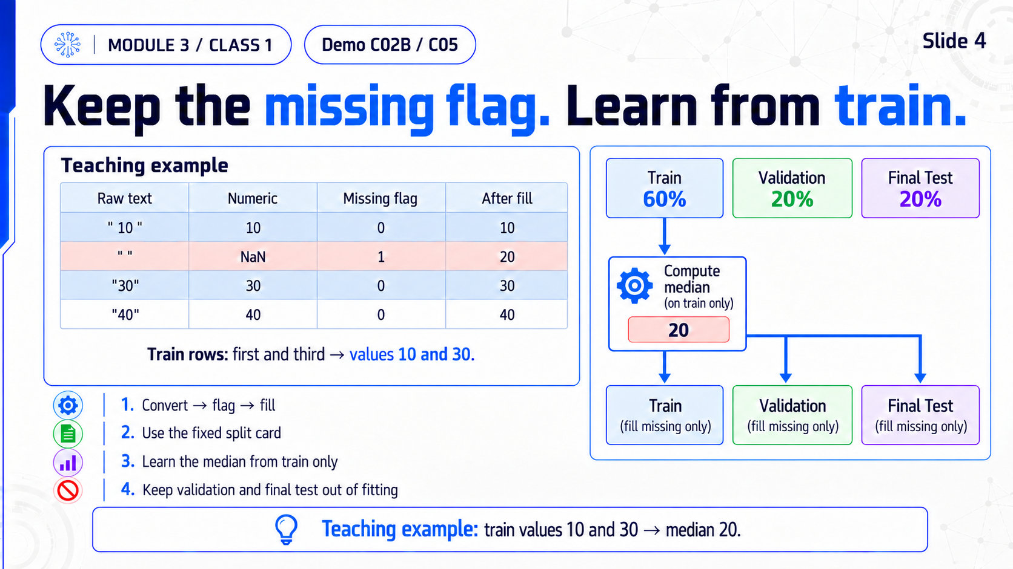
Notes:
MODULE 3 / CLASS 1. Slide 4. Keep the missing flag. Learn from train.. Convert → flag → fill; Use the fixed split card; Learn the median from train only; Keep validation and final test out of fitting. Teaching example: train values 10 and 30 → median 20.

Slide 5
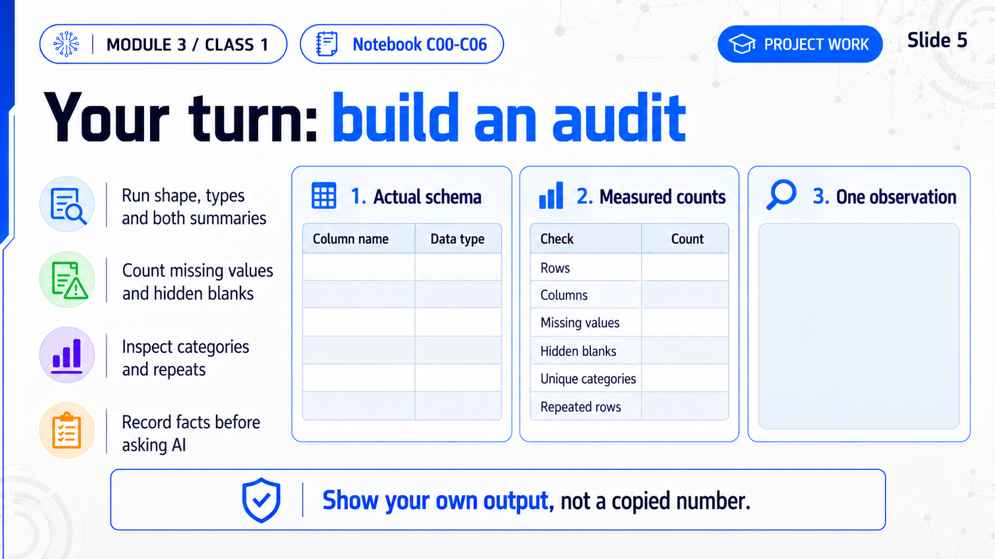
Notes:
MODULE 3 / CLASS 1. Slide 5. Your turn: build an audit. Run shape, types and both summaries; Count missing values and hidden blanks; Inspect categories and repeats; Record facts before asking AI. Show your own output, not a copied number.

Slide 6
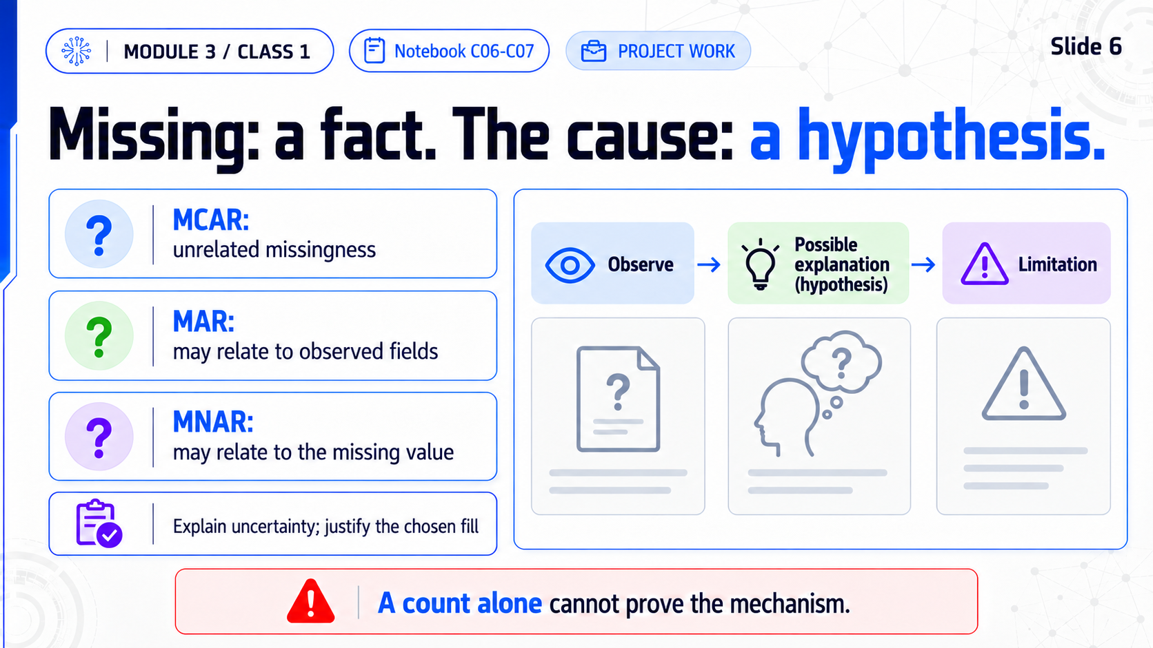
Notes:
MODULE 3 / CLASS 1. Slide 6. Missing: a fact. The cause: a hypothesis.. MCAR: unrelated missingness; MAR: may relate to observed fields; MNAR: may relate to the missing value; Explain uncertainty; justify the chosen fill. A count alone cannot prove the mechanism.

Slide 7
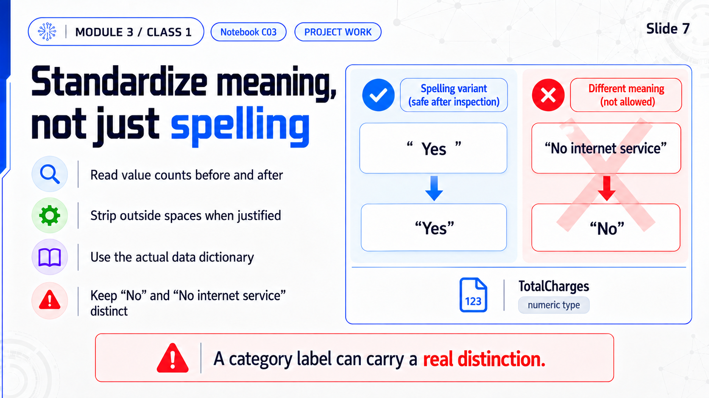
Notes:
MODULE 3 / CLASS 1. Slide 7. Standardize meaning, not just spelling. Read value counts before and after; Strip outside spaces when justified; Use the actual data dictionary; Keep “No” and “No internet service” distinct. A category label can carry a real distinction.

Slide 8
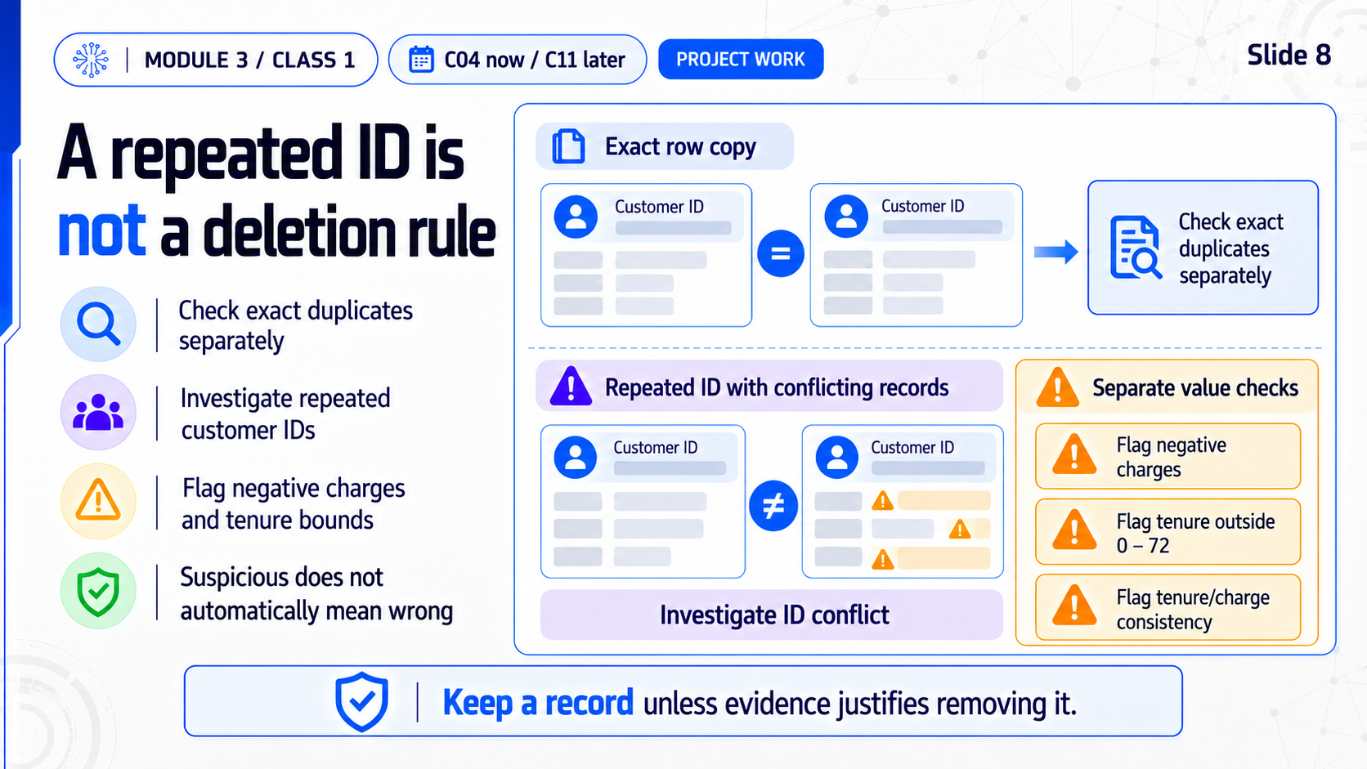
Notes:
MODULE 3 / CLASS 1. Slide 8. A repeated ID is not a deletion rule. Check exact duplicates separately; Investigate repeated customer IDs; Flag negative charges and tenure bounds; Suspicious does not automatically mean wrong. Keep a record unless evidence justifies removing it.

Slide 9
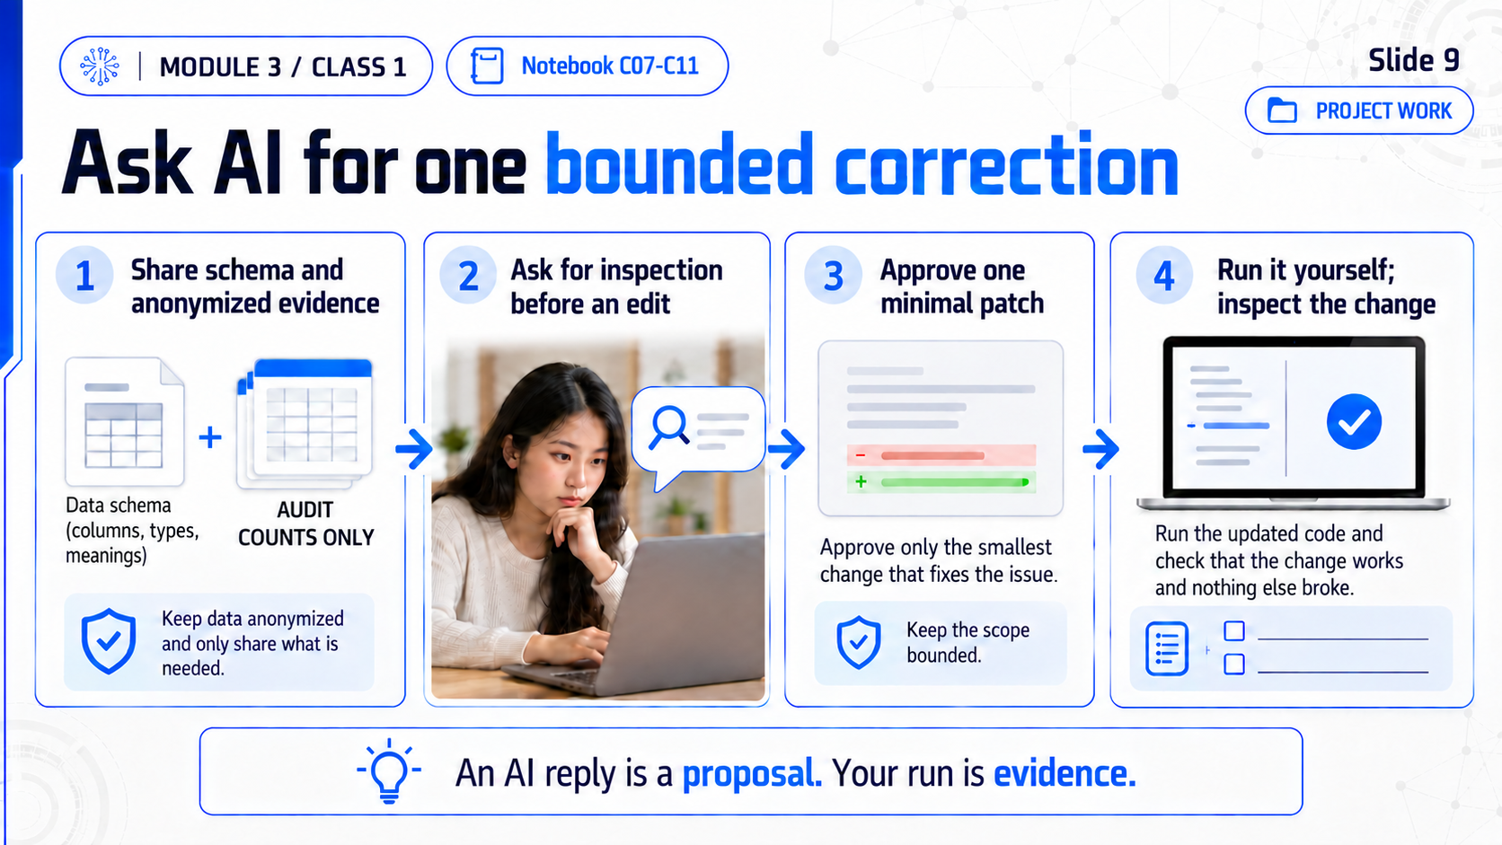
Notes:
MODULE 3 / CLASS 1. Slide 9. Ask AI for one bounded correction. Share schema and anonymized evidence; Ask for inspection before an edit; Approve one minimal patch; Run it yourself; inspect the change. An AI reply is a proposal. Your run is evidence.

Slide 10
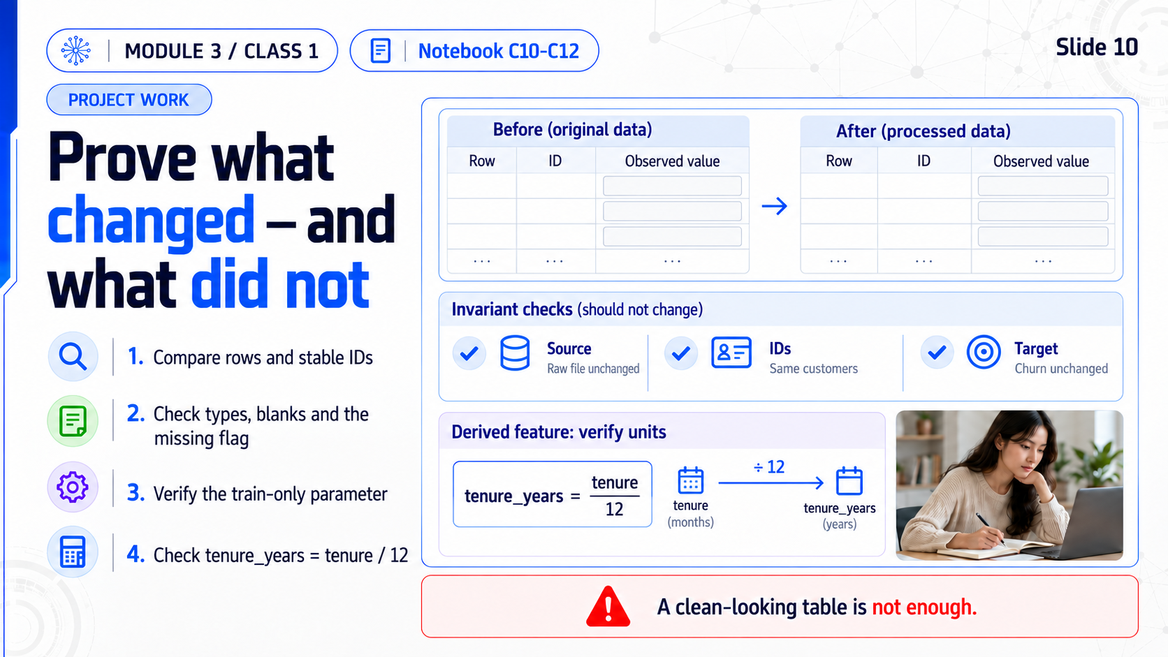
Notes:
MODULE 3 / CLASS 1. Slide 10. Prove what changed — and what did not. Compare rows and stable IDs; Check types, blanks and the missing flag; Verify the train-only parameter; Check tenure_years = tenure / 12. A clean-looking table is not enough.

Slide 11
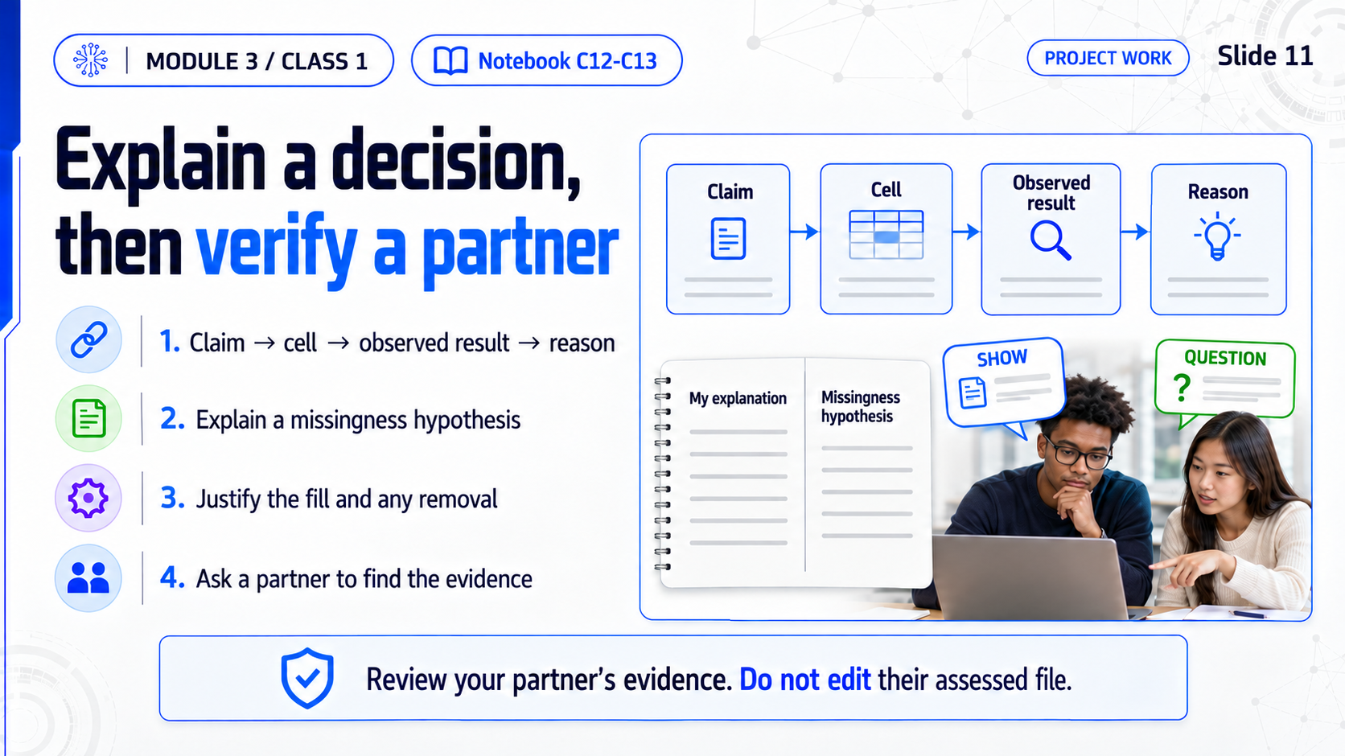
Notes:
MODULE 3 / CLASS 1. Slide 11. Explain a decision, then verify a partner. Claim → cell → observed result → reason; Explain a missingness hypothesis; Justify the fill and any removal; Ask a partner to find the evidence. Review your partner’s evidence. Do not edit their assessed file.

Slide 12
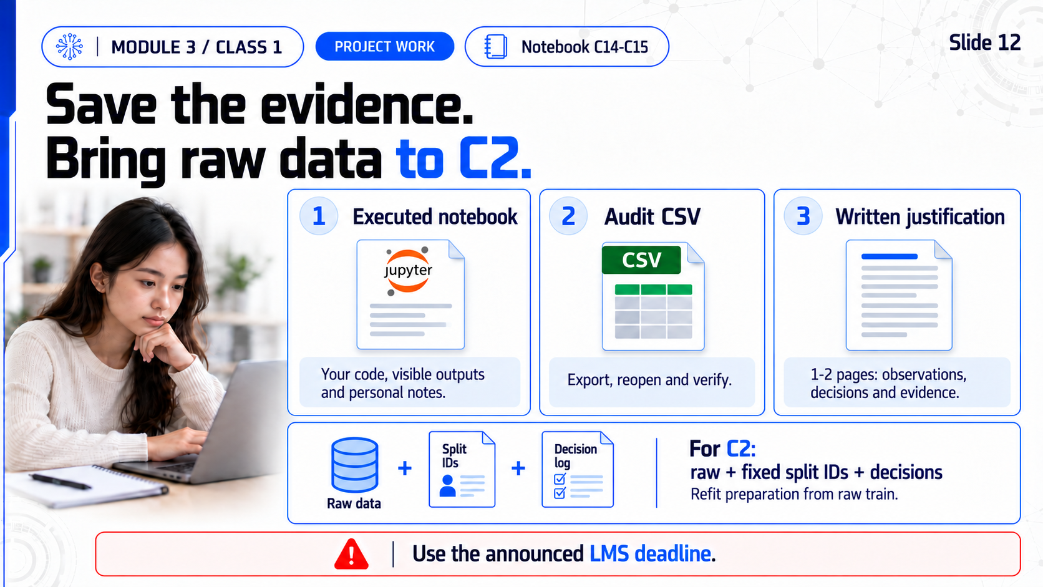
Notes:
MODULE 3 / CLASS 1. Slide 12. Save the evidence. Bring raw data to C2.. Save your executed notebook; Export telco_cleaned.csv as an audit; Complete the 1–2 page justification; Bring raw, split IDs and decisions to C2. Use the announced LMS deadline.

