Slide 1
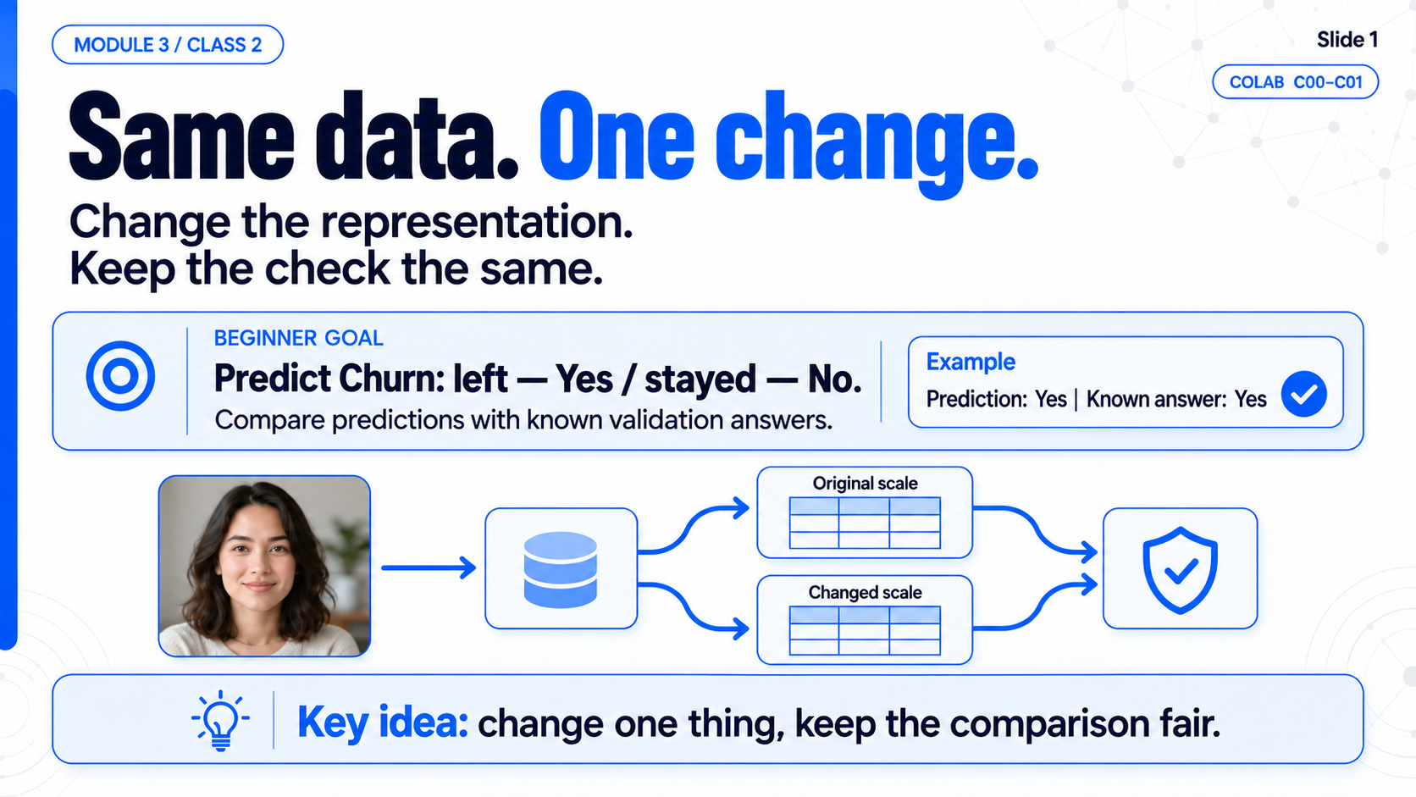
Notes:
M3C2 / SLIDE 01
Same data. One change.
Colab: C00–C01
Full-slide raster image generated with imagegen. Speech is in the mentor DOCX.

Slide 2
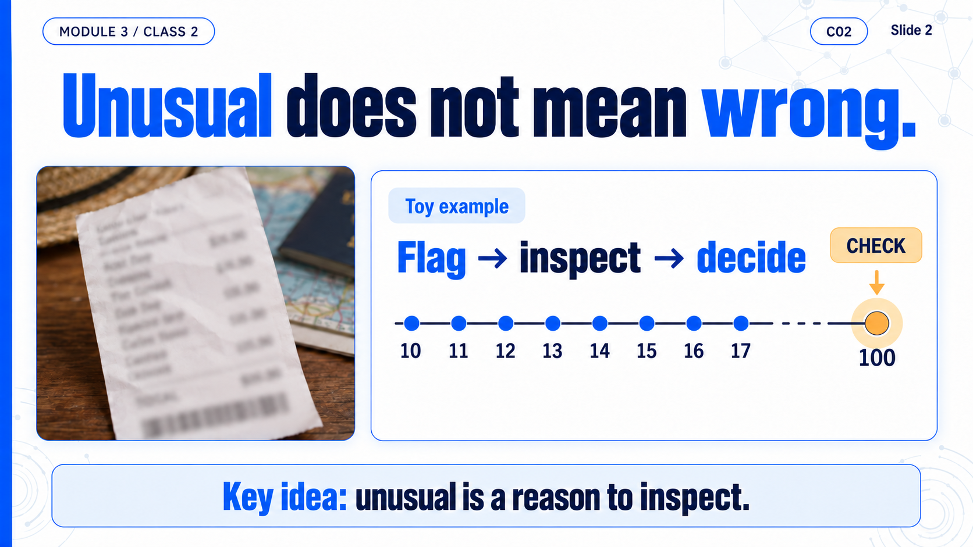
Notes:
M3C2 / SLIDE 02
Unusual does not mean wrong.
Colab: C02
Full-slide raster image generated with imagegen. Speech is in the mentor DOCX.

Slide 3
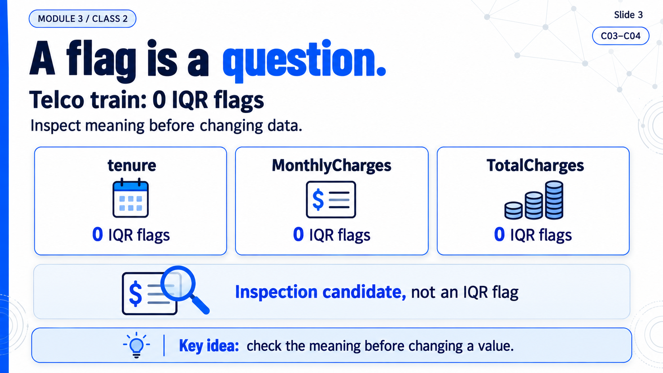
Notes:
M3C2 / SLIDE 03
A flag is a question.
Colab: C03–C04
Full-slide raster image generated with imagegen. Speech is in the mentor DOCX.

Slide 4
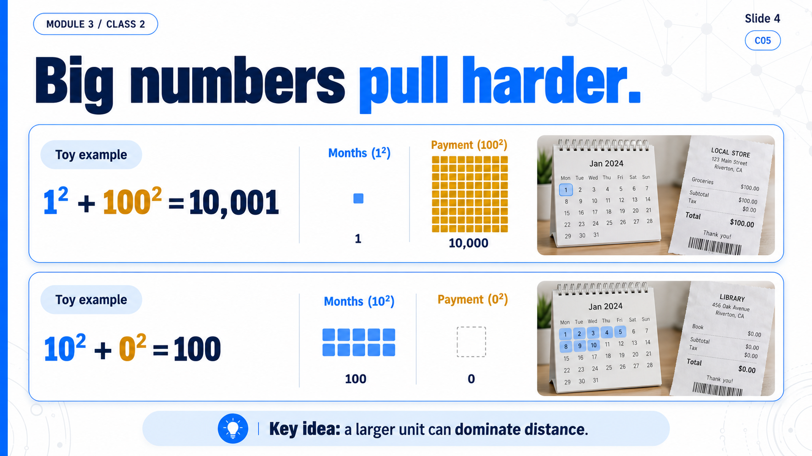
Notes:
M3C2 / SLIDE 04
Big numbers pull harder.
Colab: C05
Full-slide raster image generated with imagegen. Speech is in the mentor DOCX.

Slide 5
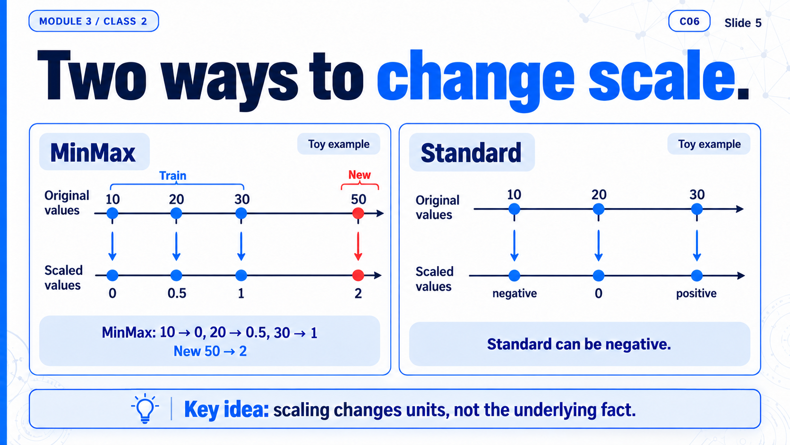
Notes:
M3C2 / SLIDE 05
Two ways to change scale.
Colab: C06
Full-slide raster image generated with imagegen. Speech is in the mentor DOCX.

Slide 6
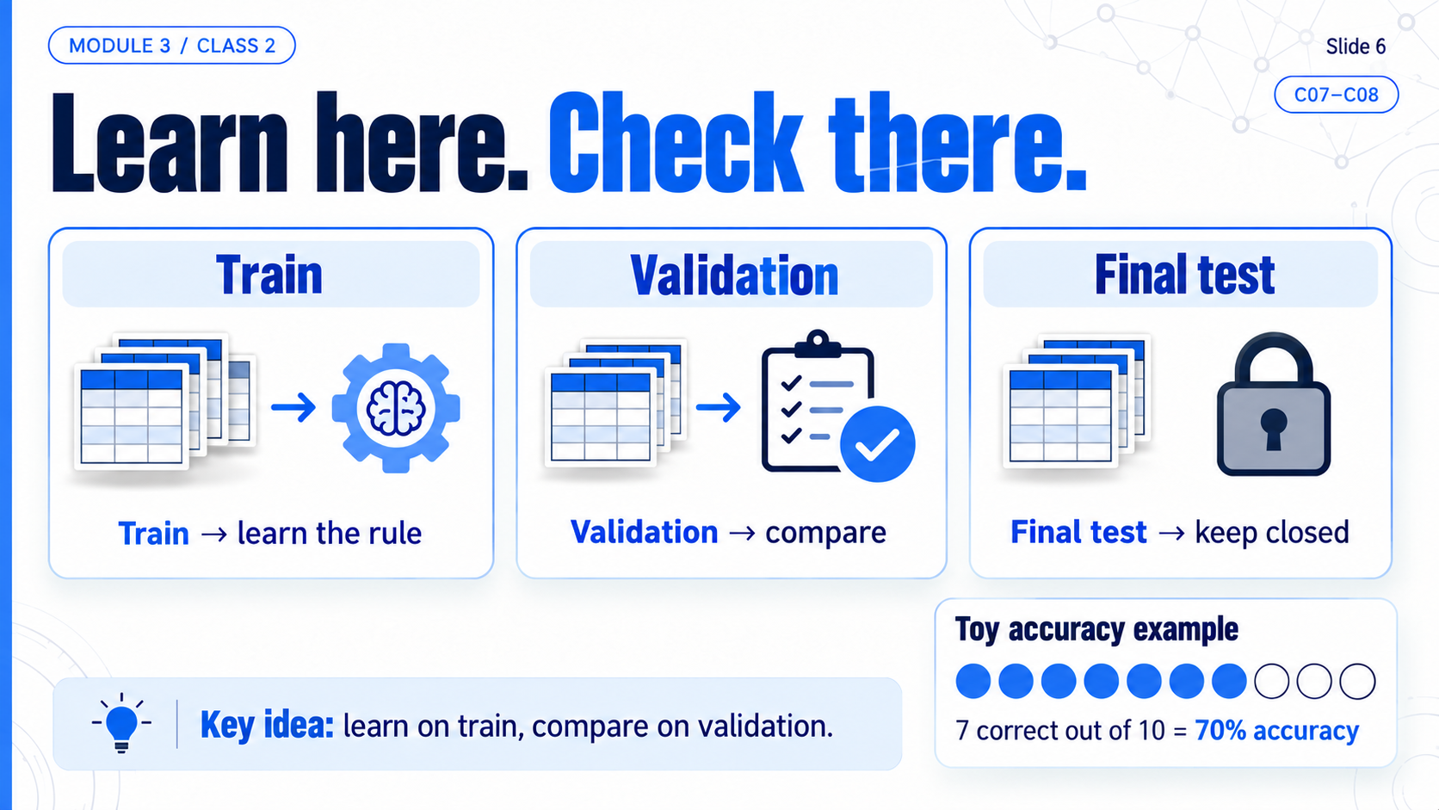
Notes:
M3C2 / SLIDE 06
Learn here. Check there.
Colab: C07–C08
Full-slide raster image generated with imagegen. Speech is in the mentor DOCX.

Slide 7
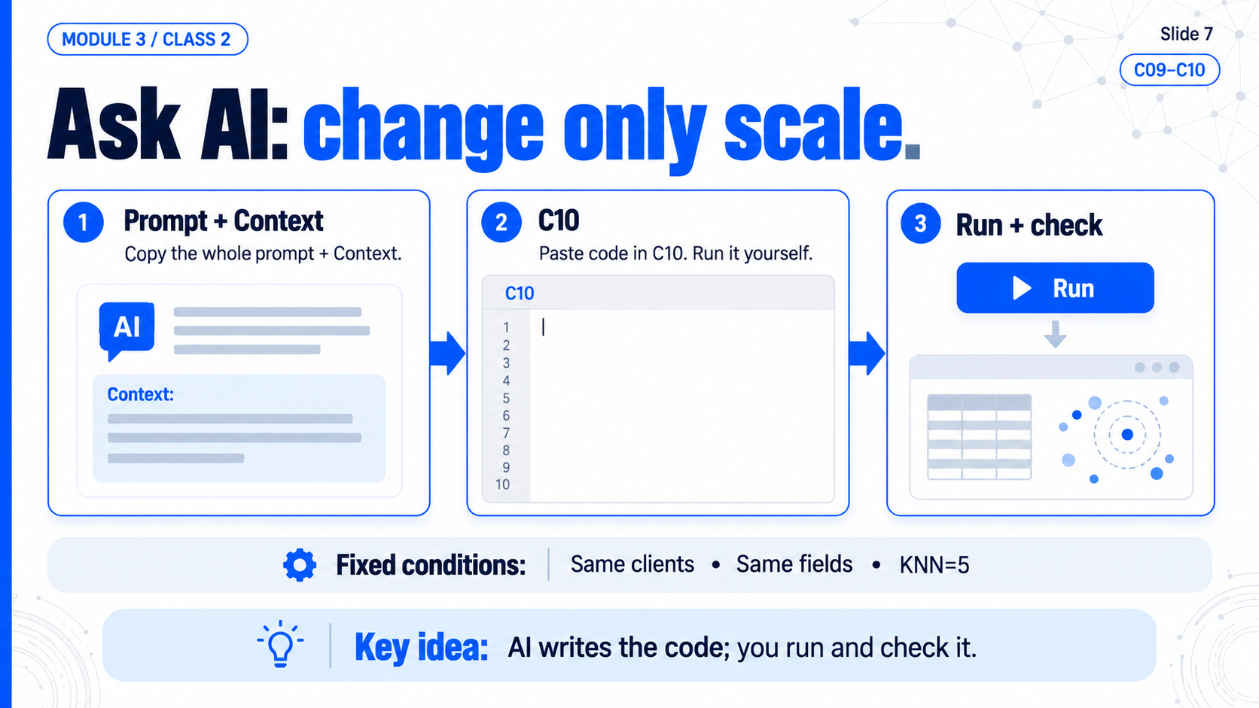
Notes:
M3C2 / SLIDE 07
Ask AI: change only scale.
Colab: C09–C10
Full-slide raster image generated with imagegen. Speech is in the mentor DOCX.

Slide 8
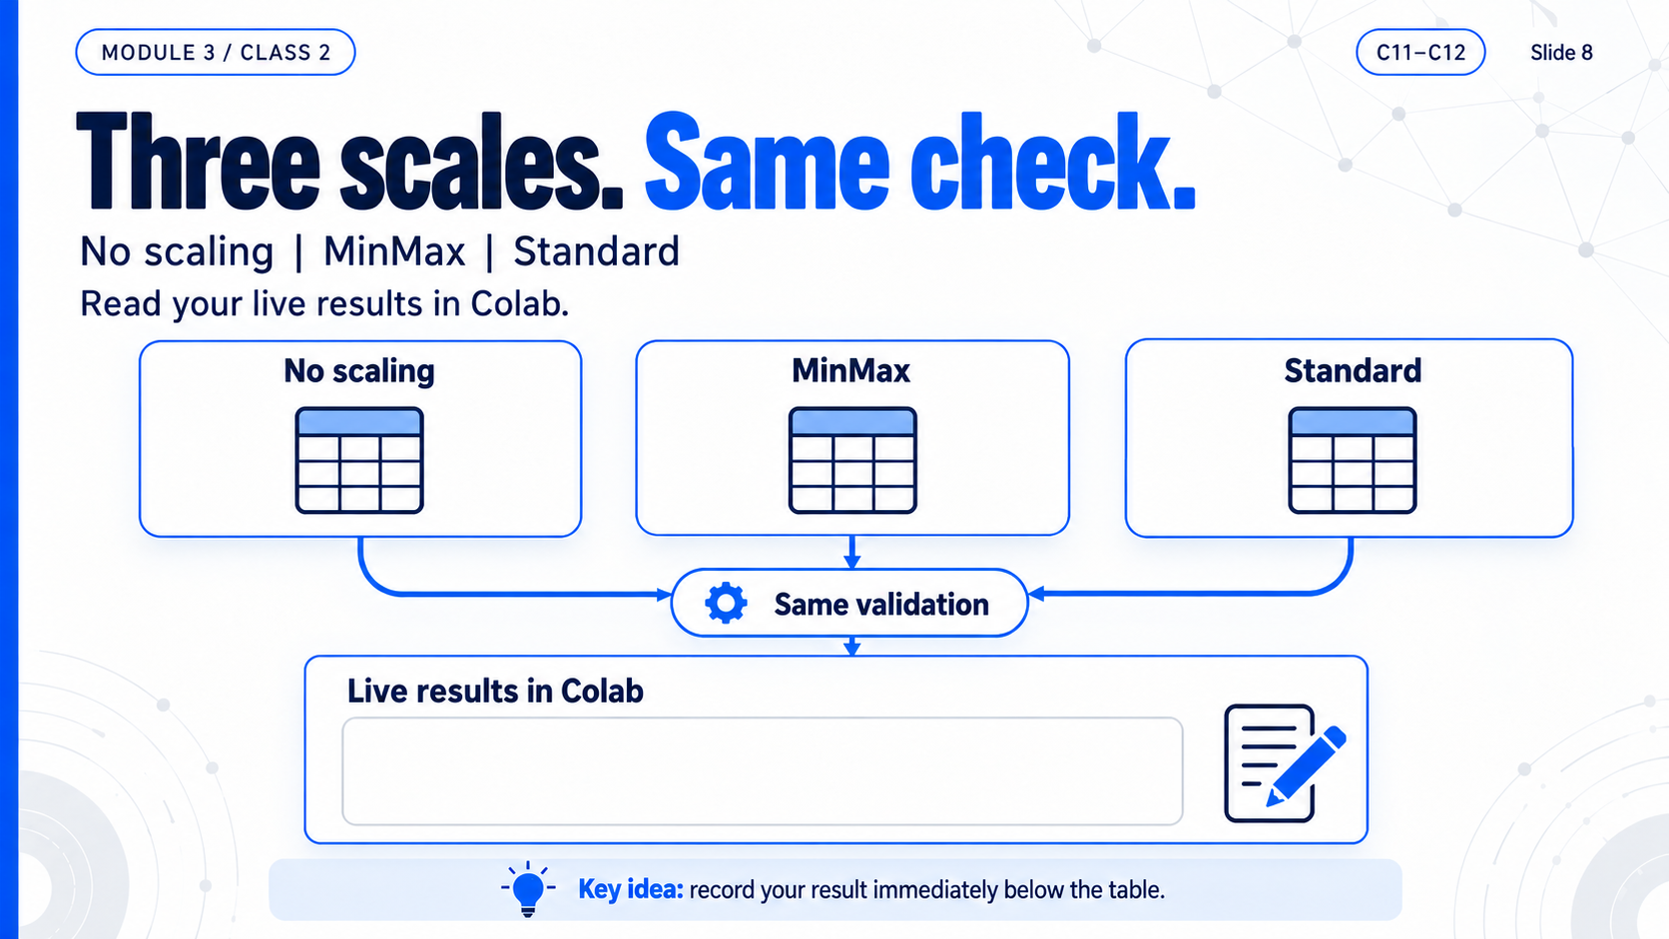
Notes:
M3C2 / SLIDE 08
Three scales. Same check.
Colab: C11–C12
Full-slide raster image generated with imagegen. Speech is in the mentor DOCX.

Slide 9
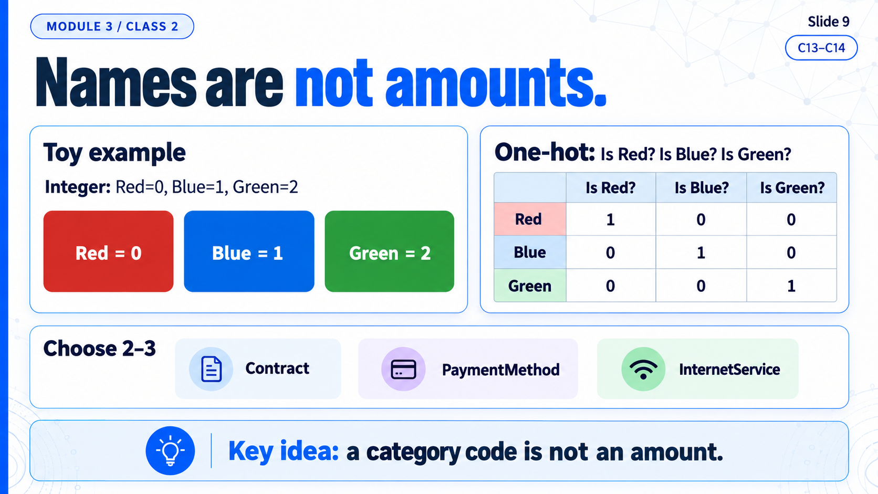
Notes:
M3C2 / SLIDE 09
Names are not amounts.
Colab: C13–C14
Full-slide raster image generated with imagegen. Speech is in the mentor DOCX.

Slide 10
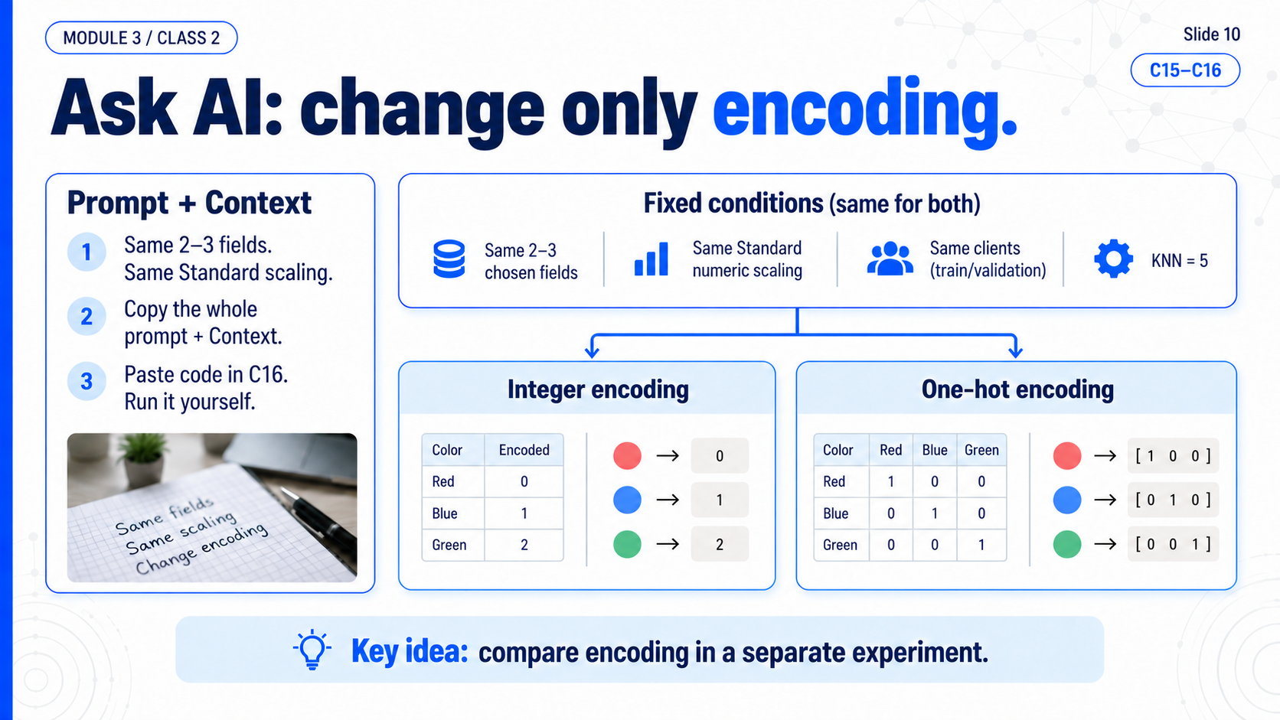
Notes:
M3C2 / SLIDE 10
Ask AI: change only encoding.
Colab: C15–C16
Full-slide raster image generated with imagegen. Speech is in the mentor DOCX.

Slide 11
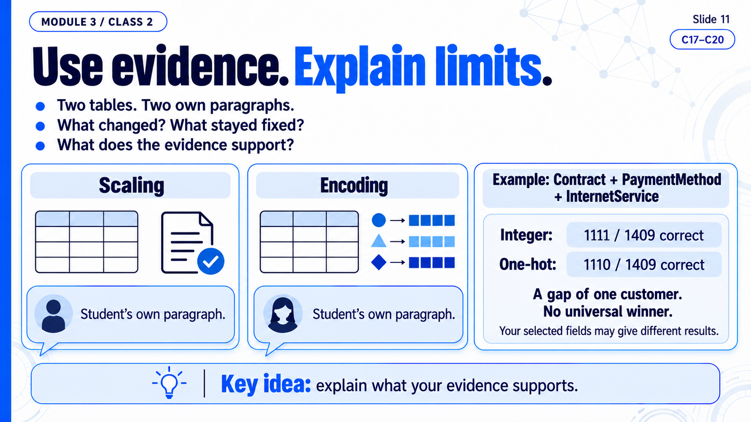
Notes:
M3C2 / SLIDE 11
Use evidence. Explain limits.
Colab: C17–C20
Full-slide raster image generated with imagegen. Speech is in the mentor DOCX.

Slide 12
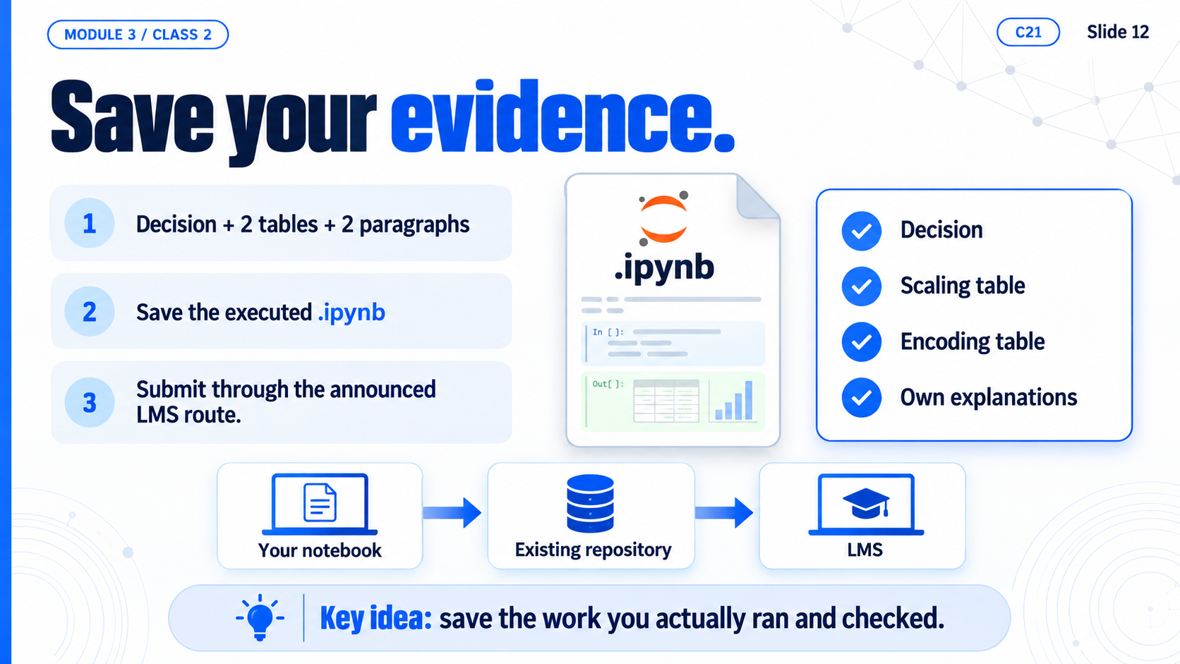
Notes:
M3C2 / SLIDE 12
Save your evidence.
Colab: C21
Full-slide raster image generated with imagegen. Speech is in the mentor DOCX.

