Slide 1
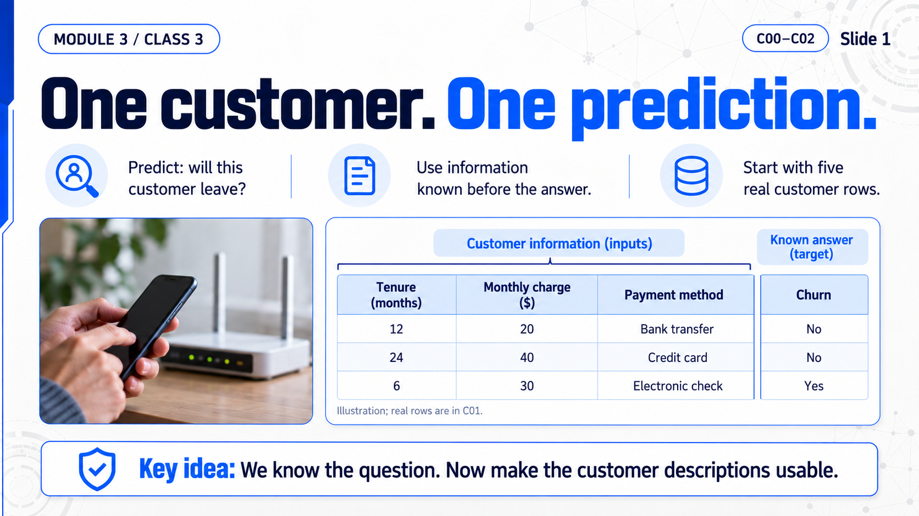
Notes:
M3C3 / SLIDE 01
One customer. One prediction.
Colab: C00–C02
Full-slide raster image generated with imagegen. Speech is in the mentor DOCX.

Slide 2
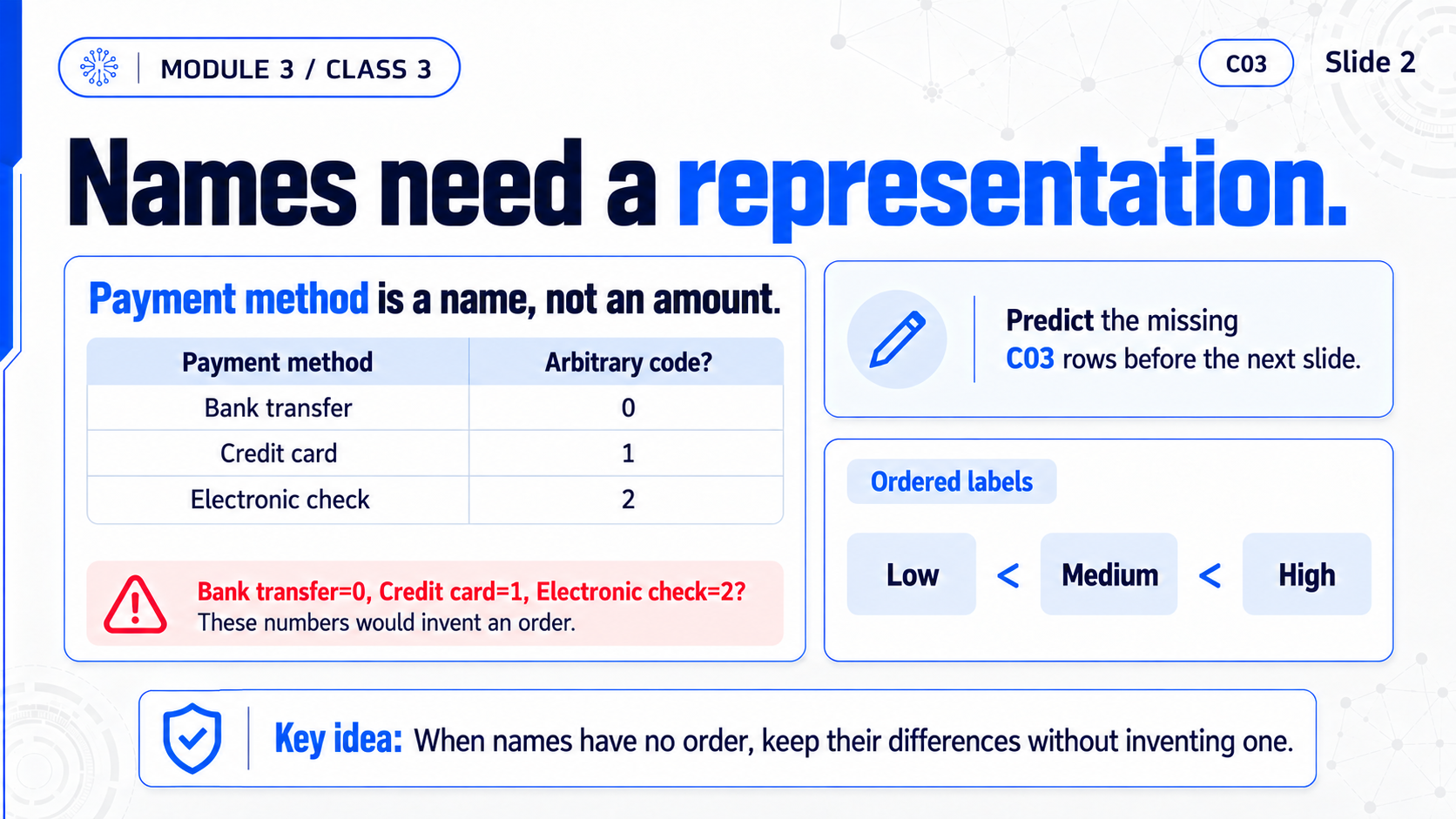
Notes:
M3C3 / SLIDE 02
Names need a representation.
Colab: C03
Full-slide raster image generated with imagegen. Speech is in the mentor DOCX.

Slide 3
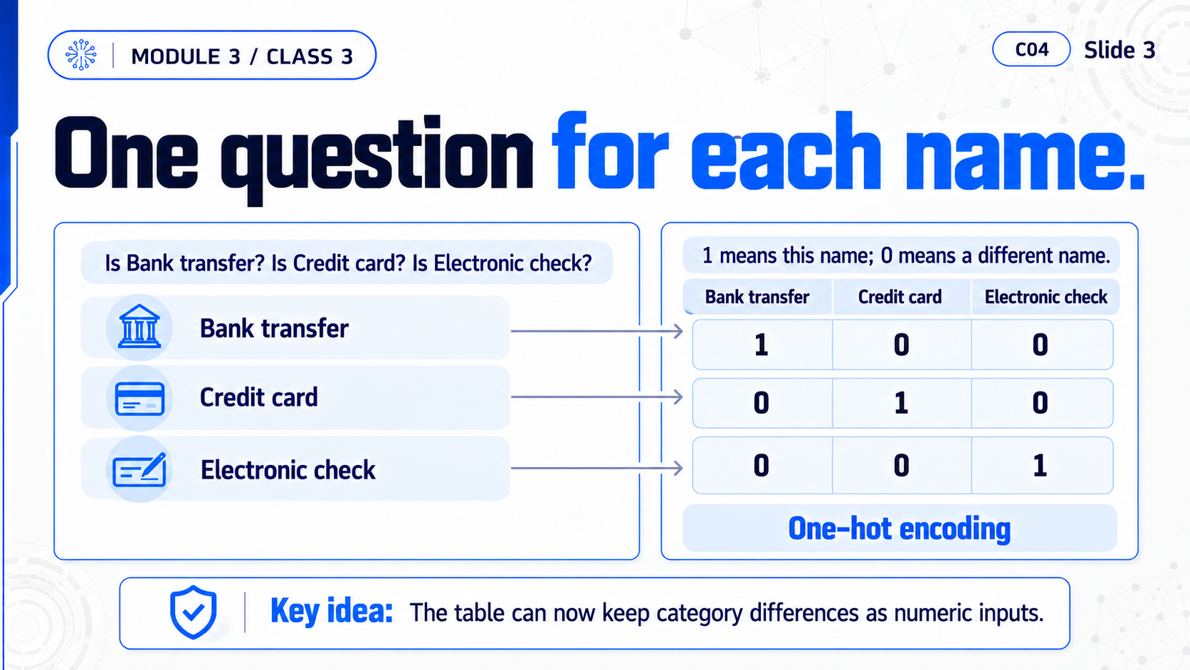
Notes:
M3C3 / SLIDE 03
One question for each name.
Colab: C04
Full-slide raster image generated with imagegen. Speech is in the mentor DOCX.

Slide 4
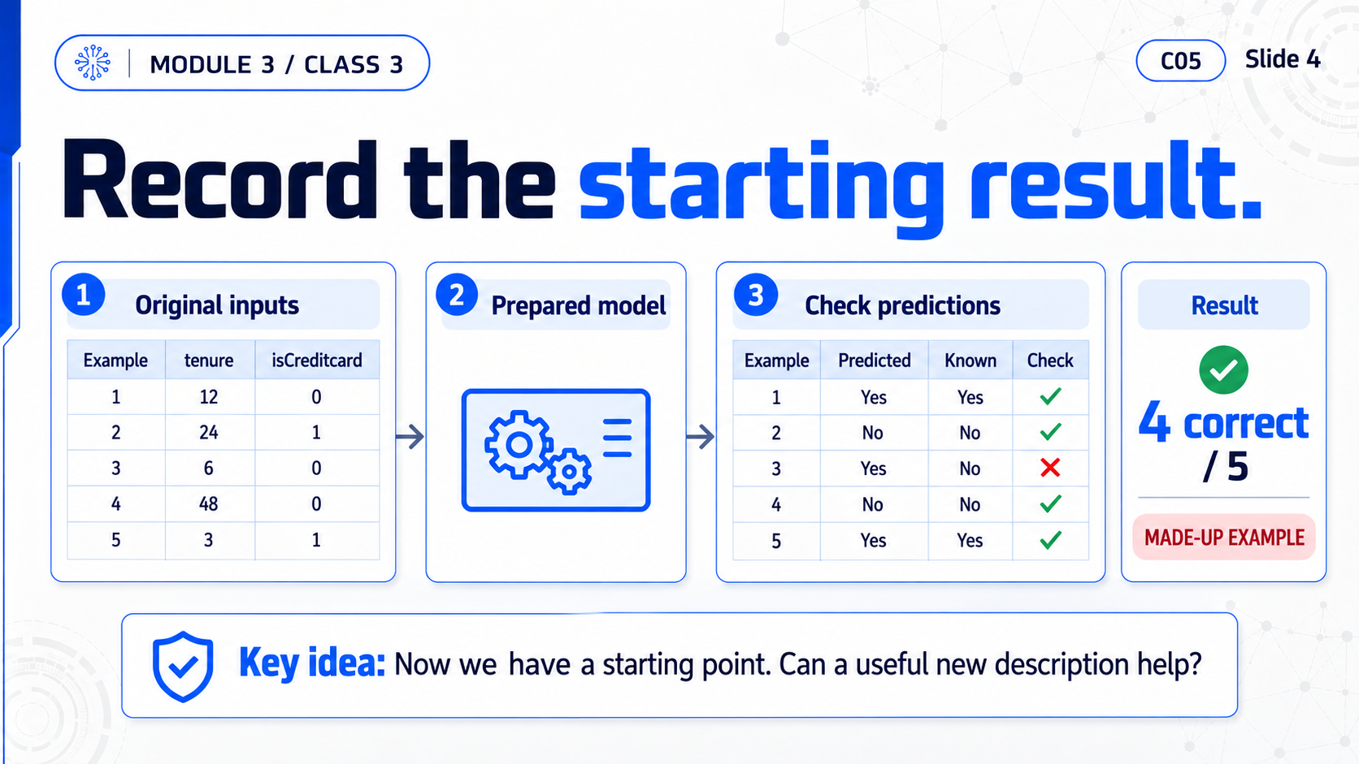
Notes:
M3C3 / SLIDE 04
Record the starting result.
Colab: C05
Full-slide raster image generated with imagegen. Speech is in the mentor DOCX.

Slide 5
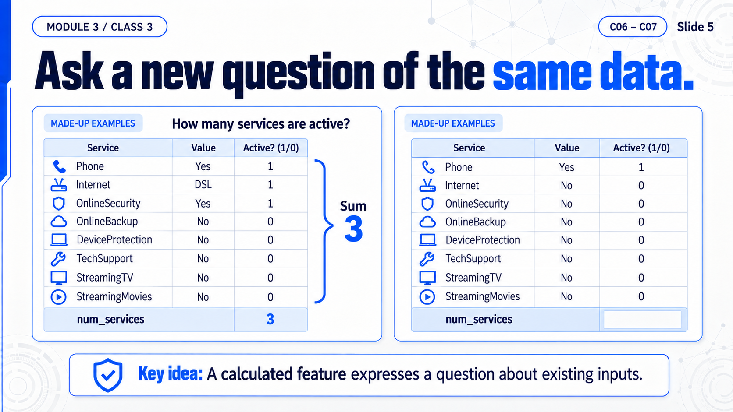
Notes:
M3C3 / SLIDE 05
Ask a new question of the same data.
Colab: C06–C07
Full-slide raster image generated with imagegen. Speech is in the mentor DOCX.

Slide 6
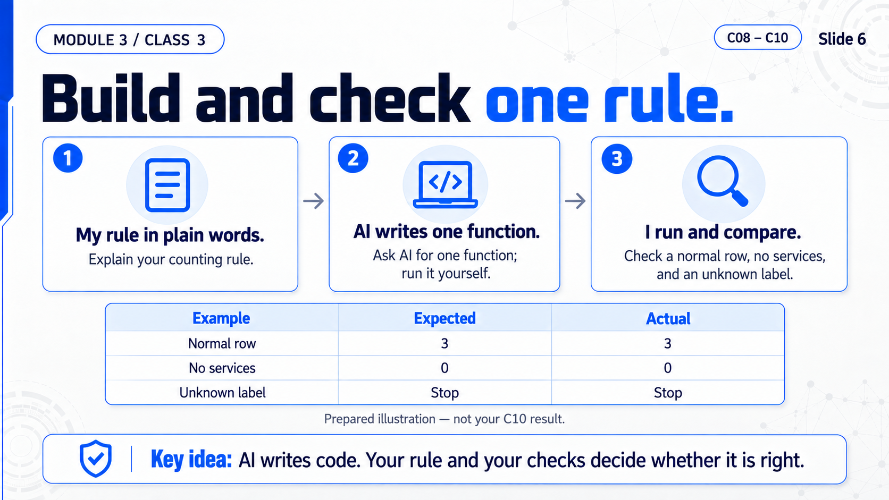
Notes:
M3C3 / SLIDE 06
Build and check one rule.
Colab: C08–C10
Full-slide raster image generated with imagegen. Speech is in the mentor DOCX.

Slide 7
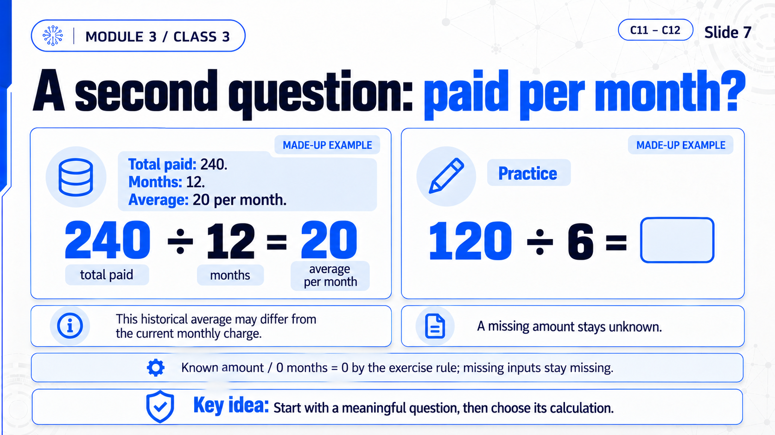
Notes:
M3C3 / SLIDE 07
A second question: paid per month?
Colab: C11–C12
Full-slide raster image generated with imagegen. Speech is in the mentor DOCX.

Slide 8
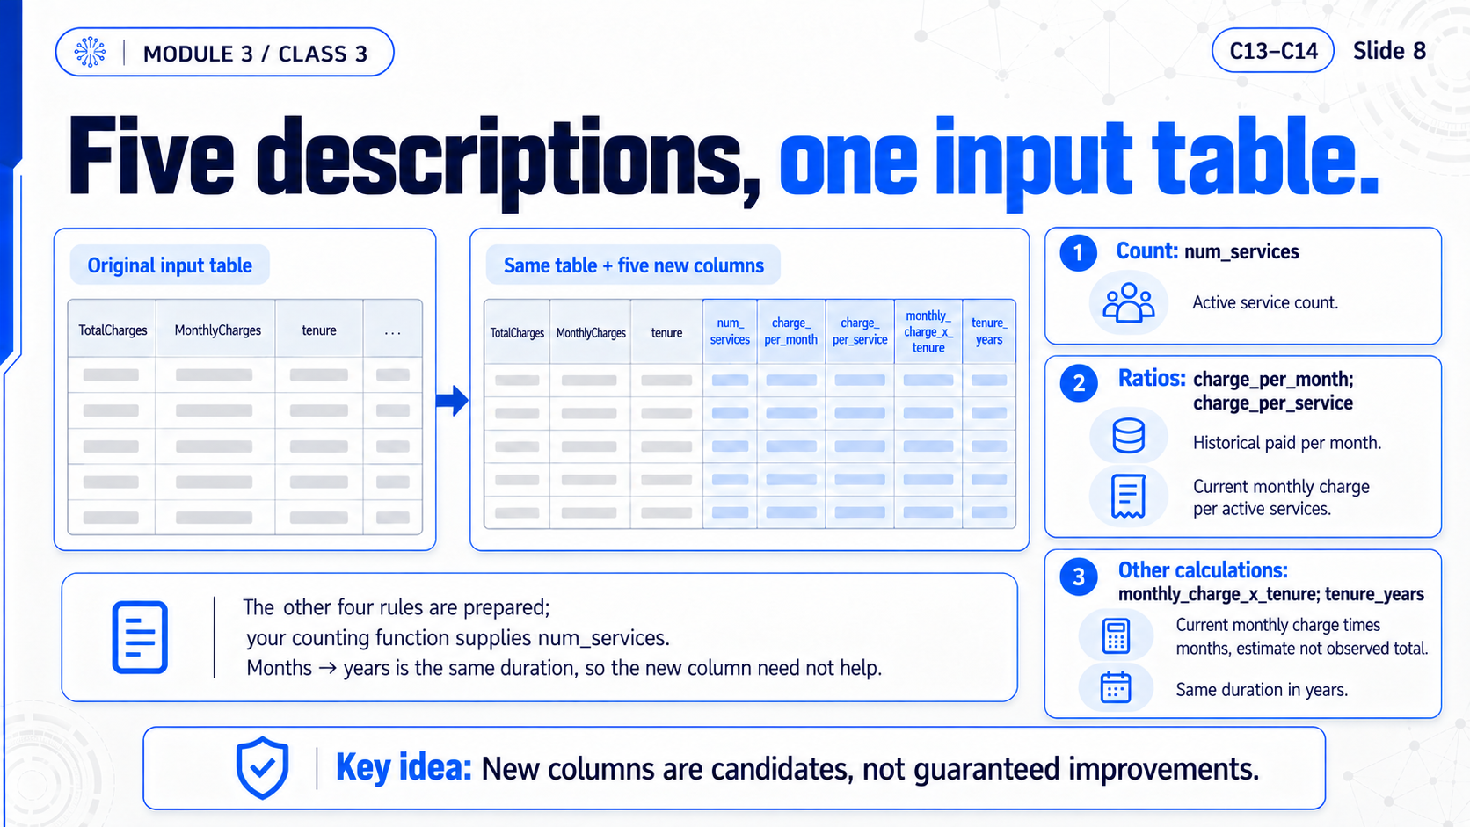
Notes:
M3C3 / SLIDE 08
Five descriptions, one input table.
Colab: C13–C14
Full-slide raster image generated with imagegen. Speech is in the mentor DOCX.

Slide 9
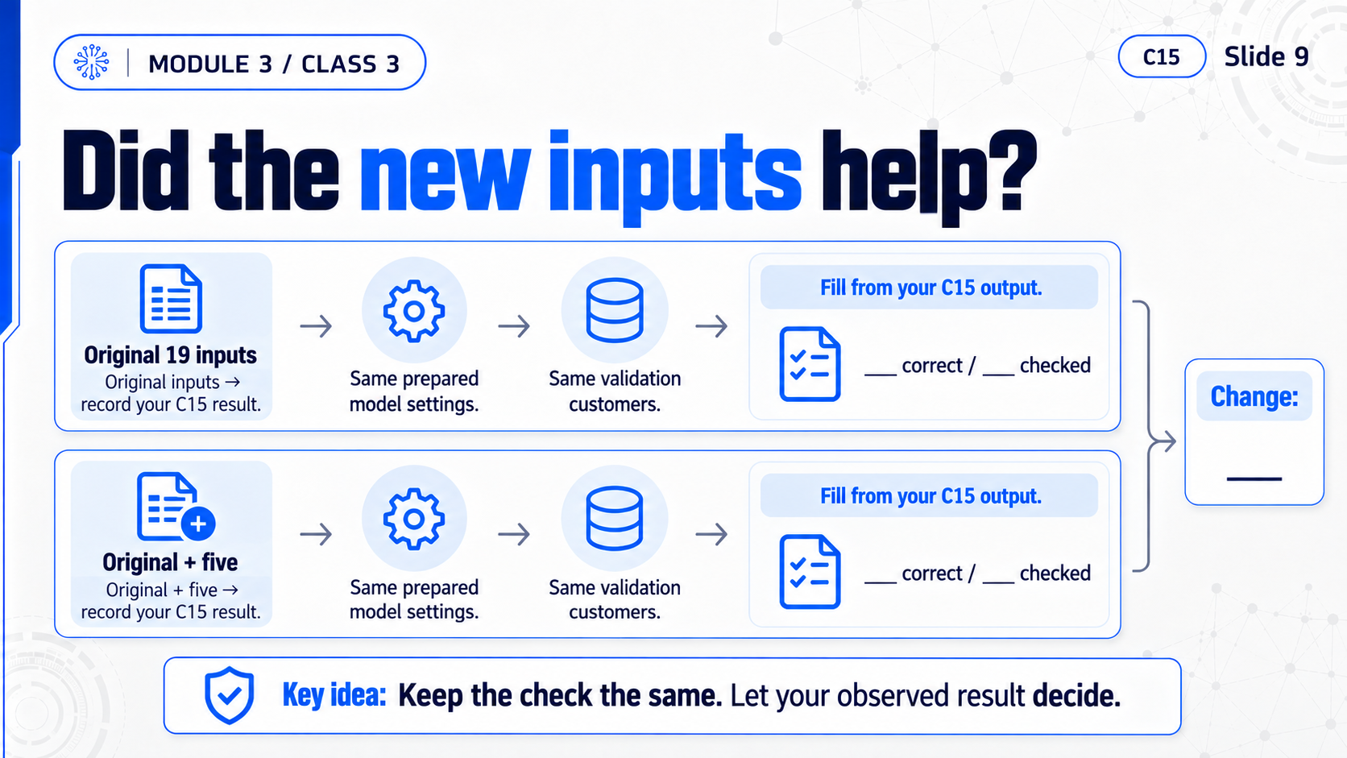
Notes:
M3C3 / SLIDE 09
Did the new inputs help?
Colab: C15
Full-slide raster image generated with imagegen. Speech is in the mentor DOCX.

Slide 10
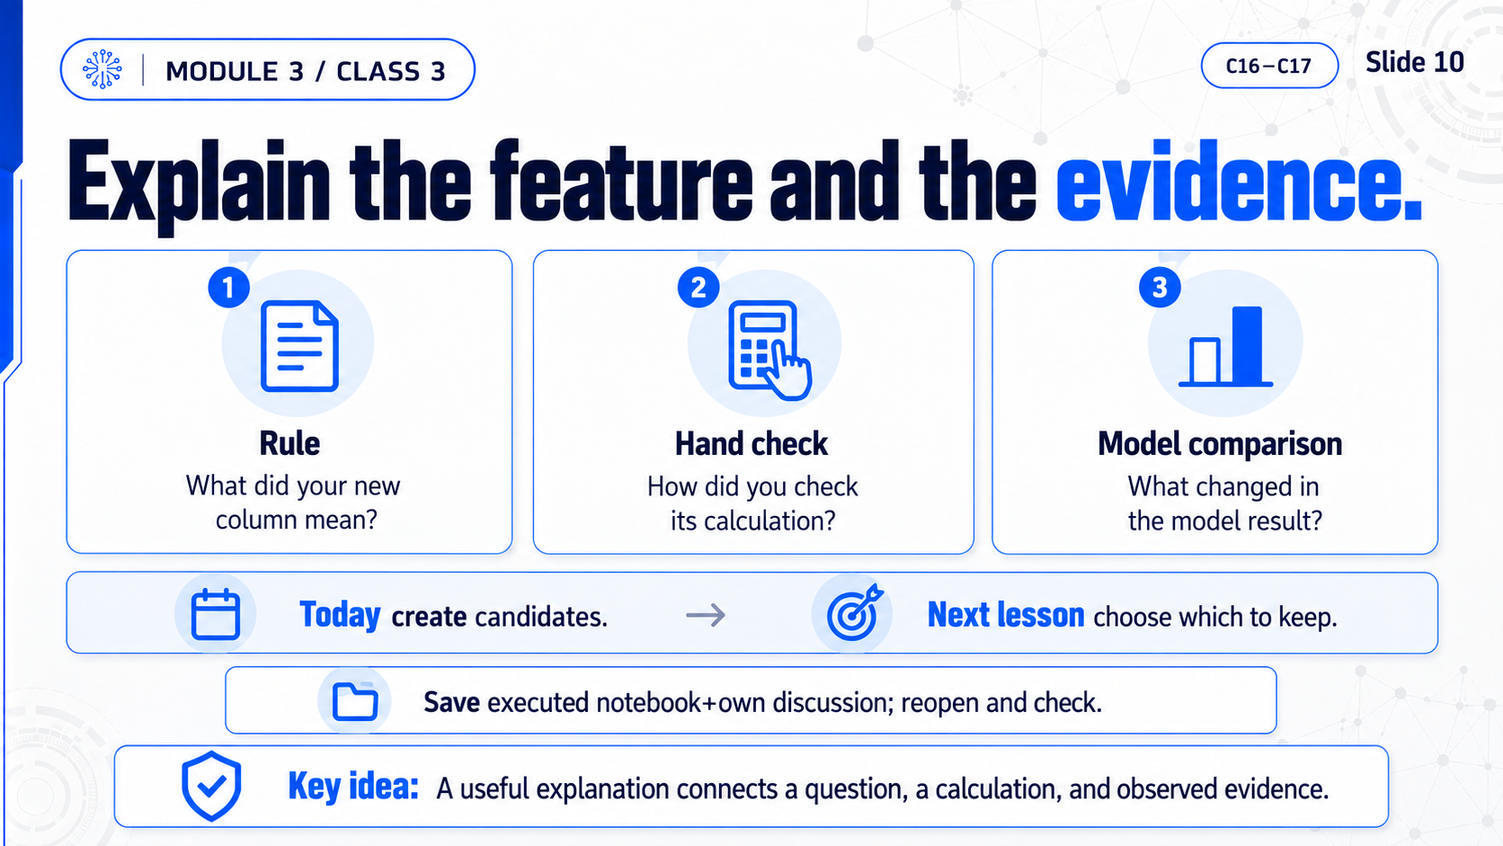
Notes:
M3C3 / SLIDE 10
Explain the feature and the evidence.
Colab: C16–C17
Full-slide raster image generated with imagegen. Speech is in the mentor DOCX.

