Slide 1
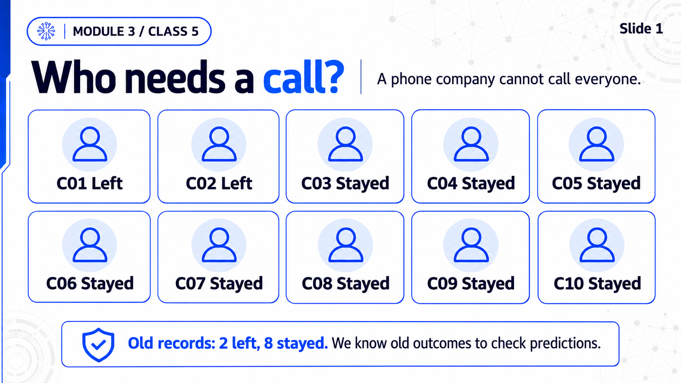
Notes:
M3C5 / Slide 1
Who needs a call?
Practice transition: Step 1 / B01
Save a personal copy. Run the small prepared ten-customer example and the everyone-stays rule. Eight right answers can still miss both people who left.
Full-slide ImageGen image. The complete RU/EN speech is in the mentor DOCX.

Slide 2
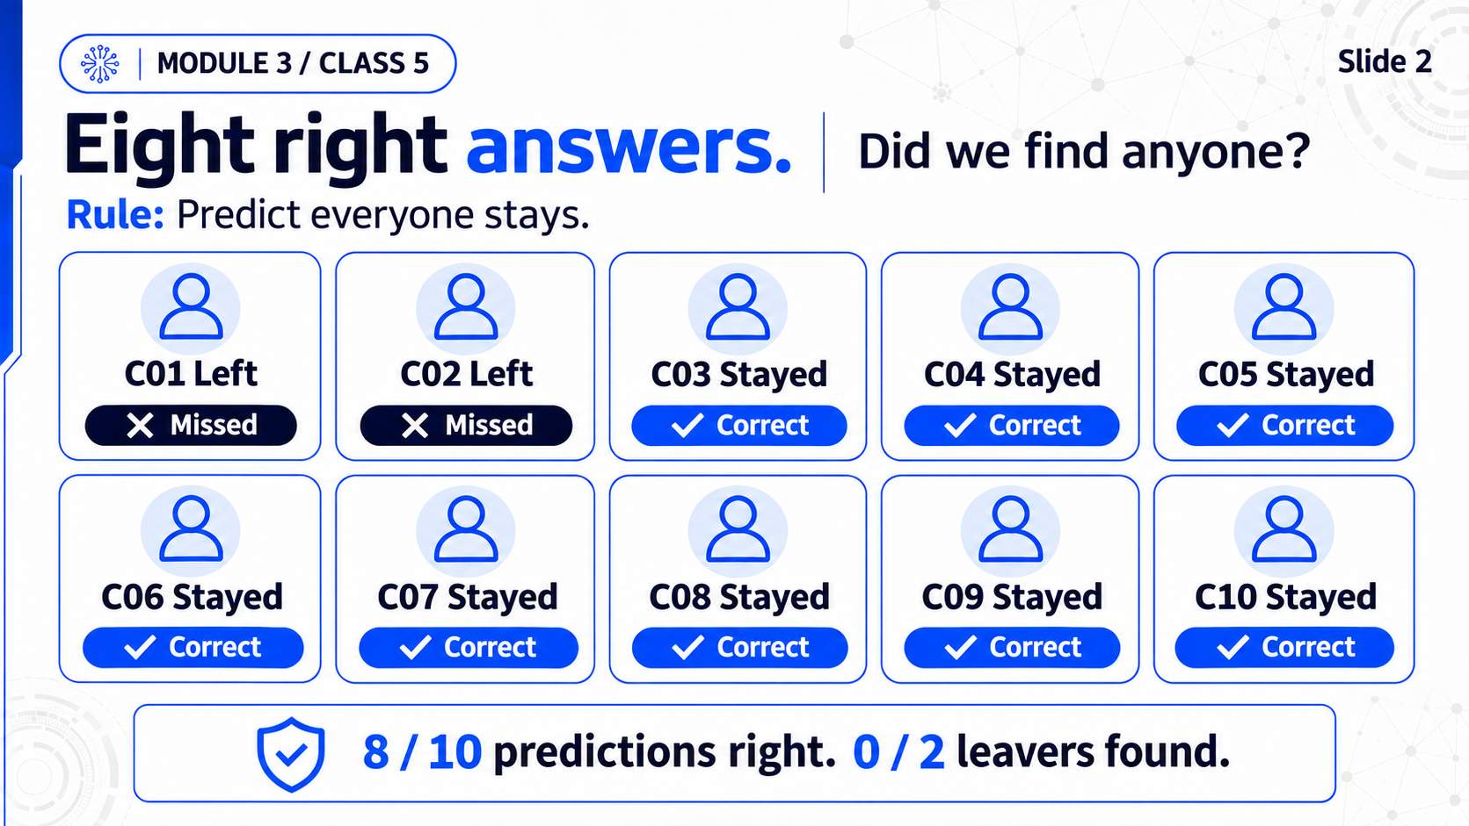
Notes:
M3C5 / Slide 2
Eight right answers. Did we find anyone?
Practice transition: Step 1 / B01
Save a personal copy. Run the small prepared ten-customer example and the everyone-stays rule. Eight right answers can still miss both people who left.
Full-slide ImageGen image. The complete RU/EN speech is in the mentor DOCX.

Slide 3
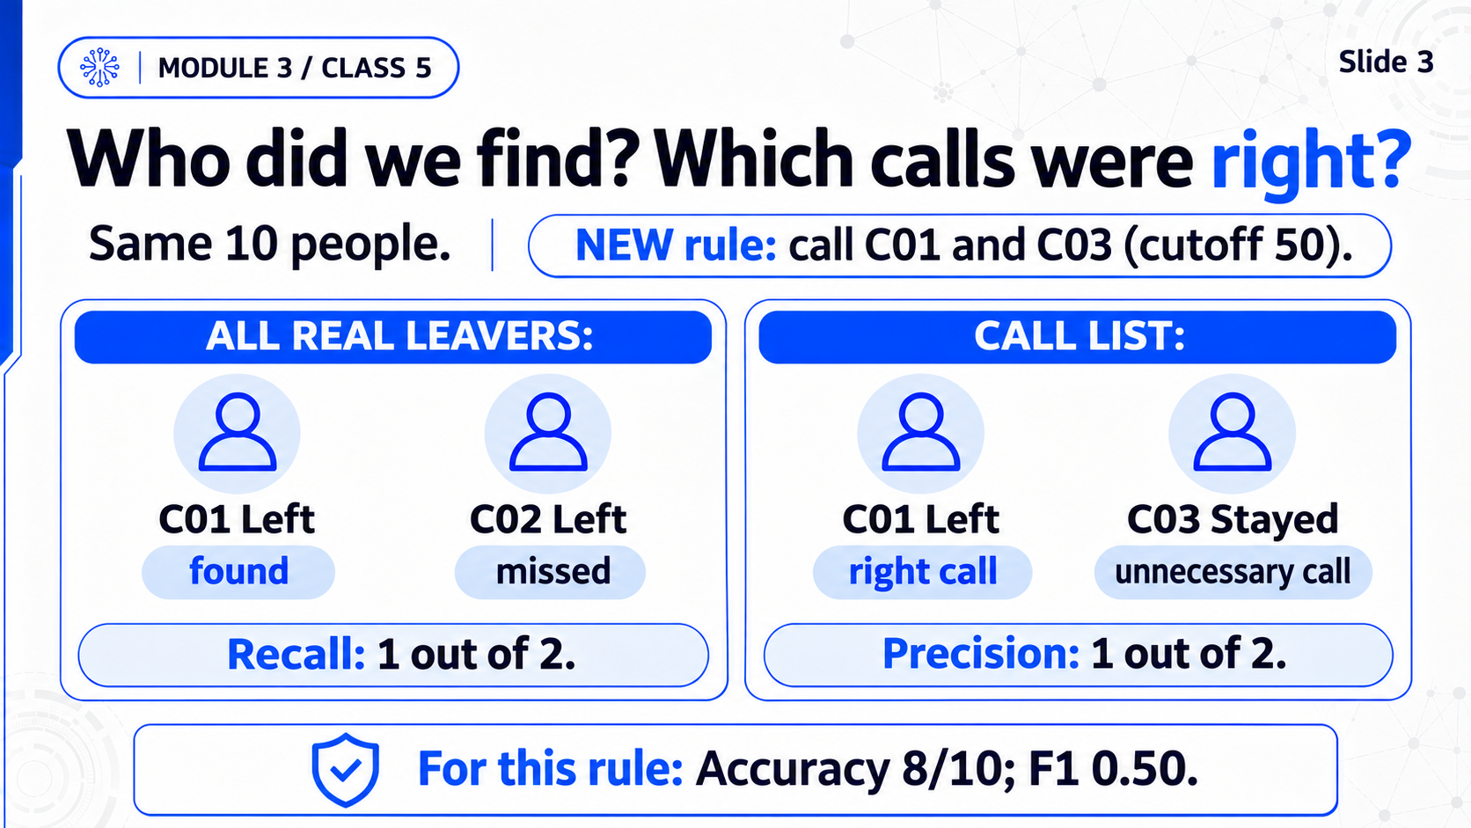
Notes:
M3C5 / Slide 3
Who did we find? Which calls were right?
Practice transition: Step 2 / B02
For the SAME ten customers use NEW cutoff50 decisions. Count real leavers and correct calls before naming metrics. Recall is1/2, precision1/2, accuracy8/10, F1.5; previous everyone-stays rule is replaced.
Full-slide ImageGen image. The complete RU/EN speech is in the mentor DOCX.

Slide 4
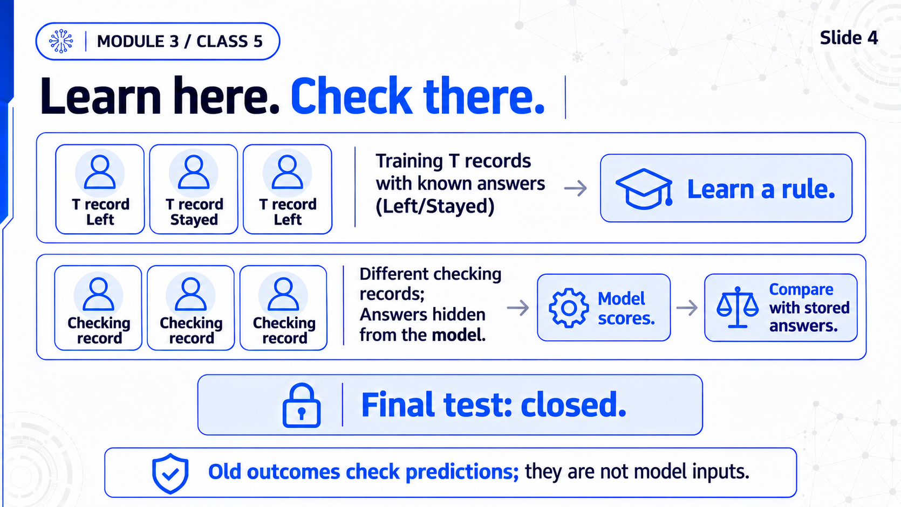
Notes:
M3C5 / Slide 4
Learn here. Check there.
Practice transition: Step 3 / B03
Upload issued CSV and runtime ZIP; all technical setup folded. Training teaches, validation checks choices, final test closed. The answer Churn is used to check, never given as a model input.
Full-slide ImageGen image. The complete RU/EN speech is in the mentor DOCX.

Slide 5
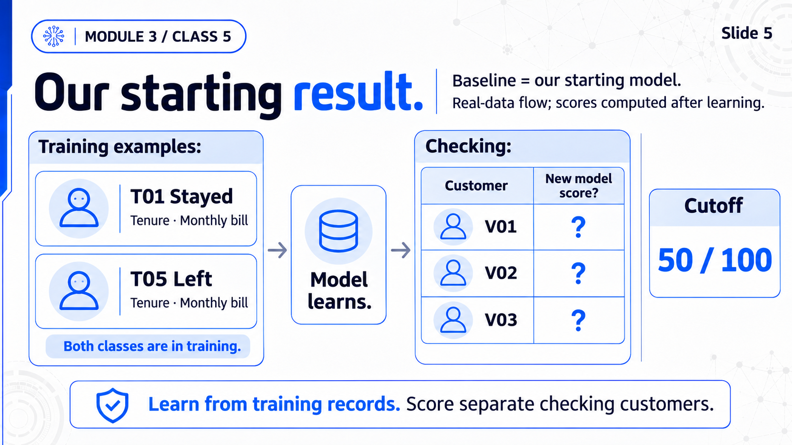
Notes:
M3C5 / Slide 5
Our starting result
Practice transition: Step 4 / B04
Run Baseline, read people found and unnecessary calls, then optional metrics. Follow real V01. V01 is a real validation example, not toy C01; read actual output.
Full-slide ImageGen image. The complete RU/EN speech is in the mentor DOCX.

Slide 6
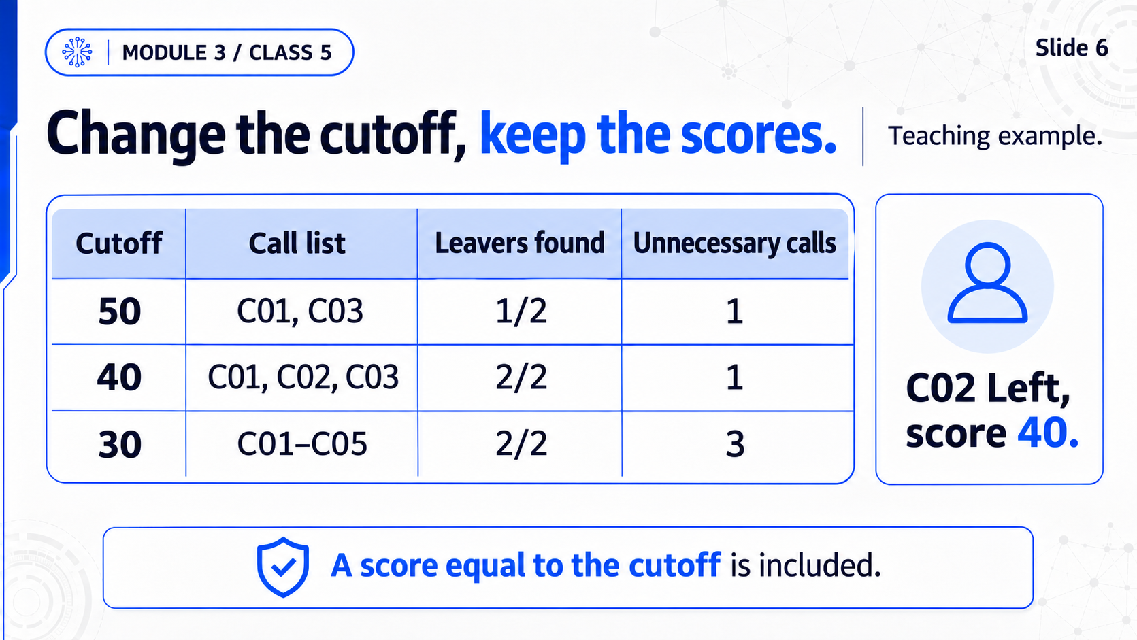
Notes:
M3C5 / Slide 6
Change the cutoff, keep the scores
Practice transition: Step 5 / B05
Run toy50/40/30 and baseline.5/.4/.3. Then reset to.5 for the training comparison. Equality included; lowering cutoff may add right and unnecessary calls; no retraining.
Full-slide ImageGen image. The complete RU/EN speech is in the mentor DOCX.

Slide 7
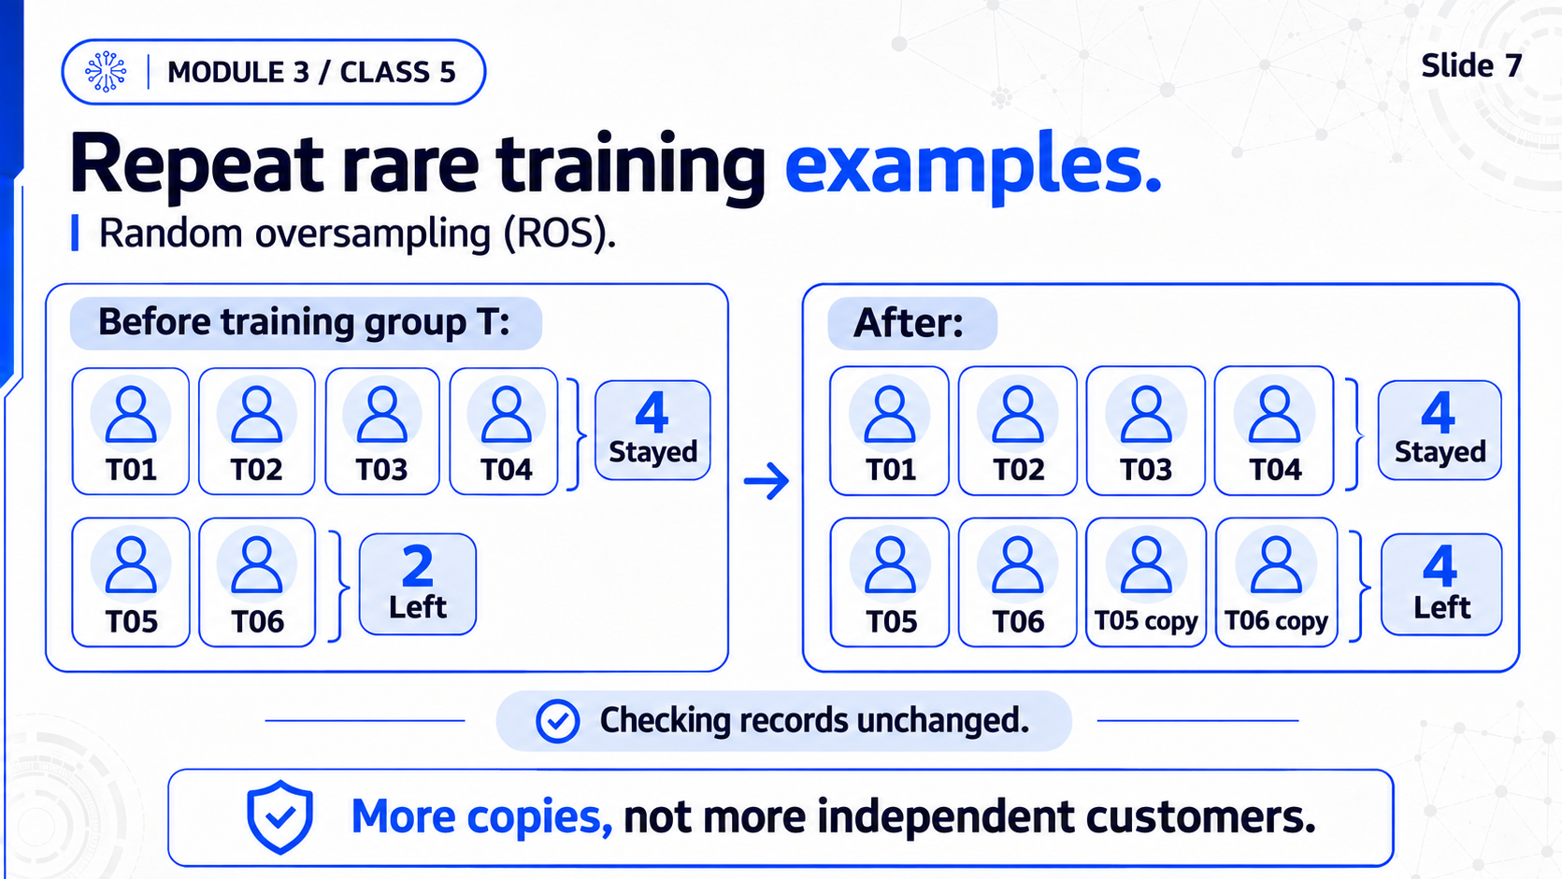
Notes:
M3C5 / Slide 7
Repeat rare training examples
Practice transition: Step 6 / B06
Run ROS and compare with Baseline on the same validation people at.5. Copies are not new independent people; validation never duplicated.
Full-slide ImageGen image. The complete RU/EN speech is in the mentor DOCX.

Slide 8
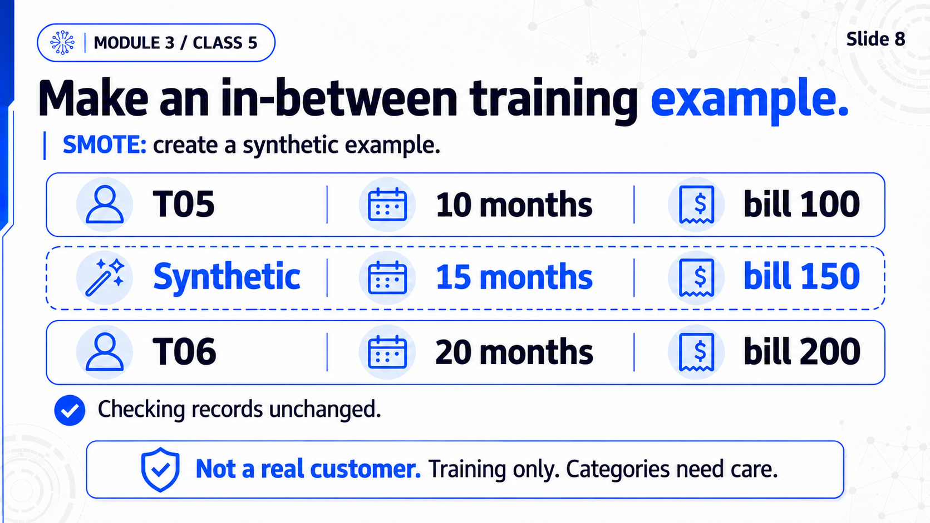
Notes:
M3C5 / Slide 8
Make an in-between training example
Practice transition: Step 7 / B07
T05(10,100) and T06(20,200) can give synthetic(15,150). Run actual SMOTE. Training only; categorical0/1 requires care. New training can change V01 score.
Full-slide ImageGen image. The complete RU/EN speech is in the mentor DOCX.

Slide 9
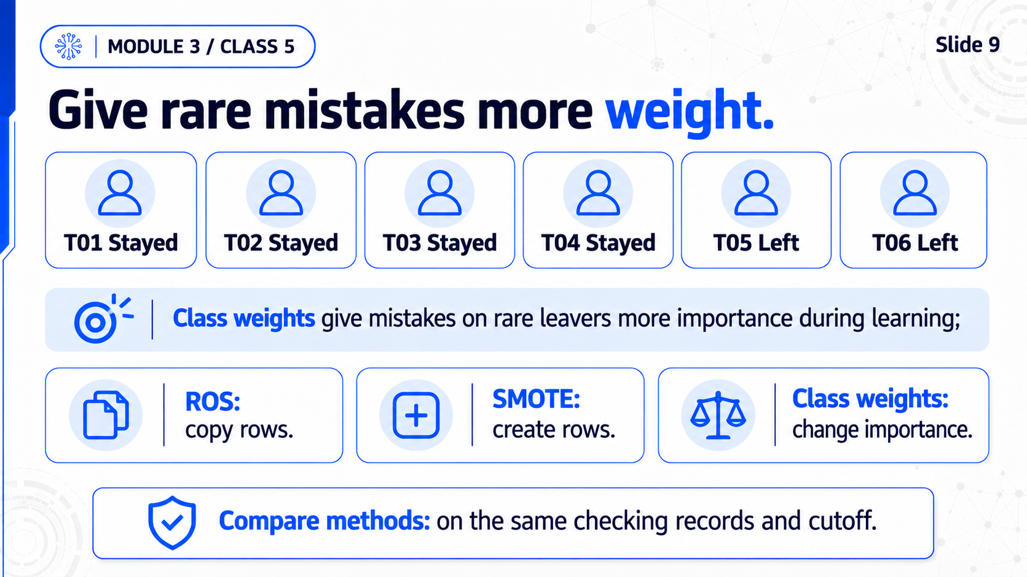
Notes:
M3C5 / Slide 9
Give rare mistakes more weight
Practice transition: Step 8 / B08
Run class_weight and the four-method table at.5. Explain copy/create/importance versus cutoff. Same validation customers and details. No method is always best.
Full-slide ImageGen image. The complete RU/EN speech is in the mentor DOCX.

Slide 10
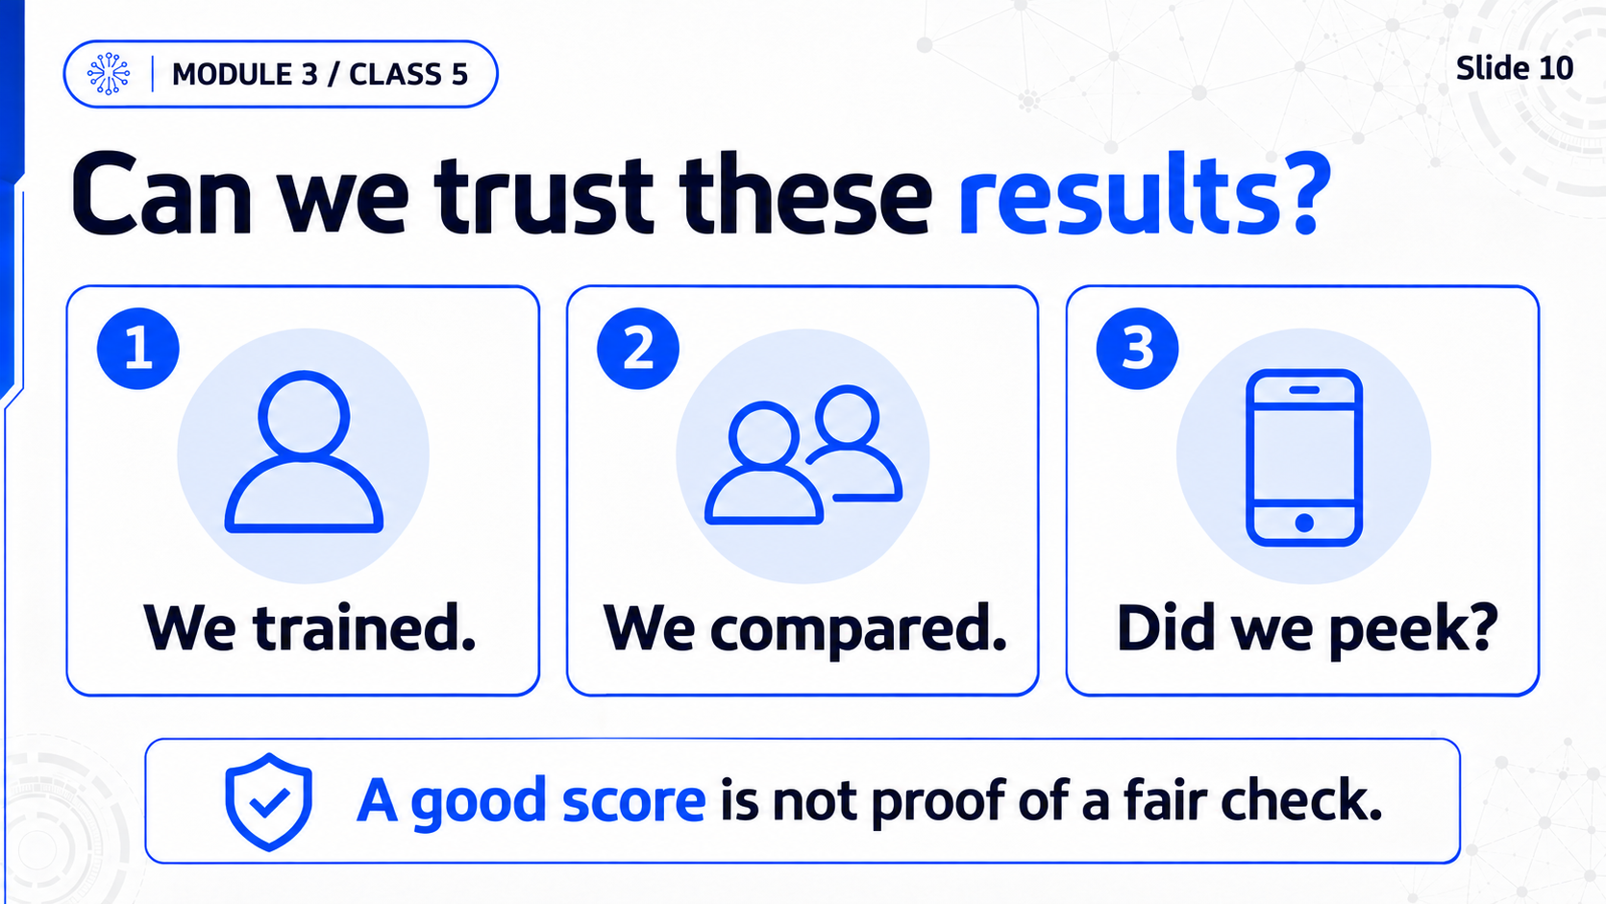
Notes:
M3C5 / Slide 10
Can we trust these results?
Practice transition: Step9 / B09
First ask whether cancellation reason exists BEFORE the call. Then show training bills100,200 average150; including separate checking bill300 wrongly changes average to200. Find the one wrong fit line and run a ready train-only repair. Level2/3 third TODO implements train-only scaler. Keep real technical audit and all metrics in optional details, not multiple main tables. Preparation learns from training only. Validation checks later. Scores may stay equal after repair; the rule was still wrong. Briefly retain group/time/stratification overview in optional support and homework, not a new main calculation.
Full-slide ImageGen image. The complete RU/EN speech is in the mentor DOCX.

Slide 11
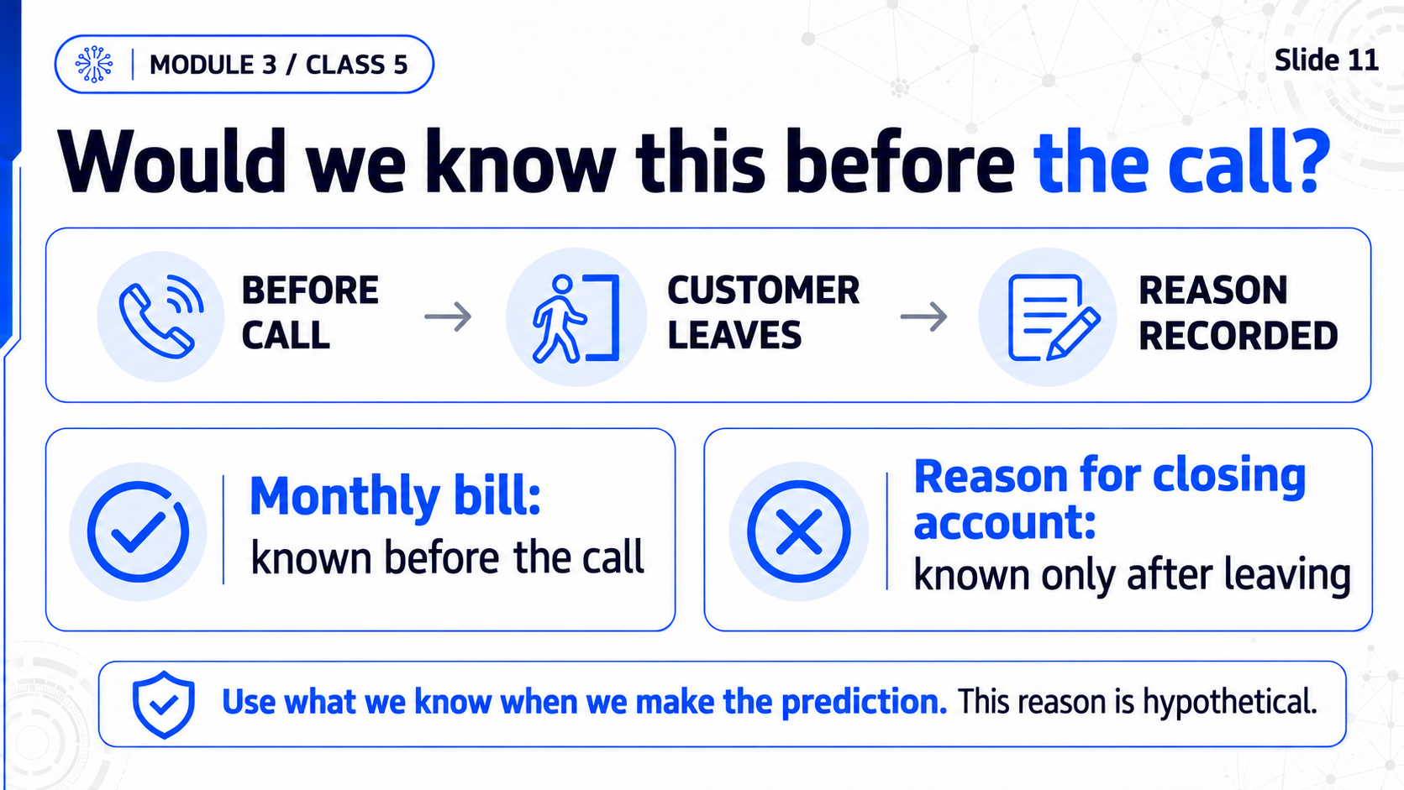
Notes:
M3C5 / Slide 11
Would we know this before the call?
Practice transition: Step9 / B09
First ask whether cancellation reason exists BEFORE the call. Then show training bills100,200 average150; including separate checking bill300 wrongly changes average to200. Find the one wrong fit line and run a ready train-only repair. Level2/3 third TODO implements train-only scaler. Keep real technical audit and all metrics in optional details, not multiple main tables. Preparation learns from training only. Validation checks later. Scores may stay equal after repair; the rule was still wrong. Briefly retain group/time/stratification overview in optional support and homework, not a new main calculation.
Full-slide ImageGen image. The complete RU/EN speech is in the mentor DOCX.

Slide 12
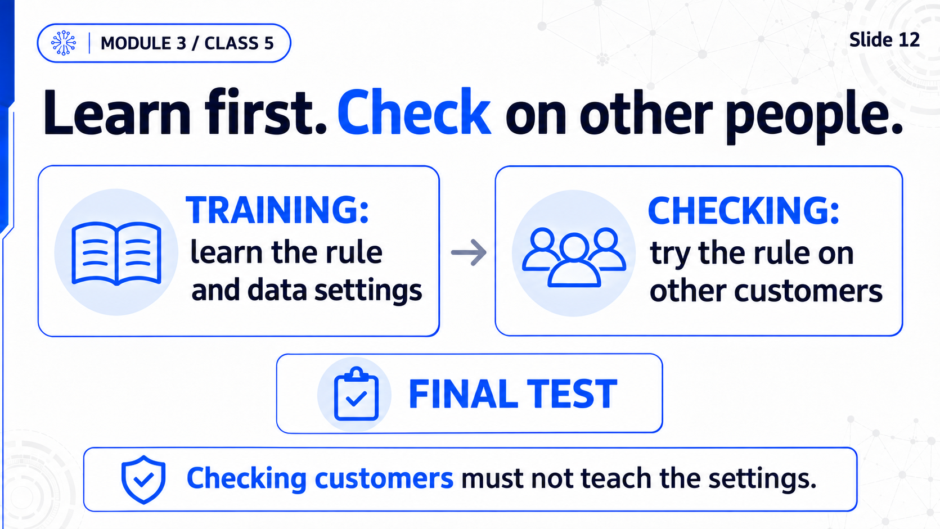
Notes:
M3C5 / Slide 12
Learn first. Check on other people.
Practice transition: Step9 / B09
First ask whether cancellation reason exists BEFORE the call. Then show training bills100,200 average150; including separate checking bill300 wrongly changes average to200. Find the one wrong fit line and run a ready train-only repair. Level2/3 third TODO implements train-only scaler. Keep real technical audit and all metrics in optional details, not multiple main tables. Preparation learns from training only. Validation checks later. Scores may stay equal after repair; the rule was still wrong. Briefly retain group/time/stratification overview in optional support and homework, not a new main calculation.
Full-slide ImageGen image. The complete RU/EN speech is in the mentor DOCX.

Slide 13
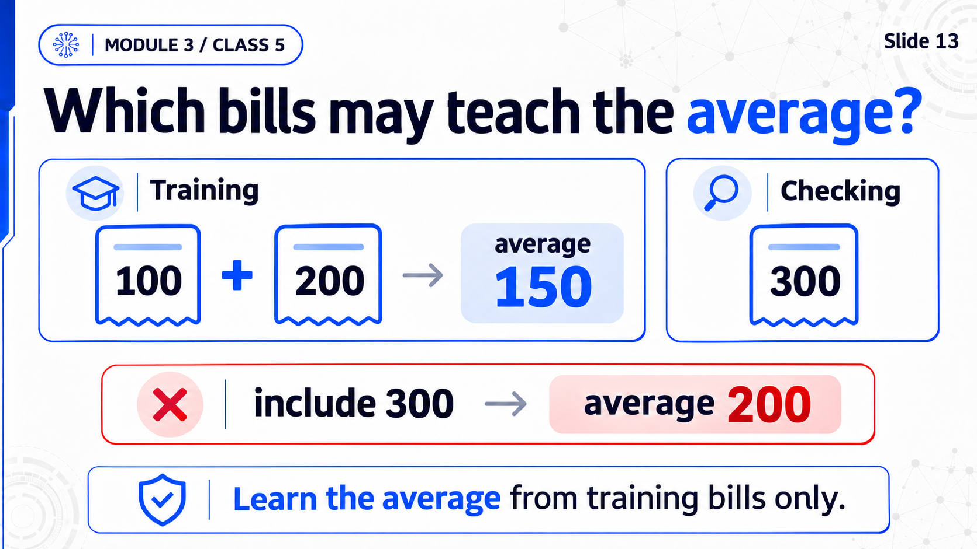
Notes:
M3C5 / Slide 13
Which bills may teach the average?
Practice transition: Step9 / B09
First ask whether cancellation reason exists BEFORE the call. Then show training bills100,200 average150; including separate checking bill300 wrongly changes average to200. Find the one wrong fit line and run a ready train-only repair. Level2/3 third TODO implements train-only scaler. Keep real technical audit and all metrics in optional details, not multiple main tables. Preparation learns from training only. Validation checks later. Scores may stay equal after repair; the rule was still wrong. Briefly retain group/time/stratification overview in optional support and homework, not a new main calculation.
Full-slide ImageGen image. The complete RU/EN speech is in the mentor DOCX.

Slide 14
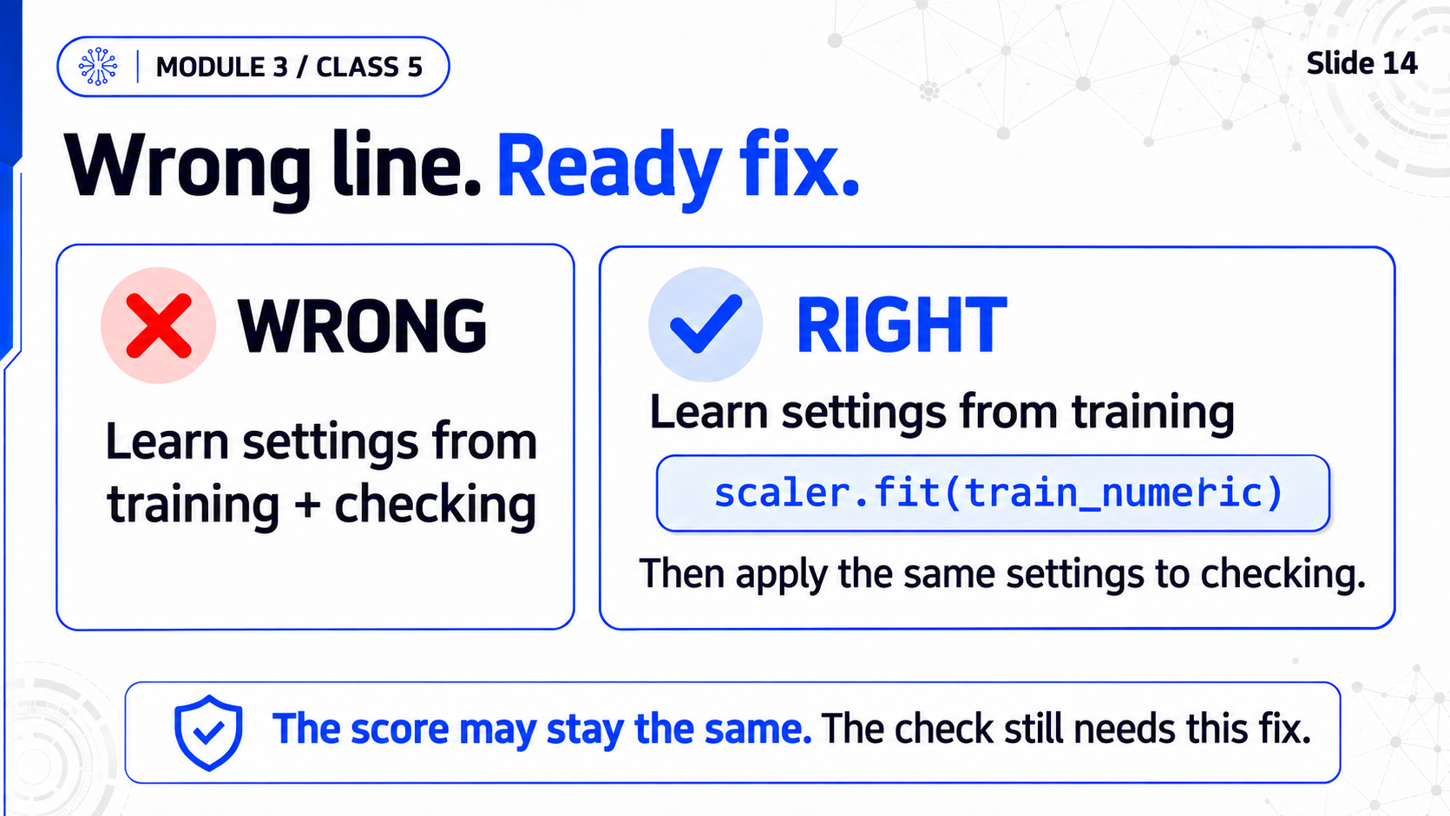
Notes:
M3C5 / Slide 14
Wrong line. Ready fix.
Practice transition: Step9 / B09
First ask whether cancellation reason exists BEFORE the call. Then show training bills100,200 average150; including separate checking bill300 wrongly changes average to200. Find the one wrong fit line and run a ready train-only repair. Level2/3 third TODO implements train-only scaler. Keep real technical audit and all metrics in optional details, not multiple main tables. Preparation learns from training only. Validation checks later. Scores may stay equal after repair; the rule was still wrong. Briefly retain group/time/stratification overview in optional support and homework, not a new main calculation.
Full-slide ImageGen image. The complete RU/EN speech is in the mentor DOCX.

Slide 15
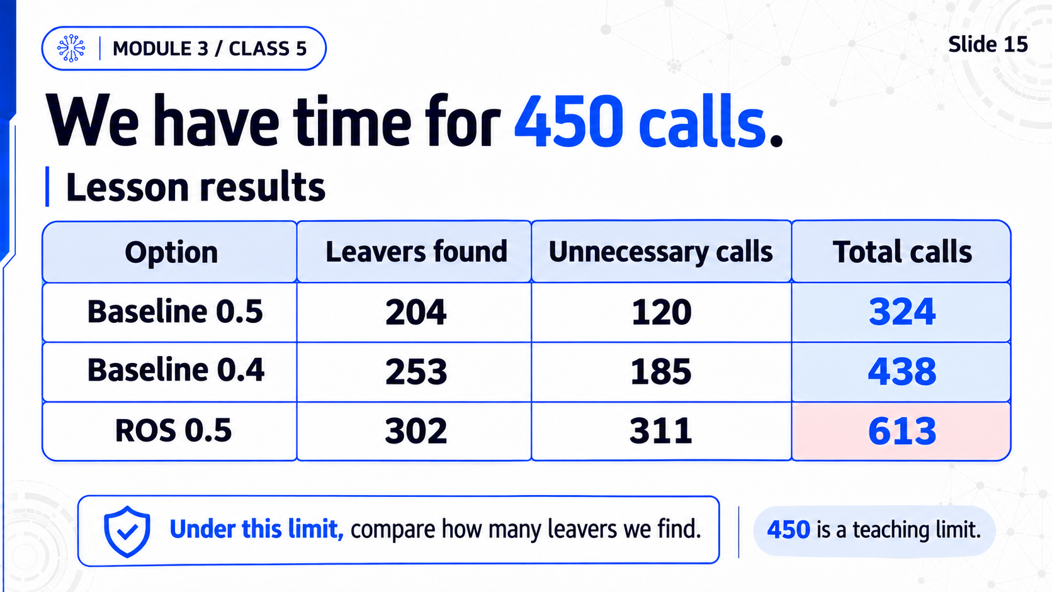
Notes:
M3C5 / Slide 15
We have time for 450 calls
Practice transition: Step10 / B10
At most450calls. Calls=found+unnecessary. Among measured eligible options find more leavers. Preserve seven measured dropdown pairs with duplicatebaseline.5 explained. Save at the clear classroom finish. Baseline.4:253found+185unnecessary=438calls,121missed. Baseline.5:204found+120unnecessary=324. This is conditional, not a universal recommendation.
Full-slide ImageGen image. The complete RU/EN speech is in the mentor DOCX.

Slide 16
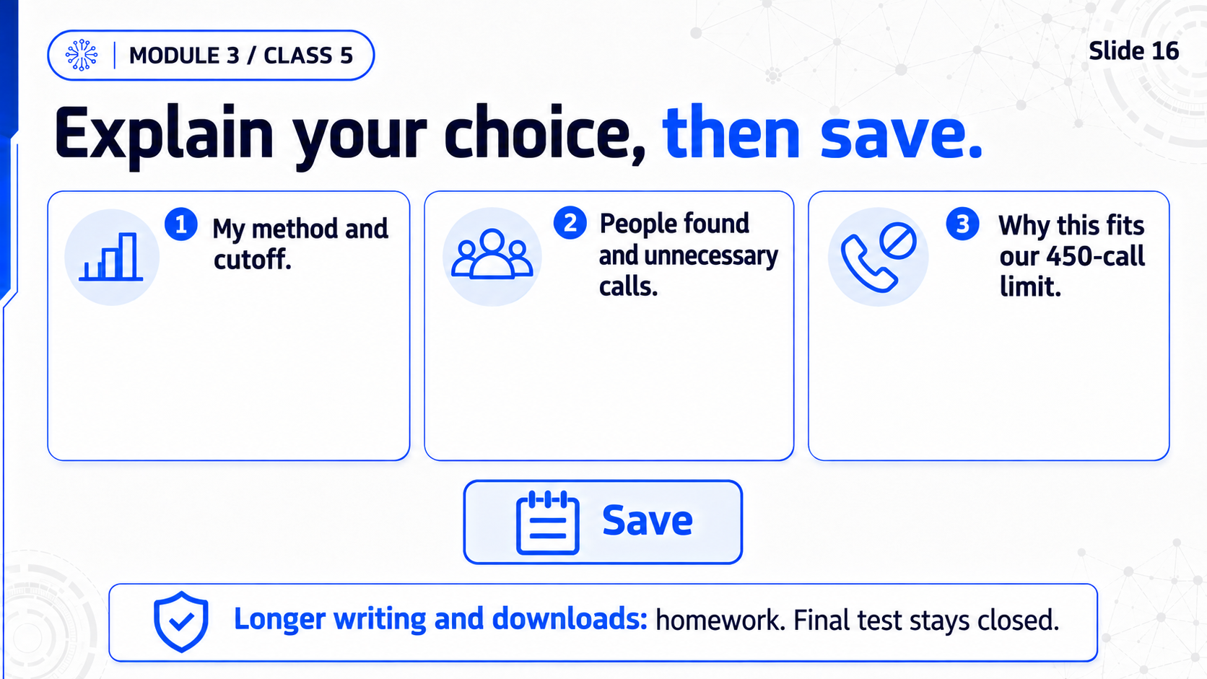
Notes:
M3C5 / Slide 16
Explain your choice, then save
Practice transition: Step10 / B10; homeH01-H03
At most450calls. Calls=found+unnecessary. Among measured eligible options find more leavers. Preserve seven measured dropdown pairs with duplicatebaseline.5 explained. Save at the clear classroom finish. Baseline.4:253found+185unnecessary=438calls,121missed. Baseline.5:204found+120unnecessary=324. This is conditional, not a universal recommendation.
Full-slide ImageGen image. The complete RU/EN speech is in the mentor DOCX.

