Slide 1
Geolocation of microblogging users Manas Sharma Tarun Gangwani Agalya Loganathan Goutham Atluri Divyesh Dyananmote Aarti Rao Shwetha Narayanan

Slide 2
OVERVIEW
With the advent of social media the growth in data generation has been exponential.
This has given a huge array of opportunities to both data scientists and analysts to mine the data and extract useful information from it.
We intent to build up on the research proposed in popular machine learning journals and build on top of their work to come up with an efficient supervised learning algorithm that would help in determining the Geolocation of a particular user based upon the content of his tweet/microblog

Slide 3
SOME STATISTICS
Twitter on an average has a reception of 500 million tweets per day
- Source www.internetlivestats.com/twitter-statistics
About 42.4% of the world's population uses the Internet.
According to the International Telecommunication Union
about 3.2 billion people, or almost half of the world's population,
will be online by the end of 2015
- Source https://en.wikipedia.org/wiki/Global_Internet_usage
Prediction of the geo-names would give us an opportunity to:
1) Give location specific information to a twitter user (for instance
information about a probable calamity in that region can be
broadcasted)
2) Leverage the model in commercial paradigm to promote a
product in a particular region.

Slide 4
THE ALGORITHM EXPLAINED
User details
extraction
Location tagging - NER
Ranking
Preprocessing of tweets
Fuzzy logic
Social tightness module
User’s top k locations

Slide 5
Module-1: Tweet Extraction and Stop Word filtering
Collected the tweets using Twitter API.
Filtered the tweets based on keywords, in Python
Stop Words Filtering : Use NLTK package for list of words, remove http links, email Ids, remove punctuations, user ids from tweet, remove numbers and other symbols.
Stored the tweets locally for now, we will be storing tweets in MongoDB

Slide 6
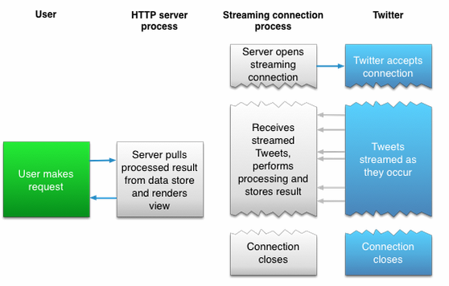
Streaming API Connection

Slide 7
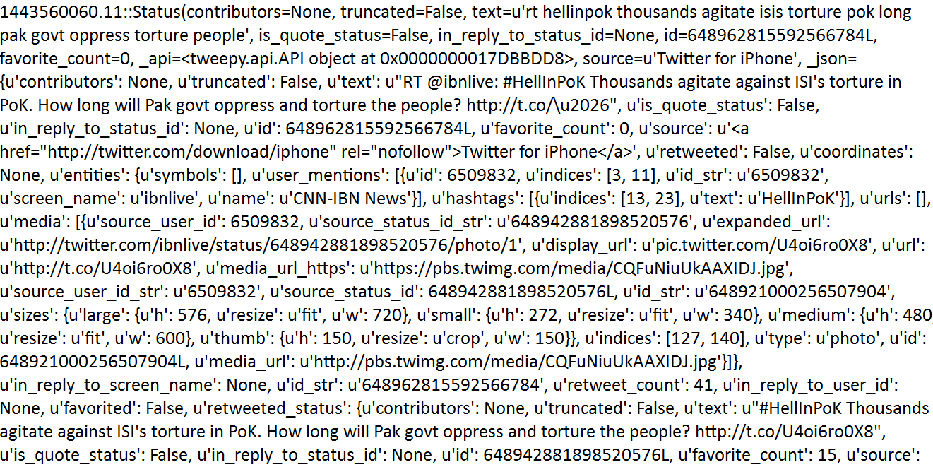
Raw Tweets in JSON format

Slide 8
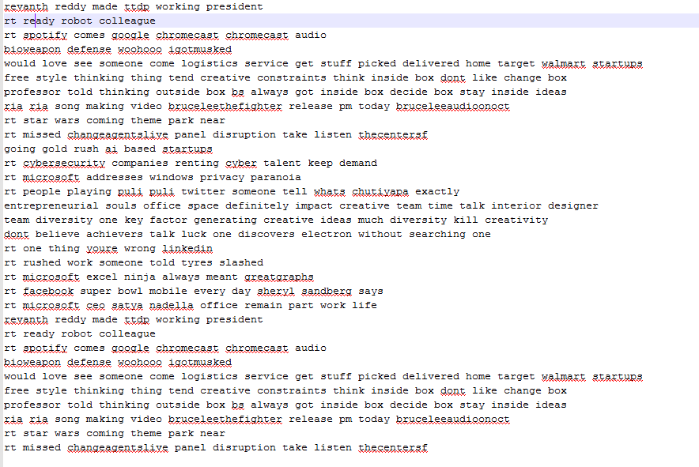
Tweets after Processing

Slide 10
Module-2: fuzzy matching algorithm
Stage 1: Collection of the pre-processed data.
Stage 2: Dictionary generation using the enchant library in Python.
Stage 3: Using enchant library to predict possible words for a string whose lookup in the dictionary fails.
Stage 4: A ranking mechanisms replaces the incorrect string with the highest ranked values in the set determined by the fuzzywuzzy library.

Slide 11
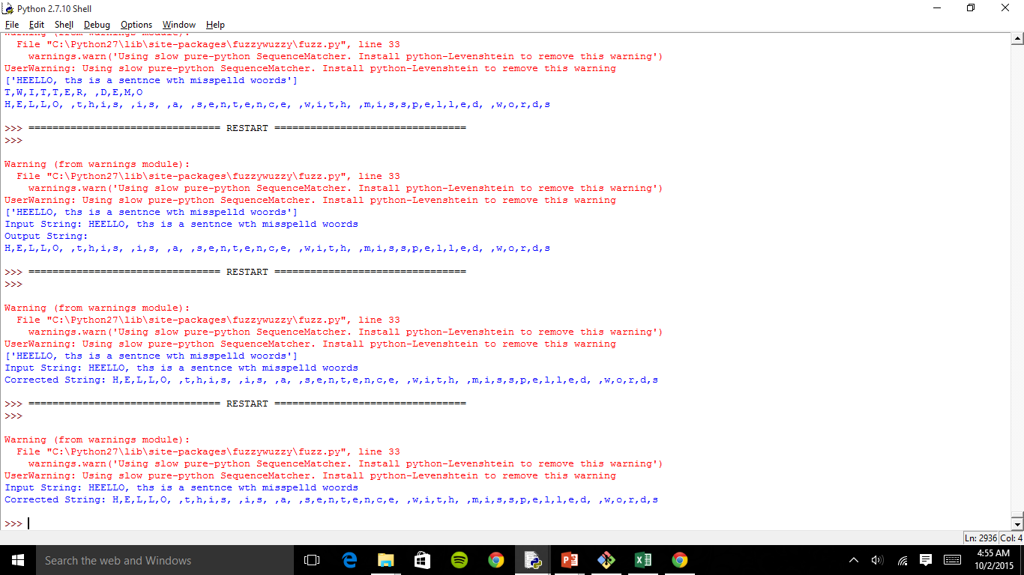
Complication
It replaces proper nouns too like names of people/cities etc.
We overcome this problem by determining nouns in the speech and ignoring it by using part-of-speech tagger.
Example

Slide 12
Module 3: Supervised Learning
Stanford NER - Based on linear chain CRF model
Existing models label sequences of words in a text (PERSON, ORGANIZATION, LOCATION)
Building a custom sequence model to identify three parts of a location in a text (POI, CITY, STATE)
NER is applied on the tweets of the user and his friends
GeoNames DB for tagging POI's and mapping POI's to states
Also to identify and tag abbreviations

Slide 13
Example
Tweet
Arizona State University’s Tempe campus gets a green revamp @ASUGreen
Point of Interest
City
I’m at Milano’s family restaurant in Springfield, VA
Great crowd for @katieschuermann’s book signing at Barnnes and noble today in Springfield, IL

Slide 14
Module 4: Social Network Graph construction using NetworkX
Scrapped Twitter (using the rest end points exposed) to fetch users and their friends in a breadth first fashion.
This user information (including friendship) is used to construct a social network graph.
Few measures like centrality and similarity are computed to get a picture of the social network
As expected, there are many users with minimal friends and a few users with maximum friends.

Slide 15
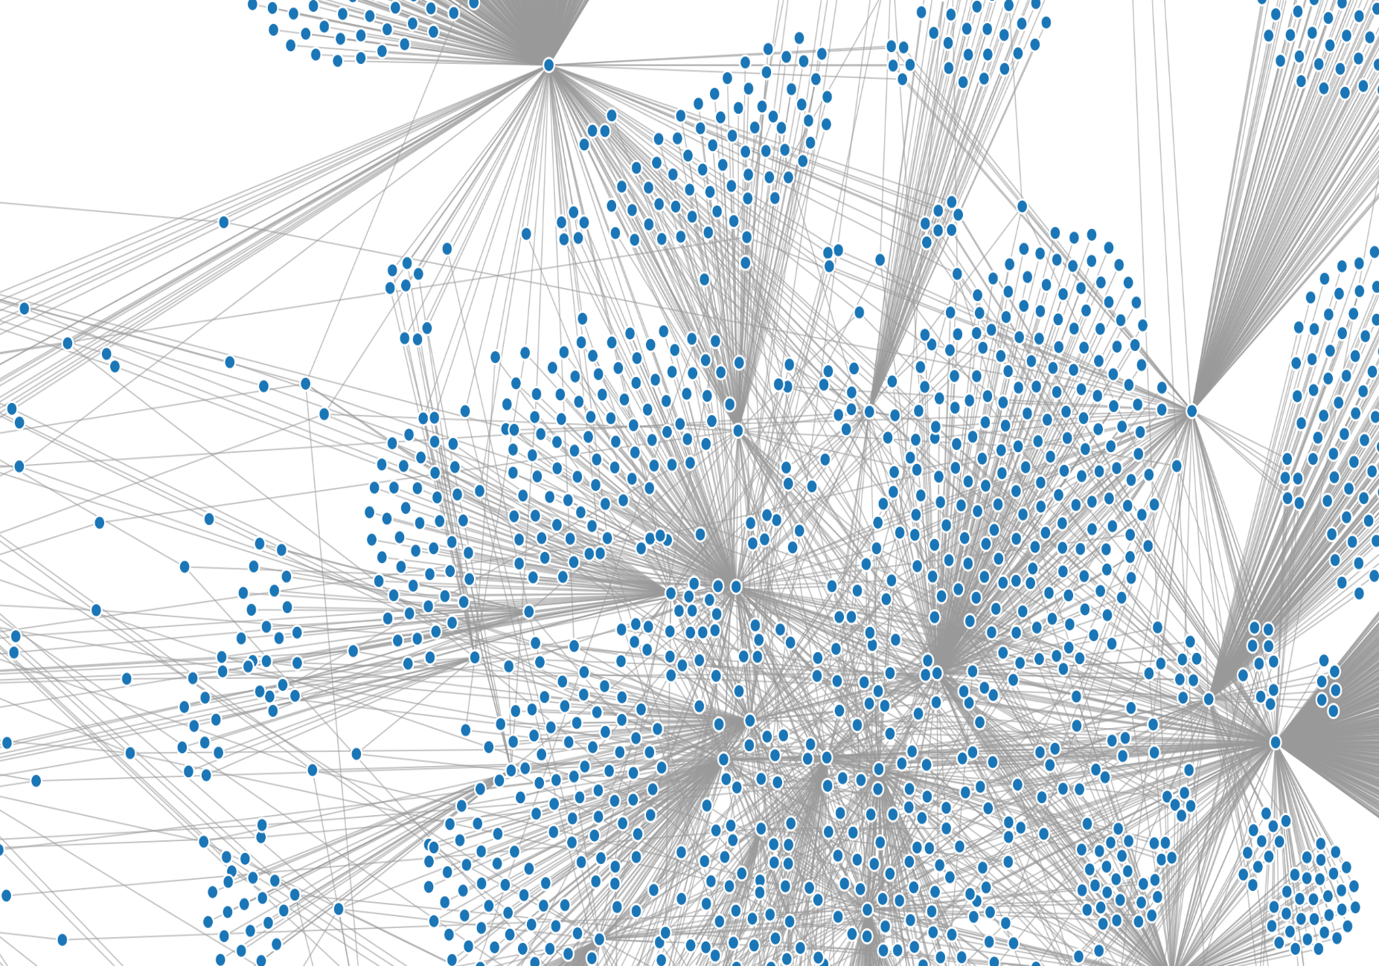
Social Network Graph

Slide 16
MODULE 5: USING SOCIAL NETWORKS TO RANK THE LOCATION PREDICTION
Use social tightness model to predict similarity between users
Identify the most influential (similar) friends of a user and extract their location (if available in user profile information)
If location information is not available, estimate the user's location and use this estimate in successive iterations
Identify (influential) friends whose location estimations are closer to the user's predicted location

Slide 17
References
[1] Chuanyang Li, Xiuqin Lin, Bin Wu, Chuan Shi Location Inference Using Microblog Text and Friendships. ASONAM 2014
[2] Guoliang Li, Jun Hu, Kian-lee Tan, Zhifeng Bao, Jianhua Feng Effective Location Identiﬁcation from Microblogs. ICDE 2014
[3] Longbo Kong, Zhi Liu, Yan Huang SPOT: Locating Social Media Users Based on Social Network Context. VLDB 2014
[4] Cheng, Z., Caverlee, J., and Lee, K. 2013. A Content-driven Framework for Geolocating Microblog Users. ACM 2013
[5] Lars Backstrom, Eric Sun, and Cameron Marlow Find me if you can: improving geographical prediction with social and spatial proximity. In Proceedings of the 19th international conference on World wide web, pages 61–70. ACM, 2010

Slide 18
References
[6] Alexandre Passant Tuukka Hastrup Uldis Bojars John Breslin LaLIC, University Paris-Sorbonne, 28 rue Serpente Microblogging: A Semantic and Distributed Approach, 75006 Paris, France
[7] Eric Lai, Daniel Moyerxy Baichuan Yuanz Eric Fox Blake H,unter Andrea L.Bertozzi rey Brantingham :Topic Time Series Analysis of
Microblogs
[8]: Sudipta Roy Sourish Dhar Saprativa Bhattacharjee Anirban Das Triguna Sen School of Technology, Assam University, Silcha:A LEXICON BASED ALGORITHM FOR NOISY TEXT NORMALIZATION AS PREPROCESSING FOR SENTIMENT ANALYSIS
[9]Reid Priedhorsky, Aron Culotta, Sara Y Locations of Tweets with Quantitative Confidence

Slide 19
THANK YOU

