Slide 1
Experiment 5: End-to-End MLOps
- Manas Tawde, E019
- FastAPI + scikit-learn -> Docker -> GitHub Actions -> Docker Hub -> Kubernetes -> Prometheus/Grafana

Slide 2
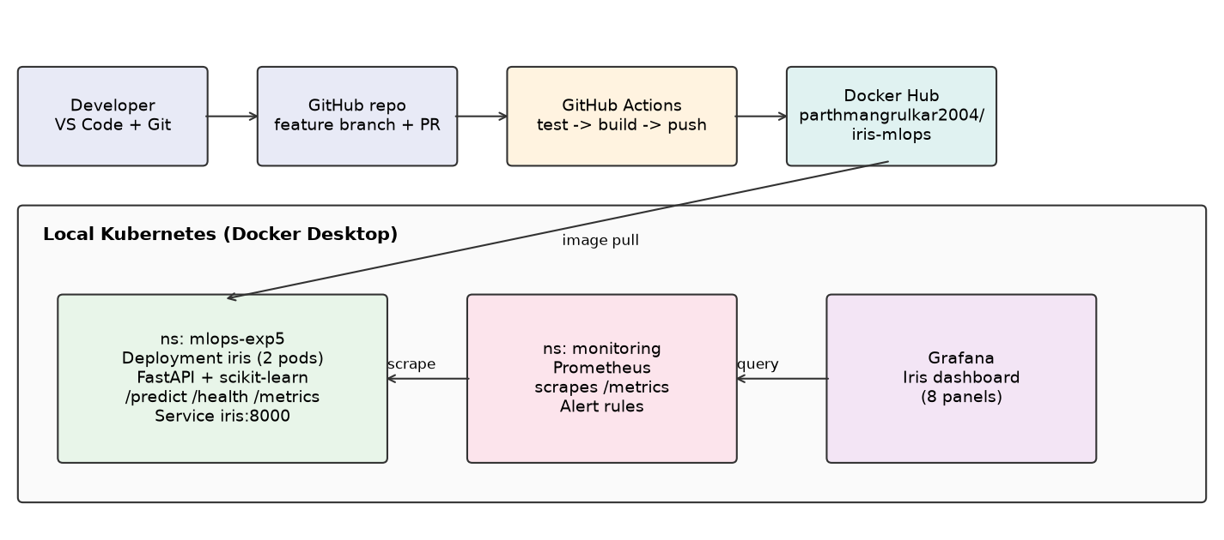
Architecture

Slide 3
CI/CD
- Feature branch + PR #1 into main
- Jobs: pytest (5 tests) -> docker build -> push on push events
- Secrets: DOCKERHUB_USERNAME / DOCKERHUB_TOKEN
- First push run failed (no secrets yet); all runs green afterwards
- Image: parthmangrulkar2004/iris-mlops (:latest, :sha)

Slide 4
Kubernetes + Monitoring
- Namespace mlops-exp5: 2 replicas, probes, resource limits
- kube-prometheus-stack via Helm; scrape job for /metrics/
- Dashboard: predictions, p95 latency, errors, health, CPU, memory, replicas, restarts

Slide 5
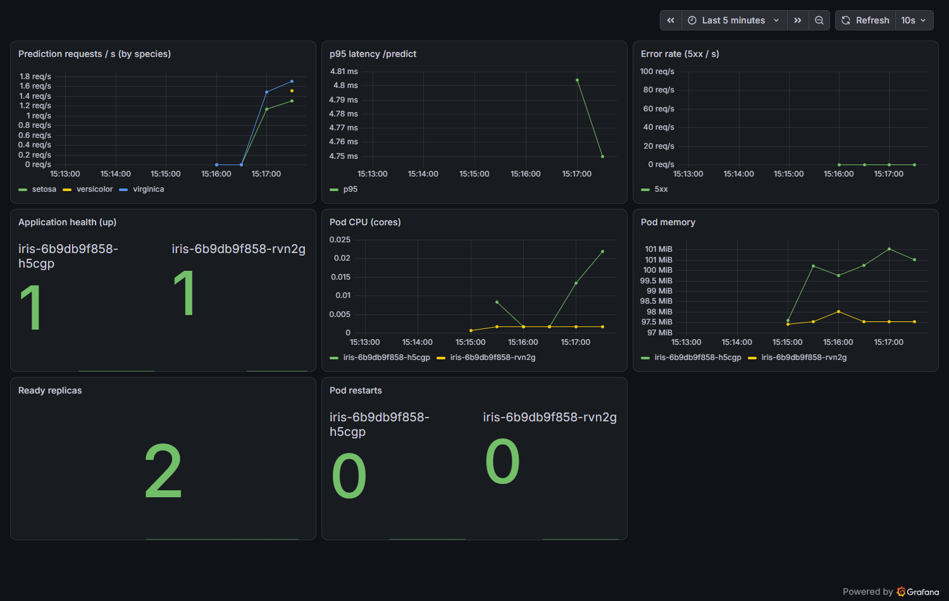
Grafana dashboard under live traffic (requests by species, p95 latency

Slide 6
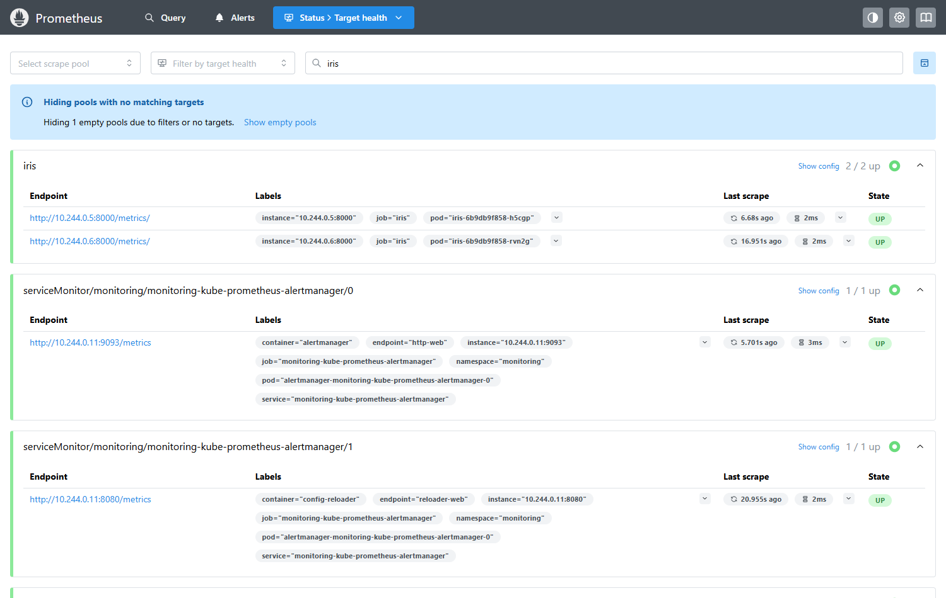
Prometheus 'iris' scrape job: both pods UP.

Slide 7
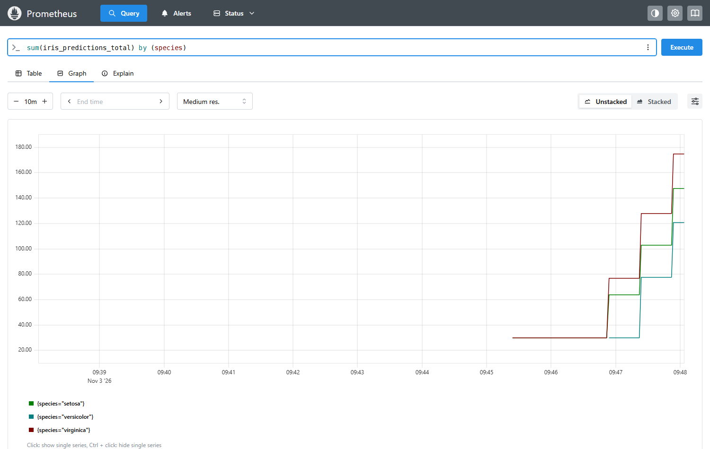
Prometheus query of iris_predictions_total by species.

Slide 8
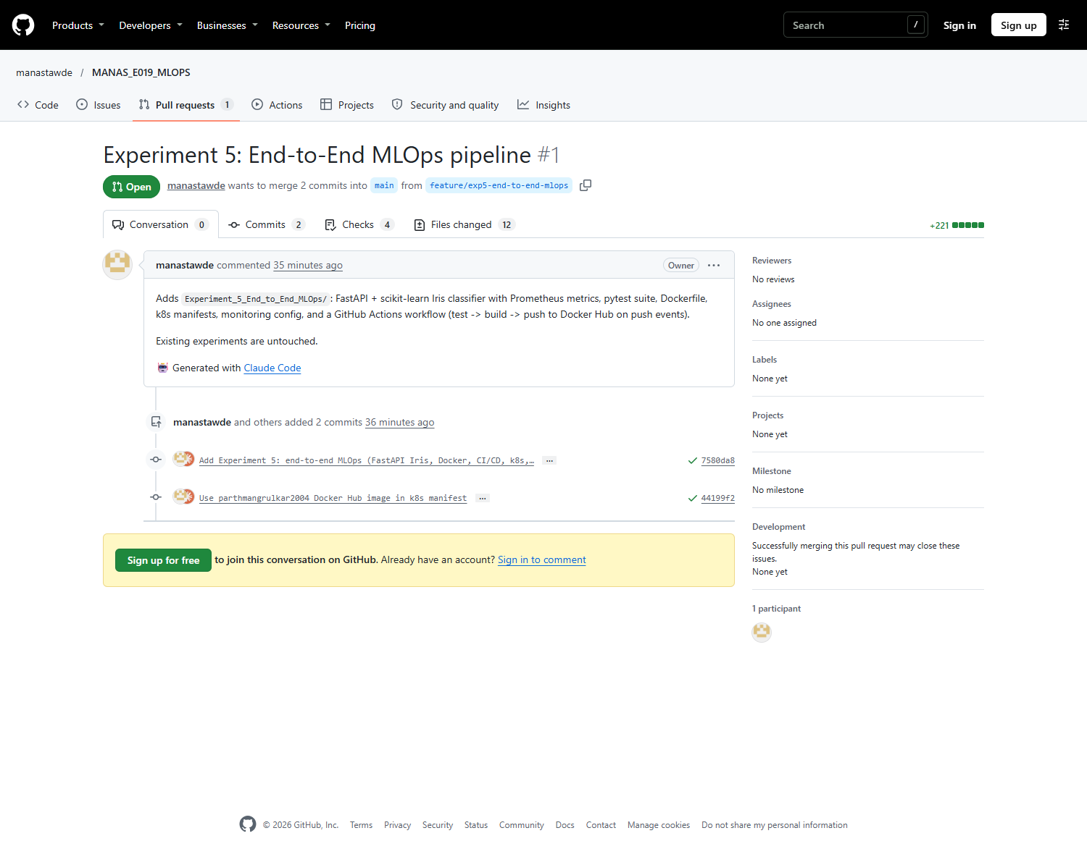
Pull request #1 into main.

Slide 9
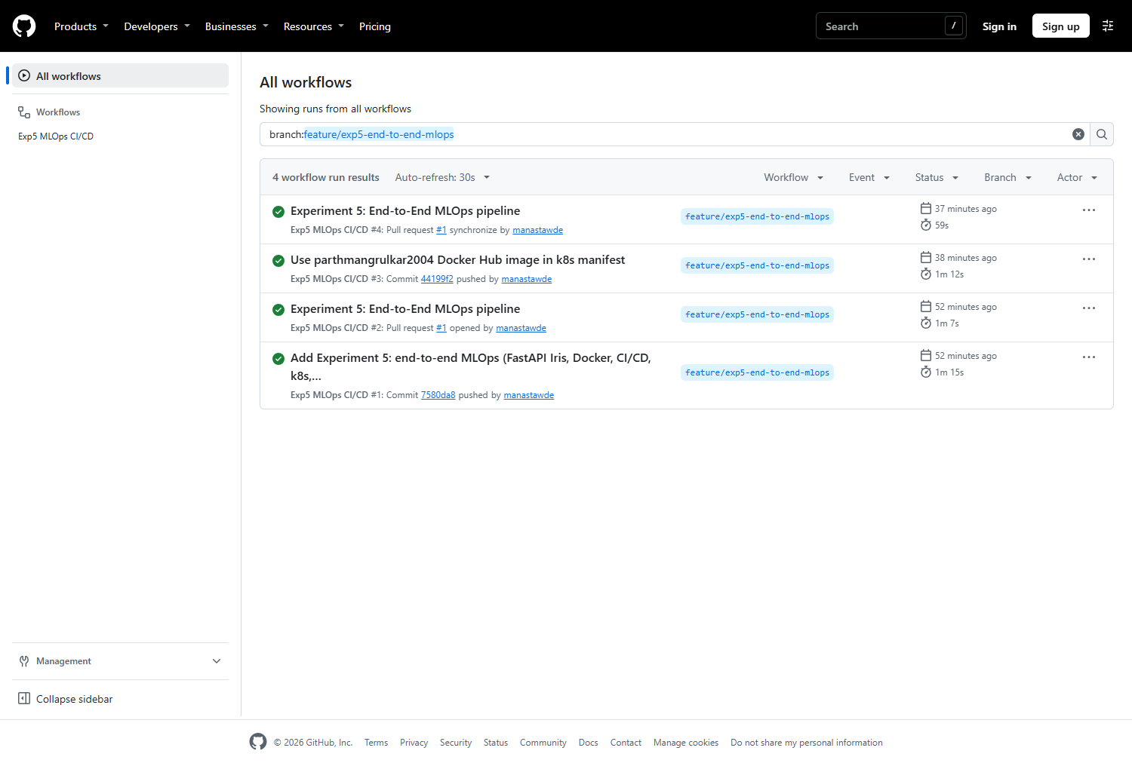
GitHub Actions runs for the feature branch.

Slide 10
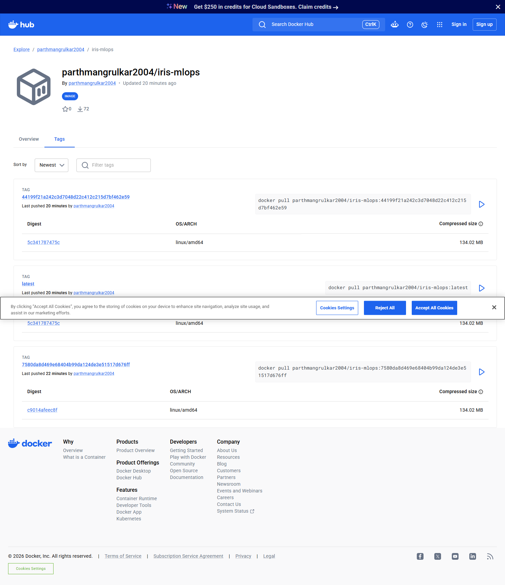
Docker Hub repository parthmangrulkar2004/iris-mlops with tags (a cook

Slide 11
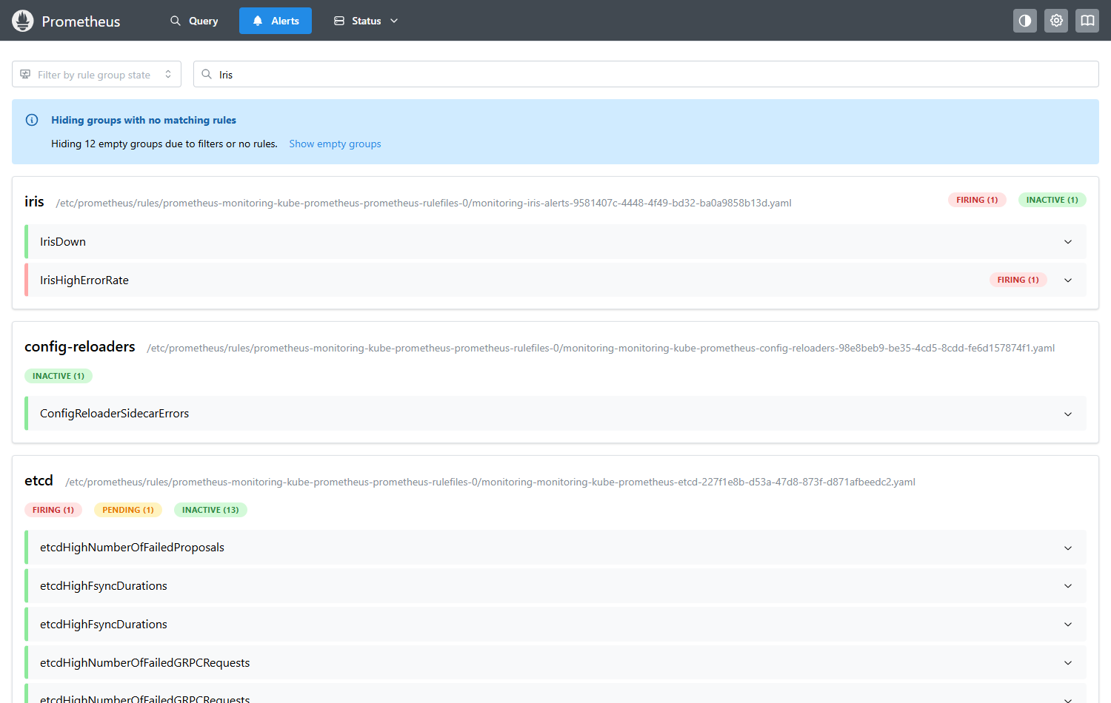
Alert test 1: IrisHighErrorRate FIRING after sustained requests to /bo

Slide 12
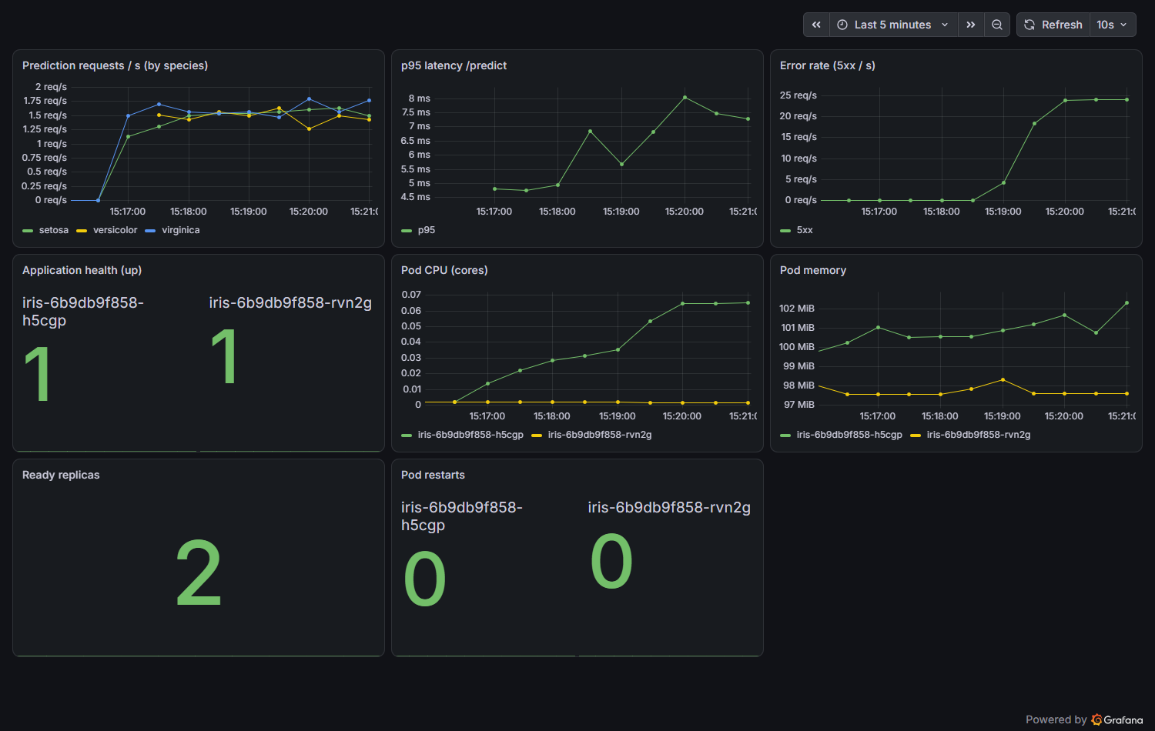
Grafana error-rate panel during the error test.

Slide 13
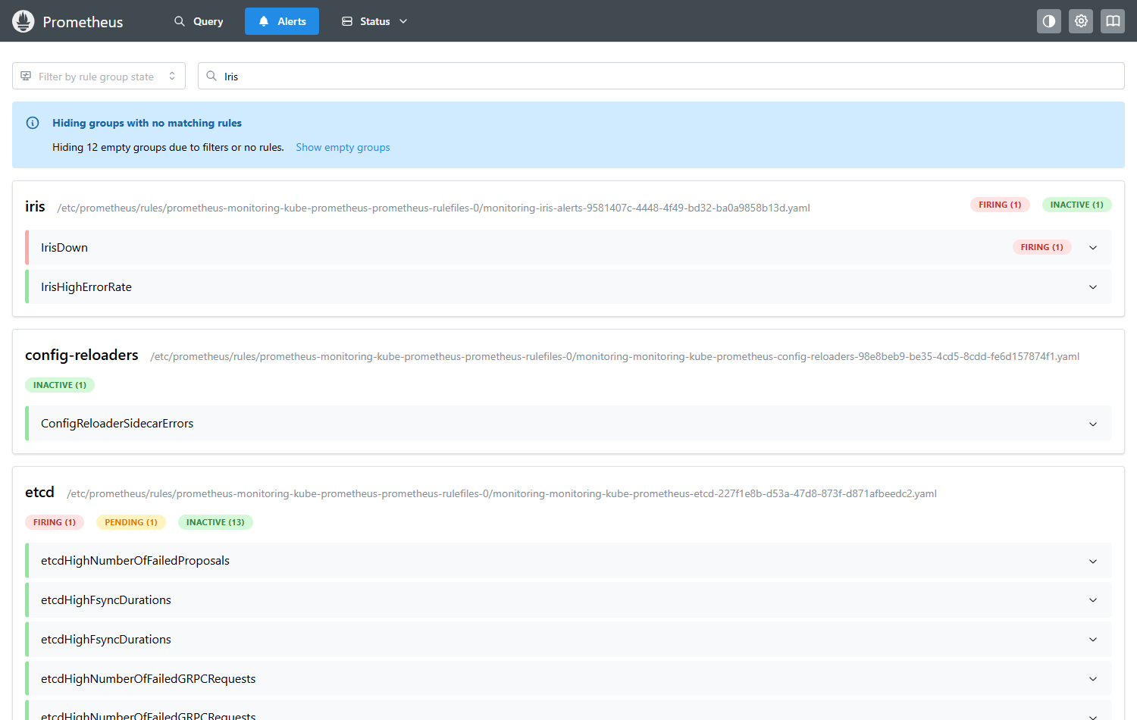
Alert test 2: IrisDown FIRING with the deployment scaled to 0 replicas

Slide 14
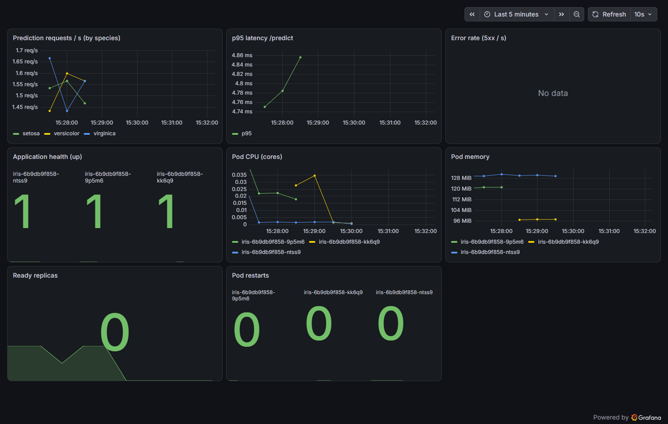
Grafana during the outage (health and replica panels).

Slide 15
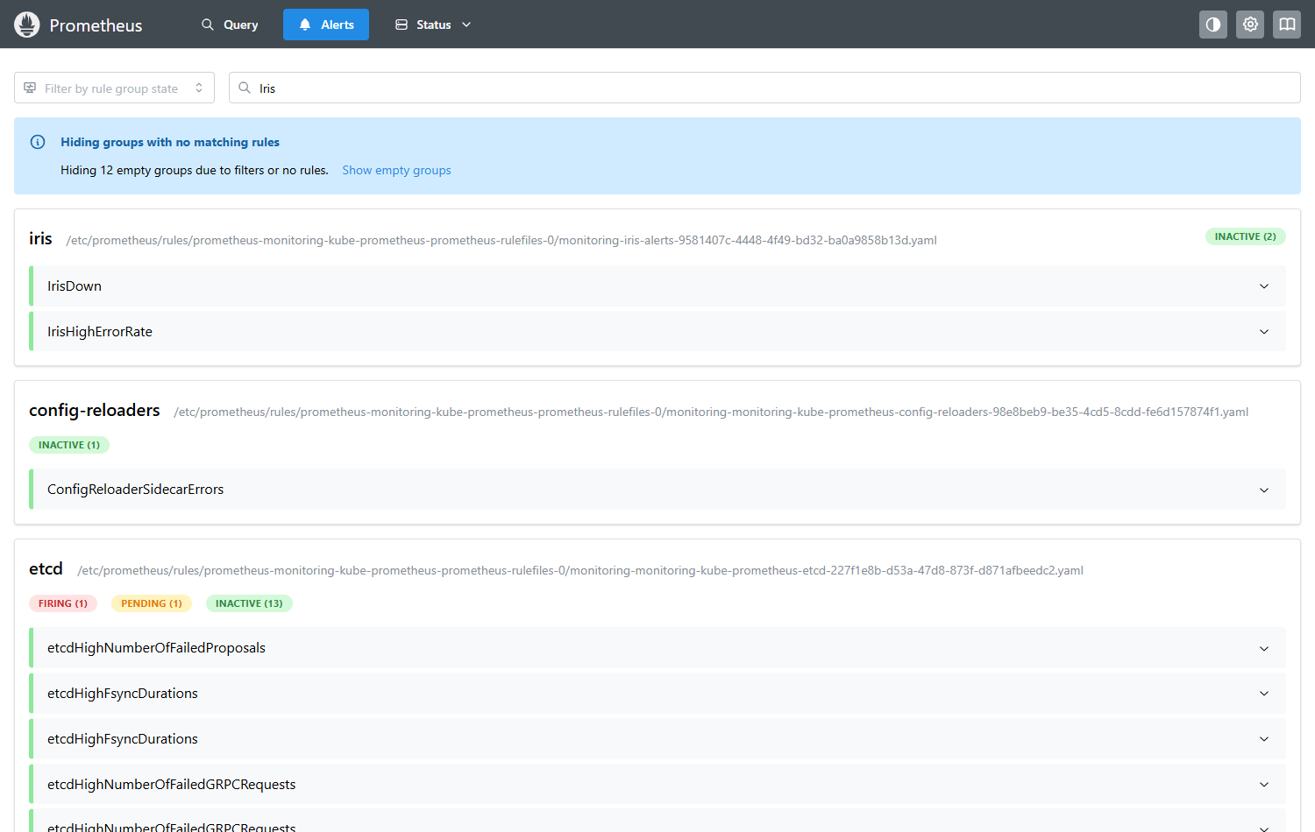
Recovery: both alerts inactive after scaling back to 2 replicas.

Slide 16
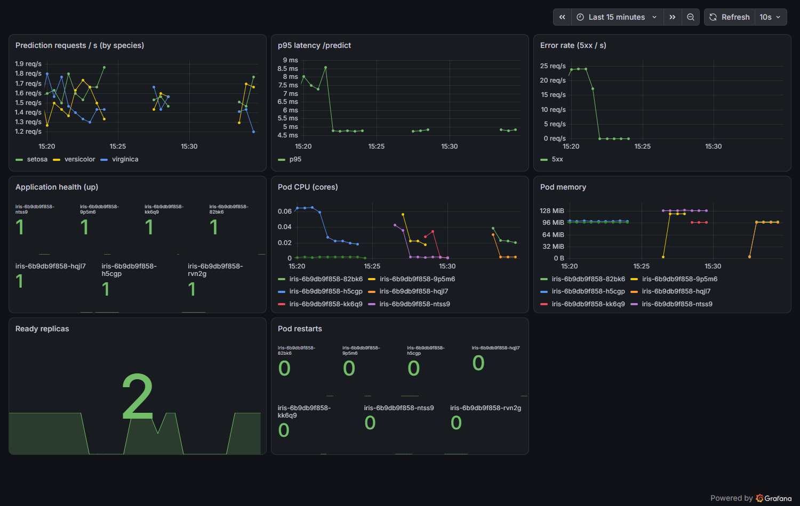
Grafana after recovery.

Slide 17
Findings and limits
- Alert test found a real bug: IrisDown never fired with 0 pods; fixed with 'or vector(0)'
- Single-node local cluster; port-forward access only
- No Alertmanager receiver configured

