Slide 1
ACTIVATION FUNCTIONS
Sign · Step · Sigmoid · Tanh · ReLU · Leaky ReLU · Softmax
and their gradients
Deep Learning & Neural Networks

Slide 2
WHY IT MATTERS
Probable Questions for M1 from this Topic
Analyze the role of activation functions in a neural network. Compare the Sigmoid and ReLU activation functions with respect to the vanishing gradient problem.
Compare the Tanh and ReLU activation functions in terms of (a) output range, (b) zero-centeredness and its effect on gradient descent convergence, and (c) susceptibility to the vanishing gradient problem.
Analyze the role of activation functions in a neural network. What would happen if a deep network used only linear activation functions?
Explain why Sign and Step functions, despite being historically important, cannot be used in modern gradient-descent-trained networks.
What is the "dying ReLU" problem? How does Leaky ReLU address it, and what new hyperparameter does this introduce?
Why is Tanh generally preferred over Sigmoid for hidden layers in RNNs, despite both suffering from saturation?
Explain why Softmax outputs a full Jacobian matrix for its gradient rather than a single scalar per element, unlike Sigmoid.
Justify the rule of thumb: "ReLU/Leaky ReLU for hidden layers, Sigmoid for binary output, Softmax for multi-class output, Tanh for RNNs."
Foundation of Deep Learning
Linear Separability is the Litmus Test
Same Logic, Modern Hardware
15

Slide 3
WHY IT MATTERS
Probable Questions for M1 from this Topic
9. Derive the gradient of the Sigmoid function starting from f(x) = 1/(1+e⁻ˣ), and show that it can be expressed purely in terms of f(x) itself.
10. Derive the gradient of the Tanh function starting from f(x) = (eˣ−e⁻ˣ)/(eˣ+e⁻ˣ), and show f′(x) = 1 − f(x)².
11. Show mathematically why Sigmoid's maximum possible gradient is exactly 0.25 and occurs at x = 0.
12. Derive the partial derivative of Softmax, ∂sᵢ/∂zⱼ, for both the i = j and i ≠ j cases. Derive the partial derivative of Softmax, ∂sᵢ/∂zⱼ, for both the i = j and i ≠ j cases.
13. Define the Sign, Step, Sigmoid, Tanh, ReLU, Leaky ReLU, and Softmax functions along with their output ranges.
14. State the derivative (piecewise, where applicable) of each of the seven activation functions.
15. What is meant by "saturation" of an activation function?
16. Why must the gradient of the loss function be non-zero for learning to occur?
17. What numerical stabilization trick is used when computing Softmax in practice, and why is it needed?
18. For f(x) = x² − 4x + 6, x₀ = 0, η = 0.1, compute 4–5 iterations of gradient descent and state the value x converges to.
19. Minimize J(θ) = θ², θ₀ = 5, η = 0.3. Compute θ₁ through θ₄ and comment on the convergence pattern.
20. Given a single sigmoid neuron with x = 0.5, w = 0.4, b = 0.1, target t = 1, η = 0.5: perform one forward pass and one backward pass, and compute the updated weight and bias.
Foundation of Deep Learning
Linear Separability is the Litmus Test
Same Logic, Modern Hardware
15

Slide 4
FOUNDATIONS
Why Do We Need Activation Functions?
1
Introduce non-linearity
2
Control neuron output range
Without it, stacking layers collapses to one linear transform — a network could never learn curves, boundaries, or complex patterns.
Squash, clip, or shape the weighted sum z = Wx + b into a value the next layer can use.
3
Enable gradient-based learning
4
Match the task
The derivative f'(x) is what backpropagation multiplies through the chain rule — its shape decides whether learning is fast, slow, or stalls.
Hidden layers favor ReLU-family functions; output layers use Sigmoid (binary) or Softmax (multi-class).
Activation Functions & Gradients
2

Slide 5
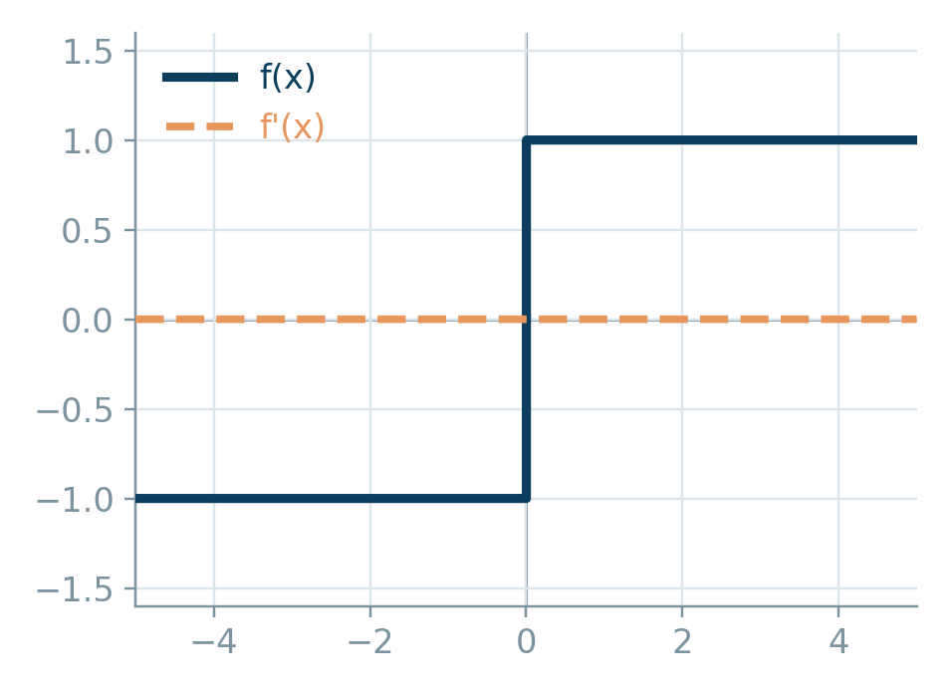
THRESHOLD FAMILY
Sign Function
Signum function — outputs the sign of the input
f(x) =
{ +1, x > 0
{ 0, x = 0
{ -1, x < 0
f'(x) =
0 (undefined at x = 0)
Output range: {-1, 0, +1}
Discontinuous at x = 0 — not differentiable there
Derivative is 0 almost everywhere ⇒ gradient carries no learning signal
Historically used in early perceptrons for binary classification
Not used in modern gradient-descent-trained networks
f(x) — navy f'(x) — amber (dashed)
Used in: Classical perceptron models (pre-backpropagation era)
Activation Functions & Gradients
3

Slide 6
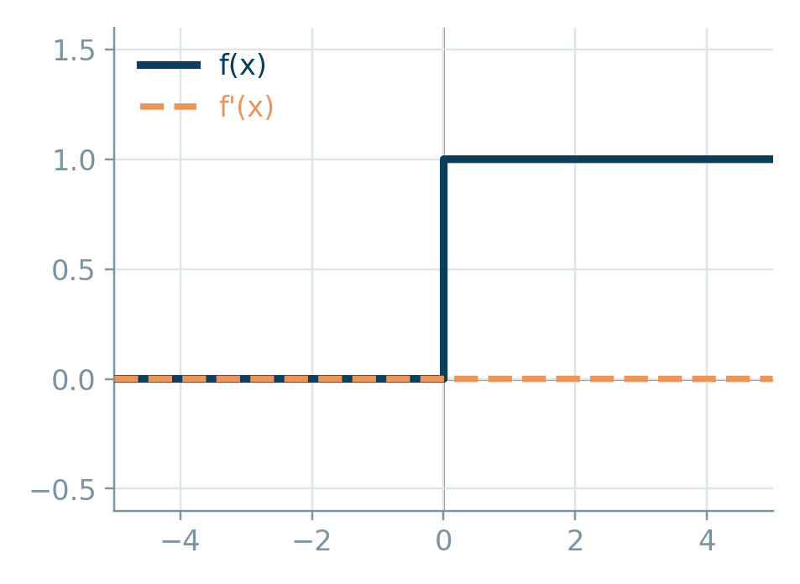
THRESHOLD FAMILY
Step (Heaviside) Function
Binary unit-step activation
f(x) =
{ 1, x ≥ 0
{ 0, x < 0
f'(x) =
0 (undefined at x = 0)
Output range: {0, 1}
Hard threshold — mimics a biological neuron firing or not
Zero gradient everywhere except an undefined jump at x = 0
Cannot be trained with gradient descent / backpropagation
Purely a conceptual / illustrative activation today
f(x) — navy f'(x) — amber (dashed)
Used in: McCulloch–Pitts neuron, simple threshold logic gates
Activation Functions & Gradients
4

Slide 7
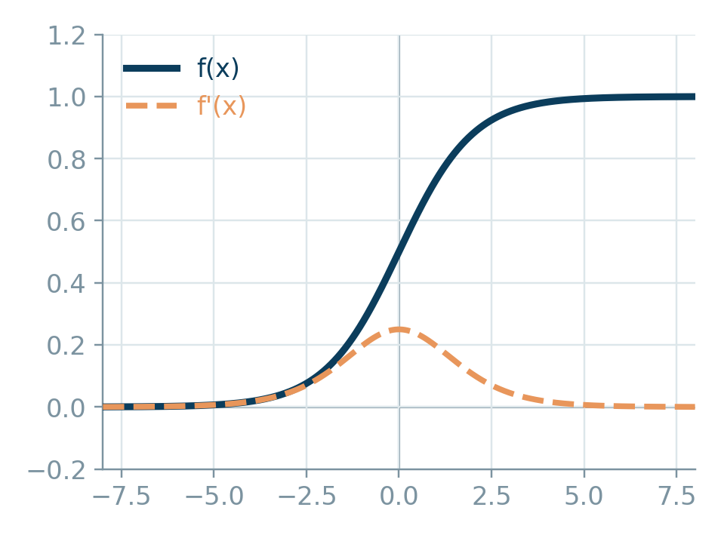
SQUASHING FAMILY
Sigmoid (Logistic) Function
Smooth S-shaped squashing function
f(x) =
1 / (1 + e^(-x))
f'(x) =
f(x) · (1 - f(x))
Output range: (0, 1)
Smooth and differentiable everywhere — clean gradient signal
Max gradient is only 0.25, at x = 0
Saturates for |x| large ⇒ vanishing gradient in deep nets
Output not zero-centered, which can slow convergence
f(x) — navy f'(x) — amber (dashed)
Used in: Binary classification output layer, gates in LSTM/GRU
Activation Functions & Gradients
5

Slide 8
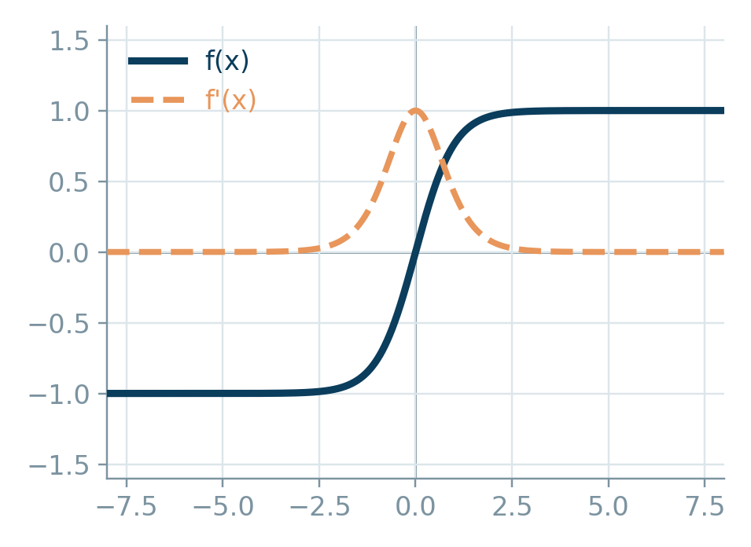
SQUASHING FAMILY
Tanh (Hyperbolic Tangent)
Zero-centered S-shaped squashing function
f(x) =
(e^x - e^-x) / (e^x + e^-x)
f'(x) =
1 - f(x)²
Output range: (-1, 1)
Zero-centered output ⇒ generally faster convergence than sigmoid
Max gradient is 1.0, at x = 0 — stronger signal than sigmoid
Still saturates for large |x| ⇒ vanishing gradient possible
Common choice for RNN hidden states
f(x) — navy f'(x) — amber (dashed)
Used in: RNN/LSTM hidden activations, normalized hidden layers
Activation Functions & Gradients
6

Slide 9
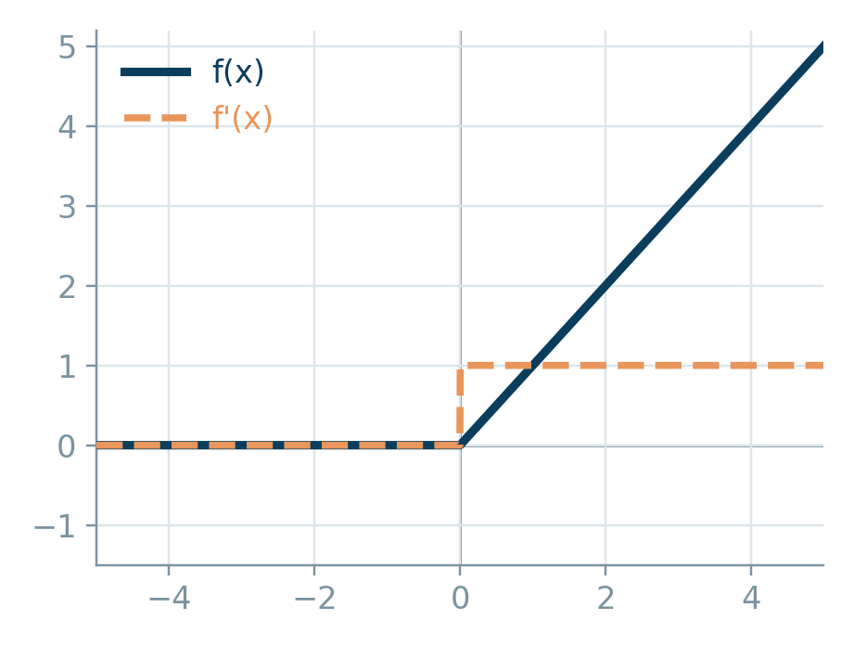
PIECEWISE-LINEAR FAMILY
ReLU (Rectified Linear Unit)
The default hidden-layer activation in modern deep nets
f(x) =
max(0, x)
f'(x) =
{ 1, x > 0
{ 0, x < 0
Output range: [0, ∞)
Computationally cheap — just a threshold at zero
No saturation for x > 0 ⇒ mitigates vanishing gradient
“Dying ReLU”: a neuron with x < 0 always has zero gradient and can stop learning
Not zero-centered; gradient undefined at x = 0 (set to 0 by convention)
f(x) — navy f'(x) — amber (dashed)
Used in: Default hidden layers in CNNs, MLPs, most feed-forward nets
Activation Functions & Gradients
7

Slide 10
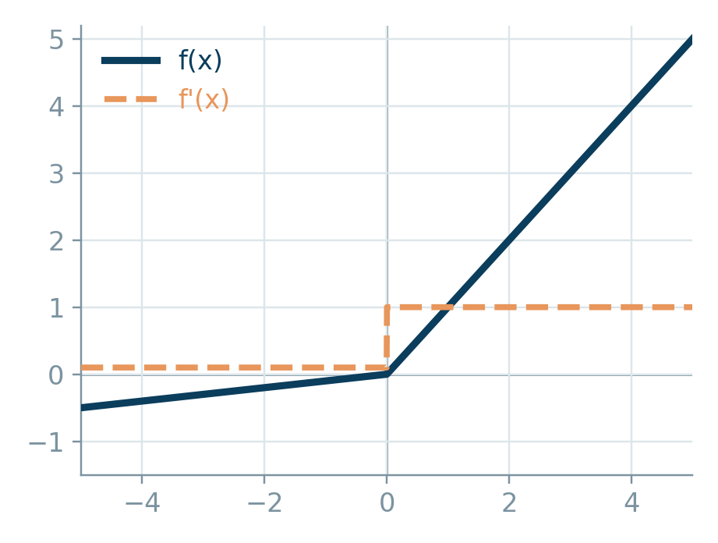
PIECEWISE-LINEAR FAMILY
Leaky ReLU
ReLU variant that fixes the dying-neuron problem
f(x) =
{ x, x > 0
{ αx, x ≤ 0 (α ≈ 0.01)
f'(x) =
{ 1, x > 0
{ α, x ≤ 0
Output range: (-∞, ∞)
Small non-zero slope α for x < 0 keeps gradients alive
Prevents neurons from permanently “dying” during training
α is a fixed hyperparameter (Parametric ReLU learns it instead)
Slightly more expensive than plain ReLU, still very cheap
f(x) — navy f'(x) — amber (dashed)
Used in: Deep CNNs / GANs where dying ReLU hurts training stability
Activation Functions & Gradients
8

Slide 11
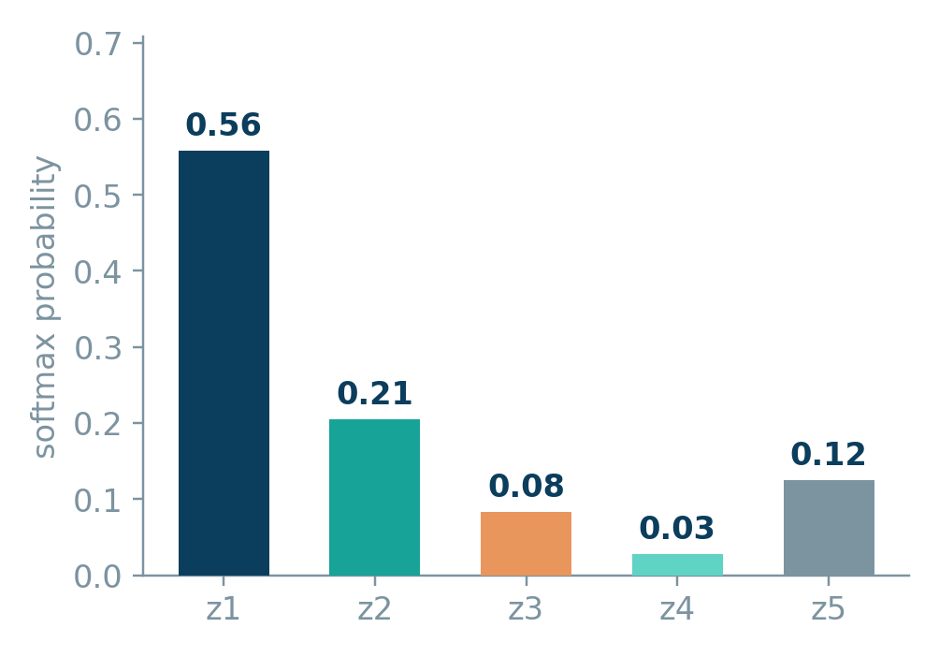
OUTPUT LAYER
Softmax Function
Converts a vector of logits into a probability distribution
softmax(zᵢ) =
e^zᵢ / Σⱼ e^zⱼ
∂sᵢ/∂zⱼ =
{ sᵢ(1 - sᵢ), i = j
{ -sᵢ sⱼ, i ≠ j
Output range: (0, 1) per element, all elements sum to 1
Generalizes sigmoid to multiple classes — a full probability vector
Gradient is a full Jacobian matrix, not a single scalar per element
Numerically stabilized in practice by subtracting max(z) before exponentiating
Paired with cross-entropy loss for a clean gradient: (softmax − target)
Example: 5 logits → softmax probabilities (sum = 1.00)
Used in: Multi-class classification output layer
Activation Functions & Gradients
9

Slide 12
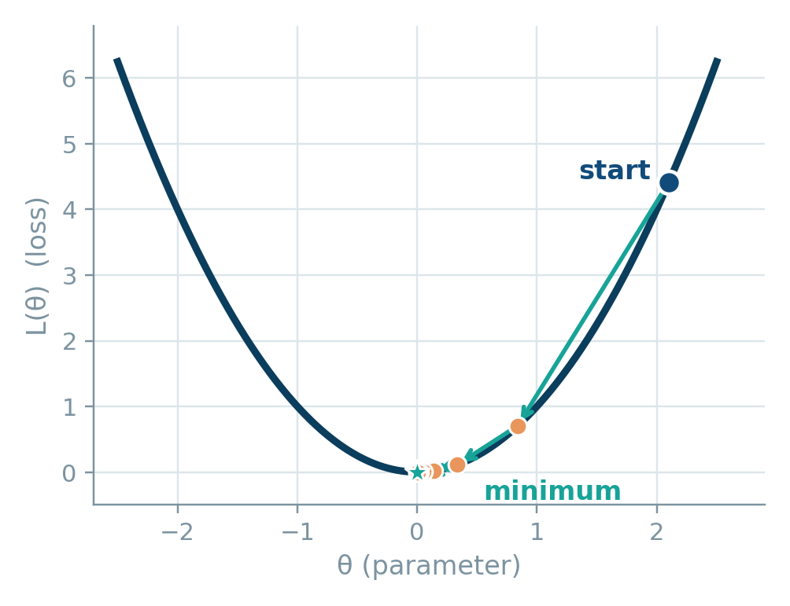
OPTIMIZATION
Gradient Descent — The Core Idea
How a network actually uses f'(x) to learn
θ
t+1 = θt - η · ∇L(θt)
θ the parameter being learned (a weight or bias)
η the learning rate — how big a step to take
∇L(θ) the gradient of the loss — the same f'(x) from the earlier slides, via the chain rule
Move opposite the gradient — it points toward steepest increase, so subtracting it descends
Repeat until the gradient is ~0 — that's a minimum (local or global)
Every f'(x) computed earlier in this deck feeds directly into ∇L(θ) here
Each step moves downhill along the loss surface
Activation Functions & Gradients
14

Slide 13
OPTIMIZATION
Types of Gradient Descent
They differ only in how much data is used per update
Batch GD
Stochastic GD (SGD)
Mini-batch GD
Uses:
Uses:
Uses:
Entire training set
One random sample
Small batch (e.g. 32–256)
Updates:
Updates:
Updates:
One update per epoch
One update per sample
One update per batch
Strength:
Strength:
Strength:
Stable, accurate gradient direction
Fast, escapes shallow local minima
Balances speed and stability
Weakness:
Weakness:
Weakness:
Slow and memory-heavy on large datasets
Noisy path, can overshoot
Batch size is an extra hyperparameter
Activation Functions & Gradients
15

Slide 14
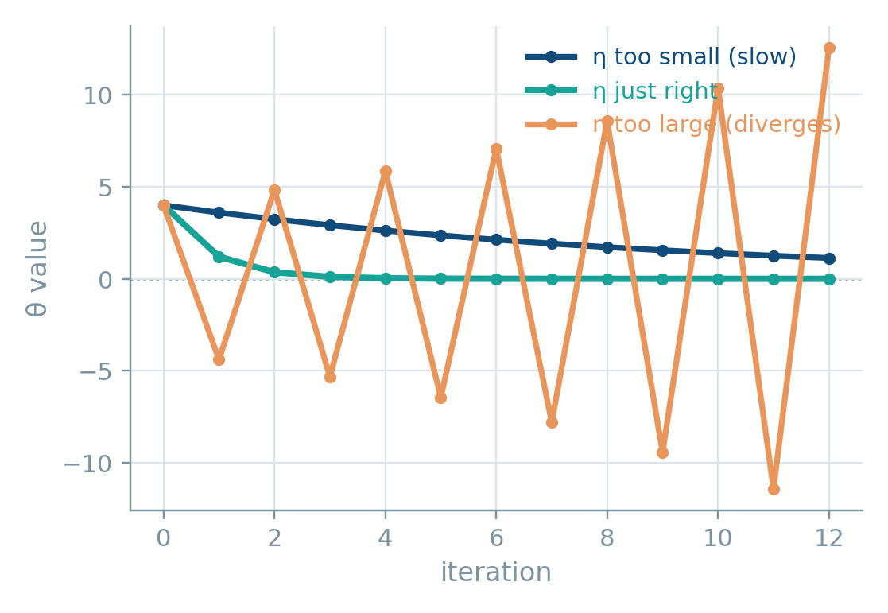
OPTIMIZATION
The Effect of Learning Rate (η)
Minimizing f(θ) = θ² from θ0 = 4, for three choices of η
η too small
Steps are tiny — the loss decreases, but training takes far more iterations than necessary.
η just right
Converges quickly and smoothly to the minimum in a handful of steps.
η too large
Each step overshoots the minimum. The oscillation grows instead of shrinking — the loss diverges.
Activation Functions & Gradients
16

Slide 15
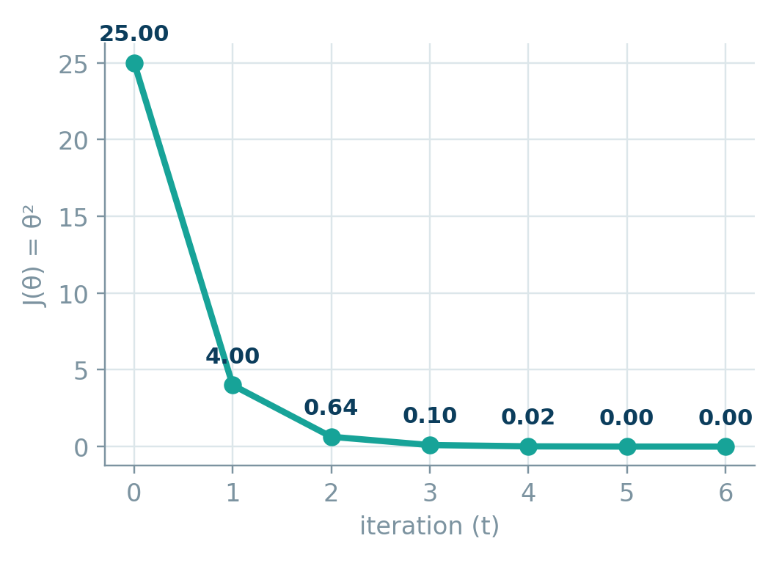
CLASS ACTIVITY
Answer Key — Watch It Converge
J(θ) = θ², θ0 = 5, η = 0.3
t | θt | ∇J = 2θt | θt+1 | J(θt) = θt²
0 | 5.000 | 10.000 | 2.000 | 25.000
1 | 2.000 | 4.000 | 0.800 | 4.000
2 | 0.800 | 1.600 | 0.320 | 0.640
3 | 0.320 | 0.640 | 0.128 | 0.102
4 | 0.128 | 0.256 | 0.051 | 0.016
Takeaway: J(θ) shrinks fast at first, then flattens as θ nears 0 — the gradient itself shrinks, so steps get smaller near the minimum.
Activation Functions & Gradients
20

Slide 16
CLASS ACTIVITY
Let's Converge to the Minimum — Together
Minimize J(θ) = θ² θ0 = 5 η = 0.3
1
Whole class
t | θt | ∇J = 2θt | θt+1
0 | 5.000 | 10.000 | 2.000
1 | ? | ? | ?
2 | ? | ? | ?
3 | ? | ? | ?
Together, compute ∇J(θ) = 2θ out loud — straight from the power rule.
2
One student, board
Use θt+1 = θt - η·2θt to find θ1 from θ0 = 5. Class verifies the arithmetic together.
3
Split the room
Group A computes iteration 2 (θ2). Group B computes iteration 3 (θ3). Compare answers on the board.
Step 4: once the table is complete, sketch J(θ) on the y-axis against iteration t on the x-axis. What shape does the class expect before drawing it?
4
Plot together
Graph J(θ) vs. iteration number and watch the curve shrink toward zero — that's convergence.
Activation Functions & Gradients
28

Slide 17
CLASS ACTIVITY
Answer Key — Watch It Converge
J(θ) = θ², θ0 = 5, η = 0.3
t | θt | ∇J = 2θt | θt+1 | J(θt) = θt²
0 | 5.000 | 10.000 | 2.000 | 25.000
1 | 2.000 | 4.000 | 0.800 | 4.000
2 | 0.800 | 1.600 | 0.320 | 0.640
3 | 0.320 | 0.640 | 0.128 | 0.102
4 | 0.128 | 0.256 | 0.051 | 0.016
Takeaway: J(θ) shrinks fast at first, then flattens as θ nears 0 — the gradient itself shrinks, so steps get smaller near the minimum.
Activation Functions & Gradients
29

Slide 18
CLASS ACTIVITY
Let's Converge to the Minimum — Together
Minimize J(θ) = θ² θ0 = 5 η = 0.3
1
Whole class
t | θt | ∇J = 2θt | θt+1
0 | 5.000 | 10.000 | 2.000
1 | ? | ? | ?
2 | ? | ? | ?
3 | ? | ? | ?
Together, compute ∇J(θ) = 2θ out loud — straight from the power rule.
2
One student, board
Use θt+1 = θt - η·2θt to find θ1 from θ0 = 5. Class verifies the arithmetic together.
3
Split the room
Group A computes iteration 2 (θ2). Group B computes iteration 3 (θ3). Compare answers on the board.
Step 4: once the table is complete, sketch J(θ) on the y-axis against iteration t on the x-axis. What shape does the class expect before drawing it?
4
Plot together
Graph J(θ) vs. iteration number and watch the curve shrink toward zero — that's convergence.
Activation Functions & Gradients
19

Slide 19
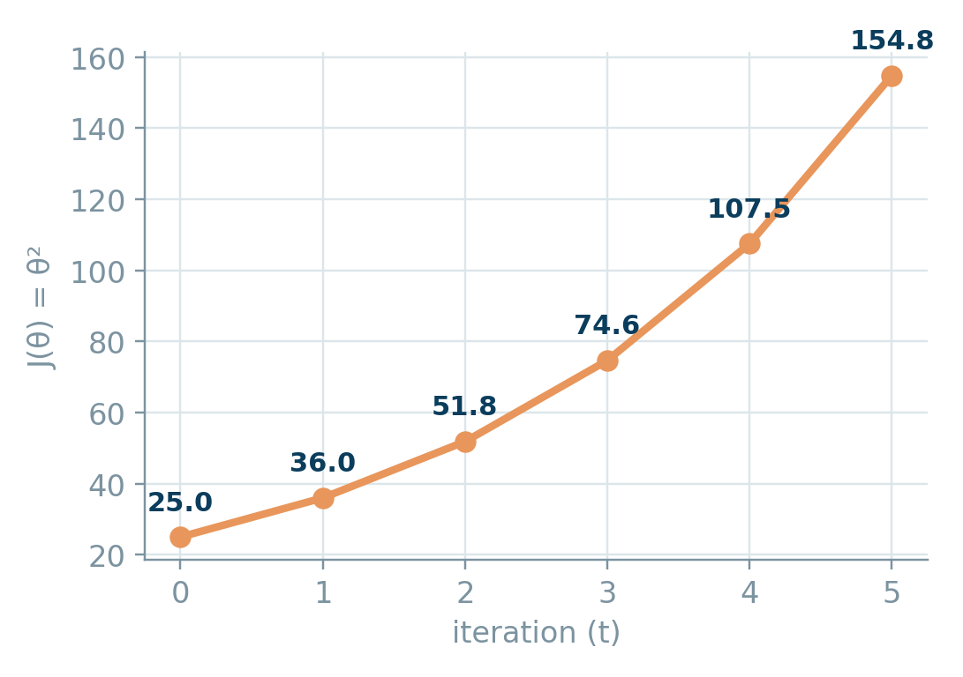
OPTIONAL EXTENSION
Now Try η = 1.1 — What Happens?
Same problem, same steps — only the learning rate changes
t | θt | ∇J = 2θt | θt+1 | J(θt) = θt²
0 | 5.000 | 10.000 | -6.000 | 25.000
1 | -6.000 | -12.000 | 7.200 | 36.000
2 | 7.200 | 14.400 | -8.640 | 51.840
3 | -8.640 | -17.280 | 10.368 | 74.650
4 | 10.368 | 20.736 | -12.442 | 107.485
Connect back: θ flips sign and grows every step — this is exactly the "η too large" case from Section 4. |1 - 2η| > 1 guarantees divergence.
Activation Functions & Gradients
21

Slide 20
WORKED NUMERICAL
Example 1 — Minimizing a Quadratic
f(x) = x² - 4x + 6 f'(x) = 2x - 4 x₀ = 0 η = 0.1
t | xt | f'(xt) = 2xt - 4 | xt+1 = xt - η·f'(xt)
0 | 0.000 | -4.000 | 0.400
1 | 0.400 | -3.200 | 0.720
2 | 0.720 | -2.560 | 0.976
3 | 0.976 | -2.048 | 1.181
4 | 1.181 | -1.638 | 1.345
5 | 1.345 | -1.311 | 1.476
Pattern: each step shrinks the distance to the minimum by a factor of (1 - 2η) = 0.8, so xt → 2 as t → ∞ — exactly where f'(x) = 0 and f(x) reaches its minimum value of 2.
Activation Functions & Gradients
17

Slide 21
WORKED NUMERICAL
Example 2 — Backprop Weight Update
A single sigmoid neuron: x = 0.5, w = 0.4, b = 0.1, target t = 1, η = 0.5
1 · FORWARD PASS
3 · UPDATE THE WEIGHT
z = wx + b = 0.4(0.5) + 0.1 = 0.300
y = σ(z) = 1/(1+e^-0.3) = 0.5744
L = ½(t - y)² = ½(1 - 0.5744)² = 0.0905
w_new = w - η·∂L/∂w
= 0.4 - 0.5(-0.0520) = 0.4260
b_new = b - η·∂L/∂b = 0.1 - 0.5(-0.1041) = 0.1520
WHY IT WORKS
2 · BACKWARD PASS (CHAIN RULE)
w increased because the neuron under-predicted (y < t) and x was positive — nudging w up raises z, raising y toward the target.
This single-neuron update is exactly what happens, per weight, across every layer of a full network.
∂L/∂y = -(t - y) = -0.4256
∂y/∂z = y(1-y) = 0.5744(0.4256) = 0.2445
∂z/∂w = x = 0.500 ∂z/∂b = 1
∂L/∂w = ∂L/∂y · ∂y/∂z · ∂z/∂w = -0.0520
∂L/∂b = ∂L/∂y · ∂y/∂z · ∂z/∂b = -0.1041
Activation Functions & Gradients
18

Slide 22
STEP-BY-STEP WALKTHROUGH
The Neuron We're Training
Same neuron as Example 2 — we'll now walk through every computation one step at a time
Given: x = 0.5 w = 0.4 b = 0.1 t = 1 η = 0.5 — sigmoid activation
x, w, b
z
y
L
x = 0.5
w = 0.4, b = 0.1
the input signal fed into the neuron
the trainable parameters — what gradient descent will adjust
t = 1
η = 0.5
the true target this neuron should learn to predict
the learning rate — how big each update step will be
Goal: find w_new and b_new that make the neuron's prediction closer to t = 1
Activation Functions & Gradients
19

Slide 23
STEP-BY-STEP WALKTHROUGH
Step 1 — Linear Combination
Weighted sum of the input
Given: x = 0.5 w = 0.4 b = 0.1 t = 1 η = 0.5 — sigmoid activation
FORWARD PASS
x, w, b
z
y
L
z = wx + b
z = 0.4(0.5) + 0.1
z = 0.300
WHAT THIS STEP DOES
Combines the input x with the weight w and bias b into a single raw number z.
z is the neuron's “raw signal” before any squashing — it can be any real number.
This is exactly the z = Wx + b you've seen throughout this deck feeding into every activation function.
Activation Functions & Gradients
20

Slide 24
STEP-BY-STEP WALKTHROUGH
Step 2 — Apply the Activation
Squash z into a usable output
Given: x = 0.5 w = 0.4 b = 0.1 t = 1 η = 0.5 — sigmoid activation
FORWARD PASS
x, w, b
z
y
L
y = σ(z) = 1 / (1 + e⁻ᶻ)
y = 1 / (1 + e⁻⁰·³)
y = 0.5744
WHAT THIS STEP DOES
The sigmoid squashes z = 0.3 into the range (0, 1) — a value we can interpret as a prediction.
y = 0.5744 is the neuron's current guess. The target is t = 1, so the neuron is currently under-predicting.
This y will be reused directly in Step 5's gradient — no need to recompute it during backprop.
Activation Functions & Gradients
21

Slide 25
STEP-BY-STEP WALKTHROUGH
Step 3 — Compute the Loss
How wrong is the prediction?
Given: x = 0.5 w = 0.4 b = 0.1 t = 1 η = 0.5 — sigmoid activation
MEASURE ERROR
x, w, b
z
y
L
L = ½(t - y)²
L = ½(1 - 0.5744)²
L = 0.0905
WHAT THIS STEP DOES
Compares the prediction y to the true target t and turns the gap into a single non-negative number.
L = 0.0905 is the value gradient descent will try to shrink toward 0 — this is “J(θ)” from the earlier gradient descent slides, now with a real neuron behind it.
Bigger gaps between y and t produce a larger loss, which (as we'll see) produces a larger gradient.
Activation Functions & Gradients
22

Slide 26
STEP-BY-STEP WALKTHROUGH
Step 4 — Loss Gradient ∂L/∂y
How L changes if y changes
Given: x = 0.5 w = 0.4 b = 0.1 t = 1 η = 0.5 — sigmoid activation
BACKWARD PASS
x, w, b
z
y
L
∂L/∂y = -(t - y)
∂L/∂y = -(1 - 0.5744)
∂L/∂y = -0.4256
WHAT THIS STEP DOES
This is the first step of backpropagation — we now move backward through the network, computing one local derivative at a time.
The negative sign means: increasing y would decrease L — which makes sense, since the neuron is currently under-predicting.
This value alone doesn't touch w yet — it still has to pass through the activation function's own gradient next.
Activation Functions & Gradients
23

Slide 27
STEP-BY-STEP WALKTHROUGH
Step 5 — Activation Gradient ∂y/∂z
How y changes if z changes
Given: x = 0.5 w = 0.4 b = 0.1 t = 1 η = 0.5 — sigmoid activation
BACKWARD PASS
x, w, b
z
y
L
∂y/∂z = y(1 - y) [sigmoid'(z) from earlier slides]
∂y/∂z = 0.5744(1 - 0.5744)
∂y/∂z = 0.2445
WHAT THIS STEP DOES
This is exactly the sigmoid derivative f'(x) = f(x)(1-f(x)) derived earlier in this deck — now plugged into a real backward pass.
0.2445 is close to sigmoid's maximum possible gradient of 0.25, since z = 0.3 is near the center of the curve, not in a saturated tail.
If z were far from 0 (deep in the sigmoid's flat regions), this value would shrink toward 0 and choke the gradient — see the earlier “saturated gradient” comparison.
Activation Functions & Gradients
24

Slide 28
STEP-BY-STEP WALKTHROUGH
Step 6 — Chain Rule: Weight & Bias Gradients
Multiply the local derivatives together
Given: x = 0.5 w = 0.4 b = 0.1 t = 1 η = 0.5 — sigmoid activation
BACKWARD PASS
x, w, b
z
y
L
∂L/∂w = ∂L/∂y · ∂y/∂z · ∂z/∂w ∂L/∂b = ∂L/∂y · ∂y/∂z · ∂z/∂b
∂L/∂w = (-0.4256)(0.2445)(0.5) ∂L/∂b = (-0.4256)(0.2445)(1)
∂L/∂w = -0.0520 ∂L/∂b = -0.1041
WHAT THIS STEP DOES
This is the chain rule in action — three local derivatives from Steps 4 and 5, multiplied together with ∂z/∂w = x and ∂z/∂b = 1.
Every gradient in this deck, from the sigmoid derivation to this neuron, feeds into a product exactly like this one.
∂L/∂b is larger than ∂L/∂w simply because ∂z/∂b = 1 while ∂z/∂w = x = 0.5 — a smaller input means a smaller share of the gradient reaches that weight.
Activation Functions & Gradients
25

Slide 29
STEP-BY-STEP WALKTHROUGH
Step 7 — Update the Parameters
Apply θ ← θ - η∇L(θ)
Given: x = 0.5 w = 0.4 b = 0.1 t = 1 η = 0.5 — sigmoid activation
GRADIENT DESCENT
x, w, b
z
y
L
w_new = w - η·∂L/∂w b_new = b - η·∂L/∂b
w_new = 0.4 - 0.5(-0.0520) b_new = 0.1 - 0.5(-0.1041)
w_new = 0.4260 b_new = 0.1520
WHAT THIS STEP DOES
Both parameters increased, because the neuron under-predicted (y < t) — nudging w and b up raises z, which raises y toward the target.
This is the exact same update rule from the Gradient Descent section — only now ∇L(θ) came from real backpropagation instead of a simple quadratic.
Run this loop thousands of times, over every weight in every layer, and this single-neuron update is literally how a full network learns.
Activation Functions & Gradients
26

Slide 30
GRADIENT DEEP-DIVE
What Does Gradient Descent Actually Minimize?
The loss function L(θ) — the activation gradient f'(z) is only one multiplier inside ∇L(θ)
θ ← θ - η∇L(θ) ∇L(θ) = ∂L/∂y · f'(z) · ∂z/∂w — gradient descent walks downhill on L, using f'(z) as a passenger
Same neuron for both cases: x = 0.5, w = 0.4, b = 0.1, t = 1, η = 0.5 — only y(1-y) differs
HEALTHY GRADIENT (this neuron, z = 0.3)
SATURATED GRADIENT (hypothetical, z = 6)
∂L/∂y
-0.4256
∂L/∂y
-0.4256
f'(z) = y(1-y)
0.2445
f'(z) = y(1-y)
0.0009
∂z/∂w = x
0.500
∂z/∂w = x
0.500
∂L/∂w
-0.0520
∂L/∂w
-0.00019
w_new = w - η·∂L/∂w
0.4260
w_new = w - η·∂L/∂w
0.400096
Same error, same loss gradient ∂L/∂y — yet the saturated neuron's weight barely moves (+0.0001 vs +0.026). Gradient descent still targets L, but a near-zero f'(z) chokes off how much of that signal reaches w.
Activation Functions & Gradients
27

Slide 31
Why the Gradient Shape Matters
Backpropagation multiplies f'(x) layer by layer through the chain rule
Vanishing Gradient
Dying ReLU
Healthy Gradient Flow
Sigmoid / Tanh saturate for large |x|, so f'(x) → 0. Across many layers, repeated multiplication shrinks the gradient toward zero — early layers barely update.
A ReLU neuron pushed to x < 0 has f'(x) = 0 permanently for that region. Leaky ReLU's small slope α keeps a trickle of gradient alive.
ReLU's constant gradient of 1 for x > 0 avoids saturation, which is why it became the default choice for deep hidden layers.
Activation Functions & Gradients
22

Slide 32
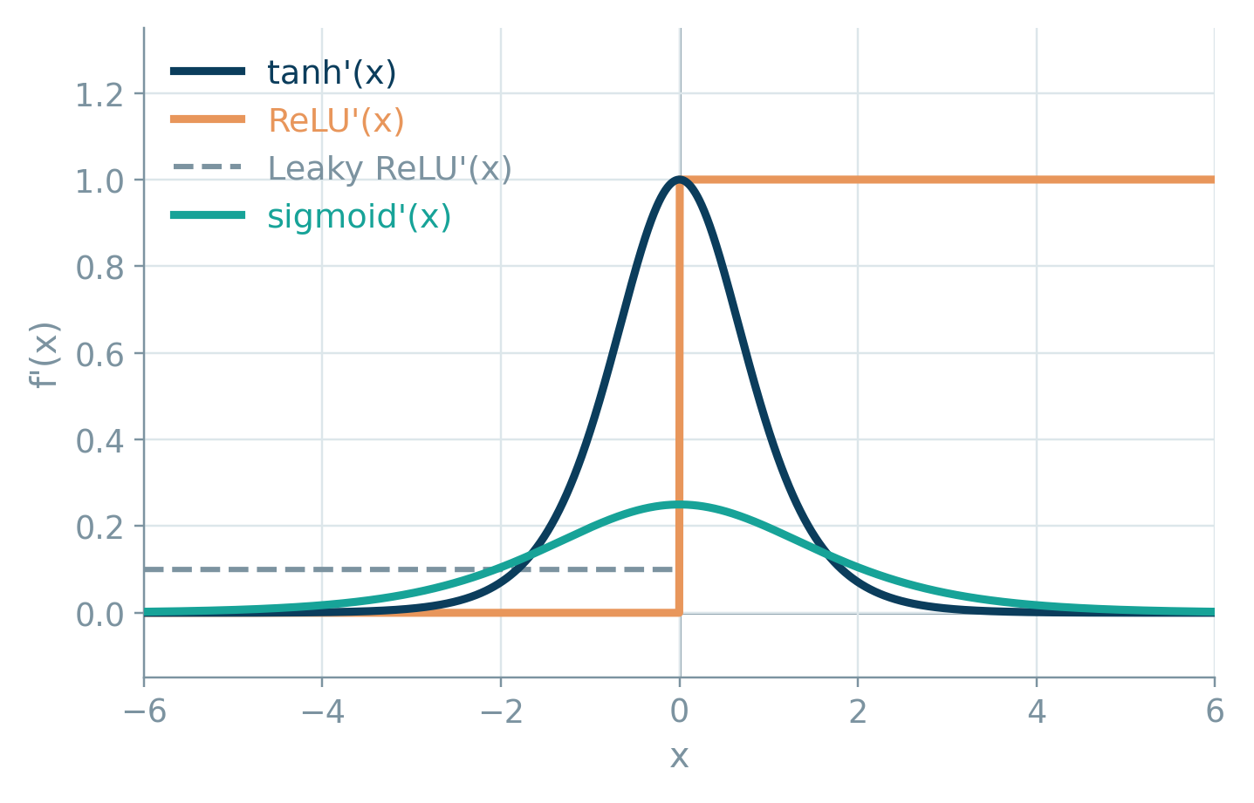
GRADIENT DEEP-DIVE
All Gradients at a Glance
Overlaying f'(x) for every function reveals why some networks learn faster than others
Sigmoid
peaks at only 0.25 — the flattest of the four, so it saturates first.
Tanh
peaks at 1.0 — four times steeper than sigmoid near x = 0.
ReLU
flat at exactly 1 for all x > 0, then a hard drop to 0.
Leaky ReLU
same as ReLU, but never fully drops to 0 — the constant α floor.
Activation Functions & Gradients
10

Slide 33
GRADIENT DEEP-DIVE
Deriving the Sigmoid Gradient
From f(x) = 1/(1+e⁻ˣ) to f'(x) = f(x)(1 - f(x))
1
Rewrite as a power
RESULT
f(x) = (1 + e⁻ˣ)⁻¹
f'(x) = f(x)·(1 - f(x))
Apply the chain rule
elegant — the derivative is written entirely in terms of the function's own output
2
f'(x) = -(1 + e⁻ˣ)⁻² · (-e⁻ˣ) = e⁻ˣ / (1 + e⁻ˣ)²
WHY IT MATTERS
Split the fraction
During backprop, y = σ(z) is already computed in the forward pass — so f'(x) costs one multiply, no extra exponentials.
This is exactly the y(1-y) term used in the Example 2 weight update on the earlier slide.
3
f'(x) = [1/(1+e⁻ˣ)] · [e⁻ˣ/(1+e⁻ˣ)] = f(x) · [e⁻ˣ/(1+e⁻ˣ)]
4
Recognize 1 - f(x)
e⁻ˣ/(1+e⁻ˣ) = (1+e⁻ˣ-1)/(1+e⁻ˣ) = 1 - f(x)
Activation Functions & Gradients
11

Slide 34
GRADIENT DEEP-DIVE
Deriving the Tanh Gradient
From f(x) = (eˣ - e⁻ˣ)/(eˣ + e⁻ˣ) to f'(x) = 1 - f(x)²
1
Set up the quotient
RESULT
u = eˣ - e⁻ˣ, v = eˣ + e⁻ˣ ⇒ f = u/v
f'(x) = 1 - f(x)²
Differentiate each part
same trick as sigmoid — expressed purely in terms of the output f(x)
2
u' = eˣ + e⁻ˣ = v v' = eˣ - e⁻ˣ = u
WHY IT MATTERS
Apply the quotient rule
At x = 0, f(x) = 0 so f'(x) = 1 — four times the sigmoid's peak gradient of 0.25.
Still saturates for large |x|, since f(x) → ±1 makes f'(x) → 0, same vanishing-gradient risk as sigmoid.
3
f'(x) = (u'v - uv') / v² = (v·v - u·u) / v² = (v² - u²)/v²
4
Simplify
f'(x) = 1 - (u/v)² = 1 - tanh²(x)
Activation Functions & Gradients
12

Slide 35
SUMMARY
Side-by-Side Comparison
Function | Range | Max Gradient | Differentiable? | Typical Use
Sign | {-1,0,1} | 0 (a.e.) | No | Legacy perceptron
Step | {0,1} | 0 (a.e.) | No | Threshold logic
Sigmoid | (0, 1) | 0.25 | Yes | Binary output / gates
Tanh | (-1, 1) | 1.0 | Yes | RNN hidden states
ReLU | [0, ∞) | 1 (x>0) | Piecewise | Default hidden layers
Leaky ReLU | (-∞, ∞) | 1 (x>0) | Piecewise | Fixes dying ReLU
Softmax | (0,1), Σ=1 | ≤ 0.25 | Yes (Jacobian) | Multi-class output
Rule of thumb: ReLU / Leaky ReLU for hidden layers, Sigmoid for binary output, Softmax for multi-class output, Tanh for RNNs.
Activation Functions & Gradients
13

Slide 36
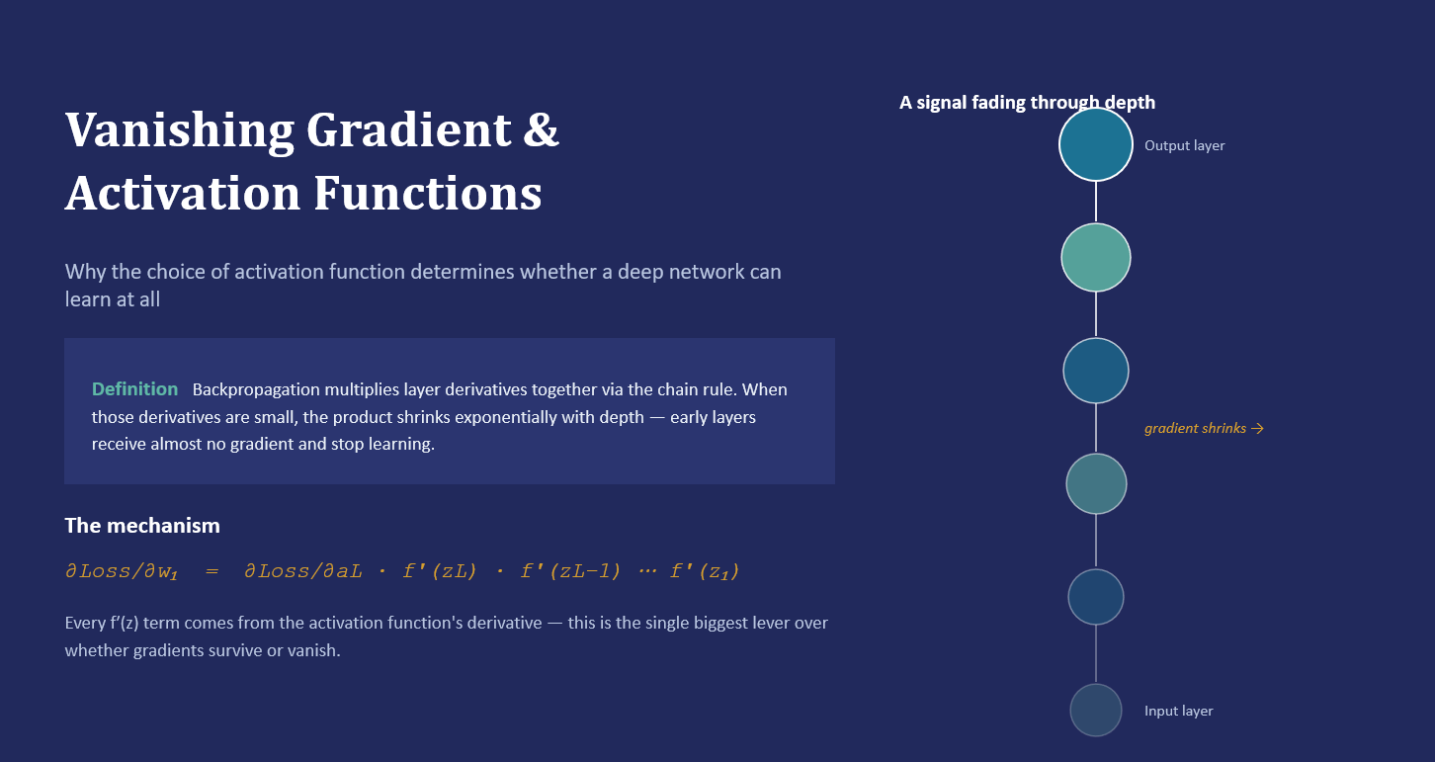

Slide 37
Sigmoid & Tanh — The Saturating Activations
Both squash their input into a bounded range — and both flatten out at the extremes
Derivative f′(x) vs. input x
Sigmoid σ(x) = 1 / (1+e⁻ˣ) → range (0, 1)
Max derivative = 0.25 at x=0. A 10-layer network attenuates the gradient by up to 0.25¹⁰ ≈ 9.5×10⁻⁷ — effectively zero.
Tanh tanh(x) = (eˣ−e⁻ˣ)/(eˣ+e⁻ˣ) → range (−1, 1)
Zero-centered output helps convergence, and its wider active range (|x| < ~2) delays saturation — but it still vanishes at depth.
Net effect: both saturate at their tails, so both are prone to vanishing gradients — sigmoid more severely than tanh.
Both curves collapse toward 0 as |x| grows — that's saturation. Tanh's peak (1.0) is 4× sigmoid's (0.25), so it decays a little less severely, but it still vanishes in deep stacks.

Slide 38
ReLU & Leaky ReLU — Solving (Most of) the Problem
No saturation on the positive side keeps the gradient signal intact at any depth
Derivative f′(x) vs. input x
No saturation → no vanishing
On the active (positive) side, gradients pass through unchanged, so networks can be trained 50–100+ layers deep.
Dying ReLU
A neuron stuck with negative input forever has derivative 0 and never updates again — a localized, permanent failure, not a gradual decay.
Leaky ReLU's fix
ReLU: derivative is a flat 1 for any positive input — no shrinking with depth. But it's exactly 0 for negative input, which can permanently silence a neuron ("dying ReLU"). Leaky ReLU keeps a small non-zero slope (α≈0.01) so no neuron's gradient is ever fully dead.
A small slope (e.g. α=0.01) for x<0 keeps every neuron's gradient non-zero, trading a little saturation-resistance for no dead neurons.

Slide 39
Vanishing Gradient — Activation Function Summary
How each activation function's derivative behavior determines its risk of vanishing gradients
Function | Max derivative | Saturates? | Vanishing risk | Depth scalability
Sign | 0 (undefined at 0) | N/A — flat | N/A (no gradient signal at all) | Not trainable by backprop
Step | 0 | N/A — flat | N/A (zero gradient everywhere) | Not trainable by backprop
Sigmoid | 0.25 | Both tails | Severe | Poor (~4–5 layers reliably)
Tanh | 1.0 | Both tails | Moderate–severe | Limited, better than sigmoid
ReLU | 1.0 (active side) | Left tail only (hard cutoff) | Minimal on active path; dying-ReLU instead | Excellent (100+ layers)
Leaky ReLU | 1.0 (α on negative side) | No true saturation | Minimal | Excellent; avoids dead neurons
Softmax | Depends on logits (layer-wide) | Can saturate with extreme logits | Low in typical output-layer use | N/A — output layer only
Practical takeaway: use ReLU (or Leaky ReLU) for hidden layers in deep networks; reserve Sigmoid/Tanh/Softmax for output layers where their bounded ranges are actually needed.

