Slide 1
SMART MATERNAL CARE INITIATIVE
IBM SkillsBuild Innovation Project
Project Metadata
Problem Statement MaaSathi - Maternal & newborn Care Companion
MaaSathi: Maternal & Newborn Care Companion
An AI-driven clinical intelligence and digital healthcare system delivering evidence-based antenatal guidance, automated vaccine schedules, FHIR health vaults, and peer birth clubs.
Domain Smart Maternal & Child Health System
Theme Healthcare / AI for Good
4
Clinical Care Pillars
10 0%
ABDM / FHIR Ready
IBM
Wat s o n x Powered
Team ID & Name SipnaHackX Track IBM SkillsBuild Certified
Our website : https://sipna-hack-x.vercel.app/
MaaSathi Healthcare Innovation · Maternal Intelligence
MaaSathi · IBM SkillsBuild Certified

Slide 2


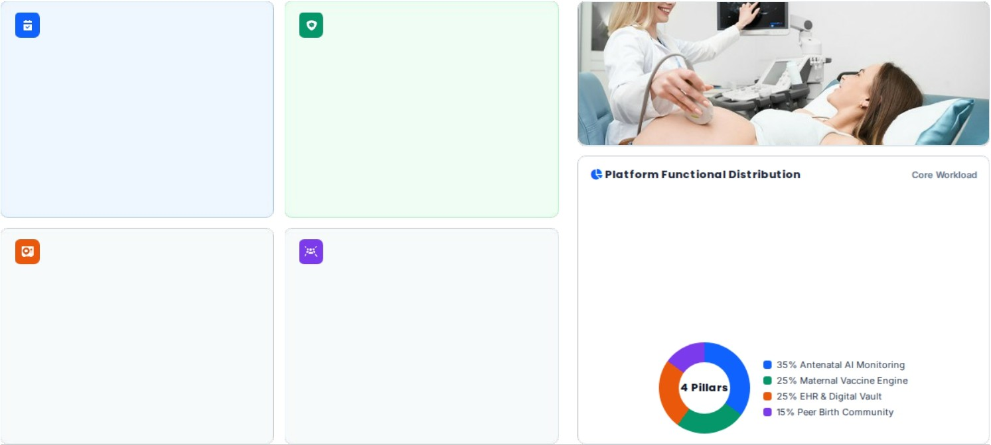
MaaSathi: Comprehensive Maternal Care Ecosystem
COMPREHENSIVE MATERNAL CLINICAL CARE
1. Antenatal Tracking
2. Vaccine Engine
Fetal growth tracking, vital sign monitoring
(BP, glucose), and automated risk classification for preeclampsia & gestational diabetes.
Evidence-based vaccination alerts (Tdap at 27- 36 weeks, seasonal Influenza, COVID-19) for
passive antibody transfer to save infants.
3. Digital Health Vault
4. Peer Birth Clubs
FHIR-compliant repository storing ultrasound
scans, lab panels, and doctor consultation notes for longitudinal clinical continuity.
Moderated cohorts grouped by delivery month connecting expectant mothers with certified
pediatricians & lactation specialists.
Key Innovation: Combines clinical decision support with empathetic community care on IBM Cloud.
MaaSathi Maternal Health Platform

Slide 3

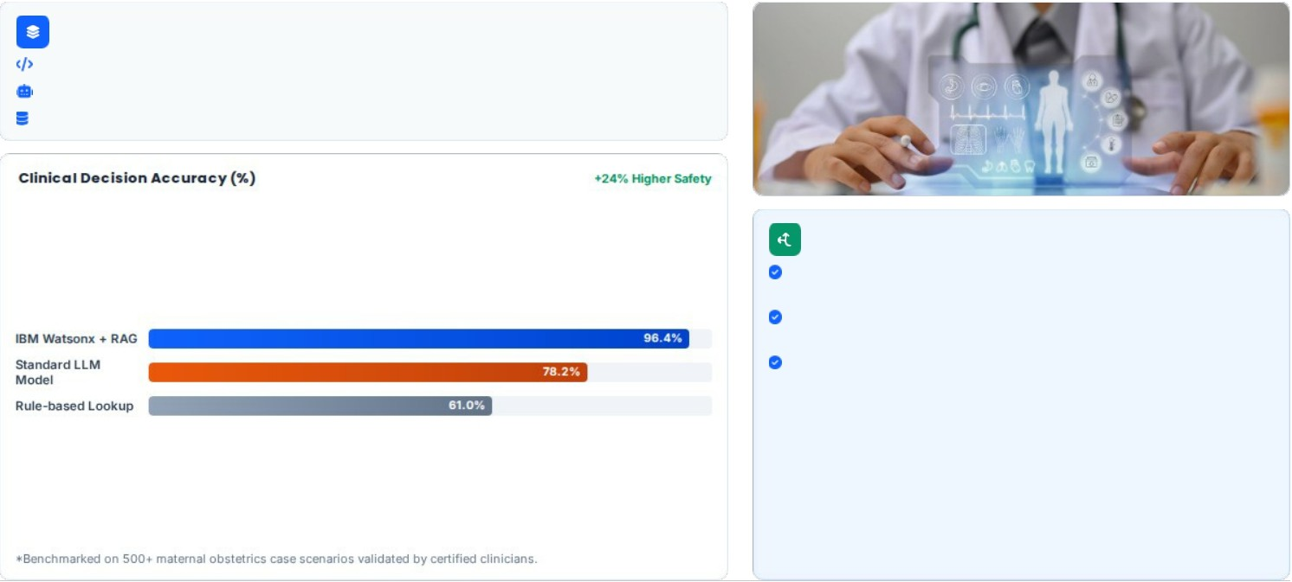
System Architecture & Technology Stack
TECHNICAL APPROACH & ARCHITECTURE
Multi-Tier Technology Stack
Frontend: React Native & PWA with multilingual voice input (Hindi, Marathi, English).
AI Engine: IBM Watsonx.ai & Granite 8B Instruct model for ICMR/WHO guidelines parsing.
Backend & Vault: FastAPI microservices, IBM Cloud Object Storage, PostgreSQL FHIR schema.
Care Delivery Workflow
Step 1 (Intake): Capture gestational age, LMP, parity, and baseline blood vitals.
Step 2 (AI Triage): Watsonx model flags high-risk pregnancies and dispatches clinic alerts.
Step 3 (Continuous Sync): Automated vaccine push reminders & ABDM health record sync.
Built leveraging IBM SkillsBuild cloud development modules & secure health data s tandards.
Secure HL7 & FHIR Protocols

Slide 4





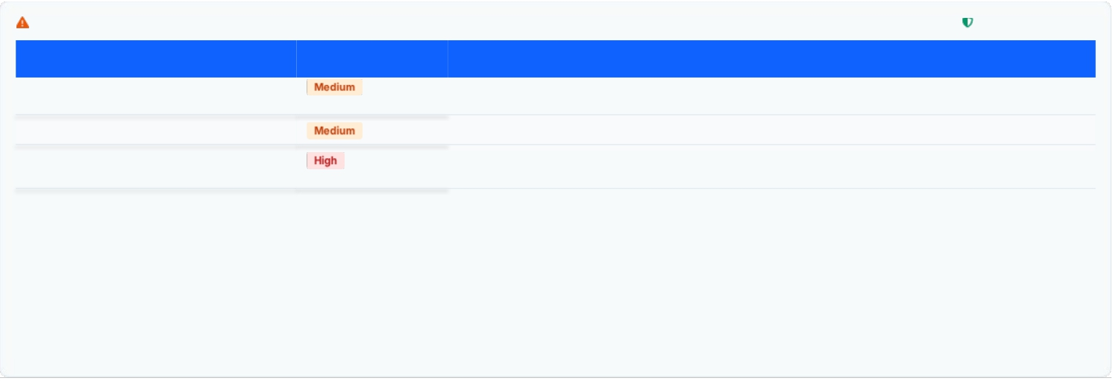
Viability Analysis & Risk Management
VIABILITY, RISKS & MITIGATION STRATEGY
Technical Feasibility
Financial Viability
Operational Scalability
Lightweight microservices and open HL7/FHIR protocols ensuring compatibility with existing hospital HMIS.
Freemium B2C tier for mothers, SaaS B2B clinic
subscriptions, and public PHC deployment through CSR & NHM.
Offline-first architecture with SMS fallback gateways enables deployment even in tier-2/3 rural PHCs.
Risk Matrix & Strategic Countermeasures 100% Risk Addressed
Risk Level Strategic Mitigation Strategy
End-to-end AES-256 encryption, HIPAA compliance, and ABDM (Ayushman Bharat) sandbox consent manager integration.
Potential Challenge / Risk
Health Data Privacy & Compliance
Digital Literacy in Rural Areas
Ve rnacular audio-visual prompts, icon-driven UI navigation, and dedicated ASHA worker co-pilot interface mode.
AI Clinical Hallucination Risk
RAG constrained strictly to validated WHO/ICMR clinical guidelines with physician disclaimers and confidence score thresholds.
Compliant with Indian Digital Personal Data Protection (DPDP) Act & Healthcare IT Stan dards.
Comprehensive Risk Controls

Slide 5


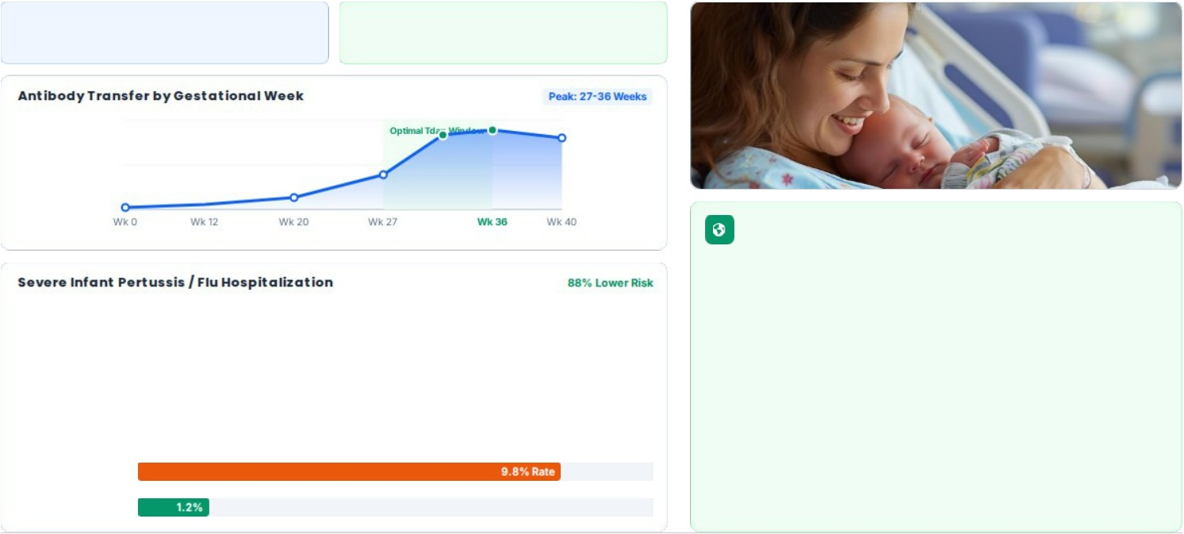
Measurable Outcomes & Health Transformation
MEASURABLE CLINICAL & SOCIAL IMPACT
40%
Reduction in Missed Antenatal Visits
92%
Vaccine Adherence (Tdap / Flu)
UN Sustainable Development Goals
Directly accelerates SDG 3 (Good Health & Well- being) targets 3.1 &
3.2 by curtailing preventable maternal mortality and neonatal infections through automated prenatal reminders and AI risk triage.
Unvaccinated Cohort
MaaSathi Va ccinated
Fostering zero-preventable maternal mortality through digital equity and clinical AI.
Sustainable Development Goals Aligned

Slide 6
Academic Citations & Project Timeline
RESEARCH, REFERENCES & ROADMAP
Research & Clinical Foundations
WHO Antenatal Care Guidelines: Standardized 8-contact routine model and gestational hypertension screening.
CDC & ACOG Maternal Immunization Protocol: Clinical trial validation for 3rd-trimester Tdap & seasonal influenza protection.
IBM SkillsBuild AI Activity (PLAN-DA048276D952): Cloud architecture, Granite LLM prompt tuning, and trusted AI pipelines.
HL7 FHIR & ABDM Guidelines: Indian National Health Authority interoperable electronic health record specifications.
Development & Pilot Roadmap
Phase 1 (MVP Launch - Q1 2026): Core prenatal tracker, Watsonx clinical AI triage, and vaccine alert scheduling system.
Phase 2 (Clinical Sandbox - Q2 2026): ABDM / ABHA ID integration, encrypted FHIR vault, and ASHA co-pilot mode.
Phase 3 (Hospital Pilot - Q3 2026): Deployment across 5 district maternity clinics and community peer network rollout.
Thank You! Team MaaSathi
IBM SkillsBuild Project · Ready for Live Prototype Demo & Q&A
Smart Maternal Health Innovation · All clinical data aligned with WHO & ICMR benchmar ks.
Te a m MaaSathi Presentation

Slide 7

Thank You…

