Slide 1
Encryption of communication using Face Detection and Eye Tracking using Morse Code
St. John College of Engineering and Management
Presented by:
Manasvi Kotian 1162066
Brandon Rodrigues 1162026
Nihar Vaidya 1162022
Guided by:
Mr. Sushant Patil

Slide 2
Contents:
Abstract
Introduction to Domain
Problem Definition
Proposed System
Objectives
Scope
Literature Survey
Requirement Analysis
System Architecture
System Design
Implementation
Conclusion
Future Scope
References

Slide 3
Abstract:
Digital image processing is the use of computer algorithms to perform image processing on digital images. The main goal of our project to create a platform for communication between individuals. The communication takes place in Morse Code. Morse Code is a binary language which consists of ‘1’ and ‘0’, the combination of these ‘1’ and ‘0’ form all the alphabets. The user sends the secret information in Morse code language via blinking his/her eyes. A normal blink refers to a ‘0’ and a long blink refers to a ‘1’. If the user keeps his/her eyes open for a long period of time, It is to display the one alphabet is been completed. The application can work in three ways i.e. any video that is been played, a live person via a camera,a 2-way communication between two users and to send a receive the Morse code data.

Slide 4
Problem Statement:
The main goal of this project is to provide the users with an interface to communicate with each other.
In regular text messengers the text data can be intercepted by the attacker to gain the knowledge. Morse code provides security.
The final objective of the project is to help doctors an the relatives to have a proper communication with patients who are unable to speak or communicate in a proper manner.

Slide 5
Proposed System:
The project creates a human interaction system in which the user can communicate via eye blink to convey any secret message by measuring the duration of the blink.
The system would first detect the face and then determine the location of the eyes. Once eyes has been detected, it works on counting the blinks.
Each alphabet is been represented by a different combination of blinks i.e. short blink(0) and long blink(1)

Slide 6
Objectives:
To get the input video and recording from the user.
To perform face detection and eye blinding monitoring procedure.
To extract the Morse code from the blinking.
To convert the blinks in to proper alphabets and blinks.
To implement 2-way communication between users.
To display the secret message.

Slide 7
Scope:
To help individual to communicate secretly.
To provide a better platform for a unique method of communication in which the text messages cannot be detected.
To create an interface for the patients to communicate with the doctors and their close ones.

Slide 8
Literature Survey I :
[1] Morse code-based communication system focused on amyotrophic lateral sclerosis patients
This application is based on face recognition and facial features techniques to extract Interest by applying filters and cascade classifier with OpenCV implemented in Visual Studio. Likewise, a software program was developed to transform blinkings into words, along with a graphical user interface; the ALS patient has the possibility to structure sentences, thus, facilitating his/her communication process with relatives and medical staff.

Slide 9
System Architecture:
Camera detection
Detected camera?
No
Yes
Read camera image
Detected image?
No
Convert image to grayscale
Yes
Blink detection
Face Detection
Blink detected?
No
Yes
Detected face?
Blink detection
No
Yes
Define “region of interest”
Visualize
Eyes detection
Yes
Detected eyes?
No

Slide 10
Advantages:
Auto completion of words
Use of assistant
Disadvantages:
No Two way communication
Low Security
Use of an external agent

Slide 11
Literature Survey II :
[2] Human computer interaction by eye blinking on real time.
There are a lot of disabled people who can't control some parts of their bodies such as ALS and real time human – computer interaction systems can help them. In this paper, a real time vision system is presented to provide a communication way to people has severe disabilities. Patients will be able to choose words on an alphabet tree which is designed on a binary tree by blinking right and left eye, thus they will make sentences.

Slide 12
System Architecture:
Input Frame
Face detecting
False
True
Is there open and close template for left and right eyes
Take a template
Is size or position changed?
True
False
Blink Detection
Moving on alphabet tree

Slide 13
Advantages:
Easy to use
Helpful for patients
Disadvantages:
Limited scope of communication
Inefficient eye tracking
No two way communication

Slide 14
Literature Survey III :
[3] Driver Fatigue Detection Based on Eye Tracking and Dynamic’ Template Matching
A vision-based real-time driver fatigue detection system is proposed for driving safely. The driver’s face is located, from color images captured in a car, by using the characteristic of skin colors. Then, edge detection is used to locate the regions of eyes. In addition to being used as the &namic templates for eye tracking in the next frame, the obtained eyes’ images are also used for fatigue detection in order to generate some warning alarms for driving safety.

Slide 15
System Architecture:
Go to next frame
failure
Face detection
success
Locate face region
failure
Eyes detection?
success
Save eye template
Goto next frame
failure
Eye tracking
Update eye templates
More frames?
yes
no

Slide 16
Advantages:
Accident prevention
Faster execution
Disadvantages:
Hard to detect face at night
Good quality of camera is required
Installation is complicated

Slide 17
Requirement Analysis:
Functional Requirements:
The application should be able to play videos and detect faces in them, once detected select one specific face.
The project should be able to take live input from the camera and do the same.
Once a face is detected, it should track the eyes and count the clinks to determine the Morse code sequence.
Once the sequence is been found, it must convert them into words and strings and then display them.
It must be able to perform a two-way video communication.

Slide 18
Requirement Analysis:
Non-Functional Requirements:
The process of selecting the face form the detected face in the given video must be simple.
The words found from the System must be checked to remove any errors.
The process of two-way communication must be seamless, i.e. lag free.
The use of this application must know the Morse code language to use it, and communicate with the system.

Slide 19
Requirement Analysis:
Hardware Requirements
35 GB HDD storage
8 GB RAM
i5 7th gen and above
GTX 750ti and above
Inbuilt camera in laptop
External Webcam for desktop

Slide 20
Requirement Analysis:
Software Requirements:
Visual Studio
Android studio
Python 3
openCV

Slide 21
System Architecture:
TRACK EYES
LONG BLINK
(DASH)
PRINT LETTER
START SYSTEM
NORMAL BLINK
(DOT)
OPEN EYE
(SPACE)

Slide 22
System Design:

Slide 23
^{Activity Diagram}
Play video
Start camera feed
Start two-way communication
View video feed of the other person
Detect Face
Find face
Detect the face in the video
Identify eyes
Identify the eyes
Identify the eyes
Count the blinks
Count the blinks
Count the blinks
Display the output
Display the message
Display the output
Activity Diagram for Video as an input:
Activity Diagram for Single person input :
Activity Diagram for two-way communication :

Slide 24
State Diagram
Detect face and eyes
Eyes ratio fall below threshold
Calculate the duration of frame
Determine if long blink (1) or short blink (0)
Display output

Slide 25
Use Case Diagram
Established communication
Input camera feed
User -01
Video of user 01
Video of user 02
User
Detect face and eyes
Detect face and the eyes
Find the code
Determine the Morse code
User -02
Display output of the video of user 01 to 02
Display the output
Display output of the video of user 02 to 01
for single user/ and video.
for two-way communication.

Slide 26
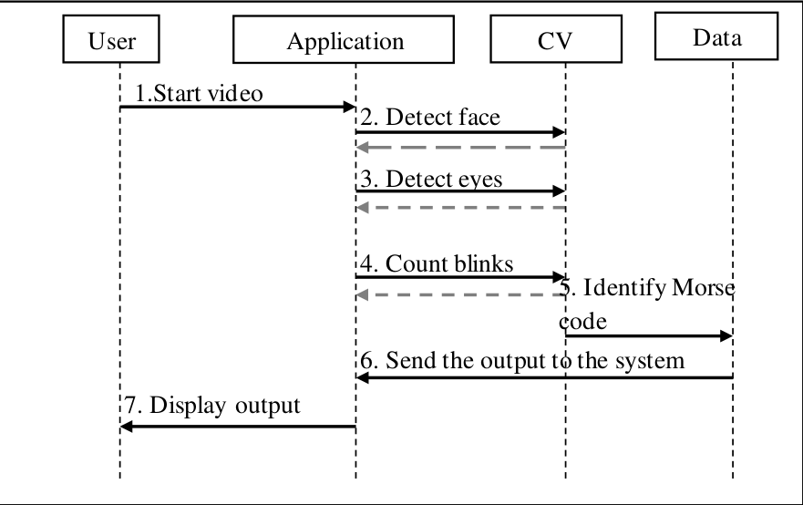
Sequence Diagram
for single user/ video input.

Slide 27
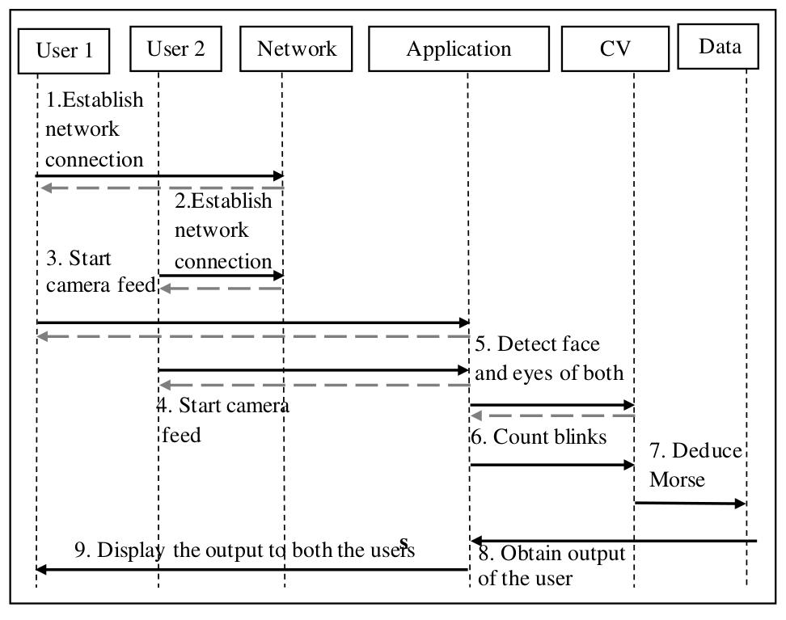
for two-way communication.

Slide 28
Data Flow Diagram
Level 0:-
User
Morse code
Detection
Application
Text output
Level 1:-
1.0
Detects Face
2.0
Capture Actions
User
4.0
Provides the
Output
3.0
Process those
Actions
Text Output

Slide 29
1.1
Tracks Eyes
1.2
Marks the
Location of Eyes
User
Level 2:-
3.1
Refers with the
Directory of Morse Cord
2.2
Records the
Pattern of
The Eye Blink
2.1
Input the
Eye Blinks
3.2
Eye Blinks are
Converted in Morse Code form
4.1
Output is Printed in the Alphabet Form
Text Output

Slide 30
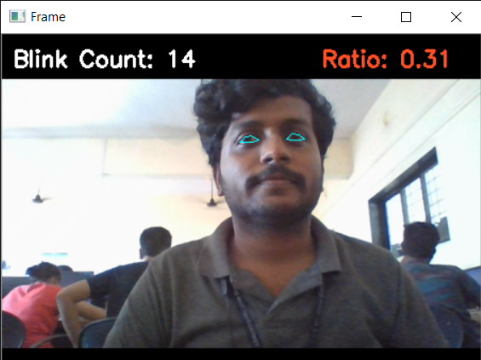
Implementation
The system is able to detect the eyes, and the ratio of the points associated with it.
When the ratio falls under 0.25 the system counts as a blink.

Slide 31
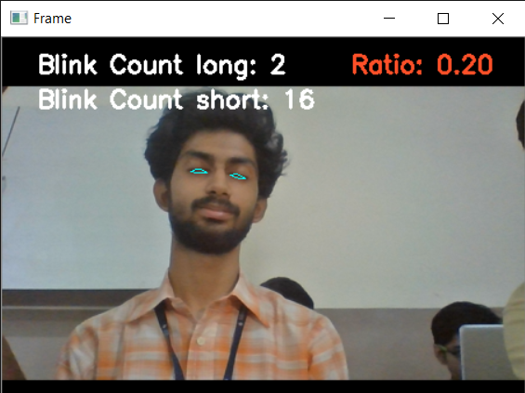
Implementation
Further the system is able to detect short and long blinks.
It counts the no. of frames for which the user’s eye ratio falls below the threshold.

Slide 32
Future Scope:
Developing a new unique secret code to keep it more secure.
Security authentication using face detection and the combination of eye blinks.
Using this platform as a framework to implement in other applications.

Slide 33
References:
[1] J. Garry and K. Casey, “Psychosocial Impact of the Tobii C12 Eye Tracking Computer in the ICU Setting.,” Crit. Care Med., vol. 41, no. 12, 2013.
[2] M. Betke and W.J. Mullally, “Preliminary Investigation of Real-Time Monitoring of a Driver in City Traffic,” Proceedings of the IEEE International Conference on Intelligent Vehicles, Dearhorn, MI, pp. 563-568, October 2000.
[3] M. Eriksson and N. Papankolopoulos, “EyeTracking for Detection of Driver Fatigue,” 11 Proceedings of the International Conference on Intelligent Transportation Systems, Boston, MA, pp. 3 14-3 19, November 1997.

