Slide 1

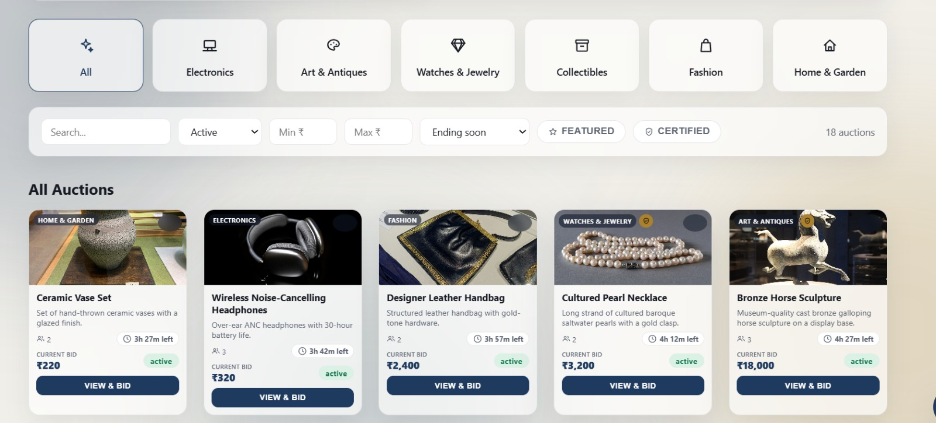
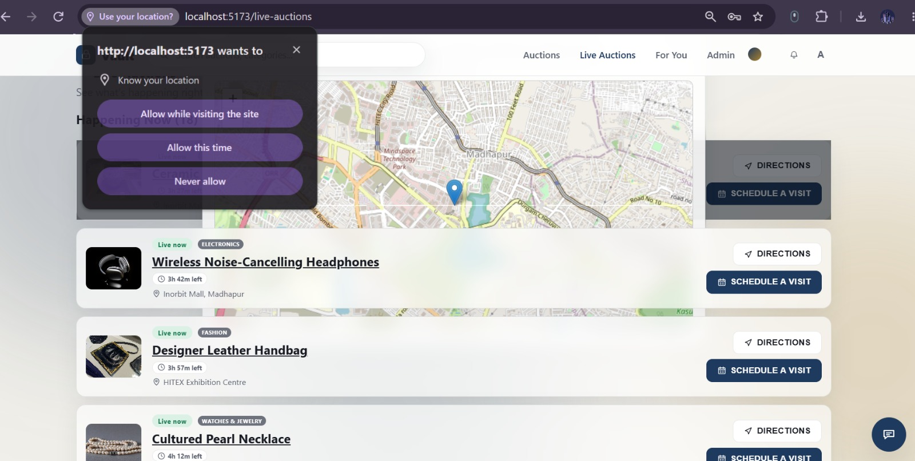
Online Auction & Bidding Platform with Real-Time Concurrency Handling
Team ID: 22 | Section: 7 | Members: Param Manasvi – 2520030072, Ch. Shravya Chowdary – 2520030322 | Guide: Dr. Y. Subbarayudu
Database Systems Engineering and Distributed Backend Development (25CS1302E) | KLH Bachupally Campus, CSE | PBL 2026-27
Abstract
Tools & Technologies
A web-based auction platform where users register, browse items and bid live, and admins manage products and auctions. Built with React, Node.js/Express, MySQL and Socket.IO.
MySQL transactions with row-level locking keep every bid correct, even when many users bid at once.
Front-End: React.js (Vite), HTML, CSS, JavaScript
Back-End: Node.js + Express.js REST APIs, JWT auth
Real-Time: Socket.IO (server and client)
Database: MySQL 8.0 (InnoDB), MySQL Workbench
Tools: Git & GitHub, VS Code, Axios, node-cron
Problem Statement & Objectives
Problem: Simple SELECT-then-UPDATE bidding is race-prone: two simultaneous bids can let a lower bid overwrite a higher one.
Objective 1: Build a web platform to register, browse auctions and bid in real time.
Objective 2: Guarantee correct bids under concurrency using transactions and row locks.
Objective 3: Keep full bid history and auto-declare the highest valid bidder as winner.
Scope: Bidders and Admin; modules for users, products, auctions, bidding, history and results.
System Architecture
Front-End
React + Vite
Login · Auctions · Bid form · Admin
REST
Back-End
Node.js + Express
REST API · JWT auth · Socket.IO server
SQL
Database
MySQL 8 (InnoDB)
users · products · auctions · bids · results
Receives live bid updates via Socket.IO
node-cron closes expired auctions every 30 s
Row lock (SELECT … FOR UPDATE) on every bid
Existing vs Proposed System
ER Diagram & Database Design
Feature | Existing System | Proposed System
Core features | Listing, bidding, timers, winner selection | Same core, plus admin module and full bid history
Concurrency | Basic systems use SELECT then UPDATE (race-prone) | One transaction + SELECT … FOR UPDATE row lock
Real-time | Varies; often manual page refresh | Socket.IO pushes each new bid to all viewers
Data integrity | Mini-projects often skip transactions | PK/FK constraints, atomic commits, deadlock retry
Limitation / Gap | Large systems are closed-source; DB design not documented | Open, documented schema with a concurrency test script
users
products
auctions
PK id
name
email (UNIQUE)
password_hash
role (user / admin)
1
N
PK id
name
description
image_url
FK created_by
1
N
PK id
FK product_id
starting_price
current_highest_bid
FK highest_bidder_id
start_time, end_time
status
1
N
N
1
1 : 1
Legend
PK primary key
FK foreign key
1 : N one-to-many
Engine: InnoDB
bids
auction_results
PK id
FK auction_id
FK user_id
amount
created_at
PK,FK auction_id
FK winning_bid_id
FK winner_id
finalized_at
Feasibility Study
Implementation Screenshots
Technical: Mainstream JavaScript + SQL stack; all tools run on Windows or Linux.
Economic: Fully open-source stack (React, Node.js, MySQL, Socket.IO); no licence cost, free-tier hosting is enough.
Operational: Simple web UI for bidders and admins; JWT login and automatic auction closing keep maintenance low.
Schedule: Core modules and concurrency testing are achievable within the semester timeline.
Screenshot 1
Auctions page: category tiles, filters and live bid cards
Screenshot 2
Live Auctions page: map view with pickup locations
Results & Testing
Conclusion
Future Scope
Simulated concurrent bids validated: no lost updates, correct highest bid
CRUD, bid validation and live updates working end to end
A secure, consistent real-time auction platform with a full bid history
Meets all objectives: atomic bids, live updates, automatic winner selection
Online payment gateway and mobile app
Email / SMS / push notifications, AI price prediction and fraud detection
References: [1] MySQL 8.0 Reference Manual, InnoDB Locking Reads (dev.mysql.com) [2] Socket.IO v4 Documentation (socket.io/docs/v4) [3] Express.js Documentation (expressjs.com) [4] Elmasri & Navathe, Fundamentals of Database Systems
QR: GitHub

