Slide 1

FINAL REVIEW
Online Auction and Bidding Platform with Real-Time Concurrency Handling
Team 22 · Section 7
Param Manasvi (Team Lead) – 2520030072
Ch. Shravya Chowdary – 2520030322
Guide: Dr. Y. Subbarayudu, Assistant Professor, Dept. of CSE
Database Systems Engineering and Distributed Backend Development (25CS1302E) · Y25 · 2026-27 · Trimester 4
Notes:
Welcome. Our project is an online auction platform whose main contribution is correct handling of simultaneous bids. The headline result: under 20 simultaneous bidders, our approach produced the correct highest bid in 10 out of 10 test rounds, while a plain SELECT-then-UPDATE approach got it right only twice in 10.

Slide 2
The Problem: A Race Condition
Why a simple SELECT then UPDATE is unsafe when bids arrive together
Highest bid in database: ₹500
Root cause
User A bids ₹600
User B bids ₹550
Read, check and write are separate, unsynchronised steps. Nothing locks the auction row between them.
t1
READ highest = ₹500
READ highest = ₹500
t2
600 > 500, looks valid
550 > 500, looks valid
t3
WRITE highest = ₹600
8 / 10
t4
WRITE highest = ₹550
rounds ended with a wrong highest bid when we ran it ourselves (20 bidders)
Database now holds ₹550: the lower bid overwrote the higher one
Team 22 | Final Review | DBDSE (25CS1302E)
2
Notes:
Suppose the highest bid is 500. User A bids 600 and user B bids 550 at almost the same moment. Both read 500, both think they are valid, A writes 600, then B writes 550 on top of it. The lower bid wins. The root cause is that read, check and write are three separate steps with nothing locking the row. We reproduced this: with 20 simultaneous bidders the plain approach ended with a wrong highest bid in 8 of 10 rounds.

Slide 3
Our Solution: One Atomic Transaction
Bid validation and update happen under a row lock, so only one bid is processed at a time
1
2
3
4
5
BEGIN
LOCK
VALIDATE
WRITE
COMMIT
Start one MySQL transaction on a pooled connection.
SELECT … FOR UPDATE takes a row lock on the auction.
Check status, end time and amount against the locked value.
UPDATE the highest bid and INSERT the bid record together.
Lock released; Socket.IO pushes bid_update to all watchers.
Isolation
Deadlock retry
Data integrity
InnoDB REPEATABLE READ plus the explicit row lock closes the read-check-write window.
On ER_LOCK_DEADLOCK the bid is retried up to 3 times with jittered back-off.
Primary keys, foreign keys and constraints keep users, auctions and bids consistent.
Team 22 | Final Review | DBDSE (25CS1302E)
3
Notes:
Our fix wraps the whole bid in one MySQL transaction. We start the transaction, then SELECT the auction row FOR UPDATE, which takes a row lock; any other bidder on that auction waits. We validate against the locked, fresh value, write the new highest bid and the bid history row together, and commit, which releases the lock. If MySQL reports a deadlock we retry up to three times with a small random back-off.

Slide 4
System Architecture
Three tiers connected by REST, WebSocket and SQL
React Client (Vite)
Node.js + Express
MySQL 8.0 · InnoDB
Login · Register
Auction list and detail
Bid form + live history
Admin dashboard
Axios + Socket.IO client
REST routes + JWT / admin guards
Controllers: auth, product, auction, bid
Socket.IO rooms per auction
node-cron: auto-close (30 s)
users · products · auctions
bids · auction_results
Row-level locks + transactions
PK / FK / constraints
REST + JWT
SQL
WebSocket
Life of one bid
1
2
3
4
5
6
POST /api/auctions/:id/bids with JWT
Auth middleware verifies the token
placeBidWithRetry() opens a transaction
Row lock, validate, write, commit
Server emits bid_update to the auction room
Every open page refreshes instantly
Team 22 | Final Review | DBDSE (25CS1302E)
4
Notes:
The React client talks to the Express server over REST with a JWT, and over a Socket.IO WebSocket for live events. The server talks to MySQL through a mysql2 connection pool; the pool matters because each concurrent bid needs its own connection to hold its own transaction and lock. Below is the life of one bid from click to every open screen.

Slide 5
Database Design
Seven InnoDB tables with enforced primary, foreign and composite keys
products
auctions
auction_results
PK id
name, description
image_url
FK created_by
created_at
1 : N
PK id
FK product_id
starting_price
current_highest_bid
FK current_highest_bidder_id
start_time, end_time
status (scheduled | active | closed)
1 : 1
PK/FK auction_id
FK winning_bid_id
FK winner_id
finalized_at
1 : N
1 : N
users
bids
Also foreign keys
auctions.current_highest_bidder_id → users
auction_results.winner_id → users
auction_results.winning_bid_id → bids
PK id
name
email (UNIQUE)
password_hash
role (user | admin)
created_at
PK id
FK auction_id
FK user_id
amount
created_at
IDX (auction_id, amount)
1 : N
Team 22 | Final Review | DBDSE (25CS1302E)
5
Notes:
The schema has five tables: users, products, auctions, bids and auction_results. A product has many auctions, an auction has many bids, a user places many bids and creates products, and each closed auction has exactly one result row. All tables are InnoDB, which is required for transactions and row-level locks, and there is an index on auction id plus amount on the bids table.

Slide 6
Concurrency Control in Code
bidController.js: placeBidTransaction() (condensed)
await conn.beginTransaction();
// 1. take the row lock
SELECT current_highest_bid, status, end_time
FROM auctions WHERE id = ? FOR UPDATE;
// 2. validate on the locked value
if (status !== 'active') → 400
if (now > end_time) → 400
if (amount <= highest) → 409
// 3. write bid + history atomically
UPDATE auctions SET current_highest_bid = ?, …;
INSERT INTO bids (auction_id, user_id, amount) …;
await conn.commit(); // lock released
1
Lock
Other bidders on this auction block here until commit or rollback.
2
Validate
The check uses the fresh, locked value, never a stale read.
3
Write and commit
Highest bid and history row change together or not at all.
Deadlock (error 1213): retry up to 3 times, back-off 50·n + random(100) ms
Team 22 | Final Review | DBDSE (25CS1302E)
6
Notes:
This is the core of the project, condensed from placeBidTransaction in bidController.js. The row lock on the auction is taken first, which is the line that makes every other bidder on the same auction wait. Validation then uses the locked value rather than a stale read. The update and the insert are in the same transaction, and commit releases the lock. If a deadlock error 1213 is raised, the wrapper retries up to three times.

Slide 7
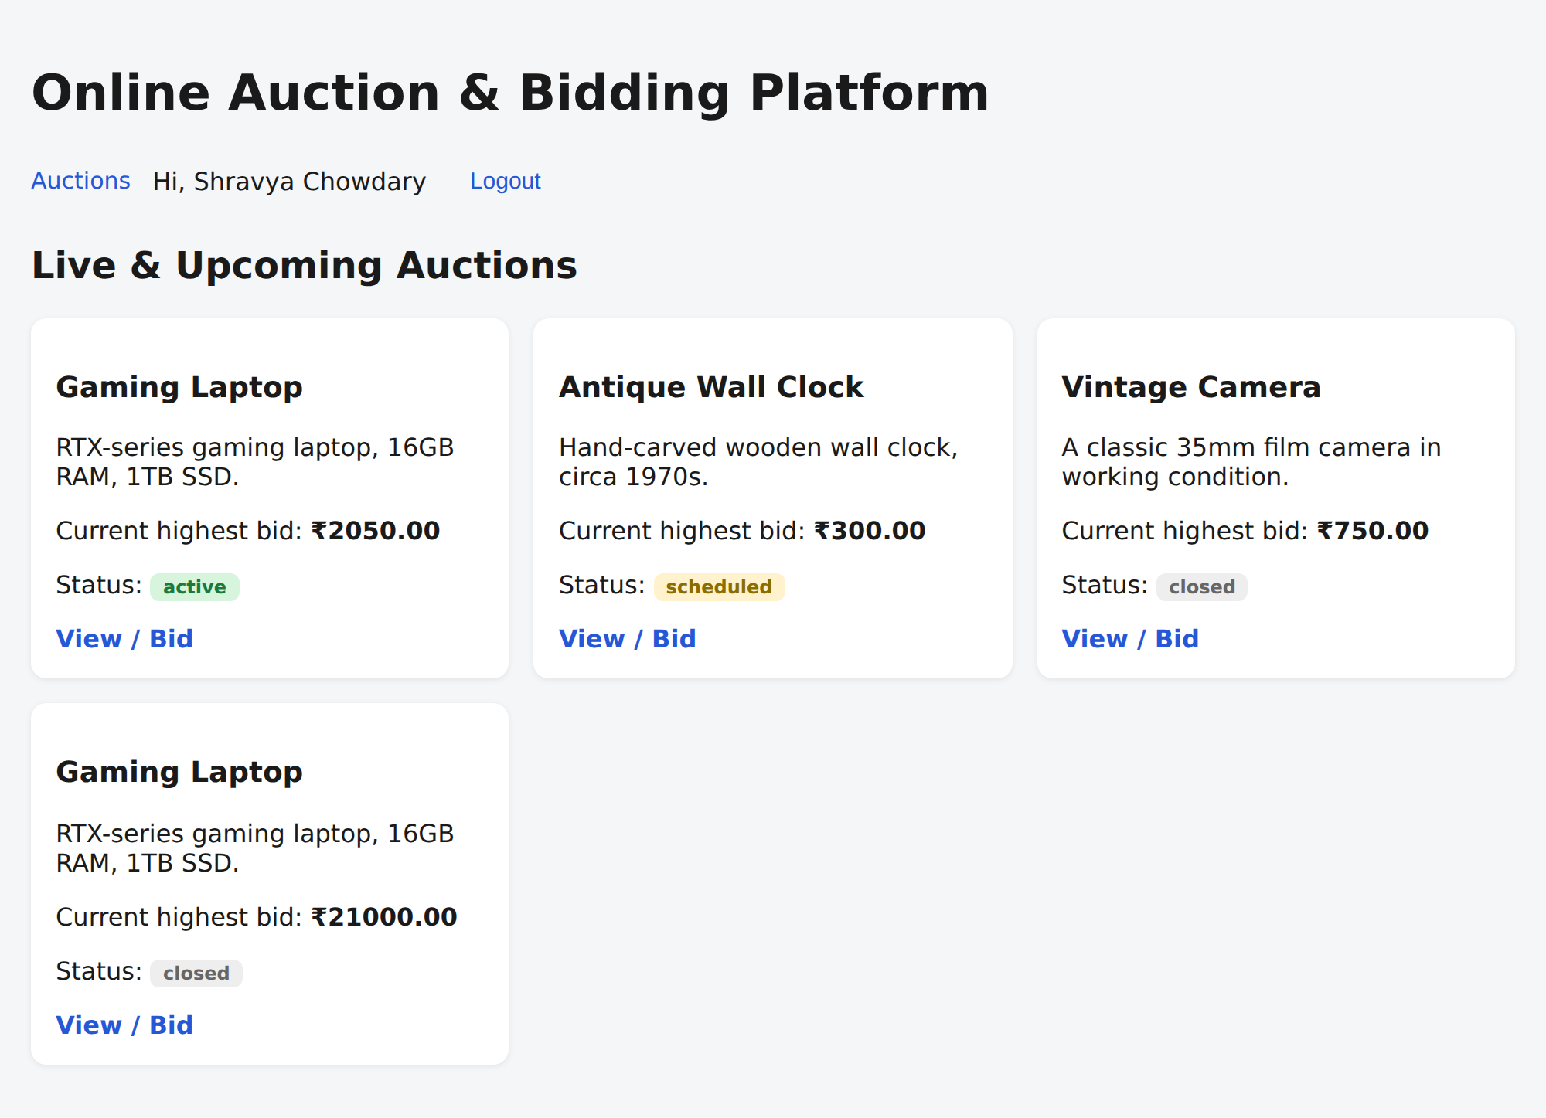
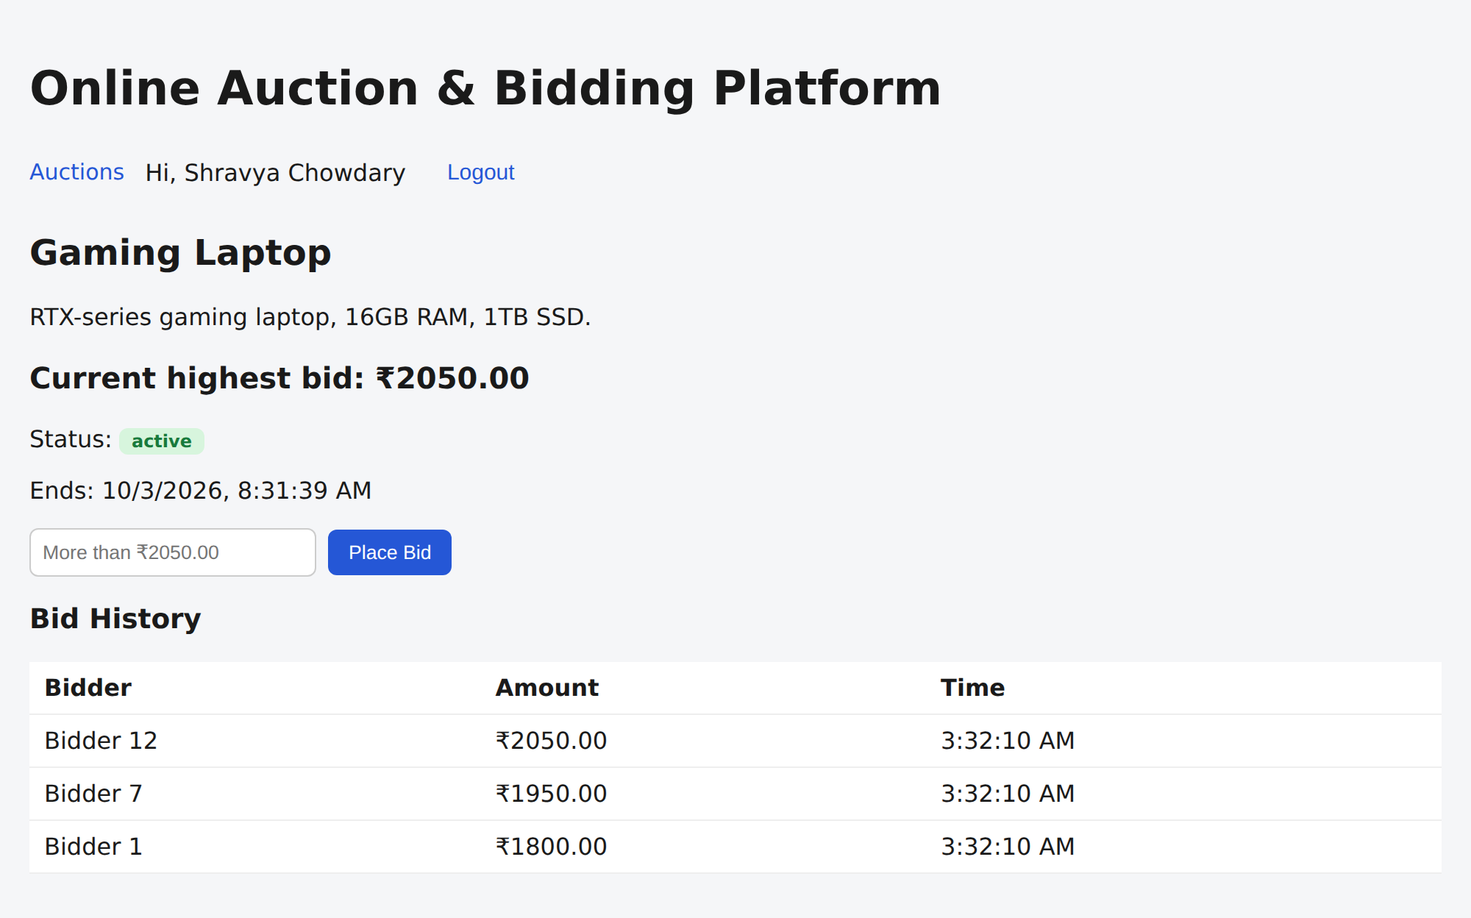
Bidder Experience
Browse live auctions, open one, and place a bid
Auction list
Auction detail with bid form and history
Register / login (JWT) → browse → bid → see the new highest bid instantly
Team 22 | Final Review | DBDSE (25CS1302E)
7
Notes:
This is the bidder flow in the running application. On the left, the auction list shows each product, its current highest bid and its status. On the right, the detail page shows the current highest bid, the bid form, and the full bid history with bidder names and amounts.

Slide 8

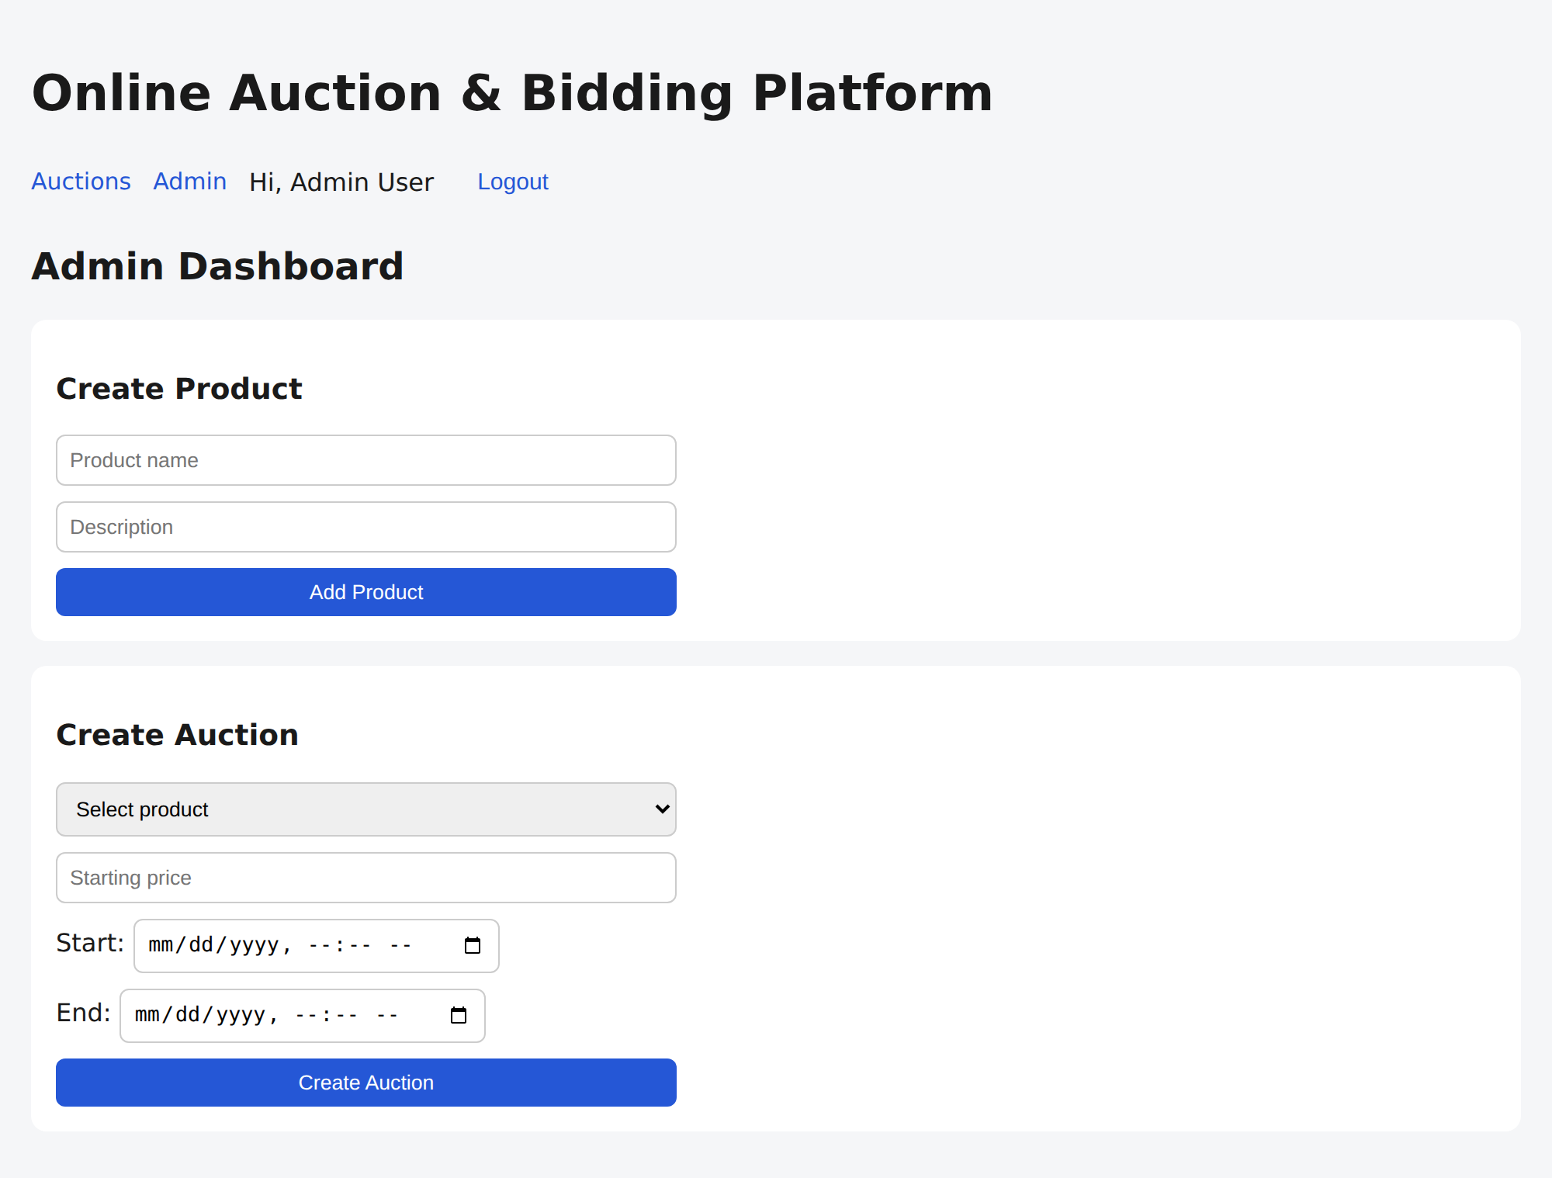
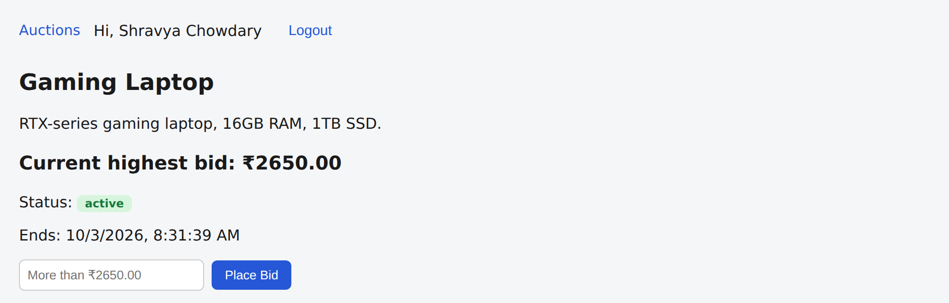
Real-Time Updates and Admin
Another user bids and the open page updates without a reload
Before: ₹2400.00
Admin dashboard
After another user bids: ₹2650.00
Team 22 | Final Review | DBDSE (25CS1302E)
8
Notes:
On the left are two captures of the same open page, taken before and after a different user placed a bid through the API. The page moved from 2400 to 2650 without any reload, pushed over Socket.IO. On the right is the admin dashboard where administrators create products and auctions.

Slide 9
Naive SELECT then UPDATE vs Row Locking
20 simultaneous bidders, 10 rounds, true highest bid = ₹2050
8 / 10
rounds with a wrong highest bid (plain SELECT then UPDATE)
10 / 10
rounds correct with SELECT … FOR UPDATE; bid history strictly increasing
Team 22 | Final Review | DBDSE (25CS1302E)
9
Notes:
We ran the same experiment ten times. Twenty users bid distinct amounts from 1100 to 2050 at the same instant, so the correct final highest bid is always 2050. The plain read-then-write version ended with a wrong value in eight of ten rounds, sometimes as low as 1300. Our row-locking version ended at 2050 every single time, and the bid history was strictly increasing. Note that the naive version includes a 20 millisecond simulated processing delay between the read and the write.

Slide 10
Test Cases and Results
Every scenario below was executed against the running application
# | Scenario | Expected | Result
1 | 4 simultaneous bids (₹600–750), different users | Highest = ₹750; all bids logged | PASS ₹750, 4 history rows
2 | 4 users bid the same ₹21,000 at once | Exactly one accepted | PASS 1 accepted, 3 × 409
3 | 20 simultaneous bids, 10 rounds | Final = ₹2050; history strictly increasing | PASS 10 / 10 rounds
4 | Bid not above the current highest | Rejected with 409 | PASS 409
5 | Bid on a closed auction | Rejected with 400 | PASS 400 not active
6 | Bid without logging in | Rejected with 401 | PASS 401
7 | Non-admin opens admin API | Rejected with 403 | PASS 403
8 | Auction passes its end time | Closed; winner stored in auction_results | PASS winner recorded
9 | Another user bids on an open page | Page updates without reload | PASS ₹2400 → ₹2650
Concurrency test environment: Node.js 22 + MariaDB 10.11 (InnoDB) + React/Vite; project schema targets MySQL 8.0.
Team 22 | Final Review | DBDSE (25CS1302E)
10
Notes:
These are the test cases we executed against the running application. The first three are the concurrency tests: four distinct simultaneous bids, four users bidding the exact same amount where exactly one must win, and the twenty-bidder stress test repeated ten times. The rest cover validation, authentication, authorisation, the auto-close job and the live update. Tests were run on MariaDB 10.11 with InnoDB, which has the same row-locking behaviour as MySQL 8.

Slide 11
Existing vs Proposed System
What we added over typical auction systems
Feature | Existing systems | Proposed system
Core features | Listing, bidding, timers and winner selection | Same features, plus live bid push through Socket.IO
Bid handling | Basic systems: plain SELECT then UPDATE | One transaction with SELECT … FOR UPDATE
Concurrency | Race conditions; a lower bid can overwrite a higher one | Row lock, REPEATABLE READ and deadlock retry
Transparency | Commercial platforms are proprietary; design not documented | Open, documented schema and bid logic for study
Limitation / gap | Mini-projects skip transaction handling and rarely test it | Verified with simulated concurrent bids (10 / 10 rounds)
Team 22 | Final Review | DBDSE (25CS1302E)
11
Notes:
Large commercial auction sites have the core features but are closed-source, so their database design and concurrency handling cannot be studied. Basic academic projects usually skip transaction handling entirely. Our system keeps the same core features and adds a documented, tested locking approach plus live bid updates.

Slide 12






Technology Stack
Open-source tools, no licence cost
Front-End
Back-End
Database
React.js (Vite)
HTML, CSS, JavaScript
Axios · React Router
Node.js + Express.js
JWT auth · bcrypt
node-cron
MySQL 8.0 (InnoDB)
Transactions, row locks
MySQL Workbench
Real-Time
Tools
Environment
Socket.IO server + client
One room per auction
bid_update, auction_closed
Visual Studio Code
Git and GitHub
Windows 10/11 or Linux
Chrome / Edge
Team 22 | Final Review | DBDSE (25CS1302E)
12
Notes:
The whole stack is open source: React with Vite on the front end, Node.js and Express on the back end, MySQL with InnoDB for storage and Socket.IO for real-time events. Development used VS Code, Git and GitHub and MySQL Workbench, and the application runs on Windows or Linux in any modern browser.

Slide 13
Course Mapping — COs to Project
13
Aligned with the DSDBE Revised 2026–27 course handout
CO1
Layered backend + request/response flow
React/Vite → Express routes → JWT/admin middleware → controllers → MySQL pool → JSON response
Direct
CO2
ER modelling + normalization
7-table relational schema; PK/FK relationships; composite keys; integrity constraints
Direct
CO3
SQL for relational data
schema.sql DDL; CRUD queries; joins, filters and grouping; advanced CTE/window topics are not primary
Strong / partial
CO4
Transactions + concurrency
InnoDB transactions, REPEATABLE READ, SELECT … FOR UPDATE, commit/rollback, deadlock retry, concurrency tests
Direct
CO5
Indexing + query execution
idx_auction_amount (auction_id, amount); retrieval-oriented query patterns; no dedicated EXPLAIN workflow
Partial
CO6
Distributed database fundamentals
Single MySQL deployment; replication, sharding and CAP are discussed as future scaling directions
Conceptual / future
CO1–CO6 in the handout cover backend layering, ER/normalization, SQL, transactions/concurrency, indexing/query execution and distributed databases.
Team 22 | Final Review | DBDSE (25CS1302E)
2026–27

Slide 14
Course Mapping — Evidence & PO/PSO
14
Implementation artefacts and the scope of evidence
CO
Project evidence
Implementation / artefact
PO / PSO
Scope note
CO1
Layered backend
Routes, JWT/admin middleware, controllers, MySQL pool, REST flow
PO1, PO2, PO3
Implemented
CO2
Relational design
7 tables, PK/FK, composite PKs, constraints
PO1, PO3, PSO1
Implemented
CO3
SQL
schema.sql + controller queries; joins/grouping/filtering
PO1, PO3, PSO1
Advanced CTE/window use not primary
CO4
Transactions & locking
SELECT FOR UPDATE; atomic update+insert; retry; tests
PO1, PO2
Core contribution
CO5
Indexing
idx_auction_amount on bids; retrieval-oriented queries
PO1, PO2
EXPLAIN not demonstrated
CO6
Distributed DB
Single-instance deployment; scaling discussed
PO1, PO3, PO4
Future / conceptual
Team 22 | Final Review | DBDSE (25CS1302E)
2026–27

Slide 15
Conclusion and Future Scope
Conclusion
Future Scope
A working auction platform: register, browse, bid, and automatic winner selection.
Row-level locking in one transaction kept simultaneous bids correct: 10 / 10 rounds, while the naive approach produced the wrong highest bid in 8 / 10 rounds.
Every open page sees new bids instantly through Socket.IO.
Demonstrates schema design, integrity constraints, SQL, transactions, isolation and locking.
Online payment gateway integration
Mobile application
AI price prediction and bid recommendations
Email / SMS / push notifications
Fraud detection and stronger security
Edit and delete screens for products and auctions
Team 22 | Final Review | DBDSE (25CS1302E)
15
Notes:
To conclude: we built a working auction platform and showed with measurements that row-level locking inside one transaction makes simultaneous bidding safe, 10 of 10 rounds correct versus 2 of 10 for the naive version. Bids reach every open page in real time. For future work we plan payments, a mobile app, notifications, AI-based price guidance, fraud detection, and edit and delete screens for products and auctions.

Slide 16
16
Thank You
Questions?
Team 22 · Param Manasvi (2520030072) · Ch. Shravya Chowdary (2520030322)
Guide: Dr. Y. Subbarayudu · Dept. of Computer Science and Engineering · KLH
Notes:
Thank you. We are happy to take questions, and we can run the concurrency test live on the running application.

