Slide 1
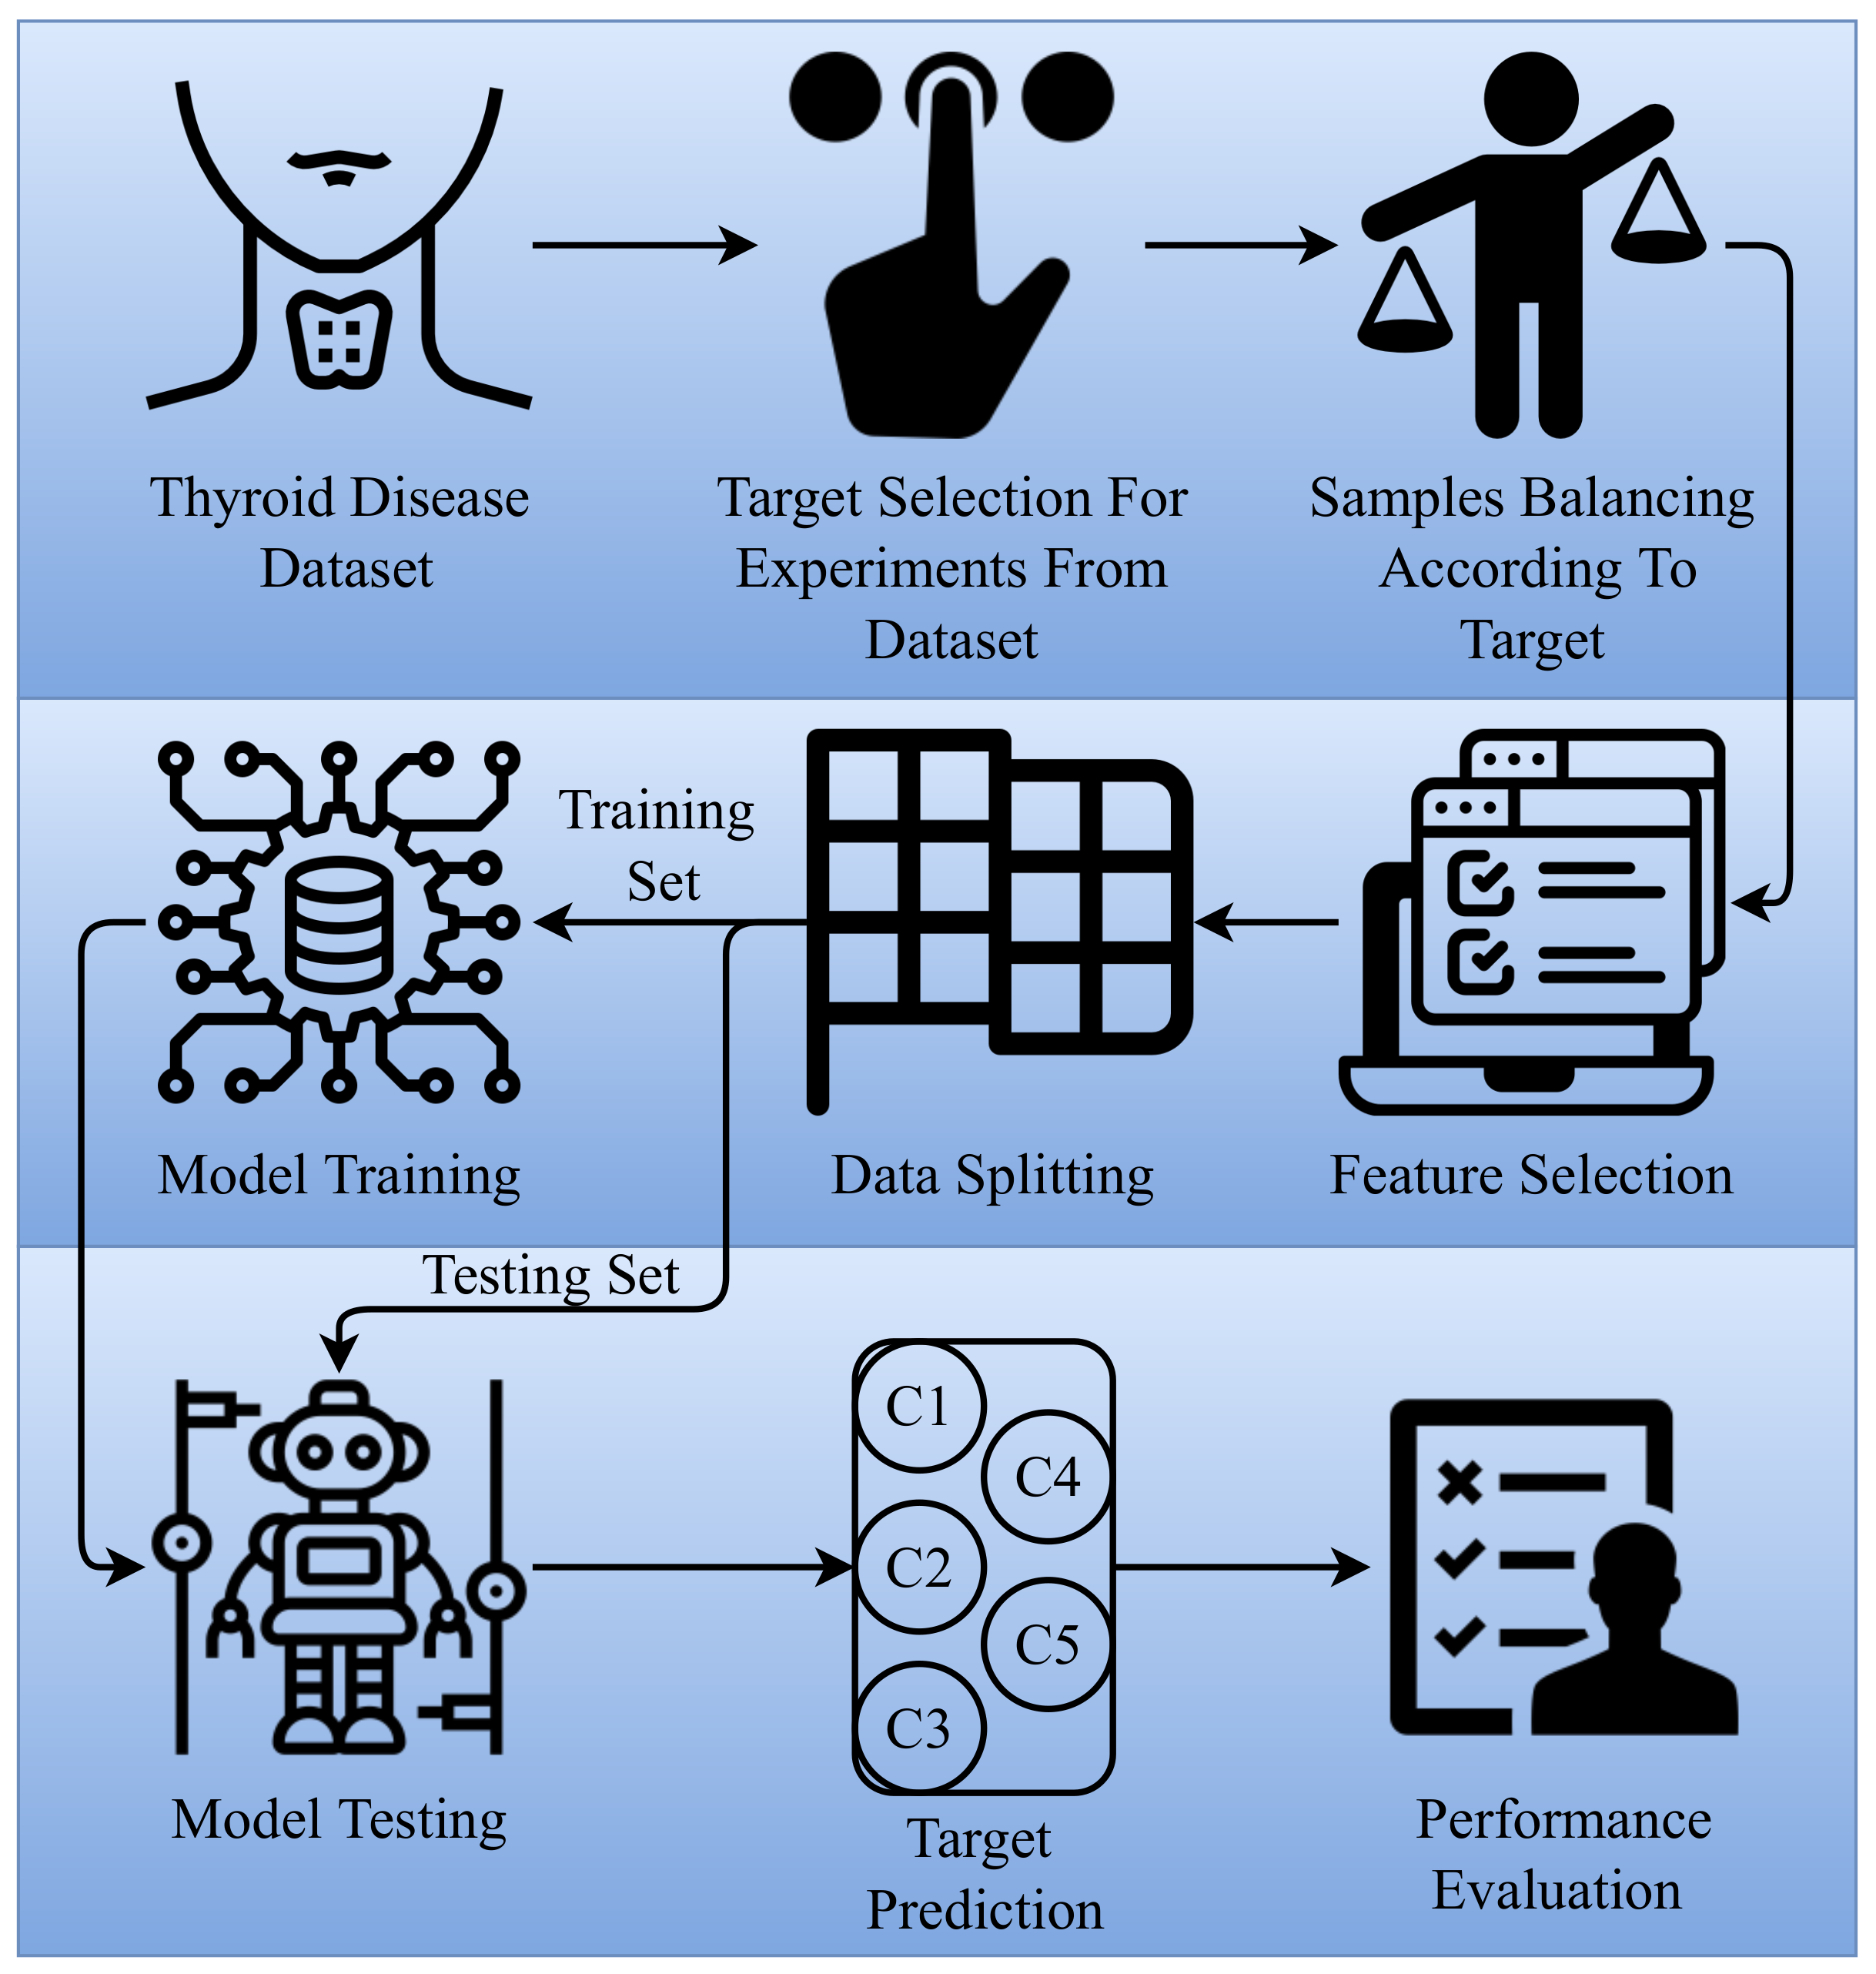
Machine learning algorithm for detecting thyroid-related disorders to increase thyroid illness diagnosis accuracy
Advance Machine Learning / Spring 2024 / Prof. Ashok Kumar Patel
By Group–11
Ajeet Singh–48
Manas Vishal–58
Rohith Kumar–13
Notes:
NOTE: Want a different image on this slide? Select the picture and delete it. Now click the Pictures icon in the placeholder to insert your own image.

Slide 2
Content Layout with List
Problem Statement
Understanding Datasets
Preparation of Datasets
Encoding features/class
Handling Missing Values
Feature Selection
Correlation Matrix for Features vs Class
Training using Models
Network Model
ANN
Statistical Model
SVC
Tree Based Model
XGBoost
GBM
Random Forest
AdaBoost
Evaluation of Model
Metrics of each model (Accuracy, Precision, Recall, F1-Score)
Conclusions

Slide 3
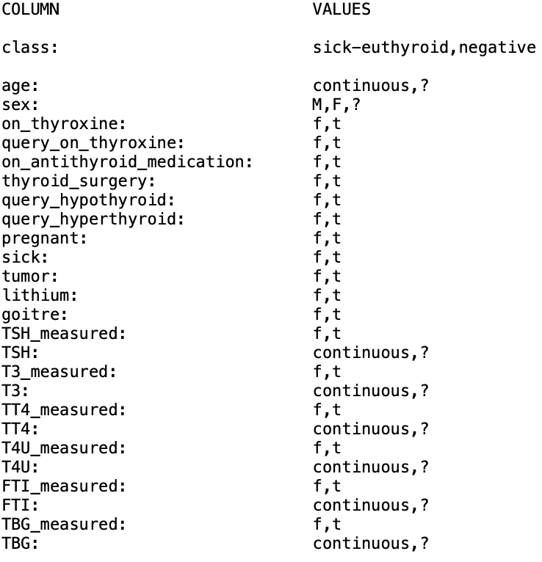
Understanding the Datasets
The dataset contains records of thyroid diagnoses from the Garvan Institute, collected between 1984 and early 1987. Each record consists of 25 attribute values, followed by a class. The attributes include various medical conditions, patient characteristics, and laboratory measurements related to thyroid function. The class contains two possible values: negative and sick-euthyroid.
Observations: 3163
Features: 25
Class: 1

Slide 4
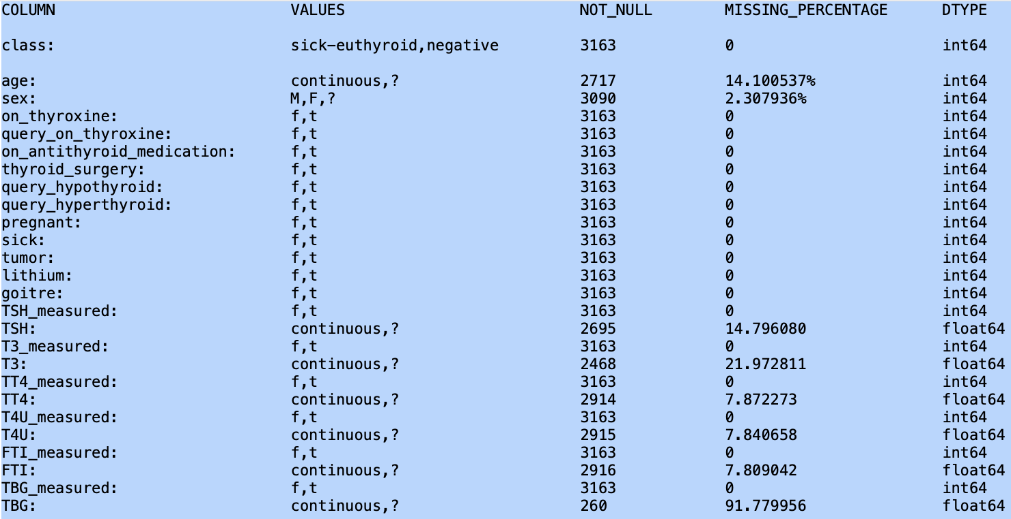
Preparation of Datasets
The thyroid datasets consists of various categorical data.
Many missing column values are represented as '?'. And so, we need to mark them NaN to get proper count of missing and valid values
Since most of the column values are categorical types and so we need to convert/map/encode to numerical values as listed below:
'sick-euthyroid' : 1, 'negative' : 0
't' : 1, 'f' : 0, 'y' : 1, 'n' : 0
'F' : 1, 'M' : 0
Since TBG feature has almost 92% missing data and so, it's better to remove that column from dataframe.
Convert the remaining measured features from Object to Integer
Replaced remaining missing values with Mean in all the features.
Replaced the Sex missing values with Median because it is Boolean values

Slide 5
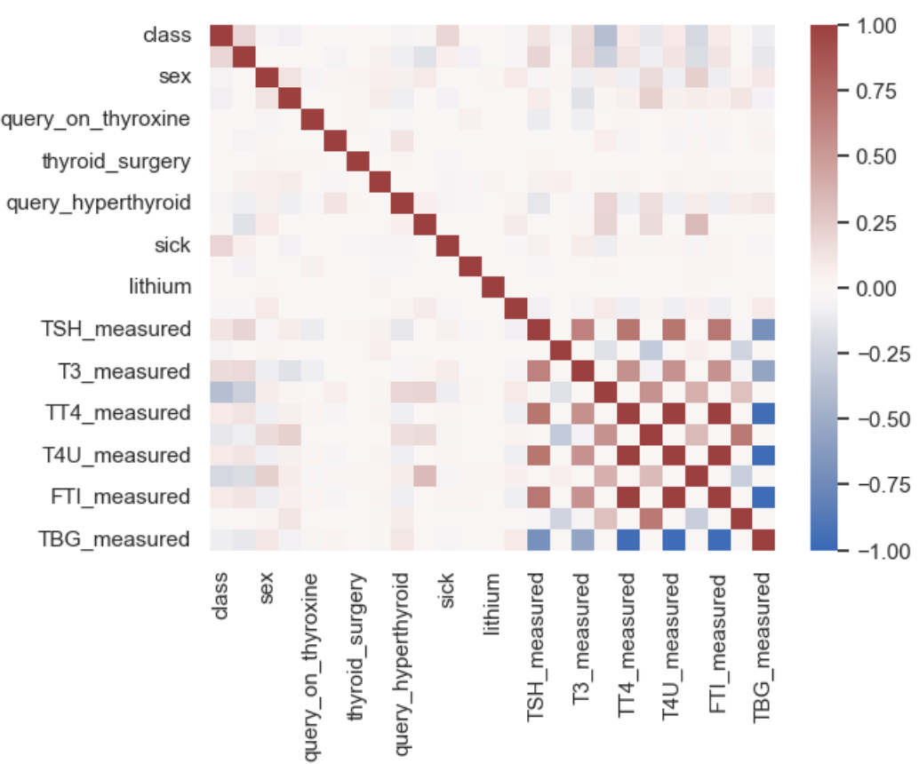
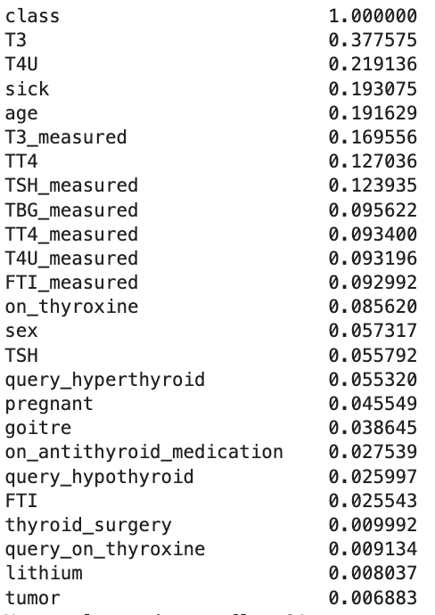
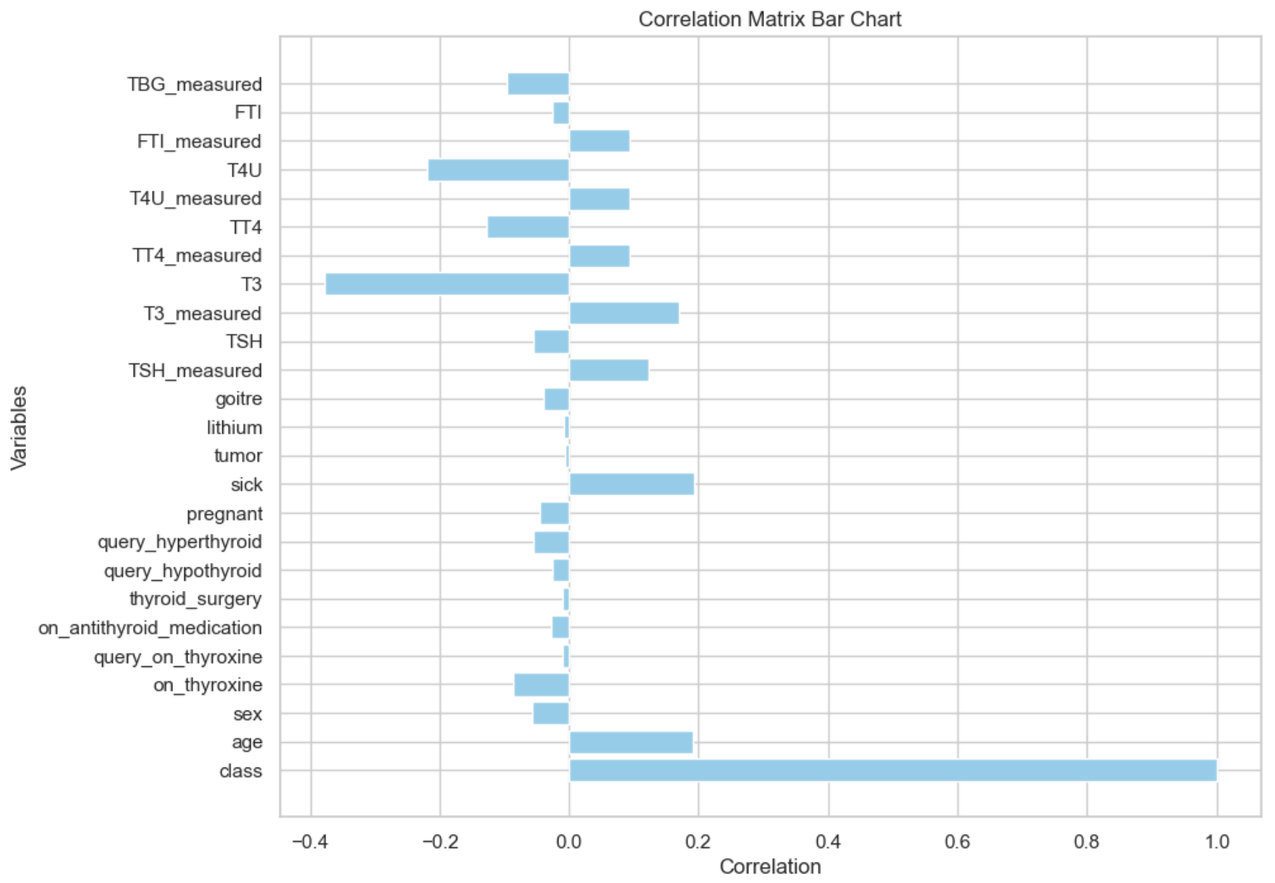
Features Selections
Correlation Matrix for all the features against the Class.
There are strong correlation for T3, T4U, sick, age, T3_measured, TT4, TSH_measured, TBG_measured.
Some of the features is not very well corelated. like, Tumor, lithium, query_on_thyroxine, thyroid_surgery, FTI, query_hypothyroid, on_antothyroid_medication, goitre.

Slide 6
Training & Testing Datasets
We divided datasets into Train set (70%) and Test set (30%). Making sure each set represent proper proportion of each Classes
Train Set: (2214, 25)
class 0 2009 1 205
Test Set: (949, 25)
class 0 861 1 88
Created X and Y variables for each datasets to use into Model Function
X_train = hold all features values for train set
Y_train = hold only class values for train set
X_test = hold all features values for test set
Y_test = hold only class values for test set

Slide 7
Training & Predicting using Various Models
We will train and test datasets using different models as listed below. And will capture the evaluation metrics for comparison and understand which model is better.
Network Model
ANN
Statistical Model
SVC
Tree Based Model
XGBoost
GBM
Random Forest
AdaBoost
Import required model's library
Train Model using Training set
trained_model = model.fit(X_train,Y_Train)
Predict Model using Testing set
Y_predict = trained_model.predict(X_test)
Evaluate Model Performance
accuracy_score(Y_test, Y_predict)
precision_score(Y_test, Y_predict)
recall_score(Y_test, Y_predict)
f1_score(Y_test, Y_predict)
Also create Confusion Matrix and plot a heatmap
confusion_matrix(Y_test, Y_predict)

Slide 8
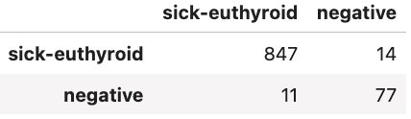
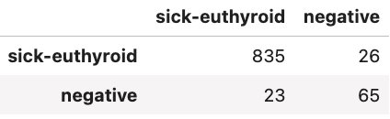
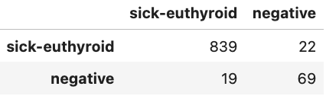

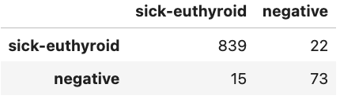
Performance Evaluation of Models (Using Confusion Matrix)
XGBoost
ANN
Random Forest
SVC
GBM
AdaBoost
A confusion matrix is a table that is often used to describe the performance of a classification model (or "classifier") on a set of test data for which the true values are known.
True Positives (TP): The number of sick-euthyroid cases correctly identified as sick-euthyroid. In your matrix, this is represented by the value in the top-left corner.
False Positives (FP): The number of negative cases incorrectly identified as sick-euthyroid. This is represented by the value in the top-right corner.
True Negatives (TN): The number of negative cases correctly identified as negative. This is represented by the value in the bottom-left corner.
False Negatives (FN): The number of sick-euthyroid cases incorrectly identified as negative. This is represented by the value in the bottom-right corner.

Slide 9
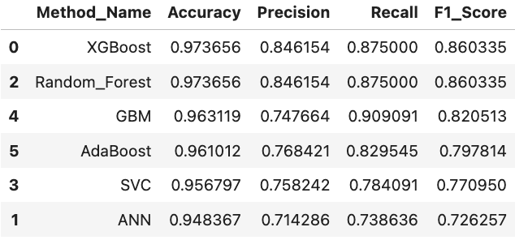
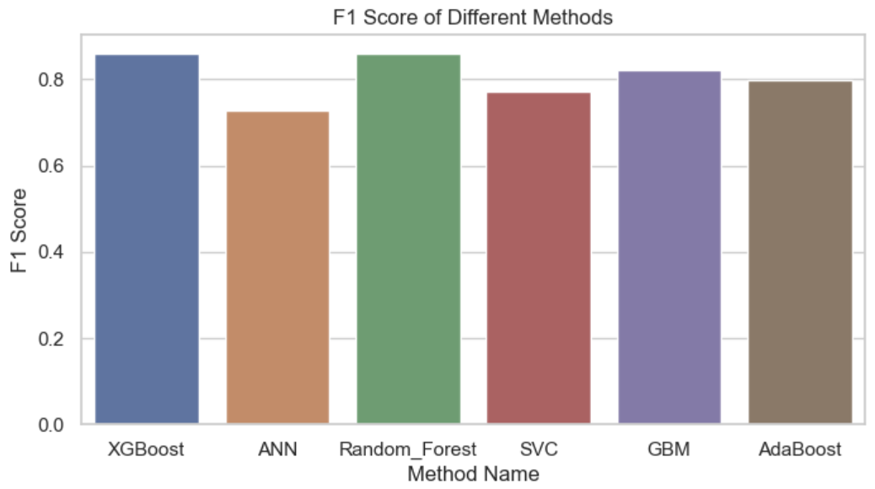
Performance Evaluation of Models (Using various Metrics)
XGBoost and the ensemble models (Random Forest and AdaBoost) performed the best in terms of accuracy, precision, recall, and F1 score, with XGBoost being the most accurate and having the highest F1 score. SVC and GBM also performed well, with GBM having the highest recall. ANN was the least accurate model, with the lowest precision and recall.

Slide 10
Conclusions and Summary
The metrics are essential for evaluating machine learning models because they provide insights into different aspects of model performance.
Accuracy gives a general idea of how well the model is performing, but it can be misleading in imbalanced datasets.
Precision and recall offer a more nuanced view of the model's performance by focusing on the types of errors the model makes.
The F1 score further refines this by combining precision and recall into a single metric, offering a balanced view of the model's effectiveness
XGBoost and the ensemble models (Random Forest and AdaBoost) performed the best in terms of accuracy, precision, recall, and F1 score, with XGBoost being the most accurate and having the highest F1 score. SVC and GBM also performed well, with GBM having the highest recall. ANN was the least accurate model, with the lowest precision and recall. We recommend XGBoost for better performance for this Thyroid datasets prediction.

