Slide 1

FULL-STACK WEB & LAN COLLABORATION • FINAL PRESENTATION
React & Node.js Collaborative Whiteboard
Real-Time Vector Synchronization, Deterministic RBAC Governance, Sandboxed Instances & WebSocket Architecture
PROJECT TEAM MEMBERS
CS24B1025
Anirudh
Node.js WebSocket Engine, Connection
Lifecycle & Event Broadcasting
CS24B1097
Krishna Chaitanya
React 18 Canvas Engine, Infinite
Pan/Zoom & Vector Toolset
CS24B1108
Harish
Synchronous Group Chat, Room Isolation
& SQLite State Persistence
CS24B1106
Manas Vivek
Deterministic RBAC Governance,
Sandboxed Instances & LAN Testing
Key Specifications: React 18 • Node.js WebSocket (ws) • SQLite • Sub-5ms Latency • Pure LAN & Cloud Dual-Mode
React & Node.js Collaborative Whiteboard • Final Presentation • Slide 1 of 10

Slide 2
PROJECT OVERVIEW
Introduction, Problem Statement & System Objectives
Architecting a resilient, zero-cloud collaborative workspace over modern Web and Local Area Networks
What is a Collaborative Whiteboard?
A synchronous digital workspace enabling distributed engineering teams, classrooms, and brainstormers to draw, annotate, design network topologies, and exchange technical data in real time over WebSockets.
Distributed Full-Stack Web & LAN Concept
Host: Manas Vivek
React Client (172.17.244.101)
Peer: Anirudh
React Client (172.17.244.102)
Limitations of Cloud Whiteboards
• Commercial cloud whiteboards (Miro, Jamboard) enforce continuous external WAN connectivity, expose proprietary IP to third-party servers, and suffer network lag.
• Traditional single-user whiteboards lack team collaboration and deterministic host permissions.
SHARED DIGITAL CANVAS
(Room TEST / SPZG)
React 18 Canvas 2D Engine
Node.js WebSocket Hub
SQLite State Engine
Project Vision & Full-Stack Capabilities
• 100% Offline Autonomy: Operates within air-gapped institutional LANs with zero external internet dependencies.
• Modern Web Architecture: Built with React 18, HTML5 Canvas 2D, Tailwind CSS, and Node.js.
• Sub-5ms Latency: Direct persistent WebSocket streaming provides instant visual synchronization.
Peer: Krishna Chaitanya
React Client (172.17.244.103)
Peer: Harish
React Client (172.17.244.104)
Synchronous state broadcast across physical LAN and Web without internet dependency
React & Node.js Collaborative Whiteboard • Final Presentation • Slide 2 of 10

Slide 3
ARCHITECTURE & PROTOCOL
System Architecture & Full-Stack Network Topology
High-Throughput WebSocket Server, Express API, and React 18 Canvas Client
Full-Stack Client-Server Network Model
• Centralized Authority: Node.js server maintains active socket registries (roomSockets, userSockets) and acts as the authoritative truth and broadcast hub.
• Bidirectional WebSocket Streaming: Persistent, full-duplex TCP WebSocket connections (ws) eliminate HTTP polling overhead, achieving sub-5ms event delivery.
• Deterministic Event Framing: Atomic JSON payloads with sequence tagging (seq) ensure in-order execution without packet loss or fragmentation.
• Multi-Room Isolation: Dynamic 4-letter room codes (SPZG, TEST) isolate memory registries and SQLite tables with zero cross-room leakage.
• Physical LAN Discovery: UDP broadcast subnet scanner binds to active physical network adapters (Wi-Fi / Ethernet), bypassing virtual adapters.
Network Topology: React Clients → Node.js Hub
React Client 1 (Host)
Manas Vivek (TEST)
React Client 2
Anirudh (TEST)
NODE.JS SERVER
http://172.17.244.200:5000
• WebSocket Daemon (ws)
• Express Static & REST API
• SQLite Database (better-sqlite3)
• Mutex Lock & Action Log
• LAN Subnet Broadcaster
React Client 3
Krishna (TEST)
React Client 4
Harish (VOXB)
Full-Duplex WebSockets with Room Isolation & SQLite Historical Persistence
React & Node.js Collaborative Whiteboard • Final Presentation • Slide 3 of 10

Slide 4
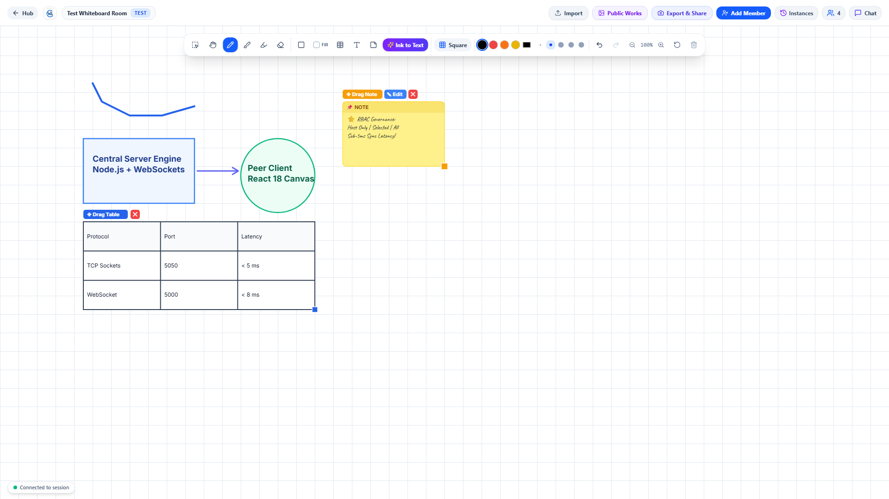
DRAWING ENGINE
React 18 Vector Canvas, Synchronized Grids & Typography
Infinite Multi-Directional Canvas, Mathematical Shapes, Synchronized Grids & Font Styling
React Canvas Capabilities & Vector Engine
• Infinite Canvas Pan & Zoom: Multi-directional infinite canvas with smooth pointer-anchored zoom (15% to 400%) and pan navigation.
• Synchronized Grid Engine: One-click cycling between Square Graph, Dot Matrix, Ruled Notebook, and Plain modes, synchronized live across all clients.
• Vector Drawing Suite: Freehand Pencil (spline smoothing), Calligraphy Brush, Translucent Highlighter with alpha blending, and Precision Object Eraser.
• Vector Shape Gallery: Rectangles, Rounded Boxes, Circles/Ellipses, Triangles, Diamonds, Stars, Lines, and Arrows with Fill Shape toggle and palette swatches.
• Dynamic Tables & Sticky Notes: Custom rows × cols creation, drag pill handle, inline cell text editing, corner resizing, and handwriting notes.
• Typography Ribbon & Ink-to-Text: 8 font families (Inter Modern, Segoe UI, Caveat, JetBrains Mono, etc.), 14–64pt sizing, bold/italic, color picker, and handwriting OCR conversion.
React 18 Application: Live Canvas & Floating Toolbar
React Feature Highlights in Screenshot:
✔ Modern Floating Toolbar: Vector tools, dynamic grid cycler, ink-to-text, and color swatches.
✔ Interactive Dynamic Table: Live row/column grid with drag pill and cell editing on canvas.
✔ Vector Shapes with Color Fill: Architectural diagrams and handwriting sticky notes.
React & Node.js Collaborative Whiteboard • Final Presentation • Slide 4 of 10

Slide 5
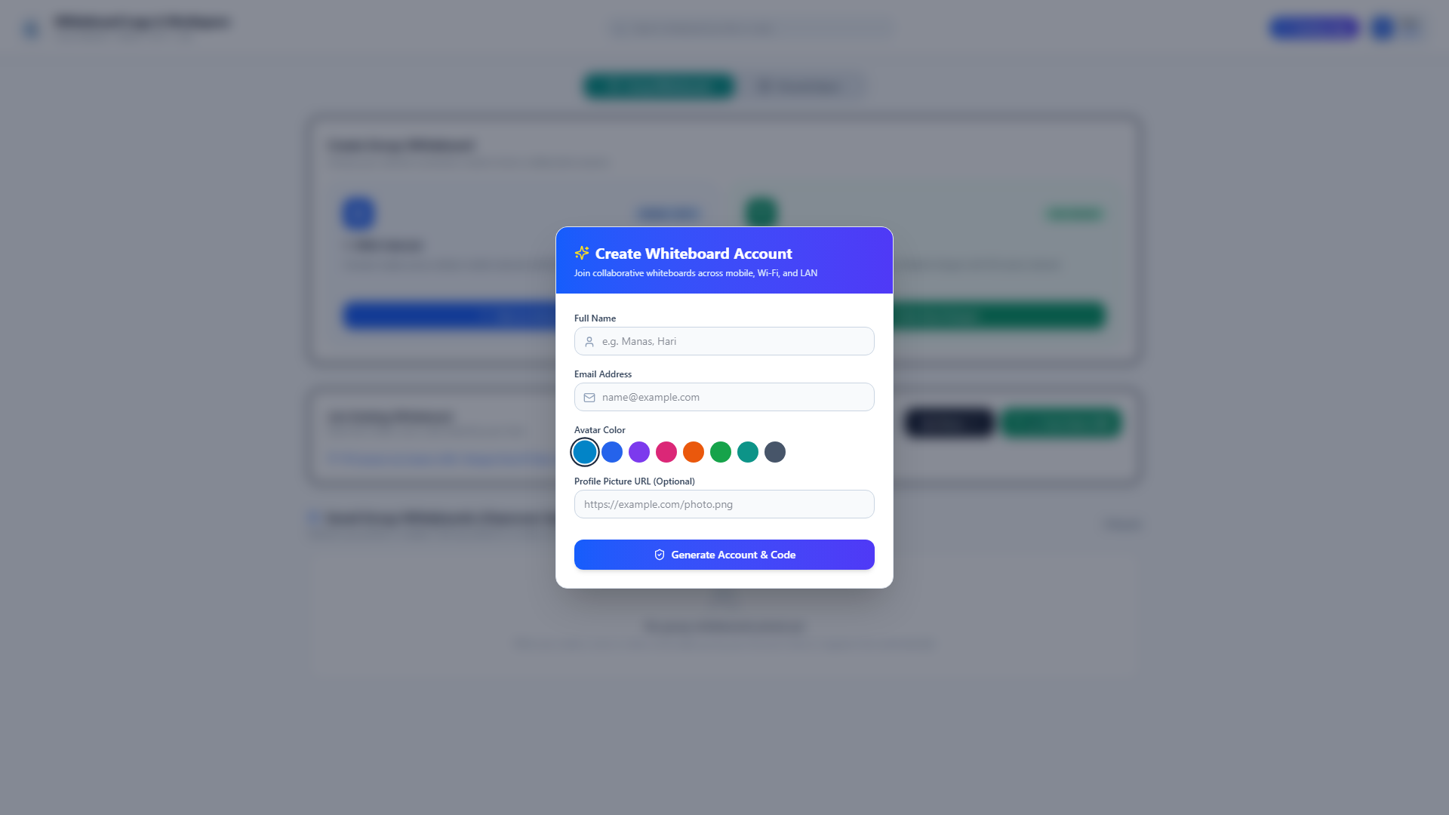
SESSION ISOLATION
Session Lifecycle, React Hub Lobby & Workspace Portability
Dynamic Room Provisioning, Zero-Config LAN Discovery, Personal Workspace & .whiteboard Packages
Room Lifecycle & Access Architecture
• Dynamic Room Provisioning: Instant room creation with collision-resistant 4-letter alphanumeric session codes (SPZG, TEST).
• Zero-Config LAN Addressing: Direct IP and port entry routes instantly across physical Wi-Fi routers or Ethernet switches without DNS or cloud proxies.
• User Identity & Avatars: Attendee name selection, custom profile avatar colors, and unique initials badges (U1, U2).
• Personal Offline Workspace: Standalone local scratchpad allowing private drafting and editing with zero network connection.
• Whiteboard Package Exchange (.whiteboard): Full-session bundle export and import, enabling offline archiving and seamless workspace migration.
• Room PIN & Privacy: Optional PIN authentication to safeguard private sessions from unauthorized subnet peers.
React 18 Application: Hub Workspace & Lobby
Verified Functionality in React Hub:
• Instant Room Creation, Join by 4-Letter Code, and Personal Offline Workspace.
• Active rooms directory with live participant counters and physical LAN adapter discovery.
React & Node.js Collaborative Whiteboard • Final Presentation • Slide 5 of 10

Slide 6
EVENT PIPELINE
Low-Latency WebSocket Event Pipeline & Dispatching
Asynchronous Frame Ingestion, Mutex Ordering, Fan-Out Broadcasting & State Hydration
WebSocket Mechanics & Concurrency
• Asynchronous WebSocket Ingestion: Event-driven Node.js engine streams incoming frames asynchronously without blocking the event loop.
• Atomic Event Serialization: Every canvas mutation (stroke point, shape drop, text input, grid cycle) is serialized into an atomic JSON dictionary with sequence numbers and timestamps.
• Server State Persistence: Server persists mutations to SQLite database in real time, guaranteeing an immutable audit trail and instant recovery.
• O(N) Fan-Out Dispatching: Dispatches updates to room peers in under 5ms, avoiding sender reflection loops.
• State Hydration for Late Joiners: Late-joining peers receive complete accumulated vector history via join_ack with zero lag or missing strokes.
• Clean Disconnect Lifecycle: Detects socket close/error immediately, safely pruning clients and broadcasting leave notices.
Event Workflow: User Action → Peer Canvas Render
Step 1: User Action: User draws stroke, inserts shape, edits table cell, or modifies text
Step 2: Client Serialization: Serialized into JSON: {'type':'draw_action', 'action':{...}}
Step 3: WebSocket Transport: Pushed over full-duplex TCP WebSocket stream (sub-2ms transit)
Step 4: Server Processing: Server validates RBAC permissions, tags sequence, logs to SQLite
Step 5: Room Broadcast: Server fan-out transmits JSON payload to all connected peer sockets
Step 6: Peer Canvas Render: Peers parse JSON and instantly draw vector element (<5ms)
React & Node.js Collaborative Whiteboard • Final Presentation • Slide 6 of 10

Slide 7
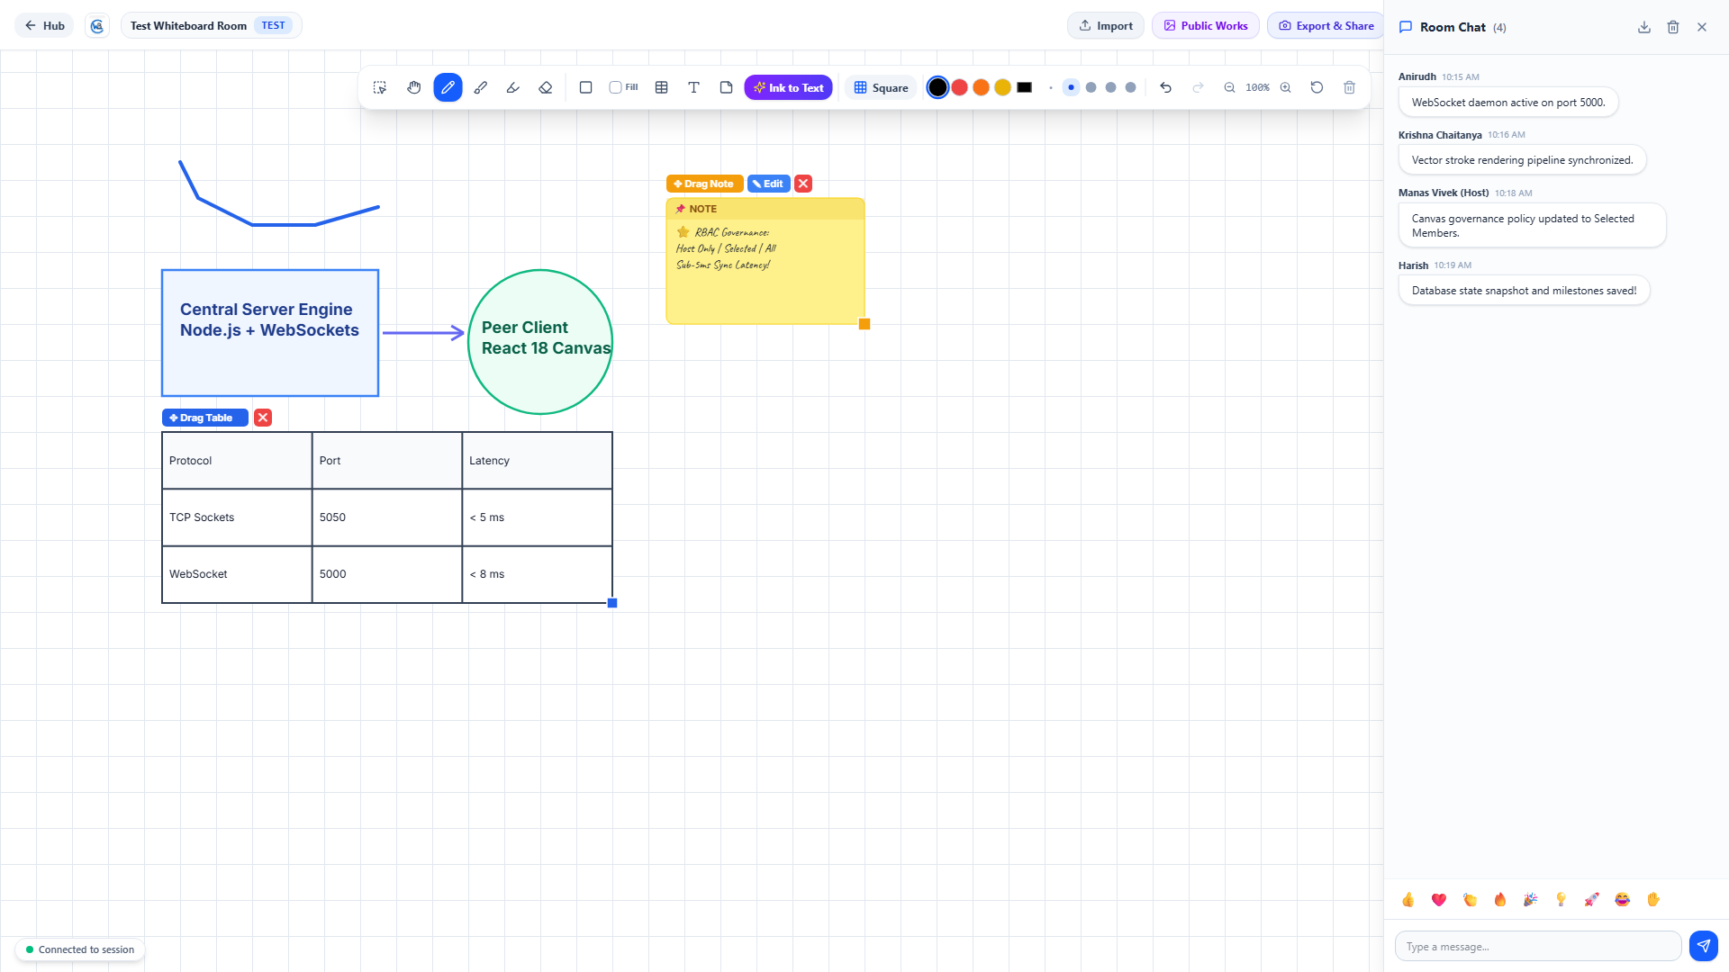
MULTI-USER COLLABORATION
Synchronous Group Chat, Remote Cursors & Presence Audit
Integrated Chat Drawer, SQLite Persistence, Live Cursor Tracking & Presence Logs
In-App Messaging & Collaboration Suite
• Synchronous Group Chat: Real-time communication drawer docked directly on the right side of the canvas, allowing discussion without switching windows.
• Rich Message Metadata: Displays sender display name, unique avatar color badge, timestamp (HH:MM), and chronological order.
• SQLite Chat Persistence: Chat history is persisted in a thread-safe SQLite database on the server, ensuring historical retrieval upon room load.
• Live Remote Cursors: Visual tracking of peers' real-time mouse positions, user names, and colored pointers across the canvas.
• Presence & Audit Logs: System automatically logs and broadcasts join and leave events (e.g. 'user2 joined the session', 'user3 left the session').
• Interactive Action Controls: Floating action bar featuring Raise Hand toggle, emoji reactions, grid cycle, and leave button.
React 18 Application: Active Whiteboard & Chat Drawer
Verified Functionality in Screenshot:
• Active room TEST with synchronized peer messages from Anirudh, Krishna, Manas, and Harish.
• Message timestamps, avatar badges, and instant transmission over WebSockets.
React & Node.js Collaborative Whiteboard • Final Presentation • Slide 7 of 10

Slide 8
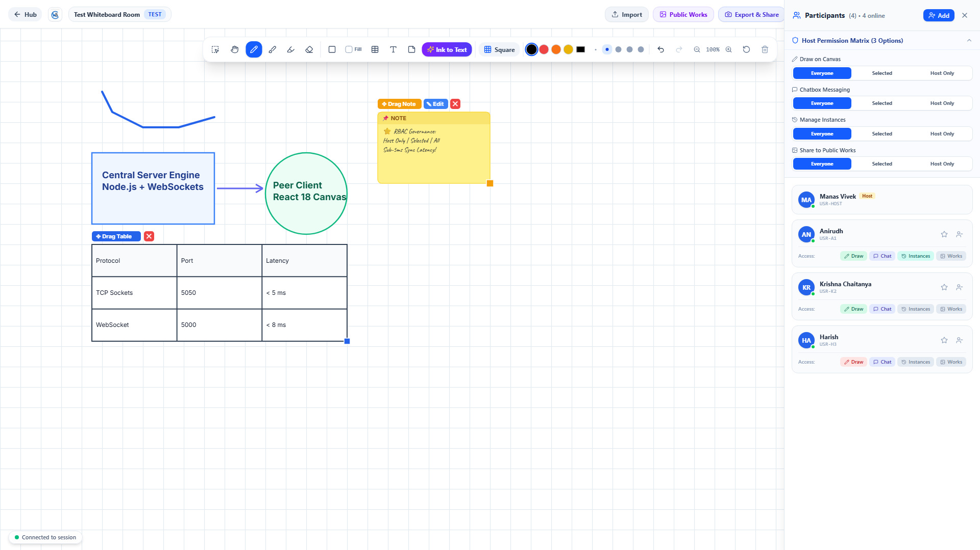
HOST GOVERNANCE
Deterministic Role-Based Access Control & Selected Members Dialog
4-Dimensional Permission Matrix, Host-Only Lockout, and Granular Member Selection
Deterministic Host Governance & Access Matrix
• 4 Independent Policy Dimensions: Host has independent governance across Canvas Drawing, Group Chat, Instances Management, and Public Works Sharing.
• 3 Deterministic Policy Modes:
1. Host Only: Strictly locks capability to Host & Co-Hosts. Regular members receive can_draw = false, entering View-Only mode with locked tools.
2. Selected Members: Dedicated dialog box with live search, Select All/Clear, and checkboxes to grant granular permissions to specific individuals.
3. Everyone: Open collaborative mode where all attendees participate freely.
• View-Only Canvas Enforcement: Server rejects unauthorized stroke_pts, clear_canvas, or shape calls; restricted clients display full-width top lock banner: '🔒 You are in View-Only mode. Drawing is paused by the Host.'
• Administrative Powers: Real-time member kicking, co-host delegation, and instant room-wide drawing freeze.
React 18 Application: Participants Drawer & Policy Matrix
Empirical Results in React App:
• 4-Dimensional policy rows (Canvas, Chat, Instances, Public Works) with 3-Option pill selectors.
• Real-time participant status, promote co-host, and kick member actions.
React & Node.js Collaborative Whiteboard • Final Presentation • Slide 8 of 10

Slide 9
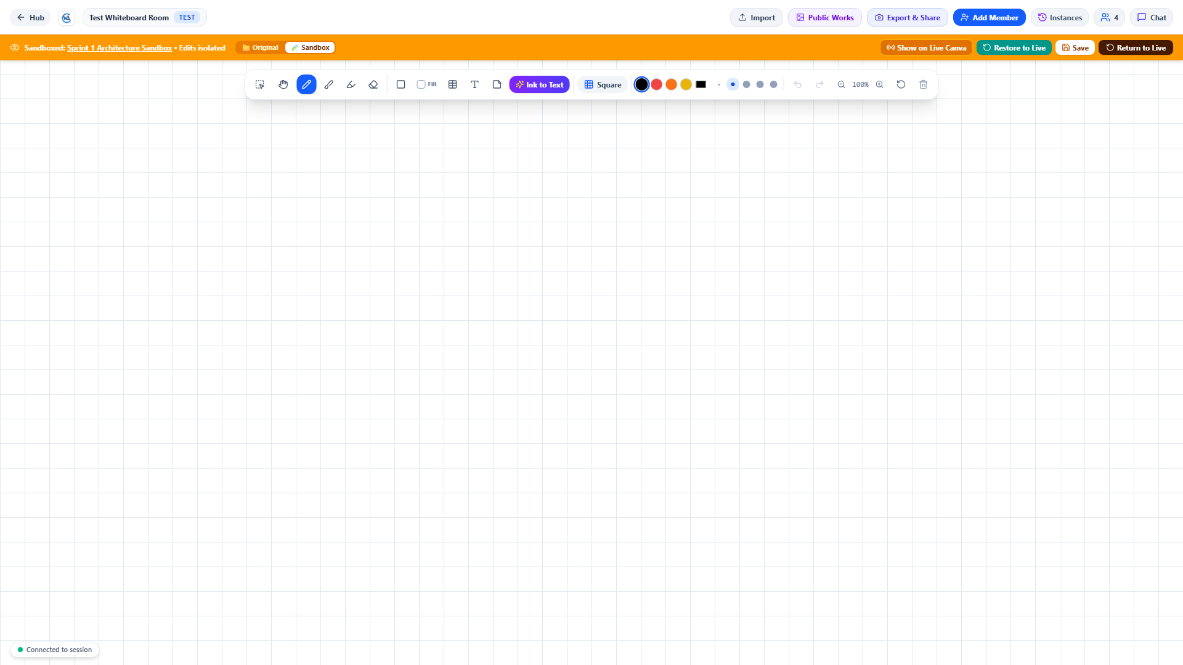
SIMULATION & STORAGE
Milestones, Sandboxed Simulation & Private vs. Public Storage
Isolated Instance Sandboxing, 3-Way Mode Toggle, and Two-Option Storage Workflows
Milestones, Sandboxed Simulation & Storage Isolation
• Point-in-Time Whiteboard Milestones: Instant snapshots of the entire vector canvas, preserving historical states without halting active collaboration.
• Isolated Instance Sandbox Mode:
• Safe Scratchpad: Any attendee can enter an isolated simulation workspace from an instance. Sketches made inside do NOT modify the live board.
• 3-Way Mode Switcher: Toggle between 📁 Original Snapshot, 🧪 Sandbox Simulation, and 👑 Host Sandbox (host's published view).
• Host-Exclusive Live Canvas Restoration: Only the session host has administrative authority to restore a milestone or sandbox back onto the live room canvas.
• Privacy Separation (2-Option Save Workflow):
• 💾 Save in My Own System (Private): Stored strictly in local machine/browser storage. Private and never shown in room public space.
• 🌐 Share to Public Works: Publishes to room-wide public gallery for all participants (guarded by host permissions).
React 18 Application: Instance Sandbox Mode Banner
Verified Functionality:
• Sandboxed in Instance banner indicates isolated edits that do not affect the live whiteboard.
• 3-Way Mode Switcher (Original vs Sandbox vs Host Sandbox), Save in Instance, and Return to Live.
React & Node.js Collaborative Whiteboard • Final Presentation • Slide 9 of 10

Slide 10
PROJECT CREDITS
Individual Team Member Contributions
Dedicated Core Responsibilities, Full-Stack Architecture, and System Deliverables
CS24B1025
Anirudh
Node.js WebSocket & Server Architecture
✔ Engineered Node.js WebSocket (ws) server with multi-client concurrent connection pool.
✔ Designed atomic JSON streaming protocol and sequence validation (seq) for in-order packet delivery.
✔ Implemented network adapter auto-discovery module filtering out virtual/tunnel adapters on host machine.
✔ Configured low-latency broadcast pipeline achieving sub-5ms event delivery across local network clients.
CS24B1097
Krishna Chaitanya
React 18 Canvas Engine & Modern Web UI
✔ Developed high-performance HTML5 Canvas 2D rendering pipeline supporting strokes, shapes, and tables.
✔ Designed structured vector action serialization format (id, kind, points, color, width, fill).
✔ Engineered infinite canvas coordinate transforms, anchor-point zoom (15%–400%), and pan navigation.
✔ Built modern floating toolbar, typography ribbon (8 font families), and dynamic synchronized grid cycler.
CS24B1108
Harish
Group Chat, Session Management & Persistence
✔ Architected real-time side-drawer chat with sender avatars, timestamps, and live audit logging.
✔ Engineered SQLite database persistence layer for rooms, chat logs, user permissions, and milestones.
✔ Implemented 4-letter alphanumeric session code generation (SPZG, TEST) and React Hub Lobby interface.
✔ Developed .whiteboard package export/import system and personal offline workspace isolation.
CS24B1106
Manas Vivek
RBAC Governance, Sandboxing & Testing
✔ Engineered deterministic Role-Based Access Control (RBAC): 4-policy matrix, View-Only canvas lock, and kick.
✔ Implemented Selected Members Dialog Box with live search, Select All/Clear, and granular checkboxes.
✔ Architected Isolated Milestone Sandbox mode with 3-way toggle (Original, Sandbox, Host Sandbox) and host restore.
✔ Authored private local system saves vs public works gallery workflow and conducted physical LAN benchmarking.
React & Node.js Collaborative Whiteboard • Final Presentation • Slide 10 of 10

