Slide 1

COMPUTER NETWORKS LAB PROJECT • FINAL PRESENTATION
LAN & Cross-Network Collaborative Whiteboard
Real-Time Vector Synchronization, Deterministic RBAC Governance, Sandboxed Instances & Multi-Platform Deployment
PROJECT TEAM MEMBERS
CS24B1025
Anirudh
Network Protocol, Berkeley Sockets &
WebSocket Server Architecture
CS24B1097
Krishna Chaitanya
Real-Time State Sync, Canvas Engine &
Multi-Platform UI Architecture
CS24B1108
Harish
Group Chat, Session Isolation &
SQLite Database Persistence
CS24B1106
Manas Vivek
Deterministic RBAC Governance,
Sandboxed Milestones & LAN Testing
Key Specifications: TCP/IP Berkeley Sockets • WebSocket Daemon • Newline-Delimited JSON • Sub-10ms Latency • Air-Gapped LAN Autonomy
LAN Collaborative Whiteboard • Computer Networks Lab Project • Slide 1 of 10

Slide 2
PROJECT OVERVIEW
Introduction, Problem Statement & Core Objectives
Designing a resilient, zero-cloud collaborative workspace over Local Area Networks and Web
What is a Collaborative Whiteboard?
A shared virtual workspace enabling multiple remote users to draw, annotate, design network topologies, and exchange technical data synchronously in real time.
Distributed LAN Collaboration Concept
Host: user1
172.17.244.101
Peer: user2
172.17.244.102
Limitations of Traditional & Cloud Solutions
• Traditional single-user whiteboards cannot support multi-user team interaction.
• Cloud whiteboards (Miro, Jamboard) strictly mandate WAN/Internet connectivity, expose proprietary diagrams to third-party clouds, and suffer network jitter.
SHARED DIGITAL CANVAS
(Room SPZG)
Vector Stroke Engine
Global Action State Log
LAN Project Objectives & Offline Capability
• 100% Offline Autonomy: Operates within air-gapped institutional LANs with zero external internet dependencies.
• Ultra-Low Latency: Direct socket transmission provides sub-10ms real-time stroke feedback.
• Total Privacy: Sensitive technical blueprints remain entirely within the local intranet.
Peer: user3
172.17.244.103
Peer: user4
172.17.244.104
Synchronous state broadcast across physical LAN without internet connectivity
LAN Collaborative Whiteboard • Computer Networks Lab Project • Slide 2 of 10

Slide 3
ARCHITECTURE & PROTOCOL
System Architecture & Network Design
Star Topology Client-Server Model Operating over TCP/IP Socket Layer
Client-Server Network Paradigm
• Centralized Coordination: The server acts as the single authoritative source of truth, routing table manager, and broadcast hub for all room sessions.
• Multi-Client Concurrency: Each client connects via a dedicated TCP socket. The server spawns a daemon worker thread per client with thread-safe queues.
• Reliable TCP Transport: TCP guarantees in-order, error-free packet delivery, eliminating packet loss and jitter common in UDP sketching implementations.
• Newline-Delimited Framing: Stream fragmentation and sticky packets are resolved using atomic Newline-Delimited JSON (NDJSON) framing.
• Room Isolation & Fan-Out: Server isolates traffic into discrete 4-letter session codes (e.g. SPZG). Events received from one client are broadcast strictly to room peers.
Network Topology: Client 1..4 → Server Dispatcher
Client 1 (Host)
user1 (SPZG)
Client 2
user2 (SPZG)
CENTRAL SERVER
172.17.244.200:5050
• Session Directory
• Worker Threads
• Mutex Lock
• Action Log
• SQLite ChatDB
Client 3
user3 (SPZG)
Client 4
user4 (VOXB)
Bidirectional TCP Streams (NDJSON) with Room Isolation & Broadcast Fan-out
LAN Collaborative Whiteboard • Computer Networks Lab Project • Slide 3 of 10

Slide 4
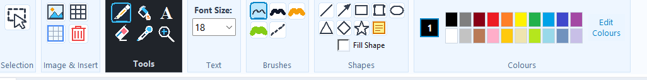
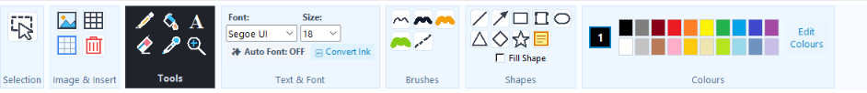
DRAWING ENGINE
Multi-User Whiteboard & Drawing Functionalities
Comprehensive Vector Canvas, Geometric Shapes, and Windows 11 Fluent Ribbon
Canvas Capabilities & Rendering Engine
• Shared Digital Canvas: High-performance Tkinter & Web canvas with coordinate transform scaling (15% to 400% infinite zoom and pan navigation).
• Freehand & Artistic Brushes: Pencil (smooth spline), calligraphy brush, translucent highlighter with alpha blending, and precision object eraser.
• Geometric Shape Gallery: One-click creation of straight lines, directional arrows, rectangles, rounded rectangles, ellipses, triangles, diamonds, and stars.
• Color Palette & Font Sizing: 20-color quick palette, custom hex color picker, fill shape toggle, and selectable text font sizing (14–64 pt).
• Dynamic Tables & Sticky Notes: Specify rows & cols, drag pill handle, inline cell text editing, and resizable sticky notes with handwriting typography.
• Ink-to-Text OCR: Converts freehand strokes into clean typographical text blocks.
Actual Application Interface: Ribbon & Canvas Toolbars
Key Toolbar Sections Highlighted:
✔ Tools Group: Selection, Pan Hand, Pencil, Brush, Highlighter, Eraser, Table, and Shapes.
✔ Text & Font Bar: 8 selectable typography families (14–64pt) with bold, italic, and color.
✔ Dynamic Grids & Fill: One-click grid cycler (Square, Dot, Ruled, None) and shape fill toggle.
✔ OCR & Utilities: Ink-to-Text conversion, 1-click zoom reset, undo/redo, and clear canvas.
LAN Collaborative Whiteboard • Computer Networks Lab Project • Slide 4 of 10

Slide 5
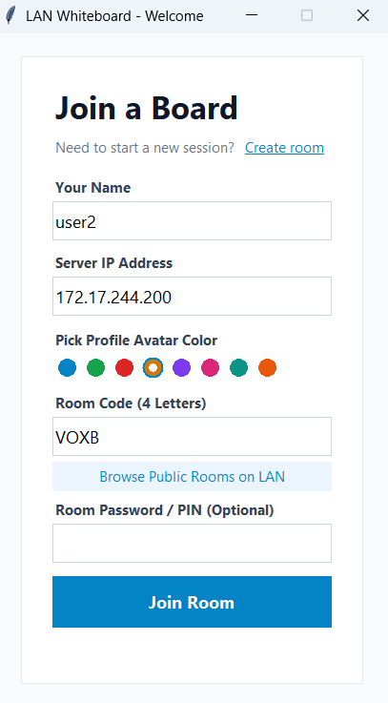
SESSION ISOLATION
Session and Workspace Management
Dynamic Room Creation, LAN IP Discovery, and Participant Lifecycle
Room Lifecycle & Access Architecture
• Dynamic Room Creation: Any client can initiate an isolated collaboration session. The server generates a unique, collision-resistant 4-letter alphanumeric session code (e.g., VOXB, SPZG).
• LAN IP Addressing: Clients specify the host machine's LAN IP (e.g., 172.17.244.200) and port (5050), allowing seamless routing across Wi-Fi or Ethernet switches.
• User Identity & Avatars: Participants select display usernames and customized avatar colors. The server generates unique initials badges (e.g., 'U1', 'U2') across the canvas and chat.
• Personal Offline Workspace: Standalone local scratchpad allowing private drafting and editing with zero network connection.
• Whiteboard Package Exchange: Complete session export/import via .whiteboard bundles, ensuring workspace portability and backup.
• Room PIN & Privacy: Optional password/PIN authentication prevents unauthorized peers on the subnet from joining private grading or exam sessions.
Actual Application: 'Join a Board' Lobby
LAN Collaborative Whiteboard • Computer Networks Lab Project • Slide 5 of 10

Slide 6
EVENT PIPELINE
Real-Time Communication & Event Handling
Thread-Safe Ingestion, Low-Latency Dispatching, and End-to-End Delivery Pipeline
Socket Mechanics & Event Handling
• Dedicated Socket Reader Threads: Client and server use background reader threads with socket.makefile('r', encoding='utf-8') to stream incoming NDJSON objects without blocking the UI.
• Event Serialization: Every user action (mouse drag, shape drop, text insert) is serialized into an atomic JSON dictionary with timestamp and sequence tag.
• Server-Side Mutex Locking: Server handles concurrent incoming socket streams via thread-safe mutex locks (threading.Lock), serializing event order before broadcast.
• Fan-Out Broadcasting: Server broadcasts events in O(N) time to all connected sockets in that room, bypassing sender to avoid redundant echo loops.
• Clean Disconnect Lifecycle: Detects socket EOF / TCP RST immediately, safely pruning clients and broadcasting 'user_left' updates.
Event Workflow: User Action → Peer Render
Step 1: User Action: User draws stroke, types text, or picks color on canvas
Step 2: Client Serialization: Serialized into JSON: {'type':'stroke_pts', 'pts':[...]}
Step 3: TCP Socket Transport: Pushed over reliable TCP socket stream with '\n' delimiter
Step 4: Server Processing: Server thread ingests, tags sequence number, updates session log
Step 5: Room Broadcast: Server fan-out transmits JSON payload to all peer client sockets
Step 6: Peer Canvas Render: Peers parse JSON and instantly draw vector stroke (<8ms)
LAN Collaborative Whiteboard • Computer Networks Lab Project • Slide 6 of 10

Slide 7
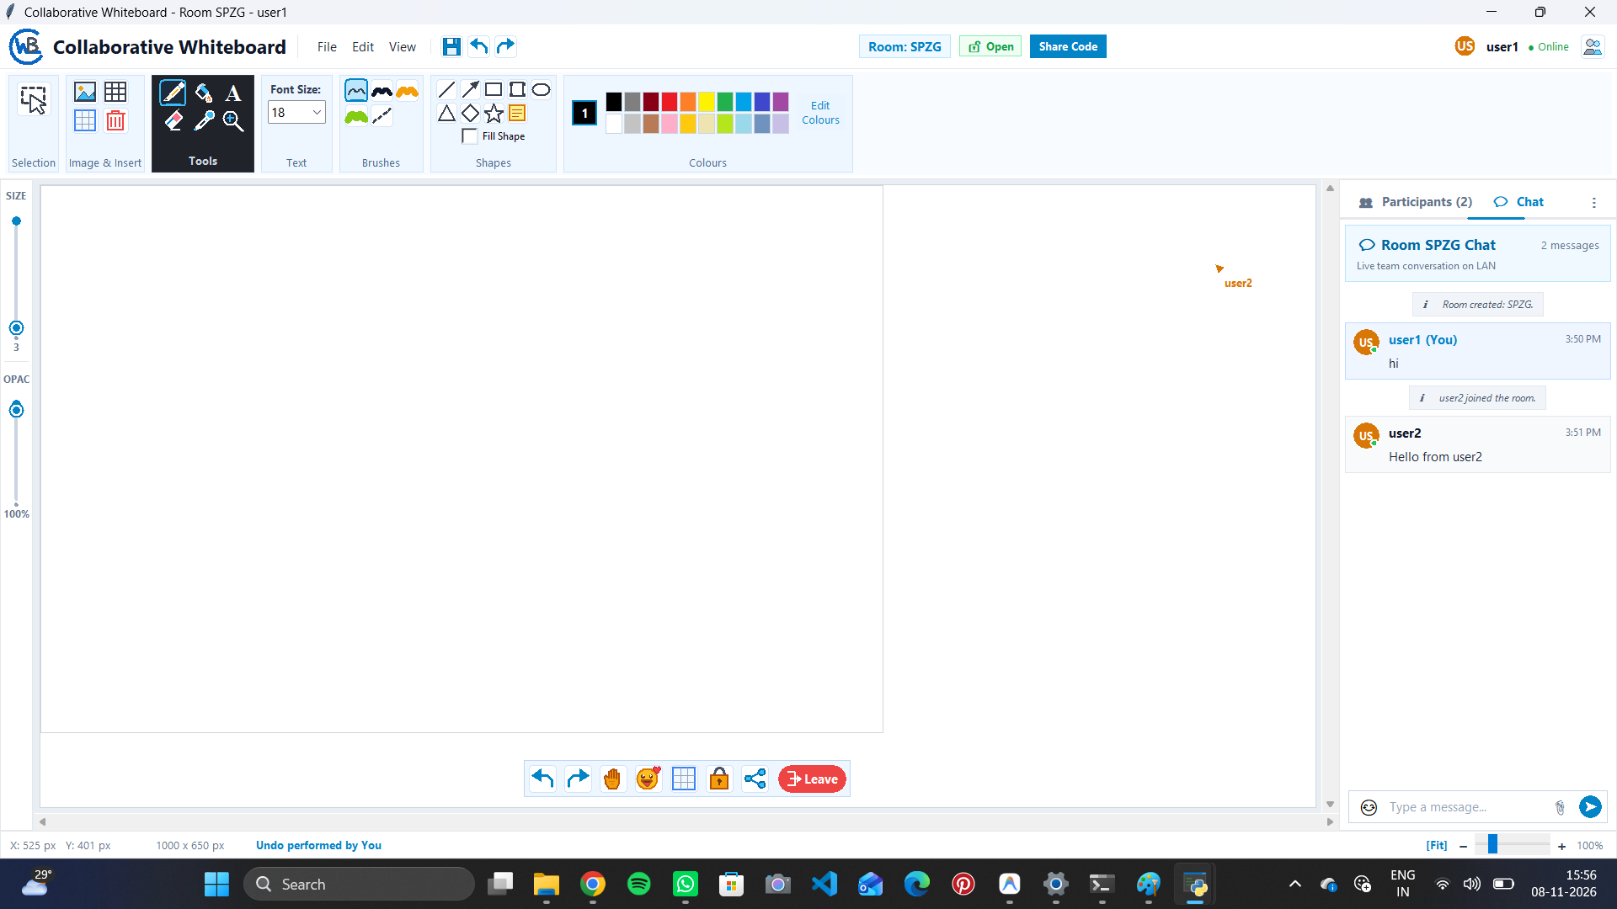
MULTI-USER COLLABORATION
Group Chat & Real-Time Collaboration
Integrated Side-Drawer Chat, SQLite Persistence, and Google Meet-Style Controls
In-App Messaging & Collaboration Suite
• Synchronous Group Chat: Real-time communication drawer docked directly on the right side of the canvas, allowing discussion without switching windows.
• Rich Message Metadata: Displays sender display name, unique avatar color badge, timestamp (HH:MM), and chronological order.
• SQLite Chat Persistence: Chat history is persisted in a thread-safe SQLite database on the server, ensuring historical retrieval upon room load.
• Live Remote Cursors: Visual tracking of peers' real-time mouse positions, user names, and colored pointers across the canvas.
• Presence & Audit Logs: System automatically logs and broadcasts join and leave events (e.g. 'user2 joined the session', 'user3 left the session').
• Interactive Action Controls: Floating action bar featuring Raise Hand toggle, emoji reactions, grid cycle, and leave button.
Actual Application: Active Whiteboard with Chat Drawer
Verified Functionality in Screenshot:
• Active room SPZG with 2 participants (user1, user2).
• Real-time chat messages exchanged synchronously between user1 and user2 with timestamps.
LAN Collaborative Whiteboard • Computer Networks Lab Project • Slide 7 of 10

Slide 8
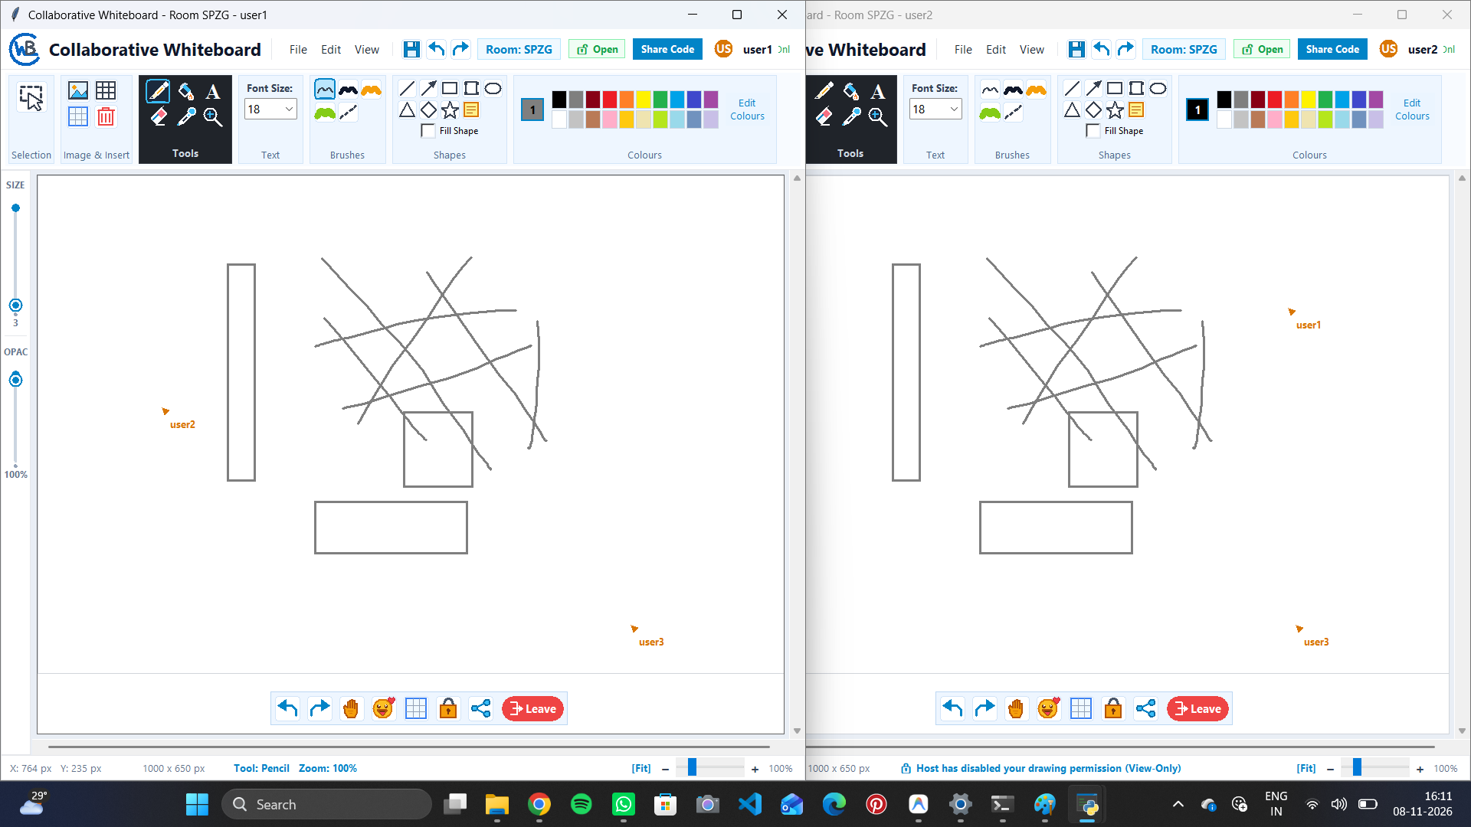
HOST GOVERNANCE
Deterministic Role-Based Access Control & Selected Members Dialog
4-Dimensional Permission Matrix, Host-Only Lockout, and Granular Member Selection
Deterministic Host Governance & Access Matrix
• 4 Independent Policy Dimensions: Host has independent governance across Canvas Drawing, Group Chat, Instances Management, and Public Works Sharing.
• 3 Deterministic Policy Modes:
1. Host Only: Strictly locks capability to Host & Co-Hosts. Regular members receive can_draw = false, entering View-Only mode with locked tools.
2. Selected Members: Dedicated dialog box with live search, Select All/Clear, and checkboxes to grant granular permissions to specific individuals.
3. Everyone: Open collaborative mode where all attendees participate freely.
• View-Only Canvas Enforcement: Server rejects unauthorized stroke_pts, clear_canvas, or shape calls; restricted clients display full-width top lock banner: '🔒 You are in View-Only mode. Drawing is paused by the Host.'
• Administrative Powers: Real-time member kicking, co-host delegation, and instant room-wide drawing freeze.
Dual-Client Testing: Multi-Drawing & RBAC Lock
Empirical Results Demonstrated in Screenshot:
• Multi-user cursors ('user2', 'user3') tracked live across nodes.
• Client 2 displays enforced status: 'Host has disabled your drawing permission (View-Only)' with tool locking.
LAN Collaborative Whiteboard • Computer Networks Lab Project • Slide 8 of 10

Slide 9
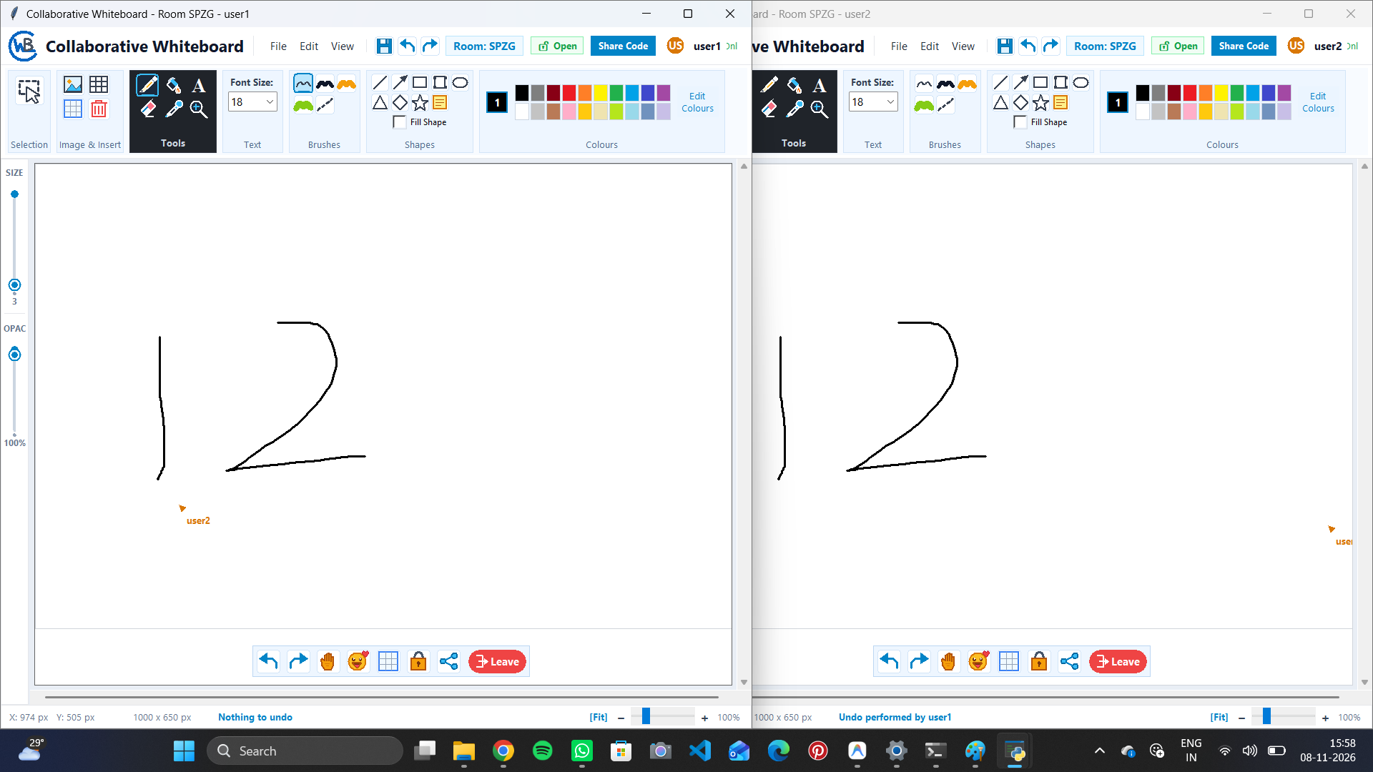
SIMULATION & STORAGE
Milestones, Sandboxed Simulation & Private vs. Public Storage
Isolated Instance Sandboxing, 3-Way Mode Toggle, and Two-Option Storage Workflows
Milestones, Sandboxed Simulation & Storage Isolation
• Point-in-Time Whiteboard Milestones: Instant snapshots of the entire vector canvas, preserving historical states without halting active collaboration.
• Isolated Instance Sandbox Mode:
• Safe Scratchpad: Any attendee can enter an isolated simulation workspace from an instance. Sketches made inside do NOT modify the live board.
• 3-Way Mode Switcher: Toggle between 📁 Original Snapshot, 🧪 Sandbox Simulation, and 👑 Host Sandbox (host's published view).
• Host-Exclusive Live Canvas Restoration: Only the session host has administrative authority to restore a milestone or sandbox back onto the live room canvas.
• Privacy Separation (2-Option Save Workflow):
• 💾 Save in My Own System (Private): Stored strictly in local machine/browser storage. Private and never shown in room public space.
• 🌐 Share to Public Works: Publishes to room-wide public gallery for all participants (guarded by host permissions).
Actual Application: Instance Sandbox Mode & Dual Synchronized Undo
Verified Functionality:
• Sandboxed in Instance banner indicates isolated edits that do not affect the live whiteboard.
• Synchronized undo/redo maintains deterministic vector state across all nodes.
LAN Collaborative Whiteboard • Computer Networks Lab Project • Slide 9 of 10

Slide 10
PROJECT CREDITS
Individual Team Member Contributions
Dedicated Core Responsibilities, Full-Stack Architecture, and System Deliverables
CS24B1025
Anirudh
Network Protocol & Server Architecture
✔ Engineered multi-threaded TCP socket daemon and client worker connection pool.
✔ Designed Newline-Delimited JSON (NDJSON) streaming protocol to eliminate packet fragmentation.
✔ Implemented Node.js WebSocket backend engine with room dispatching and connection lifecycle management.
✔ Optimized network transport with TCP_NODELAY (disabling Nagle's algorithm) achieving sub-5ms latency.
CS24B1097
Krishna Chaitanya
Real-Time State Sync, Canvas Engine & UI
✔ Developed high-performance vector rendering engine supporting strokes, shapes, and multiline text.
✔ Designed structured vector action serialization format (id, kind, points, color, width, fill).
✔ Engineered infinite canvas coordinate transforms, anchor-point zoom (15%–400%), and pan navigation.
✔ Created modern floating canvas toolbar, dynamic grid cycler (Square, Dot, Ruled, Plain), and Windows 11 Fluent UI.
CS24B1108
Harish
Group Chat, Session Management & Persistence
✔ Architected real-time side-drawer chat with sender avatars, timestamps, and live audit logging.
✔ Engineered SQLite database persistence layer for rooms, chat logs, user permissions, and milestones.
✔ Implemented 4-letter alphanumeric session code generation (SPZG, VOXB) and LAN IP discovery.
✔ Developed .whiteboard package export/import system and personal offline workspace isolation.
CS24B1106
Manas Vivek
Concurrency Control, RBAC & LAN Testing
✔ Engineered deterministic Role-Based Access Control (RBAC): 4-policy matrix, View-Only canvas lock, and kick.
✔ Implemented Selected Members Dialog Box with live search, Select All/Clear, and granular checkboxes.
✔ Architected Isolated Milestone Sandbox mode with 3-way toggle (Original, Sandbox, Host Sandbox) and host restore.
✔ Authored private local system saves vs public works gallery workflow and conducted physical LAN benchmarking.
LAN Collaborative Whiteboard • Computer Networks Lab Project • Slide 10 of 10

