Slide 1


Slide 2
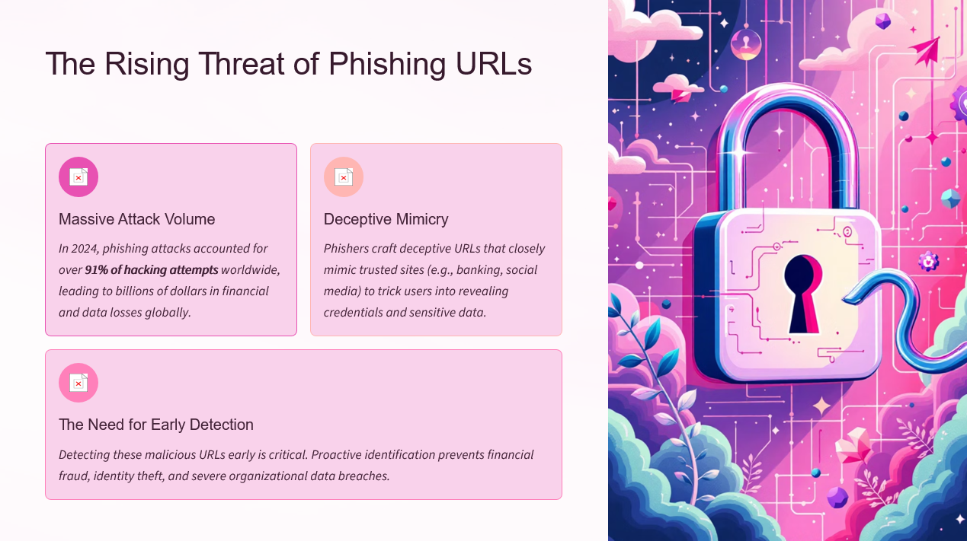

Slide 3
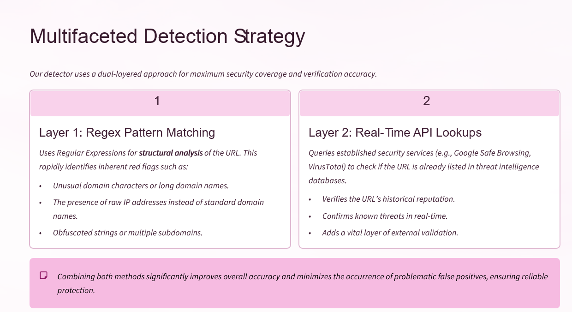

Slide 4
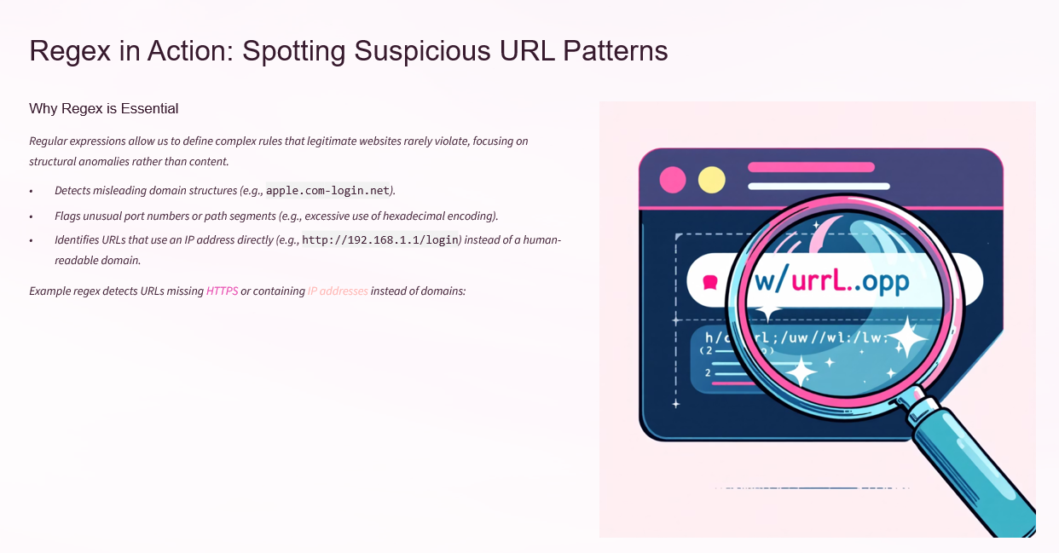
^(http|ftp):\/\/|(\d{1,3}\.){3}\d{1,3}
This example quickly filters out non-secure (HTTP) connections and direct IP-based access attempts, two common characteristics of fast-setup phishing sites.

Slide 5

Thank You.

