Slide 1
ENGINEERING CAPSTONE PROJECT – 1 · A.Y. 2026–2027
CodeInsight AI: AI-Powered Code Review & Bug Detection
Department of CSE · Engineering Capstone Project – 1
Bhashetty Shaanvi
Manaswi Divi
B. Avinash
M. Taatwik
Roll No: 2420039806
Roll No: 2420030793
Roll No: 2420030101
Roll No: 2420030103

Slide 2




Introduction
Modern software projects involve large, frequently changing codebases. Developers rely on code review to identify bugs, enforce quality standards, and maintain consistency — but manual review is time-consuming, inconsistent, and prone to missed issues as projects scale. Traditional rule-based tools detect some problems but rarely provide developer-friendly explanations or actionable suggestions.
CodeInsight AI is an AI-powered web application designed to assist developers by automating code review and bug detection.
Software Code
Large, evolving codebases requiring regular review
Code Review Challenges
Time-consuming, inconsistent, and missed issues
AI-Powered Analysis
Intelligent, automated code understanding
Actionable Code Review
Understandable feedback and improvement suggestions

Slide 3

ABSTRACT
Abstract
CodeInsight AI is an AI-powered web application that assists developers with source code review, bug detection, and code quality analysis. Users upload code or connect a GitHub repository; the backend processes submissions through the Gemini AI API, which identifies bugs, coding issues, and improvement areas. The system generates AI suggestions, a code quality score, and a review summary. Results are stored in SQLite and displayed on a review dashboard with access to previous analyses.
01
02
Code Input
Backend Processing
Upload source code or connect a GitHub repository
FastAPI/Python backend receives and prepares code for analysis
03
04
AI Code Analysis
Results & Dashboard
Gemini AI API analyzes code for bugs, issues, and quality
Suggestions, quality score, and review summary stored and displayed
Technologies: React.js · FastAPI/Python · SQLite · Gemini AI API · GitHub API
Goal: Use Artificial Intelligence to reduce manual effort, improve code quality, and support faster and more consistent code reviews.

Slide 4

LITERATURE SURVEY
Literature Survey
Research in automated code review has evolved from static analysis to AI-assisted approaches using large language models.
Traditional Automated Analysis
Machine Learning Approaches
AI-Assisted Code Review
Rule-based, predefined patterns
Data-driven bug prediction
LLM-powered suggestions and summaries
Rule-Based / Static Analysis
Large Language Models
Proposed: CodeInsight AI
Automated linting and style checks
Contextual, semantic code understanding
Integrated AI review with dashboard
Paper / Year
Main Contribution
Relevance
Reducing human effort… using automatic static analysis
Automated analysis reduces manual review effort
Motivates automation in code review
Fan et al., LLMs for Software Engineering, 2023
LLM applications in SE; reliability challenges
Supports AI/LLM use; highlights reliability needs
Automated Code Review in Practice, IEEE/ACM ICSE-SEIP, 2025
Industrial evaluation of LLM-based code review
Shows practical value and limits of AI review
Automated Code Review Using LLMs with Symbolic Reasoning, 2025
LLMs + symbolic reasoning for improved accuracy
Demonstrates enhanced reasoning in code review
The Impact of LLMs on Code Review Process, 2025
LLM effects on GitHub PR workflows
Supports AI-assisted review for reduced effort
Research Gap: Existing approaches show promise, but practical systems still need understandable feedback, useful suggestions, quality assessment, and developer-workflow integration.

Slide 5

RESEARCH GAP & PROPOSED SOLUTION
Research Gap & Proposed Solution
Existing approaches highlight the potential of automated code review, but practical gaps remain in feedback quality, consistency, and workflow integration. CodeInsight AI addresses these gaps through an AI-powered, end-to-end review system.
Existing Challenges
CodeInsight AI Approach
Manual reviews require significant time and effort
Reviews can be inconsistent across reviewers
Important issues may be overlooked in large codebases
Rule-based tools depend on predefined patterns
Developers need clearer explanations and suggestions
Upload source code or connect a GitHub repository
Process submitted code through FastAPI backend
Analyze code using Gemini AI API
Detect potential bugs and coding issues
Generate improvement suggestions and quality score
Store and display results via a review dashboard
Goal: Reduce manual effort while providing understandable and actionable AI-assisted code review.

Slide 6
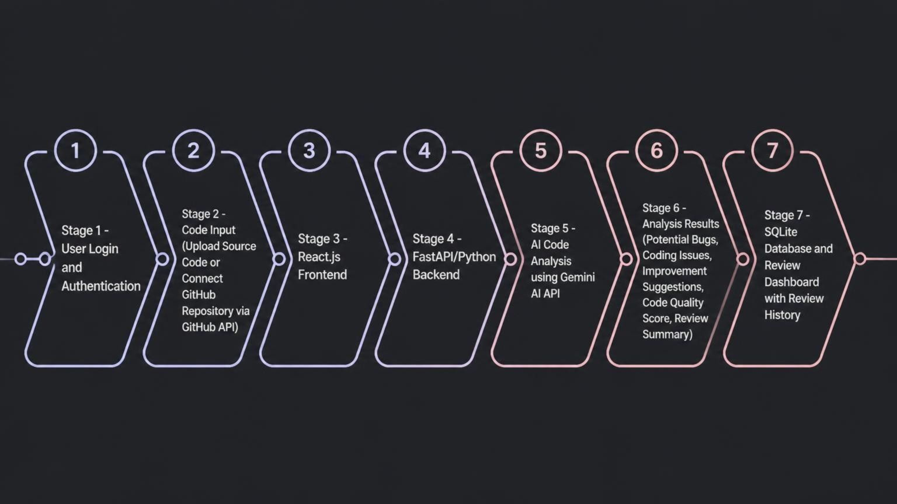
WORKFLOW ARCHITECTURE
Workflow Architecture
The system follows a client-server architecture with AI-powered analysis at its core. The React.js frontend handles user interaction and code submission. The FastAPI backend orchestrates AI analysis via the Gemini AI API, stores results in SQLite, and serves them through a review dashboard. GitHub integration enables direct repository analysis.
Technology Stack
Data Flow
Frontend: React.js
Backend: FastAPI + Python
AI: Gemini AI API
Database: SQLite
Version Control: Git + GitHub / GitHub API
Automation: GitHub Actions
User → Code Input → Backend → AI Analysis → Results → Database → Dashboard
The GitHub API connects directly to the repository input stage, enabling seamless code retrieval for analysis.

Slide 7






SYSTEM MODULES
System Modules
CodeInsight AI is organized into six interconnected modules, each handling a distinct stage of the code review pipeline from authentication through result presentation.
User Authentication
Code Upload / GitHub Integration
Allows users to securely access the application.
Accepts source code uploads or retrieves code from a GitHub repository via GitHub API.
AI Code Analysis
Bug Detection
Uses the Gemini AI API to analyze submitted code for bugs, issues, and quality.
Identifies potential bugs and coding issues within the analyzed code.
Report Generation
Review Dashboard
Produces improvement suggestions, a review summary, and a code quality score.
Allows users to view current and previous code review results stored in the database.

Slide 8
CONCLUSION
Conclusion
CodeInsight AI demonstrates how Artificial Intelligence can be integrated into software development workflows to support faster, more consistent, and understandable code reviews.
Automated Review
Integrated System
Automates key parts of the code-review process, reducing manual effort and inconsistency.
Combines a web interface, backend processing, AI analysis, GitHub integration, and database storage.
Actionable Output
Review History
Provides understandable suggestions, a code quality score, and a structured review summary.
Maintains a history of previous analyses, allowing developers to track code quality over time.
CodeInsight AI aims to support developers with faster, more consistent, and understandable AI-assisted code reviews.
References
Fan, A., Gokkaya, B., Harman, M., Lyubarskiy, M., Sengupta, S., Yoo, S., & Zhang, J. M. (2023). Large Language Models for Software Engineering: Survey and Open Problems. arXiv preprint.
IEEE/ACM International Conference on Software Engineering: Software Engineering in Practice (ICSE-SEIP). (2025). Automated Code Review in Practice.
Additional references on automated static analysis, LLM-based code review with symbolic reasoning, and LLM impact on GitHub pull-request workflows (2025).

