Slide 1
Learning Management: Online Quiz System
A Service-Oriented Platform for Creating, Conducting, and Managing Online Assessments
Team Members
Course & Department
Bhashetty Shaanvi
Deeksha
Manaswi
Srija
Course: 24SDCS03
Department: CSE, KLH Bowrampet
Guide: Navyatha Ravi

Slide 2

OVERVIEW
Overview & Problem Statement
What the System Provides
Key Challenges Being Addressed
Online quiz creation and conducting
Secure student access and role-based control
Automated evaluation of objective questions
Question and quiz management
Result and performance tracking
Scalable service-oriented architecture
Manual quiz preparation and evaluation
Delayed feedback and result generation
Managing large numbers of students
Secure role-based access management
Scalability and system maintainability
The proposed system aims to provide a reliable, secure, scalable, and automated online quiz platform for administrators, instructors, and students.

Slide 3

OBJECTIVES
Objectives
1
Online Quiz Platform
Develop a web-based platform for creating, scheduling, and conducting quizzes.
2
Secure Access & Role Management
Provide authentication and role-based access for Admin, Instructor, and Student.
3
Question & Quiz Management
Manage subjects, question banks, and quizzes efficiently across services.
4
Automated Evaluation & Results
Auto-evaluate objective questions, track results, and monitor student performance.
5
Microservice Architecture
Implement the system using SOA/microservices for modularity and scalability.

Slide 4

LITERATURE REVIEW
Literature Review & Research Gap
Existing Work
Research / System Gap
QMMS / Quiz Management Systems — 2021
Microservices-Based E-Learning — 2023
Basic quiz functions are already common. Our system proposes four additional assessment-management capabilities:
Modular e-learning with service separation for scalability and independence.
Automated handling of online quiz creation and assessment management.
Common Mistake Analysis
Question Lifecycle Tracking
Assessment Balance Checker
One-Time Quiz Access Token
Systematic Review of Online Assessment — 2023
Existing Quiz Functions → Additional Assessment Intelligence & Management
Confirms quiz creation, auto MCQ evaluation, and digital assessment are established.

Slide 5

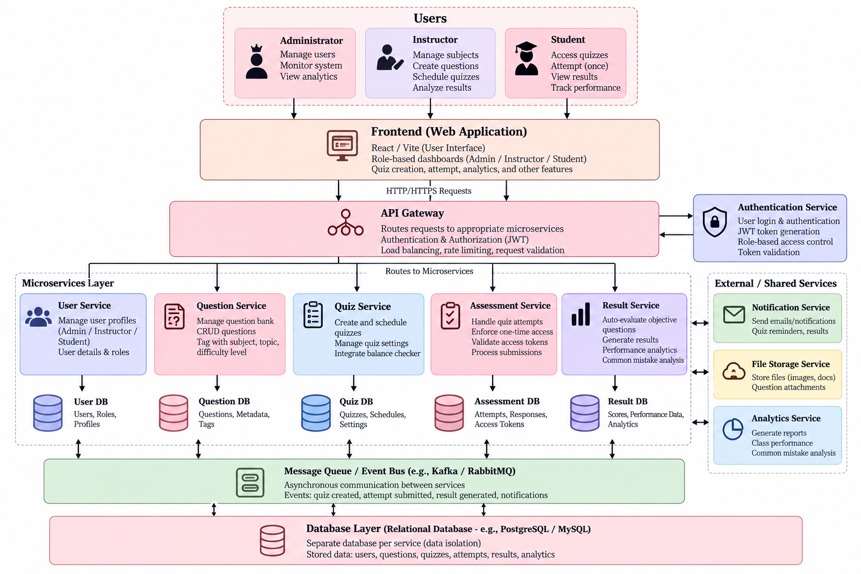
SYSTEM DESIGN
Proposed System & Architecture
Main Users
Microservice Architecture
Administrator
Manage users and system-level information.
Instructor
Manage subjects, questions, and quizzes. Analyze assessment quality.
Student
Access quizzes, attempt once, view results.

Slide 6







MODULES
Project Plan
Authentication Service
User Service
Login, authentication, and access control.
Manages student, instructor, and admin information.
Question Service
Quiz Service
Stores and manages questions and question metadata.
Creates, schedules, and manages quizzes.
Assessment Service
Result Service
Handles quiz attempts and assessment processing.
Evaluates responses and manages results and performance data.

Slide 7




DIFFERENTIATING FEATURES
Innovation, creativity and Novelty
01
02
03
04
Common Mistake Analysis
Question Lifecycle
Assessment Balance Checker
One-Time Quiz Access Token
Analyzes class-wide wrong-answer patterns to identify possible common misconceptions.
Example: 43/60 students select B instead of correct answer D.
"Possible misconception: Students may be confusing PUT and POST."
Tracks how frequently and recently each question has been used across assessments. Alerts instructor when reuse is excessive.
Checks quiz balance before publication across topics and difficulty levels.
Warnings: "Unit 3 overrepresented" · "Too many easy questions" · "Very few medium/hard questions"
Generates a unique, short-lived token per student for each scheduled quiz.
Teacher: Prevents excessive question reuse
Student: Reduces repetitive questions across assessments
Teacher: Creates better-balanced assessments
Student: Gets even syllabus coverage
Login
Token Generated
Quiz Access
Token Invalidated
Teacher: Controls authorized quiz access
Student: Secure, session-tied access
Teacher: Identifies class-wide misunderstandings
Student: Aware of common areas of confusion

Slide 8

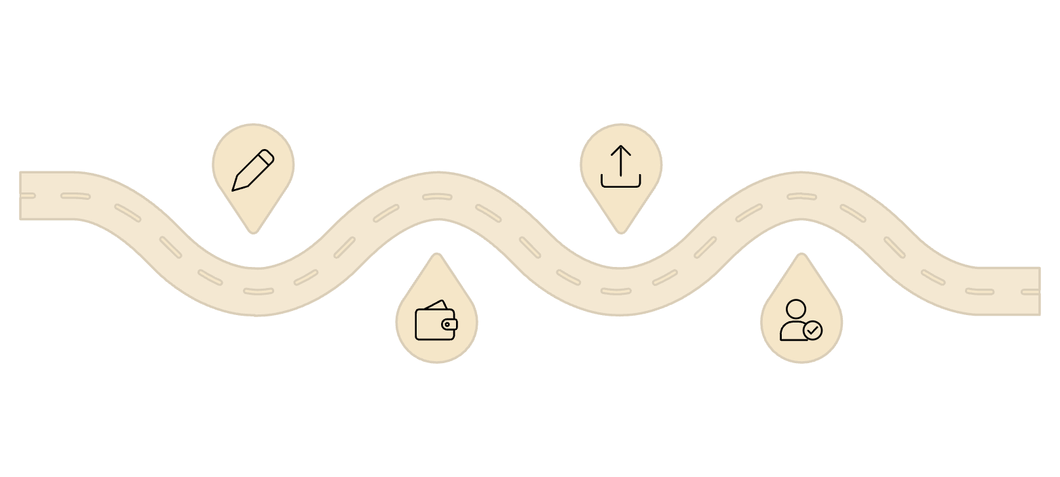

WORKFLOW & FLOWS
System Flows
Feature Integration Workflow
Functional Flows
Create Quiz
Publish & Token
INSTRUCTOR
Instructor prepares questions
Publish quiz and generate token
Login → Manage Subject → Manage Questions → Create Quiz → Check Balance → Schedule Quiz
STUDENT
Balance Check
Student Attempt
Login → Receive Access Token → Enter Quiz → Attempt Once → Submit
Verify assessment credits
Single attempt and auto-eval
SYSTEM
Evaluate → Generate Result → Analyze Mistakes → Update Question Lifecycle → Store Performance Data

Slide 9


TECHNOLOGIES & FEASIBILITY
Feasibility and Project plan
Technology Stack
Feasibility
Technical Feasibility
Frontend
Backend
Standard web technologies; REST APIs enable service communication; relational databases support structured quiz data.
Web-based user interface
Java / Spring Boot
Operational Feasibility
Architecture
Communication
Separate interfaces for each role; automated evaluation reduces manual work; instructors manage assessments through the platform.
SOA / Microservices
REST APIs
Database
Implementation Feasibility
Relational Database
Commonly available technologies; independent services are easier to maintain; architecture scales as user count grows.

Slide 10

CONCLUSION
Conclusion & Future Scope
Summary
The Learning Management: Online Quiz System provides a secure and scalable platform for creating, conducting, evaluating, and managing online assessments using SOA/Microservices.
The system combines standard quiz functionality with four proposed differentiating features:
Future Scope
Support for additional question types
More detailed assessment analytics
Integration with larger LMS platforms
Expansion of microservices
Additional reporting capabilities
Common Mistake Analysis
Question Lifecycle
Thank You
Assessment Balance Checker
One-Time Quiz Access Token
Bhashetty Shaanvi | Deeksha | Srija| Manaswi
CSE, KLH Bowrampet · Guide: Navyatha Ravi

