Slide 1


SOA PROJECT REVIEW-1 | 2026–2027
Learning Management: Online Quiz System
Course: SOA Programming and Microservices - 24SDCS03
Under the Guidance of: Navyatha Ravi
Department of Computer Science and Engineering
KLH CSE Bowrampet Campus
Team Members:
Bhashetty Shaanvi — 2420039806
Manaswi Divi — 2420030793
Deeksha — 2400031669
4. Srija — 2420030480
Date: 18 August, 2026

Slide 2


OVERVIEW
Outline of Project Work
Focus
Introduction
Online learning assessment and quiz management using SOA/microservices architecture.
Need for a digital platform for creating, conducting, evaluating and managing online quizzes in academic settings.
Challenges
Research Objectives
Manual quiz preparation, evaluation effort, delayed feedback, centralized management, scalability and secure access.
Develop an online quiz platform with secure access, quiz/question management, automated evaluation and result tracking using SOA/microservices.
Conclusion & Future Work
References & Publications
Efficient online assessment via modular architecture; future: enhanced analytics, reporting, additional assessment types.
Research literature on LMS, online assessment and SOA/microservices. No publication at this stage — project under development.

Slide 3

PROBLEM STATEMENT
Problem Statement
Introduction
Challenges
Online assessment is an essential part of modern learning management. An online quiz platform provides accessible, organized, and timely evaluation for both students and instructors in academic environments.
Manual Question Preparation
Preparing paper-based or digitally unstructured question sets is time-consuming and error-prone.
Manual Evaluation & Delayed Feedback
Paper-based or semi-digital evaluation causes delays in result declaration and student feedback.
Problem Statement
Managing Large Student Populations
There is a need for a reliable, secure, scalable and automated online quiz system that enables administrators/instructors to manage users, questions, quizzes and schedules while allowing students to securely attempt quizzes and receive timely results.
Difficulty in handling large cohorts, maintaining question banks, quiz records and schedules simultaneously.
Security & Role Management
Ensuring secure access and appropriate role-based permissions for admins, instructors and students.
Scalability & Maintainability
Poorly structured monolithic systems face serious scalability and maintenance challenges as user base grows.

Slide 4

OBJECTIVES
Objectives
1
Online Quiz Platform
Develop an online platform for creating and conducting quizzes with a user-friendly interface.
2
Secure Authentication
Provide secure authentication and role-based access control for administrators, instructors and students.
3
Subject, Question & Quiz Management
Enable administrators/instructors to manage subjects, question banks, quizzes and schedules centrally.
4
Student Quiz Access
Allow students to securely access and attempt available quizzes within defined schedules.
5
Automated Evaluation
Automate evaluation of objective-type questions and generate immediate results upon quiz submission.
6
Result & Performance Tracking
Generate and maintain quiz results and performance records for students and instructors.
7
SOA/Microservice Architecture
Apply SOA/microservice principles to achieve modularity, maintainability, scalability and structured API communication.

Slide 5

LITERATURE SURVEY
Literature Survey
Authors
Title of the Paper
Methodology
Inferences
Limitation / Future Work
Elshafey & Ghoniemy (2021)
The Development of QMMS: A Case Study for Reliable Online Quiz Maker and Management System
Case study; web-based system design for quiz creation, management and MCQ-based assessment
Demonstrated reliable quiz creation, management and automated MCQ evaluation; reduced manual effort in assessment
Limited to MCQ formats; lacks role-based access and scalable architecture; no microservice separation
X. Ren et al. (2023)
Design and Implementation of a Microservices-Based Online Learning Platform
Microservices architecture using Spring MVC, RabbitMQ for inter-service communication in an e-learning context
Modular decomposition of learning platform into independent services improved maintainability and scalability
Focused on course/video delivery; assessment and quiz management services not fully addressed
Admiraal et al. (2023) — Online Learning Journal
Online Assessment in Higher Education: A Systematic Review
Systematic review of 115 studies on online assessment tools and practices in higher education (2014–2022)
Automated assessment was used in 40% of studies; quizzes with MCQs are the dominant format for automated evaluation
Most systems are monolithic or platform-specific; scalability and interoperability across LMS platforms remain open challenges
Sources: Future Computing and Informatics Journal (2021); EIMT 2023, AHSSEH Vol. 8; Online Learning Journal Vol. 27, Issue 1 (2023).

Slide 6

PROBLEM GAP IDENTIFICATION
Problem Gap Identification
Existing Approaches
Identified Gaps
Proposed Opportunity
Monolithic LMS platforms (Moodle, Blackboard) provide quiz features but as tightly coupled modules
Web-based quiz systems offer MCQ automation but lack modular service separation
Microservice-based e-learning platforms address course delivery but not assessment management
Limited modular separation of assessment functions (auth, question management, quiz management, results)
Difficulty integrating independent services through APIs
Scalability and maintainability concerns in monolithic designs
Absence of secure role-based access for multi-user environments
Lack of centralized but modular management of assessment data
The proposed Learning Management: Online Quiz System addresses these gaps through a service-oriented/microservice architecture that separates authentication, user management, question bank, quiz management, assessment and result services — each communicating through defined APIs.
Existing Systems
Identified Limitations
Research Gap
Proposed Opportunity

Slide 7
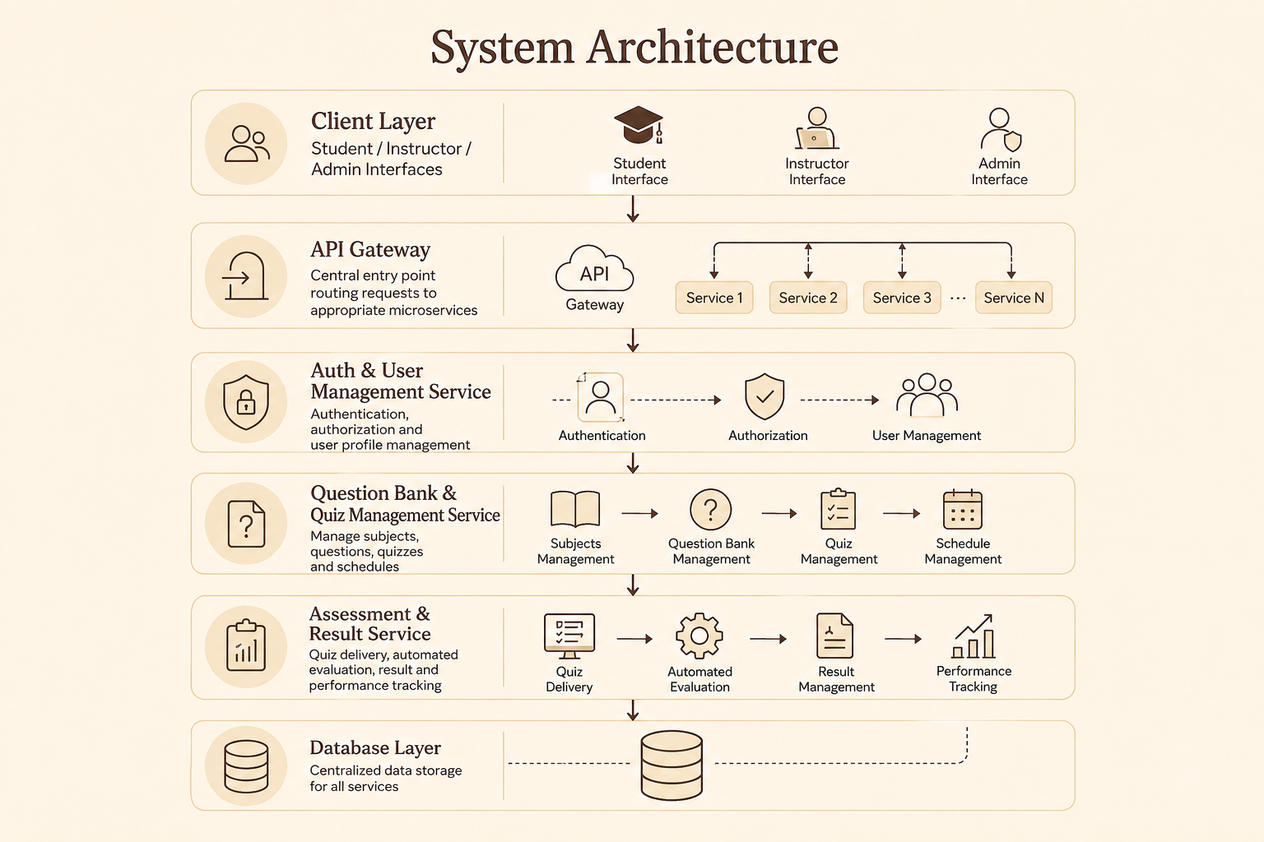
INNOVATION, CREATIVITY & NOVELTY
Innovation, Creativity, and Novelty
Innovation
Creativity
Service-oriented organization of all quiz system functions
Independent microservices for each major function
API-based inter-service communication
Role-based access: Student / Instructor / Admin
Centralized question bank and quiz management
Automated objective-question evaluation
Result and performance tracking per student
Novelty
Modularity — each service is independently deployable
Maintainability — changes in one service do not affect others
Scalability — services scale independently based on load
Structured inter-service communication through APIs

Slide 8
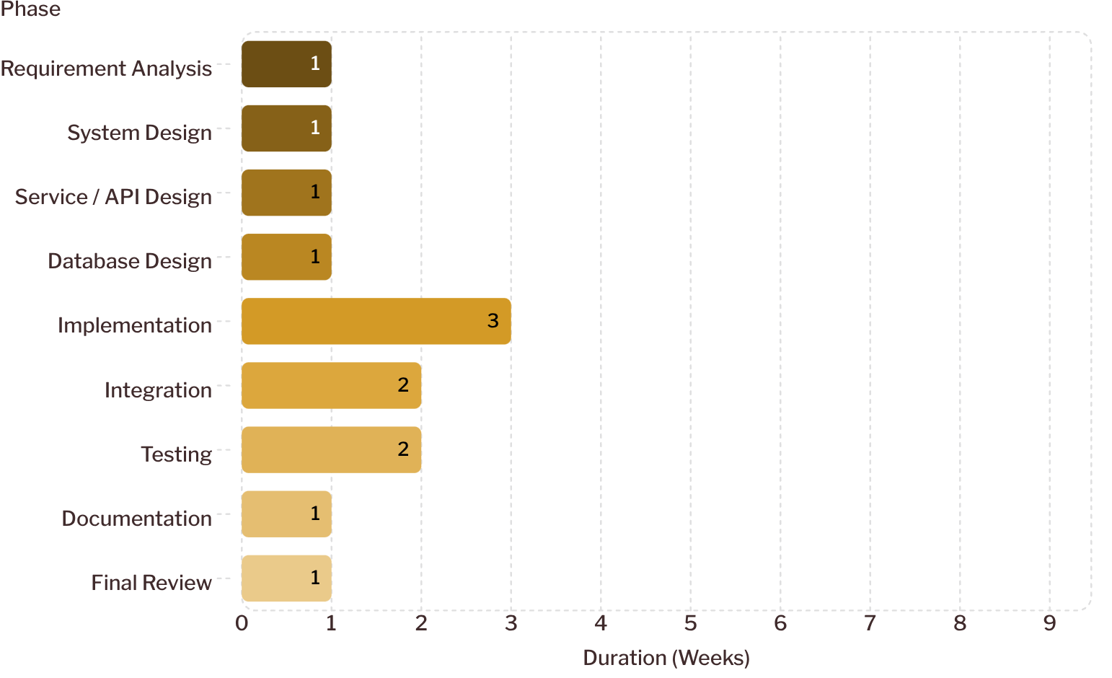
FEASIBILITY & PROJECT PLAN
Feasibility and Project Plan
Project Timeline — Development Phases
Technical Feasibility
Implementable using standard web technologies, REST APIs, relational databases and SOA/microservice frameworks.
Operational Feasibility
Students, instructors and administrators interact through role-specific web interfaces with clearly defined access controls.
Economic Feasibility
Developed using open-source technologies; no specialized hardware required. Suitable for academic project budget.
Conclusion
Timeline chart shows approximate duration in weeks for each project phase. Implementation and Integration are the most effort-intensive phases. Total estimated duration: ~13 weeks.
The Online Quiz System provides an organized approach to online assessment through automated evaluation, centralized management and a modular SOA/microservice architecture.
Future Work
Enhanced analytics, advanced reporting, additional assessment types, improved scalability and quiz management features.

