Slide 1
Stepwells of North Gujarat: field deck
Demo deck in the style of an Explorer Fellowship trip deck, assembled by the KathaGraph team from Wikimedia Commons photos and published sources (Wikipedia), to show how a static deck becomes a living archive record.

Slide 2
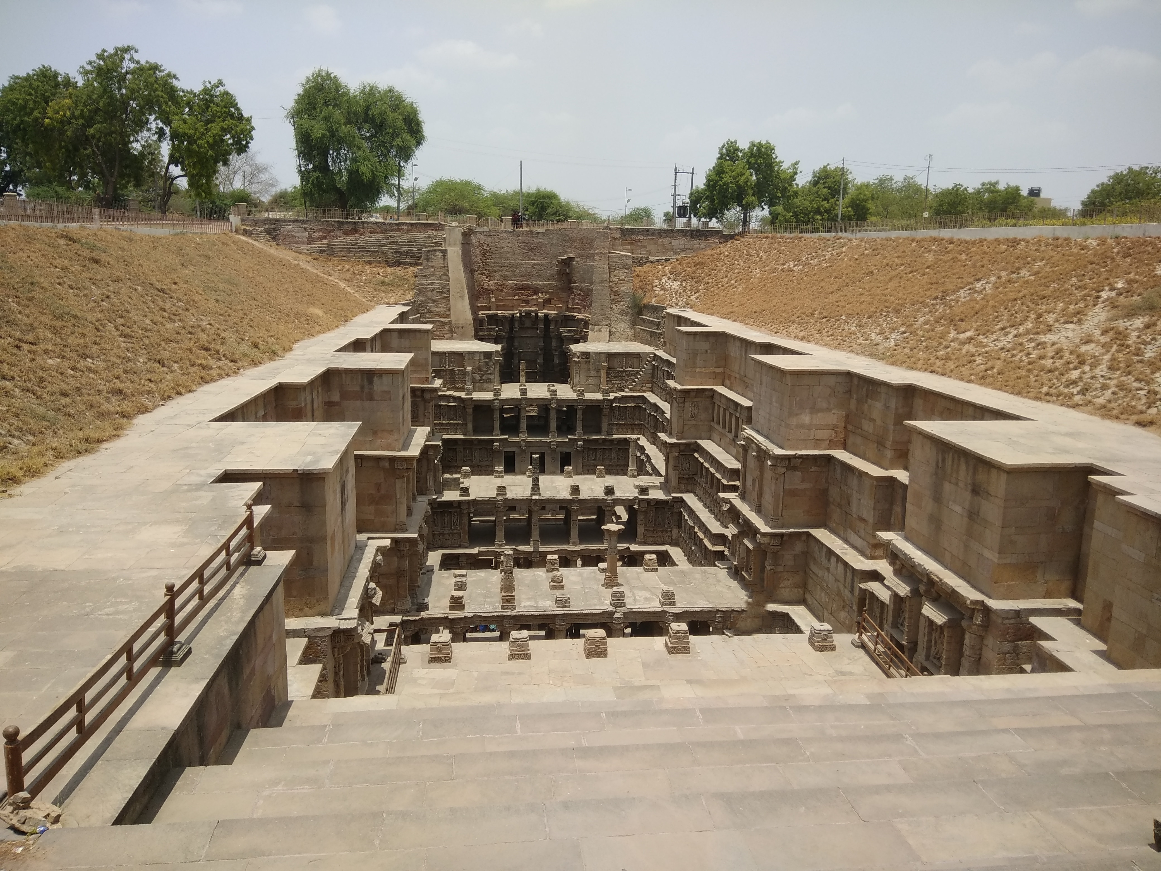
Rani ki Vav, Patan
• Stepwell on the banks of the Saraswati river in Patan, Gujarat
• Built in the 11th century during the Chaulukya (Solanki) dynasty, in memory of King Bhima I, by his widowed queen Udayamati
• Seven levels of stairs, with more than 500 principal sculptures
• Inscribed as a UNESCO World Heritage Site in 2014
Photo: K1tri, Wikimedia Commons, CC BY-SA 4.0
Notes:
Sources: Wikipedia, 'Rani ki vav' (CC BY-SA 4.0). Photo: 'Rani Ki Vav - World Heritage Site - Patan, Gujarat.jpg' by K1tri, CC BY-SA 4.0.

Slide 3
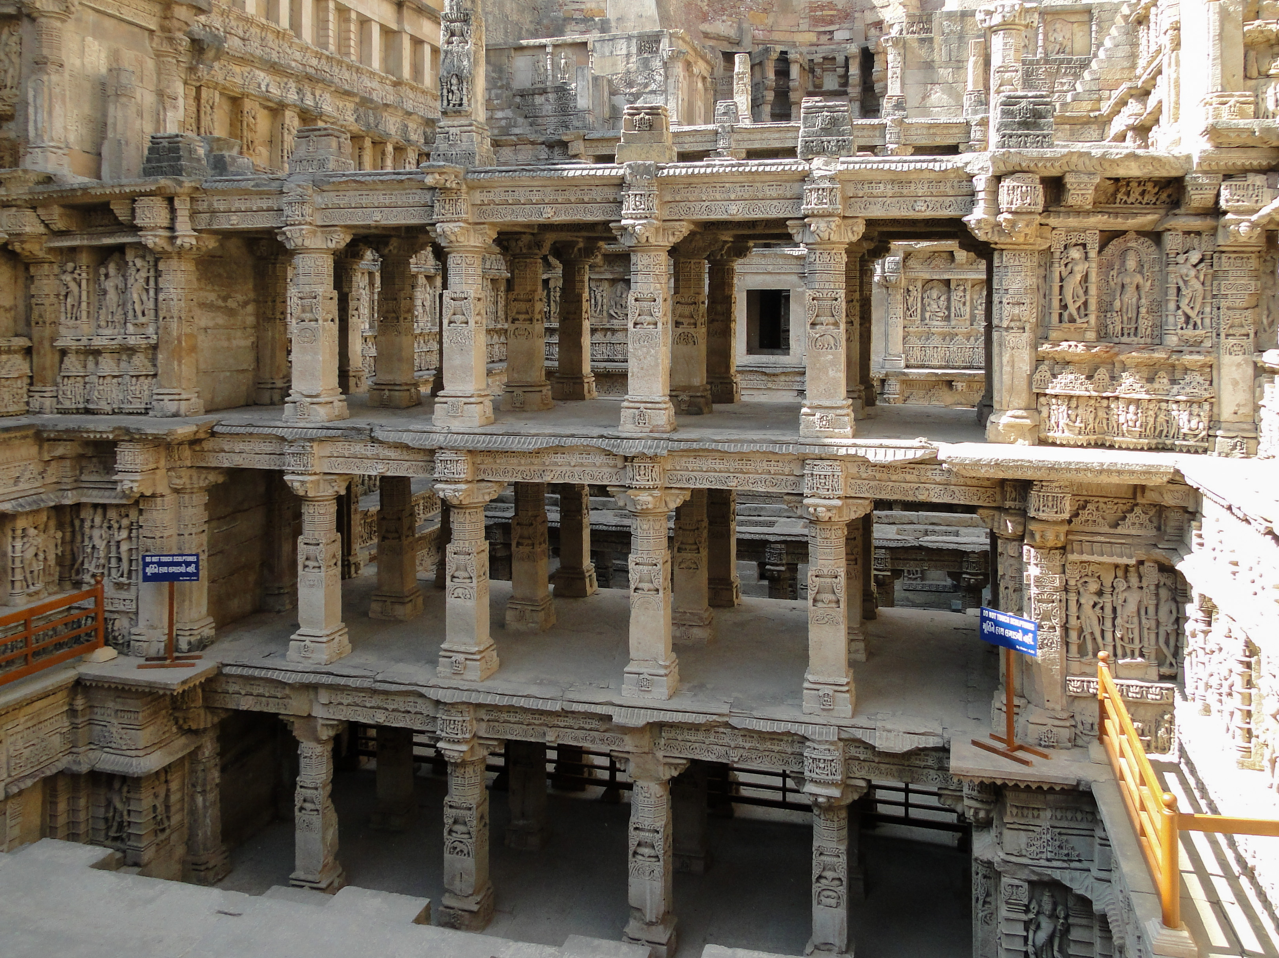
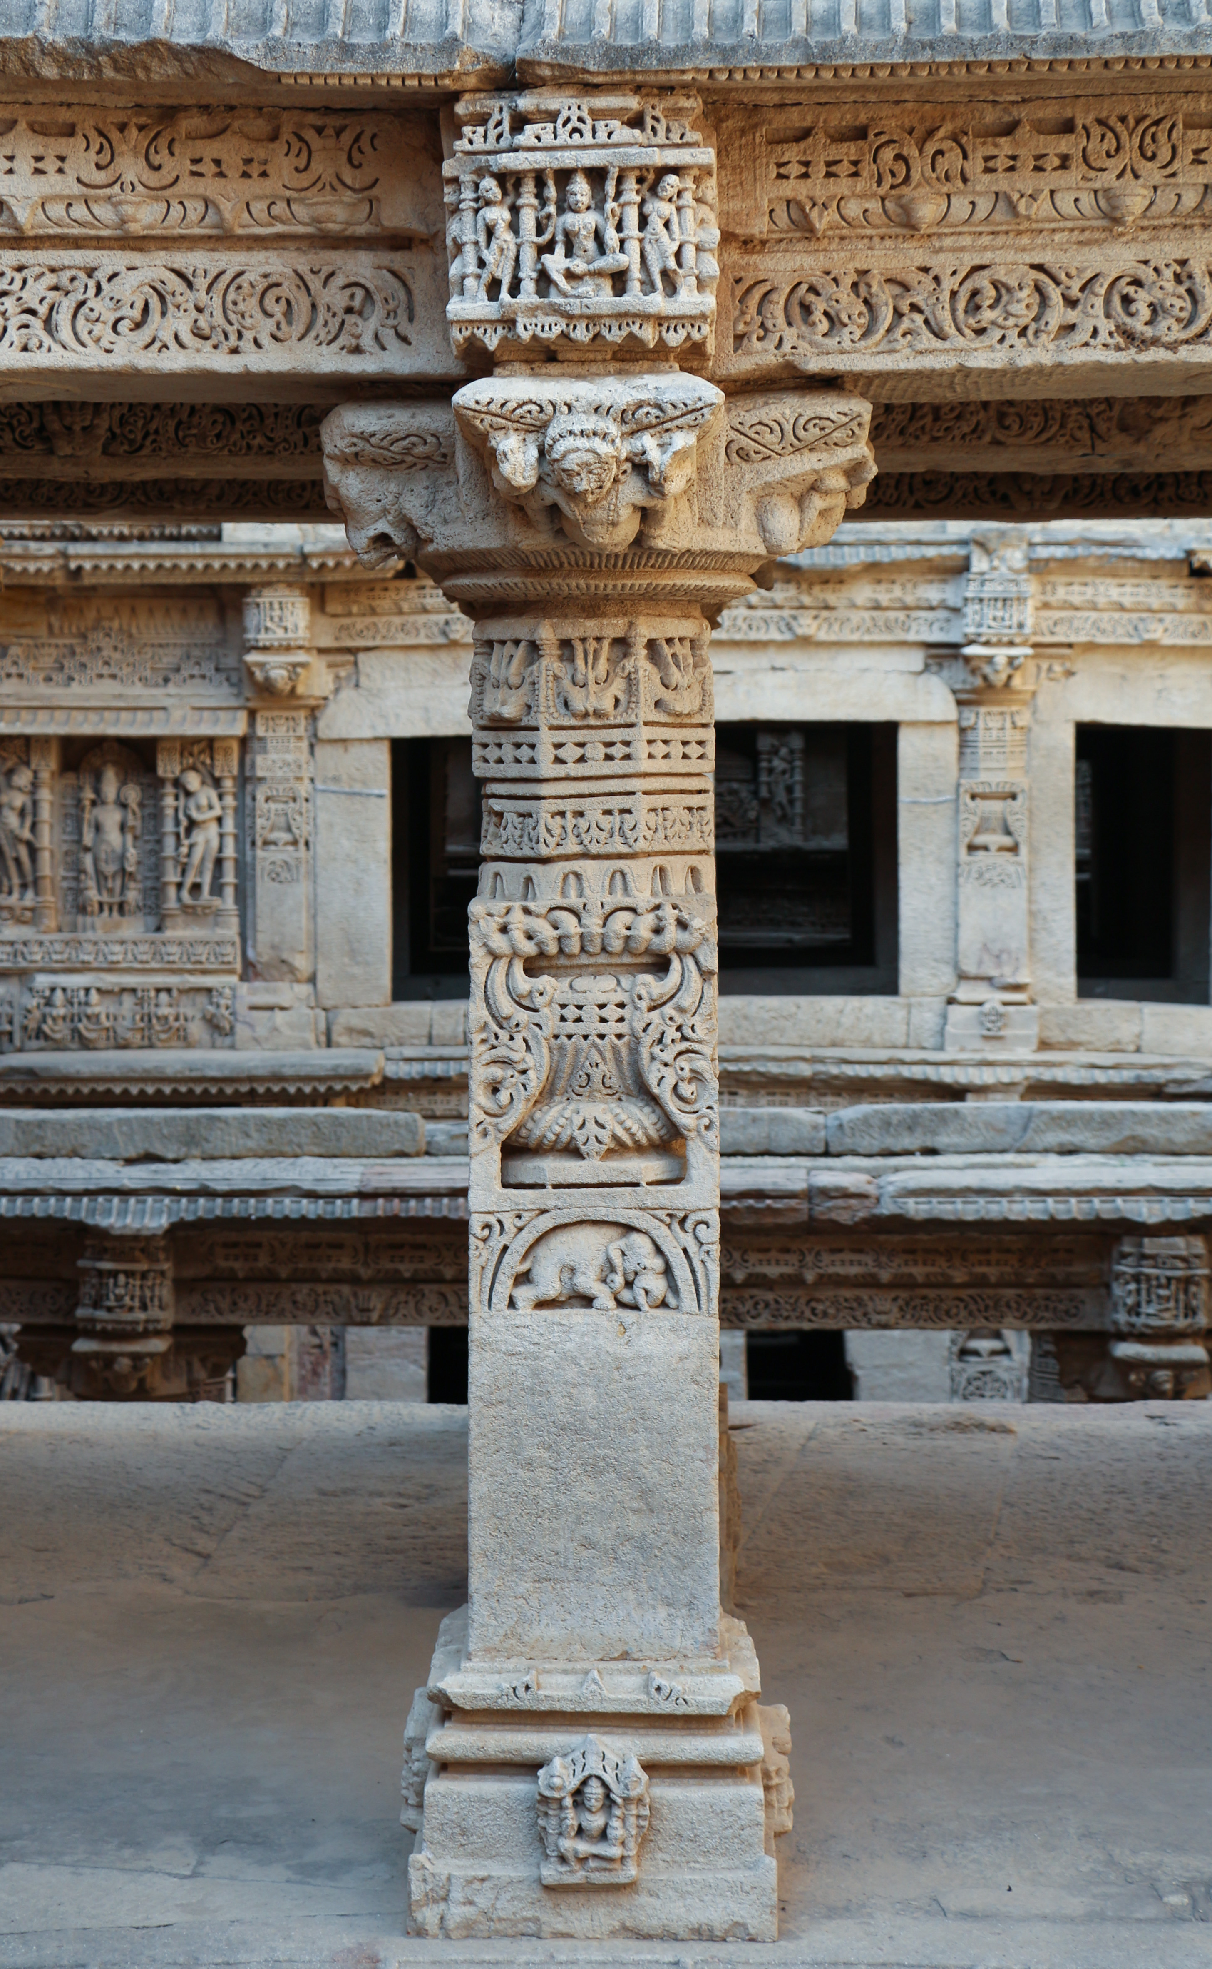
Rani ki Vav: the carvings
• Built in the Maru-Gurjara architectural style
• Most sculptures are devoted to Vishnu, in the forms of his ten avatars (Dashavatara)
• Carved pillars line every pavilion level
Photo: Bernard Gagnon, Wikimedia Commons, CC BY-SA 3.0
Photo: Bernard Gagnon, Wikimedia Commons, CC BY-SA 3.0
Notes:
Sources: Wikipedia, 'Rani ki vav'. Photos: 'Rani ki vav 03.jpg' and 'Rani ki vav 16 - pillar.jpg' by Bernard Gagnon, CC BY-SA 3.0.

Slide 4
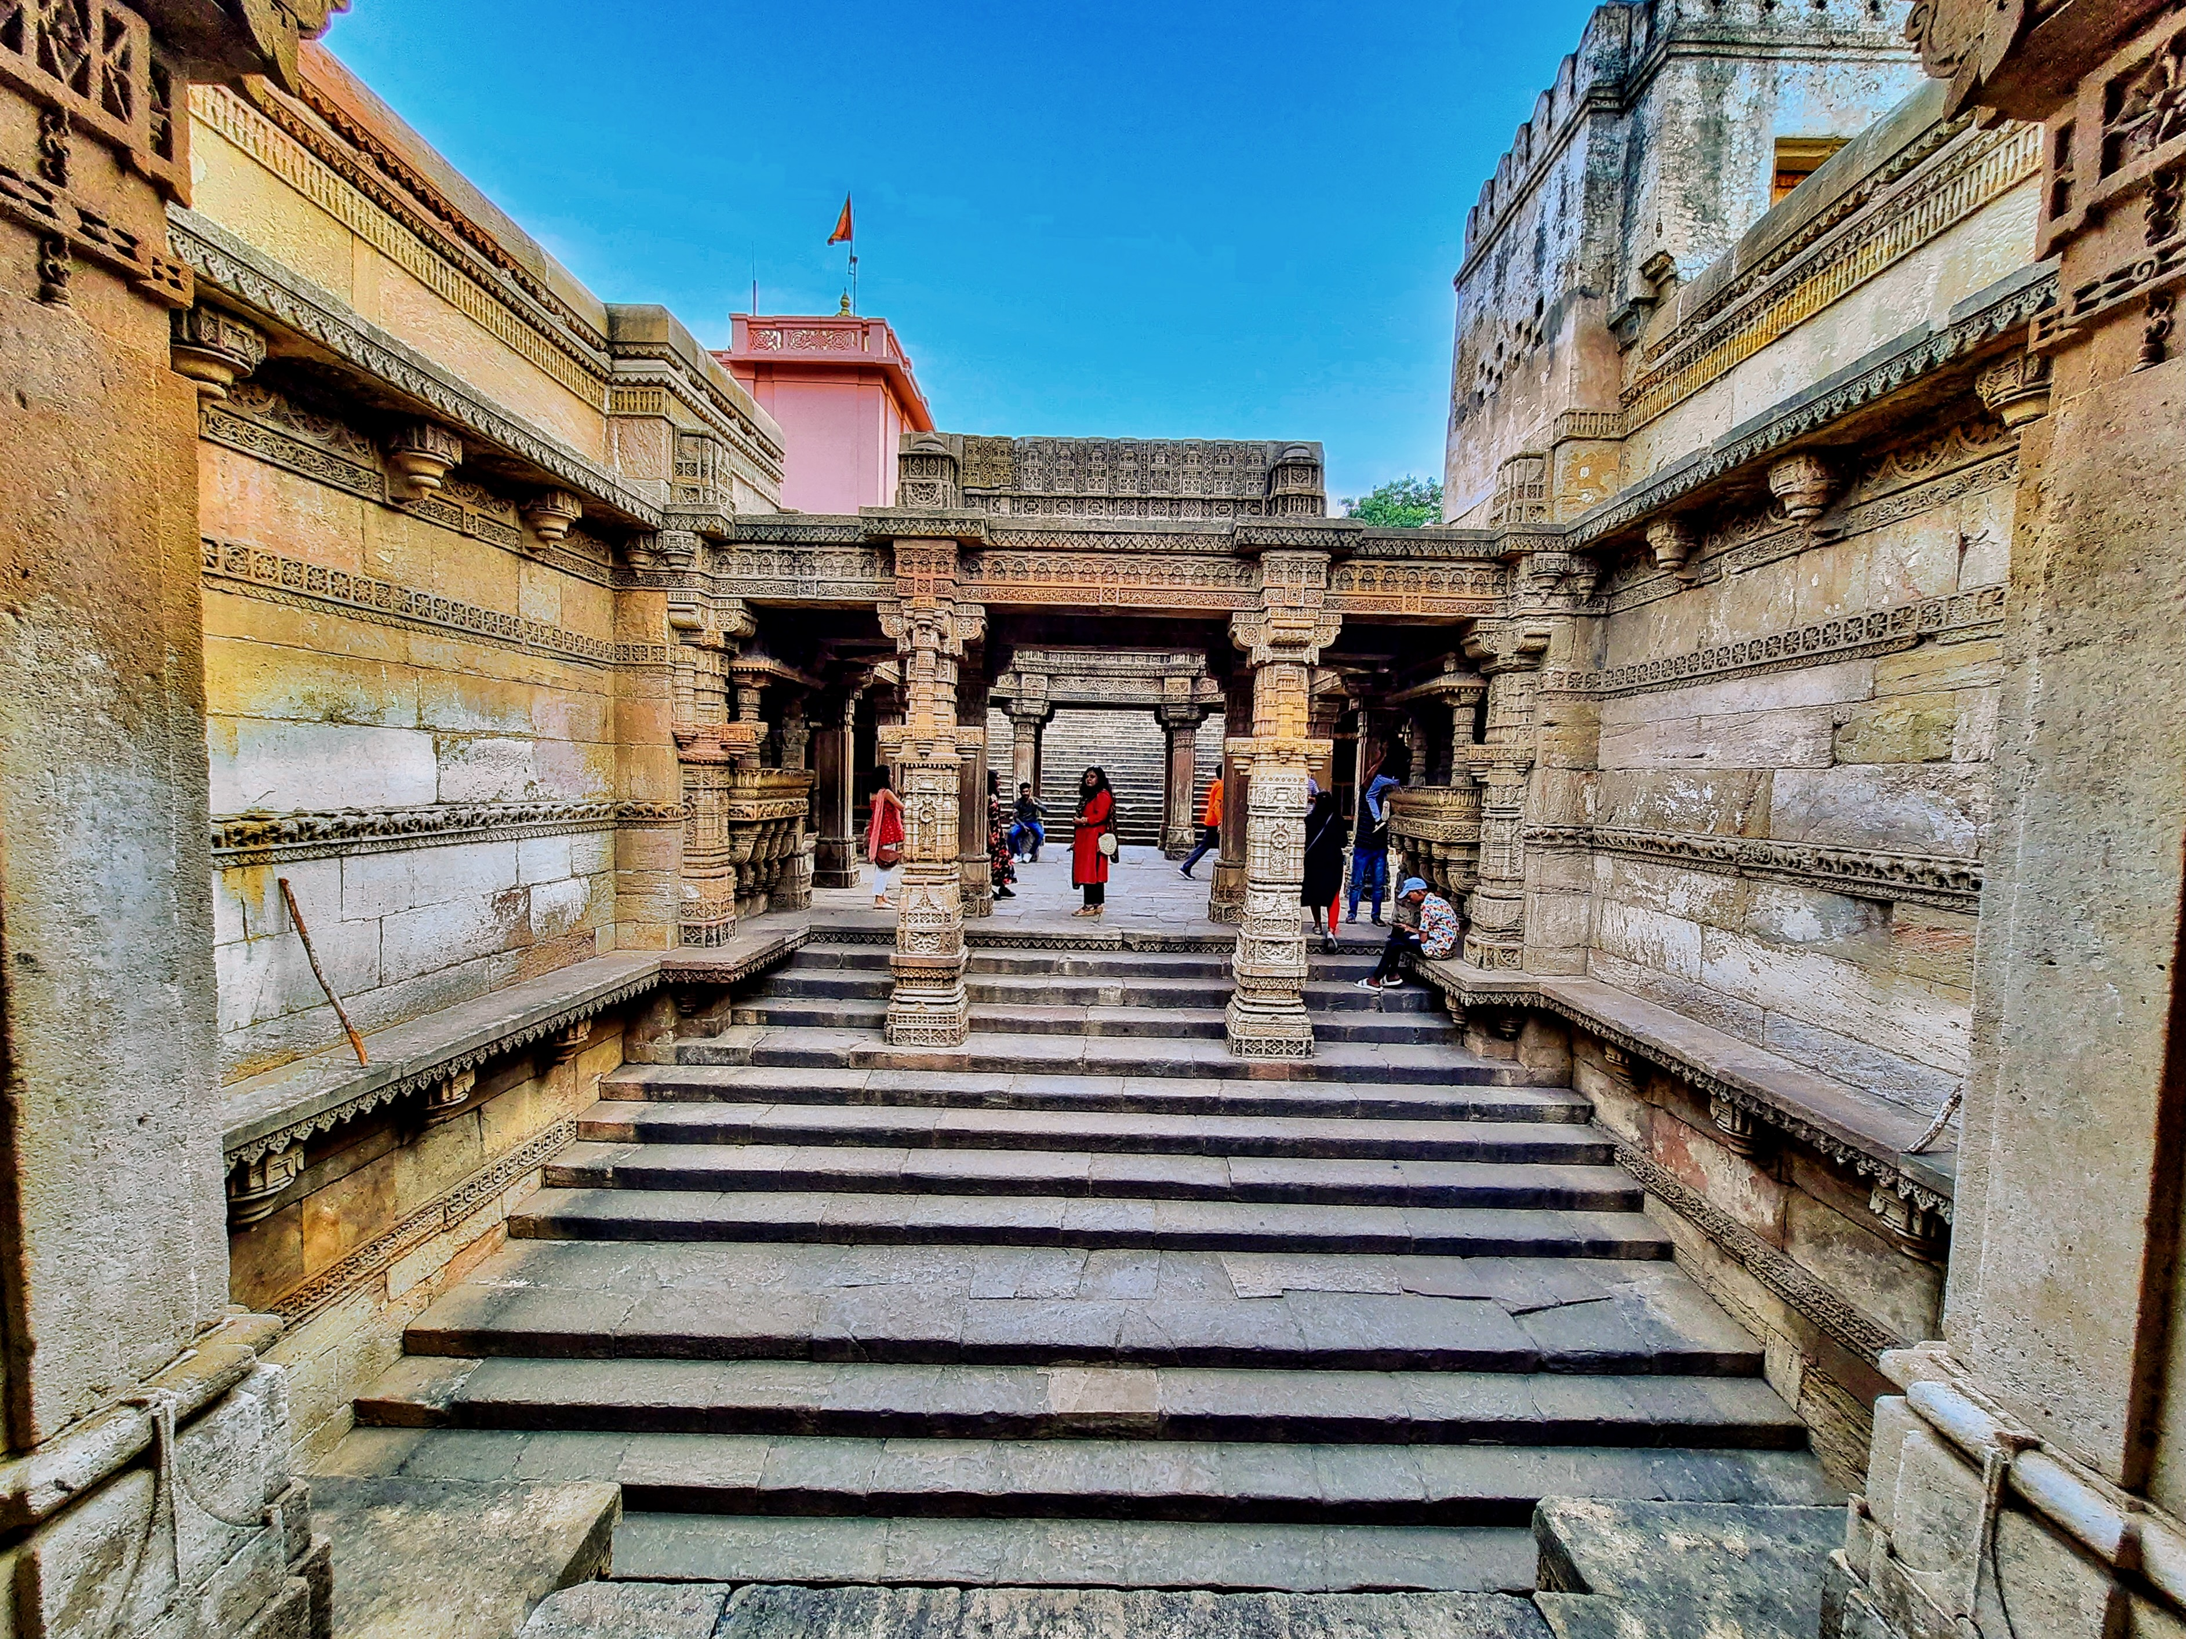
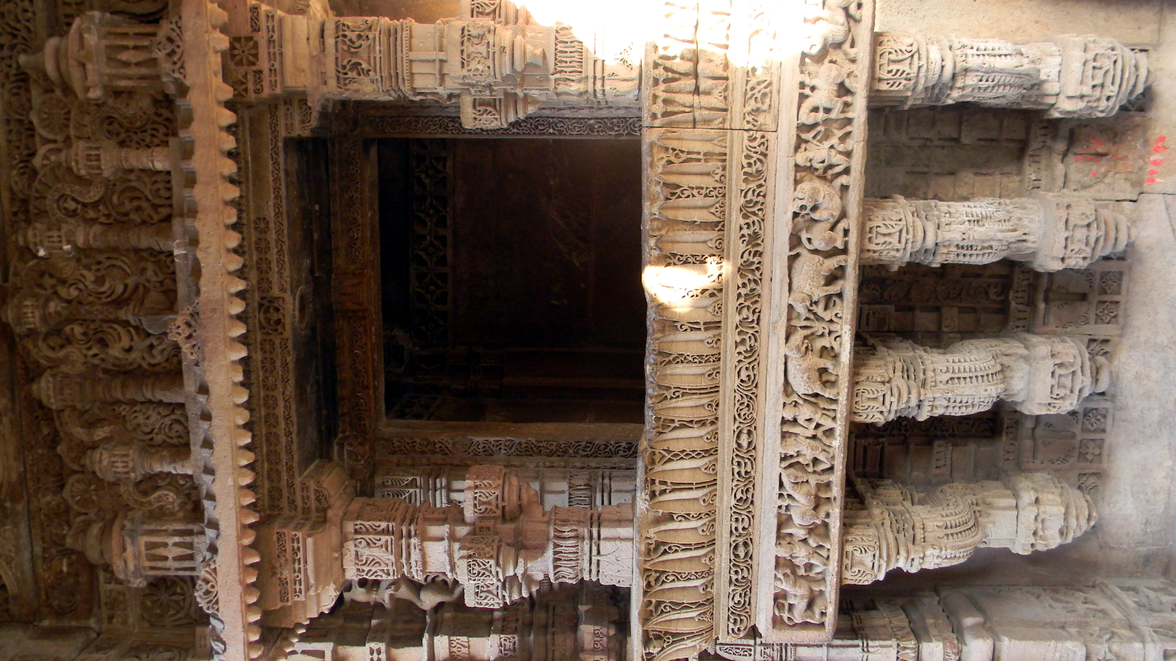
Adalaj Stepwell
• Five storeys deep, in the village of Adalaj near Gandhinagar
• Commissioned by Queen Rudabai and completed in 1498; it honours her late husband, Rana Veer Singh of the Vaghela dynasty
• A Sanskrit inscription on the first storey is dated Samvat 1555
• Built of sandstone
Photo: Ms Sarah Welch, Wikimedia Commons, CC0
Photo: Ratnesh1948, Wikimedia Commons, CC BY-SA 4.0
Notes:
Sources: Wikipedia, 'Adalaj Stepwell'. Photos: '0082423 Rudabai Step Well, Adalaj Gujarat 146.jpg' by Ms Sarah Welch (CC0) and 'Adalaj Stepwell side panel 2.jpg' by Ratnesh1948 (CC BY-SA 4.0).

Slide 5
For the next visit
• Adalaj: photograph the inscription slab on the first storey and transcribe it
• Adalaj: an exterior photograph from ground level, showing the entrance pavilions
• Rani ki Vav: photograph the well shaft from the west side
• Both: record what caretakers and local families say about the queens who built them

