Slide 1
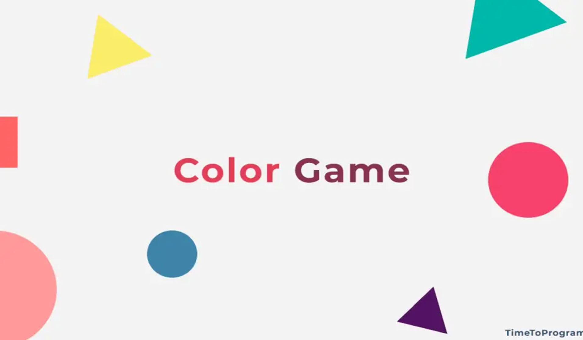

Slide 2
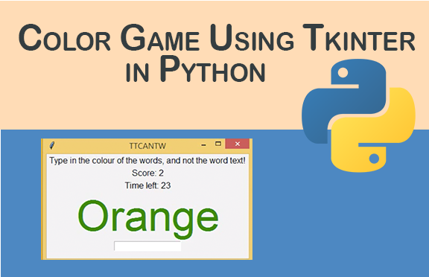

Slide 3
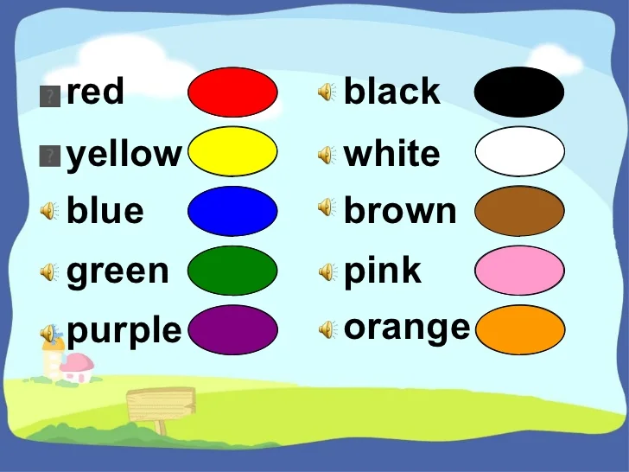

Slide 4
rules game player has to enter color of the word that appears on the screen TIME LIMIT:20 S QUALIFING SCOre:10

Slide 5
OBJECTIVE:
To enhance speed
To incorporate concentration
To upskill sportive nature
To improve logical thinking power
TKINTER: To use GUI tool kit in python which allows to create a user interface ‘window’ for input and output
THANK YOU

