Slide 1


Oakland Airport Parking Analysis

Slide 2
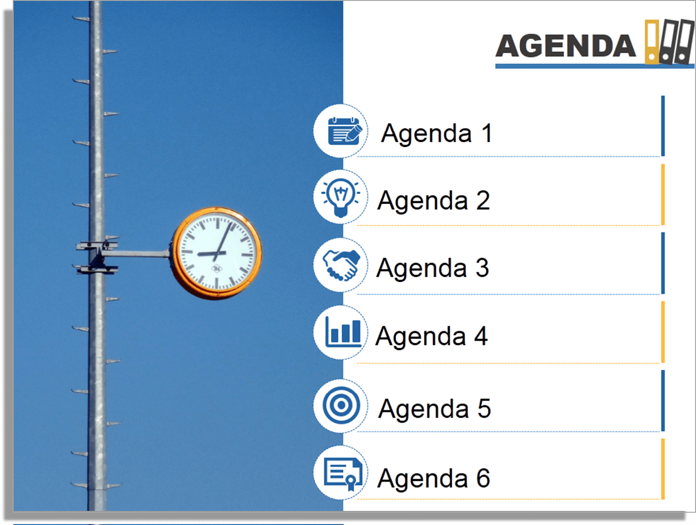
1 Business Case
2 Forecasting
3 Prediction
4 Competitor Analysis
5 Recommendations
6 Dashboard in Tableau

Slide 3
Our Goal
ONE STOP
ANALYTICAL SOLUTION
FOR LAZ PARKING
Reporting based on capacity, duration and revenue on daily, weekly and yearly basis
Prediction of number of cars based on hourly traffic from historical data
Forecasting revenue based on airport passenger traffic and weather forecasts
Competitor analysis based on 7 competitors near airport

Slide 4








Forecasting Net Revenue For October 2016 -2017
S
T
A
R
T
Primary Factors :
LAZ Parking Revenue from January 2012 – April 2015
Secondary Factors :
Airport Passenger Traffic
Monthly Weather Reports
Interventions Included :
July,2013 & August,2013 on airport passenger
Benefits to LAZ :
Prepare in-advance for best/worst scenario
Captures variation based on daily airport passenger traffic data and weather
Assumption : Airport Passenger Data is True
Weather Forecast Data is True
*Sources : Weatherwarehouse.com
S
T
A
GES
Data Integration
Time Series
Forecasting
1
DI
A
G
R
A
M
ARIMA Model
Preliminary Analysis
5 Steps
e
2
Predict
Revenue
Transform Variables
5
Model based
LAZ data
3
Regress Airport Passenger and
Weather
4

Slide 5
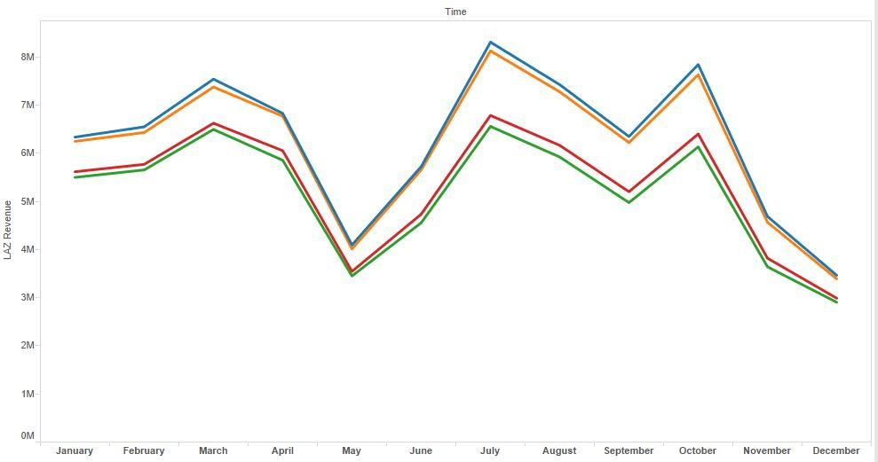
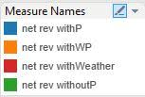
Forecasting Net Revenue For 2017
Comparing Net Revenue Forecasts including Weather and Airport Passenger Traffic
$800K
More Revenue
Predicted for 2017
Based on Airport Passenger
$136K
More Revenue
Predicted 2017
Based on Weather Forecasts
$715K
More Revenue
Predicted 2017
Based on Airport Passenger and Weather Forecasts
*P indicates Passenger
*W indicates Weather

Slide 6
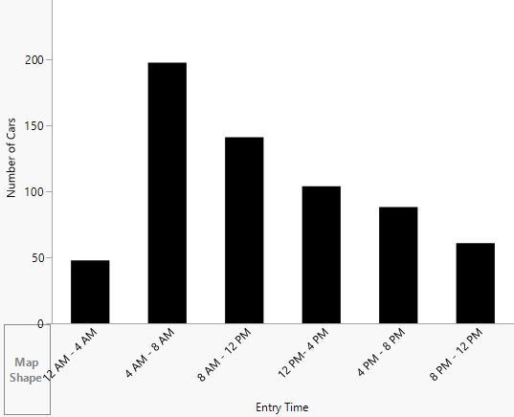
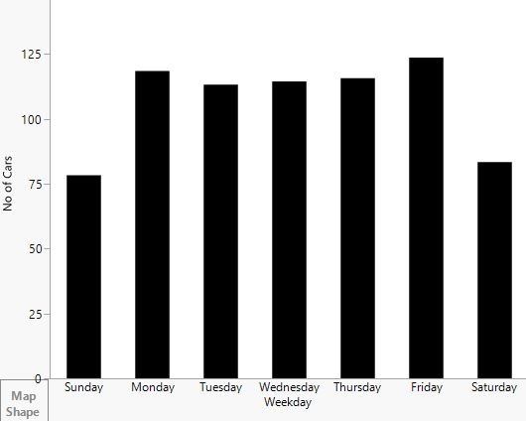
Predicting Number of Cars
18%
78%
Of Total Revenue Comes On A Monday
Of Total Cars
on Weekdays
1810
$
31%
More Daily Revenue On A Weekday
Of Total Cars From 4 am - 8 am
6

Slide 7
Predicting Number of Cars On Hourly Basis
Decision Trees Algorithm Implemented
How many cars are expected on
Dec 2,2016 ?
Business Case :
How many cars are expected on a particular day to plan resources and traffic
Benefits to LAZ :
Hourly predictions of traffic
Can be integrated with mobile applications
Premium,
Economy
Hourly,
Daily
Follows rest of the split
What is the time-frame you looking for ?
1,6,5,4
3,2
Attributes included :
Parking Lot
Month
Week of the Year
Weekday
Is Weekend ?
Time Bin:
1 – (Midnight – 4 AM),
2 – (4 AM – 8 AM),
3 – (8 AM – 12pm),
4 – (12 PM – 4 PM),
5 – (4 PM– 8 PM),
6 – (8 PM– 12 PM)
What parking lot you want ?
Daily
Hourly
Others
What entry week you looking for?
Others
49
Others
170 Cars
Predicted number of cars:
December 2- 170 cars
December 12 - 325 cars
7

Slide 8
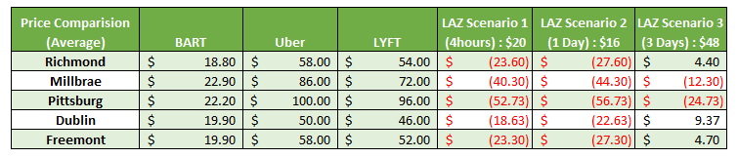
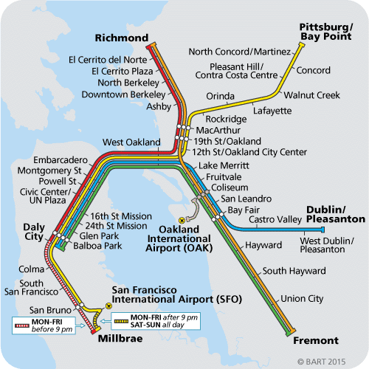
Competitor Analysis
Assumptions :
Only 1 person is traveling
Average UberX, Standard LYFT rates are considered

Slide 9
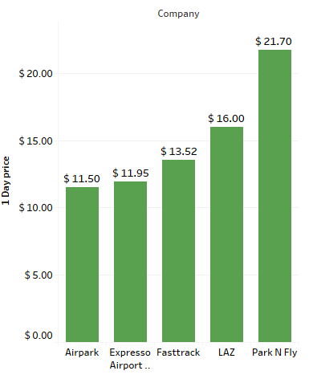
Competitor Analysis (contd..)
Insights :
Competitor rates are 15% to 28% cheaper than LAZ
Benefits to LAZ :
Needs to build pricing models based on competitors pricing
Sources :
www.airpark.com
www.expressoparking.com
www.fasttrackoak.com
www.pnf.com

Slide 10






Competitor Analysis Based on Amenities
Car wash & oil change
Online reservation
Luggage assistance
Loyalty programs
Coupons & discounts

Slide 11
Recommendations
Parking duration based coupons :
Duration: January and March
Duration: September and October
Parking Lots based on Modeling:
Staff management & Coupons based on models
Individual attention to each lot based on Data Analysis
Competitor based Pricing Solutions:
Look into the pricing strategy of LAZ to ensure optimal prices for hourly parking lot (4D)
4A
4C
Daily Lots : Monday early bird deals
4B
Premier Lots : Valet services for better customer experience
4D
Economy Lots : More weekend deals
Hourly Lots : Daily deals from 8 pm – 12 am

Slide 12
Next Steps for LAZ
Implement Strategies
Results
Marketing:
Better coupons
Better alliances
Operation :
Better staff management and maintenance
Technical :
Better mapping solutions
Better payment processing
Mobile applications
More revenue
Easy data handling
Better customer satisfaction
Data Analytics
Data
Collection
Forecast daily revenue and customer traffic
Better customer segmentation
Airport passengers & daily weather reports
Customer demography and car size details
$

Slide 13
Thank You.
Any Questions ?

