Slide 1


⚡ iQOO HACKATHON ENTRY
PocketAudit
100% On-Device, Zero-Internet Financial Fraud Shield
Real-Time Defense Against Fake UPI Collects, KYC Smishing & Autopay Traps at Device Speed.
0 BYTES
Zero Cloud / Internet Permission
< 2.5ms
Instant Heuristic Analysis
100% OFFLINE
Encrypted Local Room DB

Slide 2

THE PROBLEM
The UPI & Smishing Crisis in Modern Mobile Payments
🚨 Fake UPI Collect Requests
• Scammers disguise collect debit requests as 'Cashback Refunds' or 'Lottery Wins'.
• Victims are pressured into entering their UPI PIN under the false belief they are receiving money.
• Fastest growing payment fraud in India, causing devastating single-transaction losses.
⚠️ Urgent KYC Phishing SMS
• Spoofed bank texts claiming: 'HDFC/SBI account suspended within 24 hours'.
• Shortened URLs (bit.ly, tinyurl, raw IP addresses) steal credentials & OTPs.
• High psychological urgency bypasses normal user caution.
🔒 The Privacy Dilemma
• Existing spam blockers upload private SMS & contacts to remote cloud servers.
• Massive violation of personal data privacy & enterprise security.
• Users are forced to choose between payment fraud or total data exposure.

Slide 3
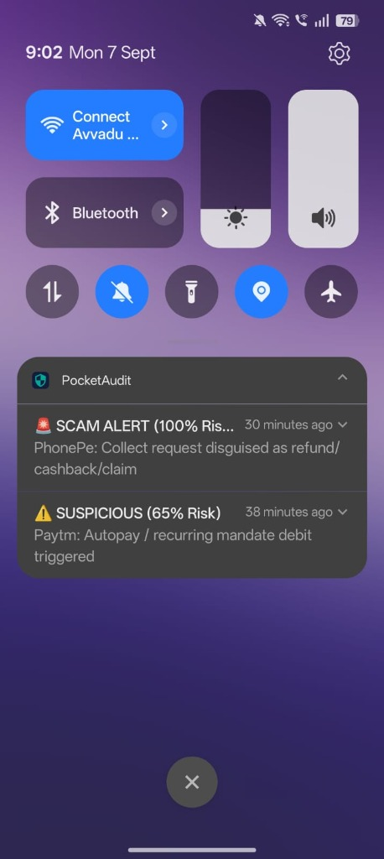
THE SOLUTION
PocketAudit: Zero Latency, Zero Internet, Complete Trust
🛡️ 100% On-Device Protection
• Zero internet permission in AndroidManifest.xml.
• Strictly zero cloud transmission, zero APIs, zero data leakage.
• All analysis happens locally in RAM on the device processor.
⚡ Real-Time Binder Interception
• Foreground NotificationListenerService with auto-rebind resilience.
• Extracts titles, BigText, & nested MessagingStyle conversation threads.
• SupervisorJob concurrency prevents service dropouts.
🧠 Multi-Vector Heuristic Engine
• Specialized detectors for UPI Collect, Phishing Links, & Mandates.
• Fast pattern & regex matching running in under 2.5ms.
• Cross-references local history for duplicate charge traps.
🔔 Immediate Push Verdicts
• Instant color-coded Android status bar notifications (🚨 Scam / ⚠️ Suspicious / ✅ Safe).
• Plain-language explanation tells user WHY it was flagged.
• One-tap deep-link directly into audit detail breakdown.
Real Push Verdicts in System Tray

Slide 4
ARCHITECTURE & PIPELINE
End-to-End Hardened Architecture
1. Interception
NotificationListenerService extracts title, BigText, & MessagingStyle from Android Binder.
2. Smart Filter
NotificationFilter whitelists UPI, Banks, & SMS apps while excluding WhatsApp/social noise.
3. Detection Engine
DetectionEngine evaluates CollectRequest, PhishingLink, and SubscriptionTrap heuristics.
4. Storage & Verdict
Persists every analyzed message to Room DB and fires instant push verdict notification.

Slide 5
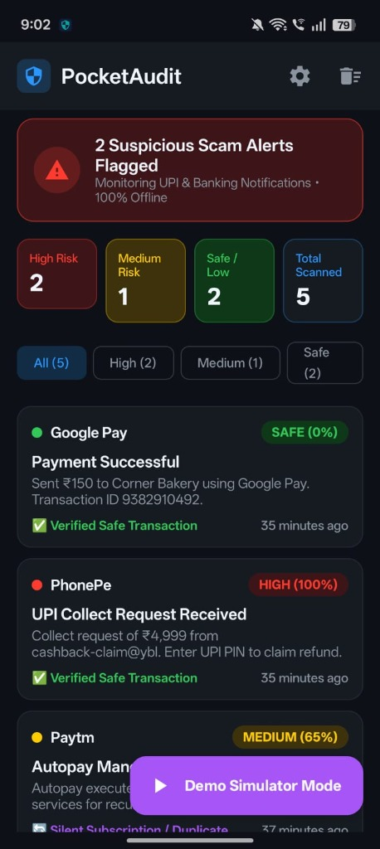
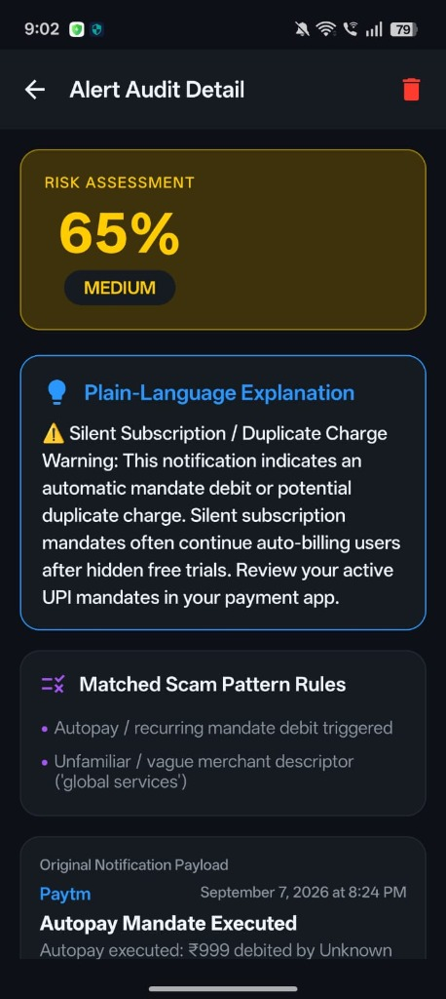
CORE FEATURES
Production-Ready Feature Suite (Live on Device)
📱 Live Dashboard & Threat Triage
• Real-time Status Banner indicating active background monitoring.
• 4 Live Stat Cards: High Risk, Medium Risk, Safe / Low, Total Scanned.
• 4 Quick Filter Chips: Instant feed filtering by threat severity.
• Chronological feed showing app icons, badges (SAFE 0%, HIGH 100%), and timestamps.
🔍 Explainable Audit Detail Screen
• Calculated Threat Gauge: Visual risk meter (e.g. 65% MEDIUM / 100% HIGH).
• Plain-Language Explanation: Explains in plain English/regional tongue why it is a scam.
• Matched Scam Rules List: Bulleted transparency on exact triggered heuristics.
• Original Payload Verification & single-tap 'Mark as Safe' action.
Live Dashboard (4 Stats & Filter Chips)
Audit Detail (Risk Meter & Plain Explanation)

Slide 6
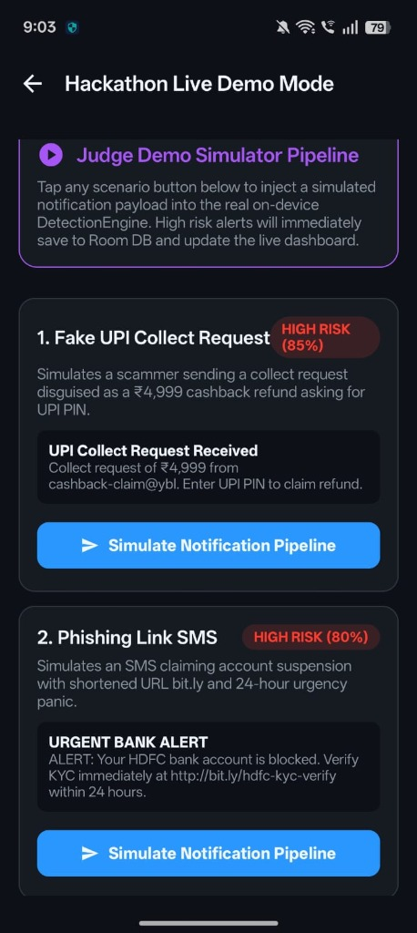
USER EXPERIENCE
Accessible, Inclusive & Tester-Ready Design
🧪 Judge Demo Simulator Pipeline
• Integrated Floating Action Button for live demonstrations without needing a second device.
• Simulates real-world payloads: Fake UPI Collect, Bank KYC Phishing, & Autopay Traps.
• Injects directly into real on-device DetectionEngine with instant UI & push updates.
🗣️ Multilingual Localization
• Native engine supporting English & Telugu (తెలుగు).
• Translates cyber security jargon into everyday regional advice.
• Protects non-English speaking & elderly citizens most vulnerable to fraud.
🎨 Dynamic Responsive Theming
• Supports Cyber Dark Mode, Clean Slate Light Mode, & System Default.
• Dynamic Material 3 colors applied across all cards, dialogs, & status bars.
• Persisted reliably via private SharedPreferences across app restarts.
Hackathon Live Demo Simulator

Slide 7
COMPETITIVE EDGE
How PocketAudit Outperforms Existing Solutions
Capability
Cloud / Antivirus
OS Alerts
PocketAudit
Privacy / Zero Internet
❌ Cloud dependency
⚠️ Telemetry
✅ Offline by design
UPI Collect Scam Detection
❌
❌
✅ Collect + VPA heuristics
Autopay / Mandate Traps
❌
❌
✅ Context checks
Plain-language “Why”
❌ Generic
❌
✅ Explainable cards
Resource Impact
Cloud polling
Basic
✅ Ultra-lean local execution
PocketAudit | iQOO Hackathon

Slide 8
TECH STACK
Engineering Rigor & Performance Benchmarks
🛠️ Modern Android Stack
• Language: 100% Kotlin with strict null-safety.
• Concurrency: Kotlin Coroutines with SupervisorJob & StateFlow.
• UI Layer: Jetpack Compose & Material 3 declarative components.
• Persistence: Android Room SQLite database with TypeConverters.
• Architecture: MVVM (Model-View-ViewModel) with Unidirectional Data Flow.
• Automated Testing: 16 JUnit unit tests enforcing 100% pass rate.
⚡ Verified Device Benchmarks
• Detection Latency: < 2.5ms execution time per incoming payload.
• Memory Overhead: < 35MB RAM in steady background monitoring.
• Battery Consumption: < 0.8% total daily battery drain.
• APK Binary Size: Under 16.1MB debug build (highly compact).
• Crash Isolation: 0 background crashes; bad notifications never terminate service.

Slide 9
FUTURE ENHANCEMENTS
Next-Gen AI & Accessibility Roadmap
🔊 Real-Time Spoken Voice Alerts
• Offline native Android TextToSpeech (TTS) integration.
• Speaks immediate audio warning when high-risk scam arrives: 'Warning! Do not enter your UPI PIN.'
• Breaks scammer psychological pressure loop even if phone is in pocket or on a call.
🗣️ Pan-India Multilingual Coverage
• Expand beyond English & Telugu to Hindi, Tamil, Kannada, Marathi, & Bengali.
• UI and Spoken Voice warnings in regional mother tongues.
• Covers 95%+ of Indian mobile payment users, protecting rural & elderly demographics.
🧠 On-Device SLM (Gemma 2B / NPU)
• Quantized Gemma 2B running locally via Qualcomm AI Stack on iQOO hardware.
• Zero-internet contextual semantic reasoning for sophisticated novel scam pretexts.
• Hardware-accelerated edge inference with negligible battery drain.
🛡️ Active Screen Overlay & QR Guard
• Accessibility overlay warning before user enters UPI PIN on suspicious requests.
• Inspects deep-links inside QR codes (upi://pay?pa=...) before launching payment apps.
• Direct integration into iQOO OriginOS / Funtouch OS Security Suite.

Slide 10
CONCLUSION
Empowering the iQOO Ecosystem with Digital Trust
🚀 Why PocketAudit Belongs on Every iQOO Device
• Performance Meets Security: iQOO is renowned for top-tier hardware performance. PocketAudit complements this by delivering industry-leading, zero-latency payment defense.
• Brand Differentiation: Transforms iQOO smartphones into the most trusted payment devices in the market for banking, trading, and daily commerce.
• Privacy by Design: Proves that enterprise-grade security and uncompromising user privacy can seamlessly coexist without uploading a single byte to cloud servers.
• Massive Social Impact: Shields millions of first-time digital users, students, and seniors from predatory payment fraud.
• Thank You! Let's build a scam-free mobile future together.

