Slide 1

Project Title - Seasonal Agriculture Performance Analysis
Student Name – Choppara.Manaswini
College Name – CMR University
AICTE STU ID : (STU69fc9b45ba1ce1778162501)

Slide 2

PROBLEM STATEMENT
Agricultural activities are influenced by seasonal variations in environmental conditions, farming practices, resource availability and market conditions. As a result, agricultural performance may differ from one season to another. However, raw agricultural data does not clearly explain how agricultural performance changes across seasons or what patterns can be observed in different seasonal conditions. The problem is to analyze the given agricultural dataset and investigate seasonal differences in agricultural performance by identifying meaningful patterns, trends, relationships and variations within the available data.

Slide 3
Project Description
Seasonal Agriculture Performance Analysis is a data analytics project that studies agricultural activities across different seasons.
The dataset contains 4,000 farm records and 28 attributes, including:
Crop and season
Rainfall, temperature and humidity
Soil conditions and nutrients
Irrigation and fertilizer usage
Yield and production
Market price, cost, revenue and profit
Water usage and disease/pest risk The analysis compares these factors across seasons to identify meaningful patterns and relationships.
A small flow:
Dataset → Data Cleaning → Exploratory Analysis → Visualization → Seasonal Comparison → Insights → Recommendations

Slide 4

WHO ARE THE END USERS?
Farmers
Understand seasonal crop performance
Improve resource utilization
Agricultural Departments
Identify regional/seasonal patterns
Support agricultural planning
Agricultural Analysts
Analyse yield, resources and profitability
Identify trends and variations
Resource Managers
Study irrigation and water efficiency
Improve resource allocation
Agricultural Planners
Use data-driven insights for seasonal decision

Slide 5

Technology Used
Python – Data analysis and processing
Pandas – Data cleaning, manipulation, and analysis
NumPy – Numerical computations
Matplotlib – Data visualization
Seaborn – Statistical visualizations and heatmaps
SciPy – Statistical analysis and ANOVA testing
Jupyter Notebook – Development and documentation environment
VS Code – Project development environment
GitHub – Project version control and sharing

Slide 6
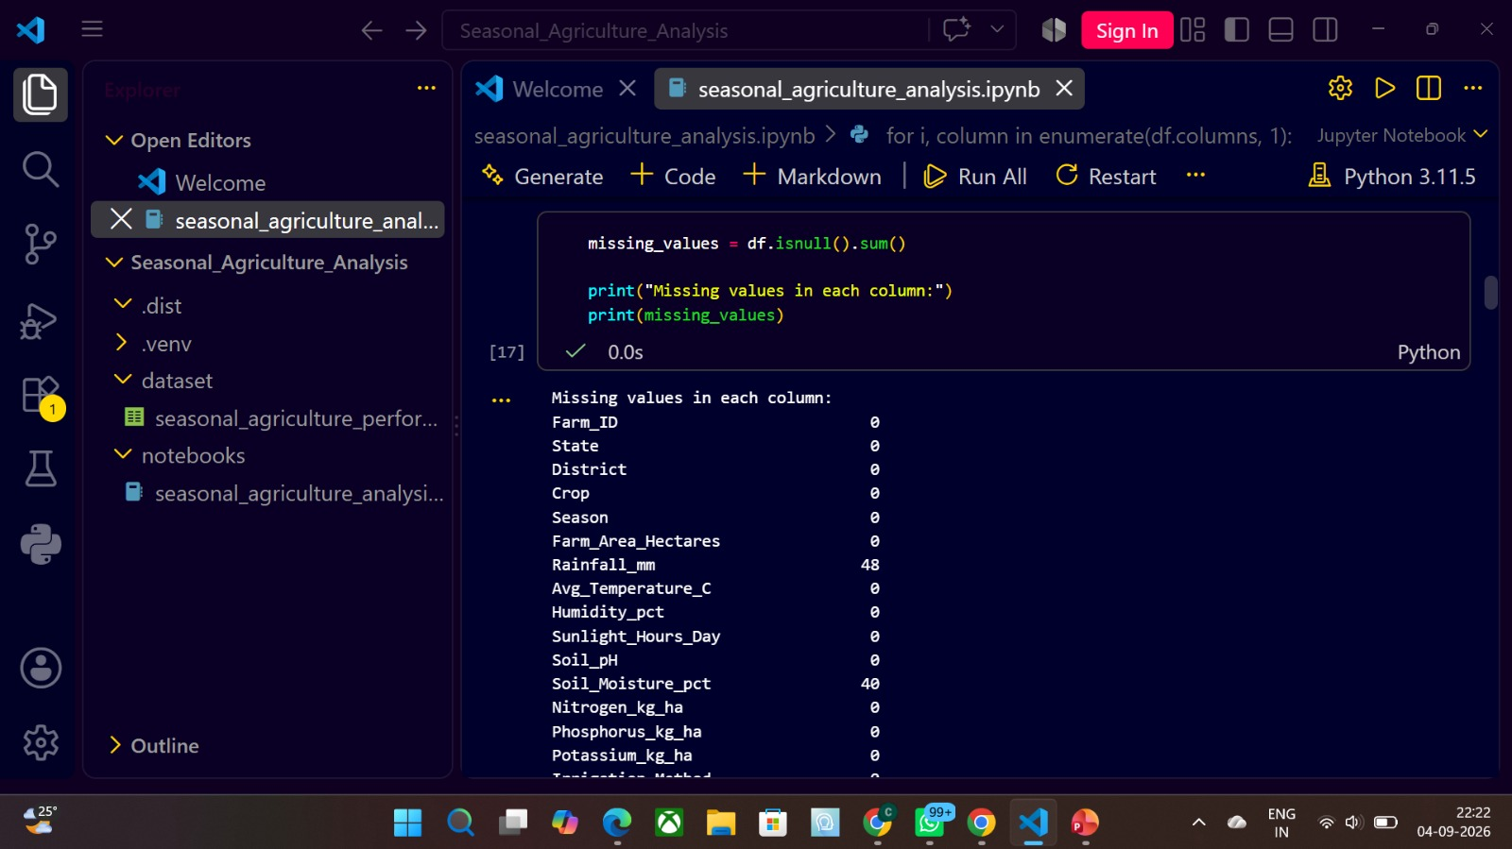
RESULTS

Slide 7
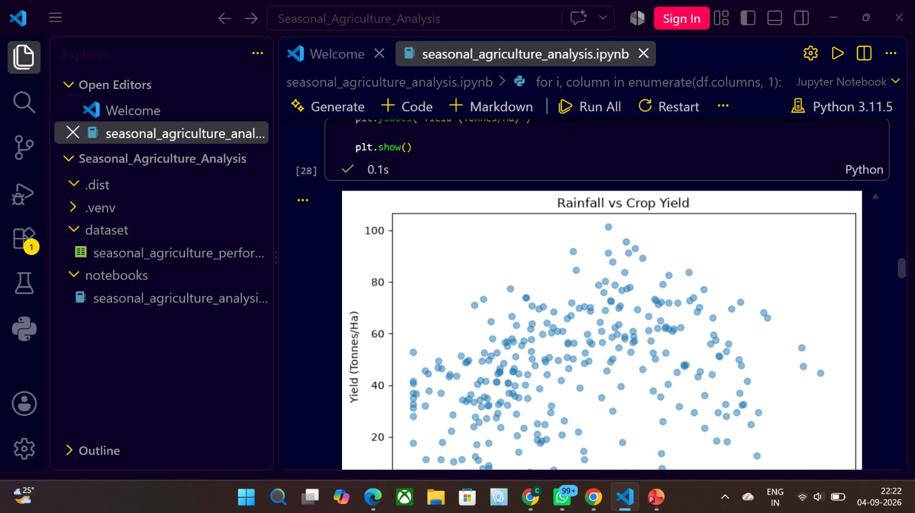
RESULTS

Slide 8
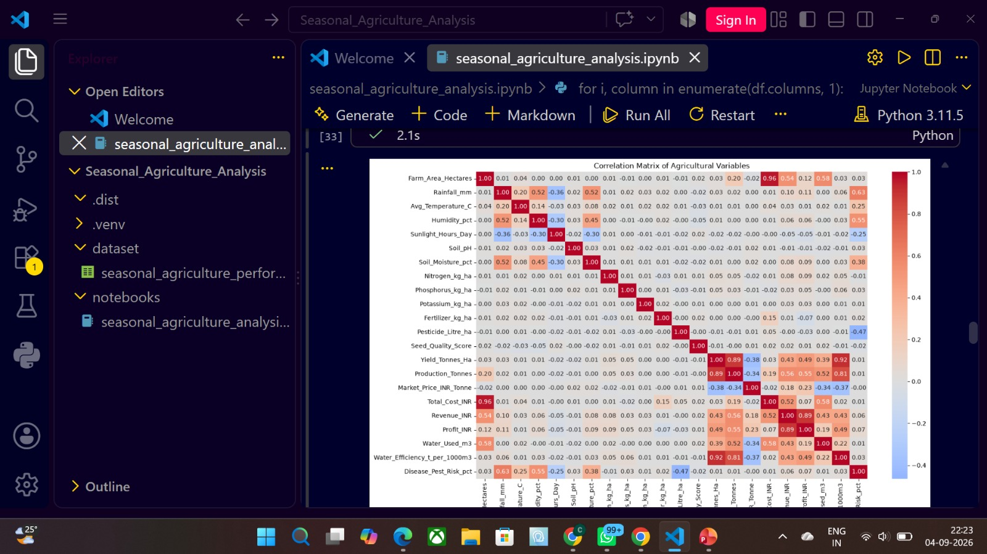
RESULTS
[A

Slide 9
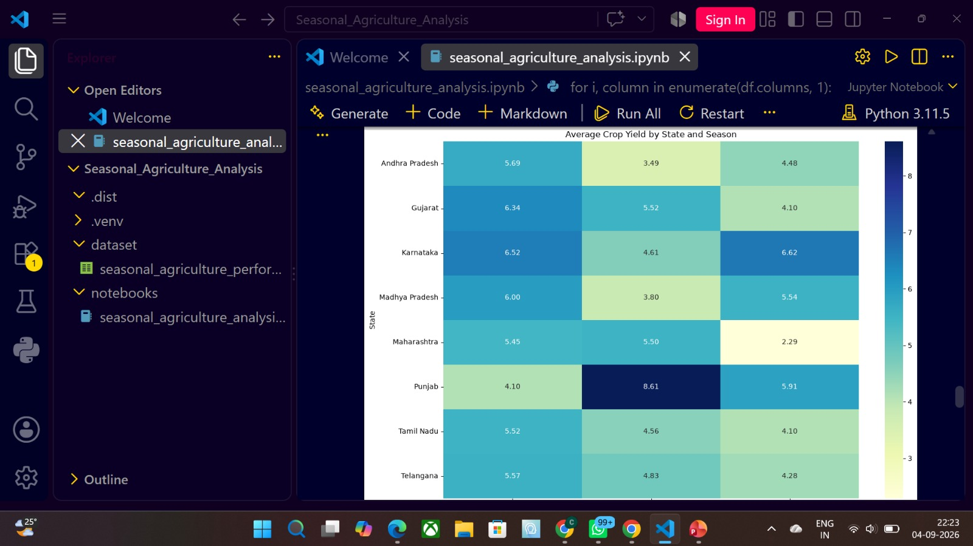
RESULTS
[

Slide 10
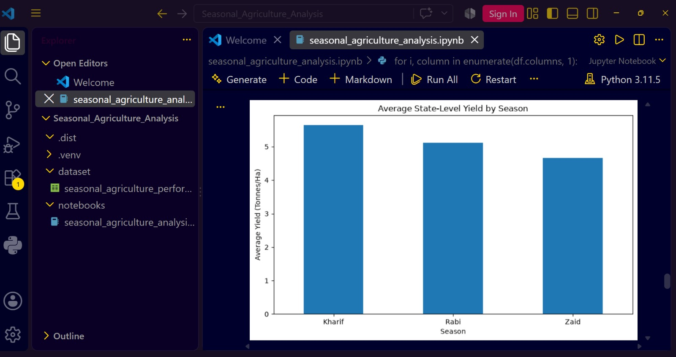
RESULTS
[

Slide 11
Future scope
Predictive Analysis:
Develop machine learning models to predict crop yield, revenue and profit for different seasons.
Weather-Based Prediction:
Integrate real-time weather data such as rainfall, temperature and humidity to improve seasonal performance analysis.
Crop Recommendation:
Recommend suitable crops based on season, soil conditions, weather and expected profitability.
Smart Irrigation:
Use water-usage and water-efficiency data to suggest efficient irrigation methods and reduce water wastage.
Disease & Pest Prediction:
Develop models to identify high-risk seasonal conditions and provide early warnings.
Regional Analysis:
Extend the analysis to compare agricultural performance across different states, districts and geographical regions.
Real-Time Dashboard:
Build an interactive dashboard for farmers and agricultural stakeholders to monitor seasonal performance and make data-driven decisions.

Slide 12
GitHub Link
https://github.com/manaswini8606-cpu/Seasonal-Agriculture-Performance-Analysis.git

Slide 13
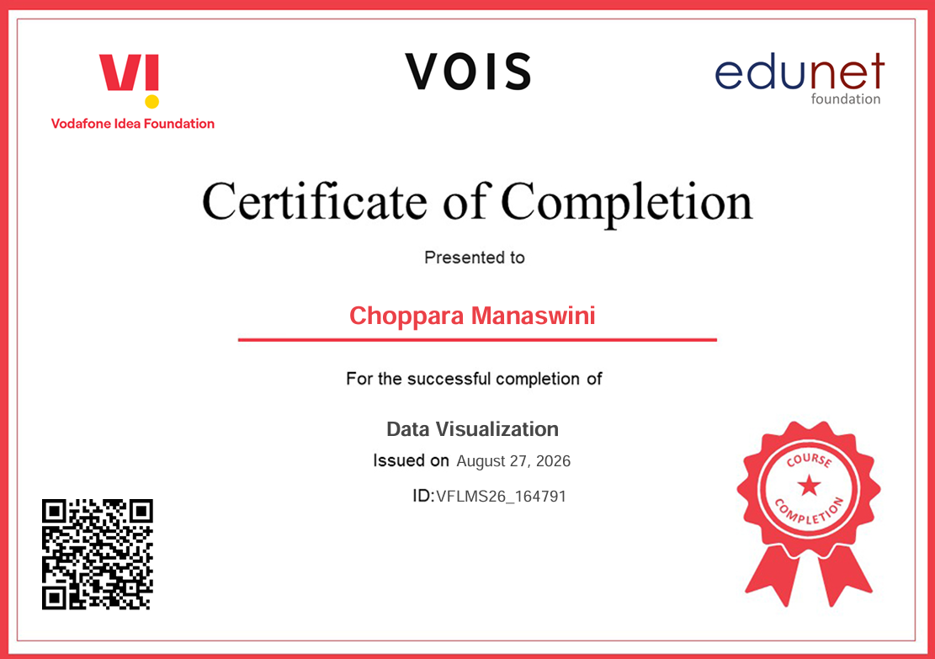
VOIS Course completion certificate Course name - Data Visualization

Slide 14
Thank you
.
.

