Slide 1

H1B Cases Analysis
-U.S.A a land of Opportunities
- Manaswini Vinnakota

Slide 2
Data Set
The data set is taken from www.kaggle.com.
The dataset has all the H1B cases ranging from the year 2011 to 2016.
The size of the data is 469mb
The series of dashboard will consider only Certified H1B cases.
Note: CERTIFIED does not mean the applicant got his/her H-1B visa approved, it just means that he/she is eligible to file an H-1B.

Slide 3
Content in Data set
Case status
Employer_name
Soc_name
Job_title
Full_time_position
Prevailing_wage
Year
Worksite
Lon
lat

Slide 4

Why tableau?
Tableau vs Excel? No, Tableau with Excel
Excel allows users to analyze data and perform calculations, while Tableau leverages visual analytics-- bringing with it a new way to interact with and analyze data.
Tableau users can visually interact with data to find insights faster, and make critical decisions that better serve customers, improve products, or even save lives.

Slide 5

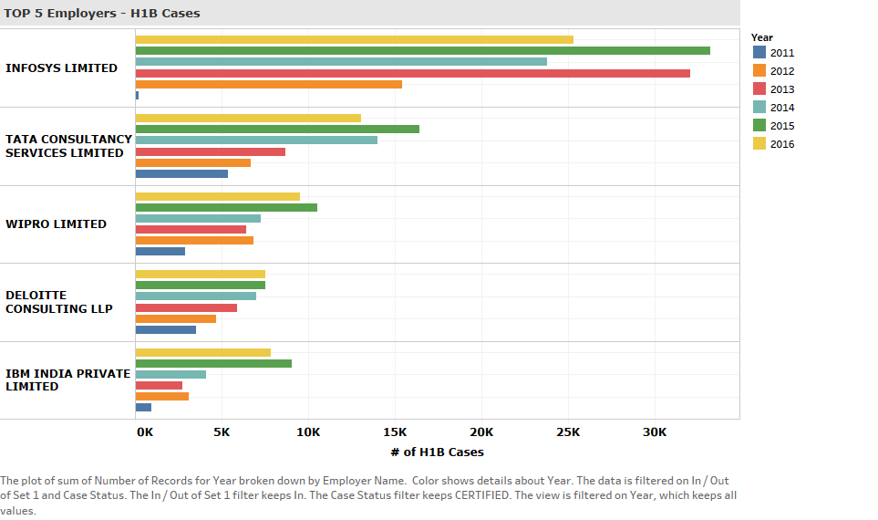
Top 5 employers-H1b cases from 2011-2016
Insight from this visualization is that Infosys is the top one to file h1 for employees from past 6 years
Also it is possible to analyze no. of records filed by different companies in different years

Slide 6
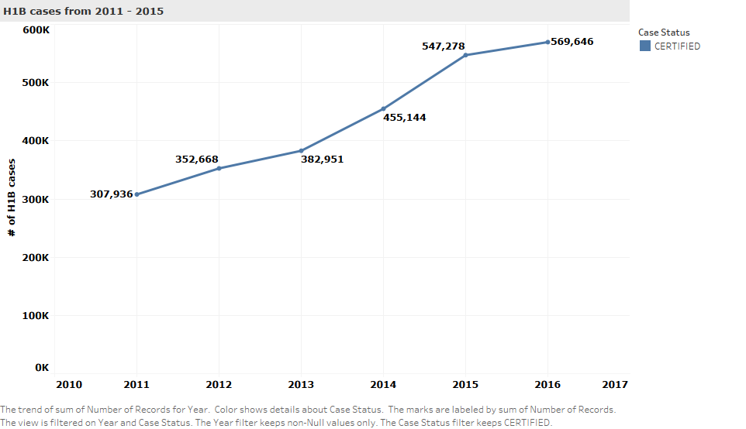
H1b cases from 2011-2015
Insight from this visualization is that number of records of h1b cases with case status certified has been increased
Also there is an tremendous increase from 2014-2015 than other years

Slide 7
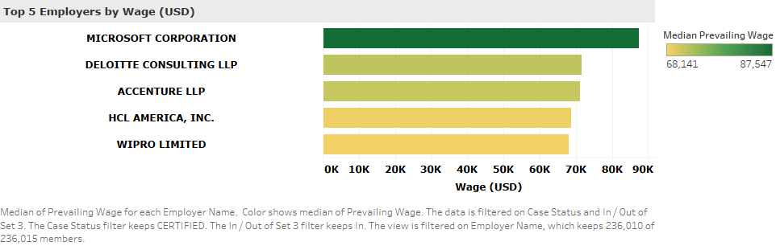
Top 5 employers by wage
Insight is that even though Infosys file more cases, Microsoft is top one employer with high wages for employees with median wage around 87k

Slide 8
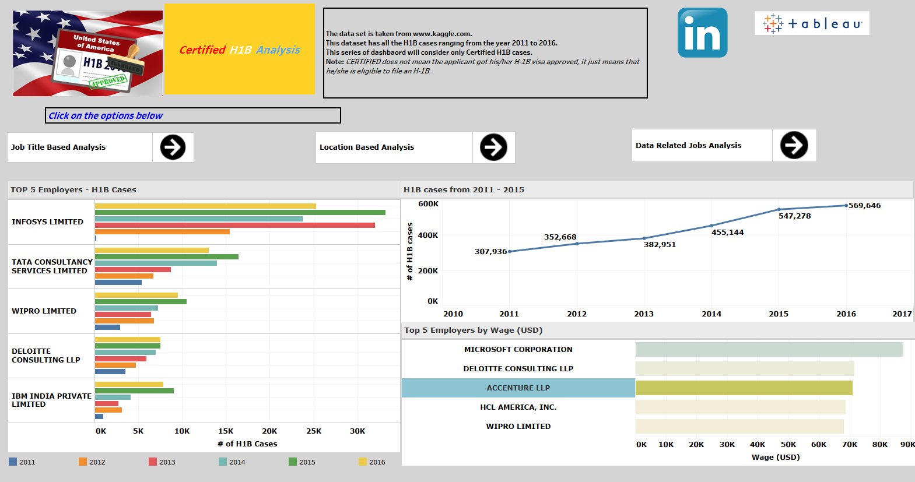
Dashboard-homepage
Interactive dashboard of all worksheets and images is built.

Slide 9
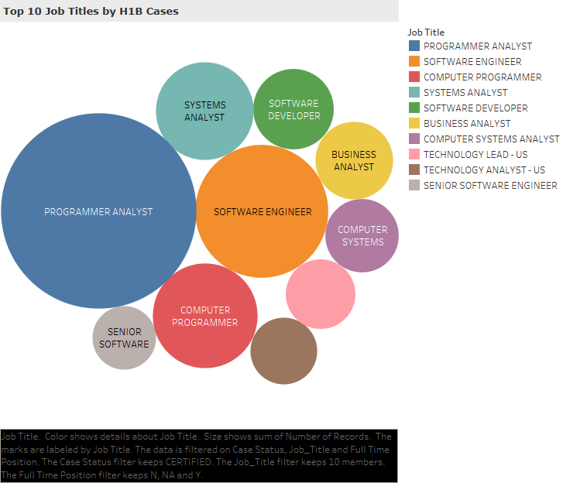
Top 10 job titles by h1b cases
Insight from the bubble chart is that highest number of h1b cases are filed for employees with programmer analyst followed by software engineer by different employers.
Top 10 job titles are retrieved by designing a set job_title on field Job Title and size of bubble shows sum of number of records.

Slide 10
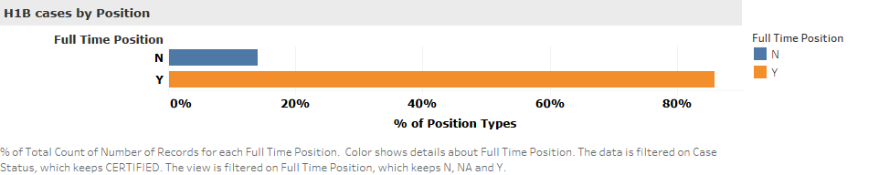
H1b cases by position
Insight from the visualization is that % of total count of number of records for full-time position type is highest when compared to other types.
The data is filtered on case status-certified.

Slide 11
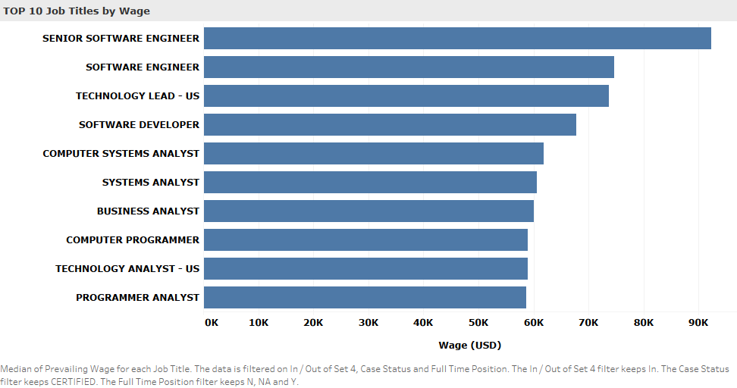
Top 10 job titles by wage
Insight from this horizontal bar chart is that even though cases with job title programmer analyst are high, but senior software engineer employees get highest prevailing wage.
The data is filtered on set 4 created on job title field limited to 10 by the count of number of records

Slide 12


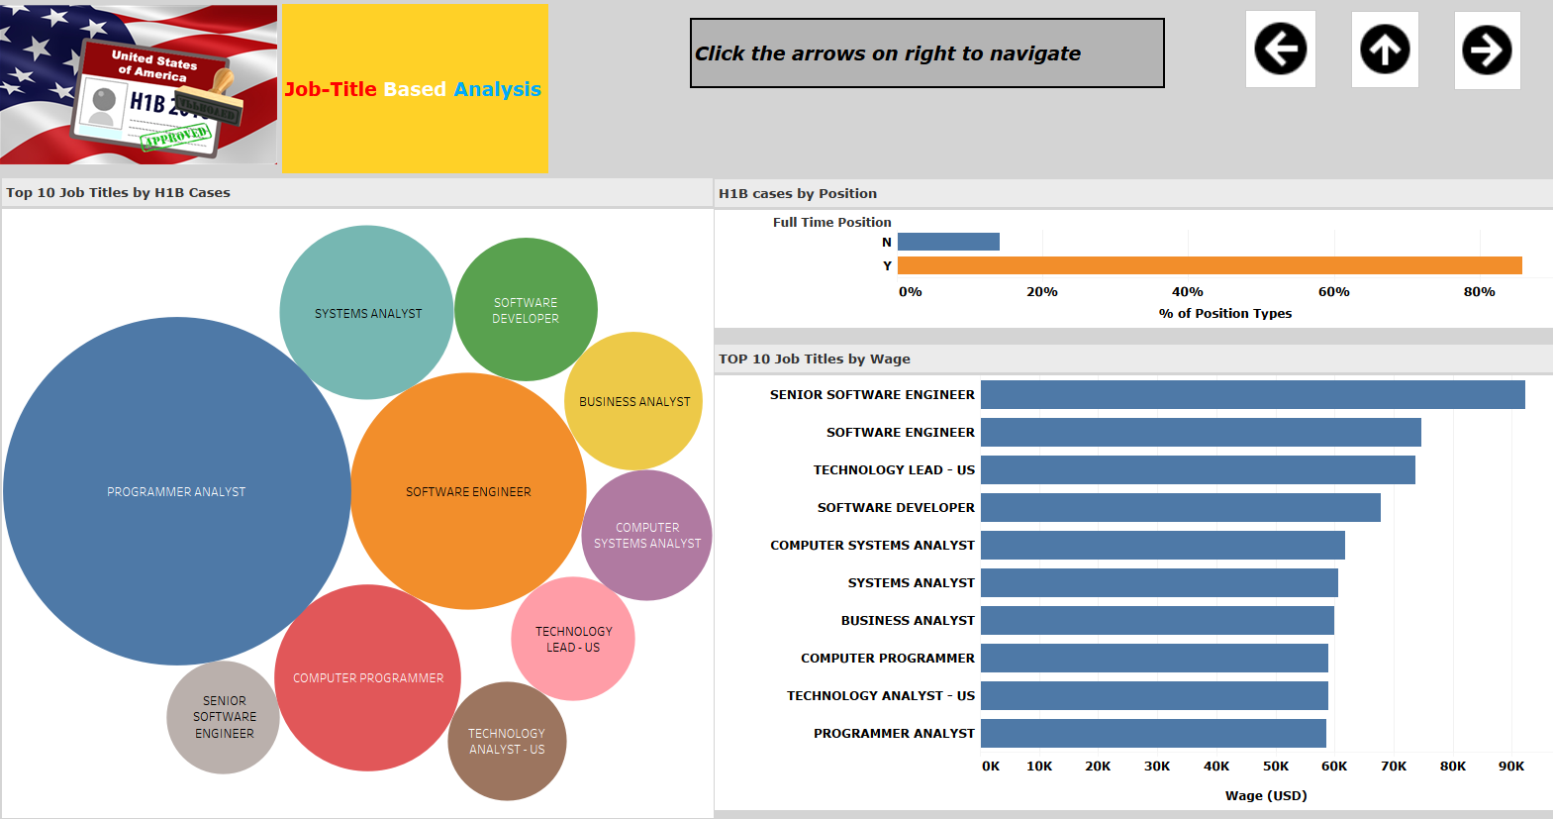
Dashboard- analysis 1
Interactive dashboard of all worksheets and images is built

Slide 13
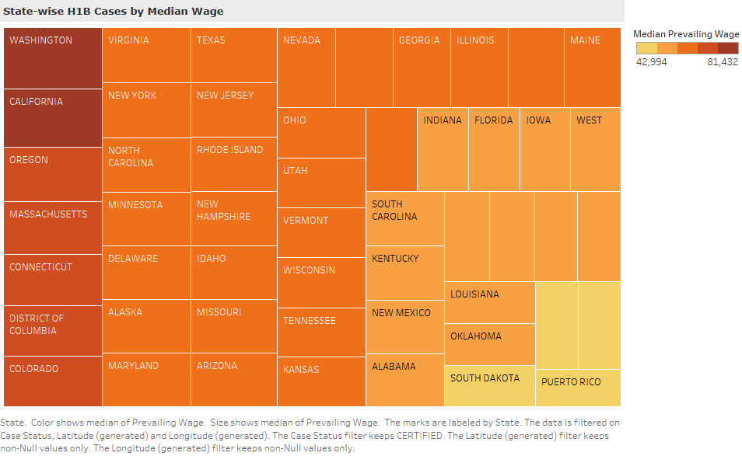
State wise h1b cases by median wage
Insight from this visualization is that Washington state has highest median prevailing wage, showed by color and size, with marks labeled by state field.
The data is filtered on case status keeping certified records, latitude and longitude keeping non-nullvalues.

Slide 14
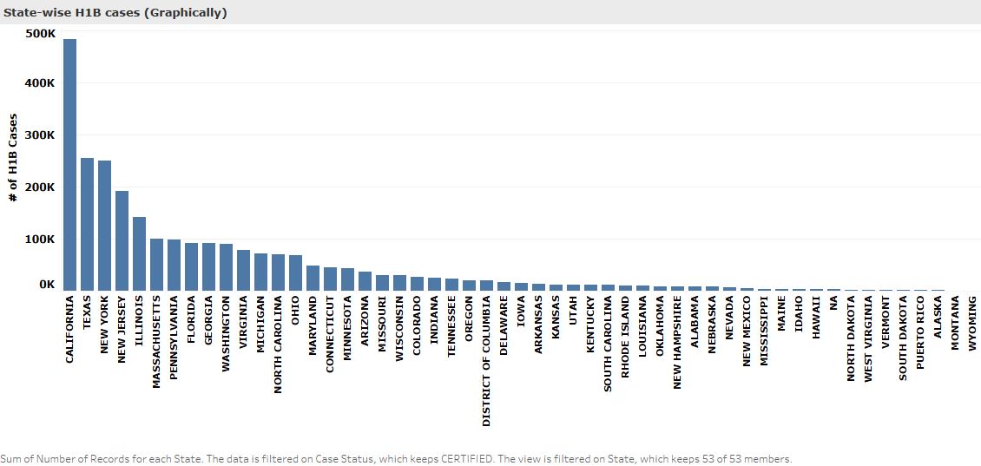
State-wise h1b cases
Insight from graph is that California state files highest number of h1b cases for all employers in all years
Data is filtered on case status keeping certified and views all 53 states

Slide 15
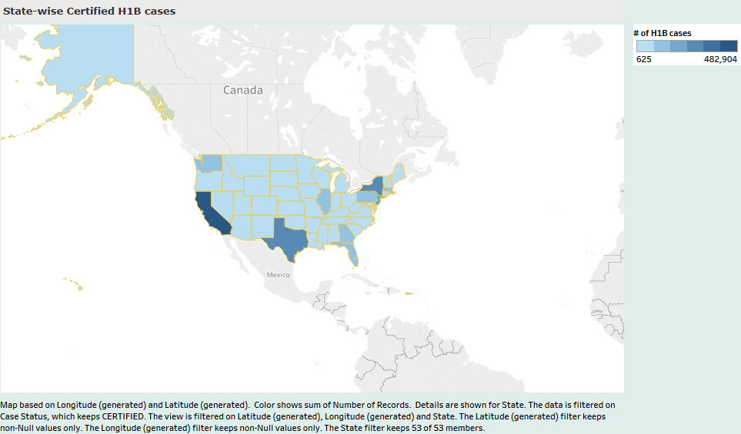
State wise certified h1b cases
Map view based on latitude and longitude, state and case status keeping certified

Slide 16
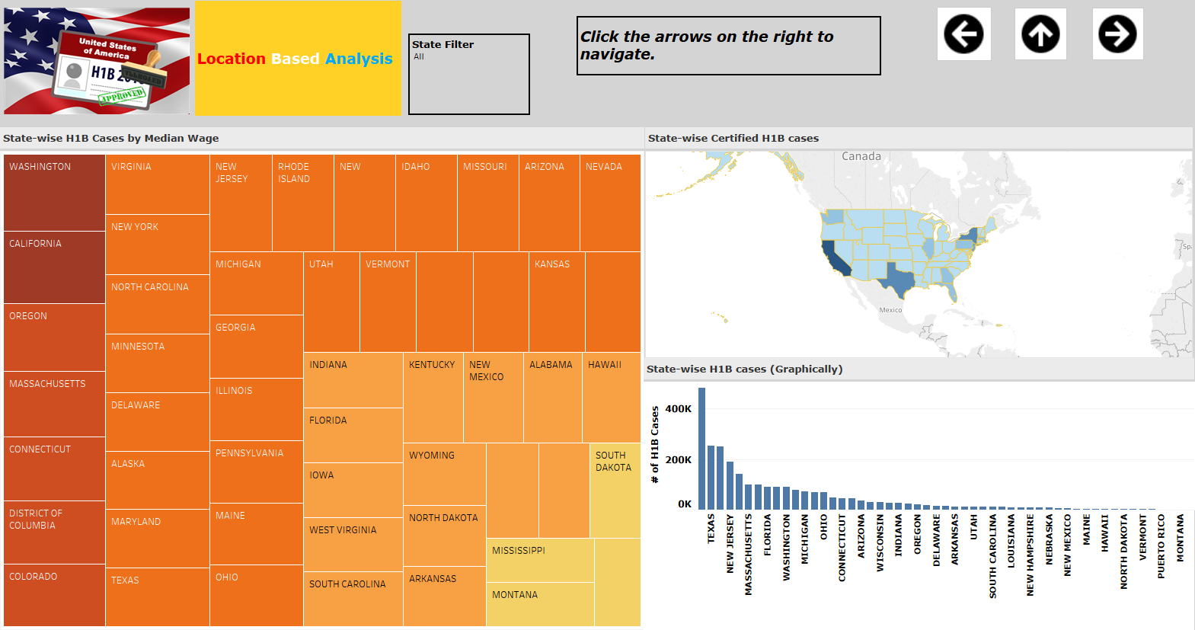
Dashboard- analysis 2
Interactive dashboard of all worksheets and images is built.

Slide 17
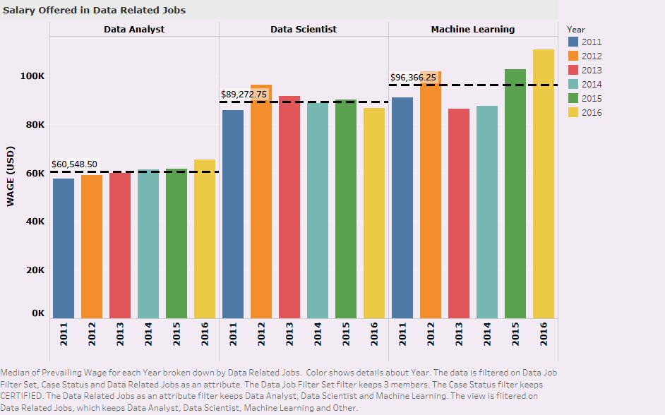
Salary offered in data jobs
Insight from the bar chart is that the median prevailing wage for machine learning related jobs is highest among data related jobs followed by data scientist and data analyst
Data is filtered on data job filter set, case status and data related jobs as an attribute

Slide 18
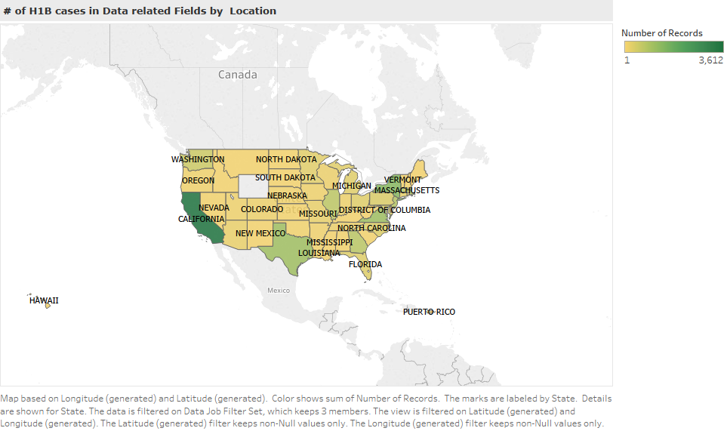
Location based H1B cases in Data jobs
Insight from the map view is that California state has highest number of records in data related jobs
Data is filtered on data job filter set. View is filtered on latitude and longitude. Marks are labeled by state.

Slide 19
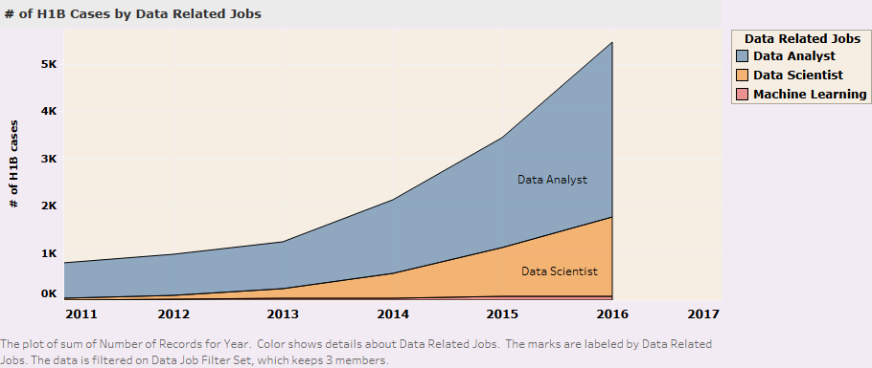
No. of h1b cases by data related jobs
Insight from the visualization is that data analyst jobs file highest h1b cases over other data related jobs.
Total number of cases by data jobs increases gradually from 2011-2016
Data is filtered on data job filter set

Slide 20
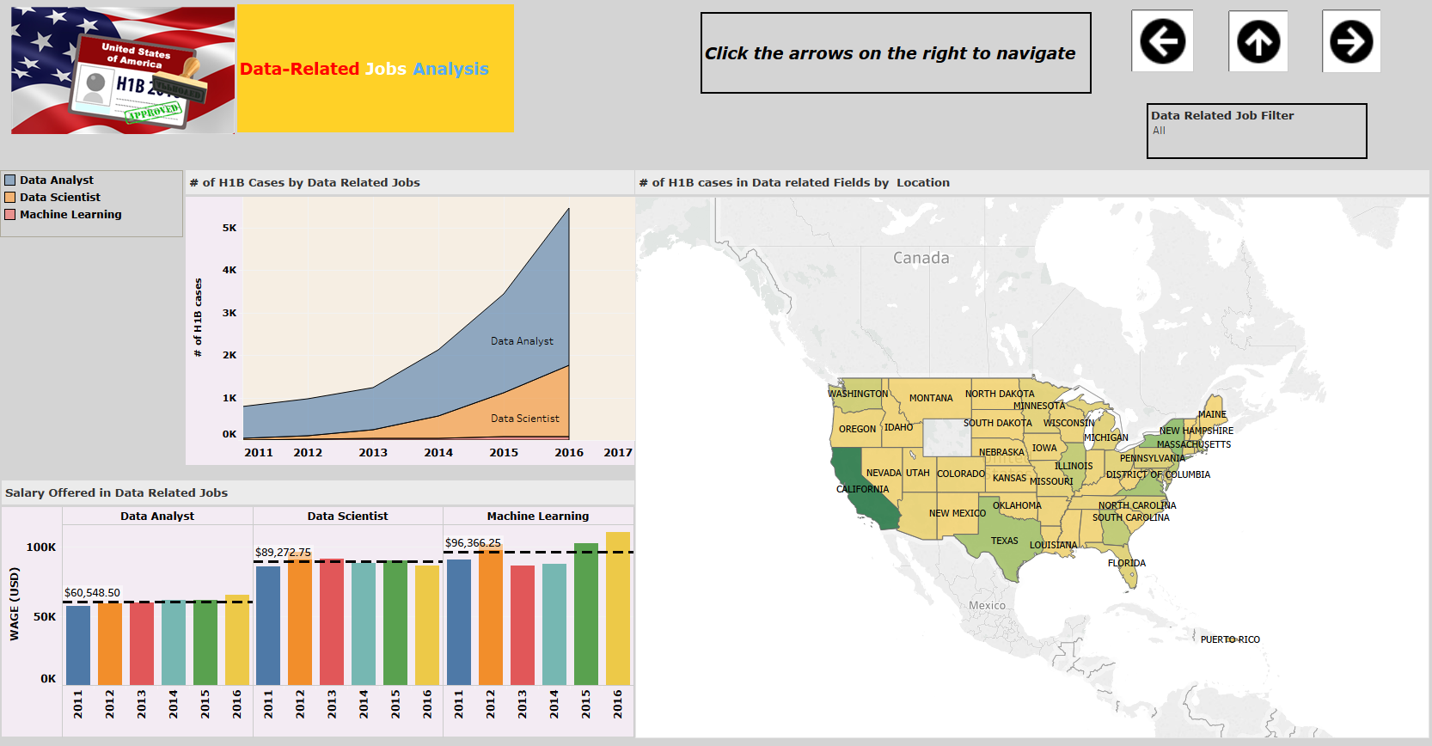
Dashboard- analysis 3 interactive dashboard of all worksheets and images is built.

Slide 21
sharing
Workbook built is uploaded in to tableau public profile and can be shared on to social media or code to embed in a web page
Link to public:
https://public.tableau.com/views/h1bcasesanalysis-usaalandofopportunities_0/homepage?:embed=y&:display_count=yes&publish=yes
SAMPLE USE CASES :
Is the number of petitions with Data analyst job title increasing over time?
Which part of the US has the most Hardware Engineer jobs?
Which industry has the most number of Data Scientist positions?
Which employers file the most petitions each year?

Slide 22


