Slide 1


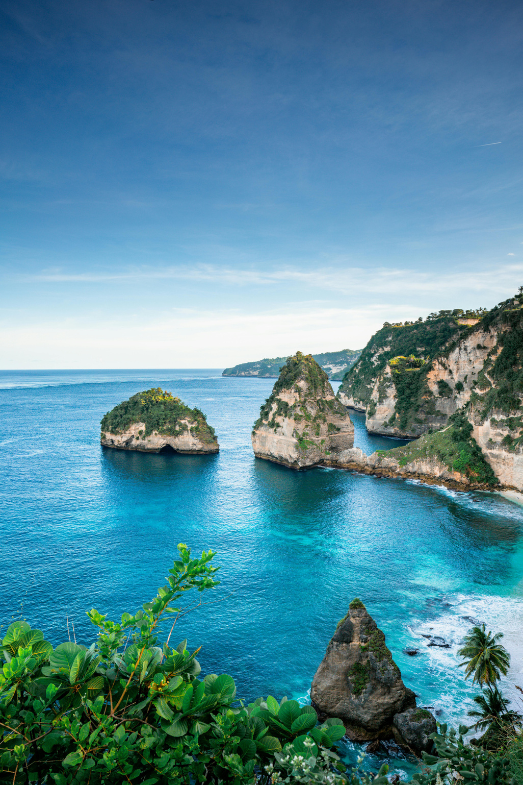
TRIP-SENSE:
DYNAMIC TRAVEL PLANNER USING NLP & HYBRID MACHINE LEARNING MODELS
Travel Presentation
2025

Slide 2

Introduction
What is TRIP-Sense?
TRIP-Sense - short for Travel Recommendation & Intelligent Planning - is an AI-driven travel companion that designs trips dynamically based on user preferences, budget, and real-time context. It doesn’t just list places - it learns the traveler. The “Sense” represents awareness - understanding your interests, weather, and surroundings to adapt plans intelligently.

Slide 3

The Idea
We’re building a smart ecosystem that learns what kind of traveler you are - food lover, explorer, peace seeker, or thrill hunter. Using Machine Learning, Natural Language Processing, and Live APIs, TRIP-Sense reacts to real-world conditions - recommending where to go, what to do, and when to do it.

Slide 4

Main Components
1. Machine Learning (Recommendations)
Hybrid model = Collaborative + Content-Based Filtering
Algorithms: SVD, KNN, Hybrid Stacking
2. Natural Language Processing (Understanding Layer)
Understands sentences like “Plan a relaxing 3-day trip near the
hills.” Performs sentiment analysis on reviews and queries.
3. Geo-Location & Real-Time Intelligence
Pulls live data from Google Maps, OpenWeather, and Eventbrite.
Adapts automatically — if it rains, suggests indoor spots.
4. Itinerary Optimization
Uses Dijkstra / A* algorithms for best routes and cost-time
balance.
5. Visualization & UI
Interactive maps and dashboards built with Streamlit, Plotly, and
Folium.

Slide 5

User enters preferences (budget, duration, interests).
NLP module builds structured profile.
ML engine ranks suitable destinations.
Itinerary Builder creates day-wise plan.
Real-time APIs update live conditions.
Dashboard displays final plan interactively.
System Flow

Slide 6


Techniques & Tools
Machine Learning: scikit-learn, pandas, numpy
NLP: spaCy, NLTK, Transformers
UI: Streamlit, Plotly, Folium
APIs: Google Maps, OpenWeather, Eventbrite
Database: SQLite
Frontend (optional): HTML

Slide 7




Advancements & Difference
Existing Systems
TRIP-Sense Adds
Static recommendations, limited personalization, no real-time response.
Real-time adaptive itineraries
Hybrid ML for deep personalization
Sentiment-based review insights
Interactive map dashboards
Focus on Indian travel datasets

Slide 8



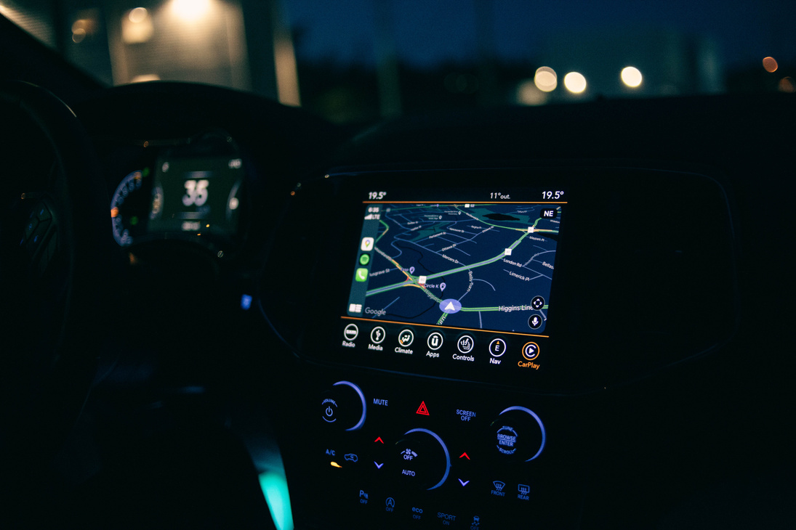
Example Case
User says:
“Plan a 3-day Goa trip under ₹20k. I love beaches and food.”
TRIP-Sense:
Learns user preferences
Suggests beaches, cafés, and local events
Builds day-wise plan with routes and costs
Adapts live to weather or timing changes
Displays interactive map dashboard

Slide 9

Summary
TRIP-Sense combines:
Machine Learning precision
NLP understanding
Real-time context awareness
to create a travel companion that plans, senses, and evolves with every journey. Not just where to go, but what makes sense for you.
TRIP-Sense doesn’t plan your trip - it understands your journey

Slide 10

Guide
Dr. K. Chaitanya
Our Team
Manaswi Priya Maddu
Praneetha Gorli
Pavan Kumar Bora
Hari Krishna Neerasa

Slide 11

THANK YOU

