Slide 1
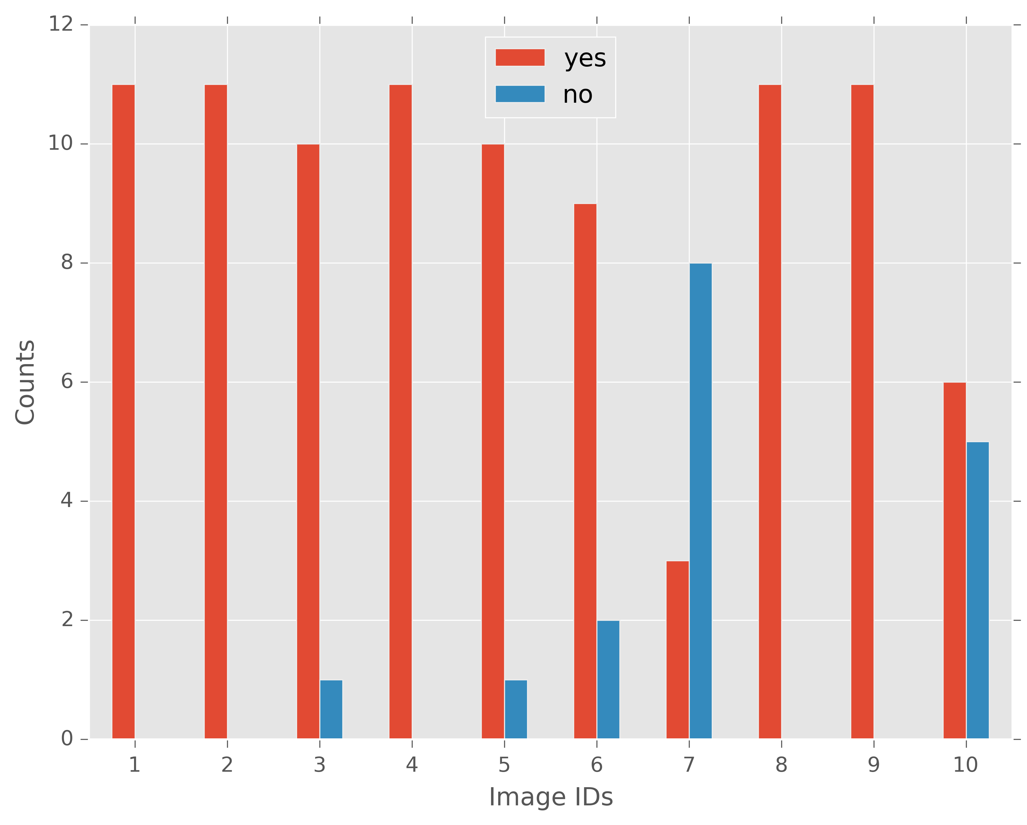
Incorrect
Prediction

