Slide 1
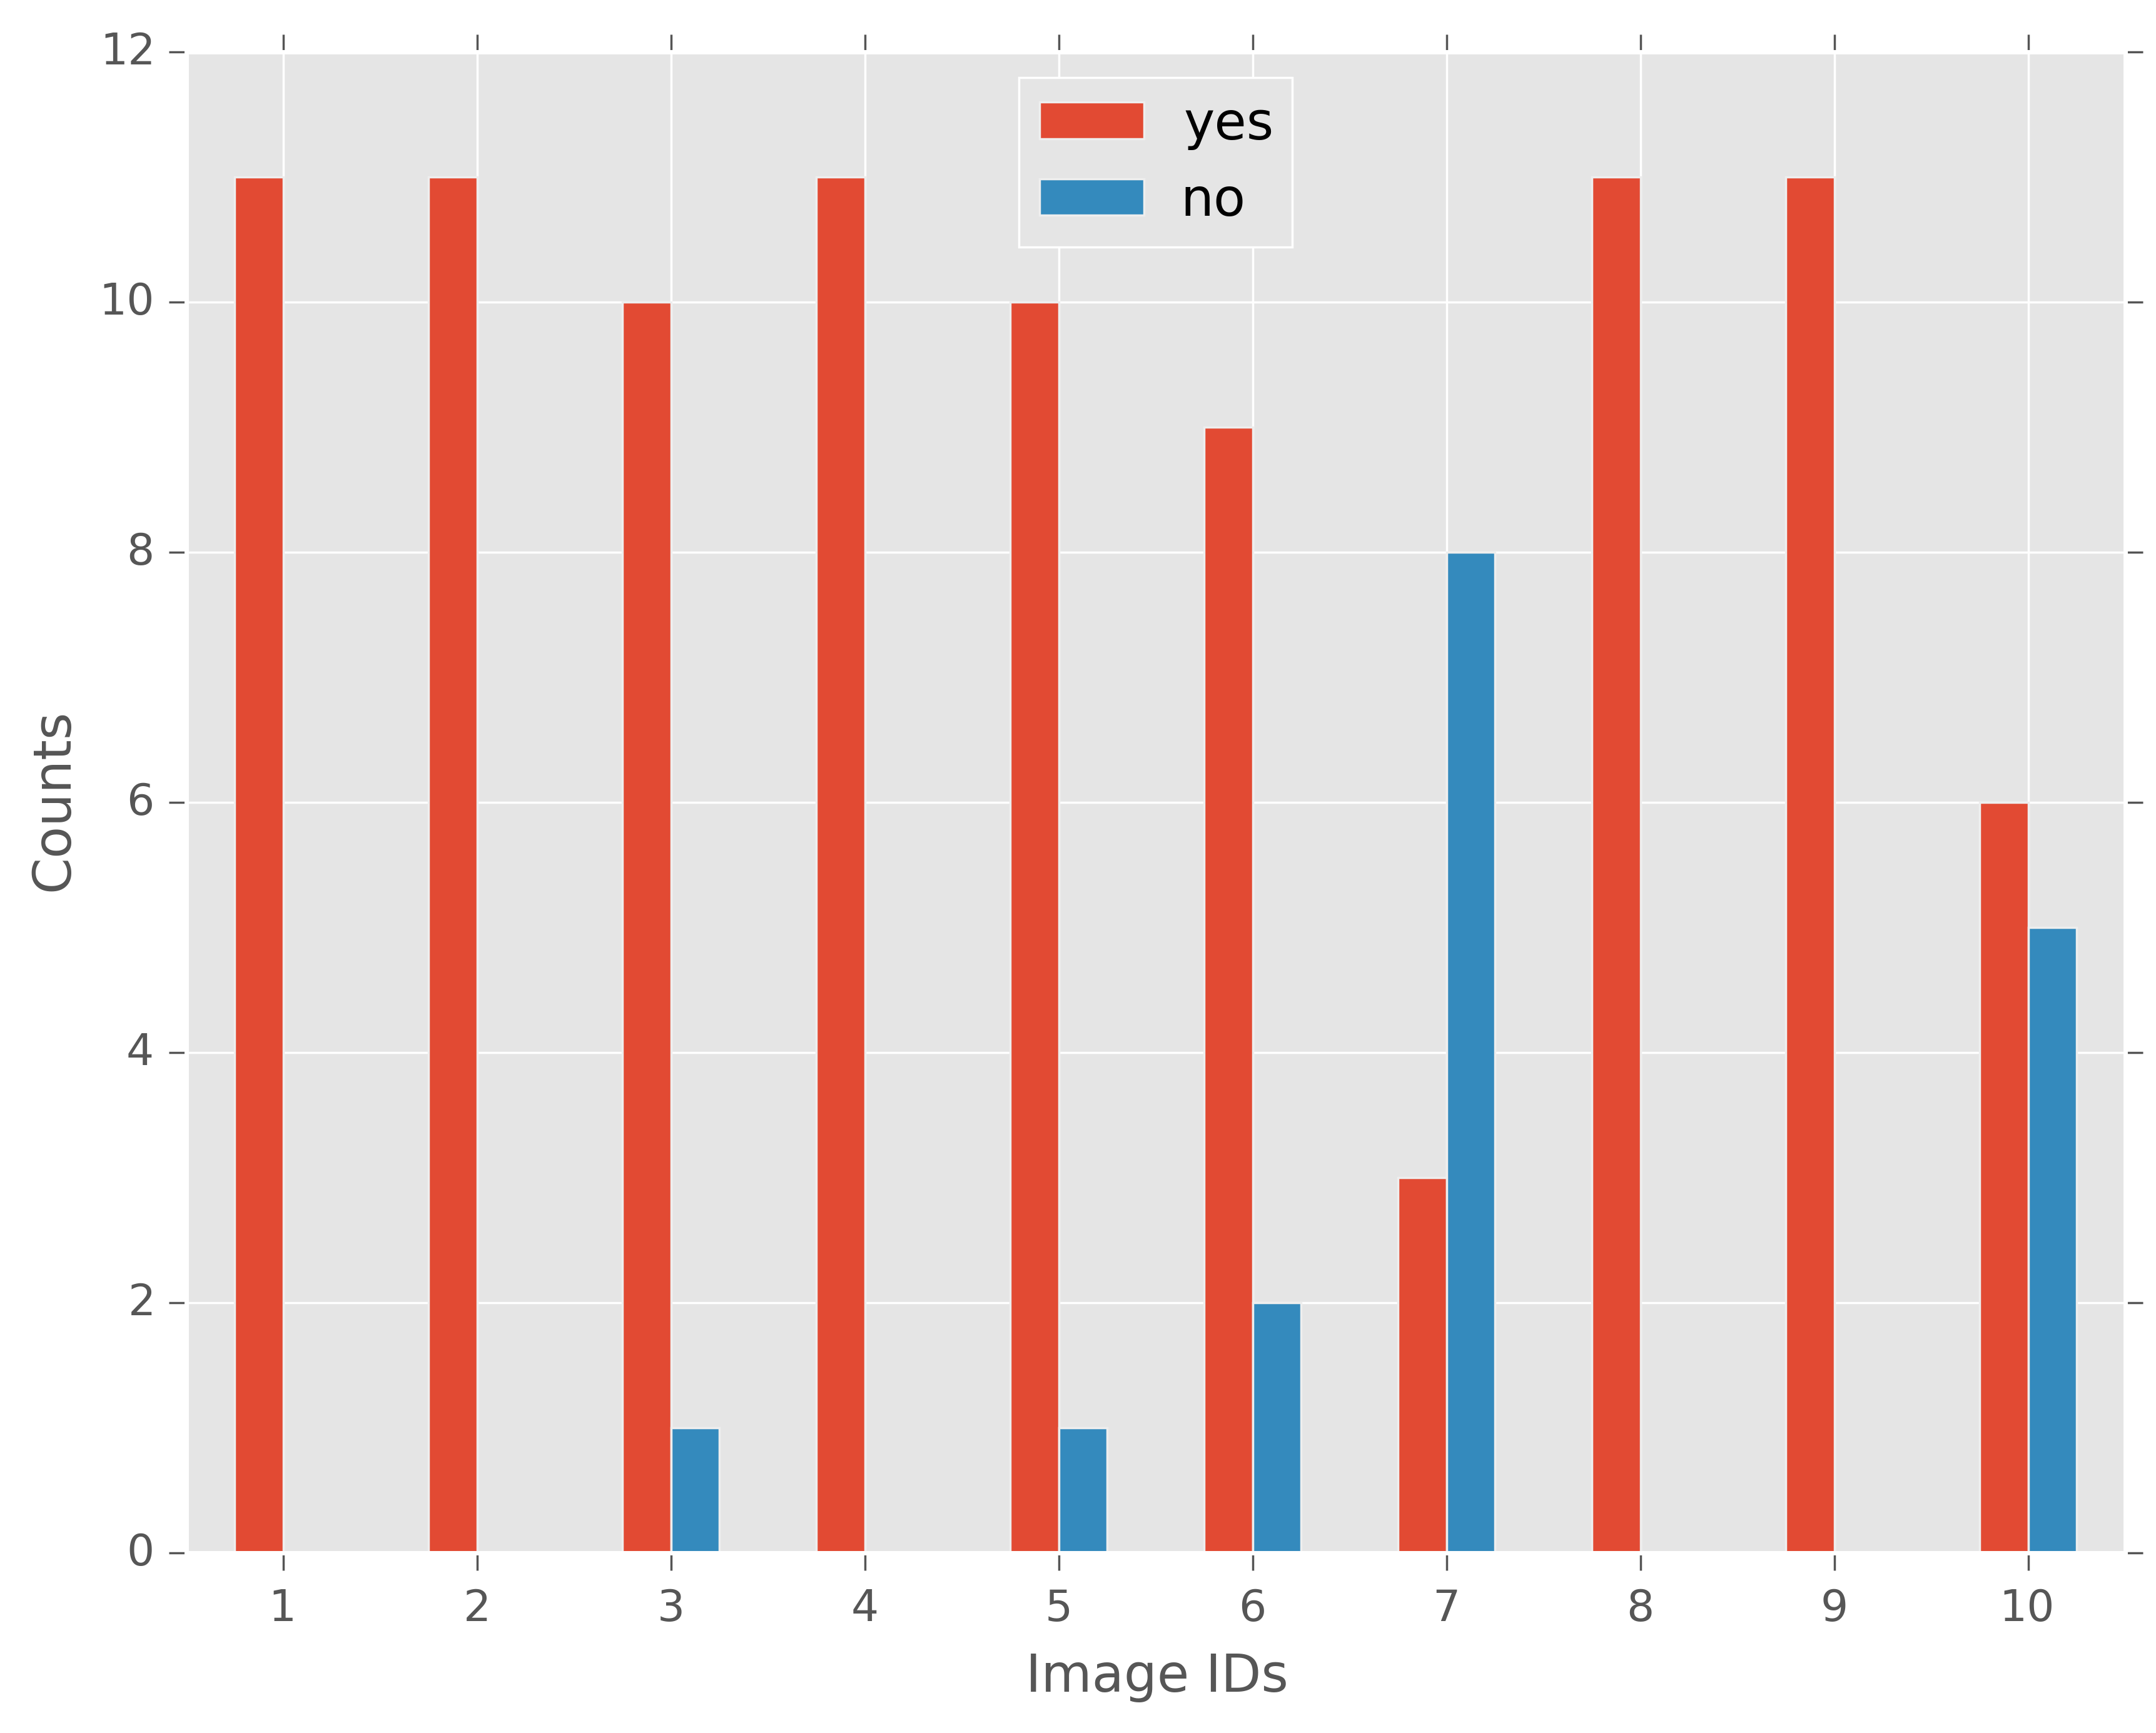
Incorrect
Prediction

Slide 2
Counts
Counts

Slide 3
Counts
Counts

Slide 4
