Slide 1
FFT, DFT, NTT and Karatsuba algorithms’ applications and uses
106119071- Manav Mohata
106119117- Sobhagya Singh Dewal
106119121- Sailesh S

Slide 2
Applications and uses:
Polynomial Multiplication
String Matching
String Matching with wildcards
All possible sums pair of elements in two arrays
All possible scalar products of two arrays

Slide 3
Problem 1:
Problem statement:
Multiply two n-degree polynomials
Given two polynomials a(x) and b(x),
a(x)=a₀x⁰ + a₁x¹+ a₂x²…+a_{n}x^{n}
b(x)=b₀x⁰ + b₁x¹+ b₂x²…+b_{n}x^{n}
We need to calculate C(x), where
C(x)=a(x)*b(x)

Slide 4
Polynomial Multiplication (Naïve Method)
Usually, for multiplying 2 polynomials of degree(n), we need to run a loop for each degree, so it would lead to time complexity O(n2)
A(x)=a₀x⁰ + a₁x¹+ a₂x²…+a_{n}x^{n}
B(x)=b₀x⁰ + b₁x¹+ b₂x²…+b_{n}x^{n}
C(x) = A(x)*B(x)
=ΣA[i]B[j]x^{k} for i+j=k

Slide 5
Polynomials
In general,
Eg:

Slide 6
Polynomial Evaluation
Horner’s Rule:
Given coefficients (a₀,a₁,a₂,…,a_{n-1}), defining polynomial
Given x, we can evaluate p(x) in O(n) time using the equation
Eval(A,x): [Where A=(a₀,a₁,a₂,…,a_{n-1})]
If n=1, then return a₀
Else,
Let A’=(a₁,a₂,…,a_{n-1}) [assume this can be done in constant time]
return a₀+x*Eval(A’,x)

Slide 7
Polynomial Multiplication Problem
Given coefficients (a₀,a₁,a₂,…,a_{n-1}) and (b₀,b₁,b₂,…,b_{n-1}) defining two polynomials, p() and q(), and number x, compute p(x)q(x).
Horner’s rule doesn’t help, since
Where,
A straightforward evaluation would take O(n²) time. The “magical” FFT will do it in O(n log n) time.

Slide 8
Karatsuba Algorithm:
In this algo, we split the array in two parts and calculate the results of the parts recursively and combine them to form the required answer. A(x) = a₀ + a₁x¹ + a₂x² + ... + a_{n/2-1}x^{n/2-1} + x^{n/2}(a_{n/2} + a_{n/2+1}x + ... + a_{n/2-1}x^{(n/2-1)}) B(x) = b₀ + b₁x¹ + b₂x² + … + b_{n/2}x^{n/2-1} + x^{n/2}(b_{n/2} + b_{n/2+1}x + … + b_{n/2-1}x^{(n/2-1)})
We can solve the answers for the two subproblems recursively, A_{x} = A_{r} + A_{l}*x^{n/2} B_{x} = B_{r} + B_{l}*x^{n/2} Product = A_{x}*B_{x} = (A_{r} + A_{l}*x^{n/2}) * (B_{r} + B_{l}*x^{n/2}) = x^{n}A_{l}B_{l} + x^{n/2}((A_{l}+A_{r})(B_{l}+B_{r}) - A_{l}B_{l} – A_{r}B_{r}) + A_{r}B_{r} In this expression to compute the product we need to find the answer for three polynomial multiplications of polynomials of size n/2. The base case is for polynomial of size 1 (degree 0), the value will be A[0] * B[0]. The recurrence is T(n) = 3*T(n/2) + O(n).By master's theorem T(n) = n^{log}₂³

Slide 9
Polynomial Interpolation & Polynomial Multiplication
Given a set of n points in the plane with distinct x-coordinates, there is exactly one (n-1)-degree polynomial going through all these points.
Alternate approach to computing p(x)q(x):
Calculate p() on 2n x-values, x₀,x₁,…,x_{2n-1}.
Calculate q() on the same 2n x values.
Find the (2n-1)-degree polynomial that goes through the points {(x₀,p(x₀)q(x₀)), (x₁,p(x₁)q(x₁)), …, (x_{2n-1},p(x_{2n-1})q(x_{2n-1}))}.
Unfortunately, a straightforward evaluation would still take O(n²) time, as we would need to apply an O(n)-time Horner’s Rule evaluation to 2n different points.
The “magical” FFT will do it in O(n log n) time, by picking 2n points that are easy to evaluate…

Slide 10
Primitive Roots of Unity
A number ω is a primitive n-th root of unity, for n>1, if
ω^{n} = 1
The numbers 1, ω, ω², …, ω^{n-1} are all distinct
Example 1:
Z*₁₁:
2, 6, 7, 8 are 10-th roots of unity in Z*₁₁
2²=4, 6²=3, 7²=5, 8²=9 are 5-th roots of unity in Z*₁₁
2⁻¹=6, 3⁻¹=4, 4⁻¹=3, 5⁻¹=9, 6⁻¹=2, 7⁻¹=8, 8⁻¹=7, 9⁻¹=5
Example 2: The complex number e^{2πi/n} is a primitive n-th root of unity, where

Slide 11
Properties of Primitive Roots of Unity
Inverse Property: If ω is a primitive root of unity, then ω ⁻¹=ω^{n-1}
Proof: ωω^{n-1}=ω^{n}=1
Cancellation Property: For non-zero -n<k<n,
Proof:
Reduction Property: If w is a primitve (2n)-th root of unity, then ω² is a primitive n-th root of unity.
Proof: If 1,ω,ω²,…,ω^{2n-1} are all distinct, so are 1,ω²,(ω²)²,…,(ω²)^{n-1}
Reflective Property: If n is even, then ω^{n/2} = -1.
Proof: By the cancellation property, for k=n/2:
Corollary: ω^{k+n/2}= -ω^{k}.

Slide 12
The Discrete Fourier Transform
Given coefficients (a₀,a₁,a₂,…,a_{n-1}) for an (n-1)-degree polynomial p(x)
The Discrete Fourier Transform is to evaluate p at the values
1,ω,ω²,…,ω^{n-1}
We produce (y₀,y₁,y₂,…,y_{n-1}), where y_{j}=p(ω^{j})
That is,
Matrix form: y=Fa, where F[i,j]=ω^{ij}.
The Inverse Discrete Fourier Transform recovers the coefficients of an (n-1)-degree polynomial given its values at 1,ω,ω²,…,ω^{n-1}
Matrix form: a=F ⁻¹y, where F ⁻¹[i,j]=ω^{-ij}/n.

Slide 13
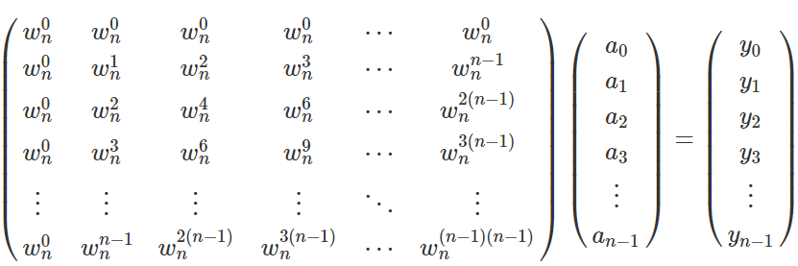
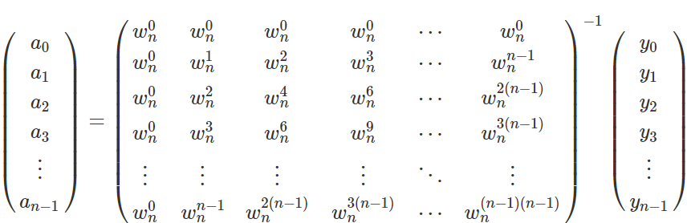
:
We can write the DFT, according to its definition, in the matrix form:
This matrix is called the Vandermonde matrix.
Thus we can compute the vector (a0,a1,…,an−1)(a0,a1,…,an−1) by multiplying the vector (y0,y1,…yn−1)(y0,y1,…yn−1) from the left with the inverse of the matrix

Slide 14
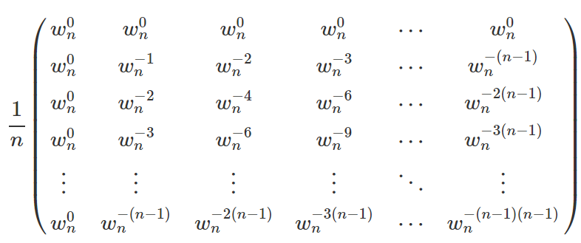
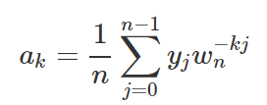
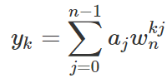
A quick check can verify that the inverse of the matrix has the following form:
Thus we obtain the for:
Comparing this to the formula for y_{k},

Slide 15
Correctness of the inverse DFT
The DFT and inverse DFT really are inverse operations
Proof: Let A=F ⁻¹F. We want to show that A=I, where
If i=j, then
If i and j are different, then

Slide 16
Convolution
The DFT and the inverse DFT can be used to multiply two polynomials
So we can get the coefficients of the product polynomial quickly if we can compute the DFT (and its inverse) quickly…

Slide 17

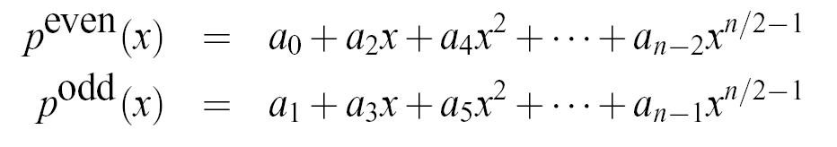

The Fast Fourier Transform
The FFT is an efficient algorithm for computing the DFT
The FFT is based on the divide-and-conquer paradigm:
If n is even, we can divide a polynomial
into two polynomials
and we can write

Slide 18
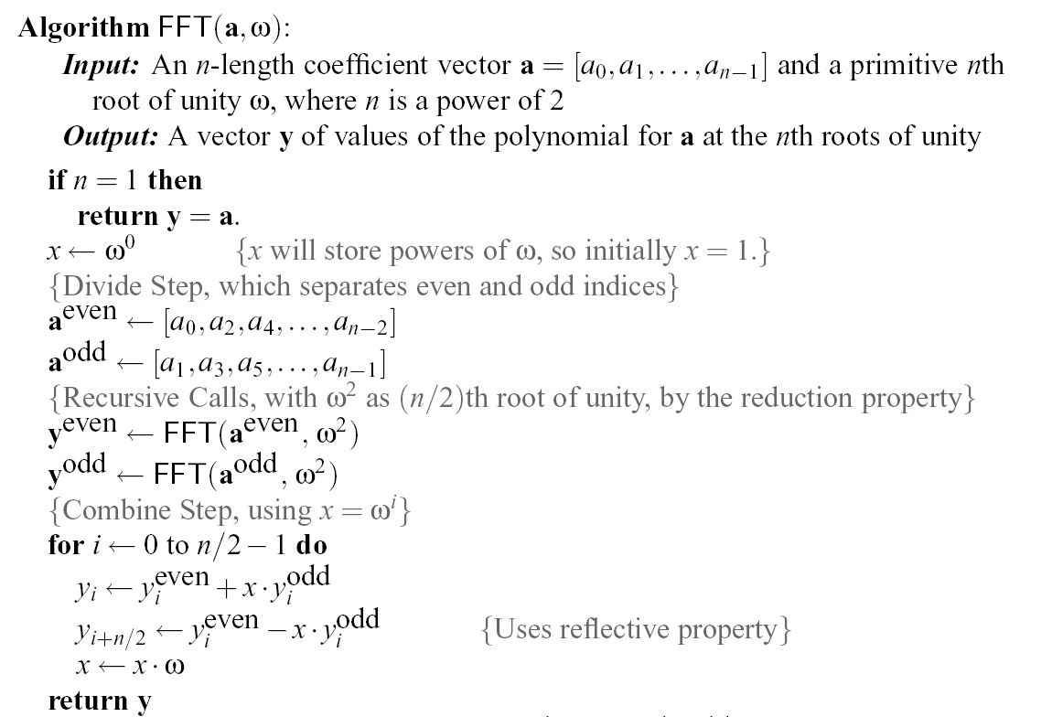
The FFT Algorithm
The running time is O(n log n). [inverse FFT is similar]

Slide 19
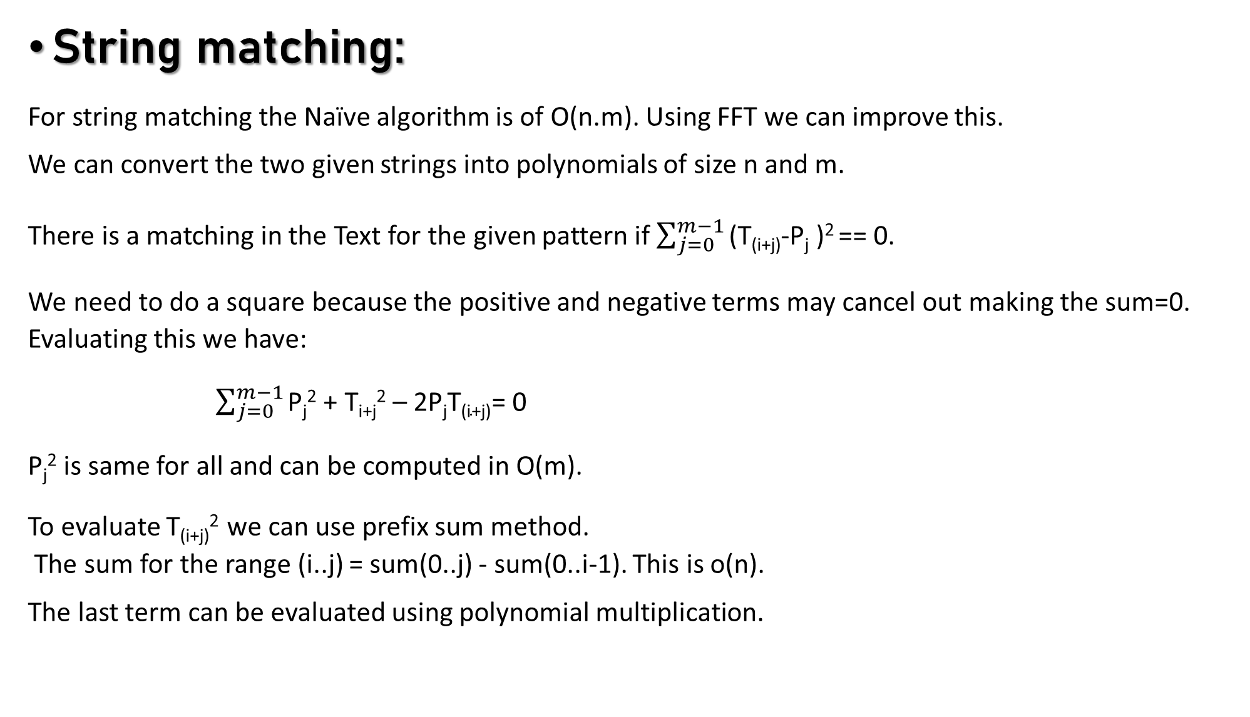
String matching:
For string matching the Naïve algorithm is of O(n.m). Using FFT we can improve this.
We can convert the two given strings into polynomials of size n and m. There is a matching in the Text for the given pattern if $\sum_{j=0}^{m−1}{\text{(}\text{T}\text{(}\text{i}\text{+}\text{j}\text{)-}\text{Pj}\text{ )}\text{2}}$== 0.
We need to do a square because the positive and negative terms may cancel out making the sum=0.
Evaluating this we have:
$\sum_{j=0}^{m−1}{\text{P}\text{j}\text{2}\text{ + }\text{Ti}\text{+}\text{j}\text{2}\text{ – 2}\text{PjT}\text{(}\text{i}\text{+}\text{j}\text{)}}$= 0
P_{j}² is same for all and can be computed in O(m).
To evaluate T_{(i+j)}² we can use prefix sum method.
The sum for the range (i..j) = sum(0..j) - sum(0..i-1). This is o(n). The last term can be evaluated using polynomial multiplication.

Slide 20
String matching: (contd.)
To evaluate the last term we can represent the polynomials as follows:
P(x) = p₀x^{n-1} + p₁x^{n-2} + p₂x^{n-3} + ... 0.x⁰
T_{x} = t₀x⁰ + t₁x¹ + t₂x² + ... + t_{n-1}x^{n-1} We reverse the pattern because now if we do the polynomial multiplication the powers will cancel out and the value at each index is computed.
Power of x at p_{j.}t_{(i+j)} = n-j-1 + i+j = n+i-1 So the value at index (n+i-1) in the polynomial multiplication will give the required sum.
We put this value in the equation and if we get 0 then there is matching for length m starting from i.

Slide 21
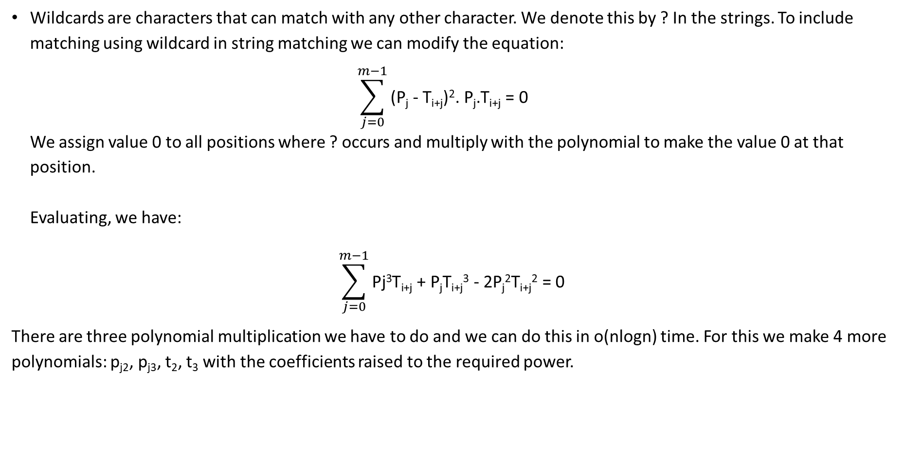
String matching with wildcards:
Wildcards are characters that can match with any other character. We denote this by ? In the strings. To include matching using wildcard in string matching we can modify the equation: $\sum_{j=0}^{m−1}{\text{(}\text{Pj}\text{ - }\text{Ti}\text{+}\text{j}\text{)}\text{2}\text{. }\text{Pj}\text{.}\text{Ti}\text{+}\text{j}\text{ = 0} }$ We assign value 0 to all positions where ? occurs and multiply with the polynomial to make the value 0 at that position. Evaluating, we have:
$$\sum_{j=0}^{m−1}{\text{Pj}\text{3}\text{T}\text{i}\text{+}\text{j}\text{ + }\text{PjTi}\text{+}\text{j}\text{3}\text{ - 2}\text{Pj}\text{2}\text{T}\text{i}\text{+}\text{j}\text{2}\text{ = 0 }}$$ There are three polynomial multiplication we have to do and we can do this in o(nlogn) time. For this we make 4 more polynomials: p_{j2}, p_{j3}, t₂, t₃ with the coefficients raised to the required power.

Slide 22
All possible sums:
In this problem we are given two arrays and we have to find the value of all possible sums we can get using a value from the first array and another from the second array. To do this, we make each array value an exponent in a polynomial. Then we take the polynomial multiplication of the two arrays. All the terms with non-zero coefficients will denote the sums that we can achieve and the coefficient will denote the number of times the sums can be achieved.

Slide 23


All possible scalar Products:
Given two arrays a[] and b[], we need to compute the products of a with every cyclic shift of b.
To do this, we first reverse a[] and append n zeroes to it.
Then we append the array b[] to itself.
On multiplying a[] and b[] as polynomials we get product c,
But since all a[i]=0 for i>=n, it can be simplified to,
If we notice carefully, the elements from c[n-1] to c[2n-2] are the scalar product of vector a with (k-(n-1))^{th} cyclic shift of b.

