Slide 1
EZCRYPTO
Problem Statement : Resolving the issue of missed out profit margins by crypto traders on a day to day basis
Team Name : CRYPCOLLARS
Team Members : 1. Yuvraj Singh
2. Yash Chhillar
3. Aayush Singh
4. Manav Saini
5. Navidha jain

Slide 2
Problem
We all know one can’t keep their tabs open 24x7 and look at those confusing graphs all day long in order to earn some money.
Now suppose one buys any cryptocurrency at X amount and sell it at amount Y where X<Y, but there was a time when the price was more significant than Y (i.e >Y) while they were holding their coins but couldn’t sell because they didn’t had their tabs open at that time.
By simply being busy at some other work lead to a smaller profit margin for this person.
Now this problem arises on a day-to-day basis with so many traders worldwide where they miss out on huge profits as they were busy with some other work during that time.

Slide 3
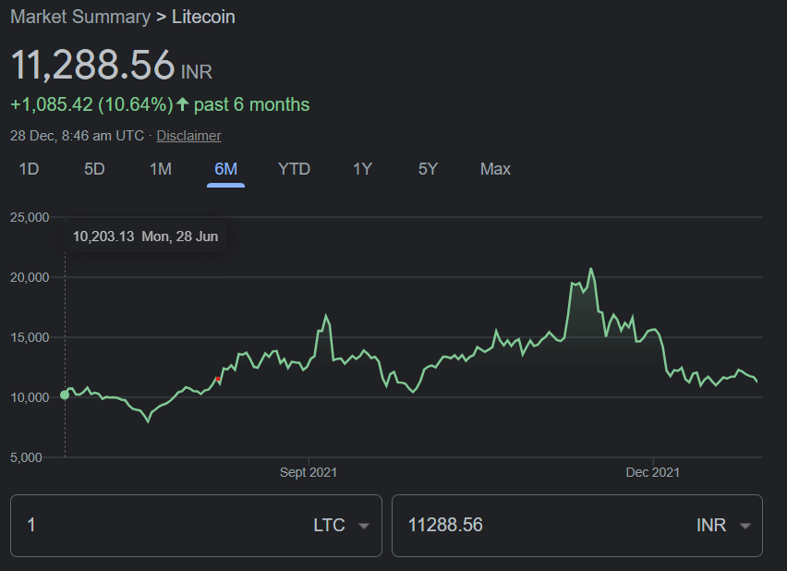
Problem
RED - Buying price
GREEN - Selling price
YELLOW - Ideal selling price

Slide 4
Problem
Another problem is that there is no concrete social media platform for crypto traders where all of them can give out their opinions and discuss.
Nowadays, most discussions happen on Reddit, but that isn’t any solid platform in the longer term.

Slide 5
Proposed Solution
Here is the solution to these problems where the traders will give us their api keys and set their buying price and selling price but with a twist and leave everything else on our algorithm.
We will create a platform with our wallet where users will transfer money into our purse and set when to buy and sell.
Now the buying and selling points will consist of % and time limits. For example, say any crypto A is at ₹10. So they will set the % as when to buy when the price falls by this much %. And similarly, for the selling point, they will again set a % that when to sell when they are assured this much % of the profit on their trade.
The user can also set a time limit to which they want to run our algorithm, if within that time the profit% is reached it will sell off their holdings if not the user will be notified and they can change the margins and try again.

Slide 6
Proposed Solution
Now we know that there are many bots available in the market but the downside of those bots is that they just notify you when the price reaches a certain level which totally defies the point of automated trading but through our app, we provide an integrated platform of wallet and a tracker which sells the coin as soon the price increases by the percentage mentioned by the user.Here we are providing a very flexible way to attain maximum profits.
We will also have a social column with weekly polls and people can discuss their predictions and all.
So basically, we will also provide a social media platform dedicated explicitly for traders.

Slide 7
Potential Impact
The country now has more than 10 crore crypto owners in the world which is by far the largest number and this number is increasing day by day.
Figures collated from exchanges showed that the number of smaller investors - those who invest Rs 2,000-10,000 - registering and investing in cryptocurrencies went up in the past two weeks. So there are many new people joining the traders world.
The impact of our service will be huge among the new traders in the market, who don’t have the proper knowledge or time for trading but still want to invest their money and make some profits.
They will benefit from learning more about various trading techniques from the experts on the social columns to ask their doubts, and some of the other traders will help them out.
Expert traders who miss out on profits will have a chance not to miss them by using our service.

Slide 8
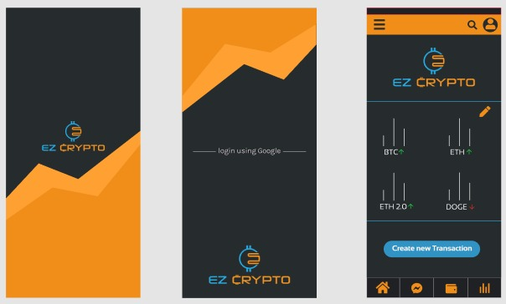
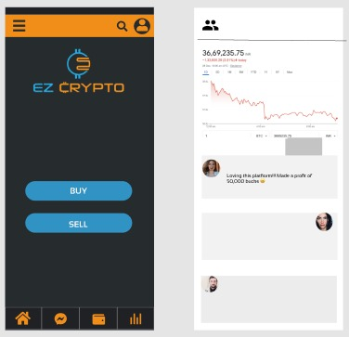
Demo
.

Slide 9

Demo
In the video, we first show our WazirX wallet. We see that we don’t have any XRP crypto tokens.
Then we open ezycrypto app, login with google, add our wazirX api keys.
We place an order for 2 XRP tokens to be bought whenever the market falls by 0.0001 %
The algo waits till it reaches the amount and once the market dips by 0.0001 %, the algo instantly executes the order.
We then head back to the WazirX app and see that 2 xrp tokens were bought.

