Slide 1
COMP264 | CLOUD MACHINE LEARNING
Email Spam Detector
Deployed on AWS SageMaker
Group 7 | Centennial College | Winter 2026
[Member 1]
[Member 2]
[Member 3]
[Member 4]
[Member 5]
Professor: [Professor Name]

Slide 2
Agenda
01
The Problem
Why spam detection still matters
02
Dataset & Model
Data5.csv + Multinomial Naive Bayes
03
AWS Architecture
S3 -> SageMaker -> Lambda -> API Gateway
04
Deployment Walkthrough
From pickle to a live HTTPS endpoint
05
Live Demo & Results
91% accuracy on held-out test data
06
Challenges & Next Steps
Lessons learned and future work
COMP264 - Cloud Machine Learning - Group 7
02 / 13

Slide 3
The Problem: Spam Is Still Winning
45%
of all email sent in 2024 was spam
Our goal
Turn a laptop-only classifier into a real cloud service.
3.4B
phishing emails sent every day
Take our working Multinomial Naive Bayes spam detector and deploy it on Amazon SageMaker as a real-time, publicly callable endpoint - fronted by Lambda, API Gateway, and a simple web UI.
$10B+
lost to email-based fraud in 2023
COMP264 - Cloud Machine Learning - Group 7
03 / 13

Slide 4
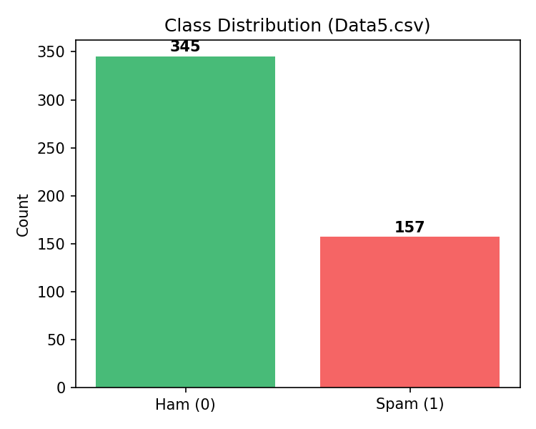
Dataset: Data5.csv
502
labelled emails after cleaning
345 / 157
ham / spam (68.7% / 31.3%)
2
columns used: Body + Label
80 / 20
stratified train / test split
Slightly imbalanced - we use stratified sampling to preserve the ratio.
COMP264 - Cloud Machine Learning - Group 7
04 / 13

Slide 5
Model: One sklearn Pipeline, Three Stages
01
02
03
Count
Vectorizer
TF-IDF
Transformer
Multinomial
Naive Bayes
Bag of words with stop-word removal and min_df / max_df filtering
Reweights tokens that are distinctive for spam vs ham
Probabilistic classifier - alpha tuned via 3-fold CV
Single pickled artifact: spam_pipeline.joblib (~60 KB). Same preprocessing at train and serve.
COMP264 - Cloud Machine Learning - Group 7
05 / 13

Slide 6
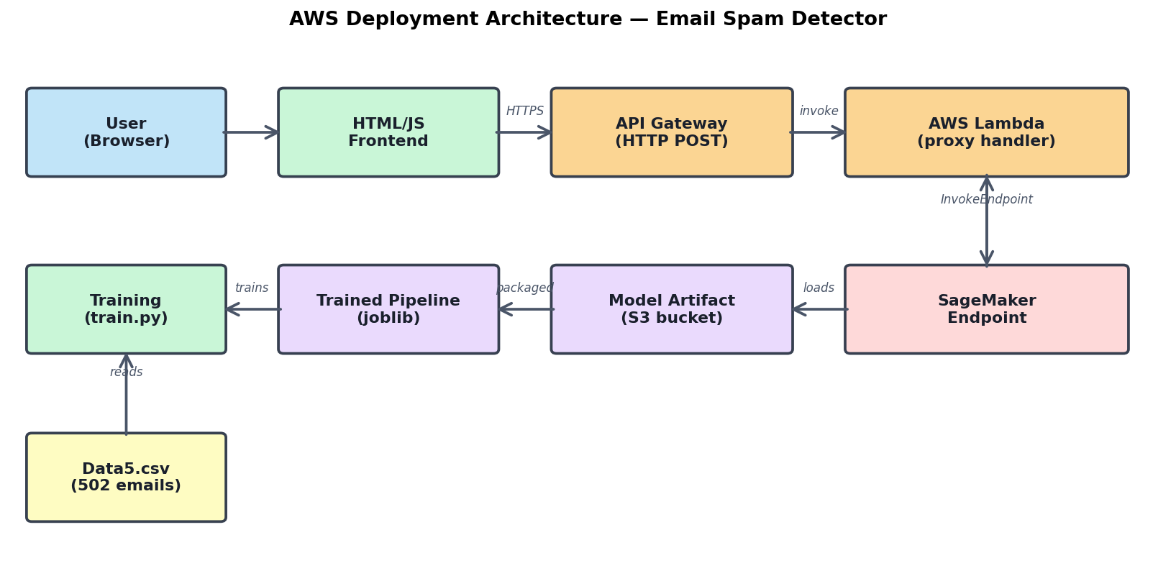
AWS Architecture
Browser -> API Gateway -> Lambda -> SageMaker Endpoint -> Joblib pipeline
COMP264 - Cloud Machine Learning - Group 7
06 / 13

Slide 7
Why Each Service?
Amazon S3
SageMaker Endpoint
Durable, cheap object storage for the model.tar.gz artifact that SageMaker pulls at deploy time.
Managed hosting for sklearn - handles the container, scaling, and HTTPS termination for us.
AWS Lambda
API Gateway
Thin proxy that validates input, handles errors, applies CORS, and invokes the private endpoint.
Public HTTPS POST /predict route - with throttling, CORS, and logging to CloudWatch.
COMP264 - Cloud Machine Learning - Group 7
07 / 13

Slide 8
Deployment in Six Steps
1
Train
2
Package
3
Upload
python train.py
-> spam_pipeline.joblib
tar.gz the joblib artifact
Put model.tar.gz into S3 bucket
4
Deploy
5
Wire up
6
Call it
SKLearnModel.deploy()
with inference.py
Lambda + API Gateway + IAM policy
Frontend POSTs JSON to /predict
COMP264 - Cloud Machine Learning - Group 7
08 / 13

Slide 9
Live Demo
https://<api-id>.execute-api.../prod/predict
SPAM
Email Spam Detector
"CONGRATULATIONS! You have WON a FREE iPhone 15 Pro! Click here NOW to claim your prize..."
97% confidence
Ham probability: 3%
Spam probability: 97%
Check Spam
<- SageMaker returned this via Lambda + API Gateway
COMP264 - Cloud Machine Learning - Group 7
09 / 13

Slide 10
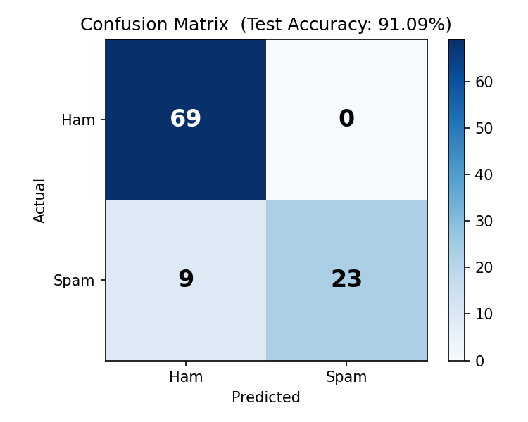
Results
91.1%
1.00
Test accuracy
Spam precision
0.72
~100ms
Spam recall
End-to-end latency
COMP264 - Cloud Machine Learning - Group 7
10 / 13

Slide 11
What Slowed Us Down
IAM Access Denied
First deploy failed because Lambda's role couldn't InvokeEndpoint. Fixed with a least-privilege policy scoped to one ARN.
Train/serve skew risk
We bundled Vectorizer + TF-IDF + NB into a single sklearn Pipeline so inference uses the exact same preprocessing as training.
Cold-start latency
First call to a fresh SageMaker endpoint can take seconds. We added a warm-up call in the demo script.
Cost control
Real-time endpoints bill per hour. Teardown commands are documented in the README so we don't burn the student budget.
COMP264 - Cloud Machine Learning - Group 7
11 / 13

Slide 12
Where We Go Next
1
Smarter model
2
Serverless hosting
Swap Naive Bayes for DistilBERT on a SageMaker PyTorch container.
Move to SageMaker Serverless Inference - no idle cost.
3
Observability
4
Permanent UI
CloudWatch dashboards + alarms on latency and 5xx errors.
Host the frontend on S3 + CloudFront for a stable demo URL.
5
Bigger data
Retrain on a larger, modern spam corpus to boost recall.
COMP264 - Cloud Machine Learning - Group 7
12 / 13

Slide 13
Thank you.
Questions?
COMP264 | Cloud Machine Learning | Group 7
Centennial College - Winter 2026

