Slide 1

DAMCO – Flows Data Lake Solution
Rakesh Davanum
Assc Architect
Microsoft

Slide 2


Shipment Data Flows

Slide 3






Disruption/Shipment & Vessel Schedule Flow
SCOPE
Input
Raw Data
Extraction
Extracted Data
Storage
Query Layer
Visualization/Presentation
Zip File
Blob Storage
HDInsight
Blob Storage
Data Lake
SQL Data Warehouse
Power BI
Data Factory Pipeline
Data Factory

Slide 4
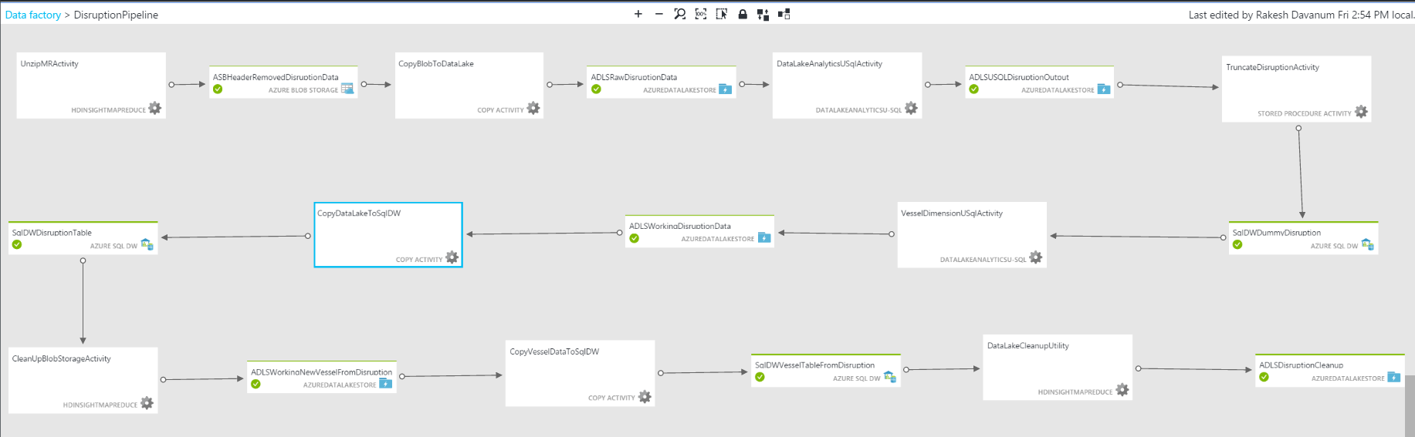
Disruption/Shipment Data Pipeline

Slide 5

Disruption Pipeline Activities
UnzipMRActivity: Extract the input zip file and remove the header row
CopyBlobToDataLake: Copy extracted file from blob storage to ADL Store
DataLakeAnalyticsUSqlActivity: U-SQL script to extract the records from the file and load the relevant records into Shipping Data Lake table. Also output the distinct records from current input file to processed folder in ADL Store
TruncateDisruptionActivity: Truncate the Disruption table in SQL DW in order to load the current updated data in ADL Store
VesselDimensionUSqlActivty: U-SQL script to extract any new Vessel information that may be present in current input file
CopyDataLakeToSqlDW: Copy the updated disruption records from ADL Store to SQL DW Disruption table
CleanUpBlobStorageActivity: Delete intermediate/working data for this run from blob storage
CopyVesselDataToSqlDW: Copy any new vessel information found in current input file to SQL DW Vessel table
DataLakeCleanupActivity: Delete intermediate/working data for this run from ADL Store and move raw file to Archived folder in ADL Store

Slide 6
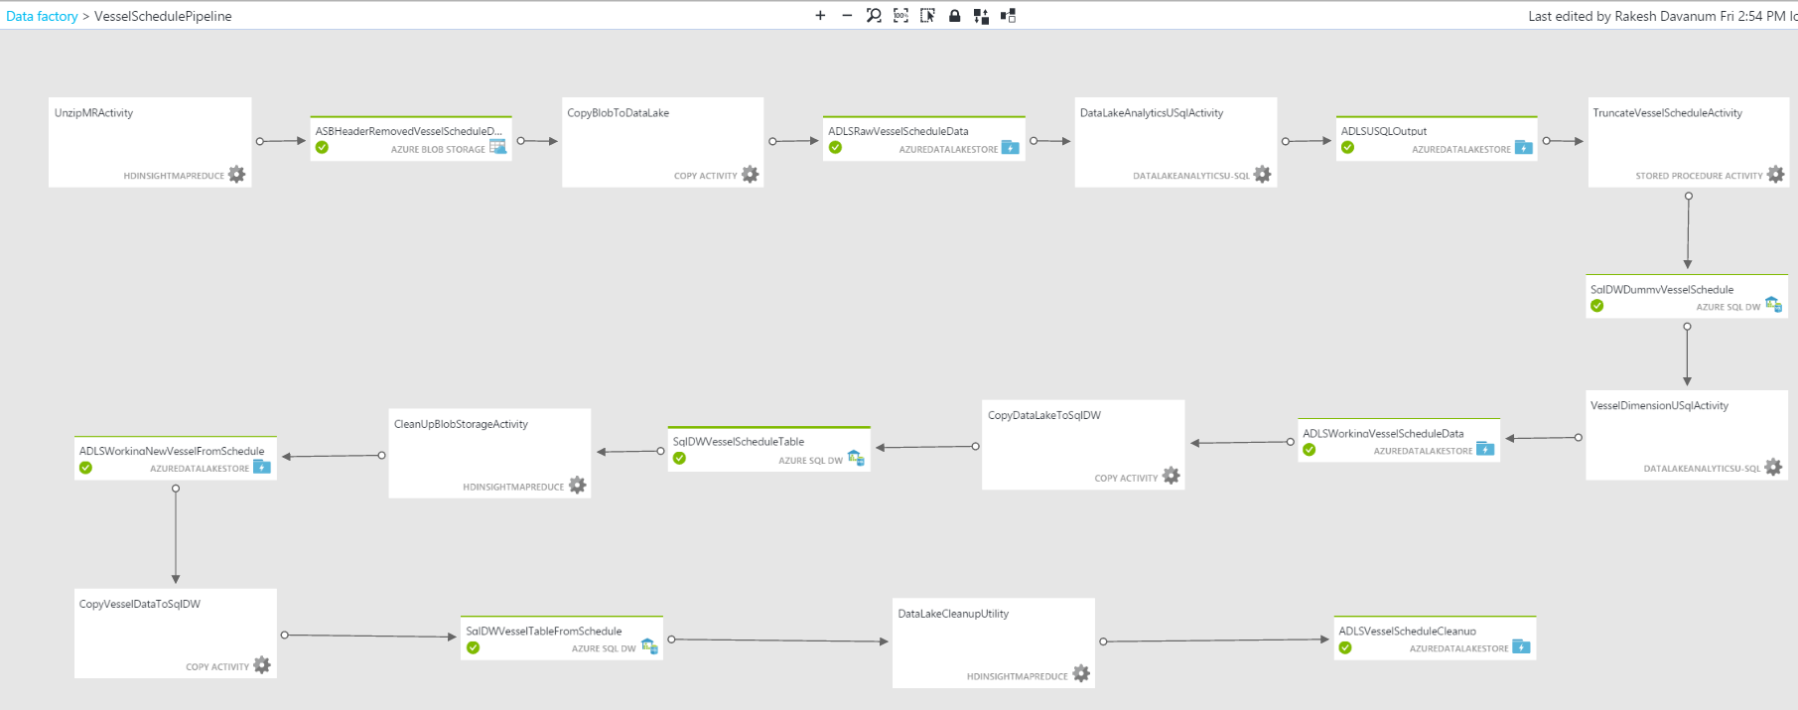
Vessel Schedule Pipeline

Slide 7
Vessel Schedule Pipeline Activities
UnzipMRActivity: Extract the input zip file and remove the header row
CopyBlobToDataLake: Copy extracted file from blob storage to ADL Store
DataLakeAnalyticsUSqlActivity: U-SQL script to extract the records from the file and load the relevant records into VesselSchedule Data Lake table. Also output the distinct records from current input file to processed folder in ADL Store
TruncateVesselScheduleActivity: Truncate the VesselSchedule table in SQL DW in order to load the current updated data in ADL Store
VesselDimensionUSqlActivty: U-SQL script to extract any new Vessel information that may be present in current input file
CopyDataLakeToSqlDW: Copy the updated vessel schedule records from ADL Store to SQL DW VesselSchedule table
CleanUpBlobStorageActivity: Delete intermediate/working data for this run from blob storage
CopyVesselDataToSqlDW: Copy any new vessel information found in current input file to SQL DW Vessel table
DataLakeCleanupActivity: Delete intermediate/working data for this run from ADL Store and move raw file to Archived folder in ADL Store

Slide 8
External Data Flows

Slide 9




External Data Flow – News & Weather Data
Blob Storage
News & Weather Feeds from the Web
Keywords
PowerShell Script
Event Hub
Stream Analytics
Blob Storage
Data Lake
SQL Data Warehouse
Data Factory Pipeline
Data Factory

Slide 10
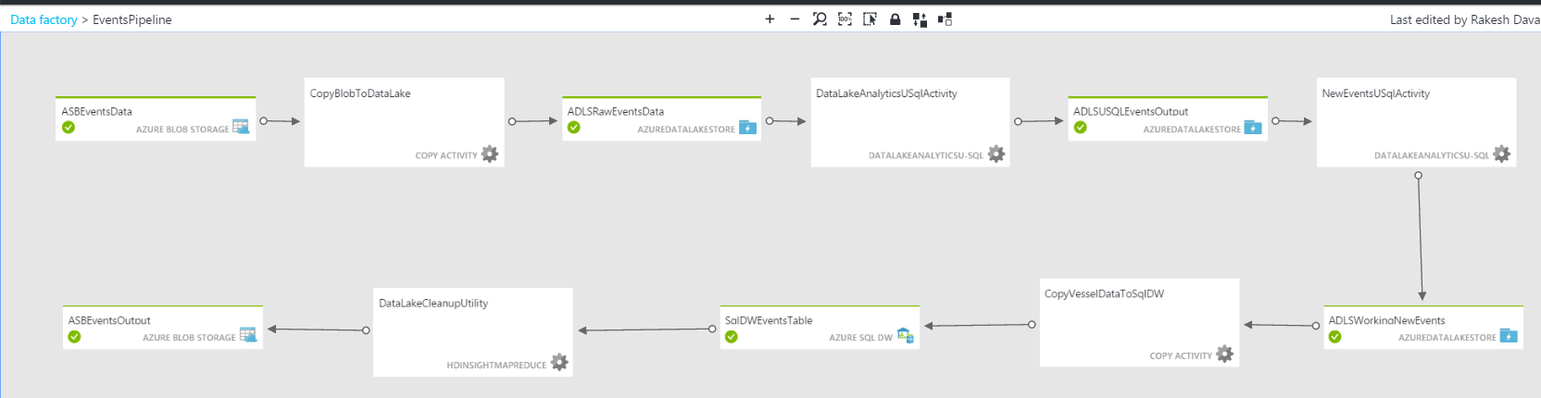
Events Pipeline

Slide 11
Events Pipeline Activities
CopyBlobToDataLake: Copy ingested events from blob store to ADL store raw folder
DataLakeAnalyticsUSqlActivity: U-SQL script to ingest selected events into TempEvents table in ADL for deduplication
NewEventsUSqlActivity: U-SQL script to compare current events with the ones already in Events and insert the new ones to Events table in ADL. Also the new events are emitted to working folder in ADL for uploading into SQL DW table.
CopyEventsDataToSqlDW: Copy the new event records from ADL Store to SQL DW Events table
DataLakeCleanupActivity: Delete intermediate/working data for this run from ADL Store and move new events file from Working folder to Processed folder in ADL Store

Slide 12
Impacted Shipments

Slide 13
Analytics Flow to identify Impacted Shipments
Shipment
Events
Retrieve all locations from Shipment data
Look for all events active today (EventStartDate <= Today <= EventEndDate)
Impacted Locations
Shipments at Origin
Shipments at Transshipment Ports
Shipments at Final Ports
Impacted Shipments (Data Lake Table)
Impacted Shipments (SQL DW Table)

Slide 14
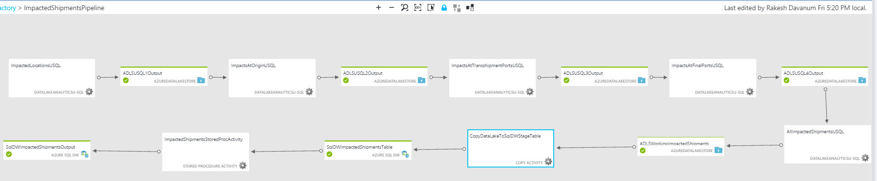
Impacted Shipments Pipeline

Slide 15
Impacted Shipments Activities
ImpactedLocationsUSQL: U-SQL script to identify impacted locations from shipment data based on active events
ImpactsAtOriginUSQL: U-SQL script to identify impacted shipments at origin location
ImpactsAtTransshipmentPortsUSQL: U-SQL script to identify impacted shipments at transshipment ports
ImpactsAtFinalPortsUSQL: U-SQL script to identify impacted shipments at final ports
AllImpactedShipmentsUSQL: U-SQL script to load all impacted shipments to ImpactedShipments ADL table
CopyDataLakeToSqlDWStageTable: Copy all impacted shipment records from ADL Store to SQL DW ImpactedShipmentsStage table
ImpactedShipmentsStoredProcActivity: Stored procedure activity to reload ImpactedShipments from stage table and truncate stage table

Slide 16
Write Back Data Flows

Slide 17


Ratings Write Back Flow
Mobile Application
App Service
Event Hub
Stream Analytics
Blob Storage
Data Lake
SQL Data Warehouse
Power BI
Data Factory Pipeline
Data Factory

Slide 18
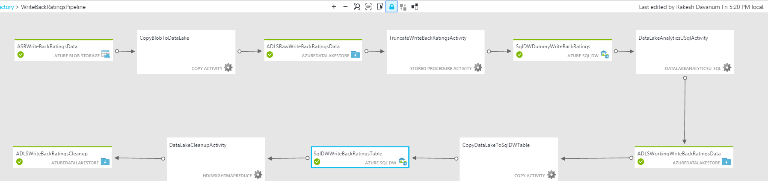
Ratings Pipeline

Slide 19
Ratings Activities
CopyBlobToDataLake: Copy ingested ratings from blob store to ADL store raw folder
TruncateWriteBankRatingsActivity: Truncate the WriteBackRatings table in SQL DW in order to load the current updated data in ADL Store
DataLakeAnalyticsUSqlActivity: U-SQL query to ingest incoming ratings into WriteBackRatings table in ADL
CopyDataLakeToSqlDWTable: Copy the new ratings records from ADL Store to SQL DW WriteBackRatings table
DataLakeCleanupActivity: Move new ratings file from Raw folder to Processed folder in ADL Store

Slide 20
Azure Blob Storage - Locations
raw
working
jobartifacts
Azure Blob Store Container
Disruption
ExtractedData
Java
Azure Blob Store Folder
VesselSchedule
HeaderRemovedData
USql
Landing zone for new compressed (ZIP) input files
Location for extracted input and header row removed input
Location for storing Java & U-SQL job artifacts (scripts, jar, etc)
keywords
externaldata
writeback
keywords.json
Events
Ratings
Keywords to look for in News & Weather events
News & Weather events matching the reference keywords
Event ratings provided by the customer via mobile application

